Slide 1
Introduction to Cyber Security
COMP3134 Week 5

Slide 2
Overview
Objective
Denial of Service (DoS)
DoS attack techniques
Distributed Denial of Service
DoS/DDoS counter measurements
Main Teaching Points
Exploitation tactic 2: Overloading
Learning Outcome(s)
Identify and filter various protocols and network ports
Implement various tactics to attack a network or application

Slide 3
Denial of Service (DoS)

Slide 4
Denial of Service
Definition
CIA
Targets availability
Goal not necessarily to infiltrate but disrupt
Comparison: Telemarketers
Keep receiving phone calls => Turn off phone => Miss Important call
A service gets denied => you suffer
Significance / Risks
Easy tool to launch but hard to defend against
Service is disrupted

Slide 5
Denial of Service
Implication
Cheap and effective way of attacker
Many monetize opportunity
Application
A search for term “booter” => many DoS services

Slide 6
DoS Attack Techniques

Slide 7
DoS Attack Techniques List (5)
Volumetric attacks
SYN flood attacks
Internet Control Message Protocol (ICMP) attacks
Application-level attacks
Permanent DoS

Slide 8
Volumetric Attacks
Definition
Consuming bandwidth of machine(s) => Blocking communication capability
Saturate bandwidth = blocked machine
Comparison
Having may applications open

Slide 9
SYN Flood Attacks
Definition
3-Way Handshake
SYN message sent to server
Server sends SYN-ACK to client
Client responds with AWK
SYN Flood is when attacker
Does not respond with AWK
Comparison: Telemarketer’s worst nightmare
Dial-tone that never ends during phone call attempt
Significance / Risks
Server is hung up / starved

Slide 10
Internet Control Message Protocol (ICMP) attacks
Definition
Sending large number of ICMP packets
Overwhelm system so cannot respond
Comparison
Sending large number of documents to printer queue
Significance / Risks
Overwhelm system so cannot respond

Slide 11
Application-Level Attacks
Definition
Exploiting a vulnerability in program
Sends large amount of data
Sends unexpected data
Sends malformed packets
Comparison
Asking waiter/waitress
A table for 25 people
Menu items not on list
Significance / Risks
Unhandled or unexpected issue causes application to not behave normally

Slide 12
Permanent DoS
Definition
Also known as phlashing
Make permanent, irreversible changes to devices or hardware
Render it unusable
Significance / Risks
Data loss may be permanent
Time to recover from such attack is significantly longer

Slide 13
Distributed Denial of Service

Slide 14
Distributed Denial of Service DDoS
Definition
Attempt to make an online service or a website unavailable by overloading it with huge floods of traffic generated from multiple sources
In DoS attack = one computer and one Internet connection
DDoS = many computers and many Internet connections
Distributed globally in what is referred to as a botnet or zombies
Multi-Phase process
Set up or infect distribution of computers (botnet, zombies)
Load attack script on master computers
Initialize attack
Master computers communicate to zombies to begin / coordinate attack

Slide 15
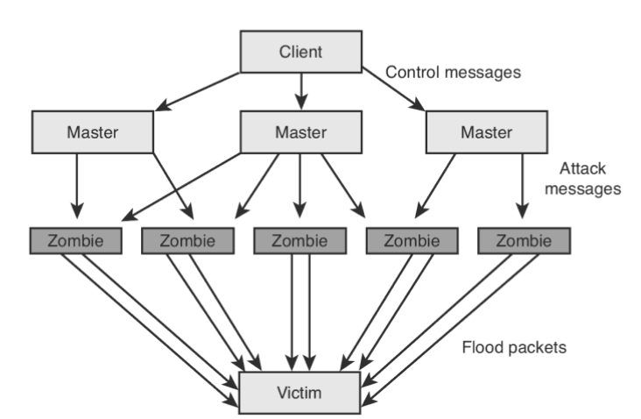
Distributed Denial of Service

Slide 16
Terms to Know
Denial of Service (DoS)
Volumetric attacks
SYN flood attacks
Internet Control Message Protocol (ICMP) attacks
Application-level attacks
Permanent DoS
Distributed Denial of Service (DDoS)

Slide 17
Resources
Websites
DoS Attack
https://www.datto.com/library/what-is-a-dos-attack
https://www.paloaltonetworks.com/cyberpedia/what-is-a-denial-of-service-attack-dos
Videos
DoS Attack
https://www.youtube.com/watch?v=0-dpSyDDEn0
DDoS Attack
https://www.youtube.com/watch?v=jXbpRhP8ztw

