Slide 1
Introduction to Cyber Security
COMP3134 Week 13

Slide 2
Overview
Objective
Database Hacking
Main Teaching Points
Database server holds very sensitive information
Application is portal to database server
Portal needs to be secure
Learning Outcome(s)
Classify levels of database insecurities
Compare and differentiate SQL injections
Critique and execute mitigation techniques

Slide 3
Database Hacking

Slide 4
Database Hacking
Definition
Web server host files / folders to display company online presence
Database server holds proprietary secrets
Models
Hierarchical database management system
Network database management system
Relational database management system
Object-oriented database management system

Slide 5
Database Hacking
Accomplished by
SQL Injection
Implication
Application may provide easier roadmap to access database
Mitigation
Secure database interface with application by applying various techniques that will be discussed later

Slide 6
Hierarchical Database Management System
Definition
Organizes data into a tree-like-structure, with a single root, to which all the other data is linked
A child node will only have a single parent node.
Significance
Efficiently describes many real-world relationships
Examples
index of a book
recipes

Slide 7
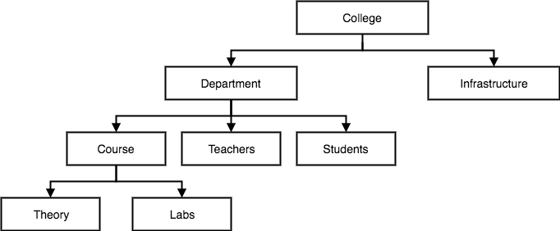
Hierarchical Database Management System

Slide 8
Network Database Management System
Definition
Extension of the Hierarchical model.
Organized more like a graph
Allowed to have more than one parent node
Used to map many-to-many data relationships.
Significance
Data is more related because more relationships permitted
Data access becomes easier and faster.
Was the most widely used database model before Relational Model was created

Slide 9
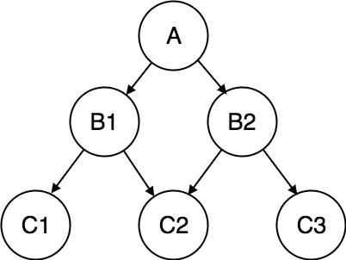
Network Database Management System

Slide 10
Relational Database Management System
Definition
Data is organized in two-dimensional tables
Relationship is maintained by storing a common field
Significance
Relationship between objects are clearly defined
Data is well structured / organized

Slide 11
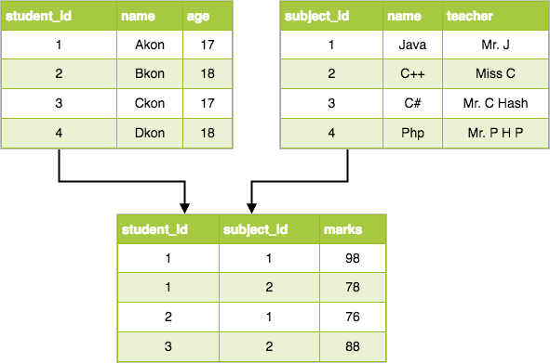
Relational Database Management System

Slide 12
Object-oriented Database Management System
Definition
Every data stored is represented as object
A data structure
Each object has its set of attributes which represent its characteristics
Different objects are related using relationships
Also know as Entity-relationship Management System
Replace object with entity
Significance
Create to overcome limitations of large relational databased
Relations between objects are defined by values

Slide 13
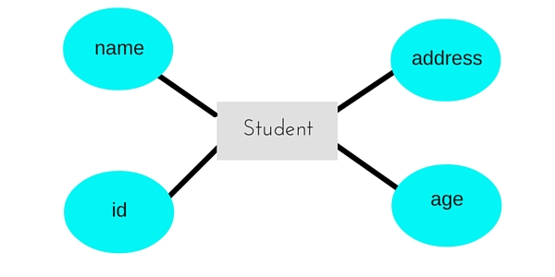
Object-oriented Database Management System

Slide 14
SQL Injection
Definition
Attacker adds/alters queries application makes to database server
SQL
Structured Query Language
Comparison
Two people make one order
Significance / Risks
Attacker executes queries to access/modify info otherwise inaccessible

Slide 15
SQL Injection
Accomplished by
Appending statement(s) to original query to execute additional queries
Mitigation
Disallow direct execution of SQL statements from user input
Run as non-admin SQL user

Slide 16
SQL Injection Categories
In-Band SQL Injection
Receive data using same channel (application) to inject SQL code
Get info from hijacking app query
Out-of-Band SQL Injection
Receive data using different channel
Get info from email, text, etc
Blind (or inferential) SQL Injection
Data reconstructed by sending specific statements and discerning behavior of application

Slide 17
SQL Injection Techniques
Union Operator
Union statement used to combine multiple queries
Boolean
Boolean operators used to verify validity of certain conditions
Error-based
Force database to generate error to enhance/refine injection
Time delay
Use database commands to delay responses
Out-of-band
Obtain records from database using different channel

Slide 18
In-Band SQL Injection
Definition
Attacker able to use the same communication channel to both launch the attack and gather results.
Variations
Error Based
Union Based
Error Based
Attacker relies on error messages thrown by the database server to obtain information about the structure of the database.
Union Based
Attacker leverages the UNION SQL operator to combine the results of two or more SELECT statements into a single result which is then returned as part of the HTTP response.

Slide 19
Out-of-Band SQL Injection
Definition
Attacker is unable to use the same channel to launch the attack and gather results
Attacker makes DNS or HTTP requests to database server to retrieve data
Accomplished by
Microsoft SQL Server’s xp_dirtree command
Can be used to make DNS requests to a server that an attacker controls
Oracle Database’s UTL_HTTP package
Can be used to send HTTP requests from SQL and PL/SQL to a server that an attacker controls.

Slide 20
Blind (or inferential) SQL Injection
Definition
Attacker reconstructs the database
Structure not data
Accomplished by
Sending payloads to server to observing the application’s response
Variations
Boolean-Based (Content-Based) Blind SQL
Time-Based Blind SQL

Slide 21
Boolean-Based (Content-Based) Blind SQL
Accomplished by
sending a query to the database which forces a Boolean value
Comparison
Slowest guessing game ever
Significance / Risks
Slow
Attacker needs to enumerate a database, character by character

Slide 22
Time-Based Blind SQL
Accomplished by
sending a query to the database which forces the database to wait for a specified amount of time (in seconds) before responding.
The response time will indicate to the attacker whether the result of the query is TRUE or FALSE.
True value returned after delay
False value returned immediately
Difference
Boolean vs time-based
May not be able to get return value
If application hangs for specified time => know statement is correct

Slide 23
Fingerprinting the Database
Definition
Get as much information about Database as possible
Management System, Version, etc
Comparison
Fingerprinting human
Significance / Risks
Once attacker knows database => can exploit more efficiently
Accomplished by
Executing statements that retrieve metadata of database
Researching error messages if any

Slide 24
SQL Injection Mitigations
Definition
How to best protect application, database application from SQL injections
Mitigation
Use immutable queries
Static queries
Parameterized queries
Stored procedures

Slide 25
Terms to Know
Database Hacking
Database Models
HDMS, NDMS, RDMS, OODMS
SQL Injection Categories & Techniques
In-Band, Out-of-Band, Blind SQL Injection
Fingerprinting Database
SQL Injection Mitigations

Slide 26
Resources
Websites
https://portswigger.net/web-security/sql-injection
Videos
https://www.youtube.com/watch?v=WFFQw01EYHM

