Slide 1
Introduction to Cyber Security
COMP3134 Week 2

Slide 2
Overview
Objective
OSI Model
Anatomy of TCP/IP protocols
Information Gathering
Main Teaching Points
Knowledge is beginning step
Listening/ monitoring / observation is intermediate step
Learning Outcome(s)
Recall security fundamental terms and diagrams
Apply and classify network discovery and security auditing techniques

Slide 3
OSI Model

Slide 4
OSI Model
Definition
Open Systems Interconnection
Framework that describes the functions of a networking or telecommunication system
Help give a visual description of what is going on with a networking system
7 Layers
Application
Presentation
Session
Transport
Network
Data Link
Physical

Slide 5
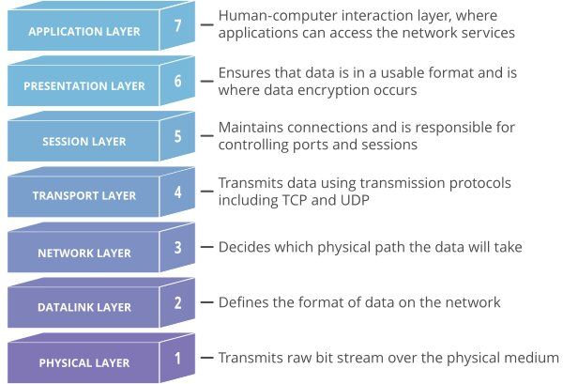
OSI Model

Slide 6
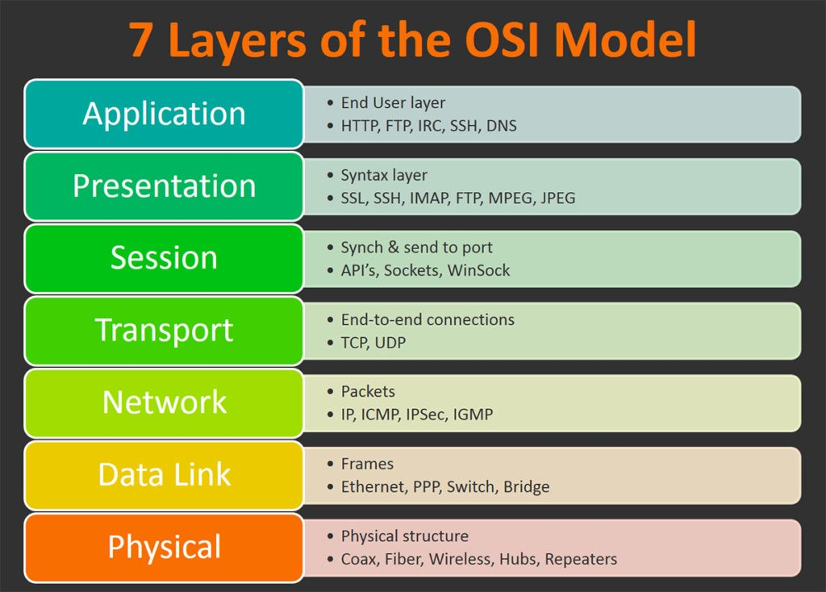
OSI Model

Slide 7
Skill Testing Quiz 1
How many layers in OSI model?
7
How many layers related to physical hardware?
2
Physical
Data Link
How many layers related to transmission
2
Network
Transport

Slide 8
Skill Testing Quiz 2
How many layers related to transmission
2
Network
Transport
How many layers related to distribution of a service to client
ALL
How many layers are average online user aware of (subjective)
3
Application
Presentation
Session

Slide 9
OSI Model
Comparison: Forearm (or any limb)
Many Layers
Outermost skin
Sub-skin (hair, glands)
Tissue
Muscle
Bone
Significance / Risks
Helps you when troubleshooting
Helps you visualize packet flow
Implication
Given the brief knowledge of OSI model, you understand flow of transmission of data (beginner step)

Slide 10
TCP/IP
What is it and what is its significance?

Slide 11
TCP/IP
Definition
Transmission Control Protocol/Internet Protocol
Set of standardized rules that allow computers to communicate on a network such as the internet.
Distinctions
IP
Gets address to which data is sent.
TCP
Data delivery once that IP located
Comparison:
Worker delivering package to address
Notes:
Students to write delivery methods

Slide 12
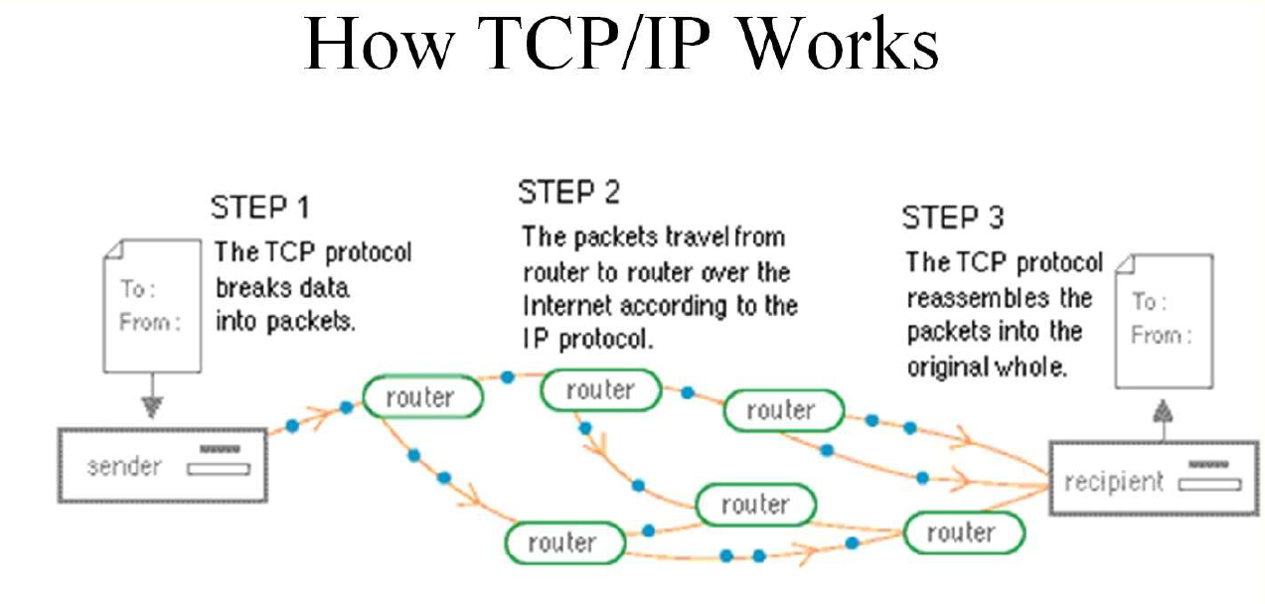
TCP/IP
Notes:
https://www.youtube.com/watch?v=aaJ1KcCDz-c

Slide 13
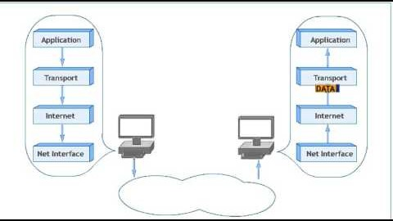
How TCP/IP Works
Notes:
Students to group and research 4 layers

Slide 14
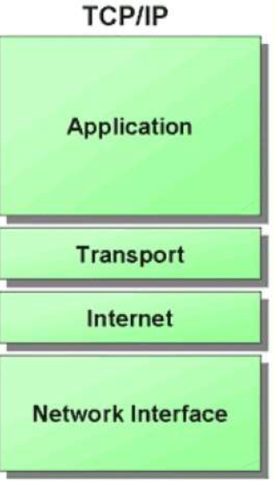
Layers of TCP/IP (4 layers)
Network Interface:
physical & data link layer
Includes Host-to-network layer protocols
Serial Line internet protocol & point to point protocol
Internet Layer
IP = primary protocol
Provides data encapsulation routing, addressing and fragmentation services to protocols at transport layer

Slide 15
Layers of TCP/IP
Transport Layer
Transmission control protocol (TCP)
User datagram protocol
Provides connection or connectionless data transfer services.
Application layer
File Transfer Protocol (FTP) Hypertext Transfer Protocol (HTTP) & more

Slide 16
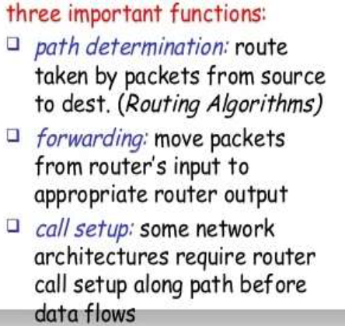
Network Interface Layer
connect the Host To Network
inform the upper layers
Begin sending the data packets.

Slide 17
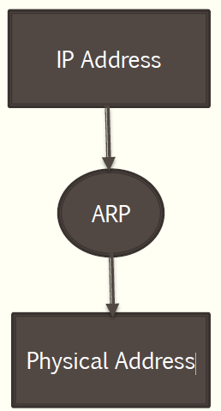
Internet Layer
Every machine on internet has one address
these address cannot be used for sending packets data
data link layer does not understand the internet address.
ARP = Address resolution protocol
Transfer IP Address to Physical Address
RARP = Reverse Address resolution protocol
Transfer Physical Address to IP Address

Slide 18
Transport Layer ( TCP and UDP )
Transport packets from the source to destination.
Deliver packets between the end points.
Two protocols
TCP
Transmission Control Protocol
UDP
User Datagram Protocol

Slide 19
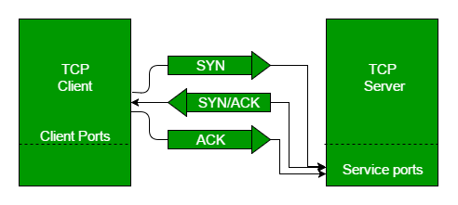
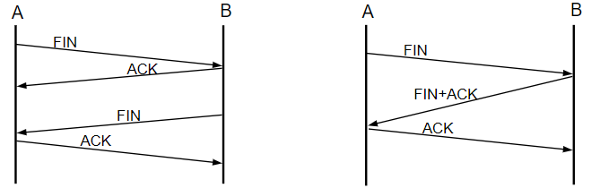
Transmission Control Protocol
Enables two hosts to establish connection and exchange data reliably
Three-step handshake at startup
Uses sequence acknowledgment numbers
At completion of data-transmission
Four-step shutdown

Slide 20

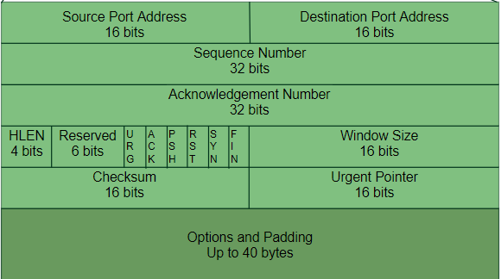
TCP Packet Structure

Slide 21
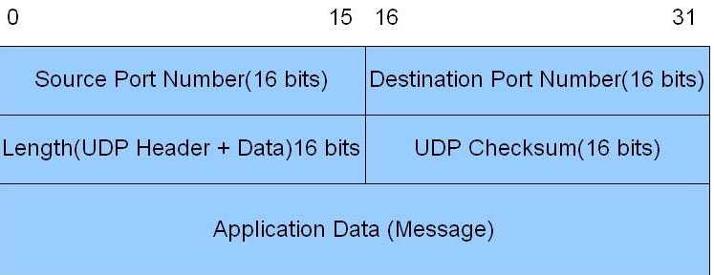
User Datagram Protocol
No handshaking
Less reliable than TCP
Faster than TCP
Packet loss may occur
Easier to spoof by

Slide 22
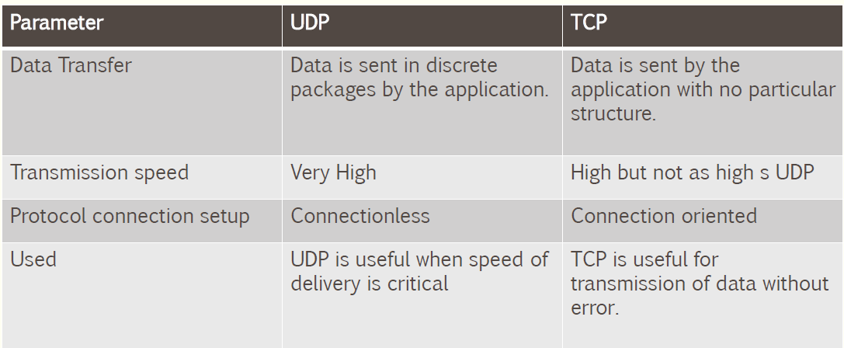
Comparison between TCP And UDP
Notes:
Discussion. Scenarios.

Slide 23
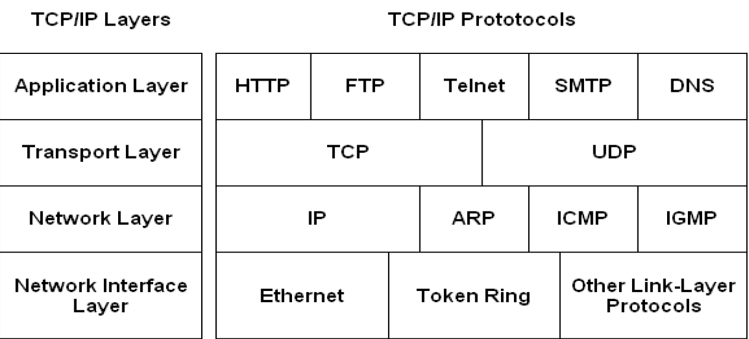
Common Protocols of TCP/IP Layers

Slide 24
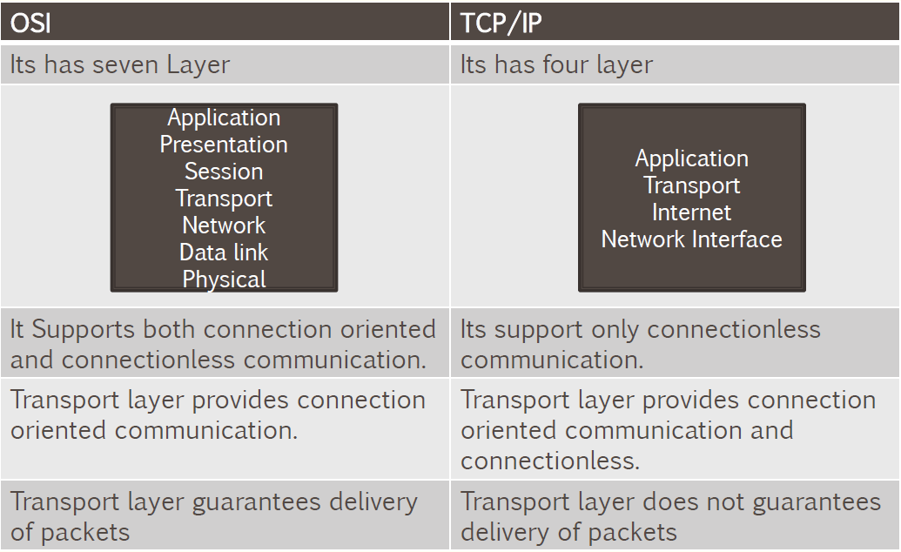
Comparison Of OSI and TCP/IP

Slide 25
Information Gathering

Slide 26
Information Gathering
Definition
First phase of determining vulnerabilities
Gather as much information as possible regarding online presence
Gather what information
Network?
Application?
Significance / Risks
The more information you have about the target, the better chance of success

Slide 27
Information Gathering Techniques
Active information gathering
Directly engage with the target
Gathering info about what
Open Ports
Services running
OS using
Downfall
Easily detected and logged
Passive information gathering
Do not directly engage with the target.
Use search engines, social media, and other websites to gather info

Slide 28
Information Gathering
Implication
Given our knowledge of OSI Model, TCP/IP structure & how to research using search engines, we should know significance of gathered information
Application
Tools used
Whois
Ping
Trace
traceroute
Nmap
Demo
Let’s use the tools and view the output

Slide 29
Review

Slide 30
Terms to Know
Open Systems Interconnection
7 layers
A P S T N D P
Transmission Control Protocol/Internet Protocol
4 layers
A T I N
(Reverse)Address resolution protocol
Transmission Control Protocol
User Datagram Protocol
Active information gathering
Passive information gathering

Slide 31
Resources
Websites
https://latesthackingnews.com/2017/05/18/information-gathering-techniques/
Videos
https://www.youtube.com/watch?v=vv4y_uOneC0

