Slide 1
CI, CD and GitOps
HPB

Slide 2

Agenda
Overview of principles and tools
Tekton
Helm
GitOps
ArgoCD
Lab
Notes:
Placeholder desno - Replace image za novu fotku.

Slide 3
Overview of principles and tools

Slide 4
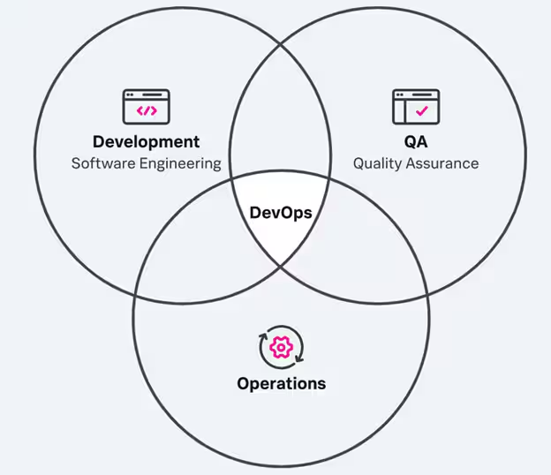
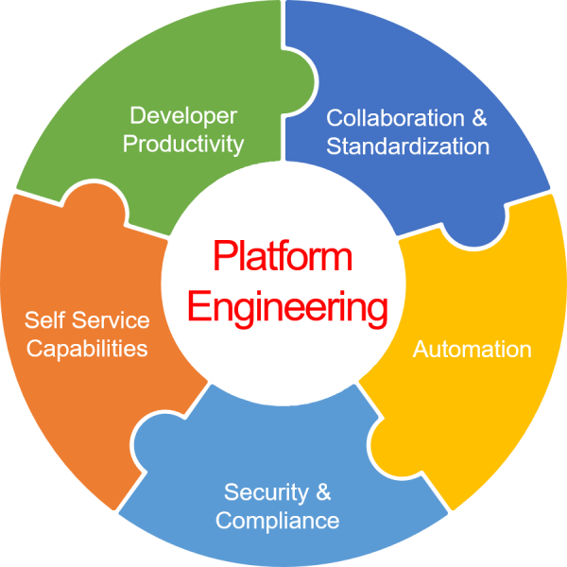
DevOps vs Platform Engineering
DevOps originates from development teams in an effort to automate the delivery of reliable, tested and secure application artefacts.
It is a way of doing things, not a set of tools and prescribes processes.
DevOps is not a means to an end, it is a means to achieve business goals
DevOps must evolve in your organization, grow and change with it
Platform Engineering is a new term and originates from System Administration point of view
Platform is a product built for development teams – standardization is a must
Development teams are the clients of the platform
It is a practice of building a centralized platform used by developers, implementing new requirements, and maintenance
Principles

Slide 5

Organizational structure
Your DevOps and Platform Engineering must follow the organizational structure of your enterprise.
Agile teams:
Big corporations with multiple teams and products
Product oriented teams (5-20 people)
You build it you run it (major impact – all skills must be present in the team)
All communication and needs are fulfilled inside the team
Easier standardization on a corporate level
Platform Engineering:
PE team is the owner of the platform
Platform as a product for the development teams
Development teams are the Clients
String standardization is a must
Principles

Slide 6
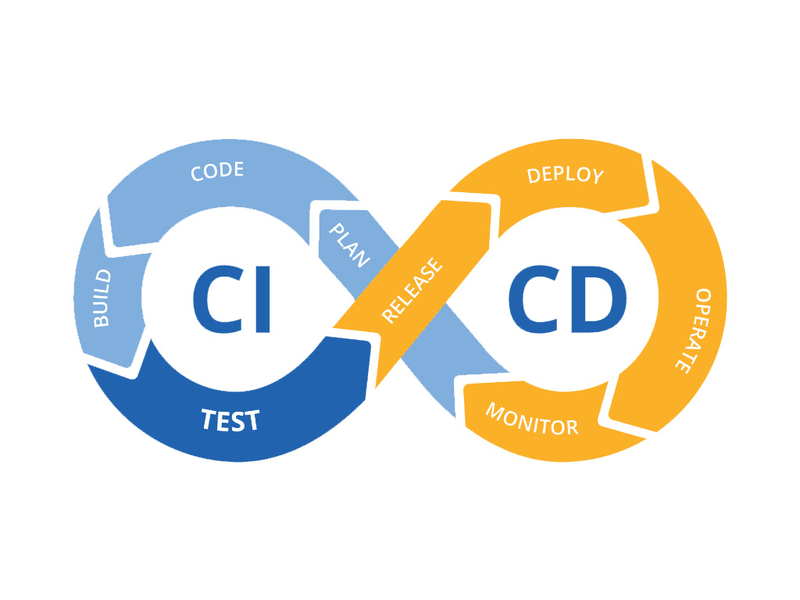
CI
Continuous Integration – Build and testing (unit, integration, security) phases of the software release process.
It is done in a continuous manner. Why?
To get the deployment artefacts (container image) as soon as possible – this cuts down the time for deployment
To get the deployment artefacts in a standardized manner – every artefacts is built and tested in the same manner
To drive the standardization across multiple teams and external vendors
Principles

Slide 7

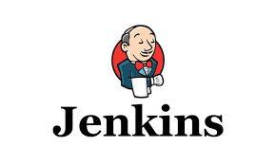
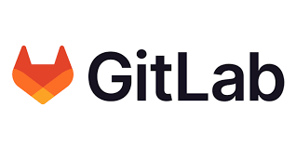





CI - tools
Principles

Slide 8
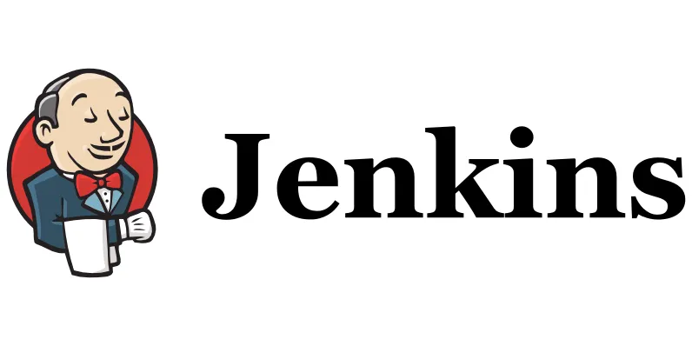
Jenkins vs TektonCI
Language - Groovy
Java based
Big community and a lot of plugins – risky updates
Parallel builds are possible if Jenkins is running in Openshift
Pipeline implementation “monolithic”
Kubernetes-native – declarative configuration
Runs natively in containers and pods
Any language supported (bash, python, java, …., groovy)
Any container image can be used to perform a task
Pipeline implementation “microservice” like – pipeline tasks as black boxes with specific interface
Officially supported version by Red Hat – Openshift Pipelines
Principles

Slide 9
CD
Continuous Delivery – deployment phase of the software release process.
It is done in a continuous manner. Why?
To get the deployment configuration as soon as possible – this cuts down the time for deployment
To get the deployment configuration in a standardized manner
To drive the standardization across multiple teams and external vendors
Continuous doesn’t necessary mean automatic.
The deployment itself can be triggered manually upon revision.
Principles

Slide 10
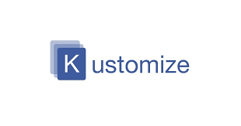

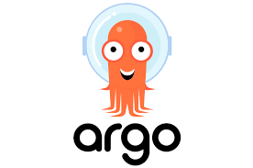
CD - tools
All CI tools plus
Principles

Slide 11
Separate CI from CD and basic prinicples
Build once, deploy everywhere
The container image is an immutable object that originates from a single GIT commit
Container image is environment agnostic, from local development to dev, test, uat, prod – app configuration should support this
Each container image is a result of CI process together with test results
Ensures provinance
Separate CI from CD
Promote to higher environment (from test onwards) tested artefacts (container images)
Provides flexibility and speed in deployment process
Responsibility is always on the person, not automatic process regardless of the process implementation
GitOps – Git as a single source of truth for application code, application and environment configuration, and a central point for starting and observing CI and CD processes
Principles

Slide 12
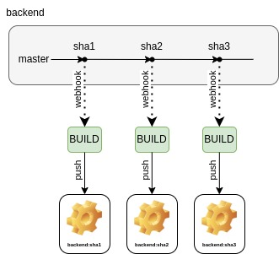
Build and test
Principles

Slide 13
Release management
Deployment to dev environment can be done utilizing container image tag which is equal to Git commit SHA
For deployment to higher environments a tagging with semantic version is advisable (Vx.y.z)
X – major version – change suggest breaking changes
Y – minor version – change suggest new features or feature upgrades without breaking changed
Z – fixpack – change suggest bug fixes without new features, feature upgrades and no breaking changes
For deployment to environment lower than prod (test, uat), a Release Candidate nomenclature is advisable (Vx.y.z_Rci) where i is a sequential number
RC ensures continuity of semantic versions in production environment (if this is required; if not RCs are not necessary)
Done through Git tagging and container image tagging. No new builds, no new container images, only the tag is applied to existing container images.
Principles

Slide 14
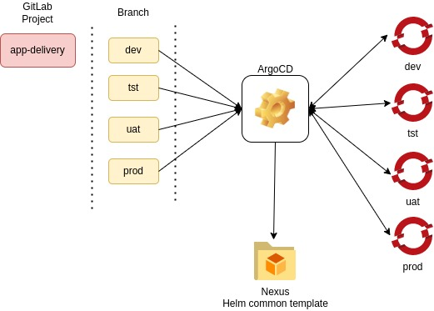
Deploy / GitOps
Principles

Slide 15
Helm

Slide 16
Helm
Helm is a package manager manager for Kubernetes (and Openshift)
Helm Chart – package format (like deb or rpm). Nexus can host them.
Helm capabilities:
Create new charts from scratch
Package charts into chart archive (tgz) files
Interact with chart repositories where charts are stored
Install and uninstall charts into an existing Kubernetes cluster
Manage the release cycle of charts that have been installed with Helm
Openshift object abstraction
Helm concepts:
The chart is a bundle of information necessary to create an instance of a Kubernetes application.
The config (values) contains configuration information that can be merged into a packaged chart to create a releasable object.
A release is a running instance of a chart, combined with a specific config.
Helm

Slide 17
Helm - components
The Helm Client is a command-line client for end users. The client is responsible for the following:
Local chart development
Managing repositories
Managing releases
Interfacing with the Helm library
Sending charts to be installed
Requesting upgrading or uninstalling of existing releases
The Helm Library provides the logic for executing all Helm operations. It interfaces with the Kubernetes API server and provides the following capability:
Combining a chart and configuration to build a release
Installing charts into Kubernetes, and providing the subsequent release object
Upgrading and uninstalling charts by interacting with Kubernetes
Helm

Slide 18
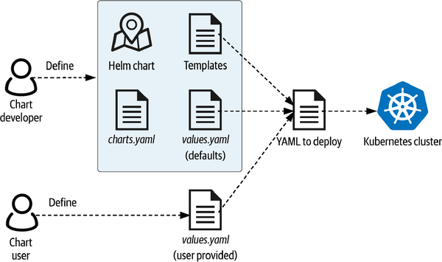
Helm
Helm

Slide 19
Helm – Chart File Structure
wordpress/
Chart.yaml # A YAML file containing information about the chart
LICENSE # OPTIONAL: A plain text file containing the license for the chart
README.md # OPTIONAL: A human-readable README file
values.yaml # The default configuration values for this chart
values.schema.json # OPTIONAL: A JSON Schema for imposing a structure on the values.yaml file
charts/ # A directory containing any charts upon which this chart depends.
crds/ # Custom Resource Definitions
templates/ # A directory of templates that, when combined with values,
# will generate valid Kubernetes manifest files.
templates/NOTES.txt # OPTIONAL: A plain text file containing short usage notes
*bold – mandatory
Helm

Slide 20
Helm – Chart.yaml
apiVersion: The chart API version (required)
name: The name of the chart (required)
version: A SemVer 2 version (required)
description: A single-sentence description of this project (optional)
dependencies: # A list of the chart requirements (optional)
- name: The name of the chart (nginx)
version: The version of the chart ("1.2.3")
repository: (optional) The repository URL ("https://example.com/charts") or alias ("@repo-name")
Helm

Slide 21
Helm templates – route example
templates/route.yaml
values.yaml
{{- if .Values.route.enabled -}}
kind: Route
apiVersion: route.openshift.io/v1
metadata:
name: {{ include "todo.fullname" . }}-fe
spec:
{{- with .Values.route.host }}
host: {{ . }}
{{- end }}
{{- with .Values.fe.route_path }}
path: {{ . }}
{{- end }}
to:
kind: Service
name: {{ include "todo.fullname" . }}-fe
port:
targetPort: {{ .Values.fe.service.port }}
tls:
termination: edge
insecureEdgeTerminationPolicy: Redirect
wildcardPolicy: None
{{- end }}
fe:
...
service:
type: ClusterIP
port: 3000
route_path: /
...
route:
enabled: true
host: todo-user1.ocp.hpb.tn.hr
Helm

Slide 22
Helm CLI
helm repo --help
helm repo add [NAME] [URL] # Adds the helm repo locally
helm repo list # Lists helm repos
helm search repo # Searches for all charts in repos
helm show --help
helm show chart [CHART] # Shows the Chart.yaml
helm show values [CHART] # Shows the default values
helm install --help
helm install [NAME] [CHART] [flags] # Installs CHART with release NAME in context
helm upgrade --help
helm upgrade [RELEASE] [CHART] [flags] # Updates installed release with NAME according to CHART with new values specified by flags
helm uninstall --help
helm uninstall [NAME] [flags] # Uninstalls release with NAME in context
helm list # Lists the installed helm releases in context
Helm

Slide 23
Tekton

Slide 24
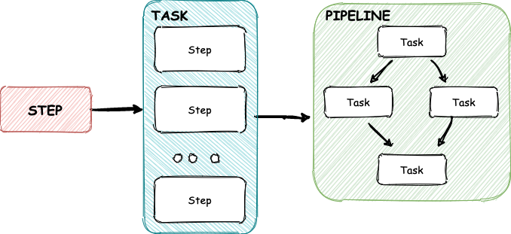
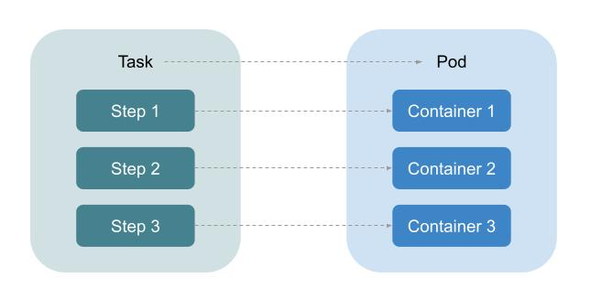
Tekton
An open source project for creating CI and CD pipelines
Runs only on Kubernetes and all Kubernetes distributions like Openshift
Pipelines as Kubernetes resources / objects written in YAML
Language agnostic
Pipeline runtime only – for implementation you can use any container images you want / need
Pipelines are sequences of tasks. Tasks are sequences of steps. Each step is run in one container. Each task is run in a pod.
Tekton

Slide 25
Tekton Runtime and Resources
Pipeline – a definition of pipeline. Definition of input parameters and workspaces together with sequence of tasks
PipelineRun – instantiation of a pipeline (a single run) with defined values for input parameters and specific workspace (any Kubernetes mountable object – PVC, ConfigMap, Secret, …)
Task – a definition of task. Definition of input parameters and workspaces together with sequence of steps. Each step uses a container image to execute a script to accomplish an operation.
TaskRun – instantioation of a task (a single run) with defined values for input parameters and workspaces. TaskRun is autimatically created by PipelineRun
ClusterTask – a definition of task on Cluster level. Pipelines from all Projects can use these tasks. NOTE: ClusterTasks are deprecated and removed in Openshift Pipelines V1.17. Use cluster resolver instead.
Tekton

Slide 26
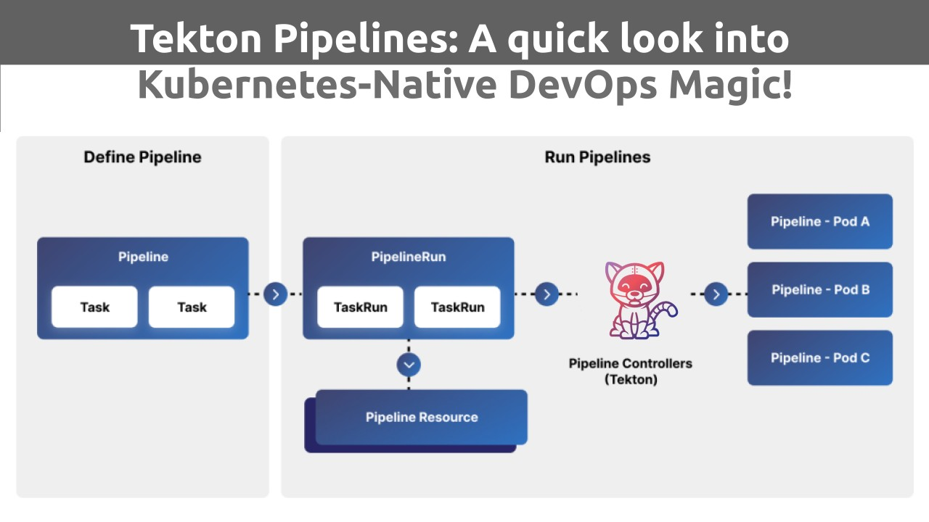
Tekton Runtime and Resources
Tekton

Slide 27
Tekton Webhooks and Resources
EventListener – Exposes a webhook. Runs in a pod. Defines criteria for running the TriggerTemplate and which TriggerTemplate to run
TriggerTemplate – references a pipeline or defines resources to create upon triggering. Usually the resources you want to create from TriggerTemplate is a PipelineRun.
(Cluster)TriggerBinding – defines how the values from webhook body are mapprd to pipeline parameters
ClusterInterceptor – used by EventListener to probe and filter requests that needs to trigger a TriggerTemplate
Tekton

Slide 28
Tekton Demo

Slide 29
GitOps

Slide 30
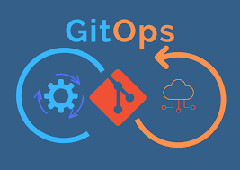
What is GitOps
GitOps is a set of practices for managing instastructure and application configuration
Uses GIT as a single source of truth for:
Application configuration
Infrastructure / Platform / Environment configuration
CI and CD definitions
Release management
Process management – Triggering and observing CI, CD, IaC processes through standard git actions like push, tag, release, pull / merge request, …
Organizational structure
The main tool that enables GitOps for Kubernetes distributions is ArgoCD.
Tekton

Slide 31
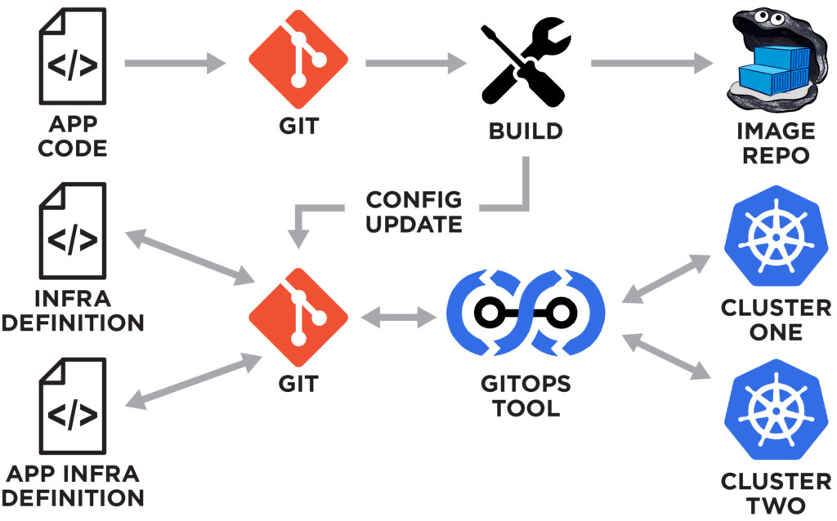
What is GitOps
Tekton

Slide 32
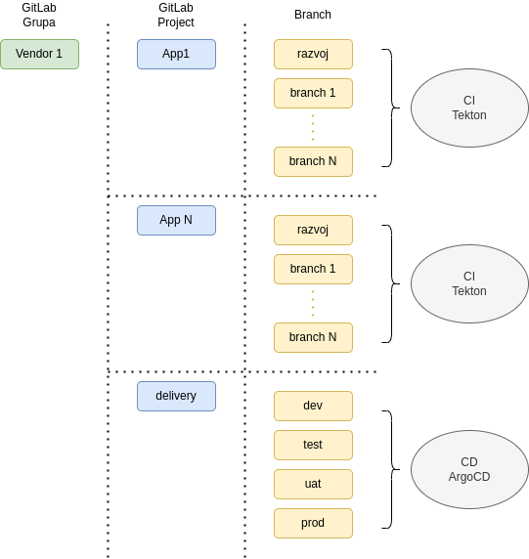
Organizational structure
Application and Vendor structure defined through GitLab (sub)groups – corresponds to OpenShift resources (Projects and Deployments)
Tekton

Slide 33
Why GitOps
Simplicity:
Tekton

Slide 34
ArgoCD

Slide 35
Hvala!

