Slide 1


Containers

Slide 2

Agenda
Virtualization
Types of virtualization
VMs vs Containers
Podman Architecture
Containerfiles
Clud Native Development
Lab
Notes:
Placeholder desno - Replace image za novu fotku.

Slide 3
Virtualization

Slide 4
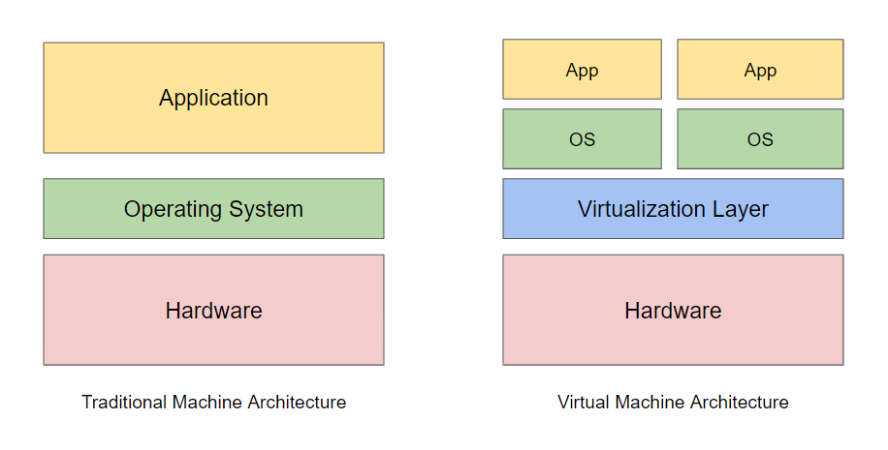
Virtualization
Virtualization is the process of running a virtual instance of a computer system in a layer abstracted from the actual hardware.
Distributing a machines physical capabilities among different users and environments
Virtualization

Slide 5
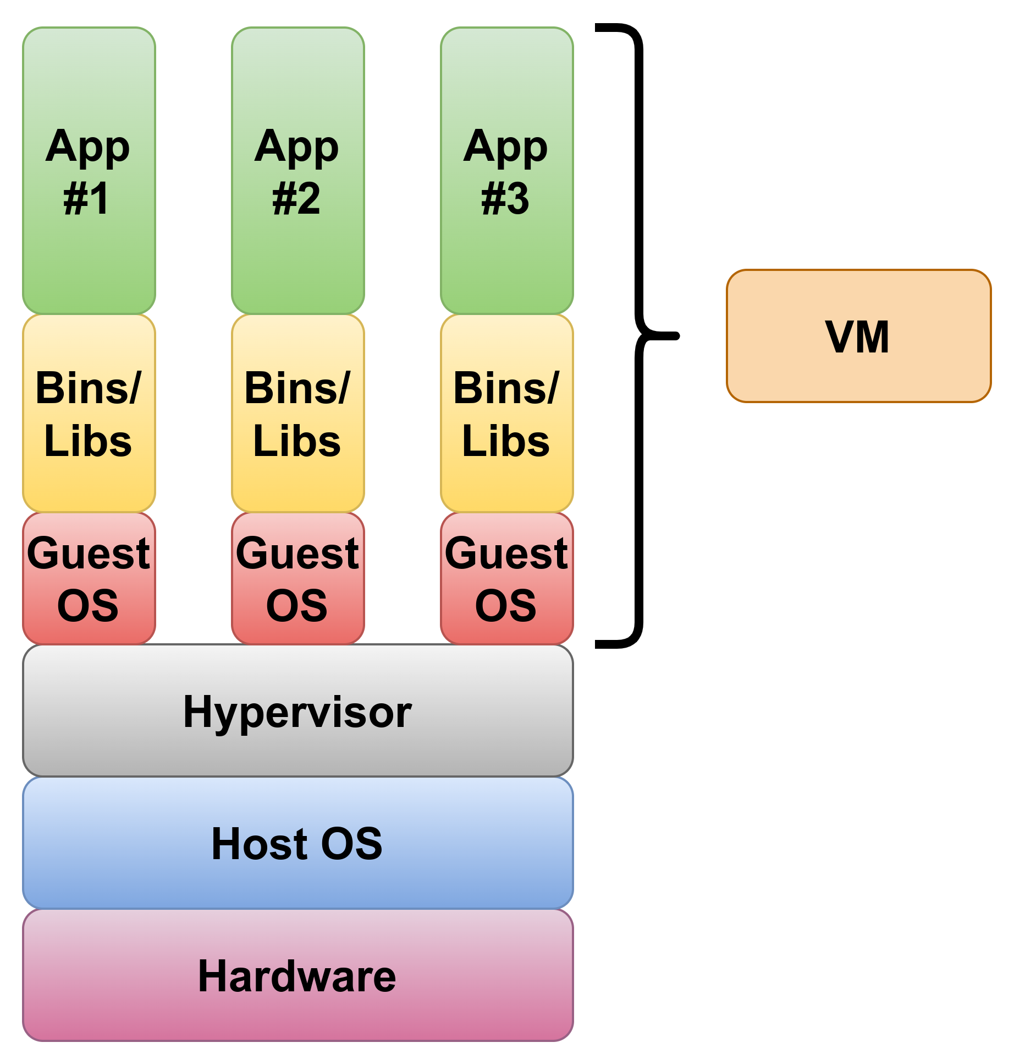
Virtual Machine
An emulation of a real computer as a virtual or software based resource.
Virtualization

Slide 6
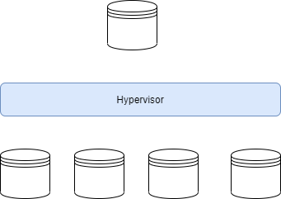
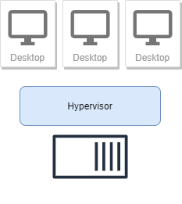
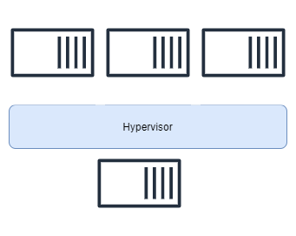
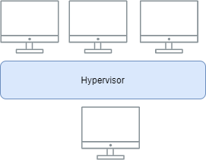
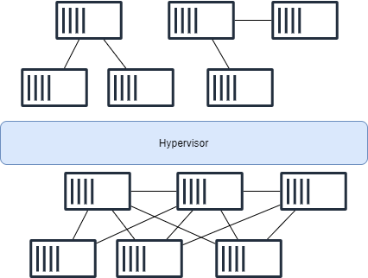
Types of virtualization
Data Virtualization
Desktop Virtualization
Server Virtualization
Operating system Virutalization
Network function Virtualization
Virtualization

Slide 7
Virtual Machines
Benefits
Provides hardware vitualization
Each new VM contains virtual hardware, a kernel (i.e. OS) and seperate user space
Partition servers
Run applications on multiple operating systems and versions
Use server resources more efficently and reduce costs
Reduce vendor lock
Easier to scale
Foundation of cloud computing
Virtualization

Slide 8
Virtual Machines
Limitations
Each VM still requires CPU allocation, storage, RAM and an guest operating system
The more VMs you run the more resources you need
Application portability is not guaranteed
Virtualization

Slide 9
Containers

Slide 10
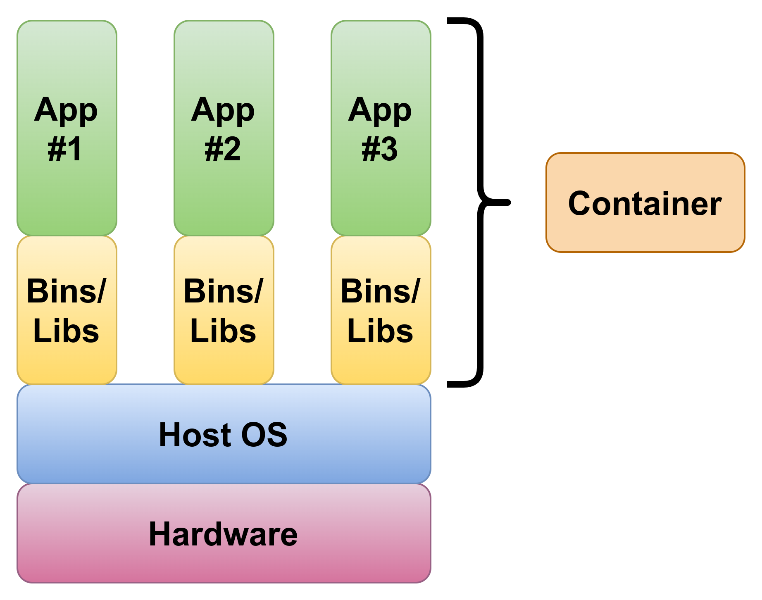
Containers
Operating-system-level virtualization by abstracting the “user space”
Share the host OS kernel
Isolate apps from each other
High level approach:
It’s a lightweight VM
Low level approach:
It’s chroot on steroids
Containers

Slide 11
Container runtimes
Open Container Initiative (OCI) - provides a set of industry standards that define a container runtime specification and a container image specification. The image specification defines the format for the bundle of files and metadata that form a container image. When you build an application as a container image, which complies with the OCI standard, you can use any OCI-compliant container engine to execute the application.
Container Runtime Interface - a plugin interface which enables kubelet to use a wide variety of container runtimes, without the need to recompile. CRI consists of a protocol buffers and gRPC API, and libraries, with additional specifications and tools under active development
Containers

Slide 12




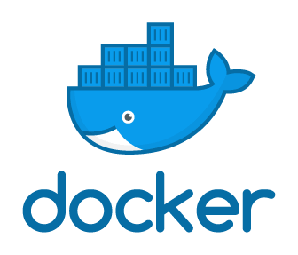
Container runtimes
Containers

Slide 13
Container Benefits
Low hardware footprint
Environment isolation
Quick deployment
Multiple environment deployment
Reusability
Containers

Slide 14
Container History
Containers have quickly gained popularity in recent years. However, the technology behind containers has been around for a relatively long time. In 2001, Linux introduced a project named VServer. VServer was the first attempt at running complete sets of processes inside a single server with a high degree of isolation. From VServer, the idea of isolated processes further evolved and became formalized around the following features of the Linux kernel:
Namespaces
Control groups (cgroups)
Seccomp
SELinux
Containers

Slide 15
Container Control groups
Control groups (also called cgroups) is a Linux kernel feature that isolates, prioritizes, and accounts for the resource usage (CPU, memory, disk I/O, network, etc.) of a set of processes.
Cgroups ensure that containers only use the resources they need and, if needed, set up limits to what resources a container *can* use.
Cgroups also ensure that a single container doesn’t exhaust one of those resources and bring the entire system down.
Containers

Slide 16
Container Isolated Union file system
Copy on Write storage
Create a new container instantly (instead of copying its whole filesystem)
Storage keeps track of what has changed
Considerably reduces footprint and boot times
Containers

Slide 17
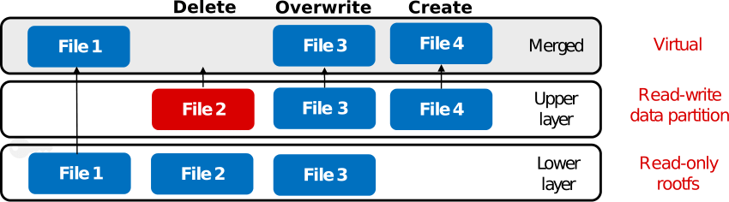
OverlayFS
Containers

Slide 18
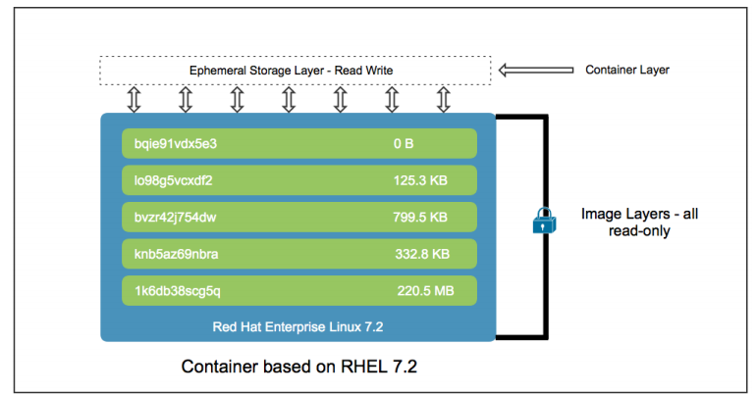
Container storage
Container storage is ephemeral, meaning its contents are not preserved after the container is removed
Containers

Slide 19
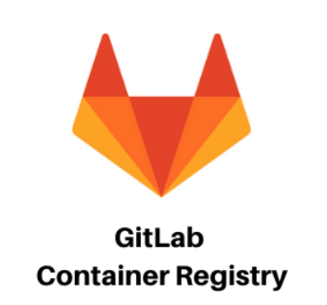
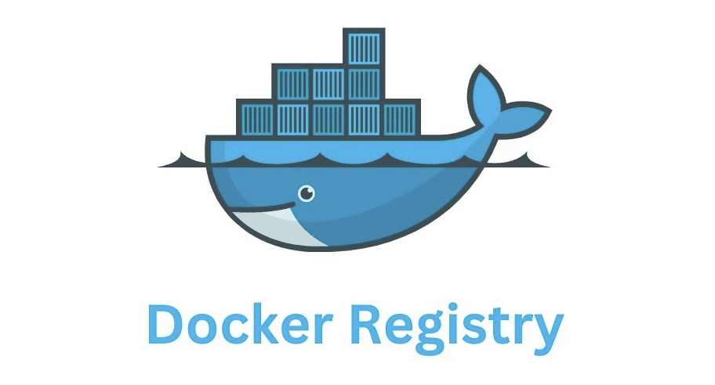


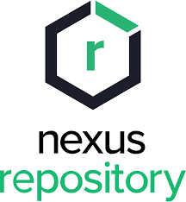

Container registries
Public or private container image repositories
Podman

Slide 20
Podman

Slide 21

What is Podman?
A daemonless, open source, Linux native tool designed to make it easy to find, run, build, share and deploy applications using Open Containers Initiative (OCI)
Relies on an OCI compliant Container Runtime (runc, crun, runv, etc) to interface with the operating system and create running containers
Podman

Slide 22
What is Podman?
Containers under the control of Podman can either be run by root or by a non-privileged user
Podman manages the entire container ecosystem which includes pods, containers, container images, and container volumes
Allows you to create, run, and maintain containers and container images
Has a RESTFul API to manage containers. Also has a remote Podman client that can interact with the RESTFul service
Podman

Slide 23
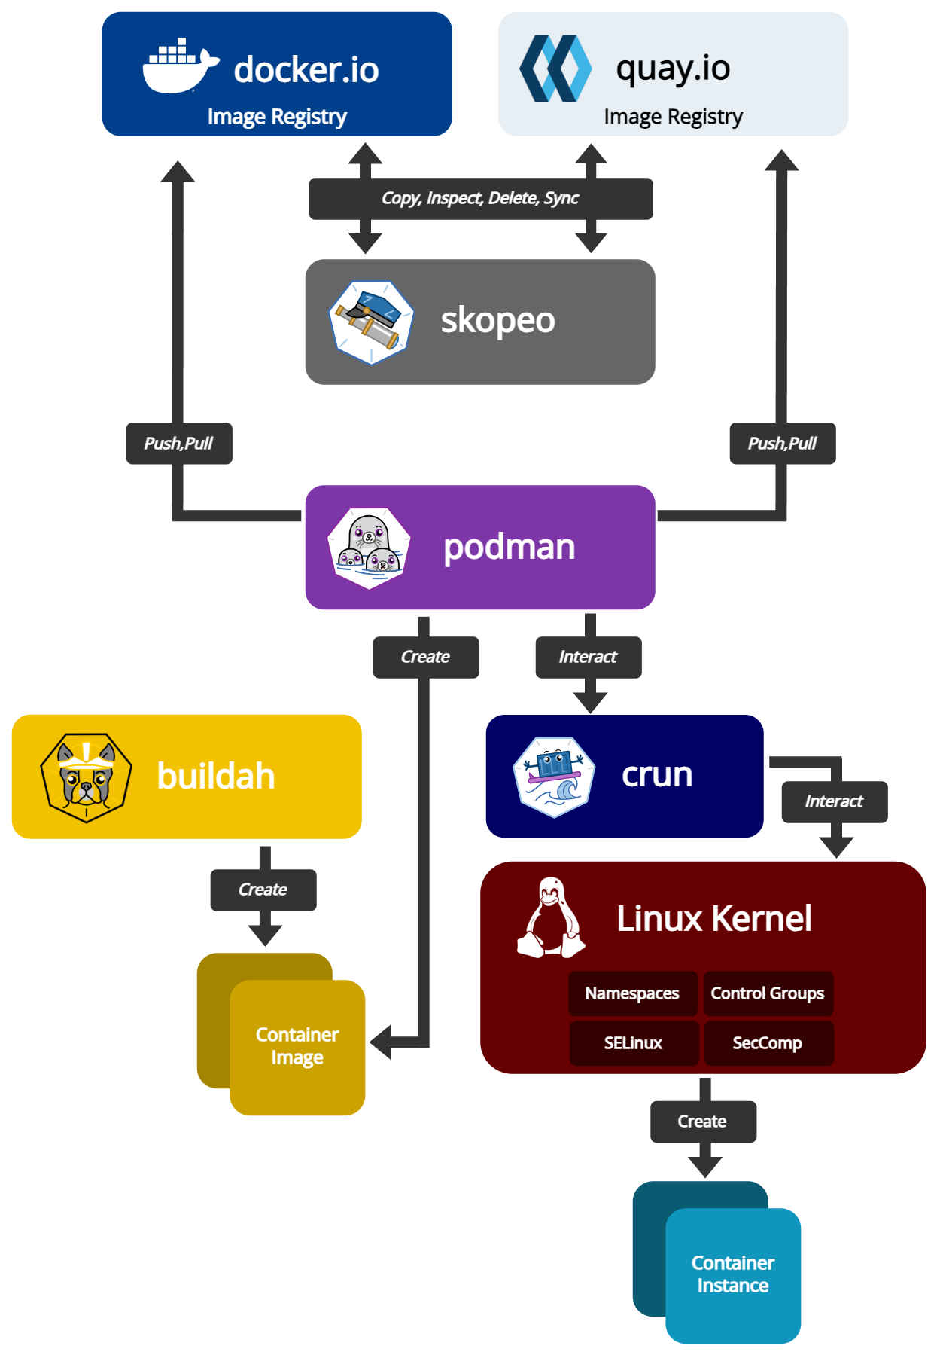
Docker Architecture

Slide 24
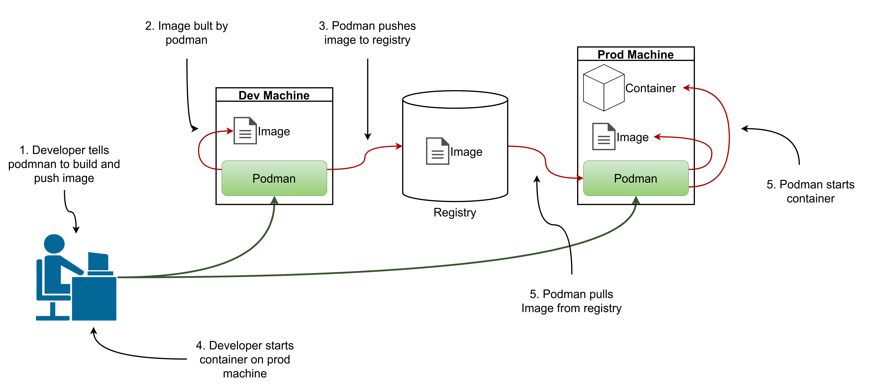

Slide 25
Container image creation
Using a running container
An immutable image is used to start a new container instance and any changes or updates needed by this container are made to a read/write extra layer. Docker commands can be issued to store that read/write layer over the existing image to generate a new image. Due to its simplicity, this approach is the easiest way to create images, but it is not a recommended approach because the image size might become large due to unnecessary files, such as temporary files and logs.
Using a Containerfile
Container images can be built from a base image using a set of steps called instructions. Each instruction creates a new layer on the image that is used to build the final container image. This is the suggested approach to building images, because it controls which files are added to each layer.
Podman

Slide 26
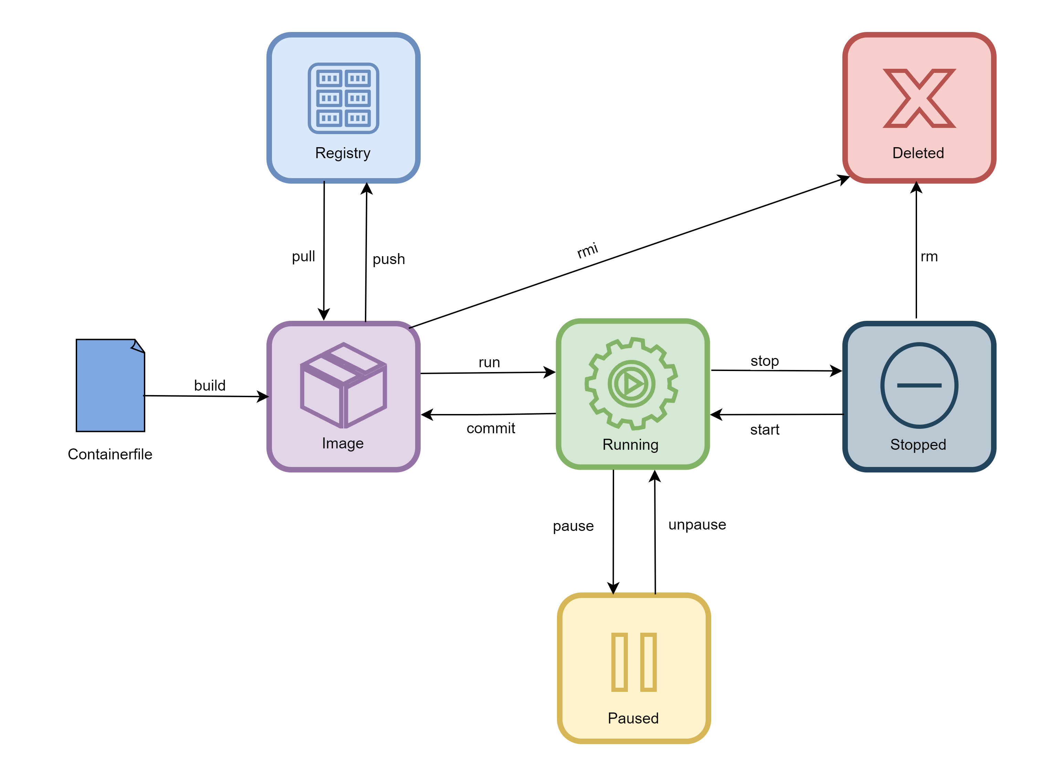
Container Lifecycle

Slide 27
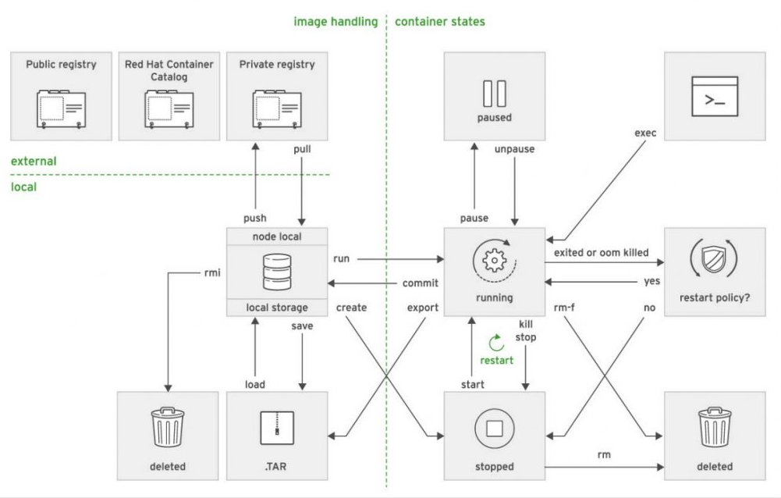
Common subcommands
Podman

Slide 28
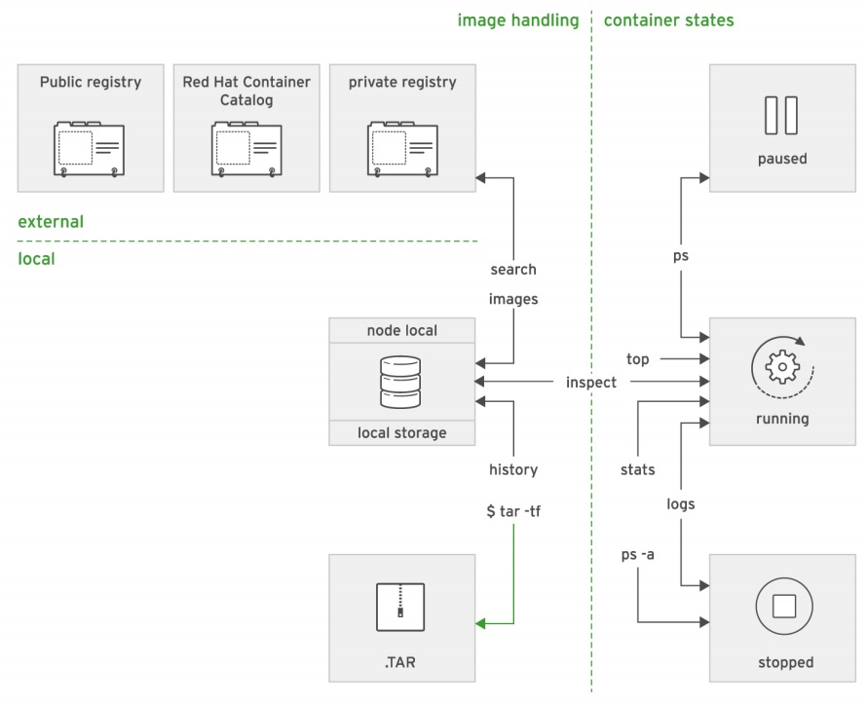
Info subcommands
Podman

Slide 29
Root and rootless containers
Podman can run as root, or as user (rootless).
When running rootless, root user inside container is actually your user on host machine.
User and group mappings are defined in “/etc/subuid” and “/etc/subguid”.
If you crate a file inside container as root, it will be owned by your user on host.
Root containers can not bind on privileged ports.
Use “podman unshare” to modify permissions with uid/gid used by podman.
Podman

Slide 30
Persistant storage
When creating containers, we can request a host directory to bind mount inside a container
# podman run -v <local_folder>:<container_folder>:Z alpine:latest
When running containers on a system with SELinux enabled (like in lab), a special label “container_file_t” for containers exists.
You can use “:Z” and “:z” flags to have podman autorelabel folders for containers
“:Z” will crate a private label for each mount, so only the last container that mounted the volume will have access to it
“:z” will label it with “continer_file_t” so all containers that mount the volume will have access to it
# semanage fcontext -a -t container_file_t <local_folder>(/.*)?
# restorecon -rv <local_folder>
Podman

Slide 31
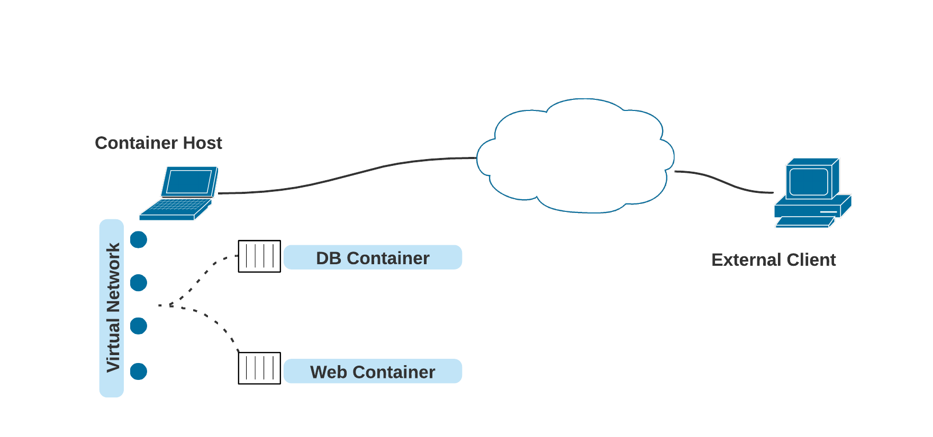
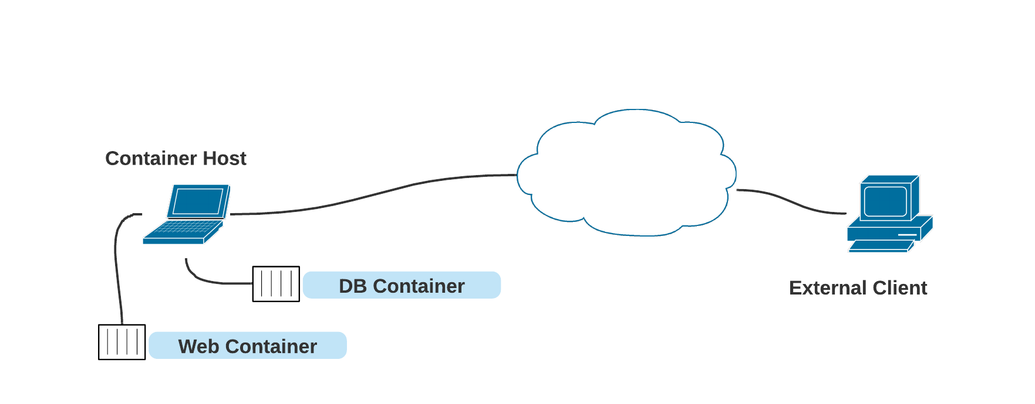
Podman Networks
By default, Podman uses a bridged network mode for root containers, which through the use of iptables and NAT, allows containers to connect to the host machines network.
By default, Podman uses slirp4netns for rootless containers. Podman creates tap device in container’s network namespace and connects to usermode TCP/IP stack. There is no virtual network and containers have to communicate through host system.
Virtualization

Slide 32
Podman Network Modes
MODE | WHAT IT DOES
bridge | Creates a network stack on the default bridge network
none | No networking is set up at all
container:<id> | Uses the same network as another container with ID id
host | Uses the host’s network stack
network-id | Uses a user-defined network (which you can create using podman network create ...)
ns:<path> | Joins a network namespace found at path <path>
private | Creates a new network namespace for the container
slirp4netns | Creates a user network stack with slirp4netns (This is the default option for rootless containers.)

Slide 33
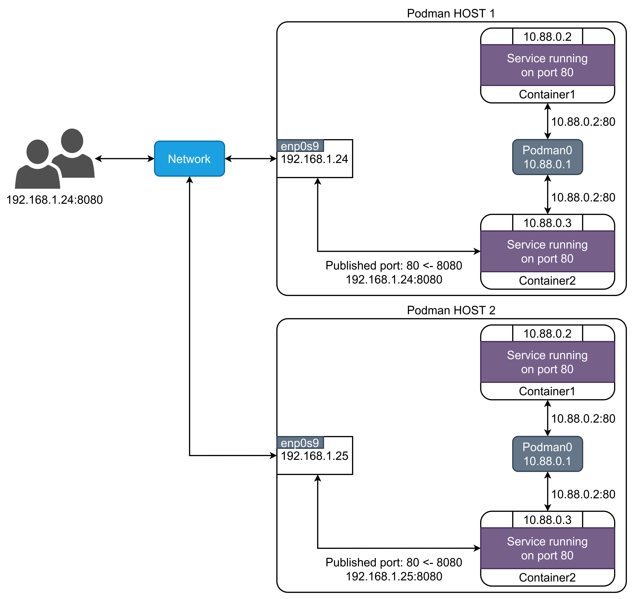
Docker Networks – Mapping network ports
Use the container host network model combined with network address translation (NAT) rules to allow external access.
# podman run -d --name httpd -p 8080:80 httpd
Virtualization

Slide 34
Managing container images
Public Registries
Podman for and downloads container images from a public registries defined in “/etc/containers/registries.conf”.
Docker Hub is the public registry managed by Docker, and it hosts a large set of container images. There a many public registries, Docker Hub and quay.io being most popular.
Private Registry
A private registry can be installed as a service.
You can add a private registry to “/etc/containers/registries.conf” to make it searchable with short name.
Podman

Slide 35
Manipulating container images
Publishing an image to a container registry
Deleting images
Deleting all images
# podman tag IMAGE[:TAG] [REGISTRYHOST/][USERNAME/]NAME[:TAG]
# podman rmi [OPTIONS] IMAGE [IMAGE...]
# podman rmi $(docker images -q)
Virtualization

Slide 36
Containerfile

Slide 37
Building container images with Dockerfile
Run operating system commands inside a container and then commit the image
Run a Containerfile that uses operating system commands and uses an operating system image as the parent
Create a Containerfile as a child of an existing container image include
Add new runtime libraries, such as database connectors.
Include organization-wide customizations such as SSL certificates and authentication providers.
Add internal libraries, to be shared as a single image layer by multiple container images for different applications.
OpenShift Source-to-Image Tool
Start a container from a base container image called the builder image
Fetch the application source code, usually from a Git server, and send it to the container.
Build the application binary files inside the container.
Save the container, after some clean up, as a new container image.
Containerfile

Slide 38
Building container images with Dockerfile
A Containerfile is the mechanism that the container packaging model provides to automate the building of container images.
Create a working directory.
Write the Containerfile specification.
Build the image with the podman command.
Containerfile

Slide 39
Building container images with Dockerfile
Lines that begin with a pound sign (#) are comments
The first non-comment instruction must be a FROM instruction to specify the base image to build upon
RUN executes commands in a new layer on top of the current image
EXPOSE indicates that the container listens on the specified network ports at runtime
ENV is responsible for defining environment variables that will be available to the container
ADD copies new files, directories, or remote URLs and adds them to the container file system.
USER specifies the username or the UID to use when running the container image
ENTRYPOINT specifies the default command to execute when the container is created
CMD provides the default arguments for the ENTRYPOINT instruction
# This is a comment line
FROM centos
LABEL description="This is a test container image"
MAINTAINER Ime Prezime
RUN yum install -y httpd
EXPOSE 80
ENV LogLevel "info"
ADD http://somewhere.com/somefile /var/www/html
COPY ./src/ /var/www/html/
USER apache
ENTRYPOINT ["/usr/sbin/httpd"]
CMD ["-D", "FOREGROUND"]
Containerfile

Slide 40
Building container images with Dockerfile
Image Layering
Each instruction in a Containerfile creates a new layer.
Having too many instructions in a Containerfile causes too many layers, resulting in large images
RUN yum --disablerepo=* --enablerepo="rhel-7-server-rpms"
RUN yum update
RUN yum install -y httpd
RUN yum --disablerepo=* --enablerepo="rhel-7-server-rpms" && \ yum update && \ yum install -y httpd
Containerfile

Slide 41
Building container images with Dockerfile
The podman build command processes the Containerfile and builds a new image based on the instructions it contains.
podman build -t NAME:TAG DIR
Containerfile

Slide 42
Multistage build
In multistage build the container image is built in several stages, usually two, distinguishing building process from runtime.
Why and when:
Application build process usually requires more tools than runtime
Runtime containers are more lightweight without unnecessary packages
Reduced container image pulling time
Reduced security attack surface
Build stage
Uses base container image with all build tools necessary
Build the application and produces runtime artifacts
Runtime stage
Uses base container image with necessary runtime
Copies the runtime artifacts from build stage into runtime container image
Examples:
Java Applications Build JDK
Runtime JRE
React / Angular Build NodeJS, NPM
Runtime Nginx
Golang Build Go
Runtime Linux
Containerfile

Slide 43
Multistage Containerfile
# Stage 1: Build Stage
FROM node:18 AS build
WORKDIR /app
COPY . .
RUN npm install && \
npm run build
# Stage 2: Runtime Stage
FROM nginx:latest
COPY --from=build /app/dist /usr/share/nginx/html
CMD ["nginx", "-g", "daemon off;"]
# Stage 1: Build Stage
FROM golang:1.17.3-alpine3.14 AS builder
WORKDIR /opt/app/
COPY . .
RUN go mod download && \
go mod verify && \
go build -o /go/bin/service
# Stage 2: Runtime Stage
FROM alpine:3.14
COPY --from=builder /go/bin/service /service
USER elf
CMD ["./service", "run"]
Buildah

Slide 44
Buildah

Slide 45
Buildah
Like Podman - open source, Linux-based tool used to build Open Container Initiative (OCI)-compatible containers
Why and when?
During development of container images
Container building without Containerfile-s or Dockerfile-s with CLI commands
Saves intermediate state
Can mount container filesystem locally
Buildah can still use Containerfile to build images by using “bud” option (Build Using Dockerfile) or in newer version simply “build”
# buildah bud .
# buildah build .
Buildah

Slide 46
Buildah – available commands
add Add content to the container
build Build an image using instructions in a Containerfile
commit Create an image from a working container
config Update image configuration settings
containers List working containers and their base images
copy Copy content into the container
from Create a working container based on an image
help Help about any command
images List images in local storage
info Display Buildah system information
inspect Inspect the configuration of a container or image
login Login to a container registry
logout Logout of a container registry
manifest Manipulate manifest lists and image indexes
mkcw Convert a conventional image to a confidential workload image
mount Mount a working container's root filesystem
prune Cleanup intermediate images as well as build and mount cache
pull Pull an image from the specified location
push Push an image to a specified destination
rename Rename a container
rm Remove one or more working containers
rmi Remove one or more images from local storage
run Run a command inside of the container
source Manage source containers
tag Add an additional name to a local image
umount Unmount the root file system of the specified working containers
unshare Run a command in a modified user namespace
Buildah

Slide 47
Buildah vs Containerfile
Containerfile
Buildah
FROM centos
LABEL description="Test container image"
MAINTAINER Ime Prezime
RUN yum install -y httpd
EXPOSE 80
ENV LogLevel "info"
ADD http://page.com/somefile /var/www/html
COPY ./src/ /var/www/html/
USER apache
ENTRYPOINT ["/usr/sbin/httpd"]
CMD ["-D", "FOREGROUND"]
# buildah from --name mycontainer centos
# buildah config --label description="Test container image" mycontainer
# buildah config --author “Ime Prezime" mycontainer
# buildah run mycontainer yum install -y httpd
# buildah config --port 80 mycontainer
# buildah config --env LogLevel=info mycontainer
# buildah add mycontainer http://page.com/somefile /var/www/html
# buildah copy ./src/ /var/www/html/
# buildah config --user apache mycontainer
# buildah config --entrypoint '["/usr/sbin/httpd"]' mycontainer
# buildah config --cmd ‘[“-D”, “FOREGROUND”]‘ mycontainer
# buildah commit mycontainer myimagerepo/centos-apache:latest
Buildah

Slide 48
Cloud-native development

Slide 49
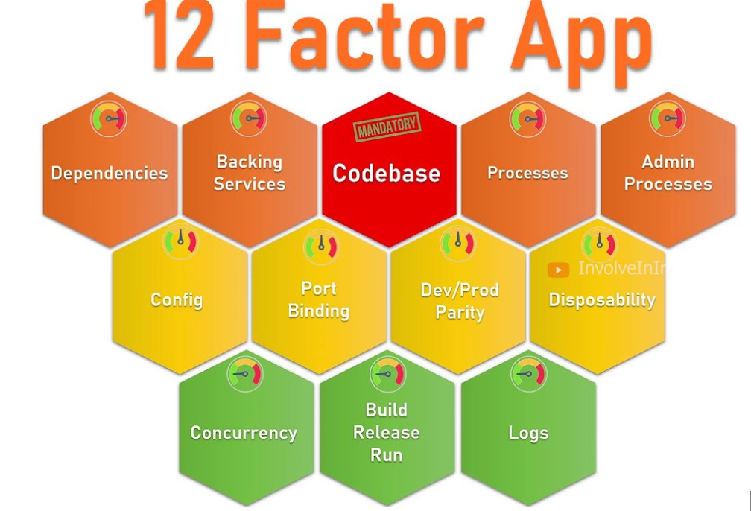
The Twelve Factors
Codebase - One codebase tracked in revision control, many deploys
Dependencies - Explicitly declare and isolate dependencies
Config - Store config in the environment
Backing services - Treat backing services as attached resources
Build, release, run - Strictly separate build and run stages
Processes - Execute the app as one or more stateless processes
Port binding - Export services via port binding
Concurrency - Scale out via the process model
Disposability - Maximize robustness with fast startup and graceful shutdown
Dev/prod parity - Keep development, staging, and production as similar as possible
Logs - Treat logs as event streams
Admin processes - Run admin/management tasks as one-off processes
Cloud-native development

Slide 50
The Twelve Factors in kubernetes world
Codebase – Container image is built once from single GIT commit and deployed multiple time throughout environments
Dependencies - Explicitly declare and isolate dependencies
Config – Config must be externalized in env variables or in file which path can be specified at app startup
Backing services – URLs to backing services needs to be externally configurable through config
Build, release, run – Separat CI from CD. Build and test the container image once in CI process and deploy the same contaner image multiple time attaching external environment specific config.
Processes – One app / microservice per container
Port binding - Export services via port binding
Concurrency - Scale out apps through container replicas
Disposability - Maximize robustness with fast startup and graceful shutdown
Dev/prod parity - Keep development, staging, and production as similar as possible
Logs – Log to SYSOUT in Kubernetes, preferably in JSON format!
Admin processes - Run admin/management tasks as Kubernetes Jobs
Cloud-native development

Slide 51
Spring guidlines
Configuration – 3 options (ordered by preferability)
Default application.yaml with env vars
Put default values in src/main/resources/application.yaml
Override these values with environment variables
application.yaml
ENV VARS
server:
port: ${SERVICE_PORT}
SERVICE_PORT=8080
server:
port: 8080
SERVER_PORT=8080
Rules for environment variables:
YAML levels are separated with dots (.)
Replace dots (.) with underscores (_)
Remove dashes (-)
Convert to uppercase
spring:
main:
log.startup-info: test
SPRING_MAIN_LOG_STARTUPINFO=test
Cloud-native development

Slide 52
Spring guidlines
2) External application.yaml
Define application.yaml for each environment and mount it into container
Start the application with “--spring.config.location=file:<path_to_config>”
3) Default application.yaml with profile
Put default values in src/main/resources/application.yaml
Write profile specific config e.g. application-openshift.yaml with environment specific configuration and mount it into container
Define environment variable SPRING_PROFILES_ACTIVE=openshift
Start the application with “--spring.config.location=file:<path_to_config>”
Cloud-native development

Slide 53
Spring guidlines
Logging
You can use any logging library
Configure this library to write the logs to SYSOUT (CONSOLE)
Preferably log in JSON format
Example logback.xml
<configuration>
<appender name="CONSOLE" class="ch.qos.logback.core.ConsoleAppender">
<encoder>
<pattern>%d{HH:mm:ss.SSS} %-5level [%thread] %logger{36} - %msg%n</pattern>
</encoder>
</appender>
<root level="INFO">
<appender-ref ref="CONSOLE"/>
</root>
</configuration>
Cloud-native development

Slide 54
Hvala!

Slide 55
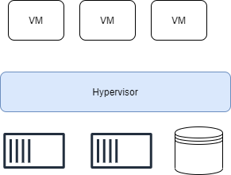
Hypervisor based virtualization
VMs run on top of a physical machine using a “hypervisor”.
hosted hypervisor
bare-metal hypervisor
Virtualization

