Slide 1


OpenShift

Slide 2
Agenda
Orchestration
Kubernetes
Openshift
Kubernetes objects
Networking
Configmaps and secrets
Storage
Openshift interface
Lab
Containr Orchestration

Slide 3
What is Container orchestration?
Container orchestration is the automation of all aspects of coordinating and managing containers. Container orchestration is focused on managing the life cycle of containers and their dynamic environments.
Why Do We Need Container Orchestration?
Container orchestration is used to automate the following tasks at scale:
Configuring and scheduling of containers
Provisioning and deployments of containers
Availability of containers
The configuration of applications in terms of the containers that they run in
Scaling of containers to equally balance application workloads across infrastructure
Allocation of resources between containers
Load balancing, traffic routing and service discovery of containers
Health monitoring of containers
Securing the interactions between containers.
Containr Orchestration

Slide 4
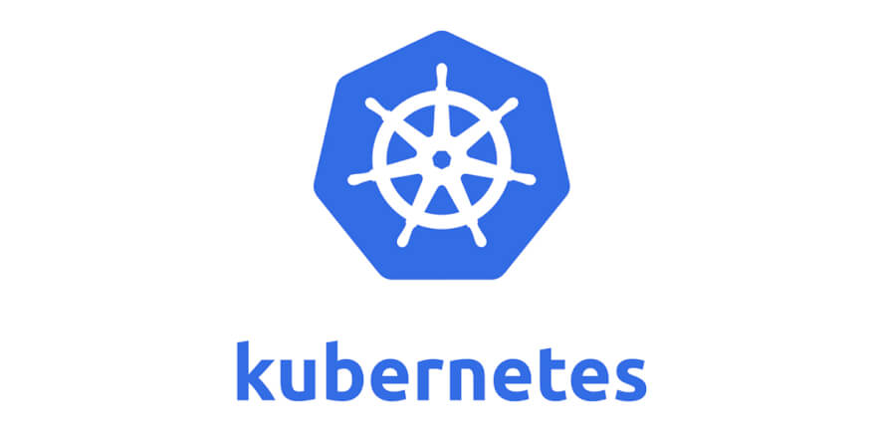
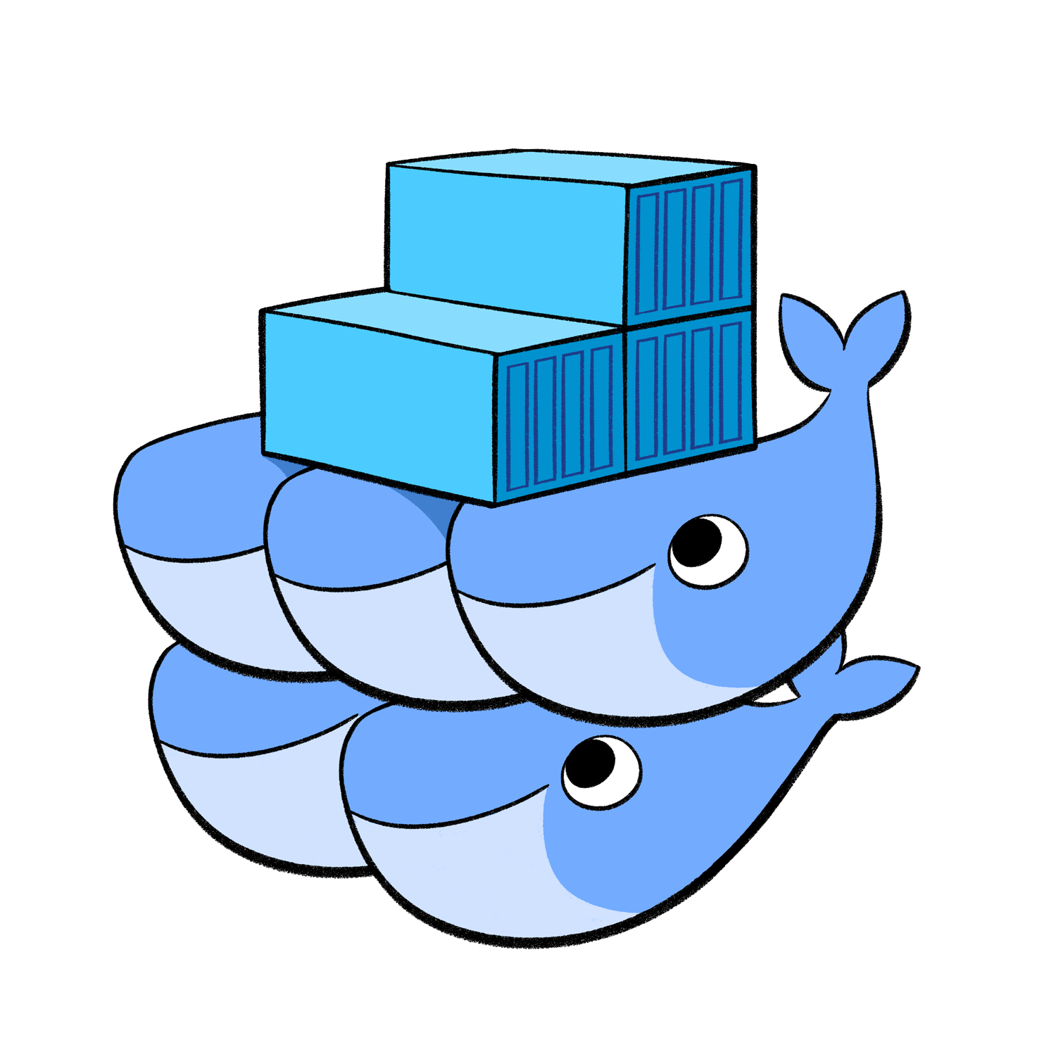


Container orchestration platforms
Containr Orchestration

Slide 5
Kubernetes

Slide 6
What is Kubernetes
Kubernetes is a portable, extensible, open-source platform for managing containerized workloads and services, that facilitates both declarative configuration and automation. It has a large, rapidly growing ecosystem. Kubernetes services, support, and tools are widely available.
Greek for „Helmsman”
Container orchestrator
Supports multiple cloud and bare metal environments
Inspired by Google’s 15 years of experience running production workloads at scale with best-of-breed ideas and practices from the community
Open source, written in Go
Manage containers, not machines
Kubernetes

Slide 7
Key benefits and capabilities
Self-healing
Manual & Auto scaling
Automatic scheduling
Automatic restarting
Cross-host managed deployments
Build-in load balancing
Container livecycle management
Kubernetes

Slide 8
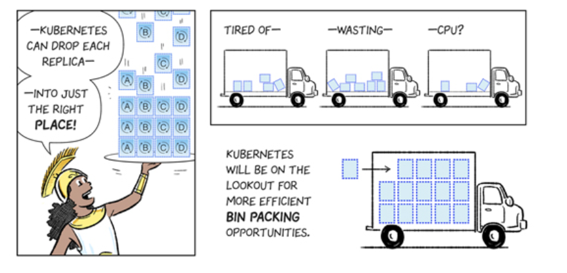
Kubernetes
https://cloud.google.com/kubernetes-engine/kubernetes-comic/
Kubernetes

Slide 9
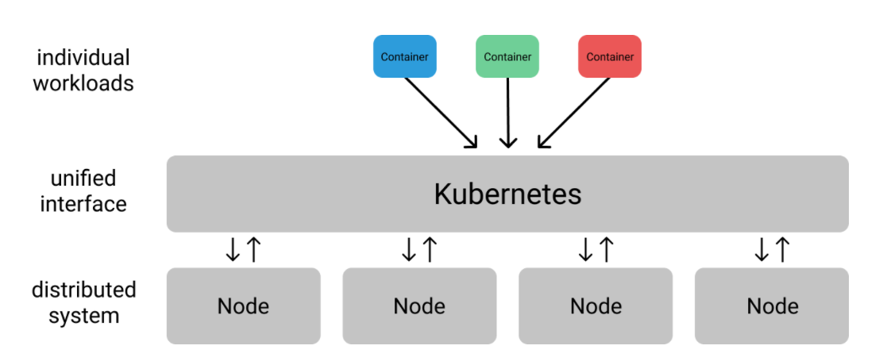
Design principles
Declarative
Distributed
Decoupled services
Immutable
Kubernetes

Slide 10
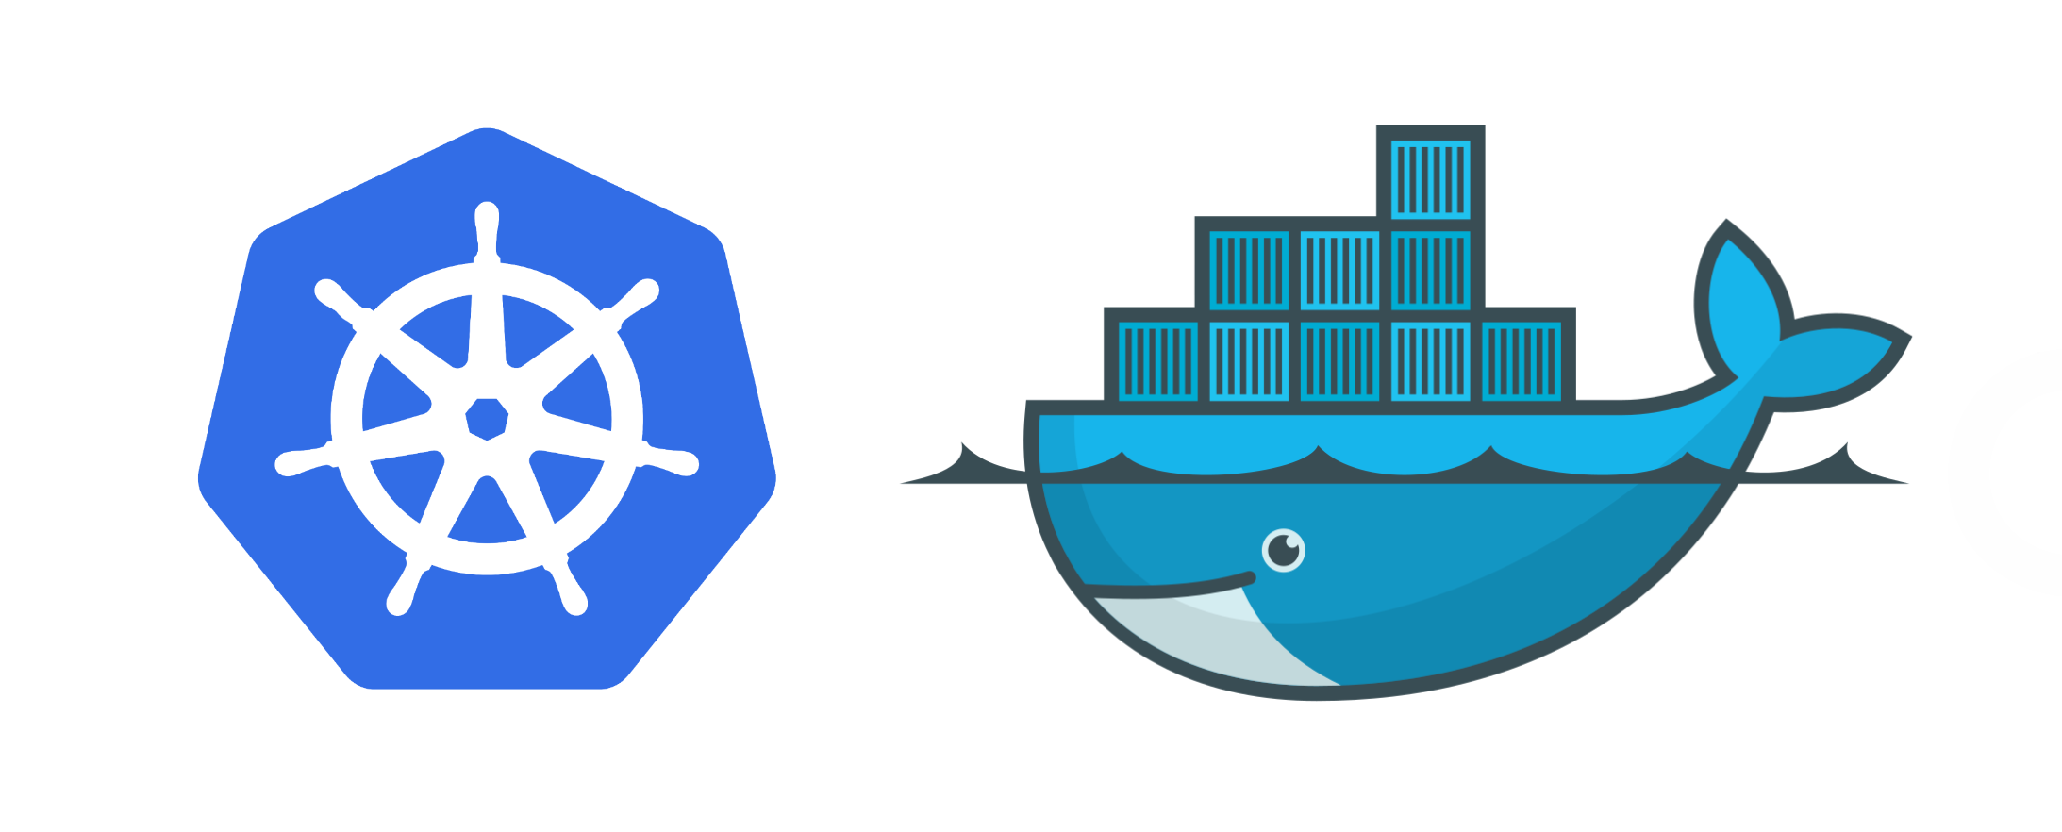
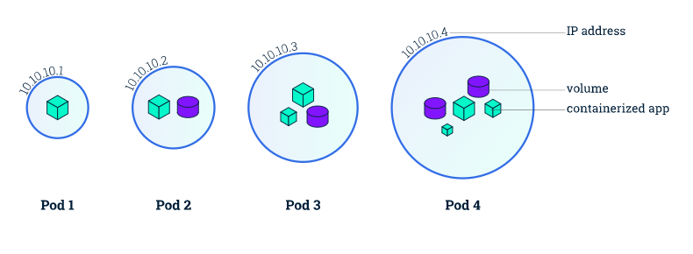
Pod
A group of whales is commonly referred to as a pod and a pod usually consists a group of whales that have bonded together either because of biological reasons or through friendships developed between two or more whales.
In many cases a typical whale pod consists of anywhere from 2 to 30 whales or more.*
Whalefacts

Slide 11
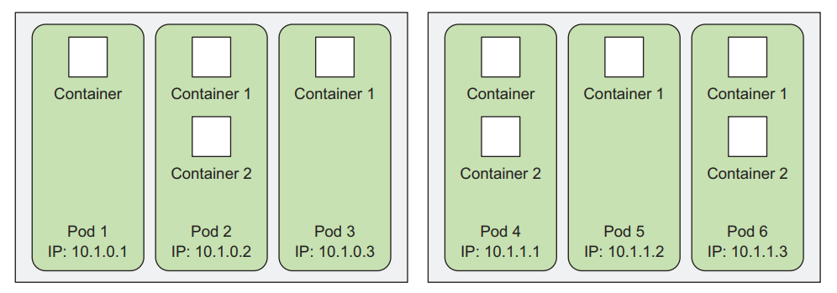
Pod

Slide 12
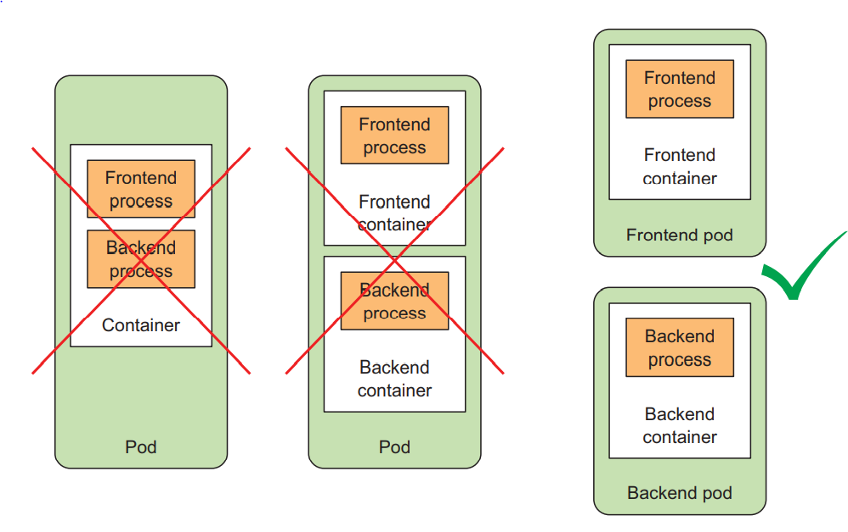
Pod

Slide 13

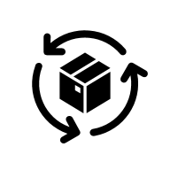

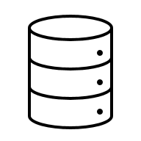
Kubernetes Terms
Pod
1* container
Shared IP
Shared storage
Shared resources
Shared livecycle
Replication Set
Deployment
Desired state
replicas
Pod template
Health checks
Resources
Images
Services
Grouping of pods
with stable VirtualIP
and DNS name
Persistent volume
Network available storage
Persisten volume
Persistent volume claims
Persistent volume classes

Slide 14

Kubernetes Terms
Label
Key value pair
Associated with an object (app=hello-world)
Enables easy selection of resources
Deamon Set
Pod runs on all nodes even unscheduleable
Each node runs exactly one pod
infrastructure-related pods
Job/ CronJob
A taks that terminates after completing task
Not continous
Jobs can ge repeated using the CronJob resource
ConfigMap and Secrets
Encapsulates pod configuration with different representation based on dana sensitivity

Slide 15
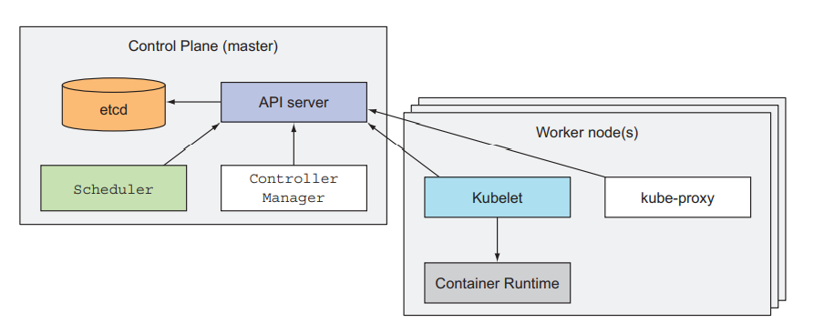
Overview
Kubernetes

Slide 16
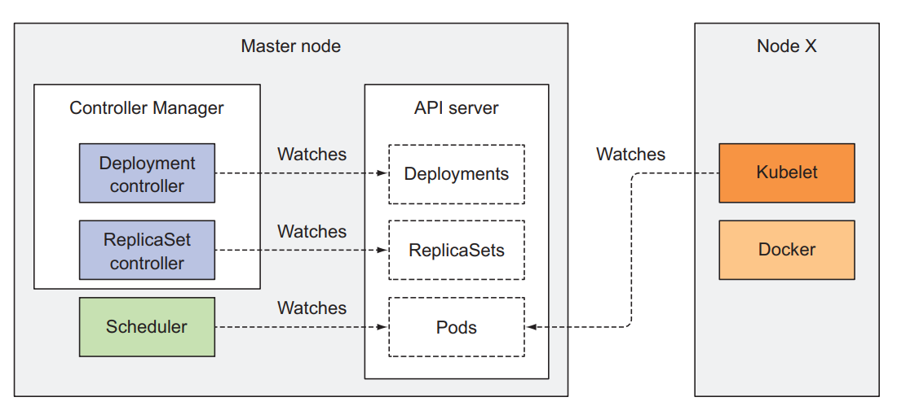
Overview – Control Plane Resources
Kubernetes

Slide 17
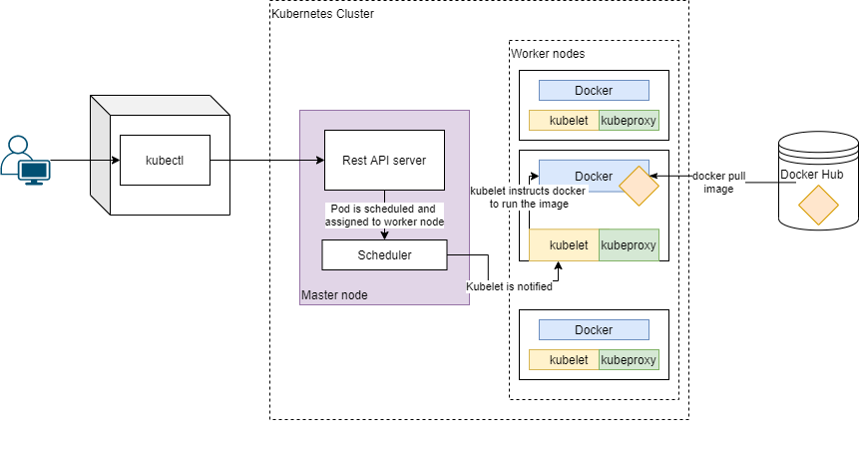
Overview - Scheduling
Kubernetes

Slide 18
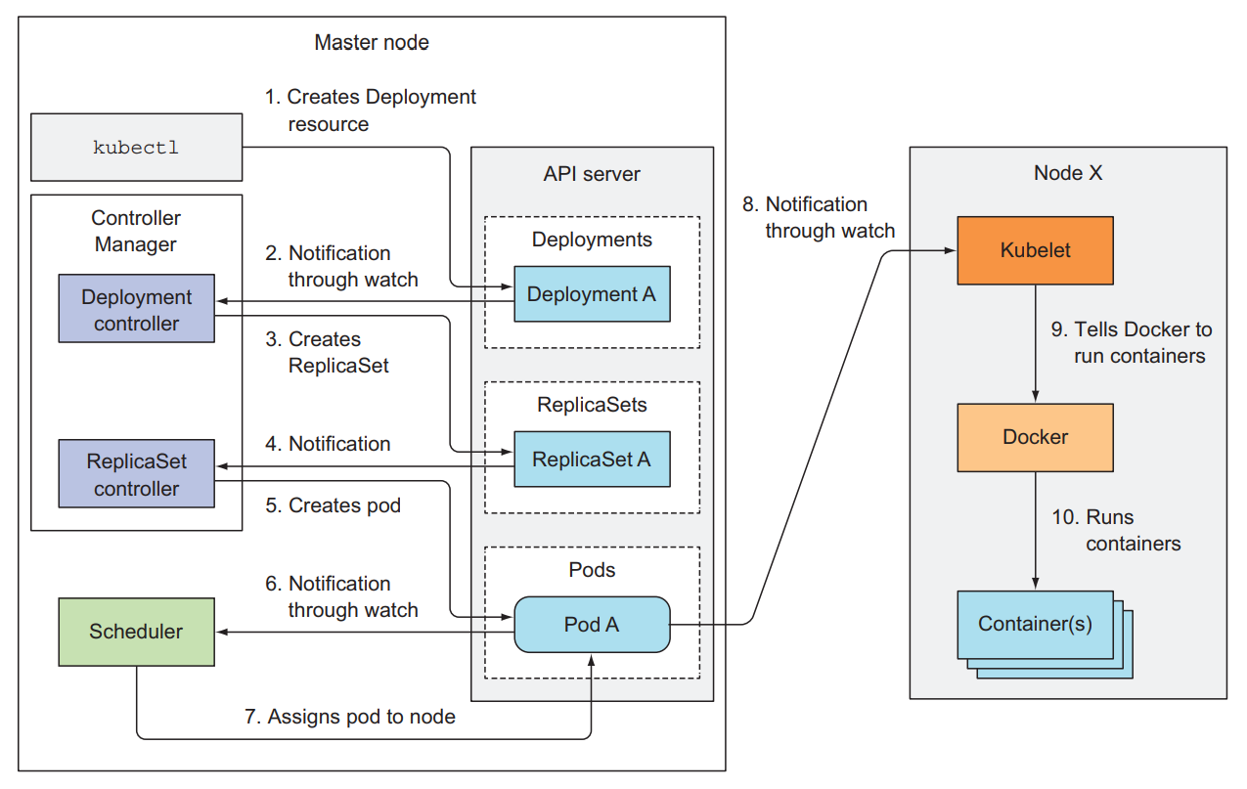
Overview - Deployment
Kubernetes

Slide 19
OpenShift

Slide 20
Red Hat Openshift Container Platform
Container orchestration platform based on Kubernetes
Enterprise-ready
Full support from Red Hat
On-premises deployment on bare metal or virtualization (VMware, RHV, OpenStack, …)
Public cloud deployment (AWS, GCP, Azure, IBM) as PaaS or on IaaS
Red Hat CodeReady Containers – minimal installation for local development and experimentation
Installation automation
Support for various persistent storage
Container images built for Openshift in Red Hat software catalog:
https://catalog.redhat.com/software/containers/explore
OpenShift

Slide 21
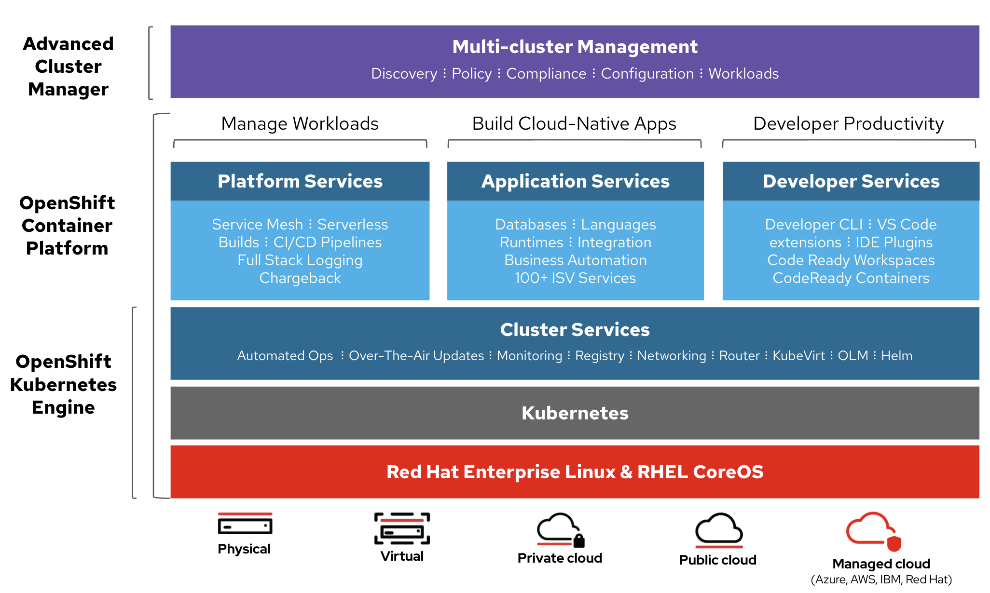
Red Hat Openshift Container Platform - Features
*source – Red Hat
OpenShift

Slide 22
Red Hat Openshift Container Platform - Features
High Availability
Lightweight Operating System (RHCOS)
Load Balancing
Automating Scaling
Logging and Monitoring
Service Discovery
Storage
Application Management
Cluster Extensibility
OpenShift

Slide 23
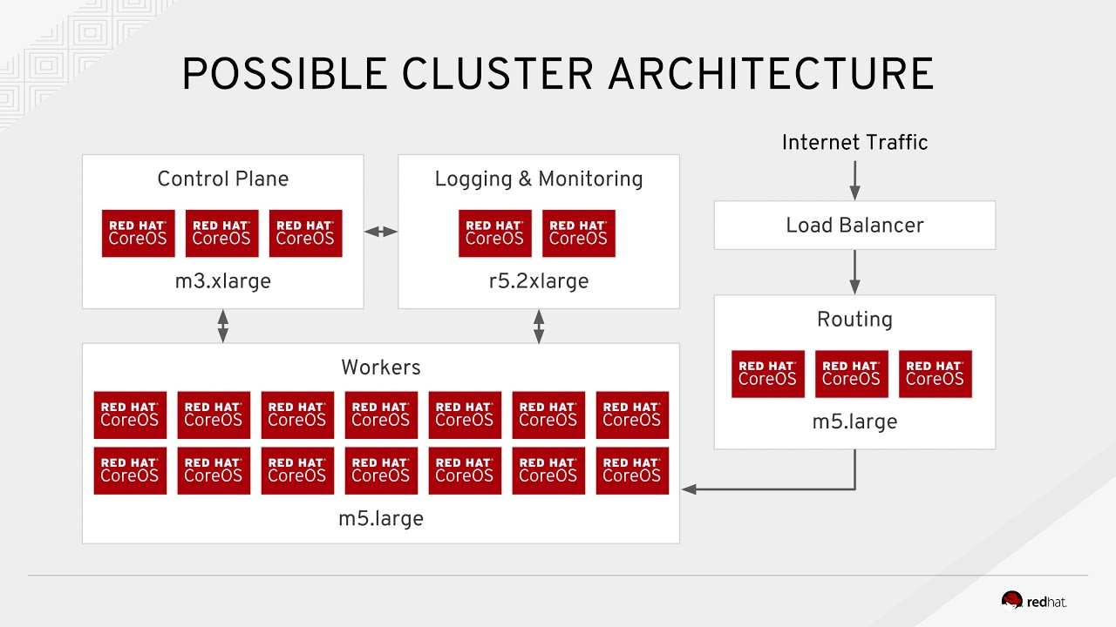
Red Hat Openshift Container Platform - Architecture
*source – Red Hat
OpenShift

Slide 24
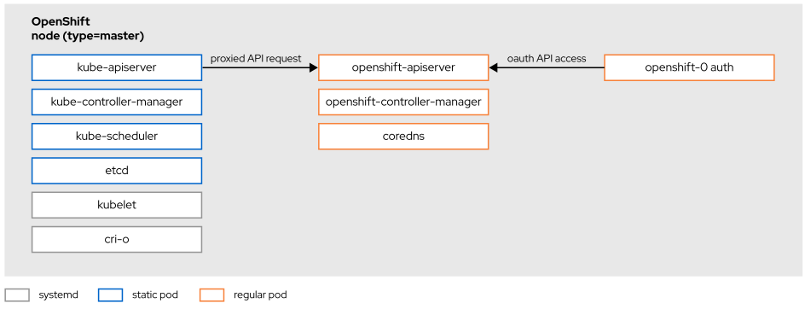
Red Hat Openshift Container Platform - Architecture
Based on standard Kubernetes
Declarative in nature
Control plane consists of master nodes that run API server, etcd and platform controllers
Worker nodes are responsible for running application workload
*source – Red Hat
OpenShift

Slide 25
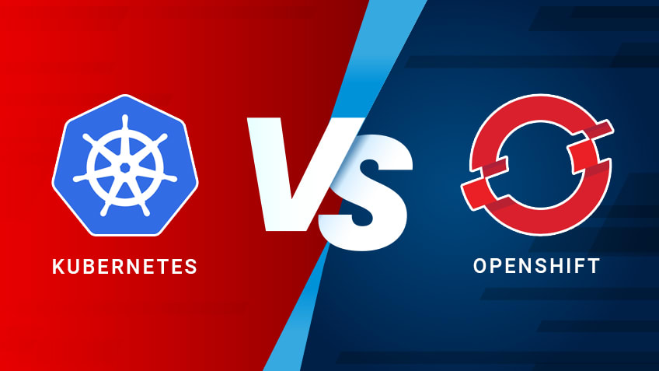
Red Hat Openshift Container Platform - Differences from Kubernetes
Community support
Basic GUI
Requires more investment in skills
Requires more ops skill and knowledge
Not secure by default
No integrated tooling
Cluster contains only few required deployments
Complex, manual upgrades
Enterprise support
Modern and comprehensive GUI
Ease of use
Easy to install, extend and manage
Secure by default
Integrated tooling
Preconfigured images, templates and examples
One-click upgrades
OpenShift

Slide 26
Red Hat Openshift Container Platform - Differences between V3 and V4
V4 advantages
Appliance flavor
IPI and UPI installation
Operators
Automatic upgrades
New tools and features (Service mesh, Serverless, CodeReady Workspaces, Tekton pipelines, …)
Cluster autoscaling
Cloud and on-premises infrastructure automation
Enhanced security with SELinux and RHCOS
OpenShift

Slide 27
Openshift – DNS and LB
Addresses consist of clustername and base domain
API adress:
api.<clustername>.<base_domain>
Routes
*.apps.<clustername>.<base_domain>
Hosts:
machineX.<clustername>.<base_domain>
For example, clustername is “ocp” and domain is “hpb.hr”:
api.ocp.hpb.hr
apps.ocp.hpb.hr
worker3.ocp.hpb.hr
OpenShift

Slide 28
Kubernetes objects

Slide 29
Kubernetes API object definitions
Kubernetes resources are usually created by posting a JSON or YAML manifest to the Kubernetes REST API endpoint.
Defining all your Kubernetes objects from YAML files makes it possible to store them in a version control system
Refer to the Kubernetes API reference documentation at http://kubernetes.io/docs/reference/ when creating objects
OpenShift

Slide 30
Project
split objects into separate, non-overlapping groups
RBAC
Resource quoting
Extension of kubernetes namespaces
Resources can live in multiple namespaces
apiVersion: v1
kind: Project
metadata:
name: custom-project
OpenShift

Slide 31
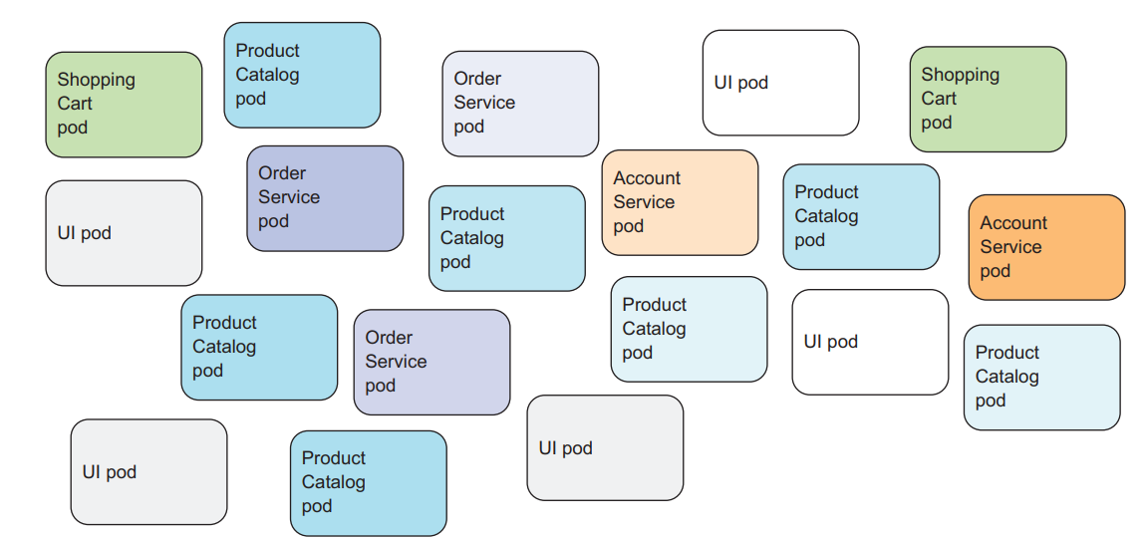
Labels
OpenShift

Slide 32
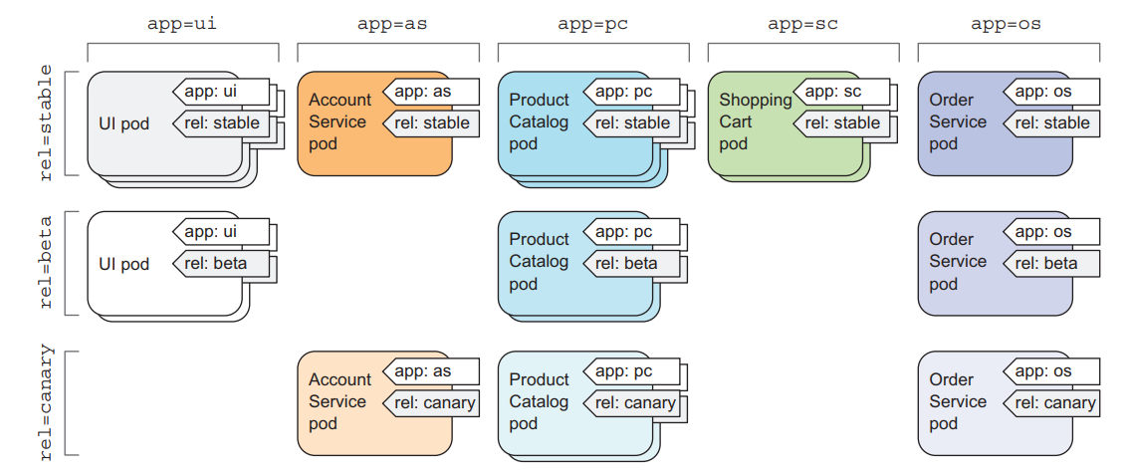
Labels
Key Value pair
Labels can be attached to any Kubernetes object, including nodes
Enabels easy and fast resource selection, querying, filtration ….
OpenShift

Slide 33
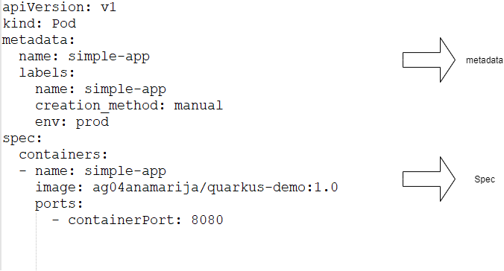
Object representation
Metadata includes the name, namespace, labels, and other information about the pod.
Spec contains the actual description of the pod’s contents, such as the pod’s containers, volumes, and other data
Status contains the current information about the running pod, such as what condition the pod is in, the description and status of each container, and the pod’s internal IP and other basic info
OpenShift

Slide 34
YAML
Indentation is essential
Everything is:
dictionary
list
key0:
key1: value1
key2:
- keyvalue1:
key3: value2
key4: value3
- keyvalue2: value4
key5: value5
OpenShift

Slide 35

apiVersion: apps/v1
kind: Pod
metadata:
name: app-pod1
spec:
containers:
- name: app-pod1
ports:
- containerPort: 5000
Protocol: TCP
image: hpb/simple-nodejs-app
ServiceAccount: default
Pods
Basic unit for deploying applications
Contains one or more pods that share same network, storage and lifecycle
Notes:
Placeholder desno - Replace image za novu fotku.

Slide 36
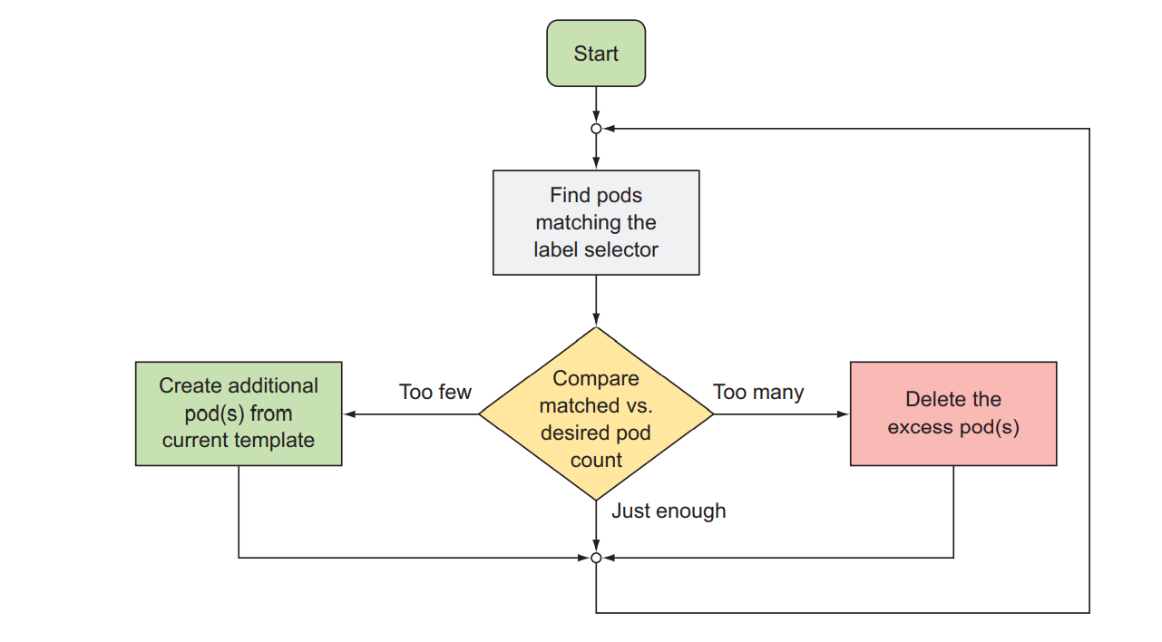
ReplicationController/ReplicaSet
Kubernetes resource that ensures its pods are always kept running
When a pod disappears for any reason the ReplicationController notices the missing pod and creates a replacement pod.
OpenShift

Slide 37
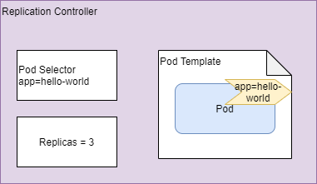
ReplicationController/ReplicaSet
A ReplicationController has three essential parts
A label selector, which determines what pods are in the ReplicationController’s scope
A replica count, which specifies the desired number of pods that should be running
A pod template, which is used when creating new pod replicas
OpenShift

Slide 38
apiVersion: apps/v1
kind: ReplicaSet
metadata:
name: simplenode-app
spec:
replicas: 3
selector:
matchLabels:
app: simplenode-app
template:
metadata:
name: simplenode-app
labels:
app: simplenode-app
spec:
containers:
- name: simplenode-app
image: hpb/simple-nodejs-app
ports:
- containerPort: 8080
OpenShift

Slide 39
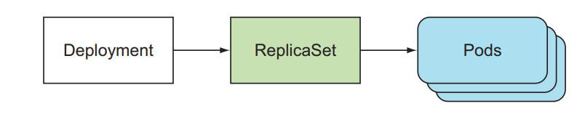
apiVersion: apps/v1
kind: Deployment
metadata:
name: simplenode-app
spec:
selector:
matchLabels:
app: simplenode-app
replicas: 2
strategy:
type: RollingUpdate
template:
metadata:
labels:
app: simplenode-app
spec:
containers:
- name: simplenode-app
image: hpb/simple-nodejs-app
ports:
- containerPort: 8080
name: simplenode-app
Deployments
Higher-level resource meant for deploying applications and updating them declaratively, instead of doing it through a ReplicationController/ReplicaSet, which are both considered lower-level concepts
Important when we do updates to coordinate different replicationSets
Notes:
Placeholder desno - Replace image za novu fotku.

Slide 40
Deployment strategy
Different applications require different ways of deployments.
Two main strategies for deployment:
Rolling
Recreate
It is possible to create custom deployment strategies
OpenShift

Slide 41
Deamon Sets
apiVersion: apps/v1
kind: DaemonSet
metadata:
name: ssd-monitor
labels:
app: ssd-monitor
spec:
selector:
matchLabels:
app: ssd-monitor
template:
metadata:
labels:
app: ssd-monitor
spec:
containers:
- name: ssd-monitor
image: hpb/monitor
Pod to run on each and every node in the cluster
For example, you’ll want to run a log collector and a resource monitor on every node.
Notes:
Placeholder desno - Replace image za novu fotku.

Slide 42
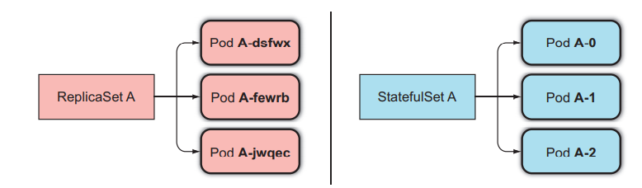
apiVersion: apps/v1
kind: StatefulSet
metadata:
name: nginx-stateful
spec:
selector:
matchLabels:
app: nginx-stateful
serviceName: "nginx-stateful"
replicas: 3
template:
metadata:
labels:
app: nginx-stateful .
spec:
containers:
- name: nginx-stateful
image: nginx
ports:
- containerPort: 8080
name: nginx-stateful
volumeMounts:
- name: data
mountPath: /usr/share/nginx/html
volumeClaimTemplates:
- metadata:
name: data
spec:
storageClassName: manual
accessModes:
- ReadWriteOnce
resources:
requests:
storage: 100Mi
Stateful Set
A StatefulSet makes sure pods are rescheduled in such a way that they retain their identity and state

Slide 43
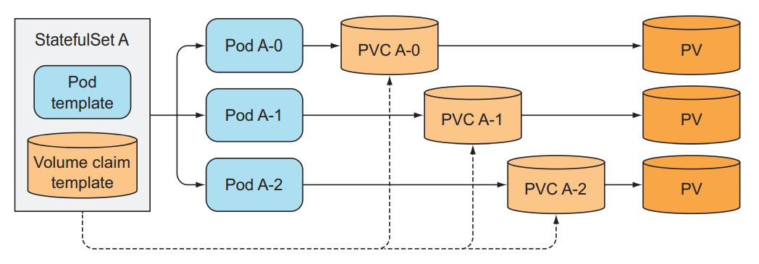
Stateful Set
OpenShift

Slide 44
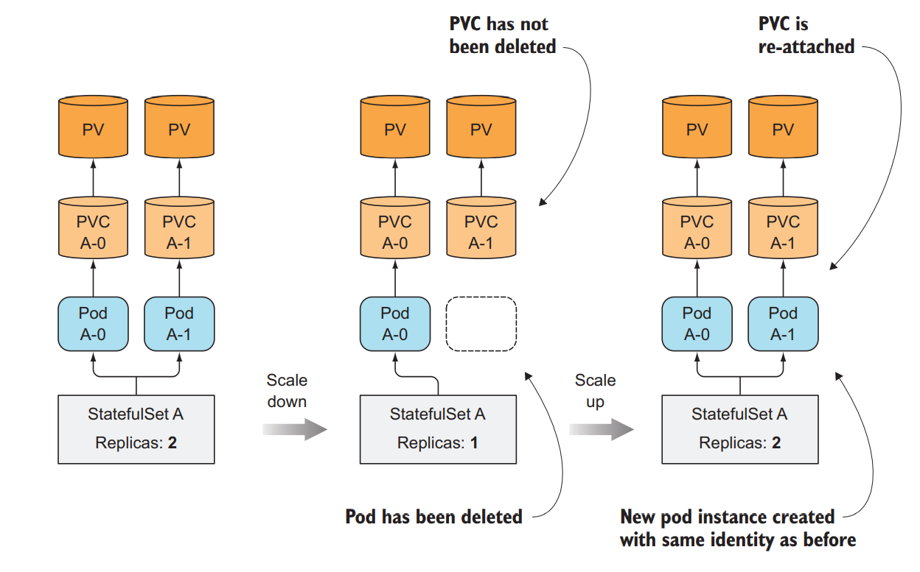
Stateful Set
OpenShift

Slide 45
Job
apiVersion: batch/v1
kind: Job
metadata:
name: batch-job
spec:
ttlSecondsAfterFinished: 100
template:
metadata:
labels:
app: batch-job
spec:
containers:
- name: main
image: hpb/batch-job
restartPolicy: Never
Perform a single completable task
Container isn’t restarted when the process running inside finishes successfully
Notes:
Placeholder desno - Replace image za novu fotku.

Slide 46
CronJob
apiVersion: batch/v1beta1
kind: CronJob
metadata:
name: simpleCronJob
namespace: default
spec:
schedule: "0,15,30,45 * * * *"
jobTemplate:
spec:
template:
spec:
containers:
- name: simple-cron-job
image: busybox
args: ['/bin/sh', '-c', 'date; echo Hello from the Kubernetes cluster']
restartPolicy: OnFailure
Job that runs periodically
Uses cron format
Notes:
Placeholder desno - Replace image za novu fotku.

Slide 47
Networking

Slide 48
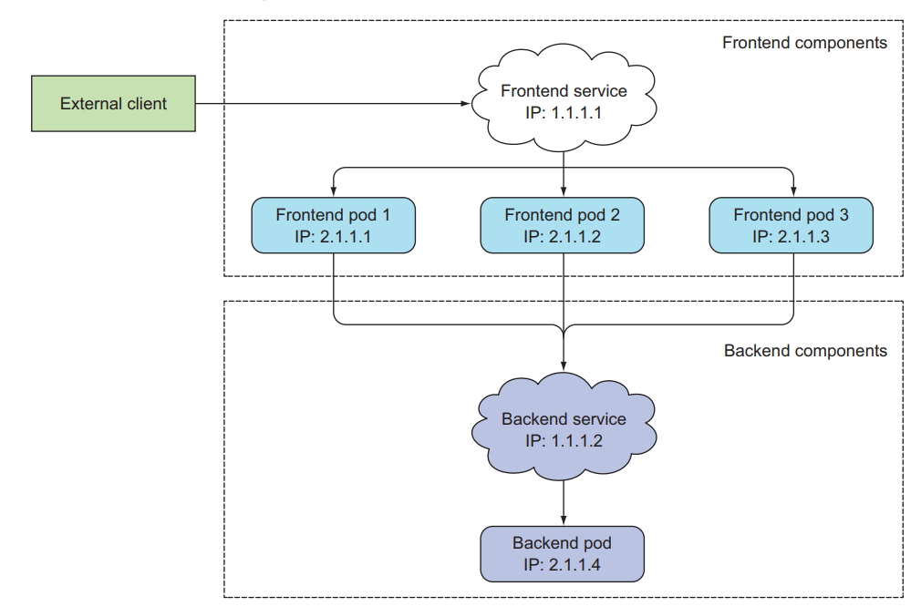
Services
Resource you create to make a single, constant point of entry to a group of pods providing the same service.
Each service has an IP address and port that never change while the service exists
OpenShift

Slide 49
Services
Different type of services
apiVersion: v1
kind: Service
metadata:
name: quarkus-demo-svc
labels:
app: quarkus-demo
spec:
type: LoadBalancer
ports:
- name: http
port: 8080
selector:
app: quarkus-demo
apiVersion: v1
kind: Service
metadata:
name: simple-nodejs-service
spec:
sessionAffinity: ClientIP
selector:
app: simplenode-app
ports:
- port: 80
targetPort: 8080
apiVersion: v1
kind: Service
metadata:
name: simplenode-app-svc
spec:
type: NodePort
selector:
app: simplenode-app
ports:
- port: 80
targetPort: 8080
nodePort: 30111
OpenShift

Slide 50
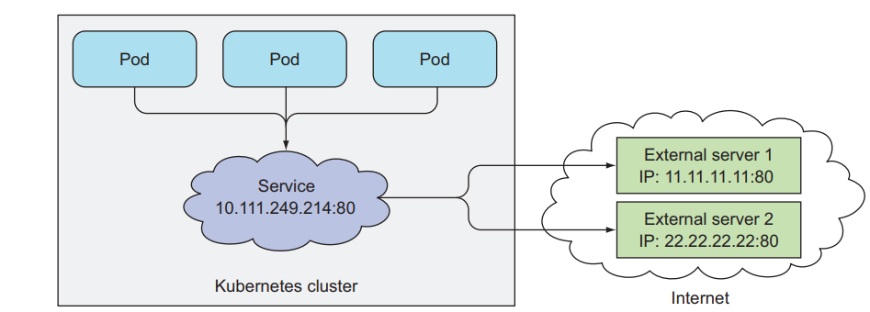
Services
External Services
apiVersion: v1
kind: Service
metadata:
name: external-service
spec:
type: ExternalName
externalName: something.somewhere.com
ports:
- port: 80
OpenShift

Slide 51
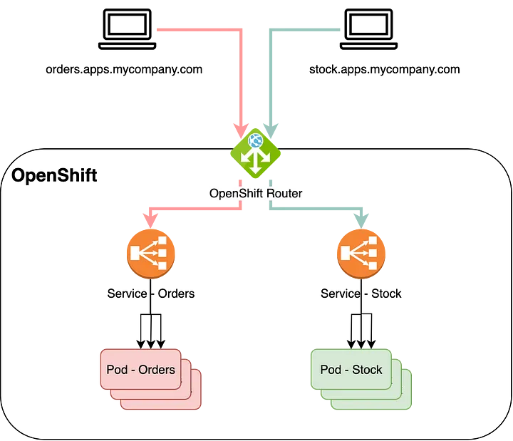
Routes
apiVersion: networking.k8s.io/v1
kind: Ingress
metadata:
name: simple-nodeapp-ingress
spec:
rules:
- host: simplenodeapp.com
http:
paths:
- path: /
pathType: Prefix
backend:
service:
name: simple-nodejs-service
port:
number: 80
OpenShift

Slide 52
Openshift – Route autogenerated names
Domain for all routes in form of:
*.apps.<clustername>.<base_domain>
Autogenerated routes in projects in form of:
<service_name>.<project>.apps.<clustername>.<base_domain>
For example, console address could be:
console-openshift-console.apps.ocp.hpb.hr
service == console
project == openshift-console
clustername == ocp
base domain == hpb.hr
OpenShift

Slide 53
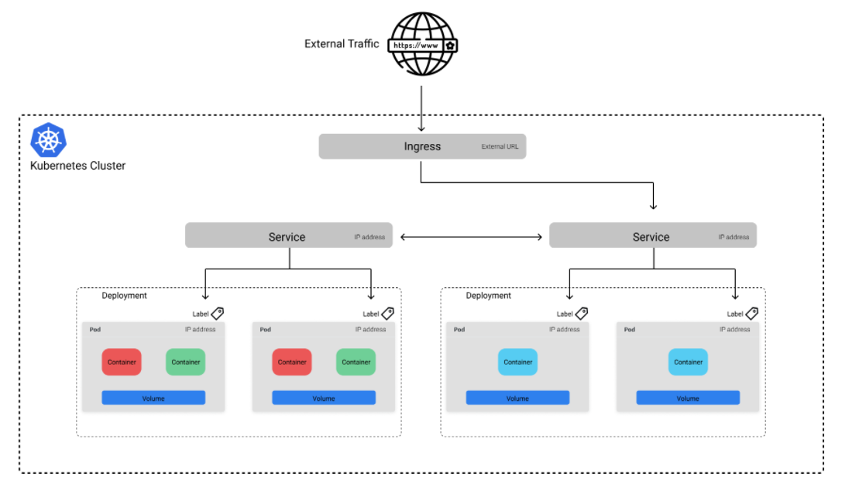
Ingress
OpenShift

Slide 54
Configmaps and secrets

Slide 55
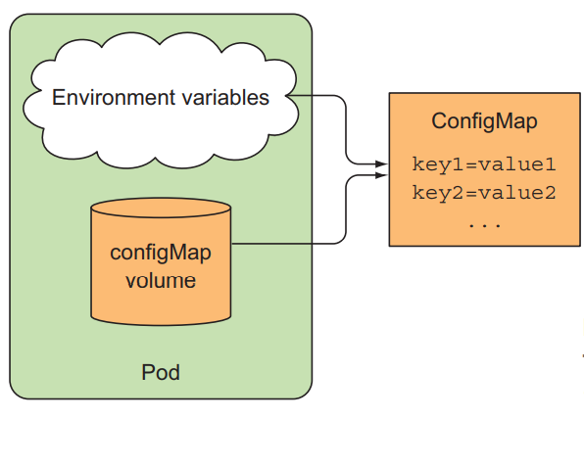
ConfigMap
Store configuration for your application.
Passing command-line arguments to containers
Setting custom environment variables for each container
Mounting configuration files into containers through a special type of volume
apiVersion: v1
kind: ConfigMap
metadata:
name: game-demo
data:
player_initial_lives: "3"
ui_properties_file_name: "user-interface.properties"
game.properties: |
enemy.types=aliens,monsters
player.maximum-lives=5
user-interface.properties: |
color.good=purple
color.bad=yellow
allow.textmode=true
OpenShift

Slide 56
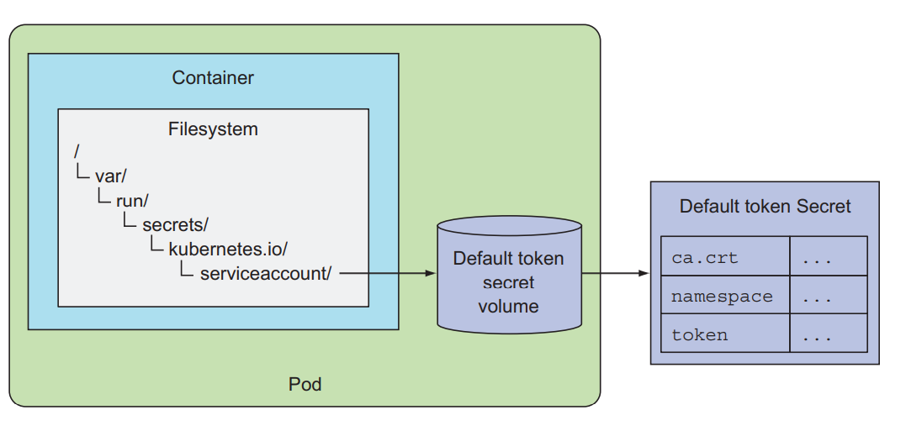
Secrets
Store sensitive configuration for your application.
Pass secret entries as custom environment variables for each container
Expose secret entries into a volume
apiVersion: v1
kind: Secret
metadata:
name: mysql-secret
type: Opaque
data:
MYSQL_USER: test
MYSQL_PASSWORD: test
MYSQL_DATABASE: test
MYSQL_ROOT_PASSWORD: test
OpenShift

Slide 57
Storage

Slide 58
Red Hat Openshift Container Platform - Storage
Types
Ephemeral – local transient storage on node that is used for container operation
Persistent – remote storage for persisting dana
Provisioning
Static – manually creating all resources (storage, PV, PVC)
Dynamic – Automatic creation of PV and underlying storage according to specification defined in PVC and StorageClass
Supported storage
Openshift Data Foundation (ODF) - supported from Red Hat (additional subscription)
ROOK
Gluster
Ceph
NFS
VMDK
Enterprise storage
OpenShift

Slide 59
Volume types
Part of a pod and share the same lifecycle as the pod
Volume types
emptyDir—A simple empty directory used for storing transient data
hostPath—Used for mounting directories from the worker node’s filesystem into the pod
gitRepo—A volume initialized by checking out the contents of a Git repository
nfs—An NFS share mounted into the pod
gcePersistentDisk (Google Compute Engine Persistent Disk), awsElasticBlockStore (Amazon Web Services Elastic Block Store Volume), azureDisk (Microsoft Azure Disk Volume)…
cinder, cephfs, iscsi, flocker, glusterfs, quobyte, rbd, flexVolume, vsphereVolume, photonPersistentDisk, scaleIO—Used for mounting other types of network storage
configMap, secret, downwardAPI Special types of volumes used to expose certain Kubernetes resources and cluster information to the pod
persistentVolumeClaim—A way to use a pre- or dynamically provisioned persistent storage
OpenShift

Slide 60
Access types
Different application require different storage access, and different stroage providers support some or all of the access modes:
RWO – read write once on a single node
RWX – read write many
ROX – read only many
RWOP – read write once on a single pod
OpenShift

Slide 61
Persistent Volume
apiVersion: v1
kind: PersistentVolume
metadata:
name: simple-pv
labels:
type: local
spec:
storageClassName: manual
capacity:
storage: 1Gi
accessModes:
- ReadWriteOnce
hostPath:
path: "/mnt/data"
Allow persisting data
Data available even when the pod is rescheduled
Accessible from any cluster node
Notes:
Placeholder desno - Replace image za novu fotku.

Slide 62
Persistent Volume Claim
apiVersion: v1
kind: PersistentVolumeClaim
metadata:
name: simple-pvc
namespace: default
spec:
# AKS: default,managed-premium
# GKE: standard
# EKS: gp2 (custom)
# Rook: rook-ceph-block,rook-ceph-fs
storageClassName: manual
accessModes:
- ReadWriteOnce
resources:
requests:
storage: 500Mi
---
Decoupling pods from the underlying storage technology
Notes:
Placeholder desno - Replace image za novu fotku.

Slide 63
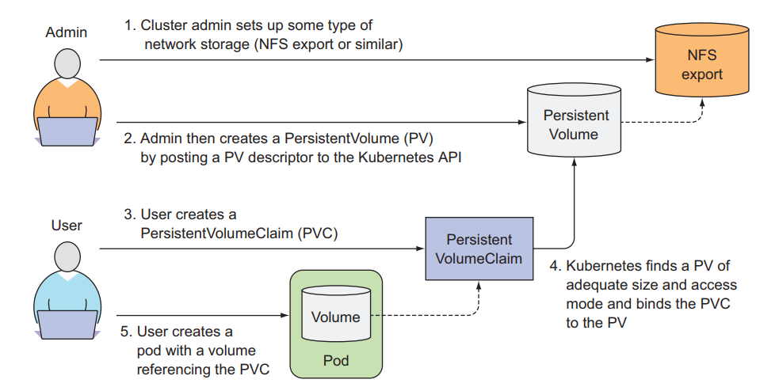
OpenShift

Slide 64
Dynamic provisioning of PersistentVolumes
The cluster admin, instead of creating PersistentVolumes, can deploy a PersistentVolume provisioner and define one or more StorageClass objects to let users choose what type of PersistentVolume they want.
apiVersion: storage.k8s.io/v1
kind: StorageClass
metadata:
name: fast
provisioner: k8s.io/minikube-hostpath
parameters:
type: pd-ssd
apiVersion: v1
kind: PersistentVolumeClaim
metadata:
name: mongodb-pvc
spec:
storageClassName: fast
resources:
requests:
storage: 100Mi
accessModes:
- ReadWriteOnce
OpenShift

Slide 65
Openshift Interface

Slide 66
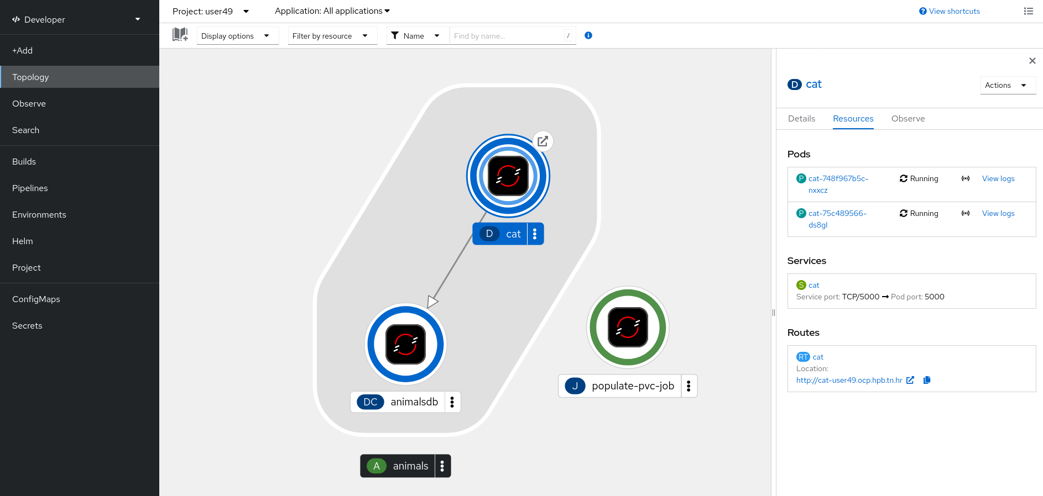
Openshift Developer web console
OpenShift

Slide 67
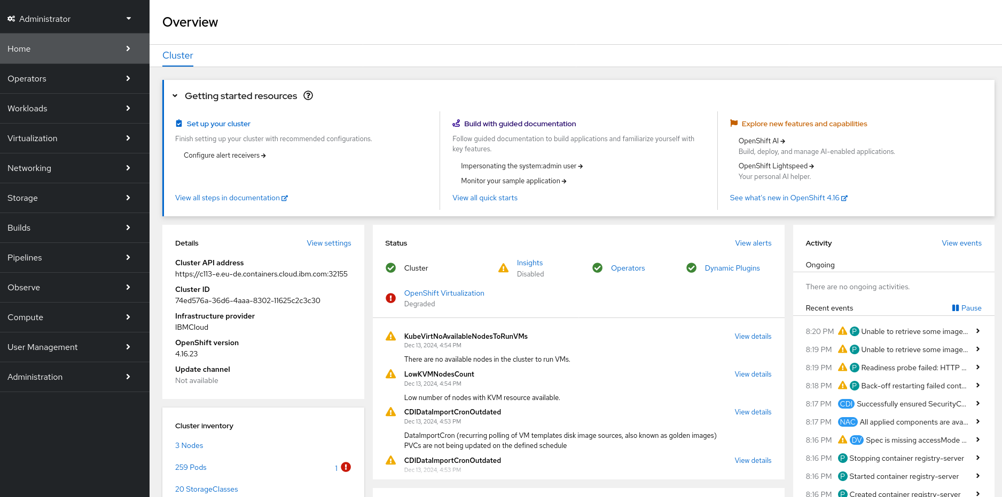
Openshift Administrator web console
OpenShift

Slide 68
Openshift oc command line interface
Can be downloaded from web interface
Login credentials available from web interface
Command refference:
https://docs.openshift.com/container-platform/4.16/cli_reference/openshift_cli/developer-cli-commands.html
Cheatsheet at:
https://learn.redhat.com/t5/DO280-Red-Hat-OpenShift/OpenShift-commands-Cheat-Sheet/td-p/35371
Also available in our git repo
Prefered way to work with OpenShift
OpenShift

Slide 69
Lab time!

