Slide 1
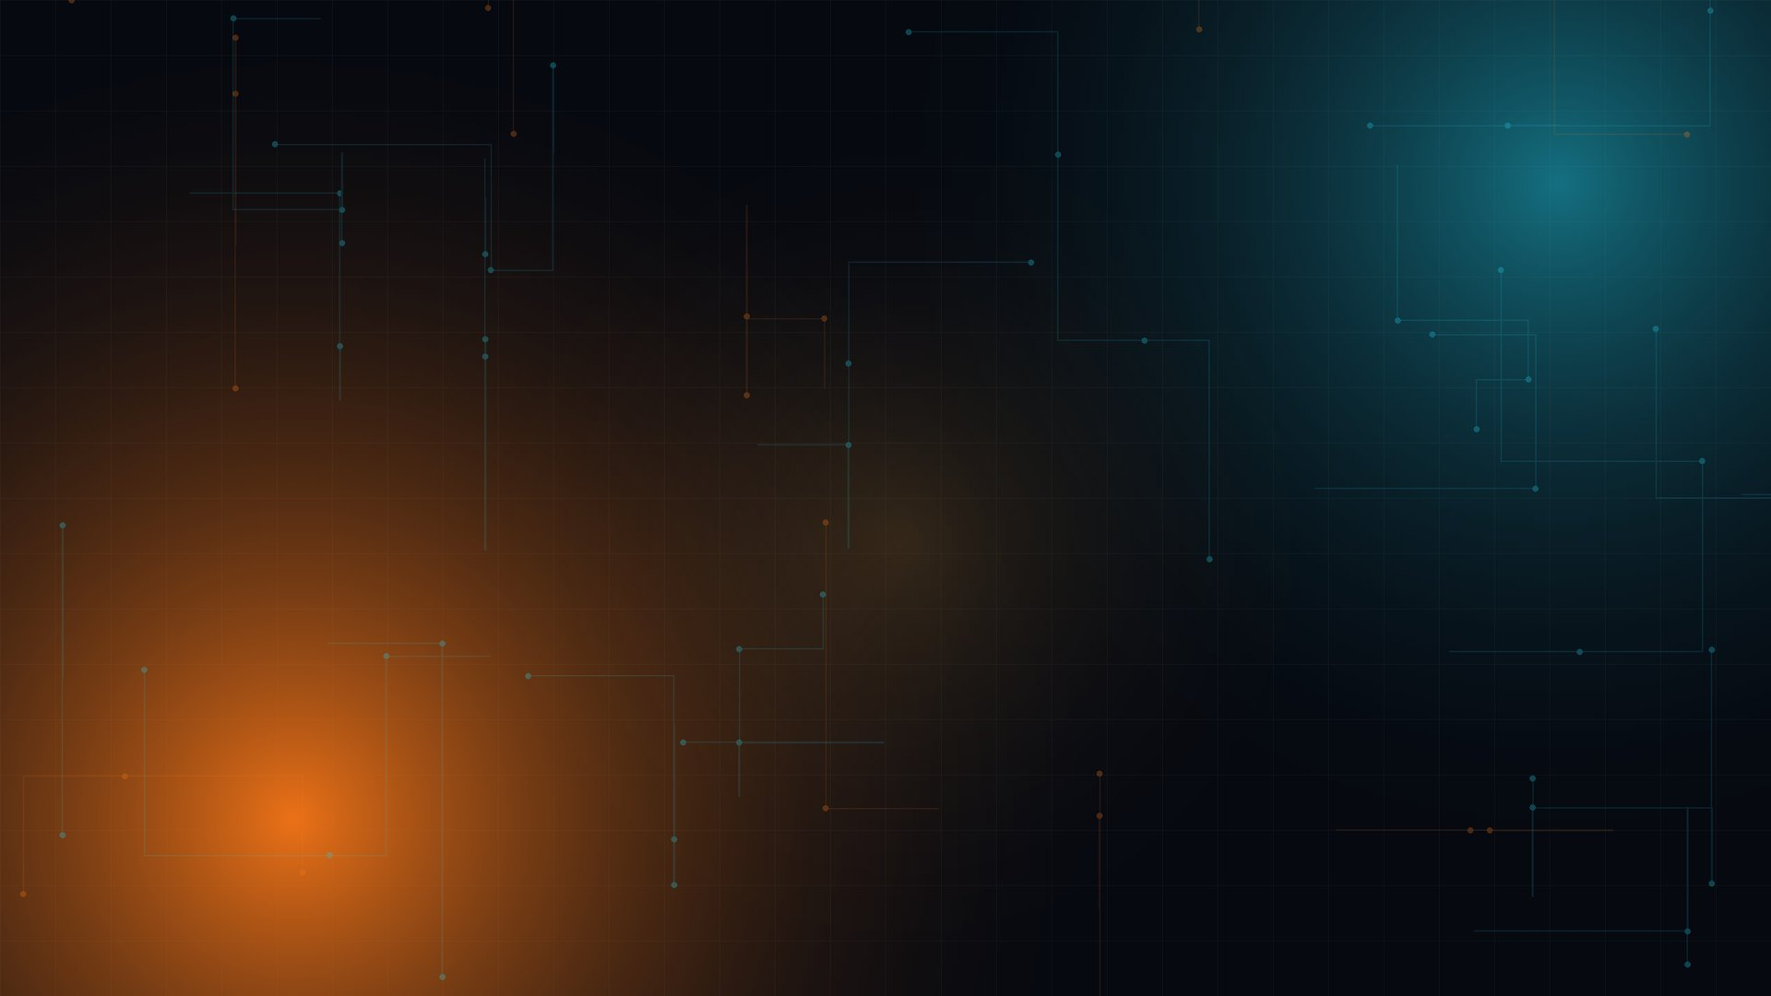

CODE AT THE EDGE
A whiteboard sketch becomes production React in 2.5 seconds — on the phone, with the radios off.
TEAM · YOUR TEAM NAME
iQOO HACKATHON · SNAPDRAGON 8s GEN 3 · HEXAGON NPU · iQOO OFFICE KIT
Notes:
[0:00 – 0:15] TITLE
Say: "Hi judges. We're team YOUR TEAM NAME, and this is SnapForge — an edge-AI
developer tool that turns a physical whiteboard sketch into production-ready
React code, instantly, using nothing but the phone in your pocket."
[CLICK 1] the SnapForge logo zooms in
[CLICK 2] "Code at the Edge" + the one-line promise
[CLICK 3] team name and hardware line
Tip: before recording, replace YOUR TEAM NAME here and on the final slide.

Slide 2
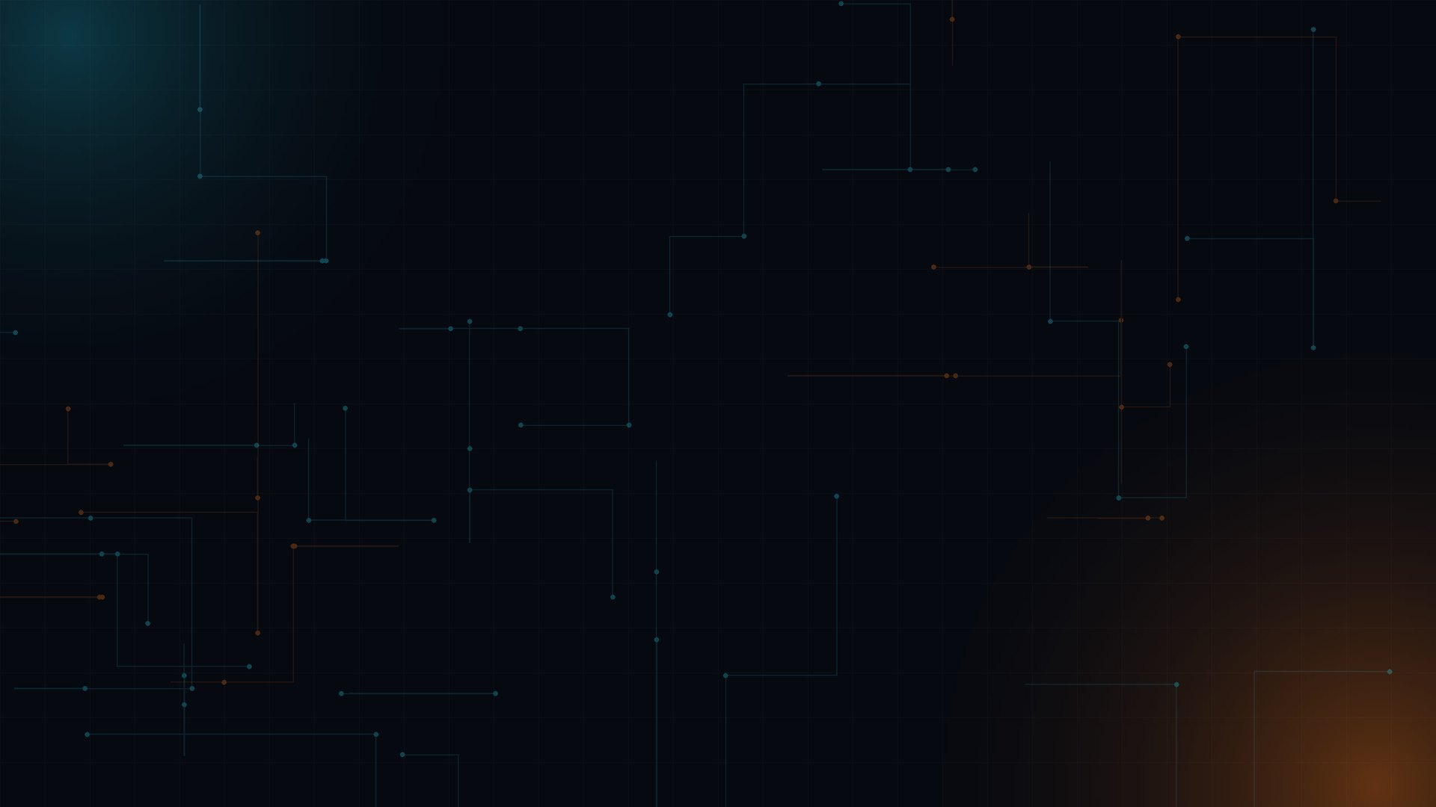
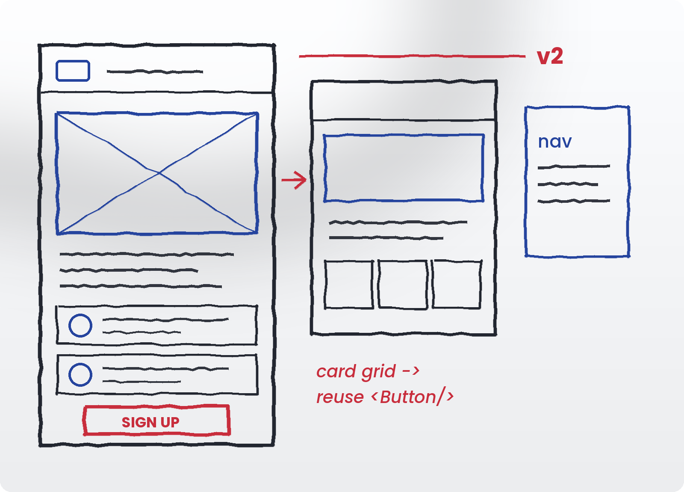
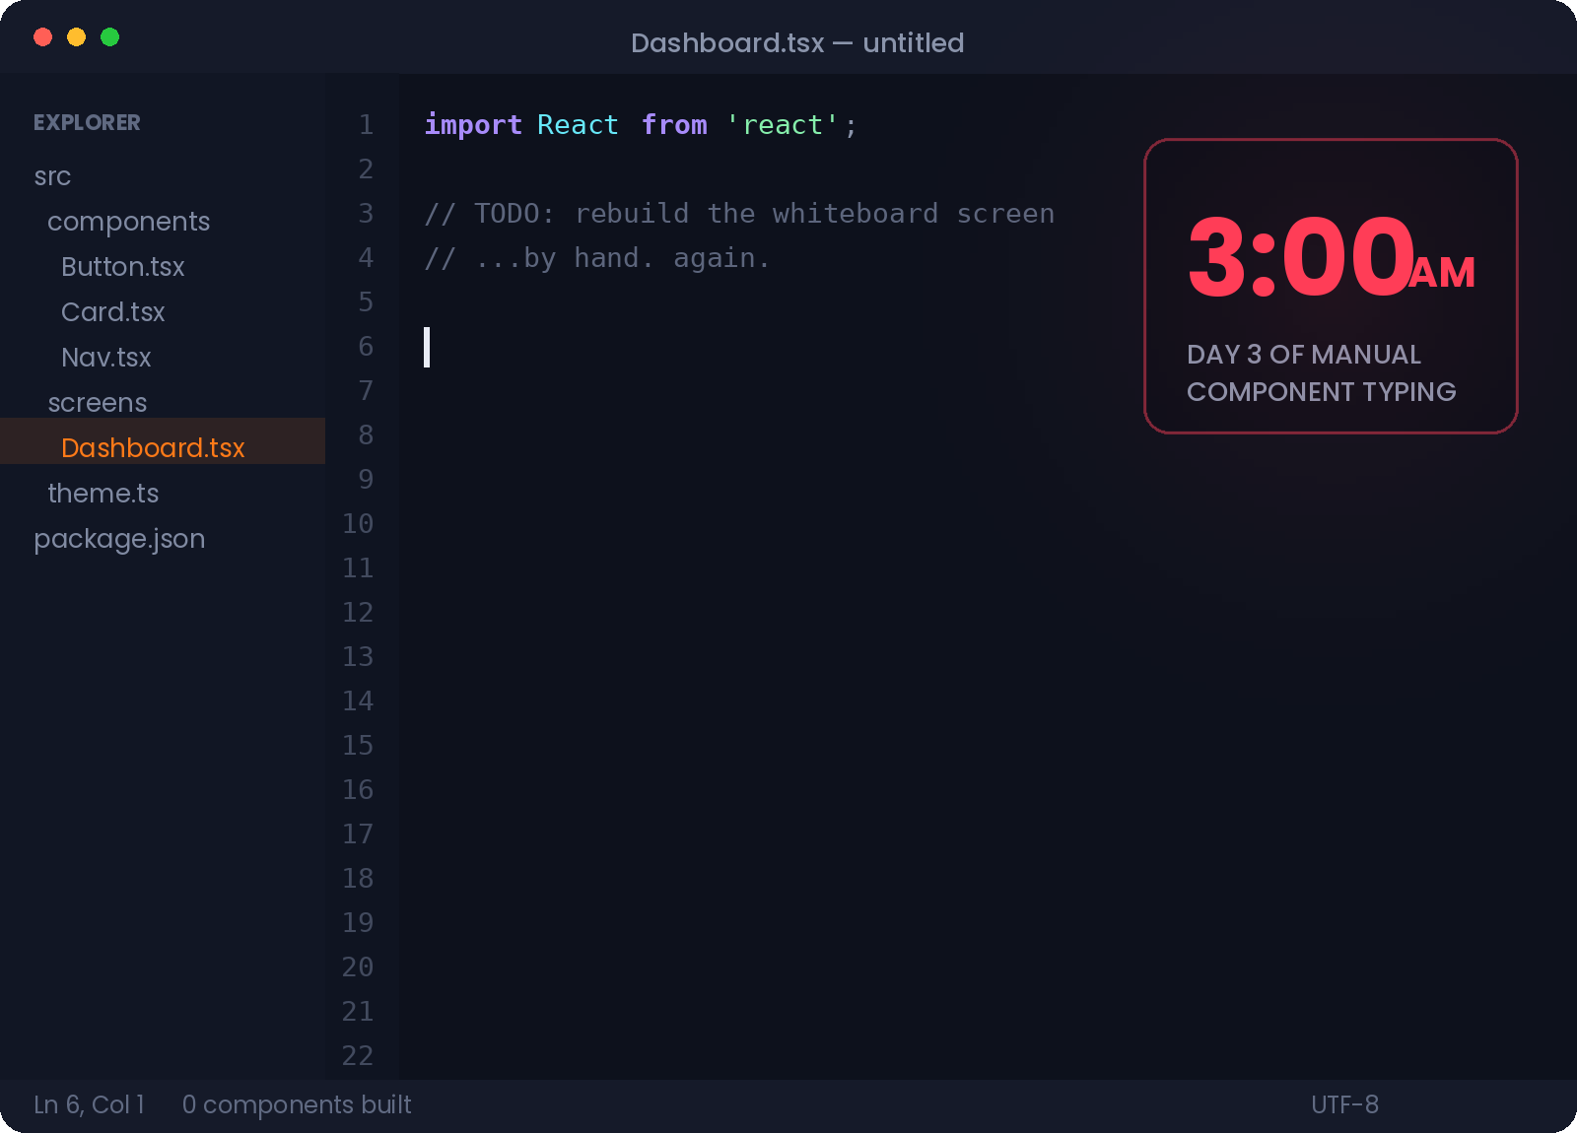

THE PROBLEM
Every great app starts on a whiteboard.
Then somebody has to type all of it out again, by hand, in your design system.
THE SOURCE OF TRUTH
Complete, agreed, signed off in the room.
THE BOTTLENECK
Days of retyping before anyone can click it.
Notes:
[0:15 – 0:45] THE PROBLEM
Say: "Every great app starts on a whiteboard. Product managers and engineers
spend hours getting these wireframes exactly right — and then the sketch dies.
Someone has to sit down and translate those marker lines into component-driven
enterprise code, by hand. That is days of typing, and it is the single biggest
bottleneck between a good idea and a screen you can actually click."
[CLICK 1] headline
[CLICK 2] the whiteboard — "this part takes an hour and everyone enjoys it"
[CLICK 3] the arrow — pause here, this is the gap
[CLICK 4] the 3 a.m. editor — "this part takes three days and nobody enjoys it"

Slide 3
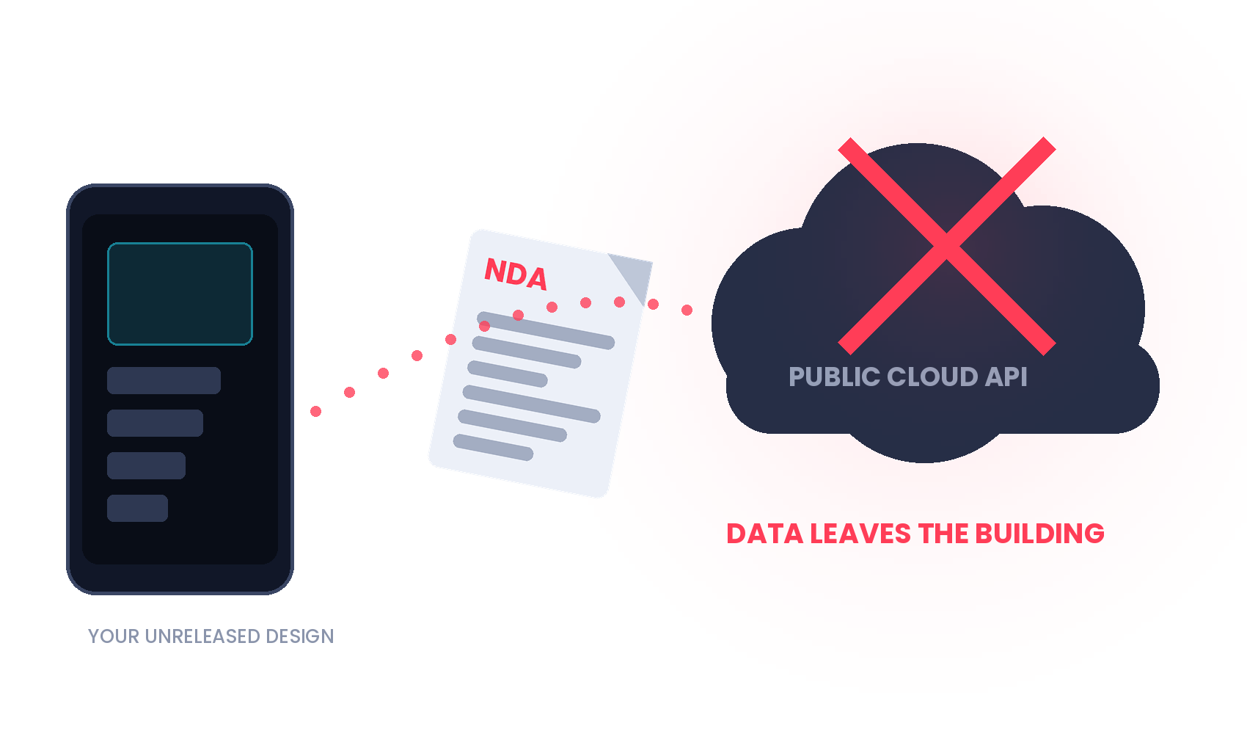



THE EXISTING, FLAWED SOLUTION
“Can’t I just photograph it and ask a chatbot?”
You can. Your security team, your design system and the venue Wi-Fi all disagree.
Your unreleased design leaves the building
Proprietary UI posted to a public API is an incident report, not a workflow.
Generic code, not your code
A general model emits div soup. It has never seen your <Button> or your <Card>.
No network, no output
Cloud tools die exactly where you need them: locked buildings and hackathon Wi-Fi.
Enterprise design data cannot leave the device. That is the whole ballgame.
Notes:
[0:45 – 1:05] WHY THE OBVIOUS ANSWER FAILS
Say: "Now you are thinking — can't I just photograph it and hand it to a chatbot?
You can. Enterprise companies just won't let you. Sending proprietary, unreleased
app designs to a public cloud API is a security incident waiting to happen. And
even where it is allowed, a general model writes generic markup, not code that
uses your company's design system. It also needs Wi-Fi, which in a locked
building — or at a hackathon — is optimistic."
[CLICK 1] headline [CLICK 2] the illustration
[CLICK 3,4,5] the three failures, one per beat
[CLICK 6] land the line about design data. Then pause.

Slide 4

THE SOLUTION
WATCH.
Live. Offline. On the phone in my hand.
NO INTERNET
NO CLOUD API
2.5 SECONDS
Notes:
[1:05 – 1:15] THE DEMO CARD
Say: "So let me just show you. Watch the phone. No internet, no cloud."
[CLICK 1] "THE SOLUTION" [CLICK 2] WATCH. [CLICK 3] the sub-line
[CLICK 4] the three pills
YOUTUBE EDIT: this is your cut point. Hold this slide for a beat, then cut to
the screen recording / phone footage. Come back on the next slide.

Slide 5
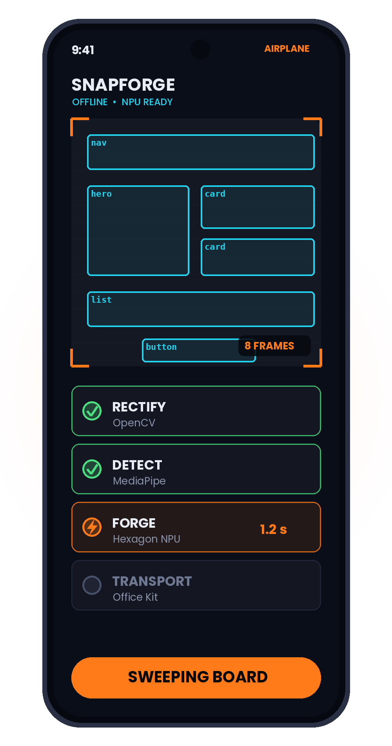
THE DEMO, STEP BY STEP
Point. Sweep. Ship.
1
AIM
Hold the iQOO at the whiteboard. Nothing is uploaded.
2
SWEEP
Tap Start Sweep. Eight frames, one haptic tick.
3
RECTIFY
OpenCV flattens the perspective into a clean plane.
4
DETECT
MediaPipe finds every box, row and text run.
5
FORGE
The Hexagon NPU emits a constrained JSON layout.
6
LAND
Office Kit syncs it; TSX appears on a new Git branch.
Total: 2.5 seconds from marker to compiling component — in airplane mode.
Notes:
[1:15 – 2:30] LIVE DEMO WALKTHROUGH
Do this live, or narrate over your recorded demo footage. One click per step.
Say: "I sweep the board. The phone captures eight frames and vibrates once.
OpenCV rectifies them. MediaPipe detects the structure. The Snapdragon NPU
forges a layout. And through iQOO Office Kit's shared clipboard, perfectly
formatted React lands on a new branch in VS Code on my laptop. No internet.
No cloud. Two and a half seconds."
[CLICK 1] headline [CLICK 2] the phone [CLICKS 3-8] one per step
[CLICK 9] the 2.5-second line
Point at the laptop on step 6. Let the judges see the branch name.

Slide 6






THE A–Z ARCHITECTURE
Seven stages. Zero packets.
01
02
03
04
05
06
07
›
›
›
›
›
›
CAPTURE
Camera · 8 frames
RECTIFY
OpenCV
DETECT
MediaPipe
FORGE
Hexagon NPU
LAYOUT
JSON schema
TRANSPORT
Office Kit
GENERATE
VS Code TSX
8
500M
0
frames swept, rectified
and fused on device
parameter vision model
quantised to INT4
bytes transmitted
to any network
Eight frames in. One deterministic JSON layout out. Nothing ever leaves the handset.
Notes:
[2:30 – 3:05] ARCHITECTURE
Say: "How is this possible offline? We sweep eight frames and rectify them with
OpenCV. MediaPipe detects the boxes and the text runs. That structure goes to a
five-hundred-million-parameter vision model — SmolVLM — running entirely on the
Hexagon tensor processor through Qualcomm QNN. It returns a layout. Office Kit
carries it across. Our companion CLI writes the TSX."
[CLICKS 1-8] the pipeline builds one stage at a time, left to right.
Stage 04 is the highlighted one — that is the stage nobody else can do offline.
[CLICK 9] the three metrics. Land on "zero bytes transmitted."

Slide 7
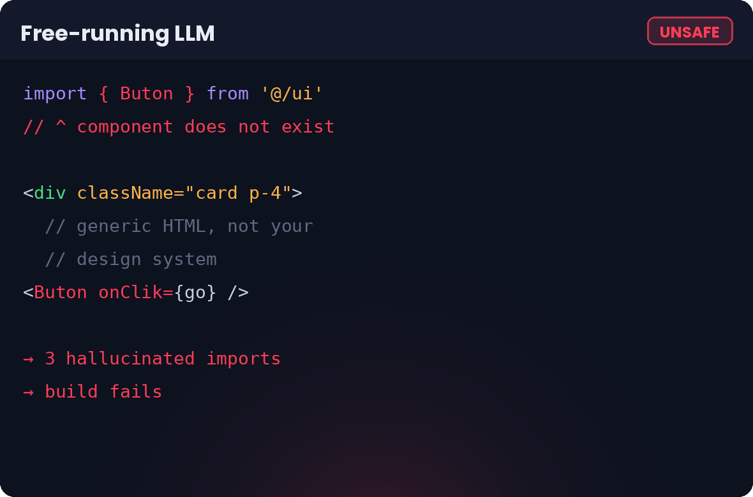
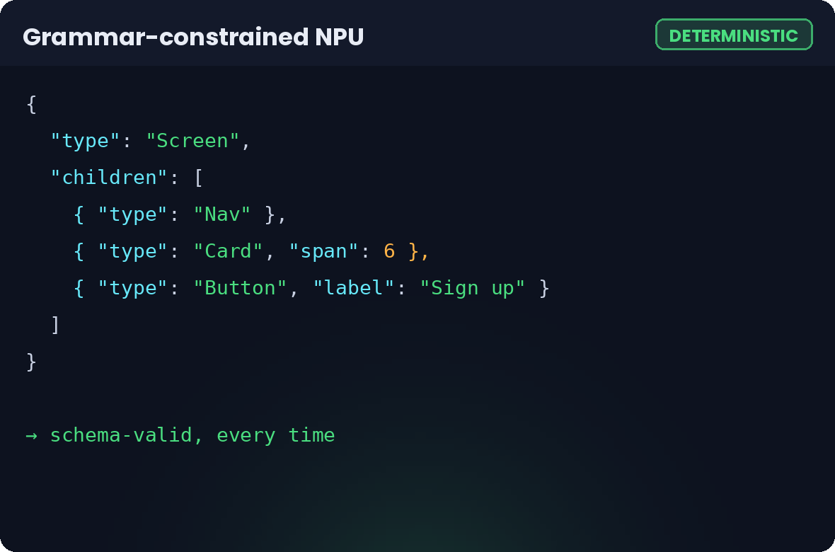
THE INNOVATION
The model never writes your code.
Grammar-constrained decoding forces the NPU to emit a schema. A deterministic renderer does the rest.
→
Hallucination becomes structurally impossible — the decoder can only emit tokens the grammar allows.
The renderer then maps every node onto the components already in your repo — your <Button>, your <Card>, your tokens.
Notes:
[3:05 – 3:30] THE SECRET SAUCE
Say: "Here is the trick: the AI does not write code. Language models hallucinate
code — imports that don't exist, props that were never defined. Instead we use
grammar-constrained decoding. The NPU is strictly forced to output a deterministic
JSON layout. Our companion app then renders that JSON into real React components
mapped to your local repo."
[CLICK 1] headline
[CLICK 2] the failure case — point at the invented import
[CLICK 3] the constrained output
[CLICK 4] the payoff line
This is the slide a technical judge will remember. Slow down here.

Slide 8
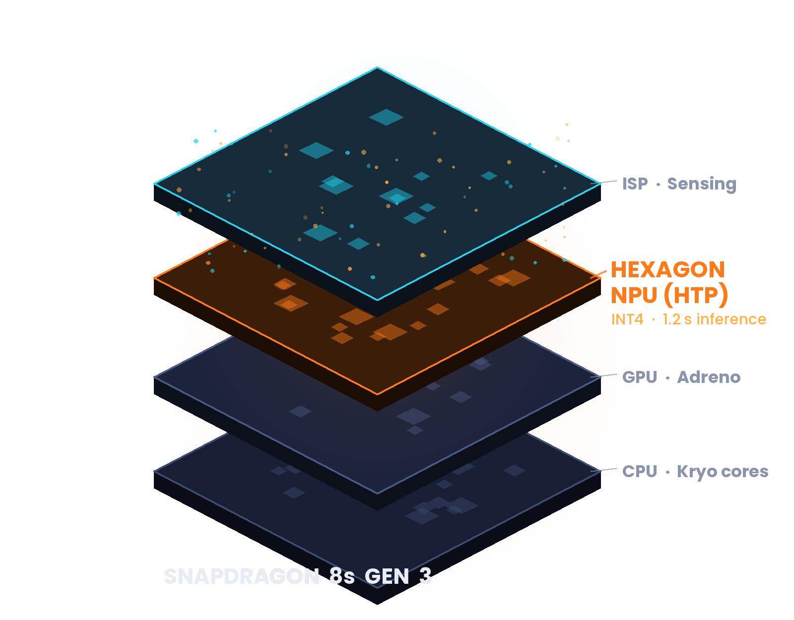

WHY iQOO · WHY SNAPDRAGON
This only runs because of the silicon.
Hexagon NPU (HTP)
A 500M-parameter vision model runs on the tensor accelerator — not the CPU, which would take minutes and cook the phone.
INT4 quantisation
Four-bit weights let the whole model sit in memory and finish inference in about 1.2 seconds.
Airplane mode by default
No radio, no API key, no telemetry. Here privacy is an architectural property, not a policy promise.
SmolVLM INT4 latency benchmarked on Snapdragon 8s Gen 3 via Qualcomm AI Hub.
Notes:
[3:30 – 4:05] THE HARDWARE CASE
Say: "We built this specifically for the iQOO ecosystem, because it needs real
on-device compute. The Snapdragon 8s Gen 3 Hexagon NPU handles INT4 quantisation,
which is what lets a vision model this size run in about 1.2 seconds instead of
minutes. On the CPU alone this demo does not exist."
[CLICK 1] headline [CLICK 2] the chip — point at the glowing NPU layer
[CLICKS 3,4,5] the three reasons
If a judge asks whether the NPU ran live today, answer honestly — the Q&A slide
near the end has the exact wording.

Slide 9
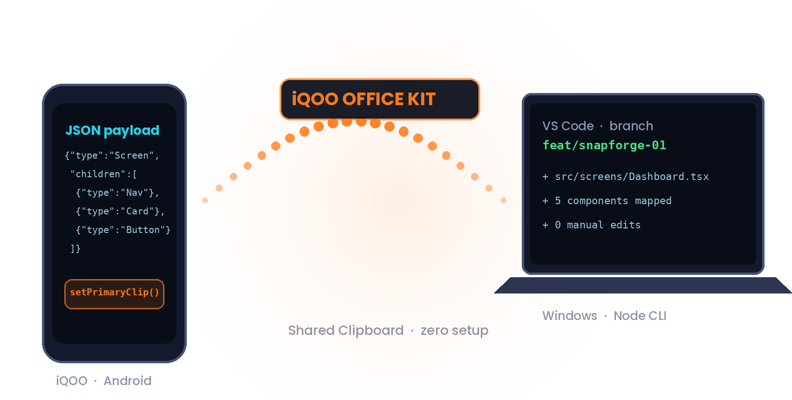
THE iQOO ADVANTAGE
Phone to laptop, with zero setup.
1
The Android app writes the JSON payload straight to the system clipboard.
2
iQOO Office Kit mirrors that clipboard to the laptop — natively, instantly.
3
Our Node CLI sees it, renders TSX and commits it to a fresh Git branch.
No ADB. No IP addresses. No pairing screen. The most stable transport the device already has.
Notes:
[4:05 – 4:25] THE TRANSPORT
Say: "Second, we solved the phone-to-laptop problem natively. Instead of asking
the user to wire up ADB or type in IP addresses, we use Office Kit's shared
clipboard. The Android app writes the payload, Office Kit syncs it to Windows,
and our Node CLI picks it up and generates the code. Zero friction, and nothing
to configure on stage."
[CLICK 1] headline [CLICK 2] the diagram [CLICKS 3,4,5] the three hops
[CLICK 6] the closing line
If you are recording: this is a good place to show the terminal actually firing.

Slide 10
THE NUMBERS
2.5 seconds, end to end.
2.5s
1.2s
marker to compiling
React component
NPU inference on the
Hexagon HTP
500M
0
parameters, INT4
quantised on device
bytes sent to any
external service
Stage budget measured on Snapdragon 8s Gen 3 via Qualcomm AI Hub. Adjust these to your own benchmark run before presenting.
Notes:
[4:25 – 4:40] THE NUMBERS
Say: "Two and a half seconds, marker to compiling component. The heavy part —
the vision model — is about 1.2 seconds of that on the NPU. Five hundred million
parameters, four-bit, entirely on the handset. And zero bytes to any external
service."
[CLICK 1] headline [CLICK 2] the four metrics cascade
[CLICK 3] the stage breakdown [CLICK 4] the source note
IMPORTANT: the chart is a native PowerPoint chart. Right-click > Edit Data to
swap in your own measured numbers before you record. The stage split shown here
sums to 2.5s and matches the 1.2s NPU figure.

Slide 11



MARKET POTENTIAL · WHO NEEDS THIS
Three audiences, one bottleneck.
ENTERPRISE DEV TEAMS
AGENCIES & PROTOTYPERS
HACKATHONS & INDIE DEVS
Banks, health and defence suppliers who cannot post an unreleased screen to a public API — and who already have a mature internal component library to map onto.
Sketch with the client in the workshop, hand them something clickable before the coffee goes cold. The whiteboard stops being throwaway.
No API bill, no rate limit, and no dependency on venue Wi-Fi — which, as everyone in this room knows, is the real constraint.
SnapForge closes the physical-to-digital gap securely, and closes it in seconds.
Notes:
[4:40 – 4:55] MARKET
Say: "Who needs this? Enterprise dev teams who need strict privacy. Agencies
doing rapid prototyping in front of a client. And developers at hackathons like
this one. SnapForge bridges the physical-to-digital gap securely and instantly."
[CLICK 1] headline [CLICKS 2,3,4] one audience per beat [CLICK 5] the close
If you are short on time in the live pitch, click once and speak over all three.

Slide 12



FUTURE ROADMAP
From one screen to whole apps.
NOW
NEXT
LATER
Single React screens
Multi-screen flows · voice edits
Flutter · SwiftUI · Vue
Sweep, forge, land. OpenCV rectification, MediaPipe detection, constrained JSON and the Office Kit transport all ship today.
›
The Hexagon NPU also handles audio. Say “make that card a list” and the layout updates — still with no network.
›
The layout schema is renderer-agnostic, so each new target is a template pack, not a new model.
The renderer is deterministic, so every new framework is a template pack — never a retrained model.
Notes:
[4:55 – 5:10] ROADMAP
Say: "Today we generate single React screens. Tomorrow we use the Hexagon NPU's
audio capability for real-time voice edits — 'change that card to a list' — and
we expand the deterministic renderer to output Flutter, SwiftUI and Vue."
[CLICK 1] headline [CLICKS 2,3,4] Now, Next, Later [CLICK 5] the close
Keep this fast. The roadmap is a promise, not a proof — do not linger.

Slide 13

WHAT THE JUDGES WILL ASK
Three questions, answered straight.
How is this different from v0.dev or Claude Artifacts?
Those run in the cloud and emit generic markup. SnapForge runs entirely on the NPU for absolute privacy, and the deterministic renderer maps output onto the components already in your repo — your <Button>, not a stranger's <div>.
Did the model actually run on the phone today?
The full pipeline is built: rectification, detection, the TSX renderer and the Office Kit transport. SmolVLM INT4 benchmarks at ~1.2 s on the 8s Gen 3 via Qualcomm AI Hub. Compiling the QNN C++ bridge did not fit in 24 hours, so the NPU layer is simulated at realistic latencies — the .bin swap is wired and ready.
Why use the clipboard for Office Kit?
Because it needs no pairing. Android writes the payload, Office Kit mirrors it to Windows, the Node CLI picks it up. No ADB, no sockets, no IP addresses — nothing that can fail on stage.
Answer the second one honestly and fast. Judges reward a team that knows exactly what it did and did not finish.
Notes:
Q&A PREPARATION (hold this slide during questions)
This slide is for the recorded version and for your own rehearsal. In a live
5-minute pitch, skip straight from the roadmap to the conclusion and keep this
one in your back pocket.
Rehearse answer 2 out loud until it is 15 seconds. Do not pad it, do not
apologise for it. "Here is exactly what is built, here is exactly what is
stubbed, here is the one-line change to swap it in" is a strong answer.
If a technical judge asks for code, show in this order:
1. android/.../capture/CaptureScreen.kt - the isProcessing state machine
2. android/.../transport/OfficeKitTransport.kt - ClipboardManager.setPrimaryClip()
3. companion/src/transport/clipboard.ts - the PowerShell Get-Clipboard listener
4. android/.../assets/preview.html - JSON parsed locally into the tree + TSX

Slide 14
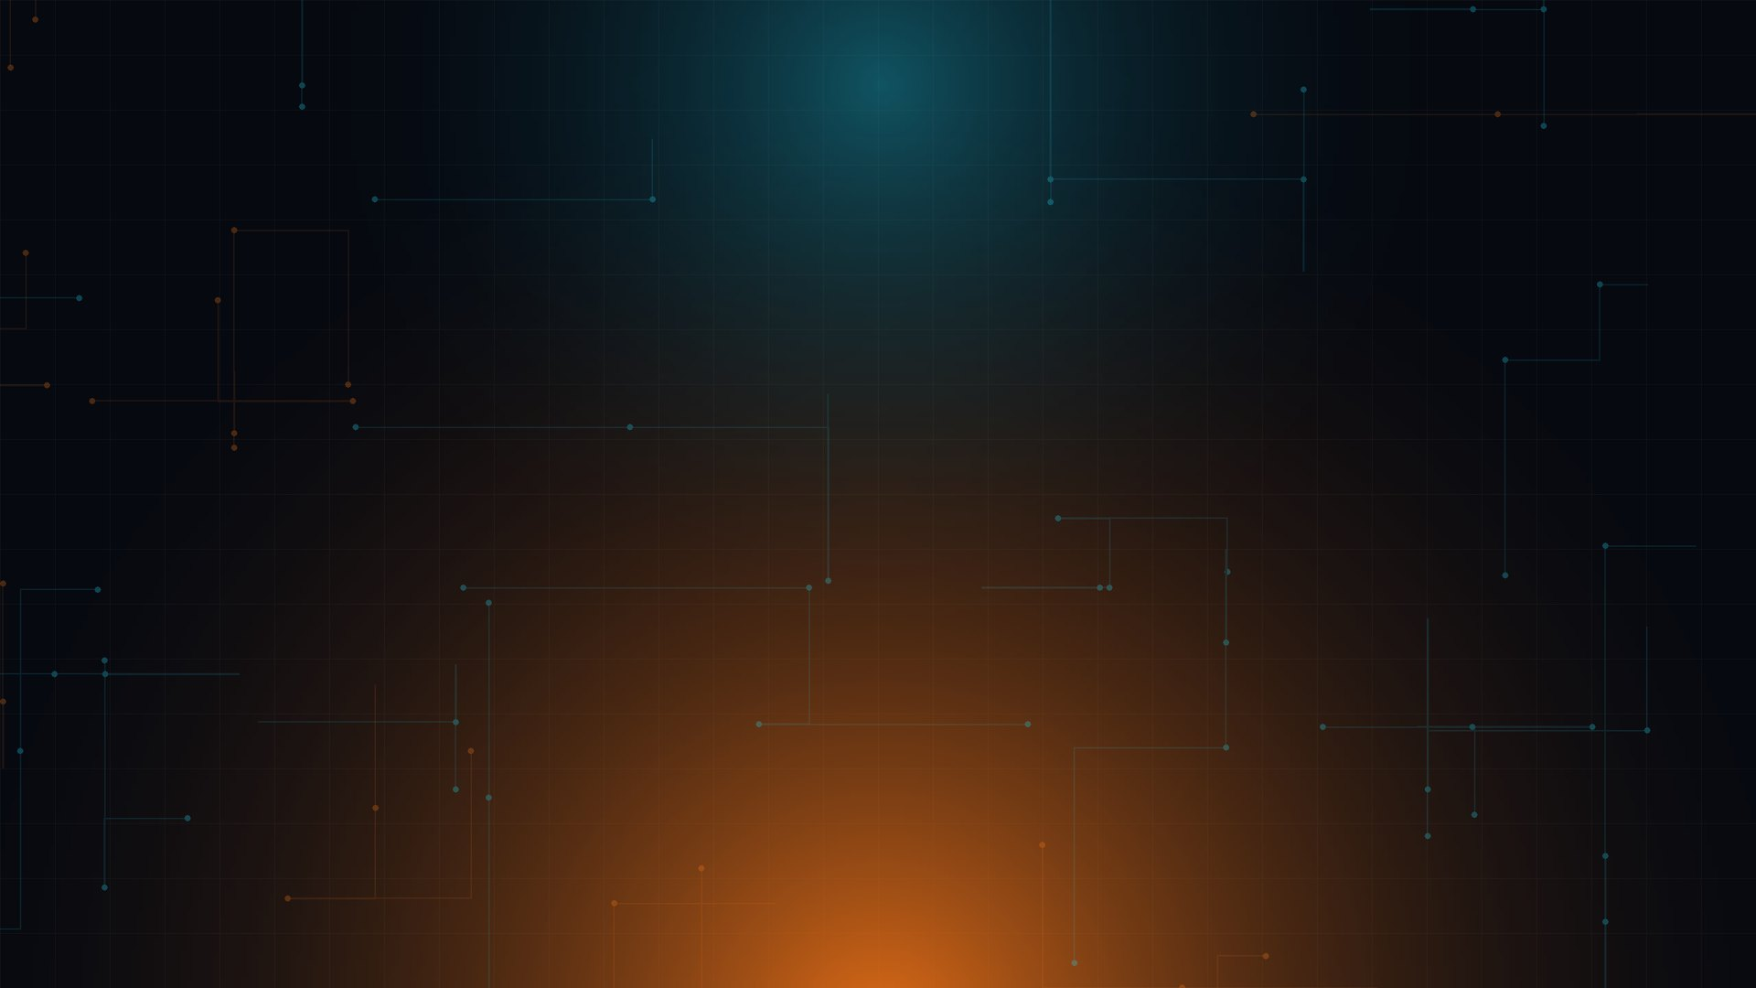
The cloud is no longer required for heavy AI.
We are bringing development to the edge — and the edge is already in your pocket.
YOUR
REPO QR
github.com/your-team/snapforge
THANK YOU
TEAM · YOUR TEAM NAME · iQOO HACKATHON · SNAPDRAGON 8s GEN 3
Notes:
[5:10 – 5:30] CLOSE
Say: "SnapForge proves that with iQOO and Snapdragon, the cloud is no longer
required for heavy AI. We are bringing development to the edge. Thank you."
[CLICK 1] the logo [CLICK 2] the headline [CLICK 3] the QR [CLICK 4] thank you
BEFORE RECORDING:
- replace YOUR TEAM NAME (this slide and slide 1)
- drop a real QR image over the dashed box, and fix the repo URL
- end the recording on this slide held for 3-4 seconds of silence
Then stop talking. Let it sit. Take the questions.

