Slide 1
Test the REST
Testing RESTful web services using REST Assured
An open source workshop by …
Notes:
Please replace the … with your own name. I would really like it if you left the bottom line intact though, as a way of thanking me. That’s really all I’m asking for, the rest of the workshop is yours to butcher (erm, improve).

Slide 2
What are we going to do?
RESTful web services
REST Assured
Get your hands dirty
Notes:
First: an introduction to RESTful web services, how they work and where they are used
Then: an introduction to REST Assured, a Java library that can be used to write tests for RESTful web services
But most importantly: you are going to have to do some work yourself! There’s not better way to learn than by doing.

Slide 3
Preparation
Install JDK (preferably 1.8)
Install Apache Maven
Install IntelliJ (or any other IDE)
Import Maven project into IDE
  https://github.com/basdijkstra/rest-assured-workshop
Notes:
Depending on the way you deliver this workshop, this sheet can be altered or even removed. When I delivered it, I had participants bring in their own laptop and asked them to follow installation instructions. I only provided them for Eclipse and mentioned that whenever they wanted to use a different IDE, they were allowed to do so. I wanted to keep things simple and therefore did not provide installation instructions for other IDEs.

Slide 4
What are RESTful web services?
HTTP request methods (GET, POST, PUT, …)
URI’s
CRUD operations on data
  POST Create
  GET Read
  PUT Update
  DELETE Delete
Notes:
Explain the concept of RESTful web services and compare it to your browser retrieving web pages, images, etc. from a web server (or sending data back to it).

Slide 5
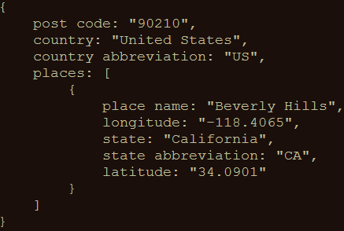
An example
GET http://api.zippopotam.us/us/90210
Result:
Notes:
A simple example. You could also perform this one live to show the participants how easy it is to invoke a RESTful web service using your browser (it really is no different from accessing a regular web page since it’s all done over HTTP)

Slide 6
Usage of RESTful web services
Mobile applications
Internet of Things
API Economy
Web applications
Notes:
Explain where RESTful web services are used.
API Economy relates to software development exposing (parts of) their applications to the outside world through APIs, so that other developers can easily integrate their applications with it. For example: Google’s Gmail API, Maps API or the PayPal or LinkedIn APIs.

Slide 7
Why I ♥ testing at the API level
Tests run much faster than UI-driven tests
Tests are much more stable than UI-driven tests
Tests have a broader scope than unit tests
Business logic is often exposed at the API level

Slide 8
Tools for testing RESTful web services
Browser (using plugins like Postman for Chrome)
Open source (SoapUI, REST Assured)
COTS (Parasoft SOAtest, SoapUI Pro)
Build your own (using HTTP libraries for your language of choice)
Notes:
Three levels of tools, ranging from the very simple to the powerful and from the free to the commercial

Slide 9
REST Assured
Java DSL for writing tests for RESTful APIs
Removes a lot of boilerplate code
Integrates seamlessly with existing Java-based testing frameworks
  JUnit, TestNG
  Selenium WebDriver
Developed and maintained by Johan Haleby
Notes:
Explain what REST Assured is and why it was written
Explain how REST Assured can easily be made part of a bigger testing framework covering everything from unit to end-to-end and user interface testing

Slide 10
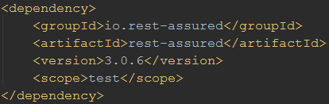
Configuring REST Assured
Download from http://rest-assured.io
Add as a dependency to your project
Maven
Notes:
Briefly discuss the options available for installing and configuring REST Assured (this should be trivial for anybody with a bit of Java development experience)

Slide 11
REST Assured documentation
Usage guide
  https://github.com/rest-assured/rest-assured/wiki/Usage
Links to other documentation (JavaDoc, getting started, release notes)
  http://rest-assured.io
Notes:
Notes on where to find additional information on REST Assured

Slide 12
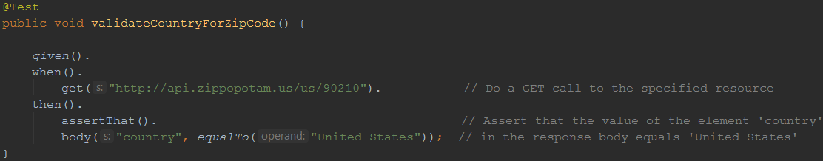
A sample test
Notes:
Demonstrate how easy it is to write a fully functional test on a RESTful web service with REST Assured. This is the only code you need. And it’s readable too!

Slide 13
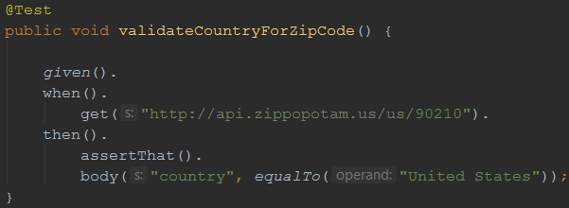
REST Assured features
Support for HTTP methods (GET, POST, PUT, …)
Support for BDD / Gherkin (Given/When/Then)
Use of Hamcrest matchers for checks (equalTo)
Use of GPath for selecting elements from JSON response
Notes:
Using the example from the previous sheet, introduce some of the basic REST Assured features

Slide 14
About Hamcrest matchers
Express expectations in natural language
Examples:
http://hamcrest.org/JavaHamcrest/javadoc/1.3/org/hamcrest/Matchers.html
equalTo(X) | Does the object equal X?
hasItem(“Rome”) | Does the collection contain an item “Rome”?
hasSize(3) | Does the size of the collection equal 3?
not(equalTo(X)) | Inverts matcher equalTo()
Notes:
Go into a little more detail with regards to Hamcrest matchers – readable matchers for creating checks

Slide 15
About GPath
GPath is a path expression language integrated into Groovy
  REST Assured is built in Groovy
Similar aims and scope as XPath for XML
Documentation and examples:
  http://groovy-lang.org/processing-xml.html#_gpath
  http://groovy.jmiguel.eu/groovy.codehaus.org/GPath.html
Notes:
Go into a little more detail with regards to Gpath for effective selection of elements from XML and JSON responses

Slide 16
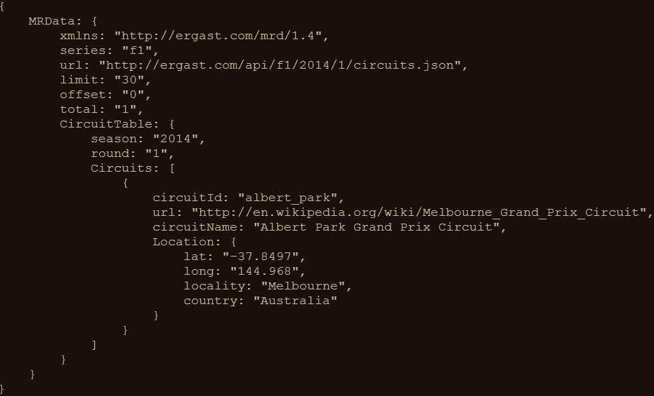
GPath example
http://goessner.net/articles/JsonPath/
Notes:
Example – also explain the [0] needed since we’re dealing with a collection of Circuits here

Slide 17
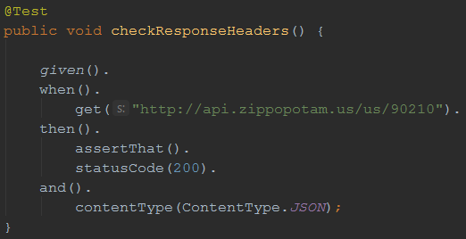
Validating technical response data
HTTP status code
MIME-type of received responses
Cookies and their value
…
Notes:
Explain how you can not only perform validations on response content, but also on response headers.

Slide 18

Our application under test
Ergast F1 API
Offers historical data of Formula 1 races, drivers, circuits, etc.
API documentation at http://ergast.com/mrd/
Mocked for demo effect mitigation purposes using WireMock
Notes:
Explain why this API was chosen (simple, lots of features, very ‘real’ data, something lots of people can relate to)
Mocks are included in the project to avoid the risk of the API being unavailable during the workshop (this actually happened to me once), feel free to remove it and test against the actual API
Alternatively, you can always use your own API of course!

Slide 19
Some examples
Data for driver Max Verstappen (in JSON):
  http://ergast.com/api/f1/drivers/max_verstappen.json
A list of circuits for the 2015 season (in JSON):
  http://ergast.com/api/f1/2015/circuits.json
Notes:
Some basic examples on how to retrieve data from the API

Slide 20
Demo
API documentation
Starting the stub server
How to use the test suite
Executing your tests
Reviewing test results
Notes:
A quick demo before the participants start with the first series of exercises might be helpful to ensure they’ve understood everything so far and are ready to go.

Slide 21
Get your hands dirty!
RestAssuredExercises1
Simple checks
  Validating individual elements
  Validating collections and items therein
  Validating technical response properties
Stubs are predefined
  You only need to write the tests using REST Assured
RestAssuredExamples contains the zipcode example
Notes:
Speaks for itself, I think.

Slide 22
Parameters in RESTful web services
Path parameters
  http://ergast.com/api/f1/drivers/max_verstappen.json
  http://ergast.com/api/f1/drivers/hamilton.json
Query parameters
  http://md5.jsontest.com/?text=testcaseOne
  http://md5.jsontest.com/?text=testcaseTwo
There is no official standard!
Notes:
Explain the difference between path and query string parameters in RESTful web services

Slide 23
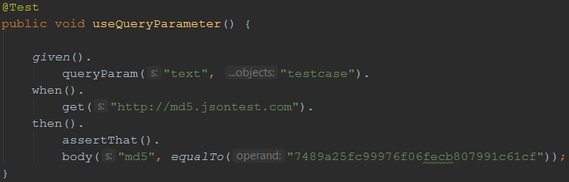
Using query parameters
GET http://md5.jsontest.com/?text=testcase
Notes:
Explain how you define query string parameters to be used when calling a service in REST Assured (using params() )

Slide 24
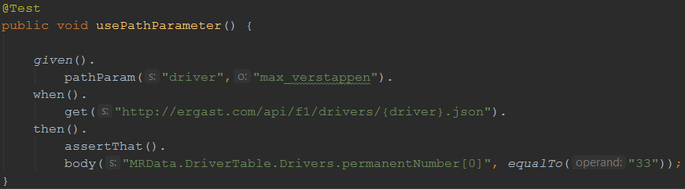
Using path parameters
GET http://ergast.com/api/f1/drivers/max_verstappen.json
Notes:
Explain how you define path parameters to be used when calling a service in REST Assured (using pathParam() )

Slide 25
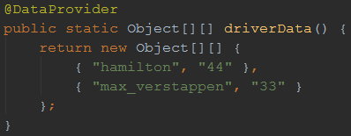
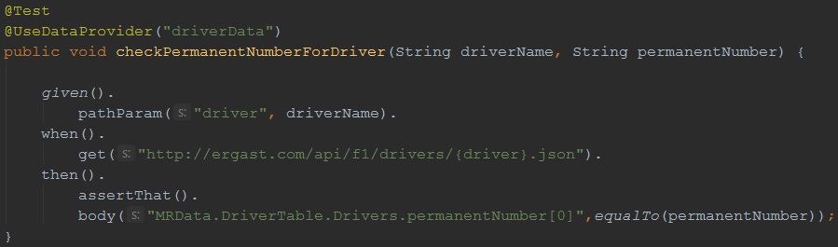
Using parameters in REST Assured
Creating test data (driver IDs and perm. numbers)
Using test data for input and output parameters:
Notes:
Explain how to create data driven tests using the TestNG @DataProvider and (path or query string) parameters

Slide 26
Get your hands dirty!
RestAssuredExercises2
Data driven tests
  Creating a test data object
  Using test data in calling the right URI
  Using test data in assertions
RestAssuredExamples contains all examples from the presentation

Slide 27
Authentication
Securing web services
Most common authentication schemes:
  Basic authentication (username / password)
  OAuth(2)
Notes:
Explain why web services sometimes need to be secured and introduce the different authentication options for RESTful web services

Slide 28
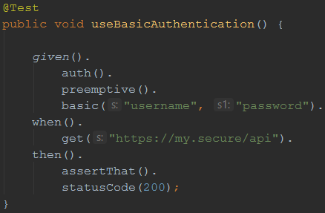
Basic authentication
Username/password sent in header for every request
In many APIs, Basic auth. is typically only used to retrieve an (OAuth) authentication token
Notes:
Explain Basic (username / password) authentication

Slide 29
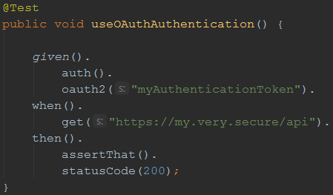
OAuth(2)
Request of authentication token based on username and password (Basic authentication)
Include authentication token in header of all subsequent requests
Notes:
Explain Oauth
Retrieve access token by calling endpoint (mostly secured using Basic authentication)
Include obtained authentication token in the header of all subsequent requests
Explain that authentication token is tied to a specific user and that it has an expiration time (after which a new token needs to be requested)

Slide 30
Measuring response times
Measuring response times for individual requests
Setting response time thresholds
  Test fails when threshold is exceeded
No full-fledged performance test
First rough indication of API performance
Notes:
REST Assured can also measure very basic response times. This is in no way equal to a full-blown performance test, but it can be a rough indication for potential performance issues. For REAL validation of performance requirements, an actual performance test should be set up, using a dedicated performance test tool such as Apache JMeter

Slide 31
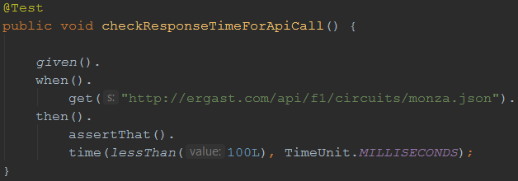
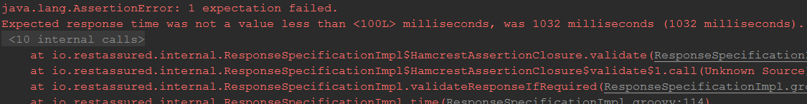
Measuring response times
An example:
Notes:
Here’s an example of how to define a response time threshold and the error generated when the actual response time exceeds this threshold

Slide 32
Get your hands dirty!
RestAssuredExercises3
Communicating with an OAuth2-secured API
  Requesting authentication token using Basic auth
  Using authentication token in subsequent requests
Measuring API response times
  Execute a specific API call
  Evaluate response time against predefined threshold
RestAssuredExamples contains all examples from the presentation

Slide 33
Sharing variables between tests
Example: authentication tests
Copy / paste required for OAuth2 token
This results in added maintenance burden
Preferably: store and retrieve for reuse!
Notes:
Refer to the exercise where you needed to manually copy and paste the OAuth authentication token. This is cumbersome, especially when you want to have your tests run unattended (which you want to ;). To be able to do so, you need a way to extract response values from a certain request (in this case the authentication token) and reuse it in subsequent tests.

Slide 34
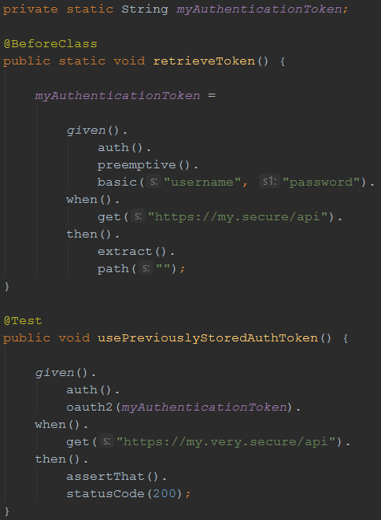
Sharing variables between tests
REST Assured
supports this
with extract()
Notes:
Explain the REST Assured extract() feature, which you can use (using GPath) to extract certain values from a response for later reuse.

Slide 35
Sharing checks between tests
Example: checking status code and MIME type for all responses
Another maintenance burden if specified individually for each test
What if we could specify this once and reuse throughout our tests?
Notes:
If you want the same check to be performed for a lot of different API calls, including them in each and every test (and having to update them X times when they require maintenance) is a waste of effort…

Slide 36
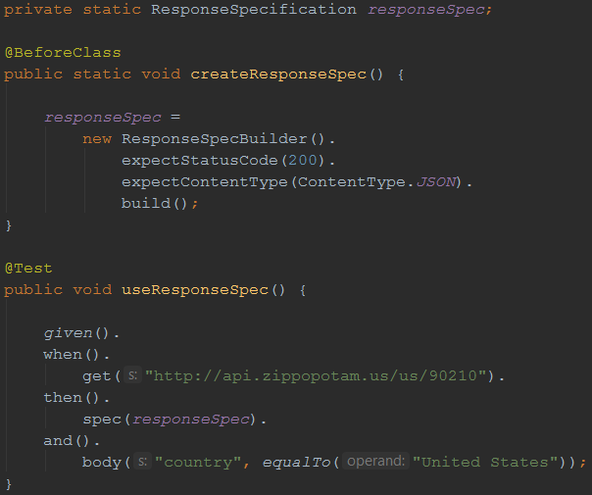
Sharing checks between tests
Solution: ResponseSpecification
Notes:
The ResponseSpecBuilder supports defining checks globally. You can then use these in your tests and combine them with test-specific checks.

Slide 37
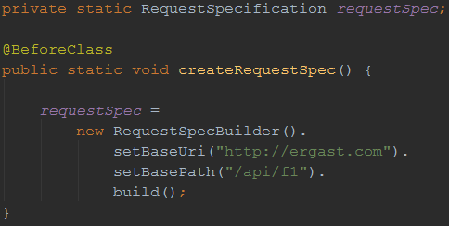
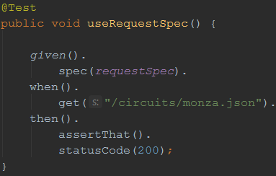
Reusing request properties
The same can be done for request properties
Example: set the base URI and path for the tests
Notes:
If you want the same check to be performed for a lot of different API calls, including them in each and every test (and having to update them X times when they require maintenance) is a waste of effort…

Slide 38
Get your hands dirty!
RestAssuredExercises4
Try it for yourself
Can you think of additional applications for reuse ?
RestAssuredExamples contains all examples from the presentation

Slide 39
XML support
So far, we’ve only used REST Assured on APIs that return JSON
It works just as well with XML-based APIs
Identification of response elements uses XmlPath instead of JsonPath

Slide 40
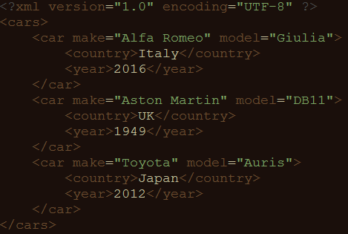
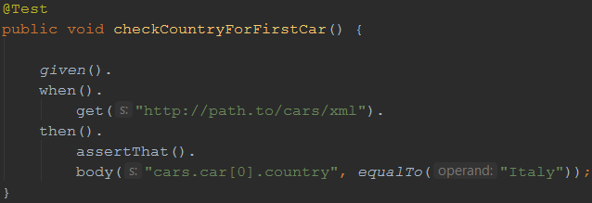
XmlPath – examples
Check country for the first car in the list

Slide 41
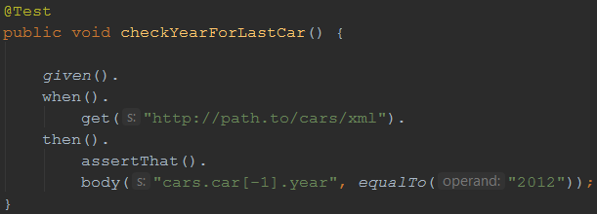
XmlPath – examples
Check year for the last car in the list

Slide 42
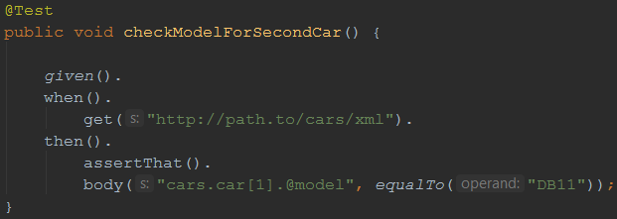
XmlPath – examples
Check model for the second car in the list

Slide 43
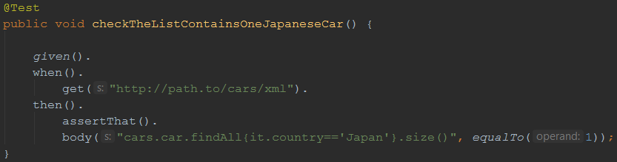
XmlPath – examples
Check there’s only one car from Japan in the list

Slide 44
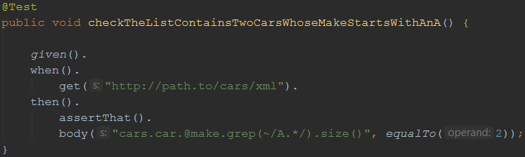
XmlPath – examples
Check there are two cars in the list whose make starts with ‘A’

Slide 45
Get your hands dirty!
RestAssuredExercises5
Communicating with an API returning an XML document
Use XmlPath to select the right nodes
Use filters, in, grep(), size() where needed
All examples can be reviewed in RestAssuredExamplesXml.java

Slide 46
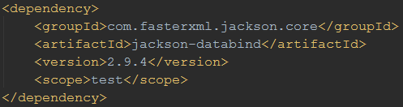
(De-)serialization of POJOs
REST Assured is able to convert POJO instances directly to XML or JSON (and back)
Useful when dealing with test data objects
Requires additional libraries on the classpath
  Jackson or Gson for JSON
  JAXB for XML

Slide 47
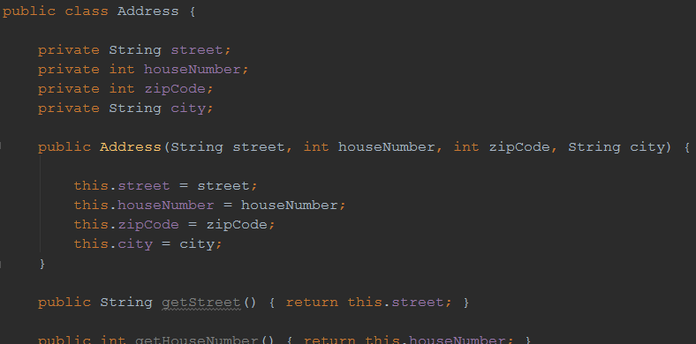
Example: serialization
POJO representing an address

Slide 48
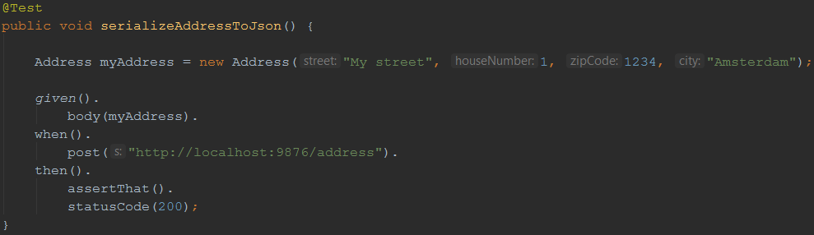
Example: serialization
Instantiating it in a test and sending it as a request body for a POST method:

Slide 49
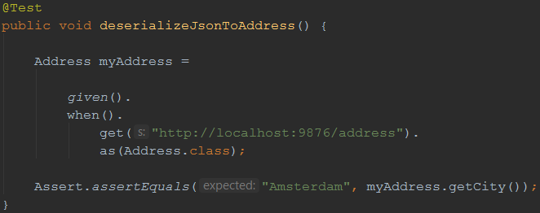
Example: deserialization
We can also convert a JSON (or XML) body back to an instance of a POJO
After that, we can do some verifications on it:

Slide 50
Get your hands dirty!
RestAssuredExercises6
Practice (de-)serialization for yourself
You don’t need to create or adapt the Car POJO
All examples can be reviewed in RestAssuredExamples.java

Slide 51
Questions
?
Notes:
Any questions?

