Slide 1


VidComply AI
Automated Global Compliance for Content Teams
Save days of manual review. Eliminate regional risk.

Slide 2

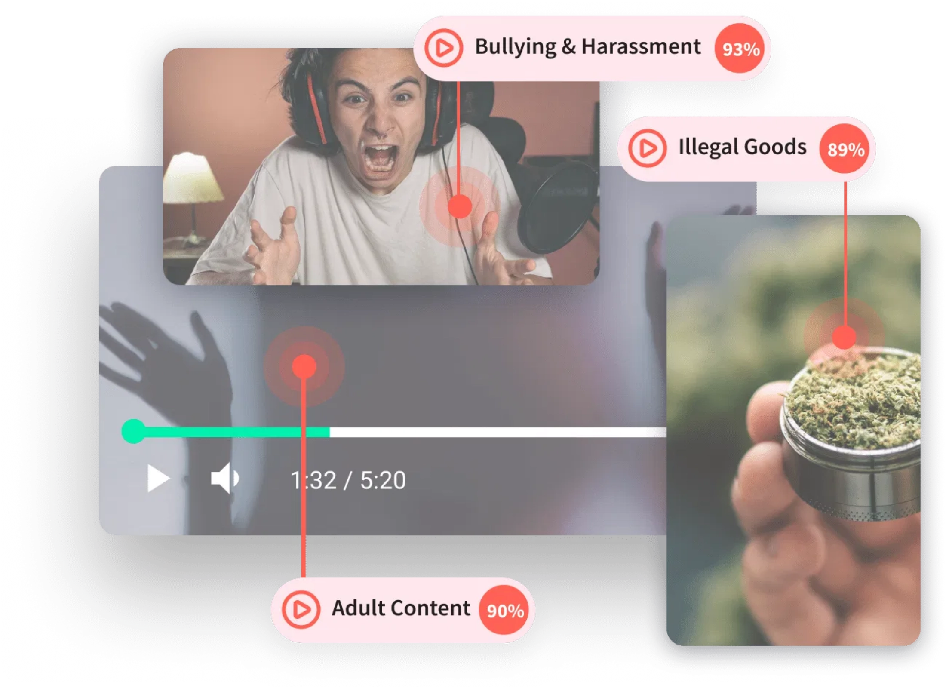



Manual Review Can't Keep Up with Regulation
Content teams are drowning in complex regulations while trying to scale globally.
Dozens of new regional rules
per year making
compliance increasingly complex
Inconsistent enforcement
and legal exposure
across different markets
3–5× higher costs
when scaling content
distribution internationally

Slide 3







Trusted by Leading OTT & Studios
"VidComply reduced our review time from 3 days to under 1 hour."
— Head of Content Ops, EU OTT Partner
StreamFlix
MediaCorp
ViewNow
GlobalStream

Slide 4
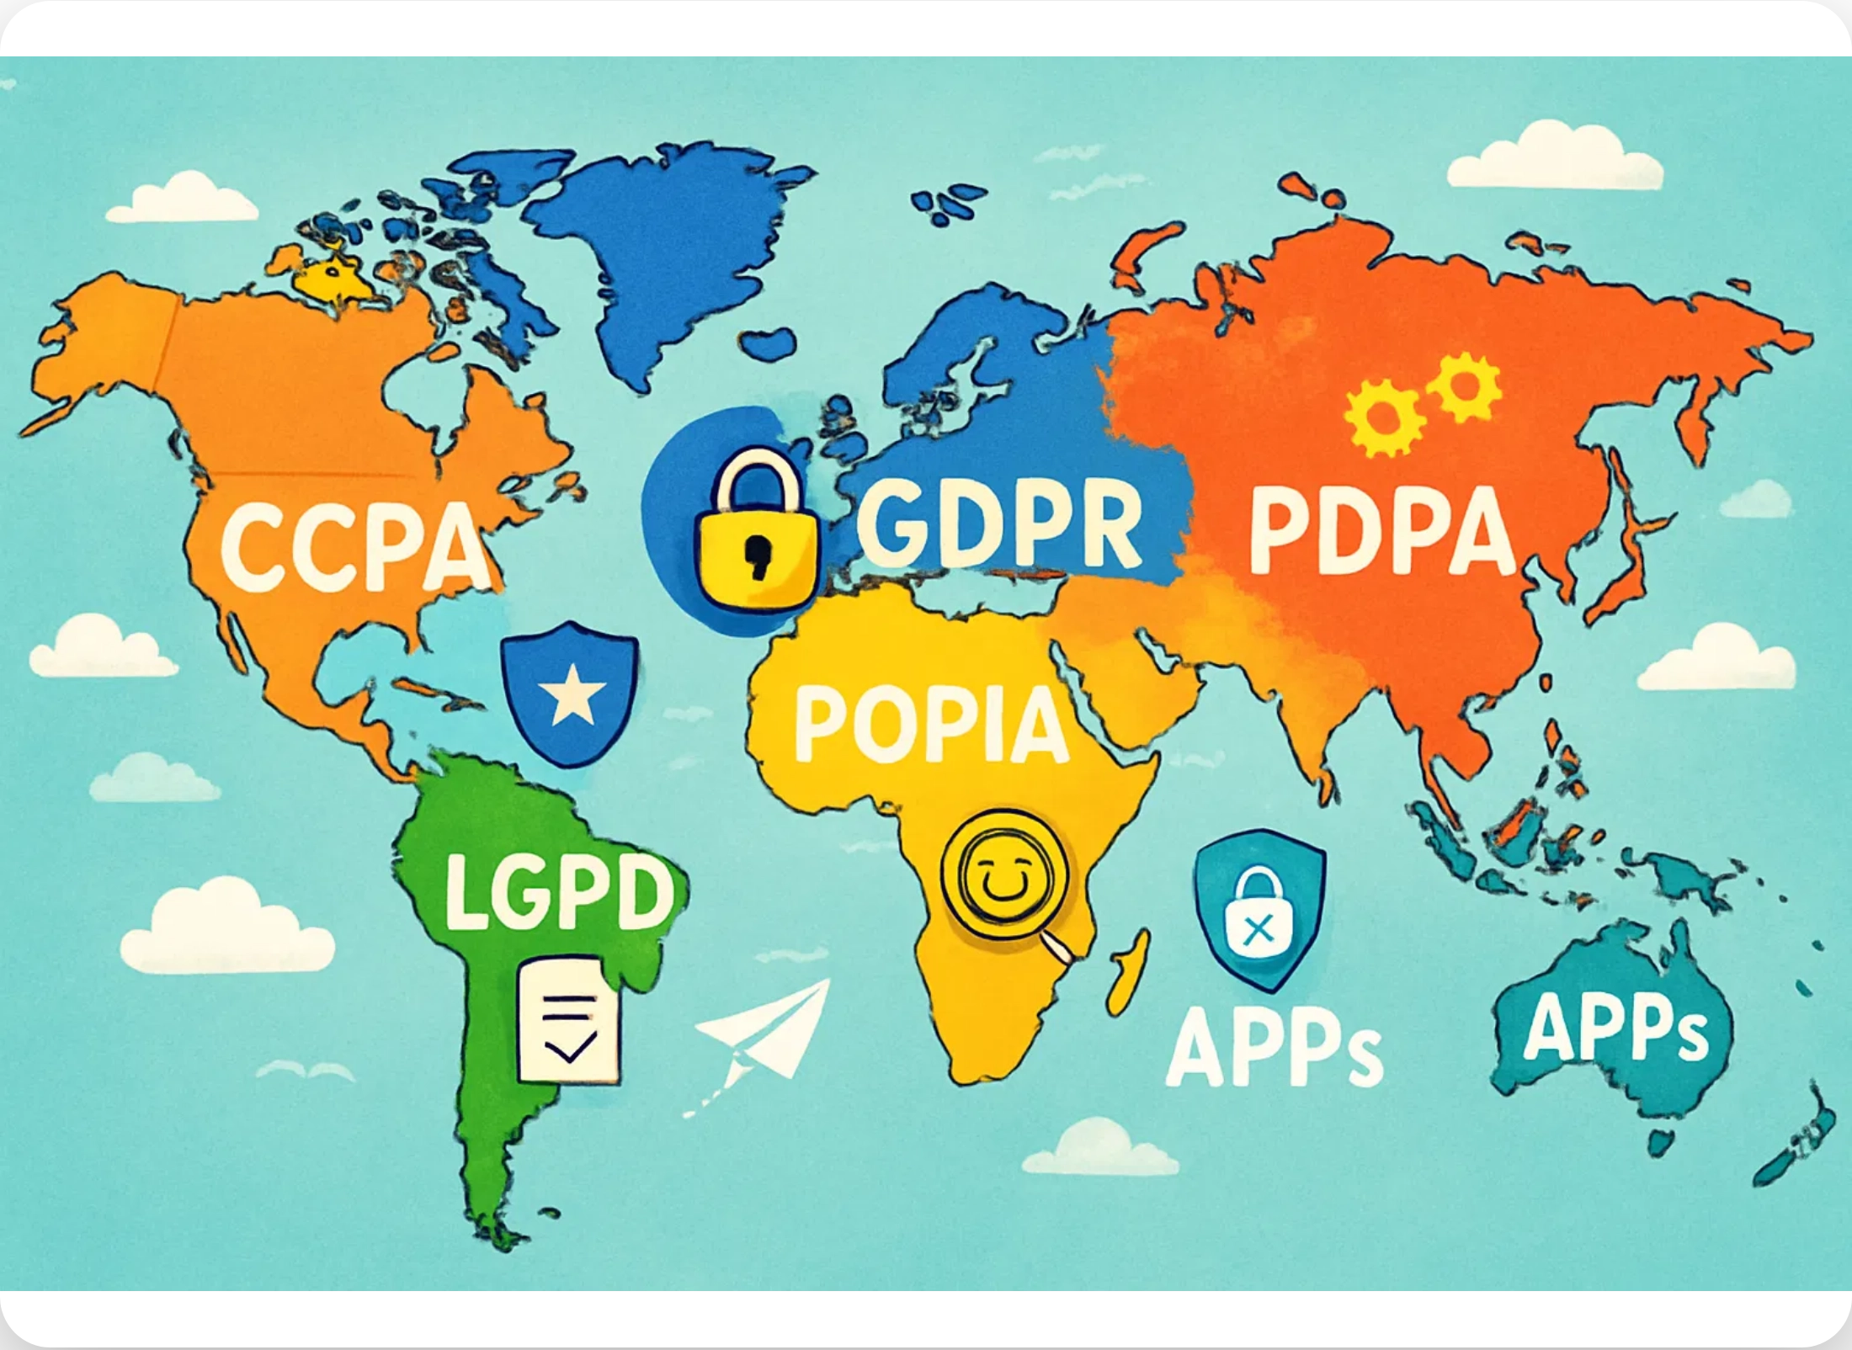
One Platform for Every Regulation
Upload once.
AI detects, fixes, and certifies
content across all markets.
1
Upload your content to our secure cloud platform
2
AI analyzes against all relevant regional regulations
3
Receive automated fixes and compliance reports
4
Export certified content ready for global distribution

Slide 5





Advanced VFX Editorial Capabilities
VidComply AI doesn't just detect compliance issues—it
automatically fixes them
using advanced VFX
techniques.
Smart Content Blurring
Automatically detects and blurs sensitive content while preserving surrounding context
Content Replacement
Intelligently replaces problematic elements with compliant alternatives
Visual Overlays
Applies appropriate warnings, age gates, or informational overlays as needed

Slide 6


Fully Agentic AI Capabilities
VidComply AI operates as a
fully autonomous agent
that doesn't just detect issues—it makes decisions and
takes action to resolve them.
Our agentic AI can
work independently
or in
collaboration with human reviewers
, adapting to your
workflow needs.

Slide 7

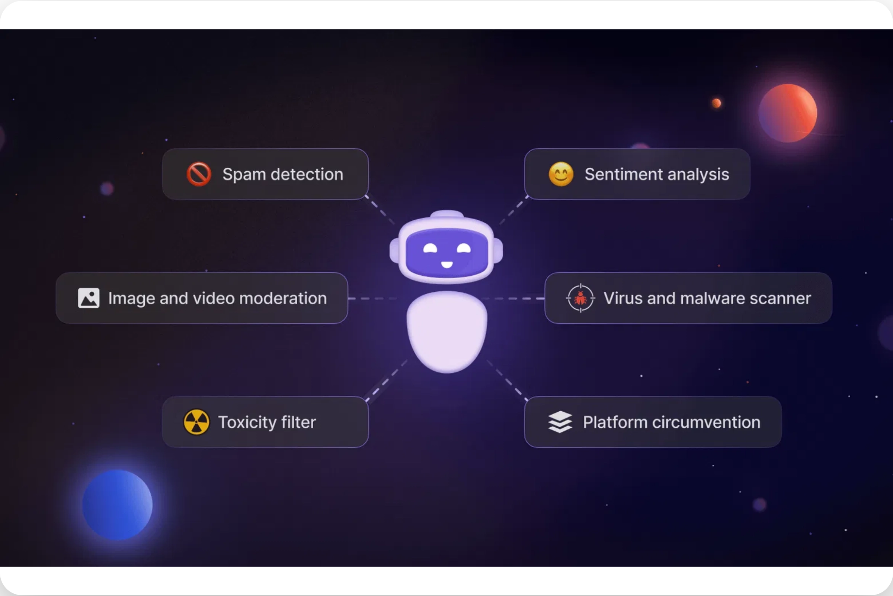
Compliance in Action
Watch how VidComply transforms a complex compliance workflow into a simple 45-minute process.
1
Scene-level flagging
15 min
2
Instant preview
20 min
3
Report export
10 min
Compliance Progress
1
2
3
Start
45 minutes

Slide 8
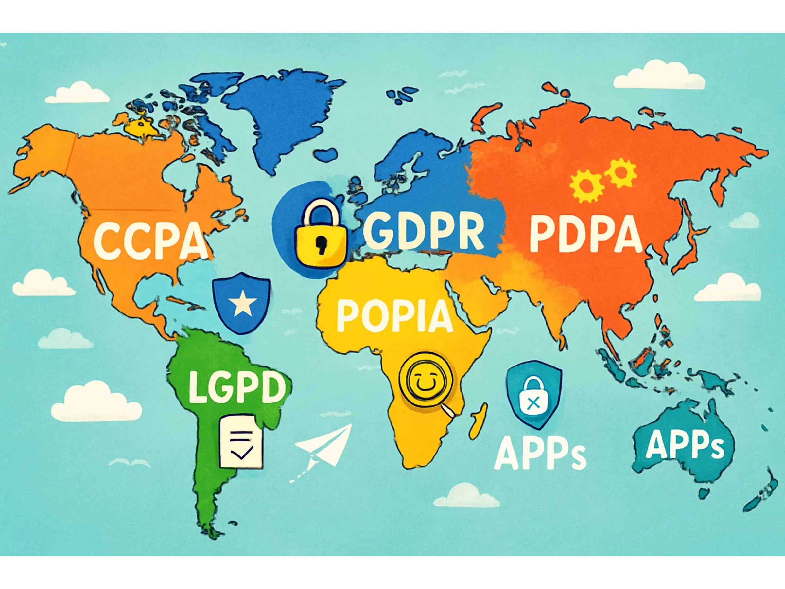






Comprehensive Global Regulation Coverage
VidComply's AI engine is trained on regulations across all major markets, ensuring your content meets local requirements everywhere.
Europe
DSA
AVMSD
United States
COPPA
FCC
Asia & Middle East
CBFC
IT Rules

Slide 9

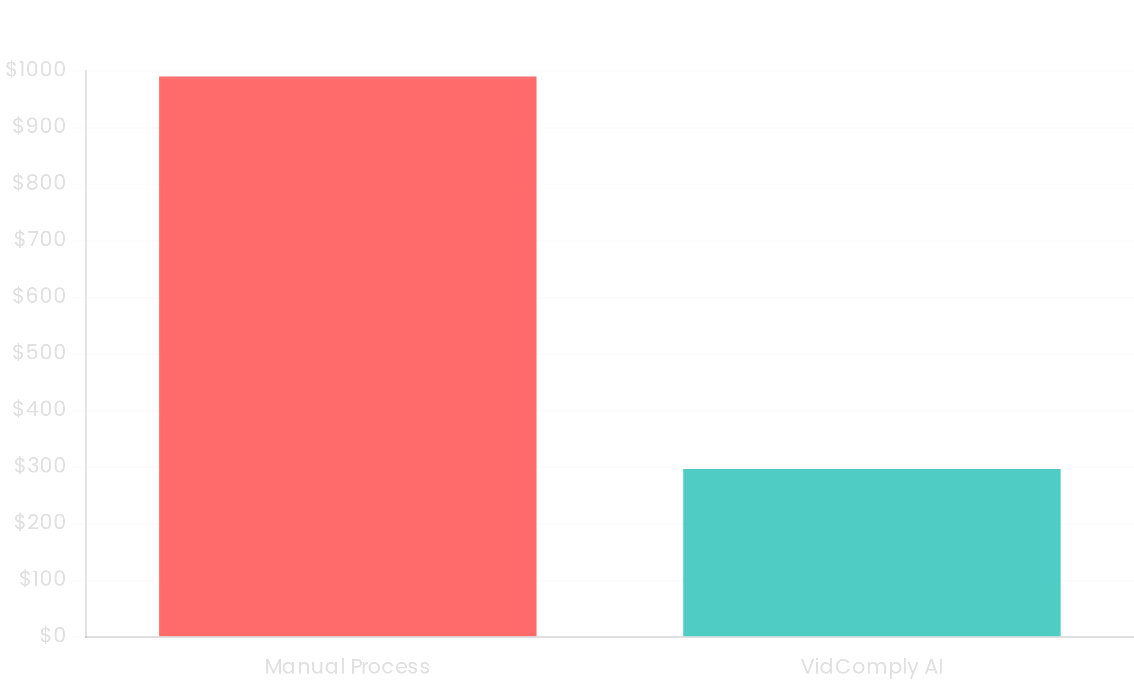
70% Cost Reduction for Sports Broadcaster
See how VidComply transformed compliance workflows for a major sports broadcaster expanding to multiple markets.
Challenge
4-hour weekly sports feed
needed distribution across 5
regional markets with different compliance requirements
Solution
Implemented
AI automation
with region-specific policy
engines and real-time content flagging
Results
70% cost savings
, zero compliance violations, and
5× faster
time-to-market

Slide 10

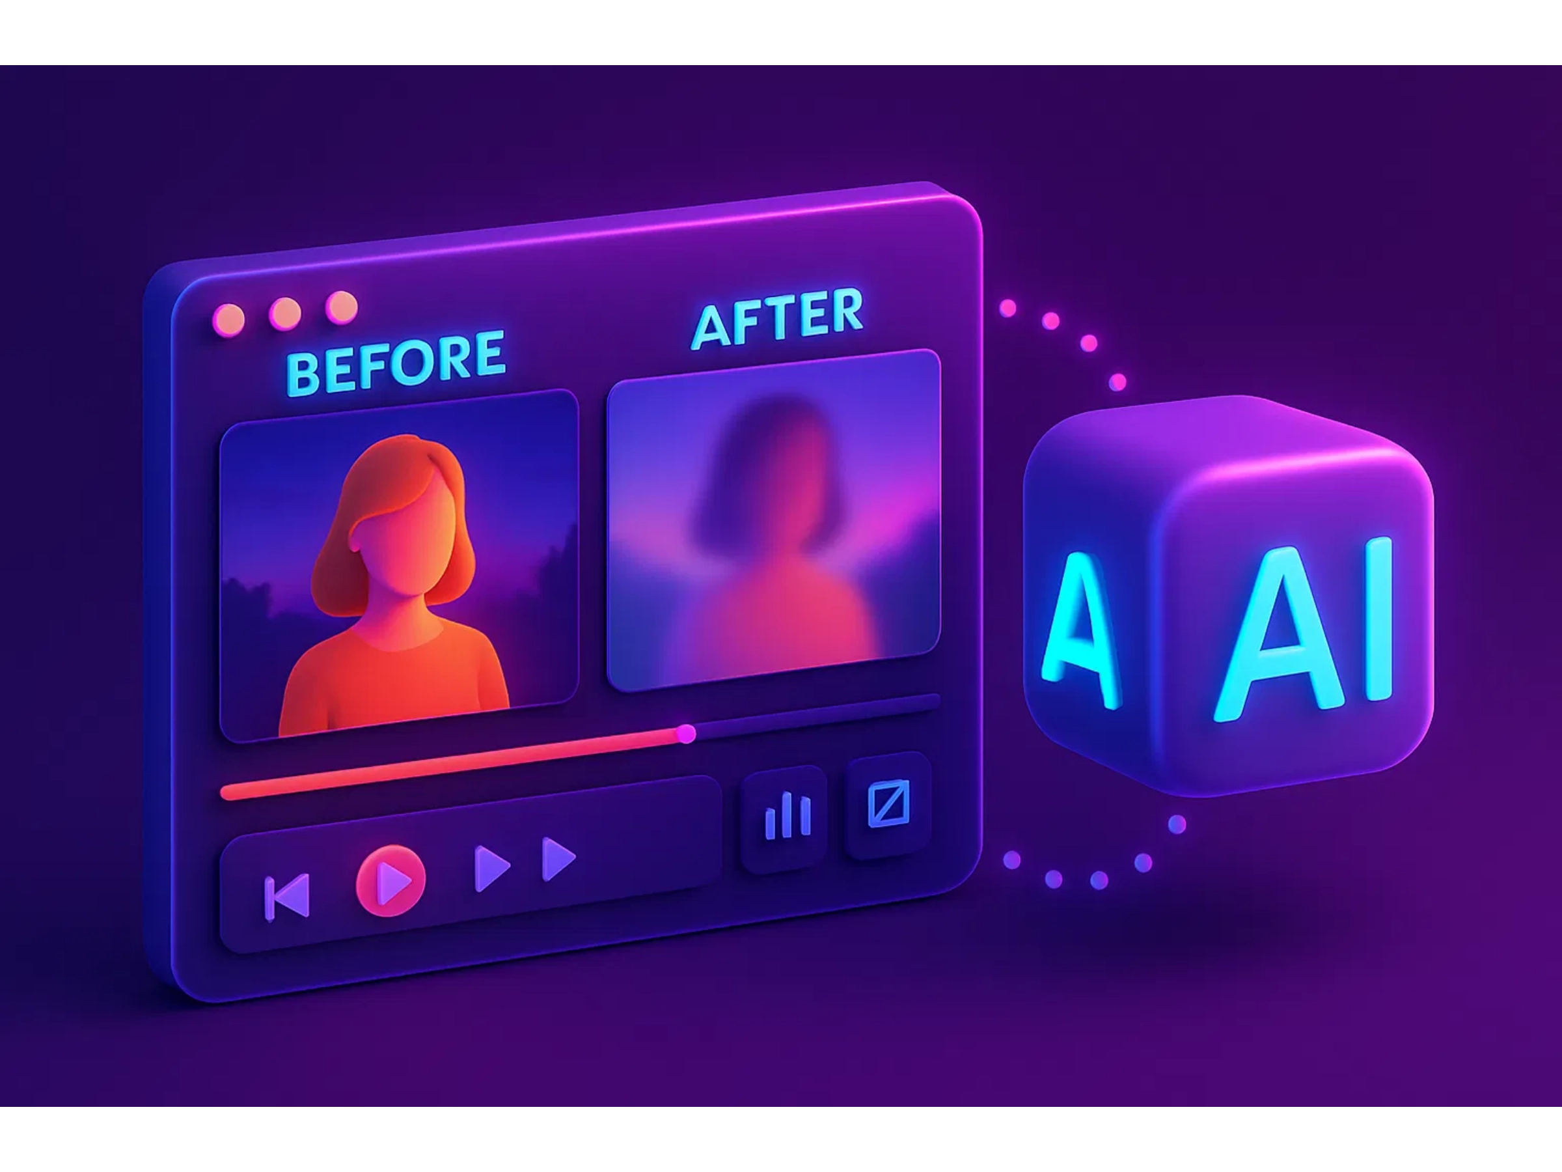



Real Savings, Faster Launches
VidComply delivers measurable ROI through automation, helping content teams achieve global compliance with less effort and cost.
10× faster
review turnaround time
70% lower
compliance processing cost
95% accuracy
in compliance detection

Slide 11
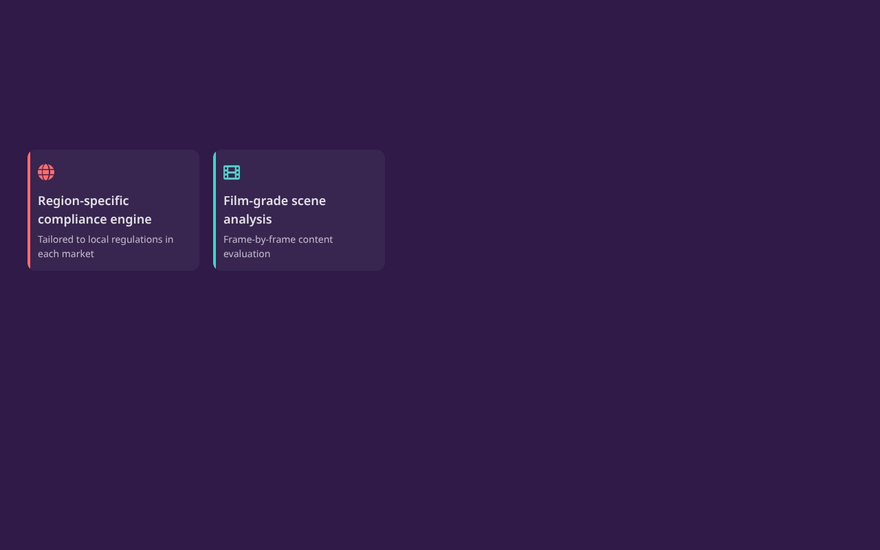
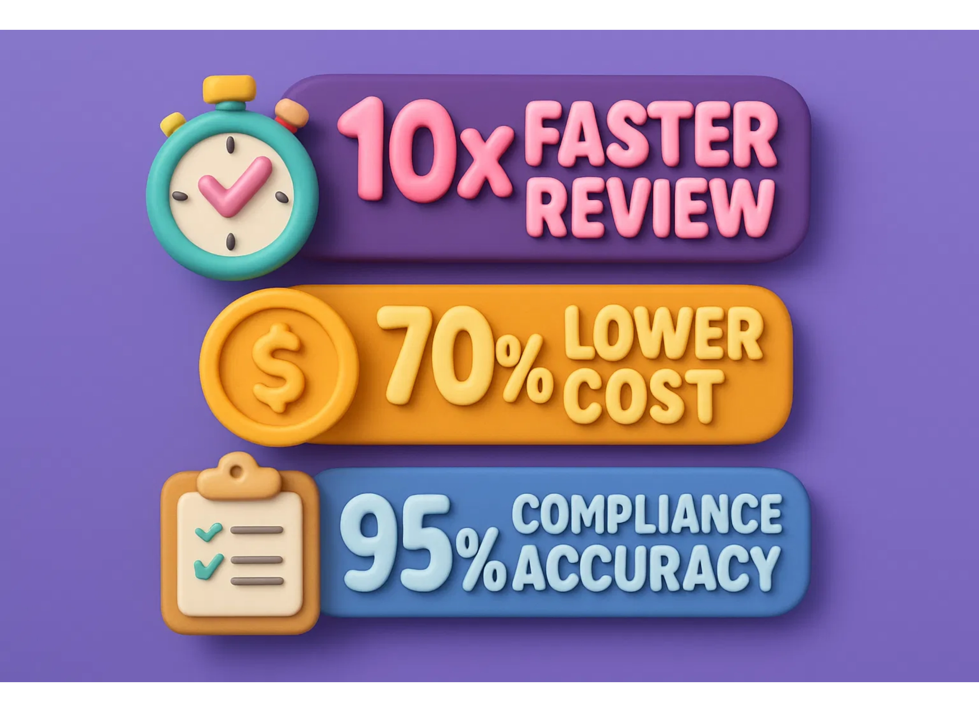
Why Leading Platforms Choose VidComply
VidComply offers unique advantages that make it the preferred choice for content platforms worldwide.

Slide 12




Make Your Next Title Global-Ready
Transform your compliance workflow from weeks to hours with AI-powered automation.
Start Your Free 14-Day Pilot
No setup fees
Full access to all features
Dedicated onboarding support

