Slide 1

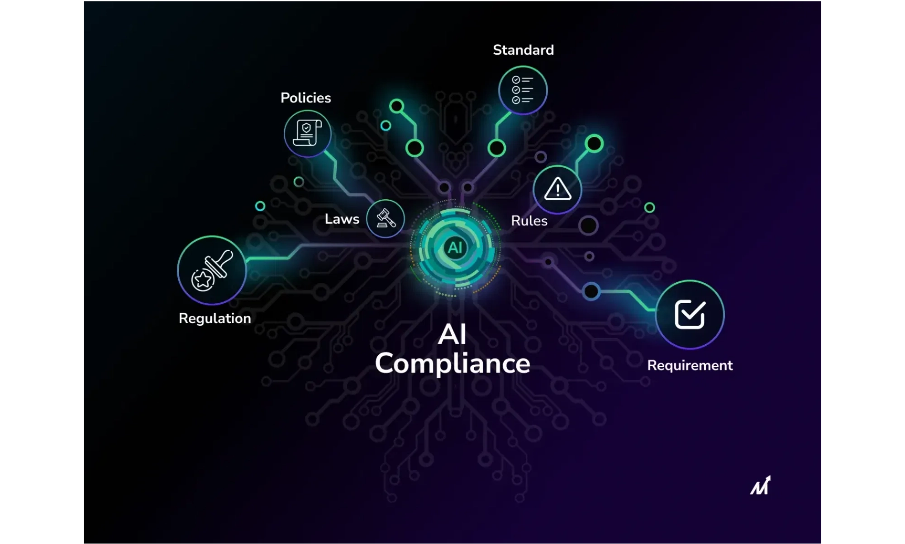
VidComply AI
Partnering for the Future of Video Compliance
Unlock faster, safer, and globally compliant content workflows with VidComply's agentic AI platform.

Slide 2
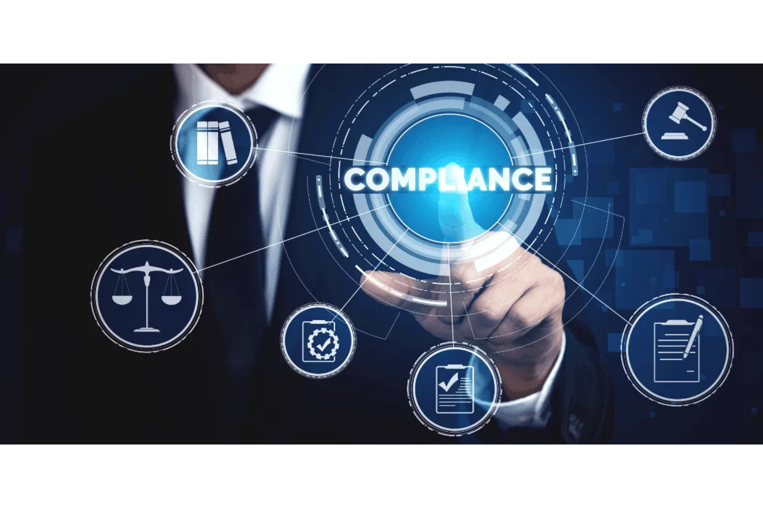
Regulation is Reshaping the Video Ecosystem
Global frameworks (
DSA, OSA, COPPA, AVMSD
) now
require proactive moderation and audit-ready
pipelines.
Platforms and tech providers need
scalable
compliance automation
built-in to meet these
requirements efficiently.
Key Regulatory Challenges:
Cross-border content distribution
Real-time moderation requirements
Audit trail documentation
Varying regional standards

Slide 3

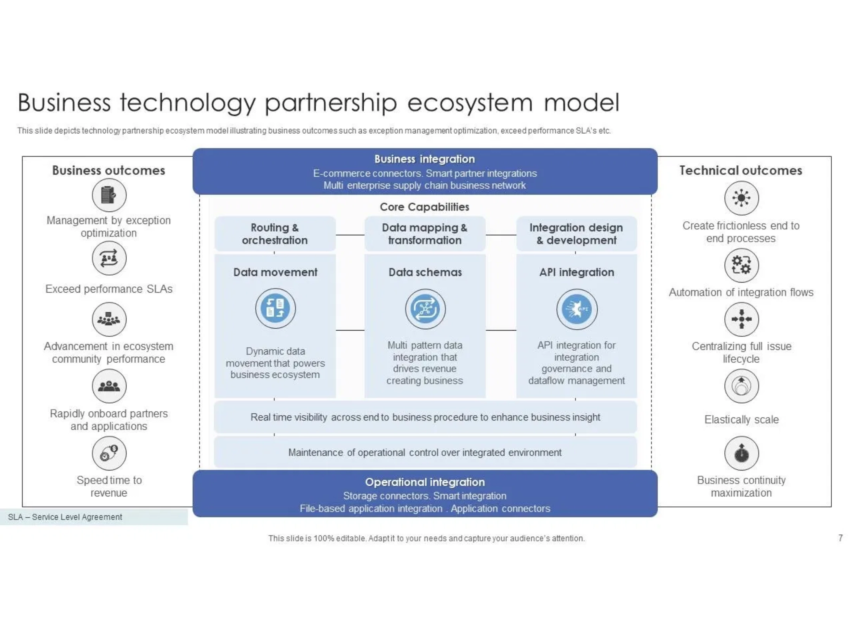

The Industry Needs a Unified Compliance Layer
Today, every OTT or CMS solves compliance differently, creating inefficiencies and inconsistencies across the industry.
A
shared standard
accelerates launches, reduces risk,
and enables new regional markets.
Key Benefits of Standardization:
Consistent compliance across platforms
Reduced duplication of effort
Faster market entry for content
Enhanced trust with regulators

Slide 4
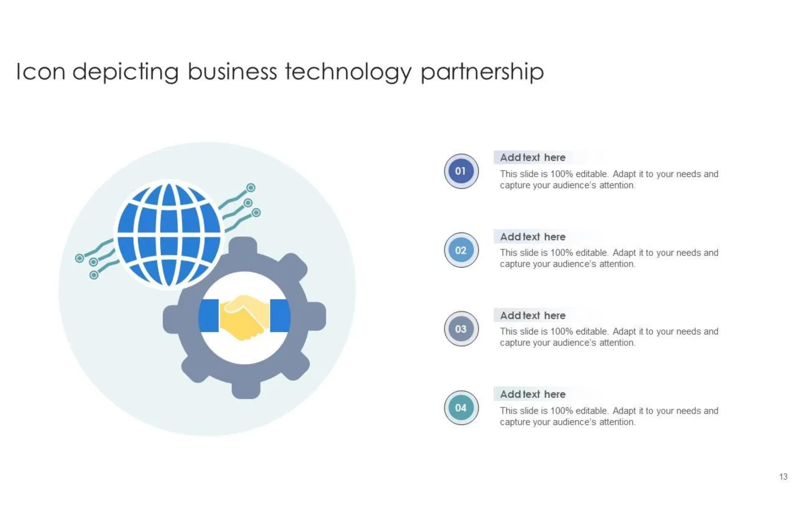



VidComply API + SDK
Embed automated video compliance into existing media workflows:
REST API
For rule-based compliance checks
SDK Integration
For post-production & CMS integrations
Region-specific Policy Engine
Maintained by AI for up-to-date compliance

Slide 5
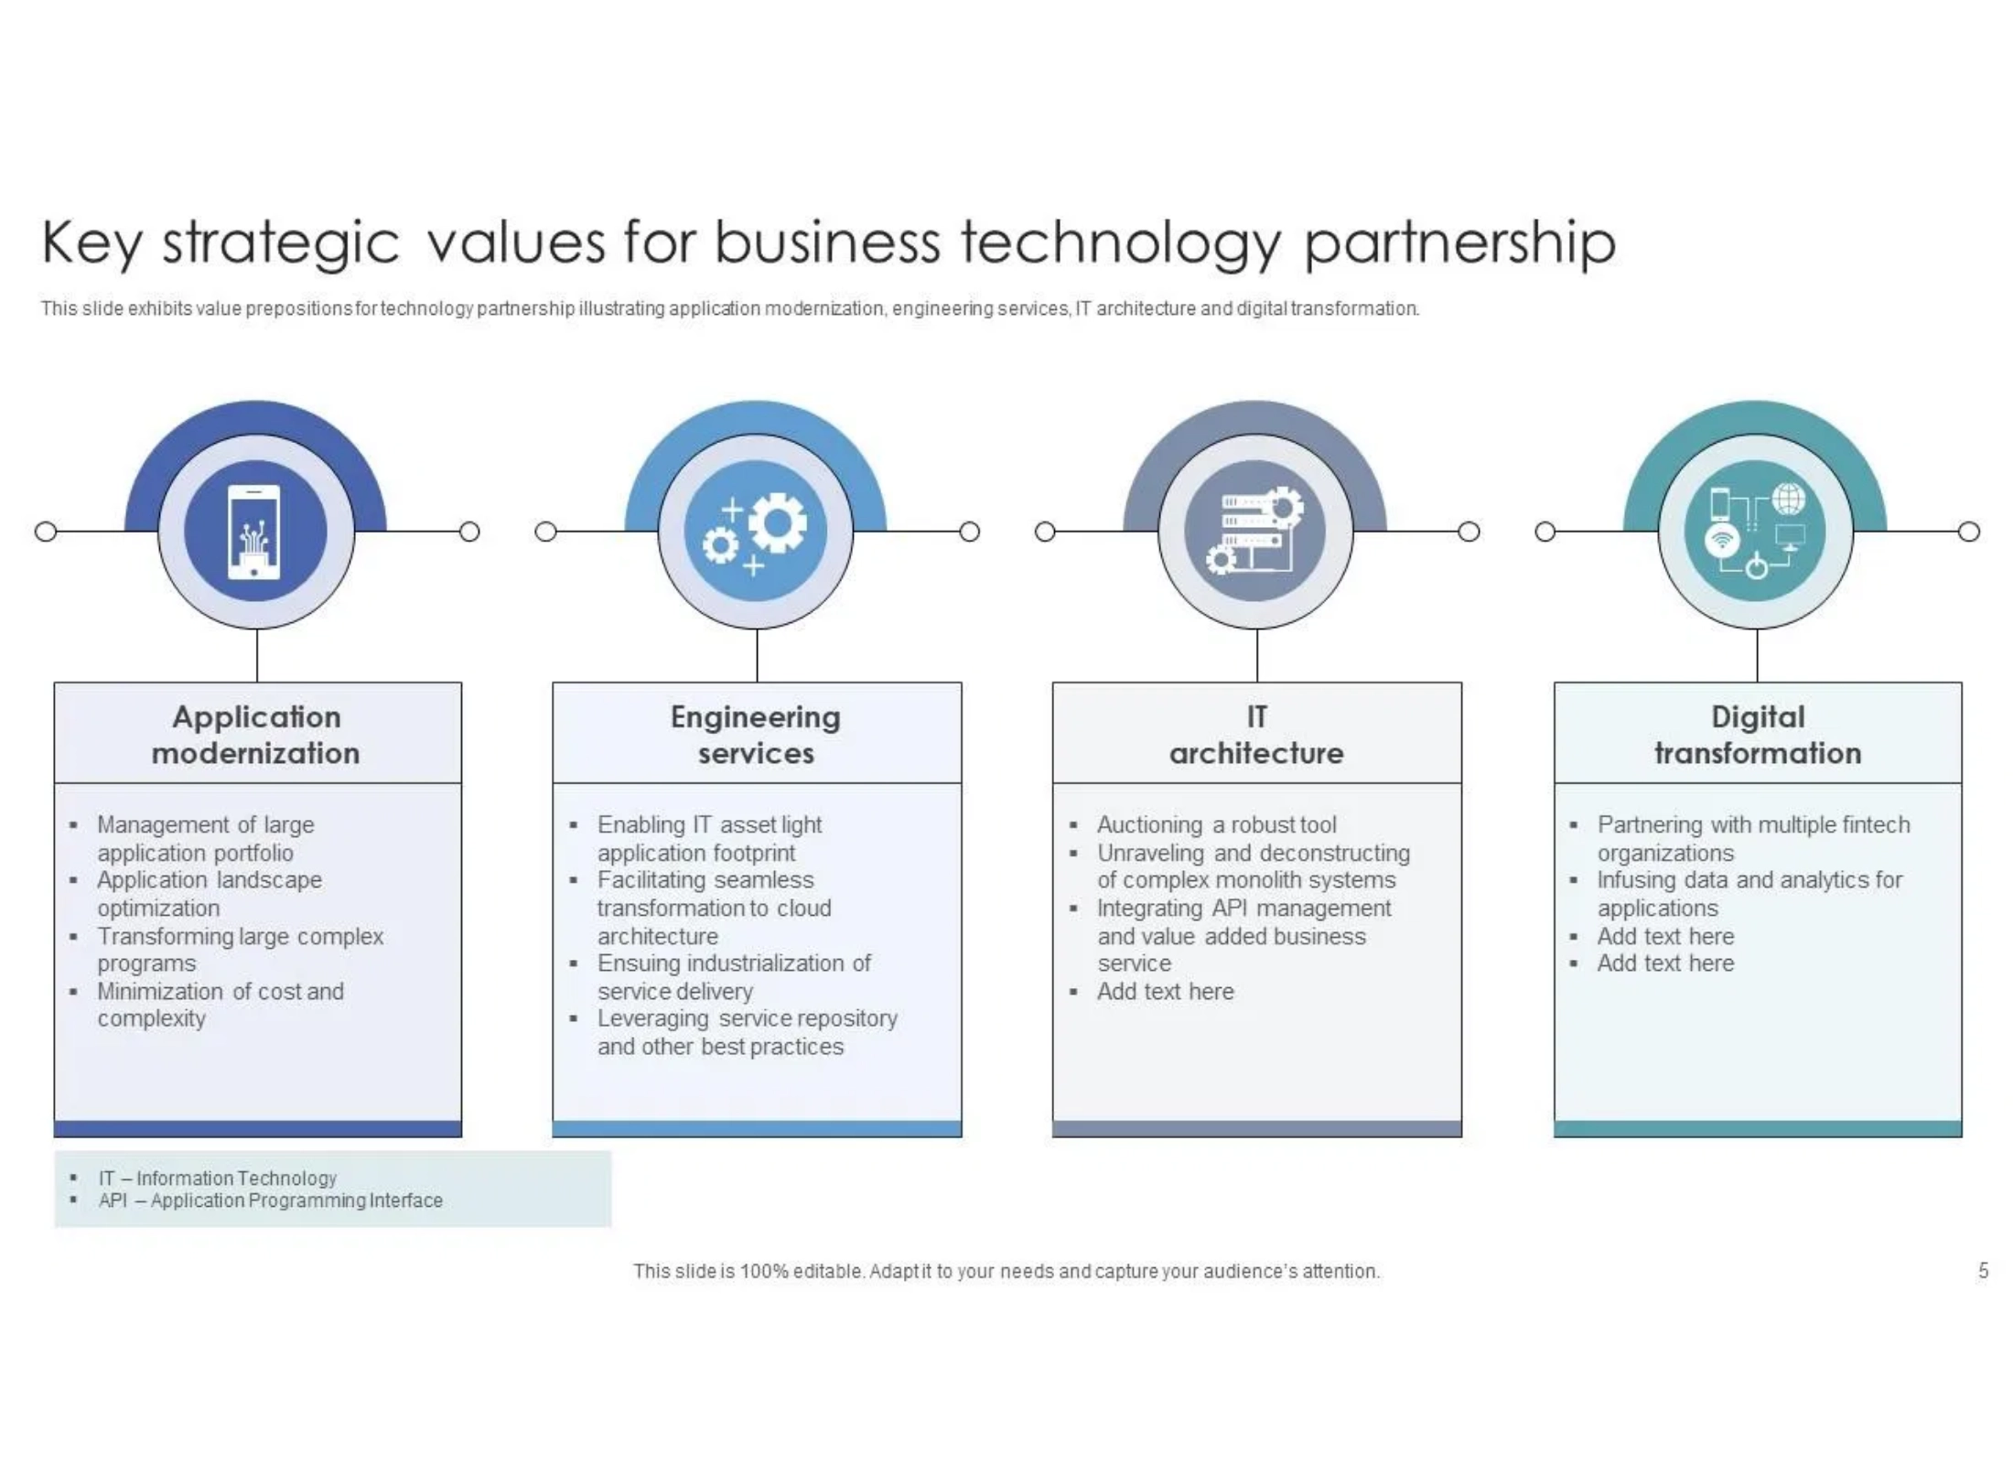




How Partners Win
Strategic partnership with VidComply delivers measurable advantages for your platform and customers.
Faster content certification
→ shorter time-to-
market
Enhanced trust
with regulators & advertisers
Reduced operational cost
for customers
Differentiated value
for platform partners

Slide 6
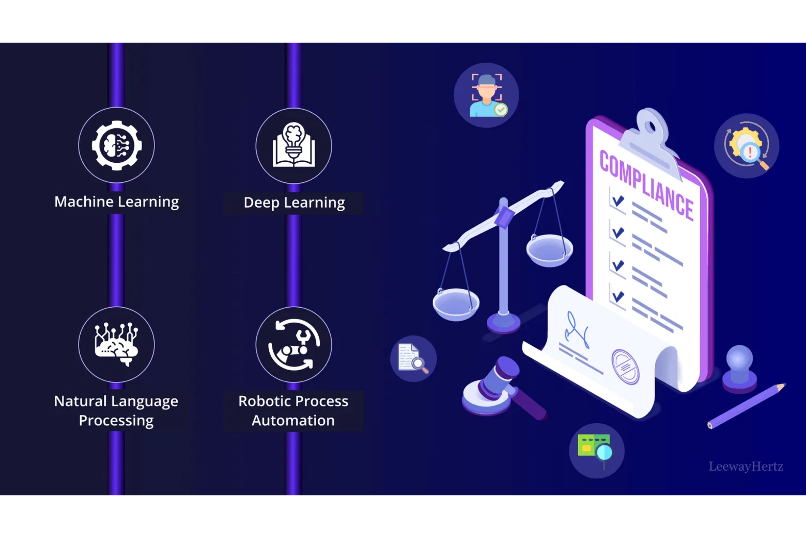




Integration Scenarios
VidComply offers flexible integration options across the video production and distribution ecosystem.
AWS MediaConvert Plugin
Automated compliance check during cloud transcoding
Adobe Premiere / DaVinci Resolve
Export validation at the editing stage
Magnite DSP
Brand-safety pre-screen for advertising content
YouTube Content ID Extension
Regulatory certification for platform uploads

Slide 7

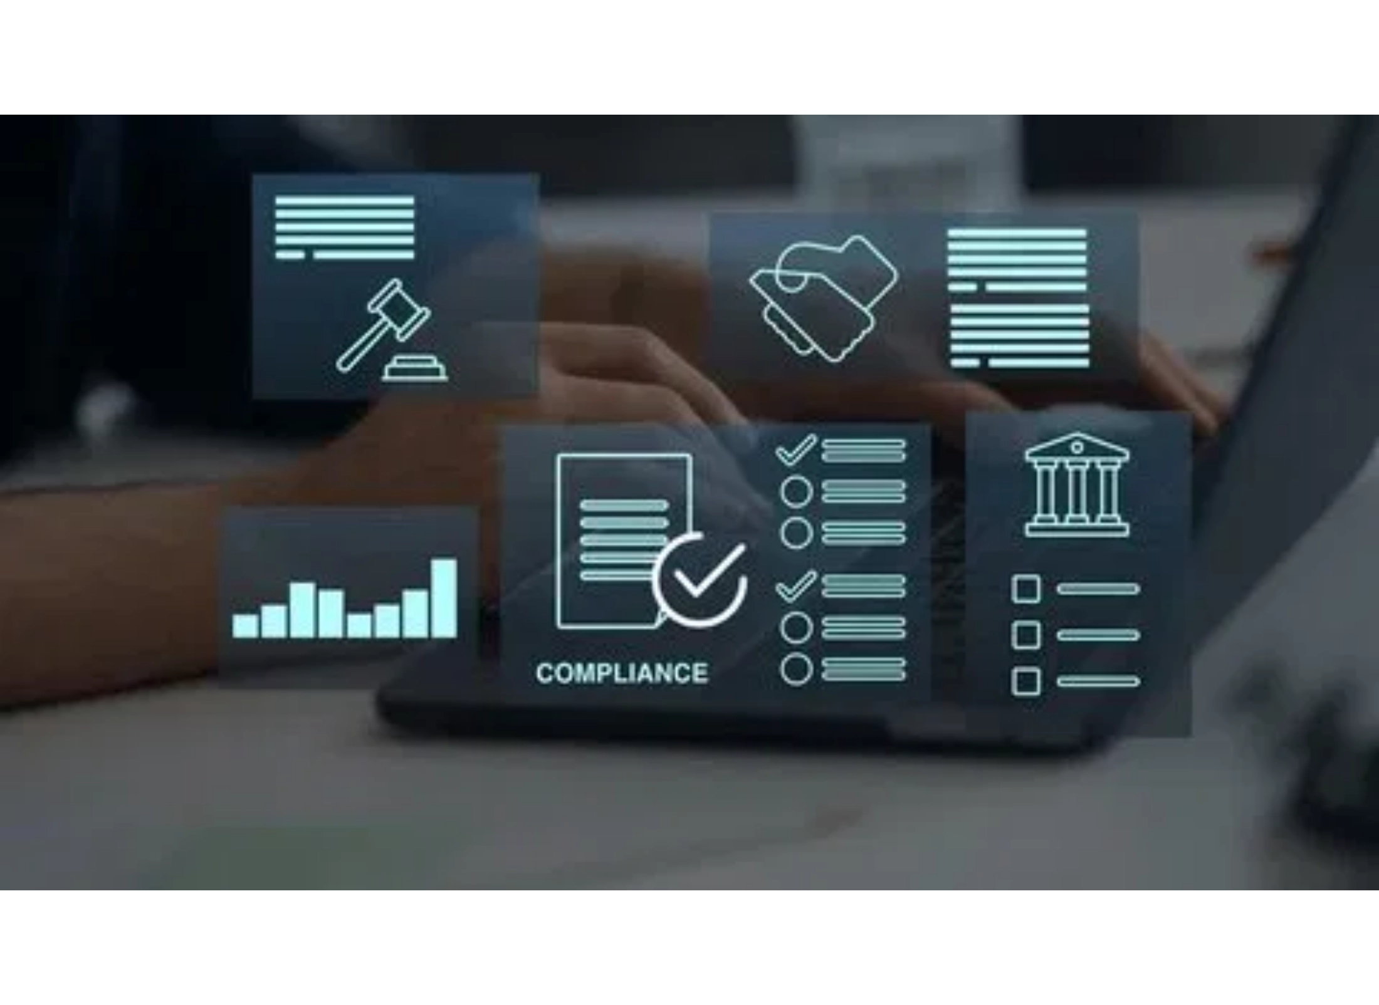
Agentic AI Stack Ready for Partnership
Our modular architecture is designed for seamless API integration, providing partners with flexible access to our advanced AI capabilities.
SceneVision
Frame & gesture analysis
AudioGuard
Speech & tone filter
PolicyBrain
Regulation database
EditBot
Auto-edit engine
VerifyAI
Certification report API

Slide 8
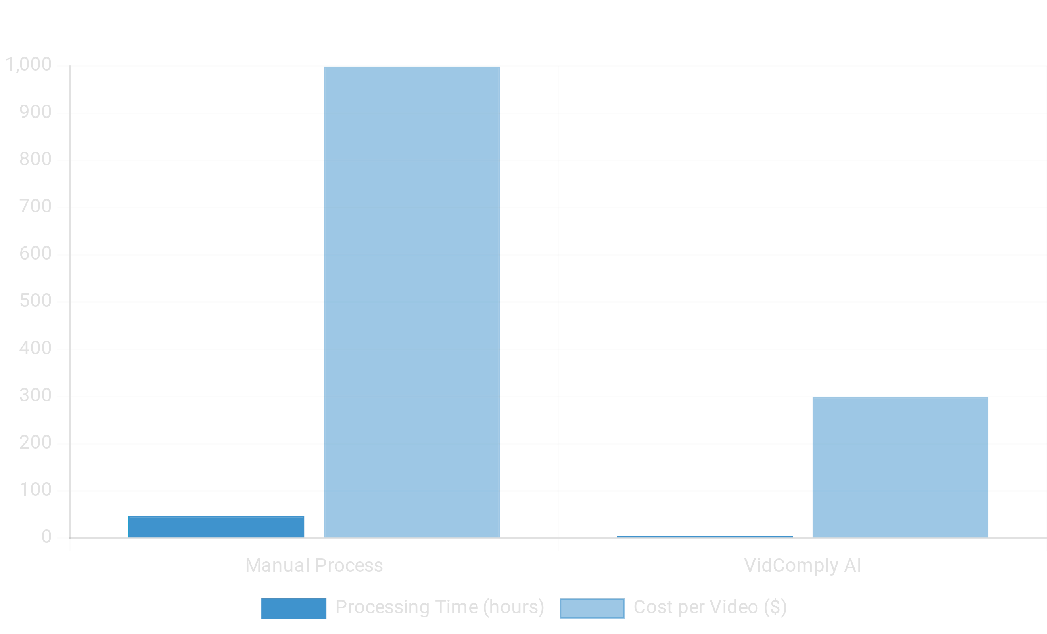




Proven Scale & Accuracy
5,000+
Videos processed across 12 pilots
95%
Approval rate from regional boards
70%
Average cost reduction vs manual QC
10×
Faster turnaround time

Slide 9
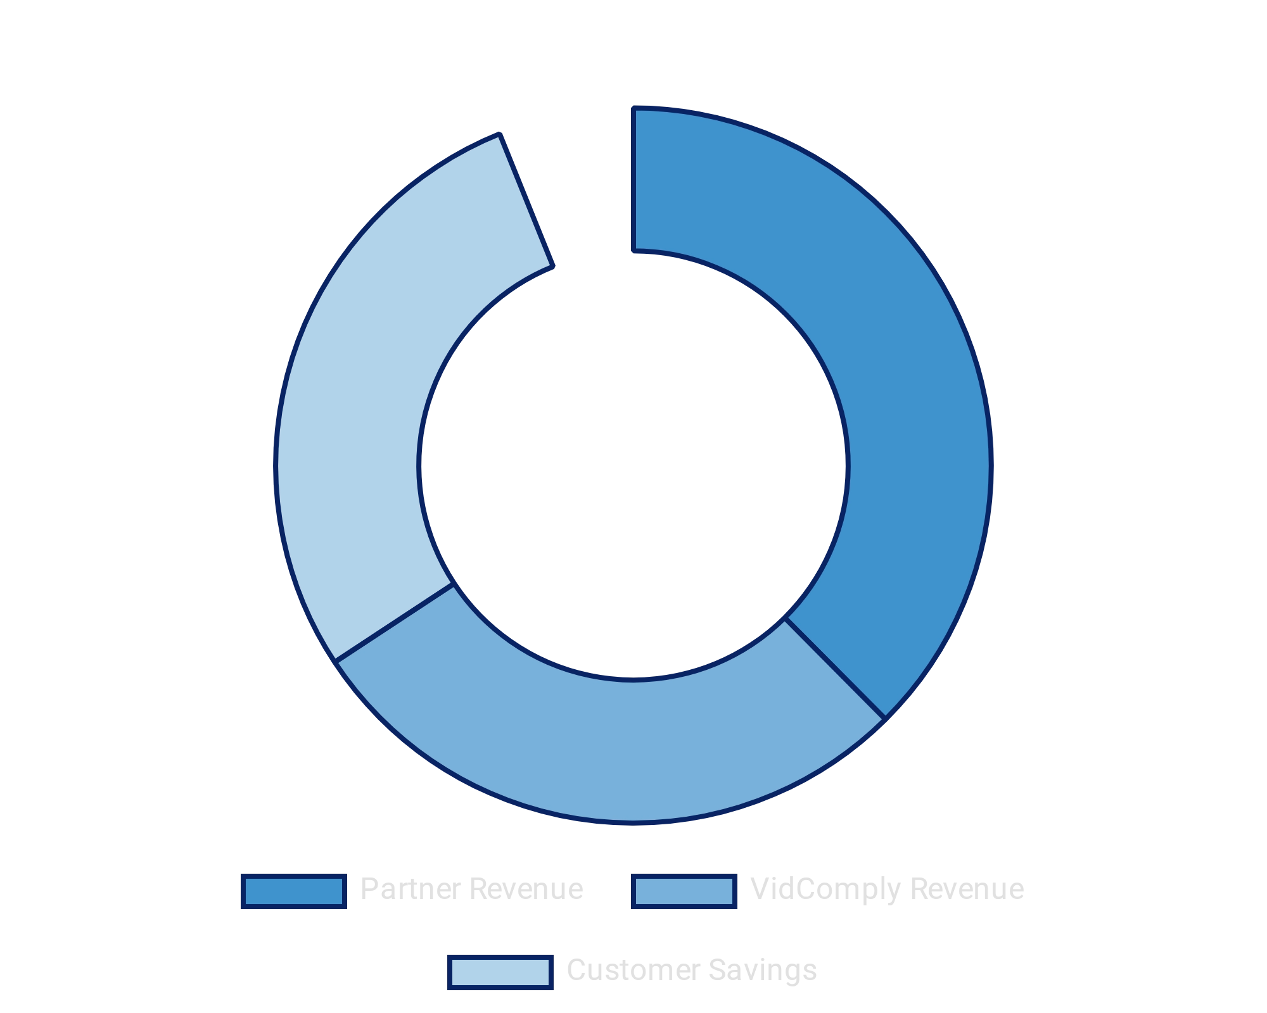



Shared Revenue and White-Label Opportunities
Flexible business models designed to align incentives and drive mutual growth.
API Usage Rev-Share
Per minute of video processed with tiered pricing based on volume
Co-Branded Offerings
Via partner marketplaces (AWS, Adobe, Frame.io) with shared visibility
Private Deployment
Options for strategic accounts requiring on-premises solutions

Slide 10
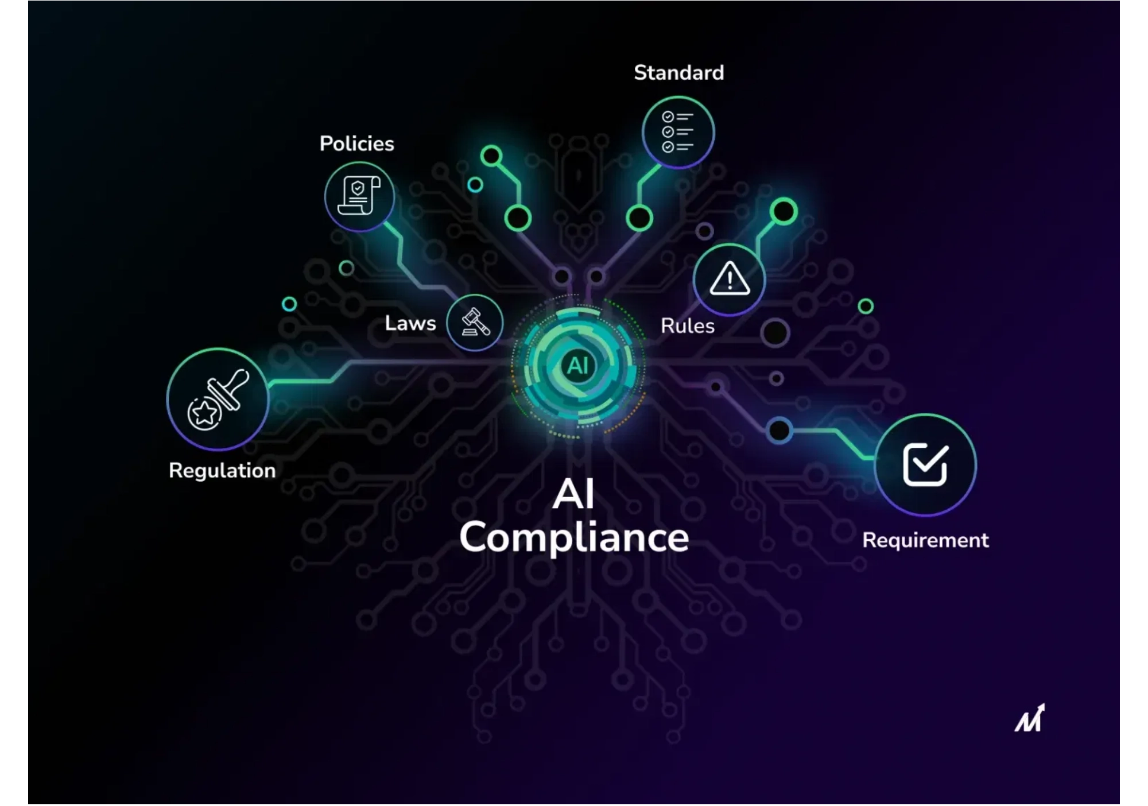


Let's Build the Compliance Standard Together
Compliance should be as standard as encoding or delivery. Join us in creating the future of video compliance.
hello@vidcomply.ai
www.vidcomply.ai/partners
Schedule a Partner Session

