Slide 1
Binned scatterplots
A simple tool to make research easier and better
Connor

Slide 2
A Need to Feel Your Data
What your attitude to data-driven research or research based on data exploration?
What do you do to get familiar with your data before a regression analysis?
Don’t treat your data set as a black box
Feel your data before analysis

Slide 3
A Need to Feel Your Data
Regression may failed!
Non-significant regression results are the most common things in research, even if your theory and hypotheses are all correct.
How can we diagnose a regression?
- Can we just try different combinations of variables until we have a satisfied regression result? … then we’re just doing data driven things…

Slide 4
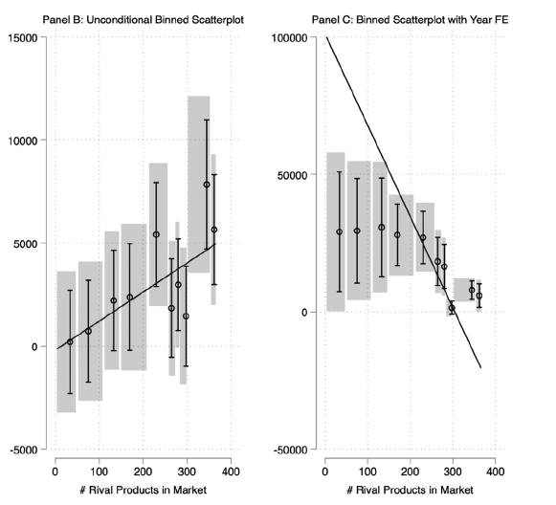
A Need to Feel Your Data
Regression can be deceptive!
Ignoring one control variable may lead to inverse significant outcomes
We cannot diagnose problems solely based on regression results.
We can not decide which regression result to believe in if we don’t know what really happen at the data level
Evan & Brent, 2018

Slide 5
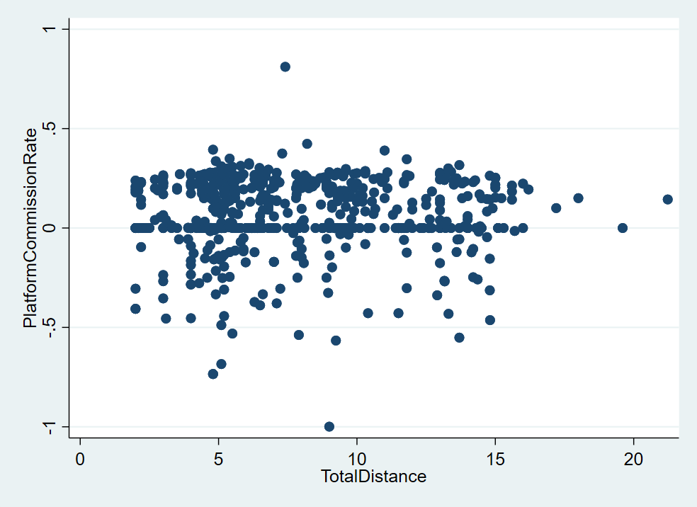
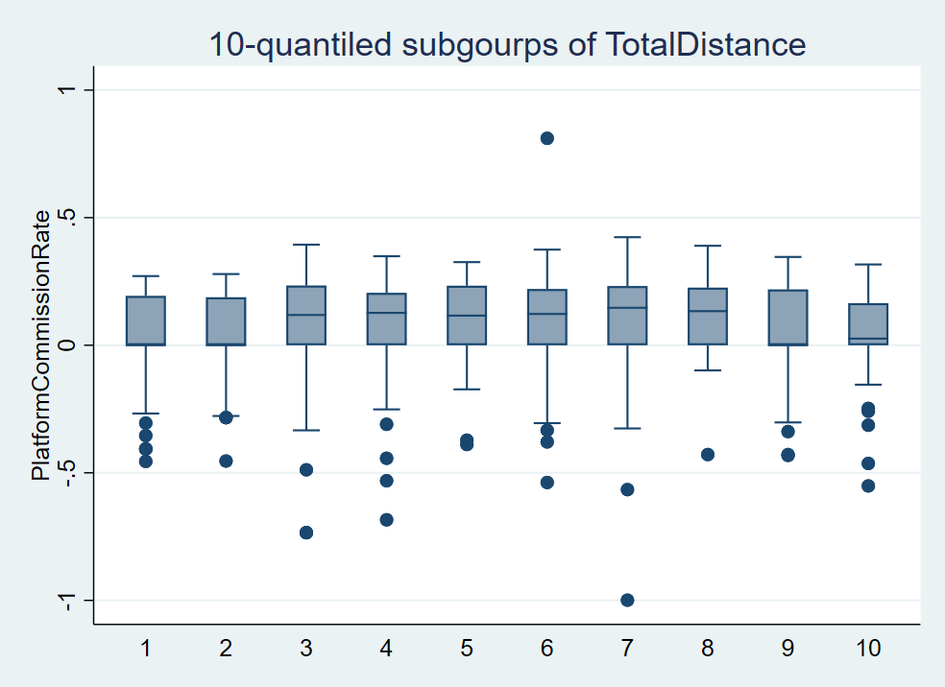
How to Feel Your Data
Traditional ways:
Scatter plots
Bins plots
Disadvantages:
Hard to find pattern when there are too many samples.
Control variables are not taken into consideration!

Slide 6
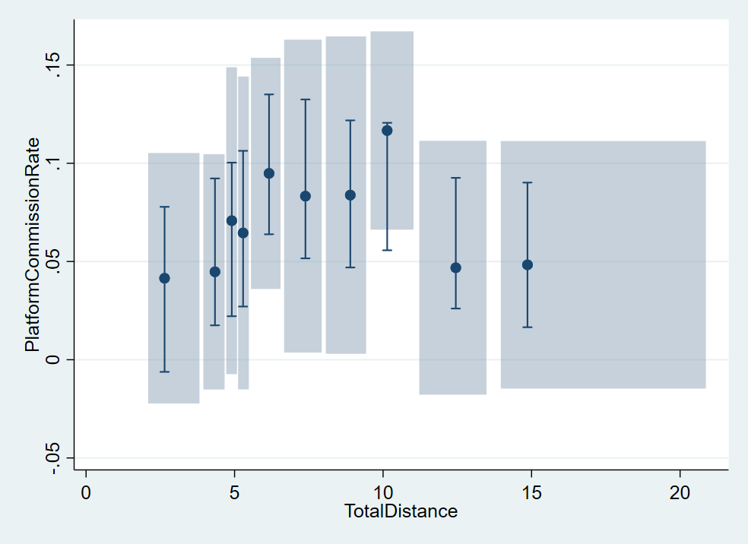
How to Feel Your Data
Why not take a binned scatter?!
Read a binned scatter:
Number of bins
Can be chosen by an optimal algorithms
Or be chosen by your need
Dots
X coordinate: Can be mean or median of x value of a bin group, by your choice
Y coordinate: The expected conditional value of y of this bin group
Confidence Intervals
Calculated by point estimation, with confidence level of your choice.
Confidence Band
Calculated by what-I-don’t-know estimation, but it takes all sample points of the bin into consideration, with confidence level of your choice.
For mathematical details, please refer to: Cattaneo, M. D., Crump, R. K., Farrell, M. H., Feng, Y. (2019). Binscatter Regressions. arXiv:1902.09615.

Slide 7
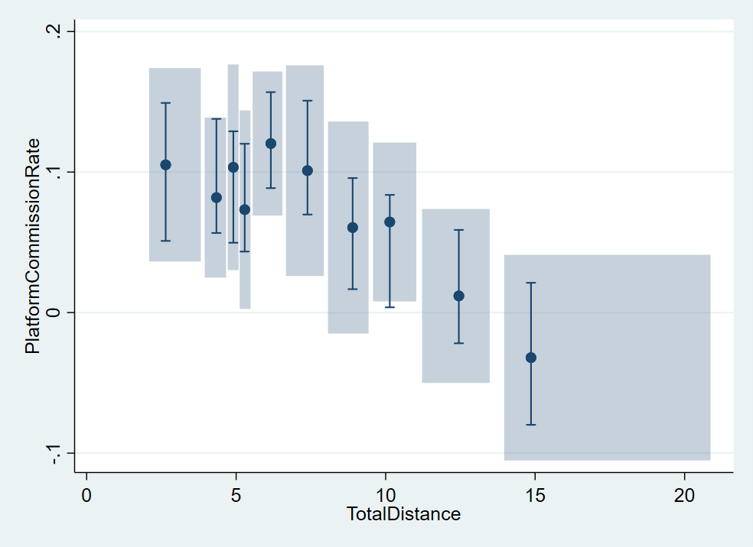
How to Feel Your Data
More important!
Binned scatter can take control variables into consideration!
Without control variables
With control variables

Slide 8
How to Feel Your Data
The core idea of binned scatter plot is:
Binned Regression!
Divide the sample
Then do regression for each part
So that you can gain insights from the detained estimation of each subgroup, along with all necessary variables controlled.

Slide 9
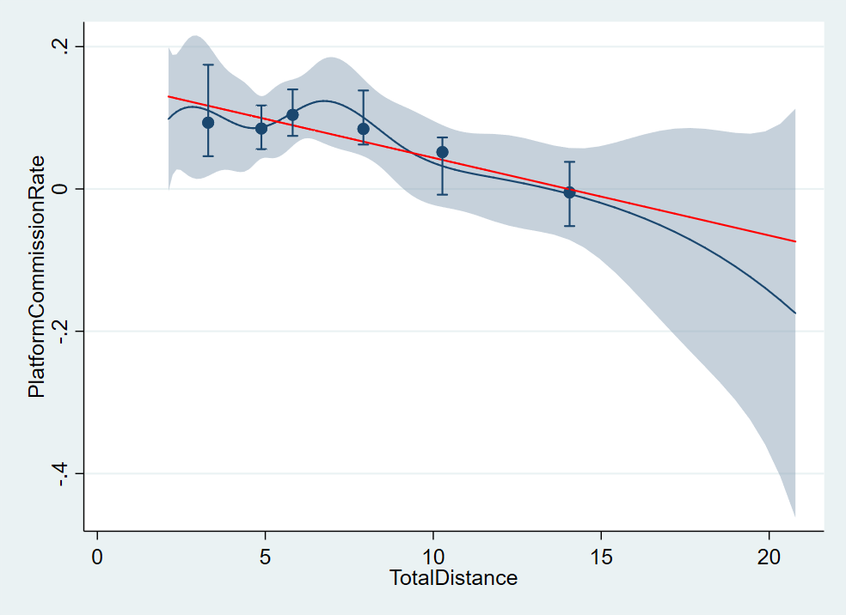
How to Feel Your Data
Other magic things:
-What the upper limit to divide the bins?
- Each point can be seen as a bin!

Slide 10
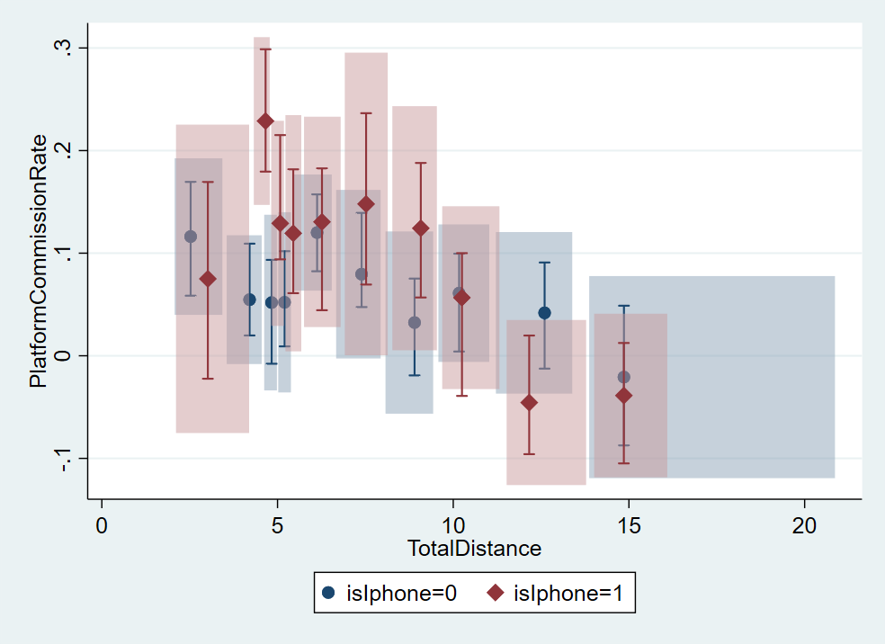
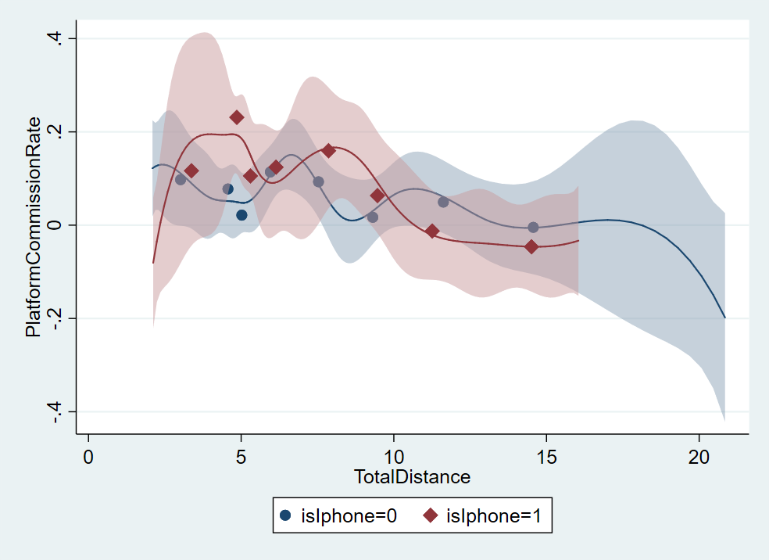
How to Feel Your Data
Other magic things:
- Group analysis

Slide 11
A Tool to Diagnose Your Regression
If this is your regression, and it’s not significant:
Where do you think the problem most likely lies?
Then you need inspect those special samples, and figure out what makes them special?
Some categorical variable you forgot to control?
Some theoretical condition ignored by previous research?
Data processing mistakes?
Measurement error?
Evan & Brent, 2018

Slide 12
More than OLS Regression
binsreg – for OLS estimation
binslogit – for Logit estimation
binsprobit - for Probit estimation
binstest – for nonparametric shape restriction/parametric model specification testing
binspwc – for quantile regression
For installation, user guide and illustrative codes:
https://nppackages.github.io/binsreg/

Slide 13
Pros and Cons
Pros
Well visualize your data for bivariable relationship
Control variables have been implemented
Diagnose your regression by allowing you to detailly observe your sample
Outliers (if there are) can only have effect within the bins where they are
Cons
It would be suggested to get familiar with some parameters of its stata command before you do binsreg
This method hasn’t been widely accepted by our community, so not suggested for publish working
Do not abuse this tool to do completely data-driven research

