Slide 1

Architecture and
Code Intelligence
Mushegh Gevorgyan | Founder
Pre-Seed | 2026

Slide 2



The Problem
AI writes the code. Nobody reviews the architecture.
Speed without structure
AI generates code fast. Architectural debt accumulates faster.
Invisible decay
Linters catch syntax. They miss circular dependencies, layer violations, dead modules, race conditions.
10x cost of delay
Teams ship on top of rotting foundations. By the time they notice, refactoring costs 10x.

Slide 3
Why Now
92%
46%
$2B+
Of US devs use AI coding tools
Of all new code is AI-generated
Cursor ARR alone
Daily usage, 2026
And growing fast
1M+ daily active users
Cursor: 1M+ daily users · Claude Code: $2.5B ARR · Codex: 2M+ weekly users

Slide 4




Static + LLM analysis
True
Course
Tree-sitter AST parsing combined with LLM semantic review
Beyond linting
Circular deps, layer violations, race conditions, security anti-patterns
Local-first architecture
and code intelligence
Fully local
Everything runs on your machine. Code never leaves your environment.
Two interfaces
Web UI for developers. CLI for AI coding agents.

Slide 5
How It Works
1
2
3
Run
Analyze
Act
npx truecourse analyze
AST + LLM review
Graph + violations + fixes
One command. Zero config.
Tree-sitter parsing + semantic analysis
Interactive results with suggestions
Works with Claude Code (no API key needed), Anthropic API, or OpenAI API

Slide 6
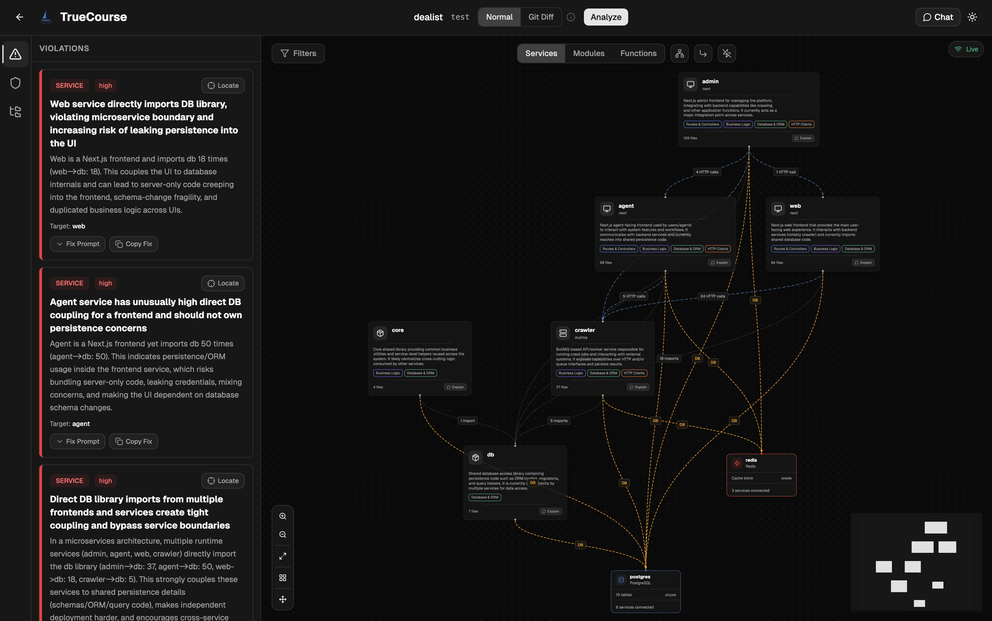
Architecture Graph
Visualize dependencies across services, modules, and methods
Interactive React Flow graph · Filter by services, modules, functions · Click to explore

Slide 7
Inline Code Review
Violations highlighted directly in your source code
[ Screenshot placeholder ]
Severity markers · Highlighted ranges · Fix suggestions · Deterministic + LLM rules

Slide 8
Flow Tracing
End-to-end request flows across service boundaries
[ Screenshot placeholder ]
HTTP calls · Route handlers · Method chains · Violation indicators along the path

Slide 9
Database Analysis
Auto-detected ER diagrams from ORM usage
[ Screenshot placeholder ]
Prisma, TypeORM, Drizzle, Knex · Tables, columns, relationships · Schema issue detection

Slide 10
Historical Analytics
Track architecture health over time
[ Screenshot placeholder ]
Violation trends · New vs resolved · Severity breakdown · Code hotspots

Slide 11
Git Diff Mode
See what your uncommitted changes break or fix
[ Screenshot placeholder ]
New violations · Resolved violations · Affected nodes highlighted in graph

Slide 12

Market
$10B
AI coding tools
market in 2026
Target Segment
Teams using AI code generation
$45B+
projected by 2030
~35% CAGR
Cursor: 1M+ daily active users
Claude Code: $2.5B ARR, doubled since Jan 2026
Codex: 2M+ weekly active users
Bottom-Up Revenue
500 teams × 5 devs × $30/mo = $900K ARR (Year 1–2)
5,000 teams × 8 devs × $35/mo avg = $16.8M ARR (Year 3)
Wedge
Open-source CLI
→ paid team/enterprise features

Slide 13
Open Core
FREE
Open Source
PRO
$30/dev/mo
Local analysis engine
Team dashboard & shared analysis
CLI for AI coding agents
PR gates (CI/CD integration)
Core architecture + code rules
Enterprise: $40/dev/mo
Single-user web UI
Self-hosted, custom rules, SLA support
Land with the free tool. Expand when teams adopt.

Slide 14
Competitive Landscape
ARCHITECTURE
vs SonarQube
TrueCourse
ArchUnit
Structurizr
No architectural analysis.
Cloud-only. Heavy setup.
vs CodeRabbit
PR-level only.
No structural analysis. No graph.
SonarQube
ESLint
CodeRabbit
Sourcery
vs Both
TrueCourse runs locally.
Code never leaves your machine.
CODE-LEVEL
Rule-based
AI-powered

Slide 15
FOUNDER
THE ASK
Mushegh
Gevorgyan
$150K–$250K
Pre-Seed
20+ years in engineering
Use of Funds
Built two companies
Community growth and adoption
Bootstrapped first to 6-figure revenue
Conferences, hackathons, sponsorships
Raised $600K+ for second company
Launch paid tier
Berkeley SkyDeck Europe Alumni
Working product · Open source · Published on npm

