Slide 1
VanGATE Website Analysis
Website Functionality Overview | 2026-06-11

Slide 2
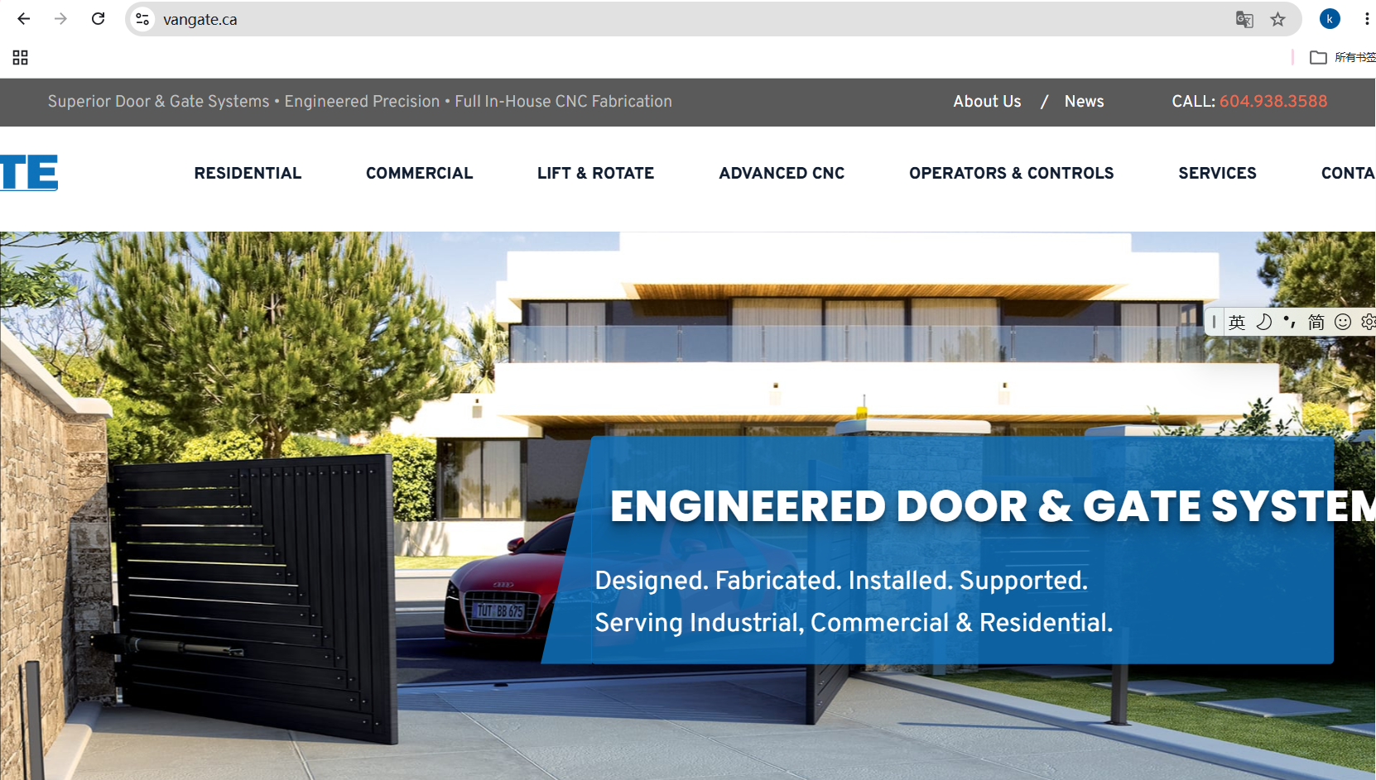

Slide 3
Website Overview
• Website URL: https://vangate.ca/
• Company: VanGATE Manufacturing & Automation
• Location: Richmond, BC, Canada
• Industry: Automatic Door & Gate Systems
• Current Platform: WordPress 6.9.4
• Business Focus: Residential & Commercial Solutions
•
• Website Purpose:
• Introduce company and products/services
• Showcase products, projects, and galleries
• Publish news and industry articles
• Display customer testimonials
• Receive customer inquiries via form and phone
• Support online marketing via SEO and analytics

Slide 4
User Roles
Role | Current Functions | Status
Website Visitor | Browse content, view products/services, gallery, news; submit inquiry, call | Confirmed
Content Editor | Manage pages, articles, images, menus, SEO info | Assumed
Administrator | Manage users, themes, plugins, forms, settings | Assumed

Slide 5
Part 1
Functionality Overview

Slide 6
Functionality Summary
Module | Main Features | Status
Navigation | Desktop top nav, mobile menu, logo, footer links | Confirmed
Homepage | Hero, products overview, gallery, testimonials, news, CTA | Confirmed
Company | Company introduction page | Confirmed
Products/Services | Category listing, product detail pages | Confirmed
Gallery | Project photos with lightbox | Confirmed
News/Articles | Article listing, detail pages, pagination | Confirmed
Contact | Contact form, phone, address, department info | Confirmed
CMS Backend | WordPress admin, content management | Assumed

Slide 7
Part 2
Detailed Functionality List

Slide 8
Navigation & Public Areas (WEB Series)
ID | Function | Status
WEB-001 | Desktop top navigation bar | Confirmed
WEB-002 | Mobile menu | Confirmed
WEB-003 | VanGATE logo with home link | Confirmed
WEB-004 | Navigation entries: Products, Services, Company, News, Gallery, Contact | Confirmed
WEB-005 | Clickable phone number | Confirmed
WEB-006 | Footer with services, products, company, address, phone | Confirmed
WEB-007 | Back to top button | Confirmed
WEB-008 | Responsive design (desktop, tablet, mobile) | Confirmed

Slide 9
Homepage (HOM Series)
ID | Function | Status
HOM-001 | Introduction to residential & commercial solutions | Confirmed
HOM-002 | Primary CTA: contact and call buttons | Confirmed
HOM-003 | Main products and services overview | Confirmed
HOM-004 | Project/gallery image showcase | Confirmed
HOM-005 | Gallery images can be enlarged | Confirmed
HOM-006 | Link to full gallery | Confirmed
HOM-007 | Customer testimonials section | Confirmed
HOM-008 | Recent news/articles | Confirmed
HOM-009 | Link to full news list | Confirmed
HOM-010 | Effects: carousel, lightbox, scroll animations | Confirmed

Slide 10
Products & Services Catalog (CAT Series)
ID | Function | Status
CAT-001 | Products and services organized by category | Confirmed
CAT-002 | Category listing pages | Confirmed
CAT-003 | Individual product/service detail pages | Confirmed
CAT-004 | Content includes: name, description, images | Confirmed
CAT-005 | Each product/service has unique URL | Confirmed
CAT-006 | Product pages include contact CTA | Confirmed
CAT-007 | Catalog covers both residential and commercial | Confirmed
CAT-008 | Backend category and content maintenance | Assumed

Slide 11
Gallery & News (GAL/NEW Series)
ID | Function | Status
GAL-001 | Project/product gallery | Confirmed
GAL-002 | Gallery displayed as image collection | Confirmed
GAL-003 | Gallery responsive on all screen sizes | Confirmed
GAL-004 | Images can be enlarged, browse prev/next | Confirmed
GAL-005 | Backend image upload and reuse | Assumed
NEW-001 | News or article listing | Confirmed
NEW-002 | List shows: title, date, summary, image | Confirmed
NEW-003 | Each article has dedicated detail page | Confirmed
NEW-004 | News list supports pagination | Confirmed
NEW-005 | Backend article CRUD operations | Assumed

Slide 12
Contact & Inquiries (CON Series)
ID | Function | Status
CON-001 | Contact page | Confirmed
CON-002 | Company address and phone display | Confirmed
CON-003 | Clickable phone number on mobile | Confirmed
CON-004 | Online inquiry form | Confirmed
CON-005 | Form validates required fields | Confirmed
CON-006 | Form submission triggers analytics event | Confirmed
CON-007 | Form submission sends email to recipients | Assumed
CON-008 | Form fields, recipients, spam protection details | To Confirm

Slide 13
SEO & Analytics (SEO Series)
ID | Function | Status
SEO-001 | Page supports independent SEO title and description | Confirmed
SEO-002 | Page outputs canonical URLs | Confirmed
SEO-003 | Page outputs Open Graph and Twitter card info | Confirmed
SEO-004 | Page outputs structured data (JSON-LD) | Confirmed
SEO-005 | Website provides XML sitemap | Assumed
SEO-006 | Google Analytics integration | Confirmed
SEO-007 | Google Tag Manager integration | Confirmed
SEO-008 | Contact form as analytics conversion event | Confirmed

Slide 14
Technical Environment
Component | Current Implementation | Status
Web Server | LiteSpeed | Confirmed
Server Language | PHP 7.4.33 | Confirmed
CMS | WordPress 6.9.4 | Confirmed
Theme | Custom 'vangate' theme | Confirmed
Page Editor | Elementor | Confirmed
Frontend | Bootstrap 4.5.3, jQuery, Custom CSS | Confirmed
Contact Form | Contact Form 7 | Confirmed
SEO Plugin | Yoast SEO | Confirmed
Security | Wordfence | Confirmed
Components | Swiper, Slick, PhotoSwipe, Lity, WOW.js, Font Awesome | Confirmed

Slide 15
Items to Confirm
• Which pages and homepage modules can clients edit?
• Products/services: custom post type or theme template?
• Does gallery and testimonials have independent admin entry?
• What fields does contact form include, who receives emails?
• Are contact form records saved to database?
• What admin users and roles exist?
• Are there unpublished pages still in use?
• Are article categories, tags, authors, comments used?
• Who manages analytics and search console accounts?
• Is there regular backup and security update schedule?

Slide 16
Part 3
New Website Design Styles

Slide 17
Three Design Styles Overview
Style | Positioning | Target Audience | Key Features
Modern Minimal 现代极简 | Clean & Professional 专业清新 | High-end homeowners Repair chains B2B clients | Light theme, ample whitespace Soft shadows, refined details Trust and professionalism
Industrial Professional 工业专业 | Heavy-Duty & Bold 稳重功能 | Commercial clients Repair technicians Fleet managers | Dark theme, industrial orange Bold typography Data-focused layout
Vibrant Contemporary 活力现代 | Bold & Dynamic 年轻动感 | Young car owners Auto enthusiasts E-commerce retail | Gradient colors, micro-animations Card-based layout Energetic and modern

Slide 18
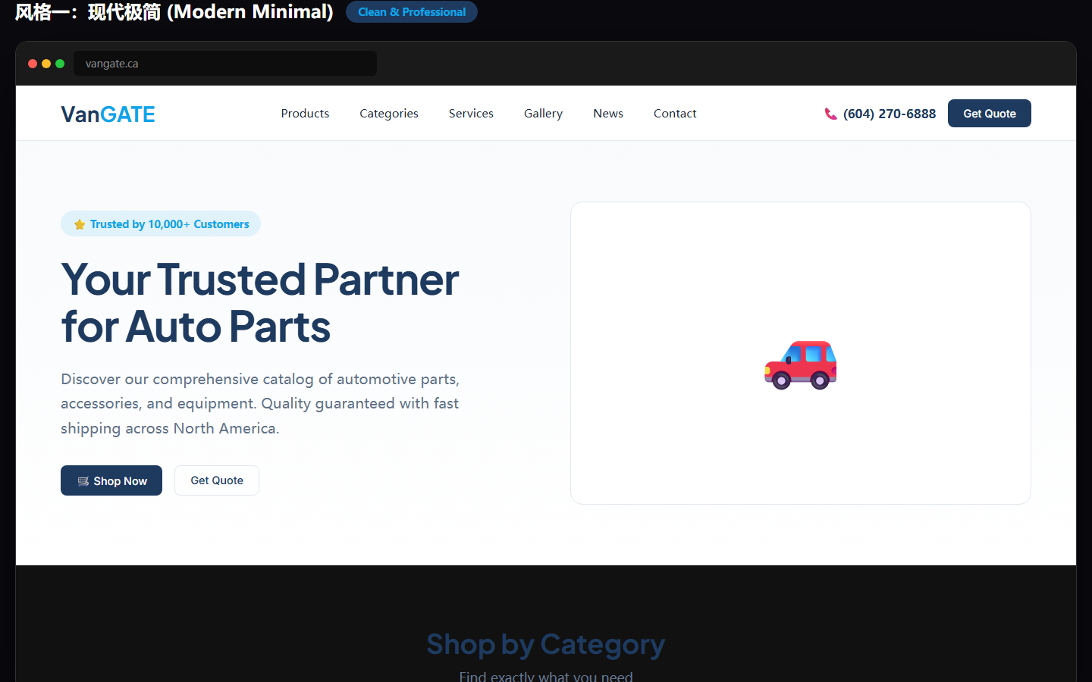

Slide 19
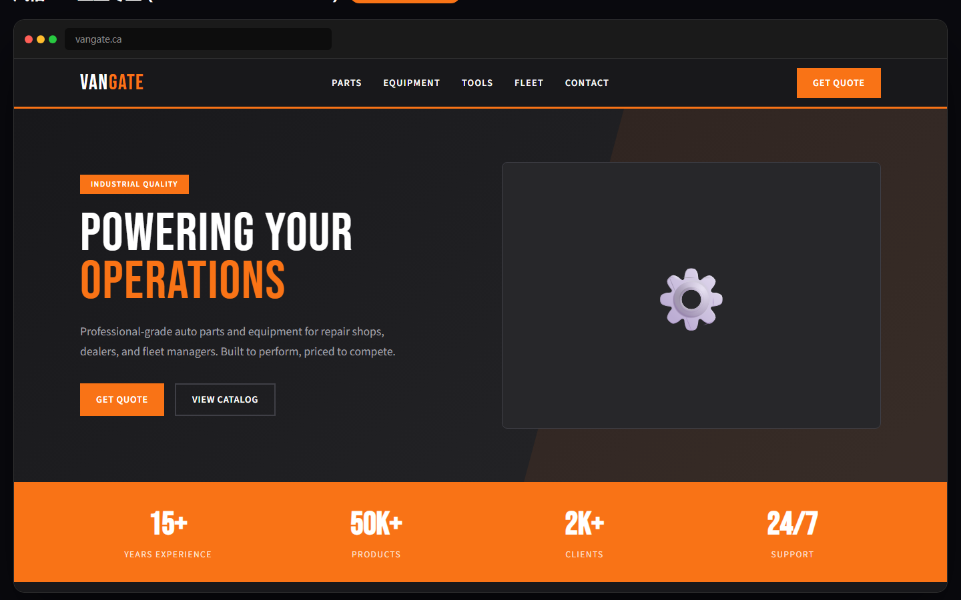

Slide 20
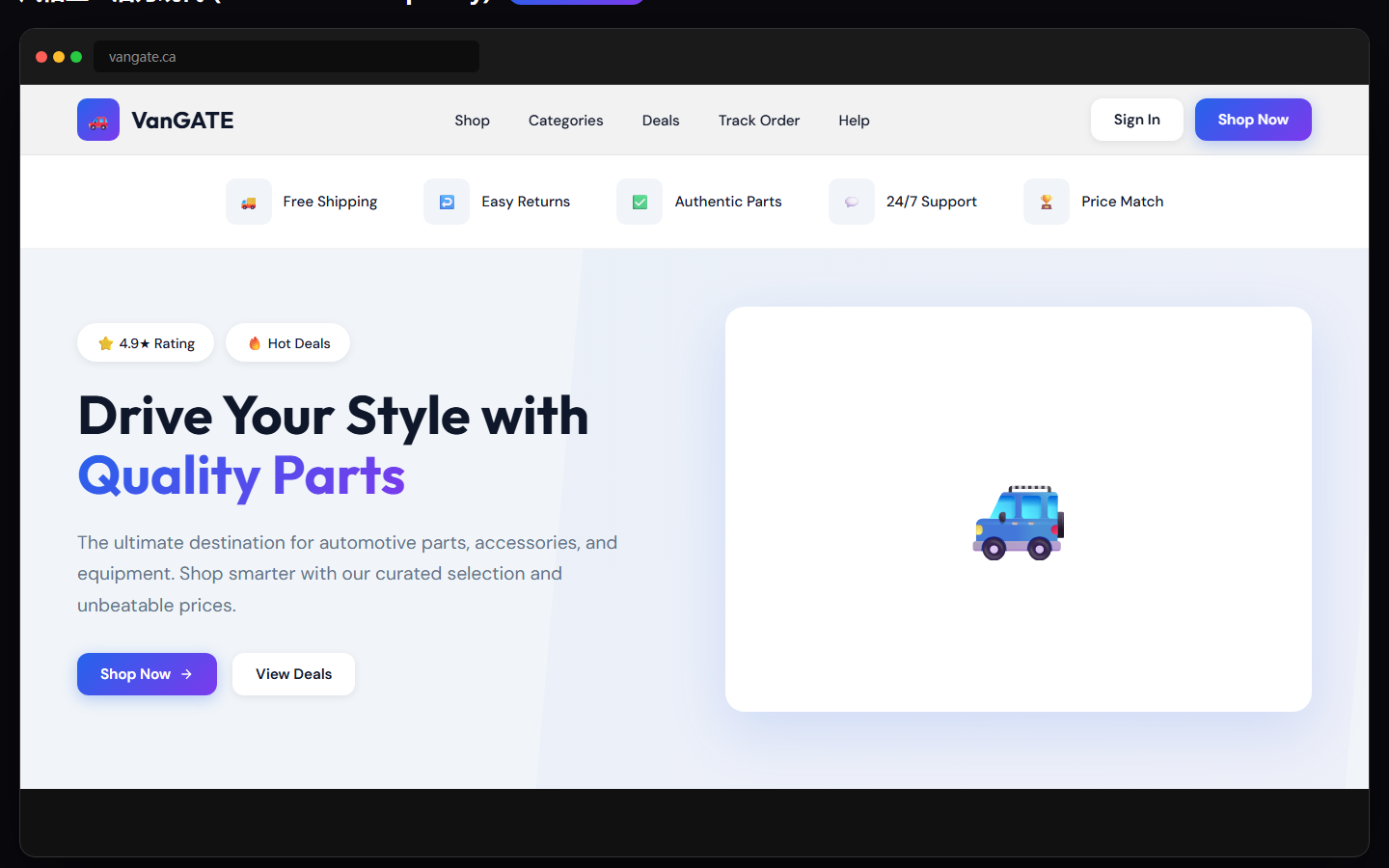

Slide 21
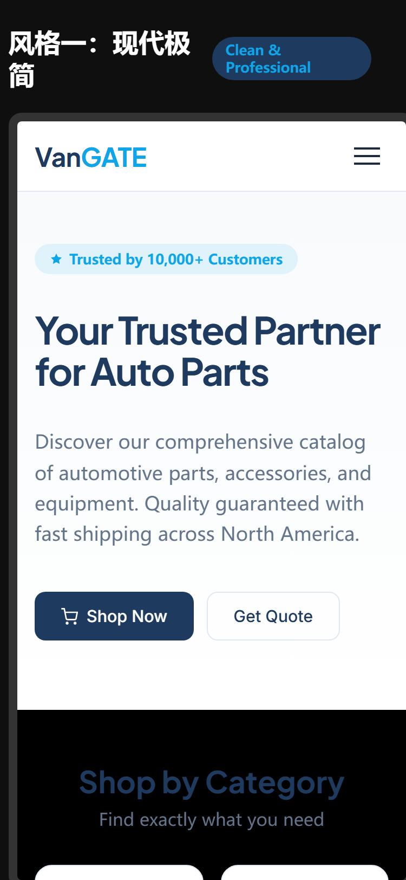
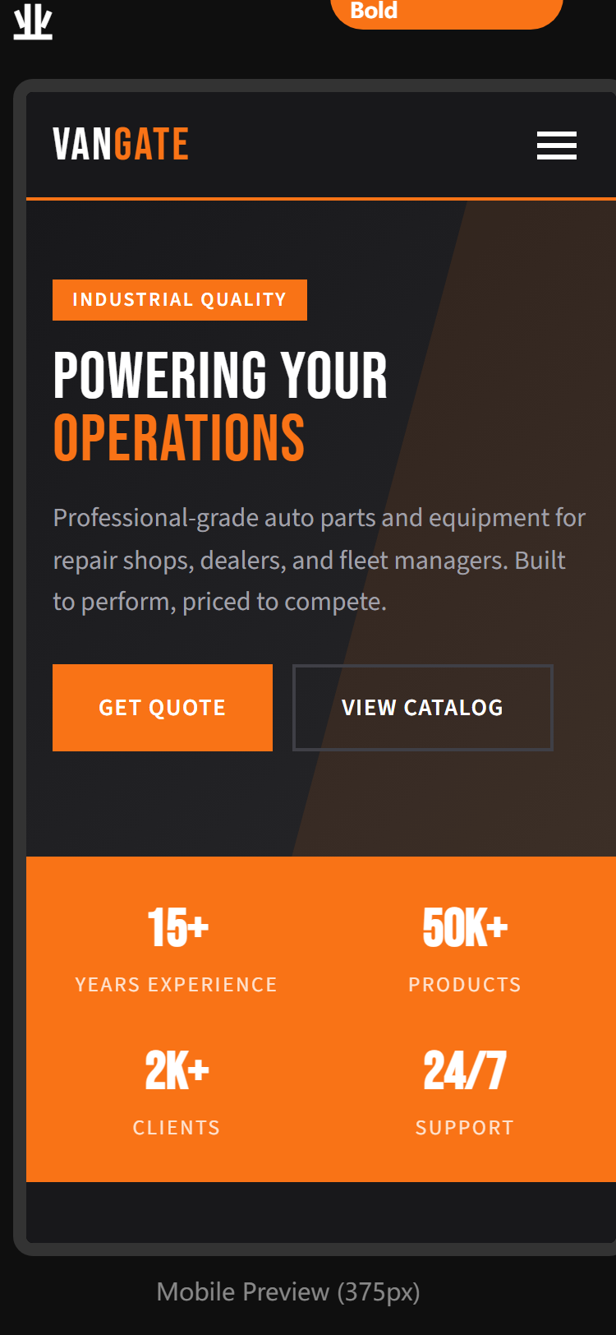
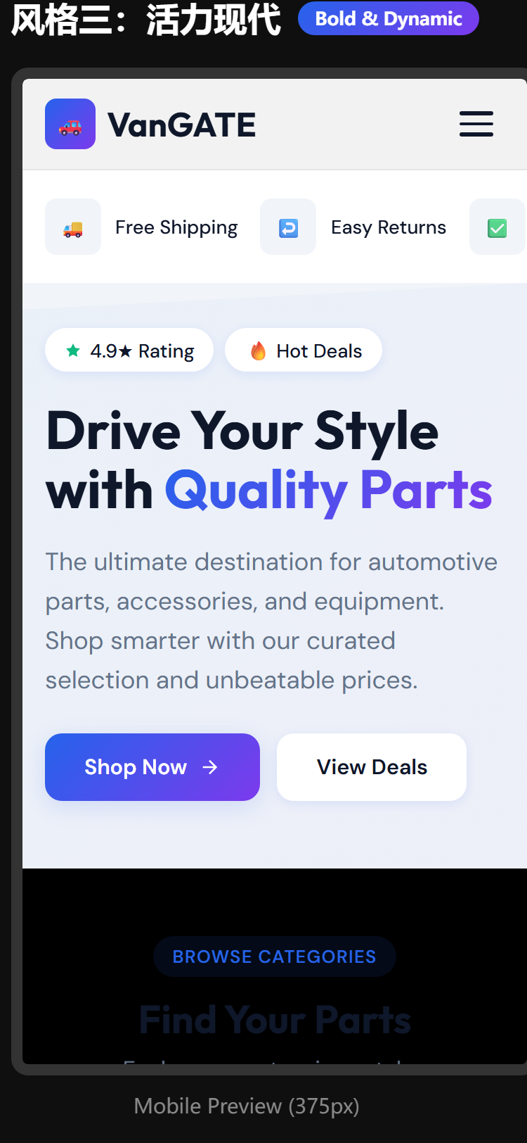

Slide 22
Analysis Complete
Questions & Discussion

