Slide 1
practical training – NCSA
Qatar university | CMPS399 by: Mohammad Ahmad | 202002453

Slide 2
AGENDA
Training Overview
Learning Objectives
Main Project – Cyberthon
Q/A

Slide 3
Training Overview

Slide 4
Training overview
Agenda for Training at NCSA (in collaboration with DCE)
  Soft/Power skills
  Technical concepts
  Technical skills
  Practical demonstration

Slide 5

Learning Objectives

Slide 6
Learning Objectives
Can be summarized into
  Getting familiar with the Linux environment
  Understanding the importance of key power/soft skills
  Grasping various cybersecurity fundamentals
  Practicing and demonstrating practical skills

Slide 7
Main Project – Cyberthon

Slide 8
Cyberthon
What it is
What was done
A project-based assessment where groups of trainees conduct vulnerability assessments:
  Host and Target systems provided
  Expectations outlined
  Results demonstrated
Conducted the requested vulnerability assessment:
  Reported findings according to standard
  Relevant Common Vulnerabilities and Exposures (CVEs) listed
  Mitigations suggested
  Presented the above to examiners

Slide 9
Cyberthon (cont.)
Main Project Phases
Technical Tools Used
Network Reconnaissance
Nessus Scanning
Testing Discovered Vulnerabilities
  nmap – network mapping
  Metasploit – vulnerability research framework
  Nessus – vulnerability scanner
  xtightvncviewer – remote desktop application
  Netcat – reading/writing in a network

Slide 10

Cyberthon (cont.)
Network Reconnaissance - Objectives
Scan network to discover target
Conduct a simple vulnerability scan on target
Tools Utilized
nmap

Slide 11
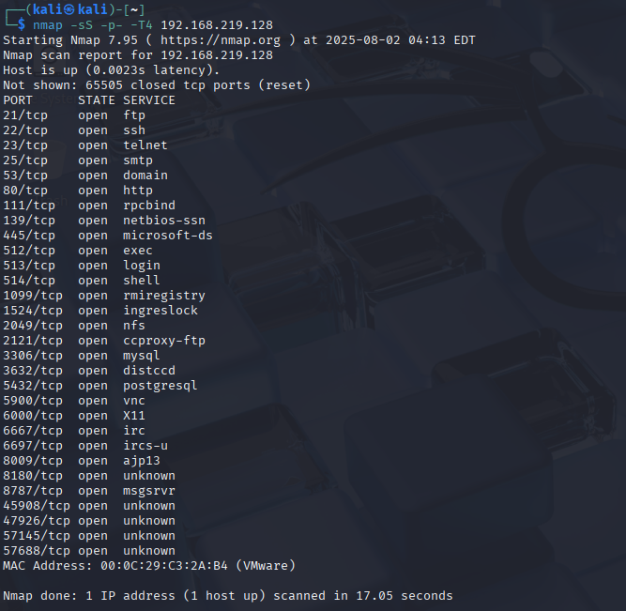
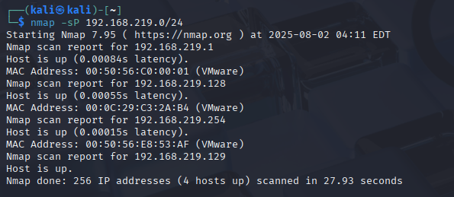
Figure 1 – nmap network scan
Figure 2 – nmap target full port scan

Slide 12
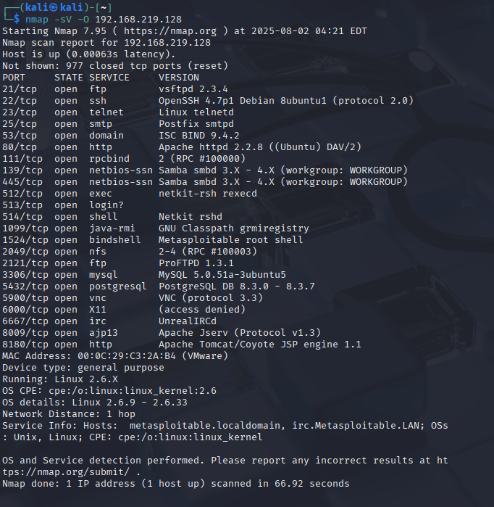
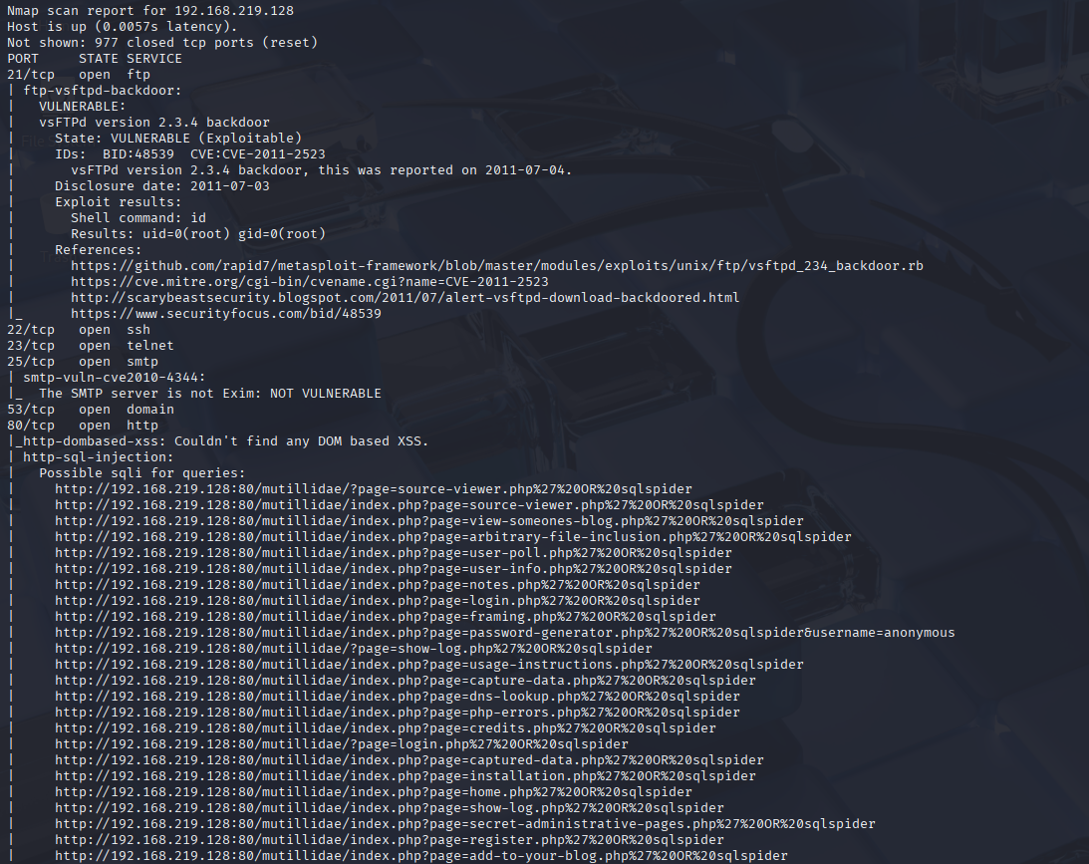
Figure 4 – nmap target vulnerability scan
Figure 3 – nmap target full service version scan

Slide 13
Cyberthon (cont.)
Nessus Scan - Objectives
Conduct a thorough vulnerability scan on target
Cross-check findings
Report detailed vulnerability findings
Tools Utilized
Nessus

Slide 14
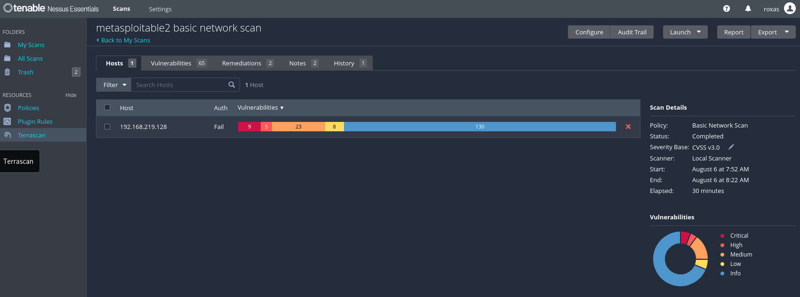
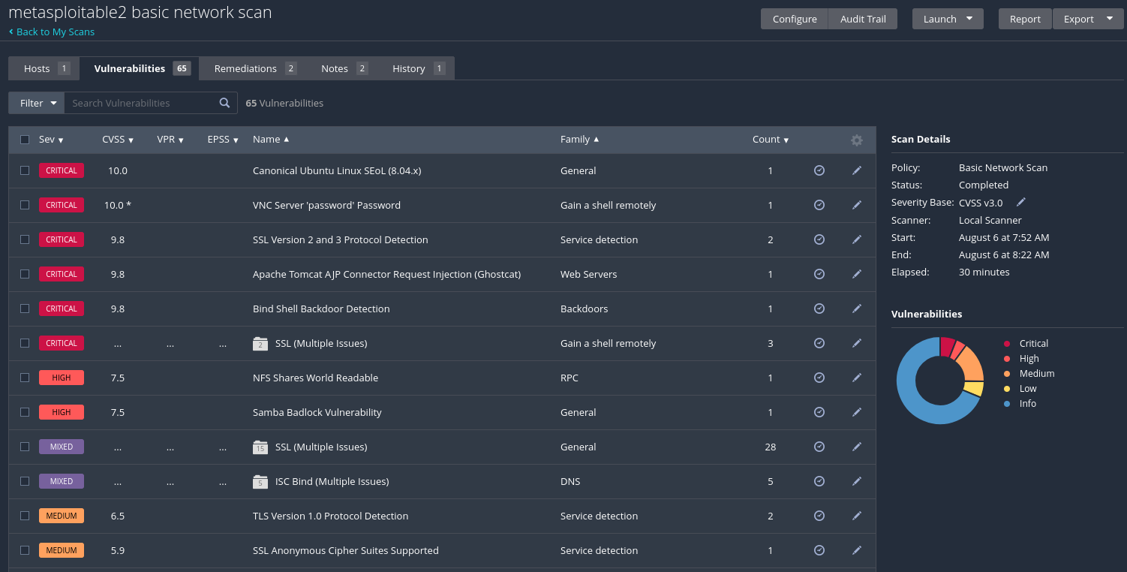
Figure 5 – Nessus scan summary
Figure 6 – Nessus scan details

Slide 15
Nessus Scan Findings
RISK LEVEL | # OF VULNERABILITIES | %AGE
Critical | 9 | 20
High | 5 | 11
Medium | 23 | 51
Low | 8 | 18
Total | 45
Findings can be summarized into the following

Slide 16
Cyberthon (cont.)
Testing Discovered Vulnerability - Objectives
Conduct tests to verify vulnerability presence
Tools Utilized
Metasploit, xtightvncviewer, netcat

Slide 17
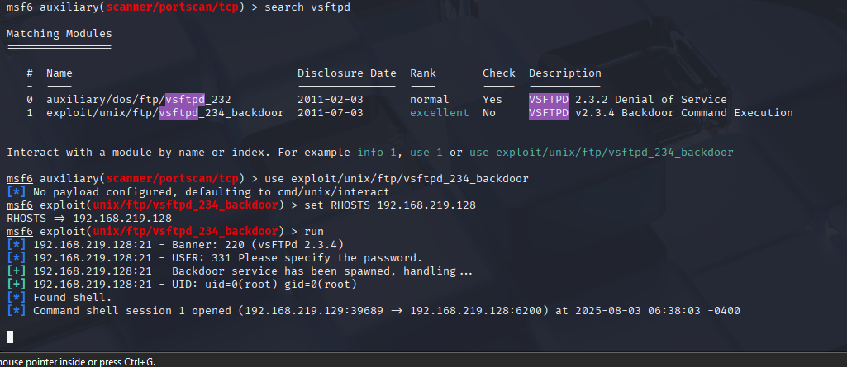
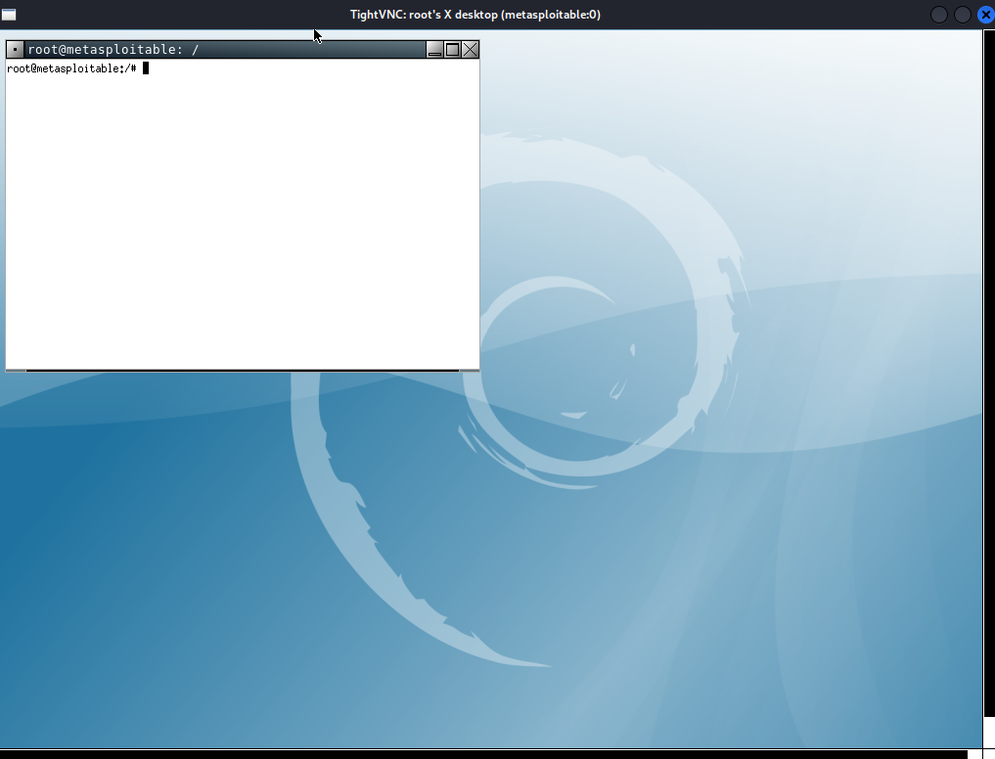
Figure 7 – vsFTPd backdoor
Figure 8 – Root compromised via VNC

Slide 18
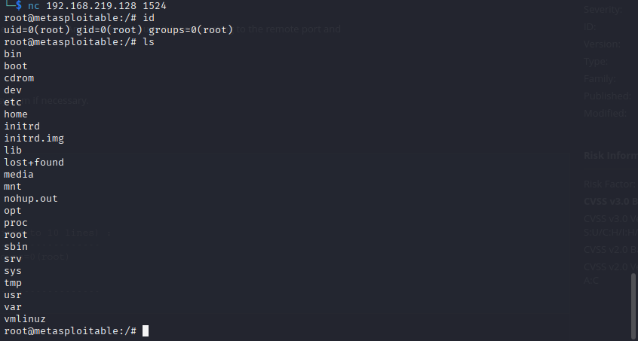
Figure 9 – Bind shell backdoor

Slide 19
Overall Scan Findings
VULNERABILITY | PORT/SERVICE | CVE | RISK LEVEL
vsFTPd Backdoor | 21/ftp | CVE-2011-2523 | Critical
Canonical Ubuntu Linux 8.04.x | 80/tcp/www | See details here | Critical
VNC Server ‘password’ Password | 5900/tcp/vnc | N/A | Critical
SSL Version 2 & 3 | 25/tcp/smtp 5432/tcp/postgresql | CVE-2014-3566 | Critical
Apache Tomcat AJP Connector Request Injection | 8009/tcp/ajp13 | CVE-2020-1745, CVE-2020-1938 | Critical
Bind Shell Backdoor | 1524/tcp/wild_shell | N/A | Critical
Debian OpenSSH/OpenSSL RNG Weakness | 5432/tcp/postgresql 25/tcp/smtp 22/tcp/ssh | CVE-2008-0166 | Critical
Samba Badlock Vulnerability | 445/tcp/cifs | CVE-2016-2118 | High
Details of ‘high+’ risk vulnerability findings

Slide 20
MITIGATIONS
VULNERABILITY | MITIGATION
vsFTPd Backdoor | Uninstall vsFTPd 2.3.4 and install secure version; add firewall rule to restrict port 21
Canonical Ubuntu Linux 8.04.x | Upgrade to a version of Canonical Ubuntu Linux that is currently supported with latest patches that offer greater security
VNC Server ‘password’ Password | Secure the VNC service with a strong password or disable the service if not needed
SSL Version 2 & 3 | Consult application documentation to disable SSL 2.0 and 3.0, use TLS 1.2 or higher instead
Apache Tomcat AJP Connector Request Injection | Update the AJP configuration to require authorization and/or upgrade the Tomcat server to 7.0.100, 8.5.51, 9.0.31 or later
Bind Shell Backdoor | Verify if host has been compromised and reinstall system if necessary; disable service if not in use, otherwise secure with strong password. Add firewall rule to restrict port 1524
Debian OpenSSH/OpenSSL RNG Weakness | All previously generated cryptographic material on remote host is guessable; all SSH, SSL and OpenVPN key material must be regenerated
Samba Badlock Vulnerability | Upgrade to Samba version 4.2.11 / 4.3.8 / 4.4.2 or later
Recommendations to harden system security

Slide 21
THANK YOU
Questions?

