Slide 1



Senior Design Project II
Group 20
ACADEGUIDE
By :
Mohammad Ahmad (202002453)
Omar Qutb (202106170)
Obada El-Refai (202110207)

Slide 2




Overview
  Detailed Design
  Demo
  Conclusion
  Problem Statement
  Proposed Solution
  Key Features
  System Arch

Slide 3


Problem
  High school graduates often don’t know which major to choose
  Decisions are influenced by external pressure (like parents or peers)
  Students feel overwhelmed with too many unclear options
A right decision today shapes a better tomorrow.

Slide 4

Motivation
  Many of us or people around us have faced the stress of picking the “right” major
  Students often feel uncertain, unsupported, and afraid of making the wrong choice
What if students had a tool that really understood them?
  We believe that choosing a major shouldn’t feel like a gamble
  Our goal is to make the journey smoother and more personalalized

Slide 5



Solution
is a comprehensive academic advising platform designed to address the challenges students face in selecting majors and universities.

Slide 6

Target Users & Stakeholders
Primary Users:
  High school graduates.
Stakeholders:
  Qatar University: hosting institution.
  Ministry of Education: Alignment with national education goals.

Slide 7
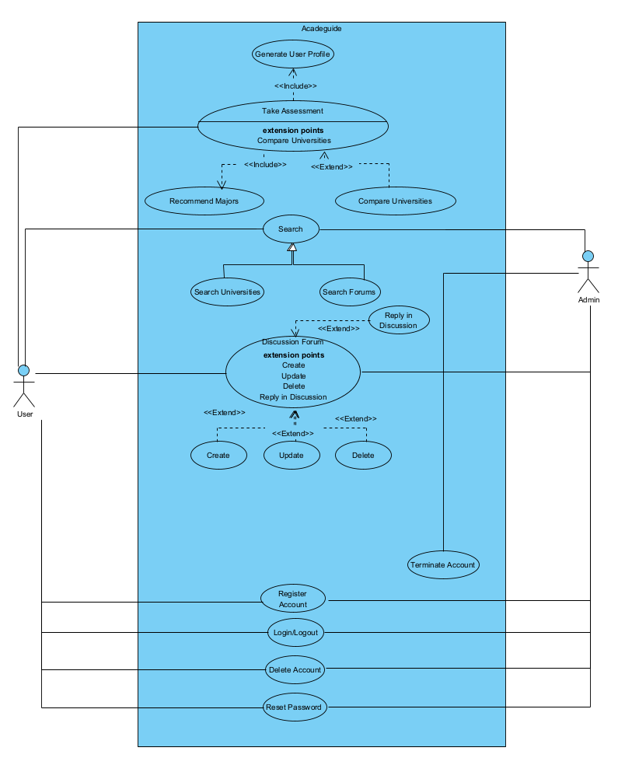
Key Features
Users can:
  Create profiles through assessments.
  Create interactive forums.
  Search universities/forums
  Get matched with optimal academic majors
  Advisor AI Chatbot

Slide 8
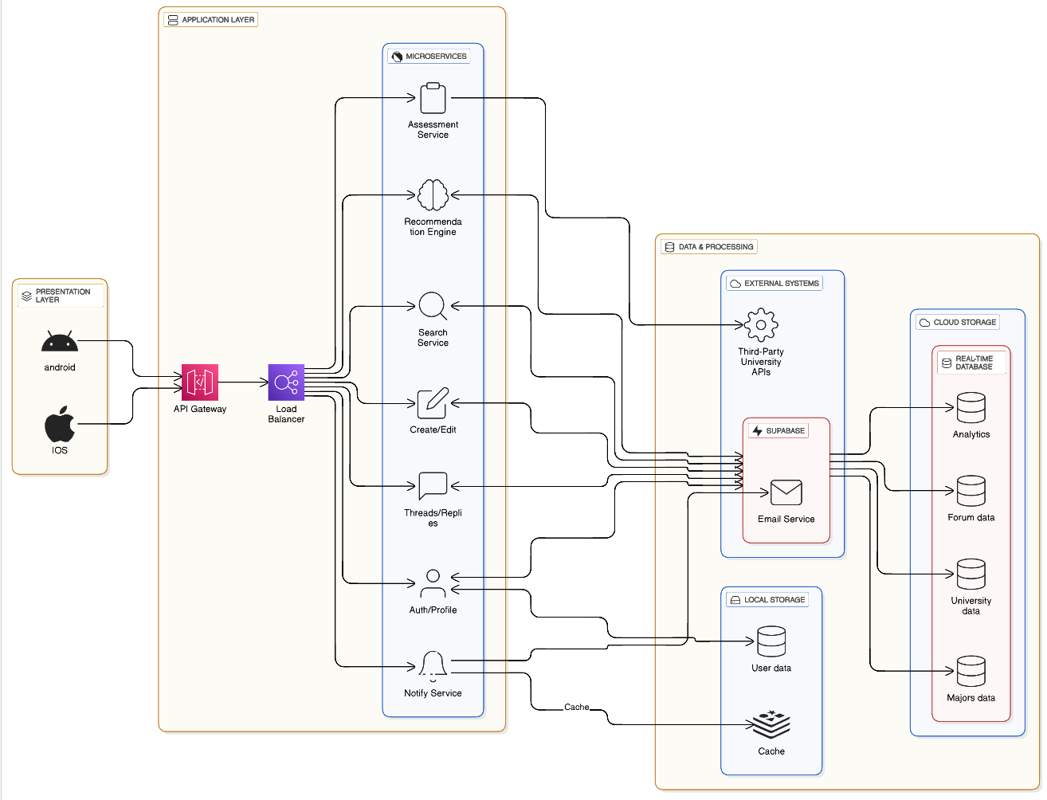
System Arch
Acadeguide’s architecture follows a three-tier model consisting of:
  presentation layer: the user-facing interface, built with Flutter handles all interactions.
  application layer: powered by Node.js and Supabase services, this layer manages core logic.
  data layer: combines Supabase PostgreSQL (cloud) for bulk data, with local storage for encrypted user profiles.

Slide 9




Technologies Used
  Frontend:
    is built with Flutter, ensuring responsive, cross-platform interfaces
  Backend:
    is powered by Node.js, Supabase (Cloud database) and Floor (Local database).
  Security:
    is prioritized through AES-256 encryption for locally stored user profiles and SSL/TLS protocols for cloud communications.

Slide 10
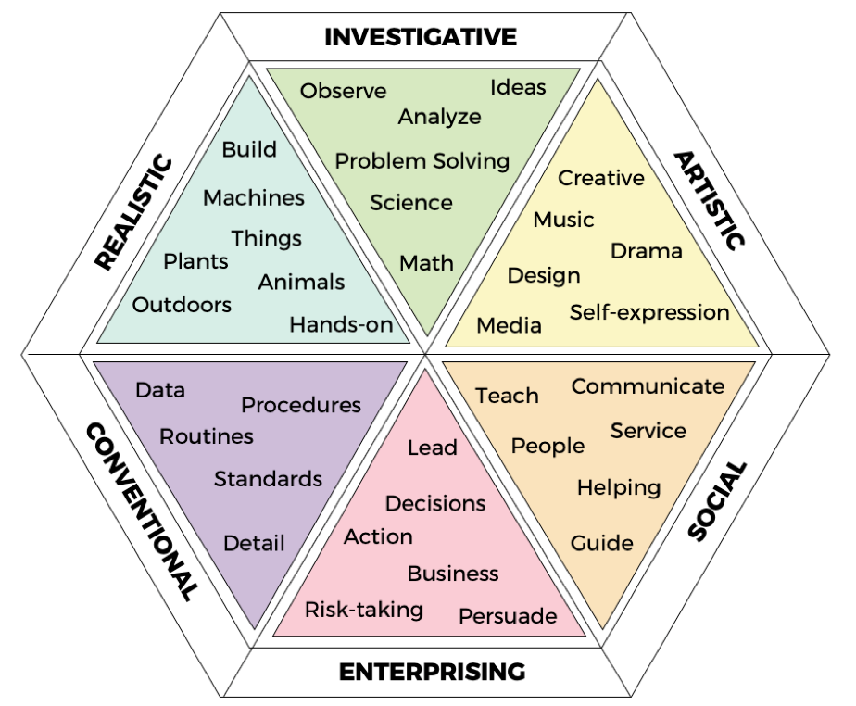
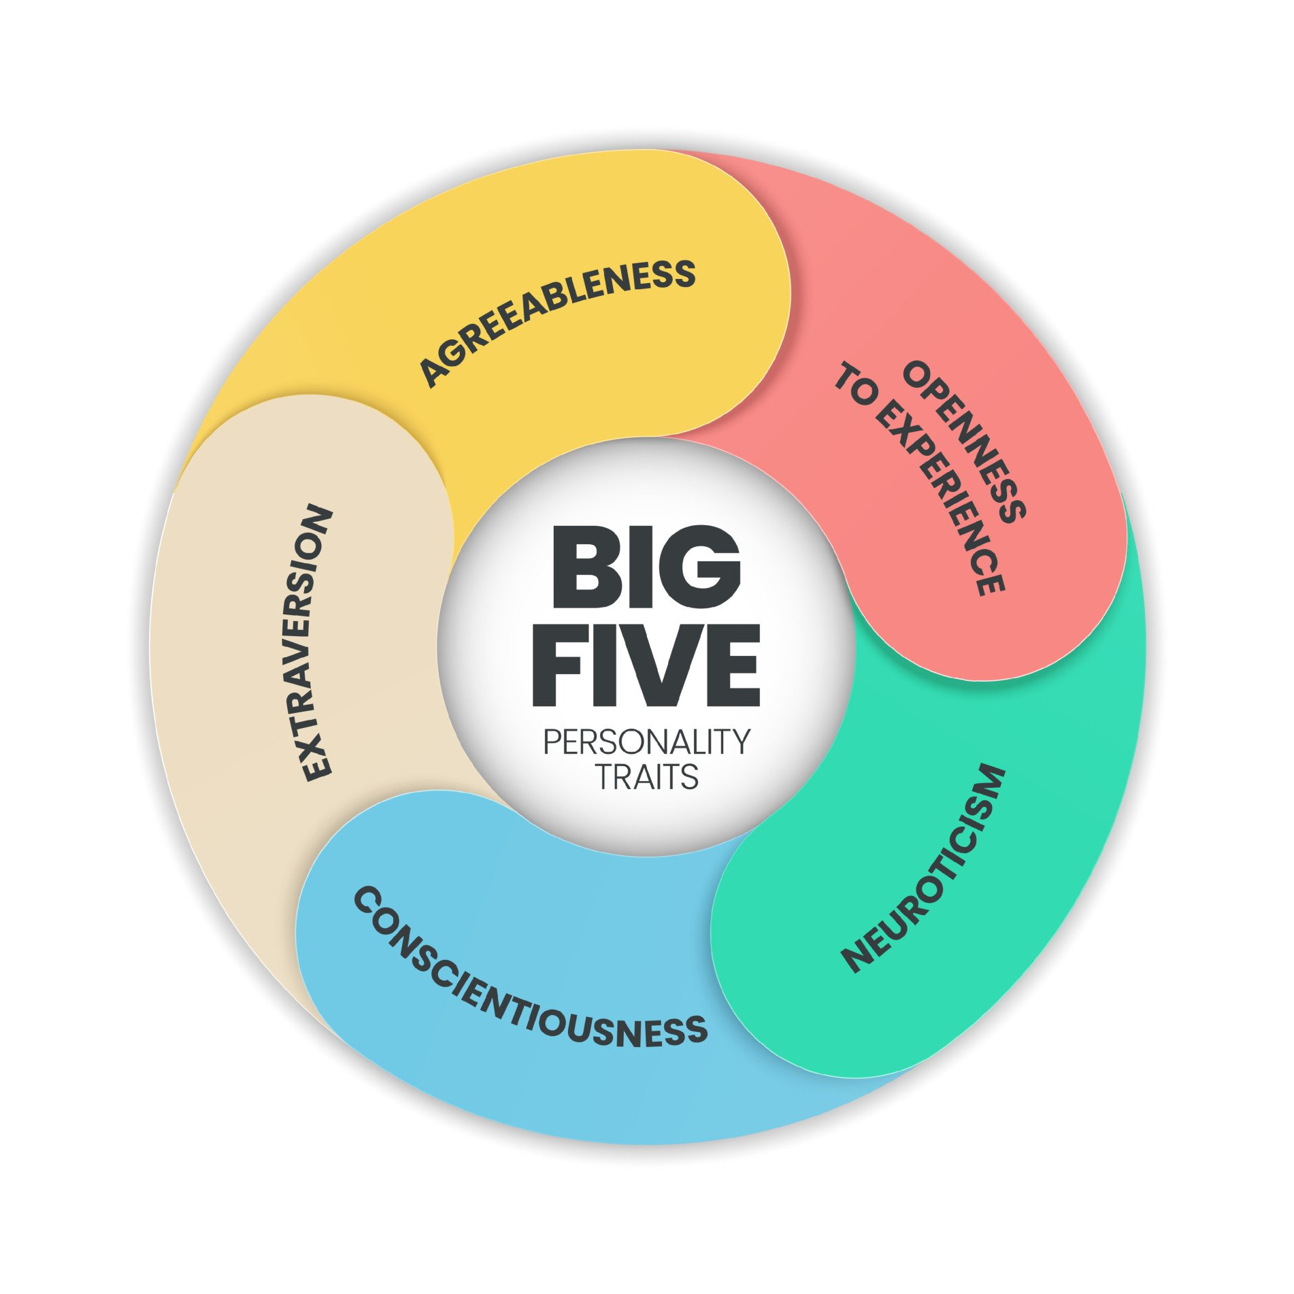
Recommendation Engine
  Phycological perspective
RIASEC MODEL
Big 5 personality traits

Slide 11
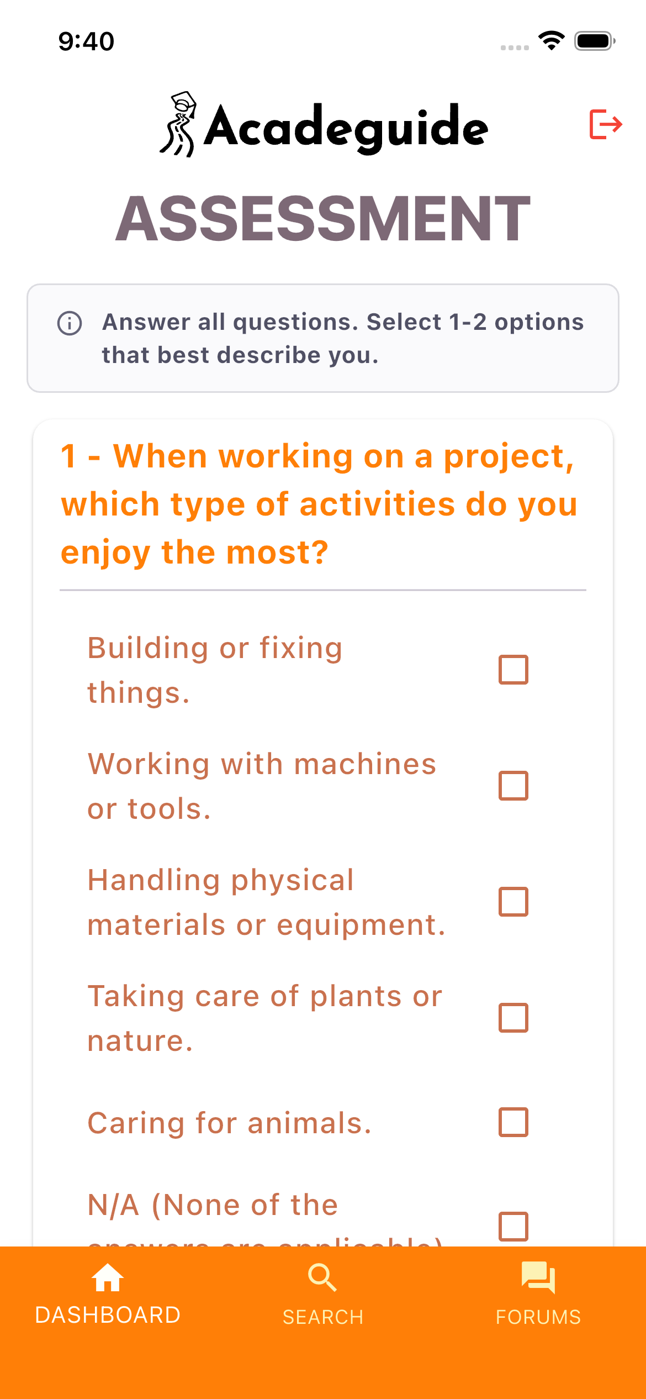

Recommendation Engine
  Engineering Perspective
Data Collection: A comprehensive questionnaire captures user interests and personality traits.
Qatar-Specific Database: All available majors in Qatar are mapped to relevant interest categories and traits.
Weighted Scoring: The algorithm awards 2 points per interest match and 1 point per trait match.
Statistical Ranking: We calculate the normal distribution to filter data and present the Top 3 majors.

Slide 12
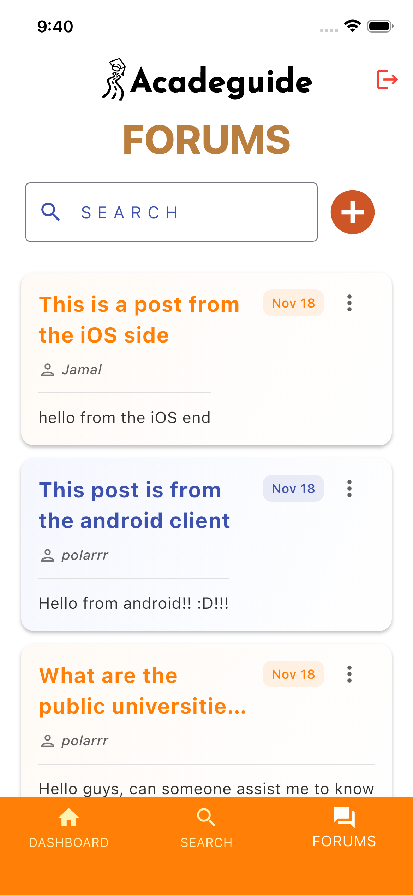
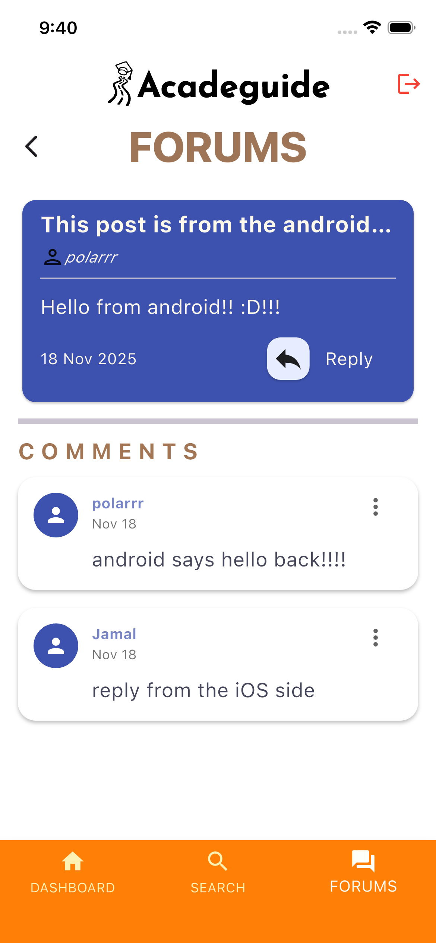
Discussion Forums
Enable collaborative knowledge sharing by allowing users to ask questions and receive insights from peers and field experts.
Promote peer-to-peer learning through the exchange of real experiences, practical solutions, and best practices.
Promoting a supportive community environment where discussions are archived for ongoing learning and future reference.

Slide 13
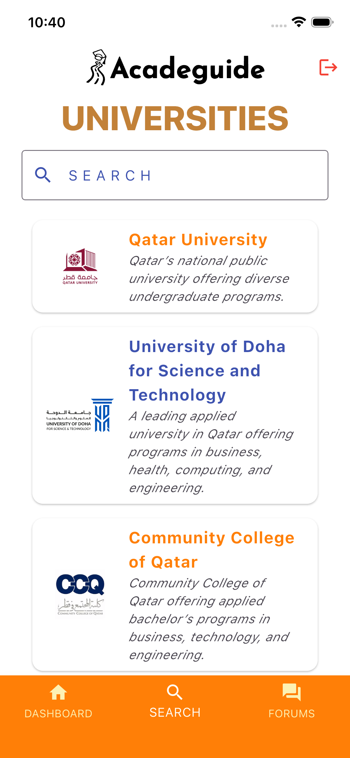

University Catalog
Provides access to a wide range of universities for students to explore.
Offers detailed program information, including majors and admission details.
Includes essential facts such as tuition fees and official university websites for easier comparison.

Slide 14


Slide 15
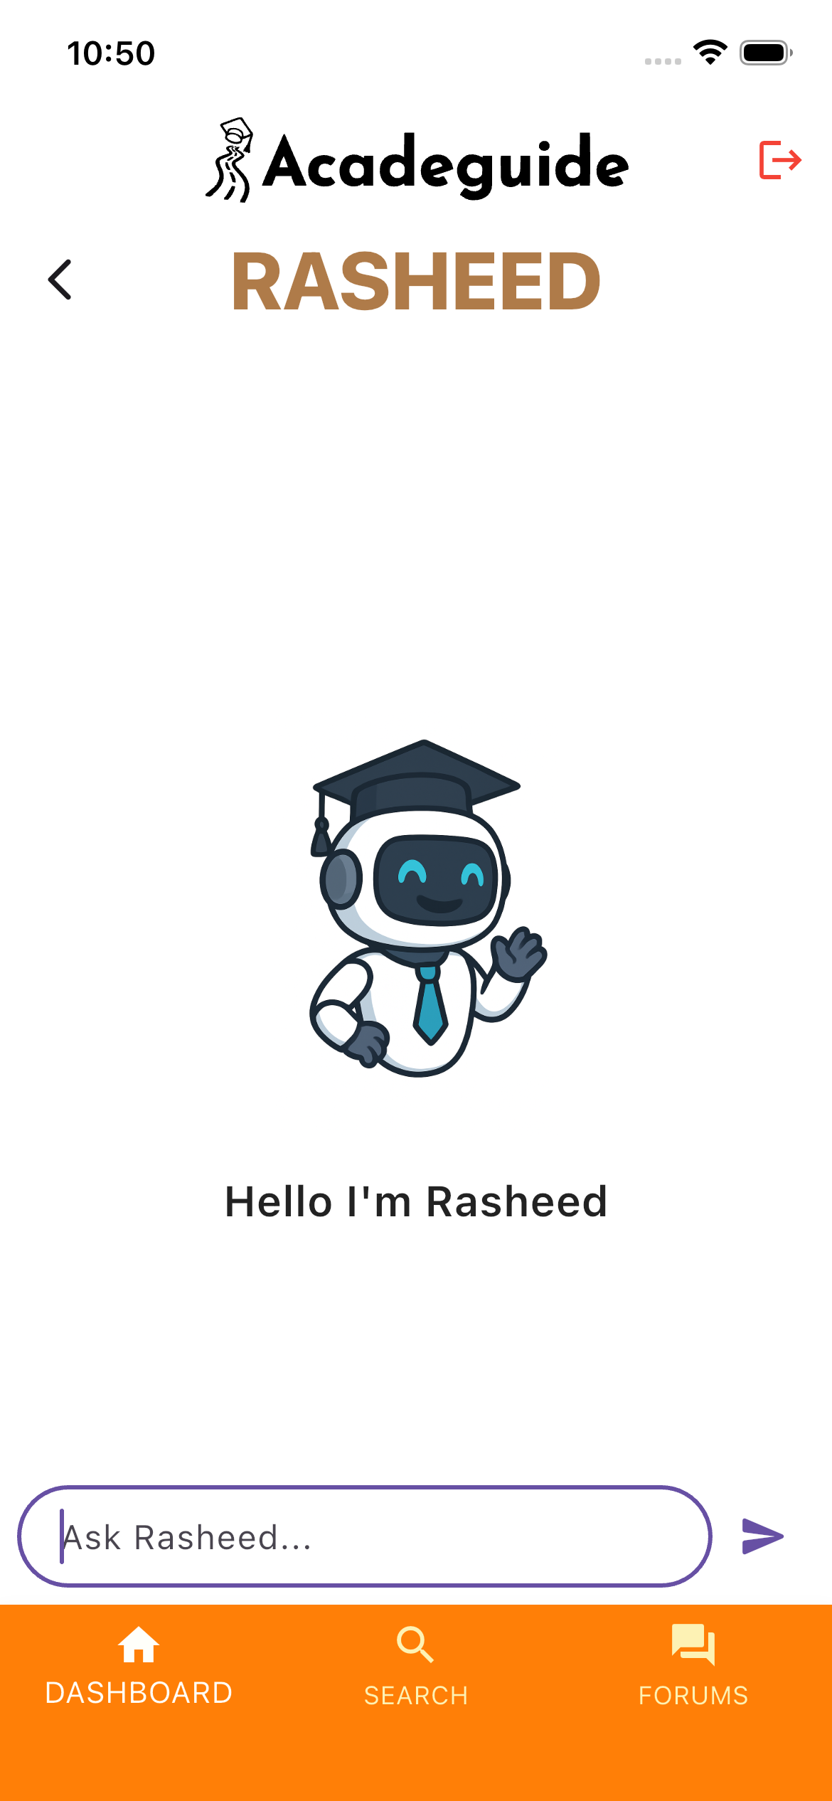
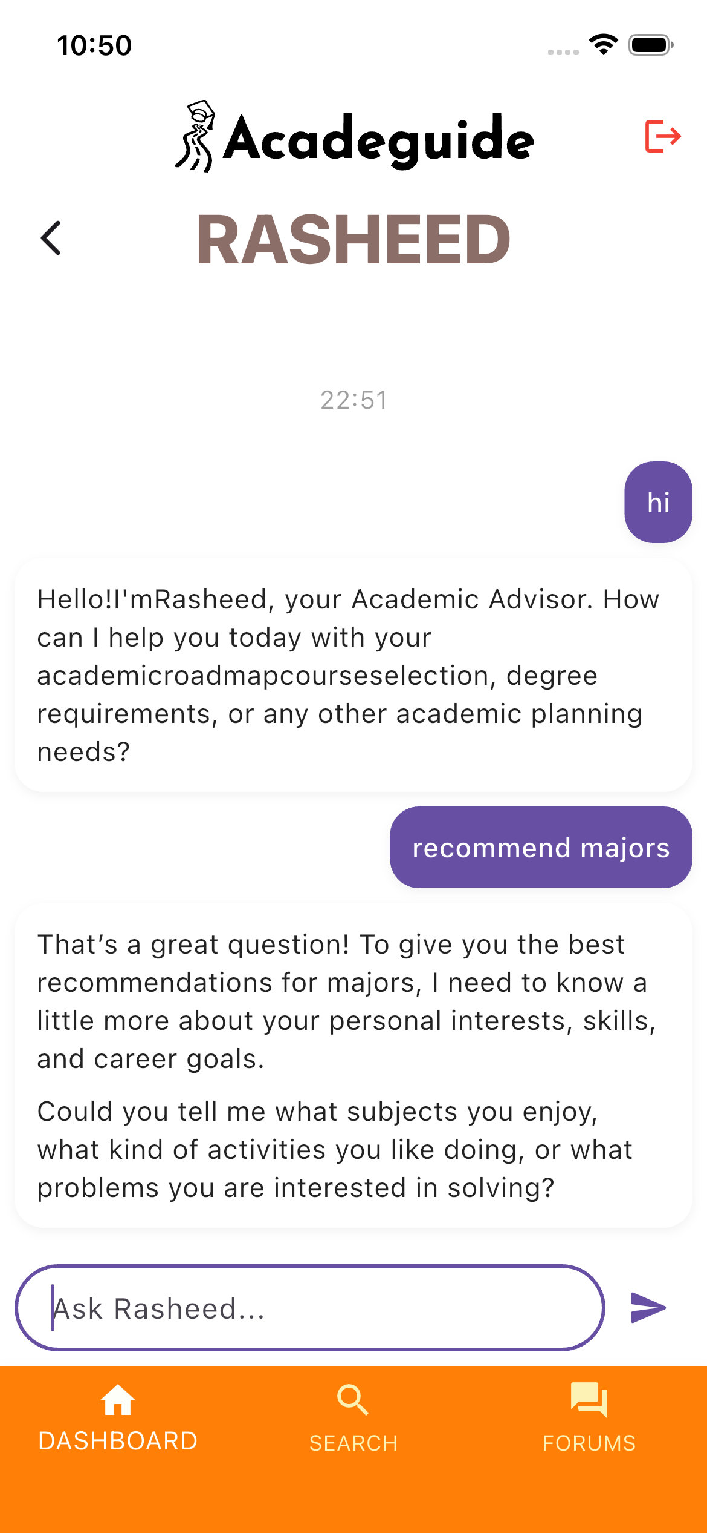
Rasheed
(Chatbot advisor)
Personalized Major Recommendations: Analyses user interests through a test or interactive questions to suggest suitable academic paths.
Guidance & Support: Provides roadmaps, study tips, and additional advice to help users plan their education effectively.
Interactive Assistance: Offers ongoing support to students, making academic planning more accessible and tailored to individual needs.

Slide 16

Demo

Slide 17

Ethical Consideration
Privacy Protection
  Only the user’s necessary data is being collected.
  Data is securely stored and not shared with third parties.
Accessibility
  The app provides the ease of use to all users accessing the features is not a challenge to most users.
User Safety
  Features designed to prevent misuse or harm.
Responsible Use of AI
All AI responses are within the academic advising scope and the user is not allowed to ask anything beyond that scope.

Slide 18

Future Work
Adaptive, Multistage Assessments
  Dynamic questionnaires that adjust based on previous answers.
  Provides more personalized and accurate recommendations.
Planning Tool & Career Roadmap
  Visualize academic journey & plan semesters.
  Align education with potential career paths using labor market data.
  Long-term guidance, not just one-time recommendations.
Required Resources & Collaboration
  Larger datasets & cloud infrastructure for scalability.
  Partnerships with universities, education departments, and career centers.

Slide 19

Challenges
  Authentication-Driven Routing:
    Implementing seamless navigation between the login screen and dashboard
  Secure Password Reset:
    initially relied on email links which demanded deployment.
  Finding the best approach to deliver our test.
  Dealing with manual data gathering.

Slide 20

Conclusion
Acadeguide empowers students to make confident academic decisions by giving them the essential information they need. It ensures a smoother, less stressful journey through higher education, helping students move forward with clarity and confidence.

Slide 21

Thank You

