Slide 1




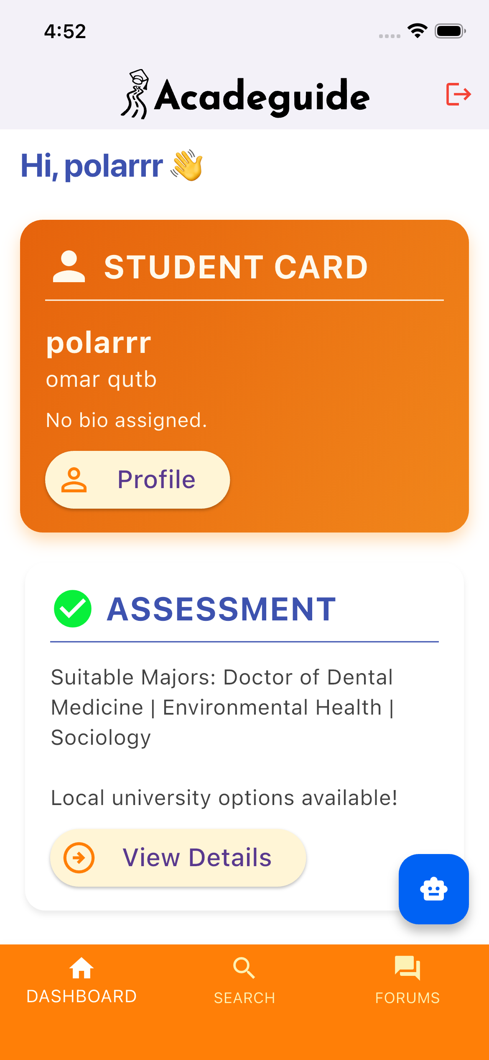
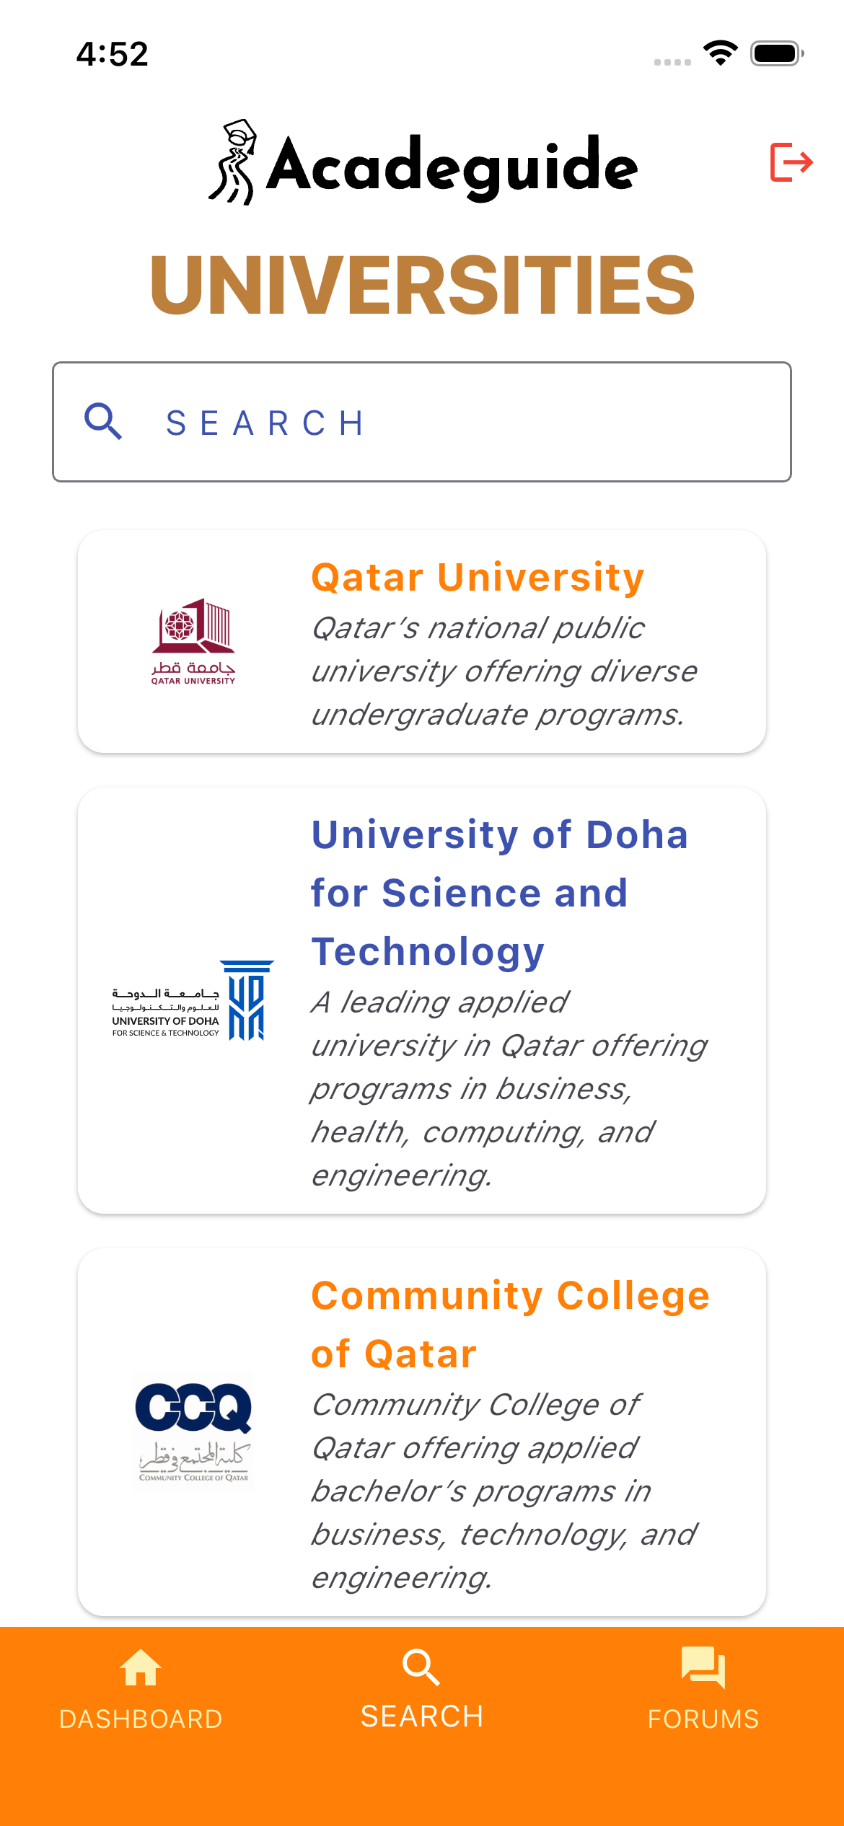
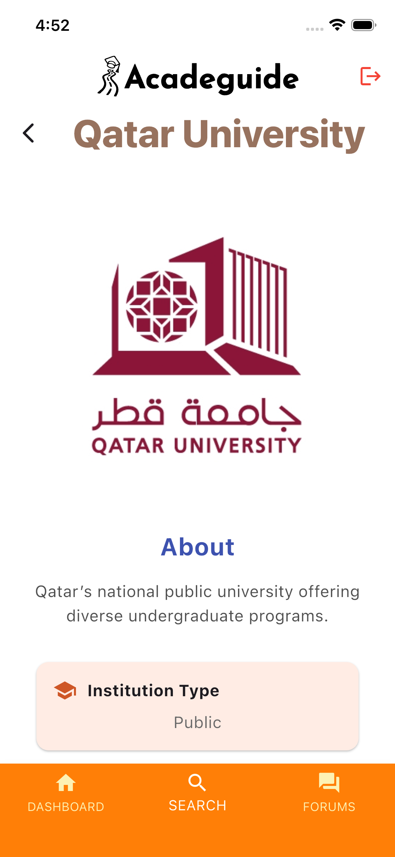
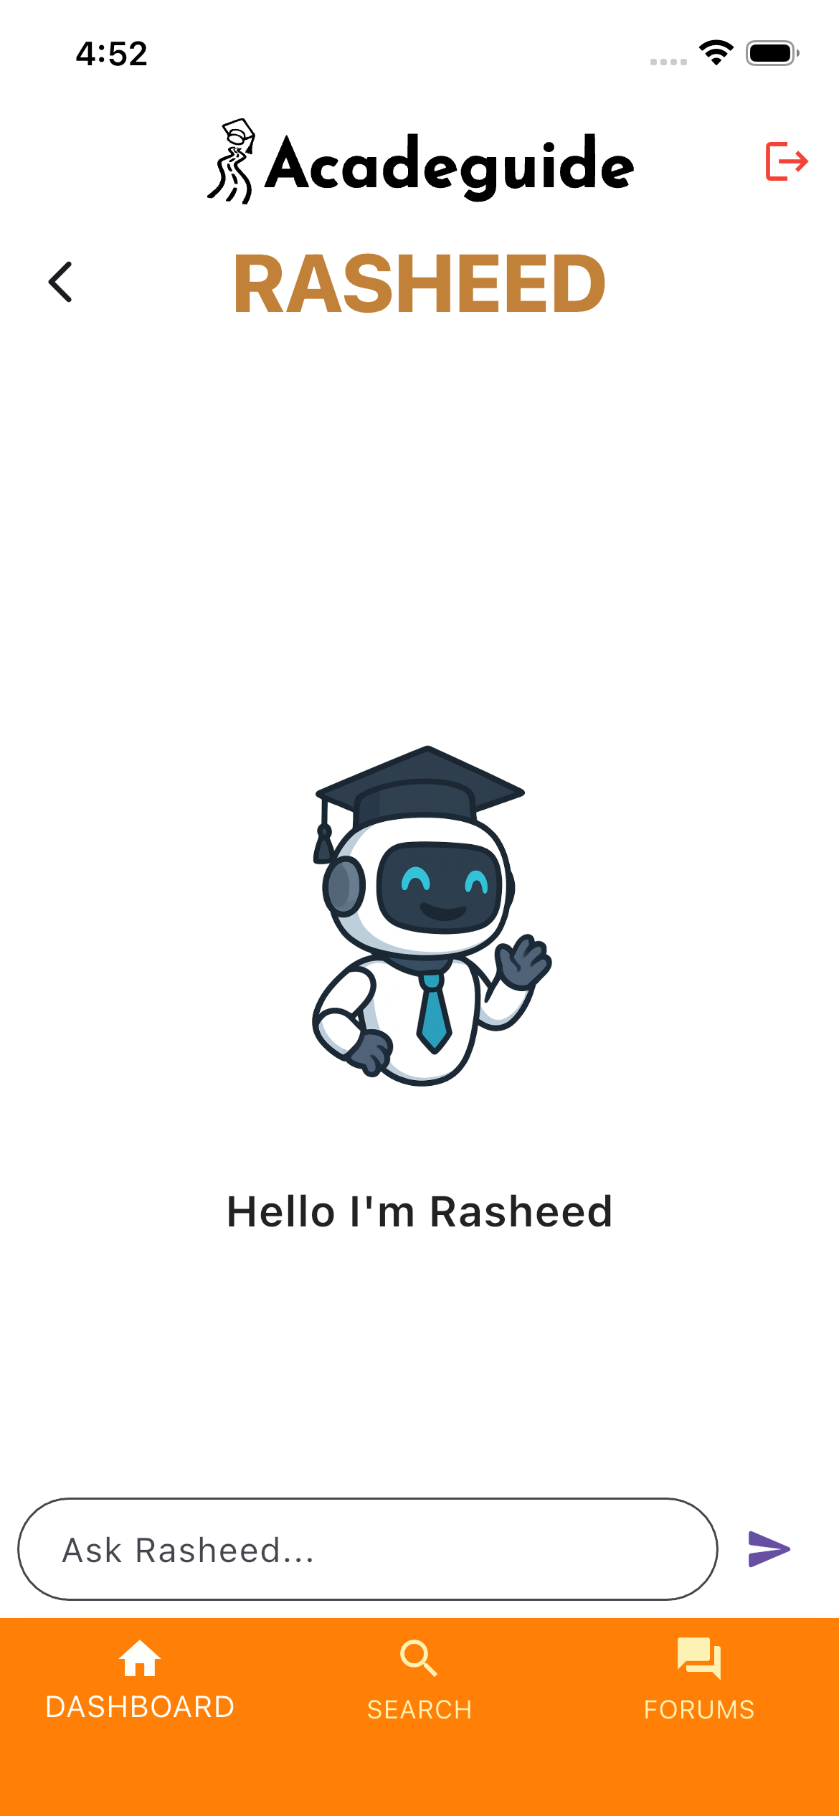
G20
Computer Science and Engineering Department
Qatar University
2025 – 2026
Delivered by
Mohammad Ahmad (202002453)
Omar Qutb (202106170)
Obada Alrefai (202110207)
Under the supervision of
Prof. Rehab Duwairi
Your Personal Academic Guide
Helping students choose the right major
ABSTRACT
Many students struggle to choose the right major because of limited guidance and unclear interests. Our mobile app helps solve this by asking personalized questions to understand each student’s strengths and preferences. It then recommends suitable majors and provides a 24/7 AI chatbot for academic support. By centralizing important university information and offering smart, tailored guidance, the app helps students make confident and informed decisions about their future.
MOTIVATION
SOLUTION
Many students struggle with the pressure of choosing the “right” major and often feel uncertain, unsupported, or afraid of making the wrong decision. With limited guidance available, this process can feel overwhelming and risky. Our motivation is to create a tool that truly understands students, helping them explore their strengths and interests with confidence. We believe that choosing a major shouldn’t feel like a gamble our goal is to make the journey clearer, smoother, and genuinely personalized.
Acadeguide is an intelligent guidance platform designed to help high-school students confidently choose their ideal major and discover universities that match their goals, strengths, and interests. Built with recommendation algorithms and an intuitive user experience, Acadeguide transforms the overwhelming process of career and major selection into a clear, personalized journey.
KEY FEATURES
Major Recommendation Test
University Explorer
Collaborative Discussion Forums
Rasheed (Academic Advisor)
Personalized Profile
Meet Rasheed !
Your Academic Advisor
KEY FEATURES

