Slide 1
iQVR - CMPS 310 Software Engineering Lab Project
Team Hydrogen

Slide 2
Introduction
Project Name: iQVR Vehicle Services Platform
Course: CMPS 310 Software Engineering Lab
Instructor: Georges Younes
Team Members:
  Mahmoud Al-Qudeimat - 202204636
  Mohammad Ahmad - 202002453
  Obada Alrefai - 202110207
  Yahya Taha - 202103476

Slide 3
Project Overview
An online platform offering:
  Vehicle registration renewal
  Ownership transfer
  Insurance policy management
  Fitness certificate management
  Accident reporting
  Penalty handling
Focused on providing a secure, efficient system for vehicle-related services.

Slide 4
Design Decisions
Architecture:
Implemented a structured class design as per the class diagram.
  Used ECB (Entity-Control-Boundary) for designing sequence diagrams.
Key Consideration:
Data confidentiality by isolating core vehicle and ownership data from general user access.

Slide 5
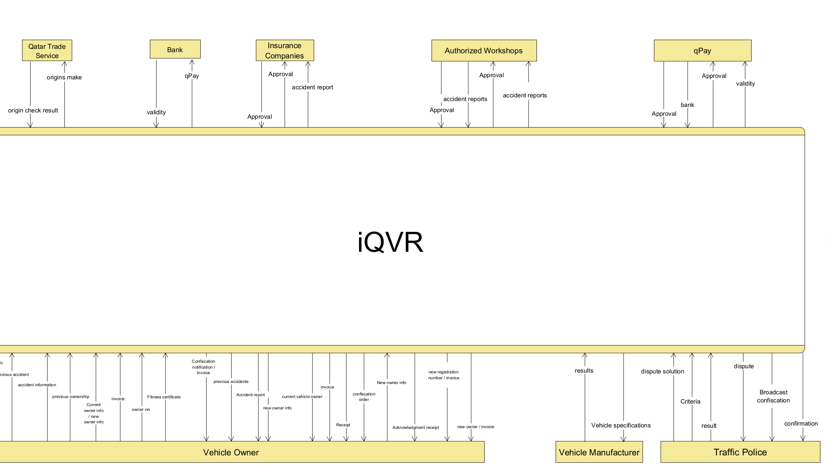
Diagrams
DFD Level 0

Slide 6
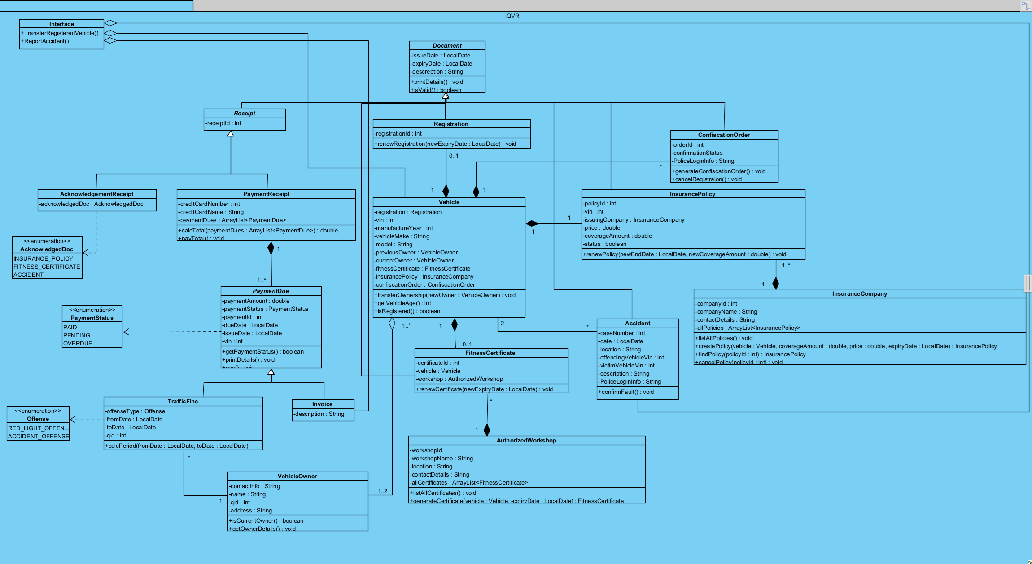
Class Diagram

Slide 7
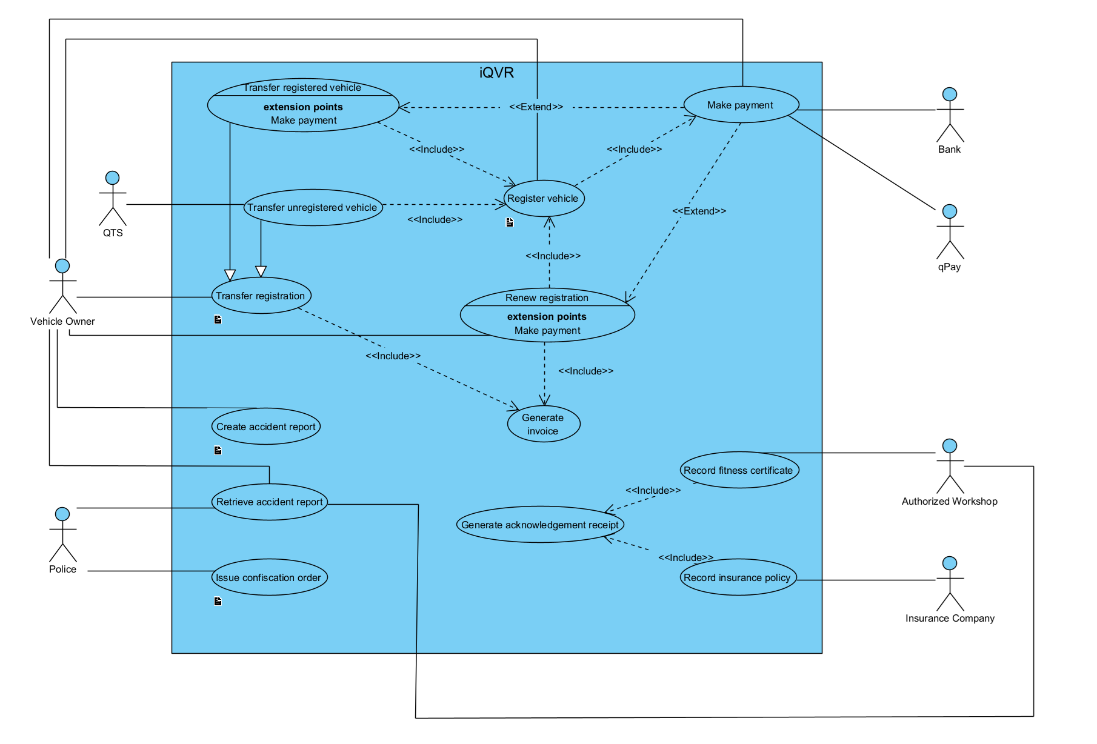
Use Case Diagram

Slide 8
Technology Stack
Programming Language: Java
UI Framework: JavaFX
Documentation Tools: Markdown, Obsidian
Diagram Modeling: Visual Paradigm, draw.io, GanttProject
Presentation Generation: Markdown and Pandoc

Slide 9
Core Functionalities
Finance Section: Handles payments.
Penalty Section: Manages fines and offenses.
Registration Section: Processes renewals and ownership transfers.
Accident Section: Handles accident-related matters.
Technical Section: Manages vehicle fitness certificates.

Slide 10
Code Structure
Main Classes:
  Accident.java
  InsurancePolicy.java
  Vehicle.java
  Registration.java
  TrafficFine.java
  Invoice.java
  FitnessCertificate.java
  And others…
Organized Modules: Each class corresponds to specific system functions, ensuring modularity and maintainability.

Slide 11
Data Management
Data flow illustrated in:
  Class Diagram: Defines the relationships and structure.
  Sequence Diagram: Demonstrates the registration renewal and confiscation order processes.
  DFD (Level 1): Shows data interactions across modules.
Secure handling of vehicle and ownership data through access control.

Slide 12
Technical Achievements
Successfully implemented a comprehensive class and sequence diagram that ensured clear system interactions.
Ensured secure handling of vehicle and ownership data by implementing access control mechanisms.

Slide 13
Challenges Faced
Module Integration:
Integrating various modules like finance, penalty, and accident management was complex and required regular reviews.
Scheduling Conflicts:
Managing time and coordinating efforts across team members with different schedules.

Slide 14
Lessons Learned
Effective Communication:
Clear communication among team members was crucial.
Early Planning:
Early and detailed planning helped avoid last-minute challenges.
Documentation:
Maintaining thorough documentation ensured smooth progress.
Time Management:
Learned to balance time effectively for different project phases.
Utilizing Tools:
Leveraged tools like Visual Paradigm and GanttProject to streamline development.

Slide 15
Future Improvements
Enhanced User Authentication:
Implement multi-factor authentication for better security.
Mobile App Development:
Develop a mobile version to increase accessibility.
Reporting Dashboard:
Introduce analytics and reporting features for vehicle management insights.

Slide 16
Conclusion
Project Impact:
Developed a comprehensive platform for vehicle services, ensuring efficiency and security.
Future Prospects:
Expand functionality and enhance user experience based on feedback and further development.

Slide 17
Thank you!

