Slide 1
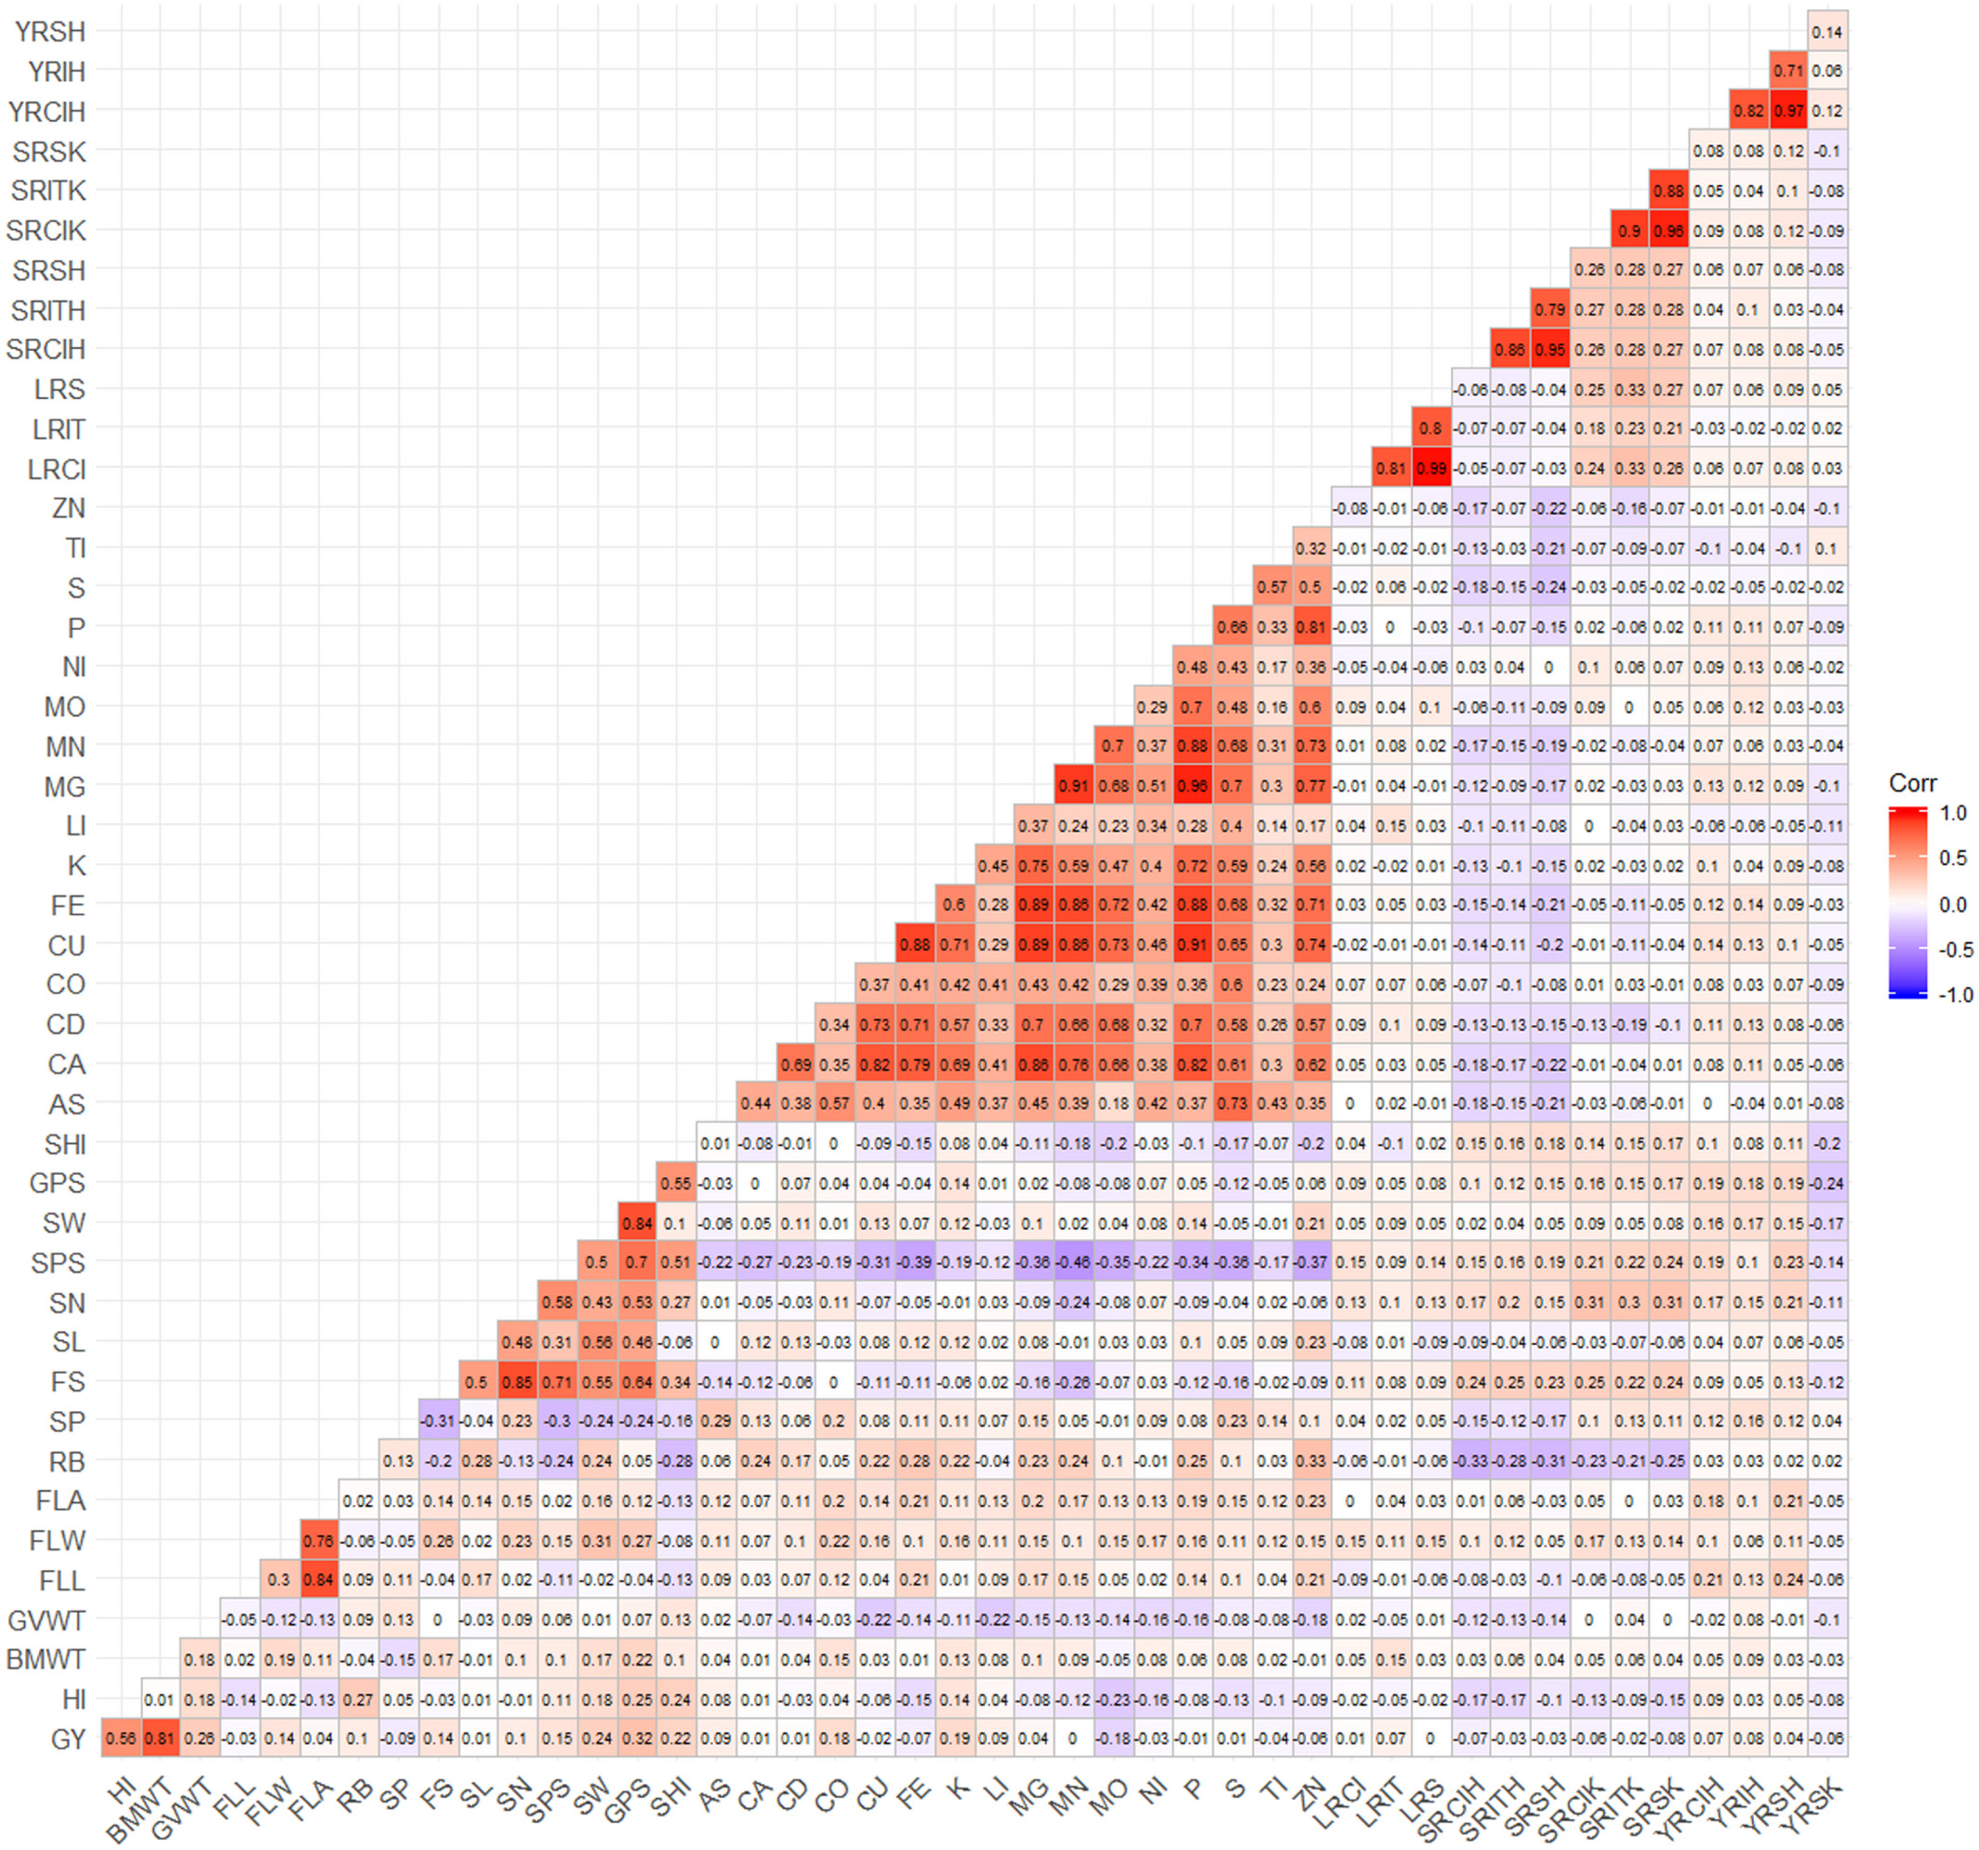
Modeling multiple phenotypes in wheat using data‐driven genomic exploratory factor analysis and Bayesian network learning
Plant Direct, Volume: 5, Issue: 1, First published: 25 January 2021, DOI: (10.1002/pld3.304)
Notes:
Pairwise Pearson's correlations between 45 phenotypes. AS, arsenic; BWT, biomass weight; CA, calcium; CD, cadmium; CO, cobalt; CU, copper; FE, iron; FLA, flag leaf area; FLL, flag leaf length; FLW, flag leaf width; FS, fertile spikelet; GPS, grain weight per spike; GVWT, grain volume weight; GY, grain yield; HI, harvest index; K, potassium; LI, lithium; LRCI, leaf rust coefficient of infection; LRIT, leaf rust infection type; LRS, leaf rust severity; MG, magnesium; MN, manganese; MO, molybdenum; NI, nickel; P, phosphorous; RB, rachis break; S, sulfur; SHI, spike harvest index; SL, spike length; SN, spikelet number; SP, sterile spikelet; SPS, seeds per spike; SRCIH, steam rust coefficient of infection at Haymana; SRCIK, stem rust coefficient of infection at Kastamonu; SRITH, stem rust infection type at Haymana; SRITK, stem rust infection type at Kastamonu; SRSH, stem rust severity at Haymana; SRSK, stem rust severity at Kastamonu; SW, spike weight; TI, titanium; YRCIH, yellow rust coefficient of infection at Haymana; YRIH, yellow rust infection type at Haymana; YRSH, yellow rust severity at Haymana; YRSK, yellow rust severity at Kastamonu; ZN, zinc
IF THIS IMAGE HAS BEEN PROVIDED BY OR IS OWNED BY A THIRD PARTY, AS INDICATED IN THE CAPTION LINE, THEN FURTHER PERMISSION MAY BE NEEDED BEFORE ANY FURTHER USE. PLEASE CONTACT WILEY'S PERMISSIONS DEPARTMENT ON PERMISSIONS@WILEY.COM OR USE THE RIGHTSLINK SERVICE BY CLICKING ON THE 'REQUEST PERMISSIONS' LINK ACCOMPANYING THIS ARTICLE. WILEY OR AUTHOR OWNED IMAGES MAY BE USED FOR NON-COMMERCIAL PURPOSES, SUBJECT TO PROPER CITATION OF THE ARTICLE, AUTHOR, AND PUBLISHER.

