Slide 1

Overcoming Barriers to Implementing a Just Culture
Lea Trueworthy
Module 9.2 Assignment
CSD 380 DevOps (2257-DD)
July 11, 2025

Slide 2
What is a Just Culture?
A just culture encourages openness, fairness, and learning from errors
It distinguishes between human error, at-risk behavior, and reckless behavior
The focus is on systems improvement, not blame
A foundation for safer, more accountable organizations (Colorado Firecamp, 2004; Kim et al., 2021)

Slide 3
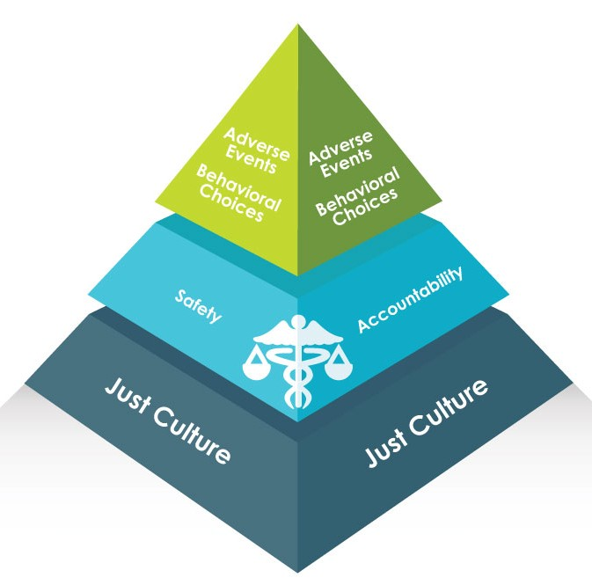
Foundation of a Just Culture
This model provided by Just Culture Healthcare shows that a just culture is the base that supports organizational learning, safety, and appropriate responses to adverse events.

Slide 4
Barrier 1 – Fear of Blame and Punishment
Employees may hide mistakes to avoid discipline
Fear undermines transparency and discourages reporting
Especially common in top-down, punitive environments (Lewis, 2024; Humanistic Systems, 2023)

Slide 5
Barrier 2 – Leadership Resistance or Misunderstanding
Some leaders fear a loss of control or accountability
Just culture is often misinterpreted as no consequences
Real change requires a mindset shift at all levels (Shorrock, 2023; Rushmer, 2024)

Slide 6
Barrier 3 – Lack of Training and Clear Policies
Unclear policies leave staff unsure what’s safe to report
Organizations often fail to distinguish error from negligence
Clear definitions and consistent responses are essential (GAIN Working Group, 2004)

Slide 7
Barrier 4 – Cultural Inertia and Legacy Systems
Longstanding blame cultures are difficult to break
Legacy systems and outdated processes reinforce old habits
Building trust and culture change takes time and persistence (Rushmer, 2024; Kim et al., 2021)

Slide 8
Moving Forward – Overcoming the Barriers
Provide leadership training and demonstrate visible support for just culture principles
Develop clear and fair frameworks for responding to errors and behaviors
Foster open communication and build trust throughout the organization
Start with small initiatives, learn from successes, and scale gradually (Kim et al., 2021)

Slide 9
References
GAIN Working Group E. (2004). Colorado Firecamp - A Roadmap to a Just Culture. Www.coloradofirecamp.com. https://www.coloradofirecamp.com/just-culture/definitions-principles.htm
JustCulture Healthcare. (n.d.). Introduction to Just Culture | Just Culture in Health Care. Www.justculture.healthcare. Retrieved July 13, 2025, from https://www.justculture.healthcare/introduction-to-just-culture/
Kim, G., Debois, P., Humble, J., Willis, J., & Forsgren, N. (2021). The DEVOPS Handbook: How to Create World-Class Agility, Reliability, & Security in Technology Organizations (2nd ed.) [Book]. It Revolution Press.
Lewis, D. H. (2024, August 20). Patient safety in a “just culture”: Encouraging reporting and learning from errors. WTW. https://www.wtwco.com/en-ca/insights/2024/08/patient-safety-in-a-just-culture-encouraging-reporting-and-learning-from-errors
Rushmer, P. (2024, March 27). Why is a just culture important? A just culture is important for several reasons, particularly in safety-critical industries such as transport, logistics & fleet operations. Here’s why it matters: Encourages Reporting of Errors: In environments where blame and punishment are prevalent, employees may. Linkedin.com. https://www.linkedin.com/pulse/understanding-implementing-just-culture-your-business-pete-rushmer-l3lfe
Shorrock, S. (2023, October 18). Why Is It Just So Difficult? Barriers to “Just Culture” in the Real World. Humanistic Systems. https://humanisticsystems.com/2023/10/18/why-is-it-just-so-difficult-barriers-to-just-culture-in-the-real-world/

