Slide 1
The Technology Value Stream
Assignment 1.2 Assignment:
The Technology Value Stream
Presented by: Lea Trueworthy

Slide 2
What Is the Technology Value Stream?
A value stream is the sequence of activities an organization undertakes to deliver value to customers.
In technology, it spans from idea (or customer need) to the delivery of working software in production.
It includes planning, coding, building, testing, and releasing software.

Slide 3
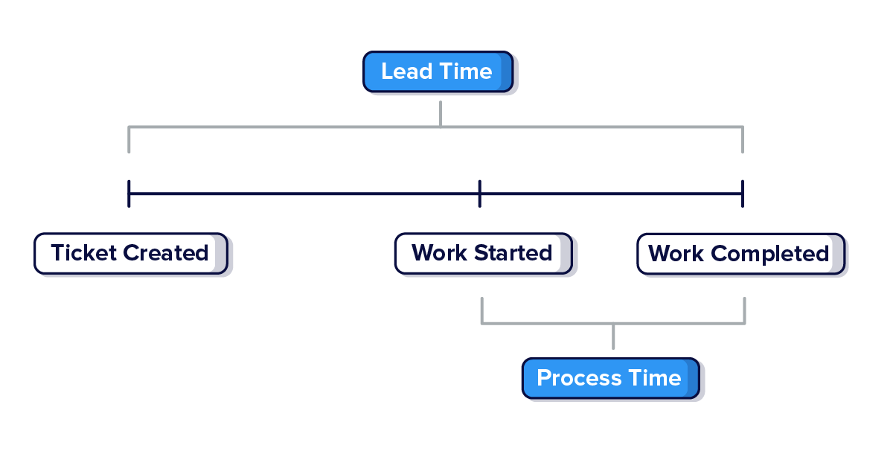
Lead Time vs. Processing Time
Lead Time: Total time from when a request is made to when it's delivered.
Processing Time: The time actively spent working on the request.
Lead time includes delays, wait time, and rework; processing time does not.
Example: A feature request might have a lead time of 2 weeks but a processing time of only 3 days.

Slide 4
The Common Scenario: Deployment Lead Times Requiring Months
Many organizations experience long lead times due to:
Manual handoffs between silos
Approval delays
Inefficient processes
This results in:
Reduced responsiveness to change
Higher risk of failure
Increased costs

Slide 5
The DevOps Ideal: Deployment Lead Times of Minutes
DevOps aims for:
Automation of testing and deployments
Continuous Integration / Continuous Delivery (CI/CD)
Cross-functional collaboration
Outcomes:
Faster feedback loops
Safer and more frequent releases
Greater agility and innovation

Slide 6
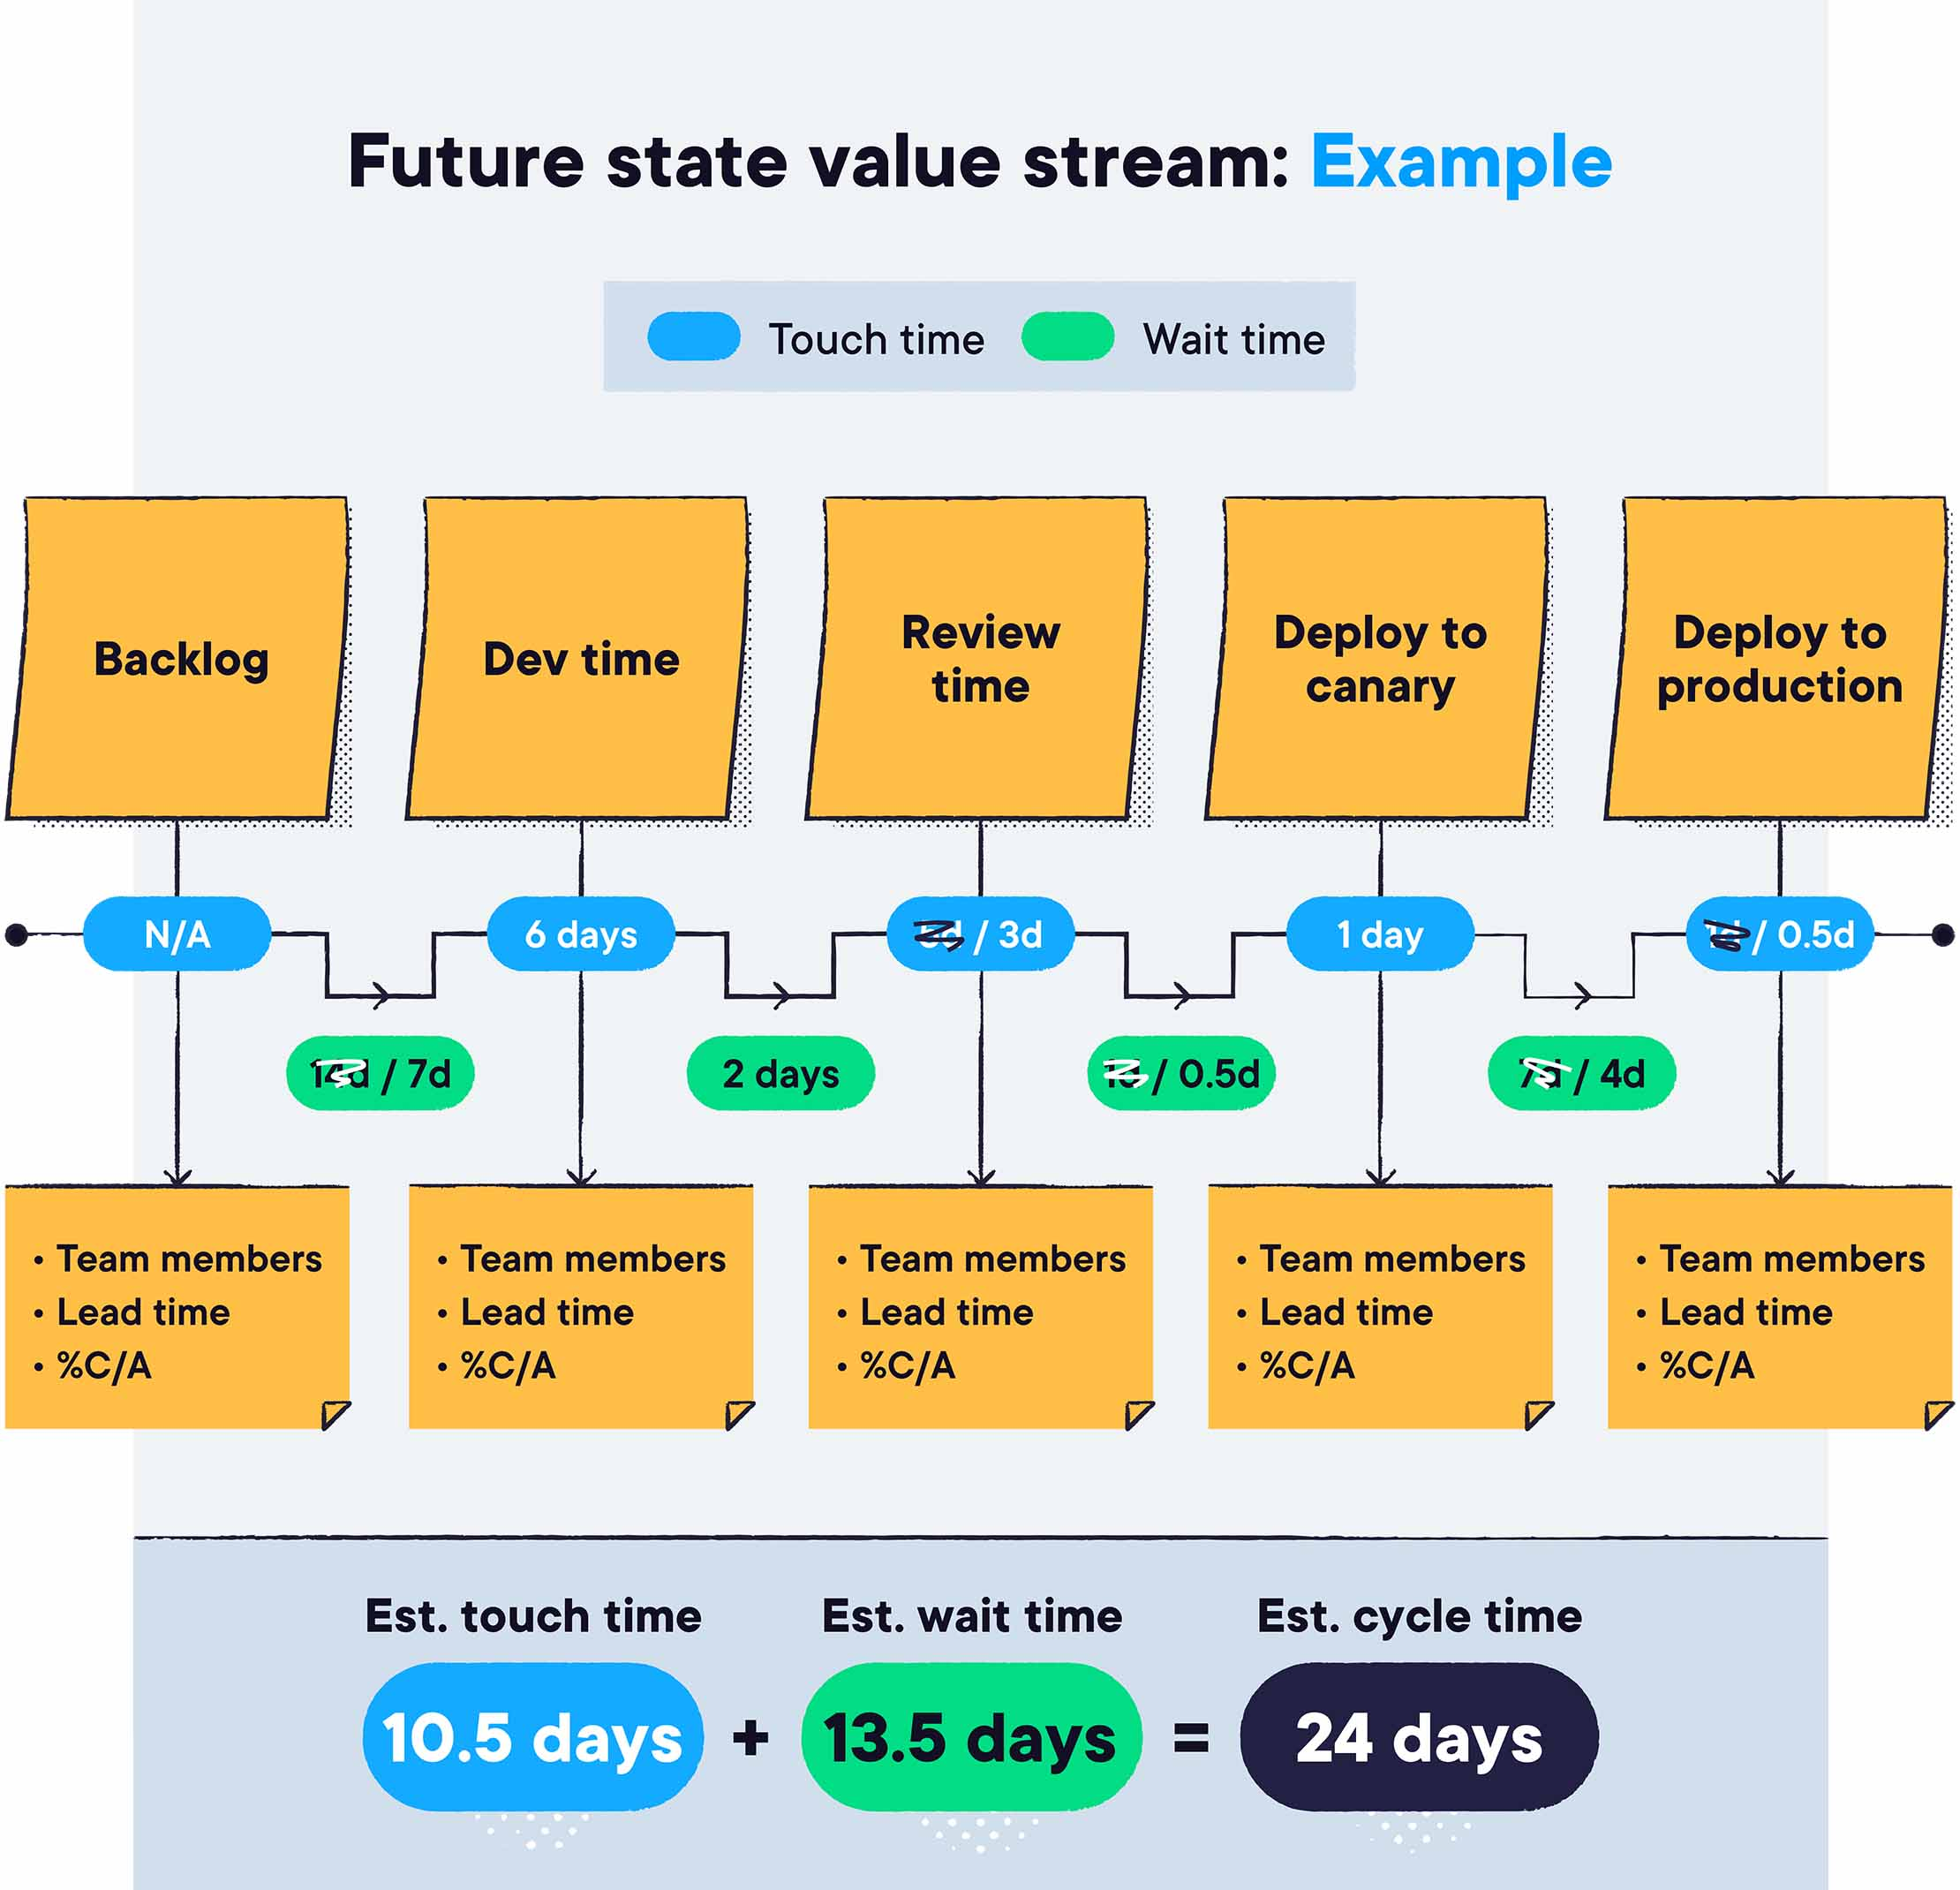

Slide 7
Why VSM is important
Enables real-time visibility into work across the pipeline
Helps teams measure and improve flow efficiency
Ties technical activities to business outcomes

Slide 8
How VSM works
Metrics to Track in VSM:
Lead Time (from idea to delivery)
Cycle Time (time spent actively working on a feature)
Throughput (rate of feature delivery)
Work-in-Progress (WIP) (how much work is in progress at any time)
The Importance of Data: By tracking and improving these metrics, teams can understand where bottlenecks occur and how to optimize the value stream.

Slide 9
Why reducing lead time is valuable
Faster delivery of features and updates.
More reliable and stable software.
Ability to quickly adapt to market changes and customer needs.
Increased innovation due to faster feedback loops.

Slide 10
References
Flow Transformation Team. (2023, March 10). Value stream mapping: What it is + how it relates to DevOps. Pluralsight.com. https://www.pluralsight.com/resources/blog/business-and-leadership/value-stream-mapping
Kim, G., Debois, P., Willis, J., & Humble, M. "Jez. (2021). The DevOps handbook : how to create world-class agility, reliability, & security in technology organizations (2nd ed.). It Revolution Press, Llc. (Original work published 2016)
Kumbhani, J. (2022, January 5). Value Stream Management: The Future of DevOps. Zymr.com; Zymr. https://www.zymr.com/blog/the-future-of-devops-is-in-value-stream-management
Pinheiro, G. (2023, April 28). Lessons on using DevOps to become more efficient and reliable. OfferZen. https://www.offerzen.com/blog/using-devops-efficient-and-reliable/
Prakash, S. (2024, March 4). What is a Value Stream, Value Stream Mapping, and Value Stream Management? Devopsinstitute.com. https://www.devopsinstitute.com/value-stream-management-explained-in-plain-english/
Takakura, T. (n.d.). What is Value Stream Management? Atlassian. Retrieved May 28, 2025, from https://www.atlassian.com/agile/value-stream-management

