Slide 1

House Hold Energy Power Consumption
A statistical analysis

Slide 2

Introduction
My data came from http://archive.ics.uci.edu, directly from an archive containing 2075259 measures, reduced to 566 measurements in my project, gathered in a house located in Sceaux (7km of Paris, France) between December 2006 and November 2010 (47 months).
Q: Which room uses the most energy?
Q: Which variables are the most correlated?
The Variables being studying are :
Kitchen Energy usage in watt-hour of active energy. It corresponds to the kitchen, containing mainly a dishwasher, an oven and a microwave (hot plates are not electric but gas powered).
Laundry Room Energy usage in watt-hour of active energy. It corresponds to the laundry room, containing a washing-machine, a tumble-drier, a refrigerator and a light.
Temperature Alteration Energy Usage, It corresponds to an electric water-heater and an air-conditioner.
Active Energy, household global minute-averaged active power in kilowatt
Voltage, minute-averaged voltage in volt
Intensity, household global minute-averaged current intensity in ampere

Slide 3
Methodology
Selected 6 variables
Summarized variables
Ran a blox.stats on variables
Found standard deviations
Checked for missing data in any variables
Check for outliers both visually Box plots & Histograms, and programmatically IQR & Ranges
Determine correlations between variables
Completed a time series analyzation
Ran a multi-variable linear regression between the quantitative variables
Checked for heteroscedasticity, normality, and influential observations

Slide 4
Issues
Since the original data set had 2075259 measures, I had to reduce it to 566 measurements because my internet connection and computer memory combined caused R-studio to crash, thus being incapable of knitting. I also didn’t have 4 rooms to analyze against Active power so I included other variables that didn’t necessary directly correspond.
I also had trouble trying to do a time series analyzations on my data since I have never done it before, and I needed to understand what the graphs and data were telling me.

Slide 5
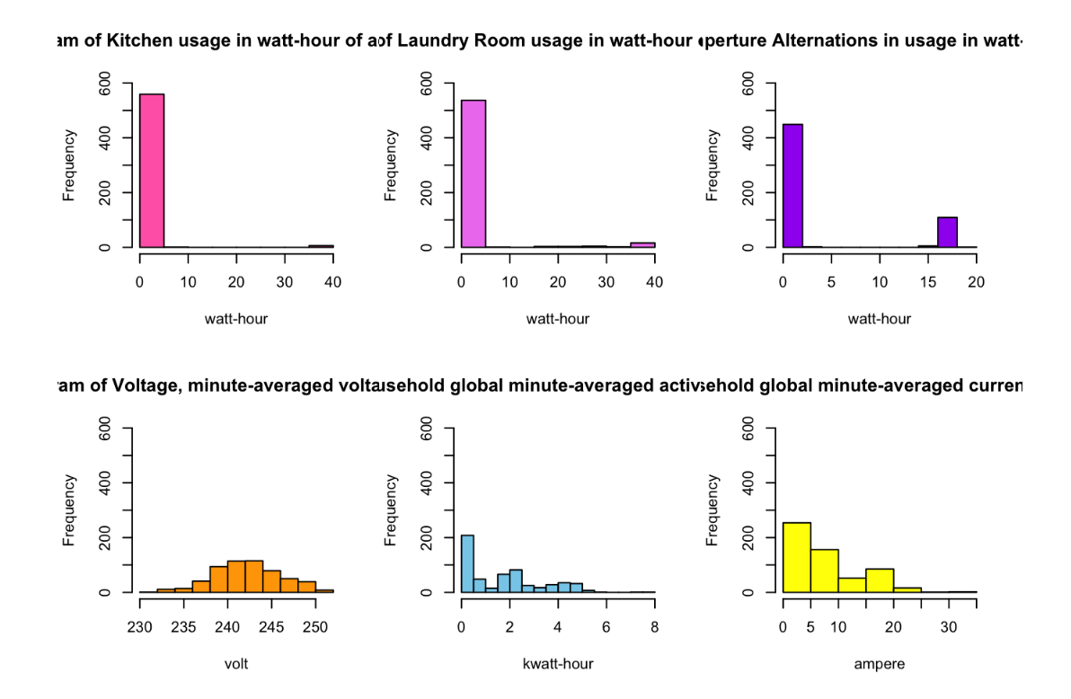
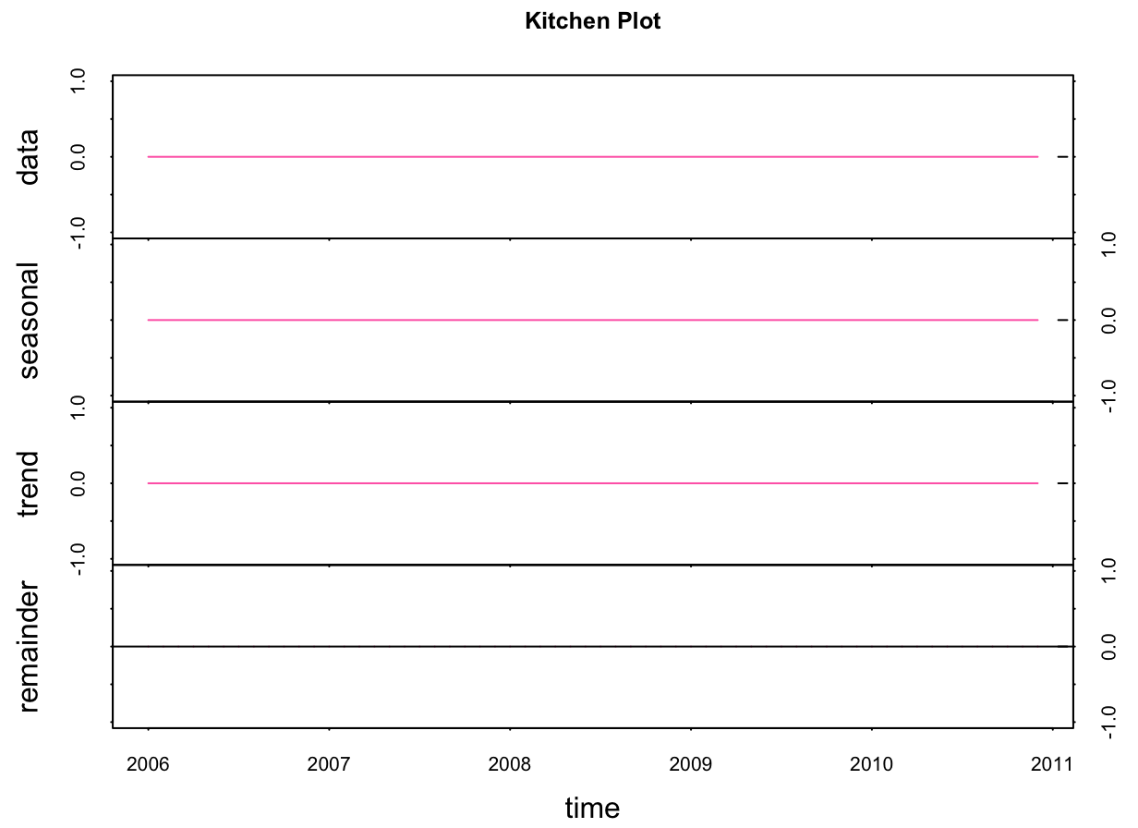
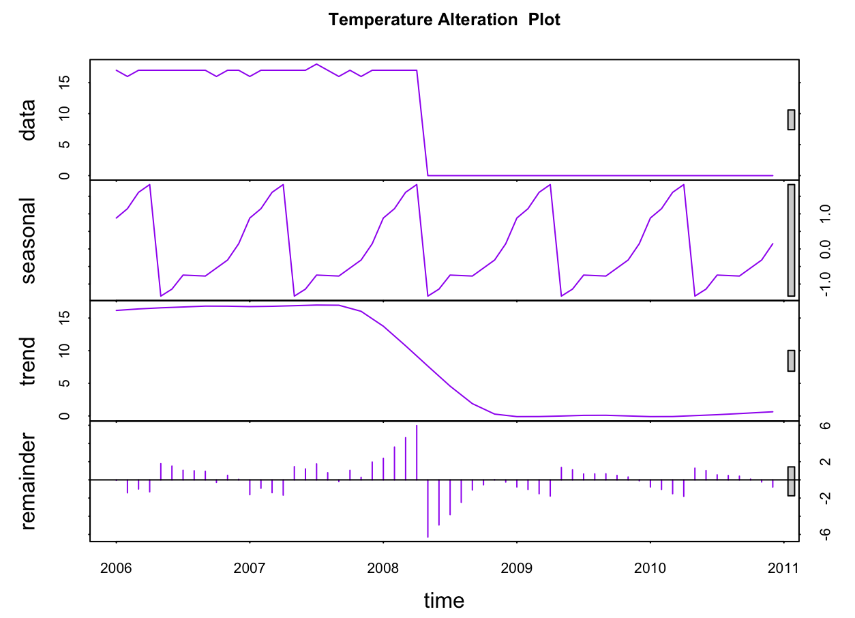
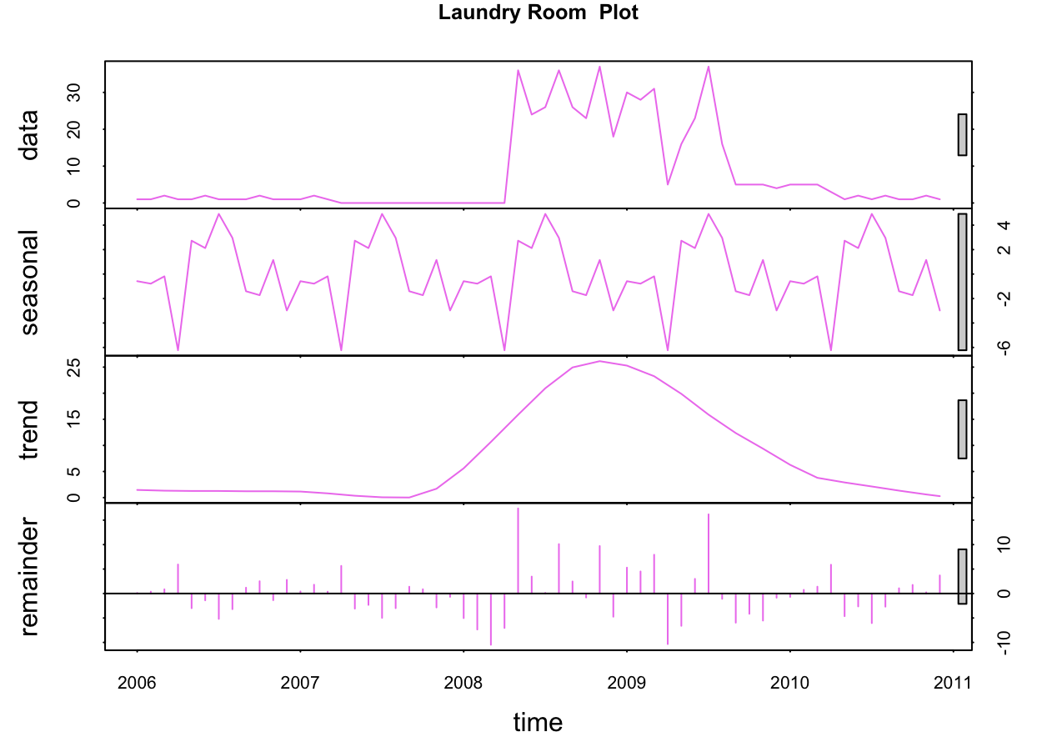
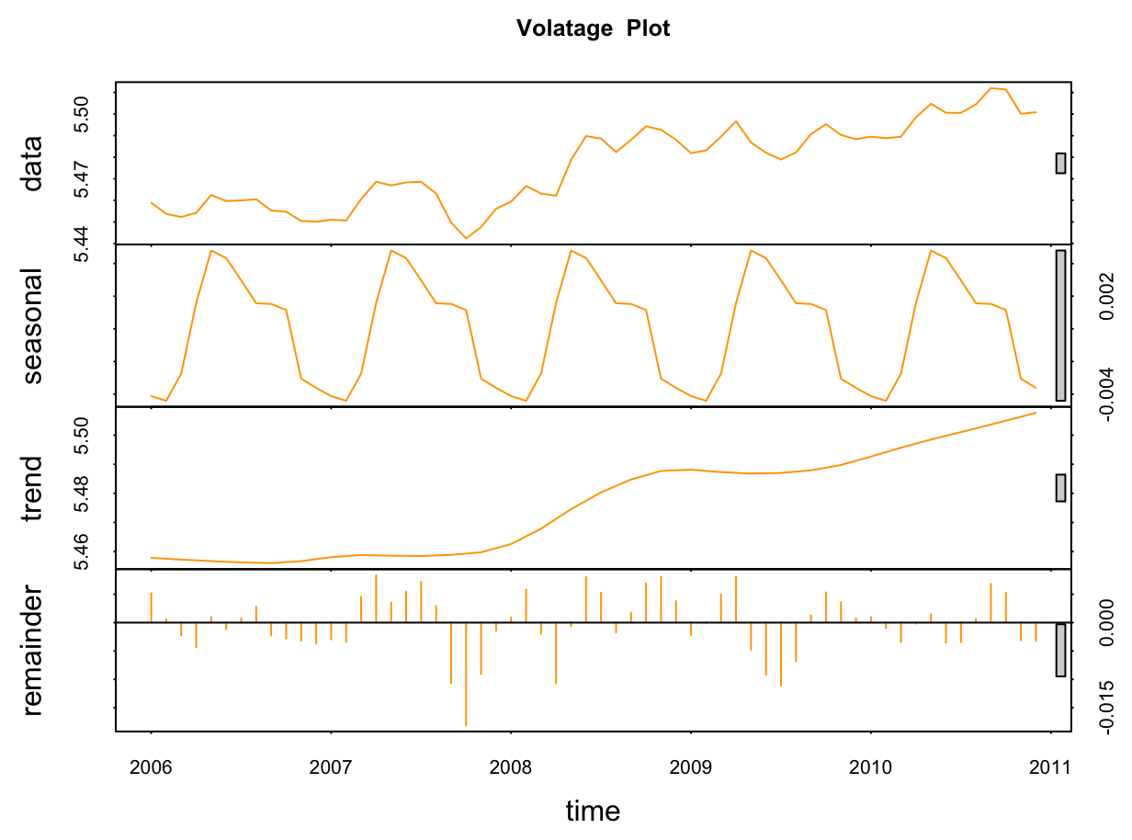
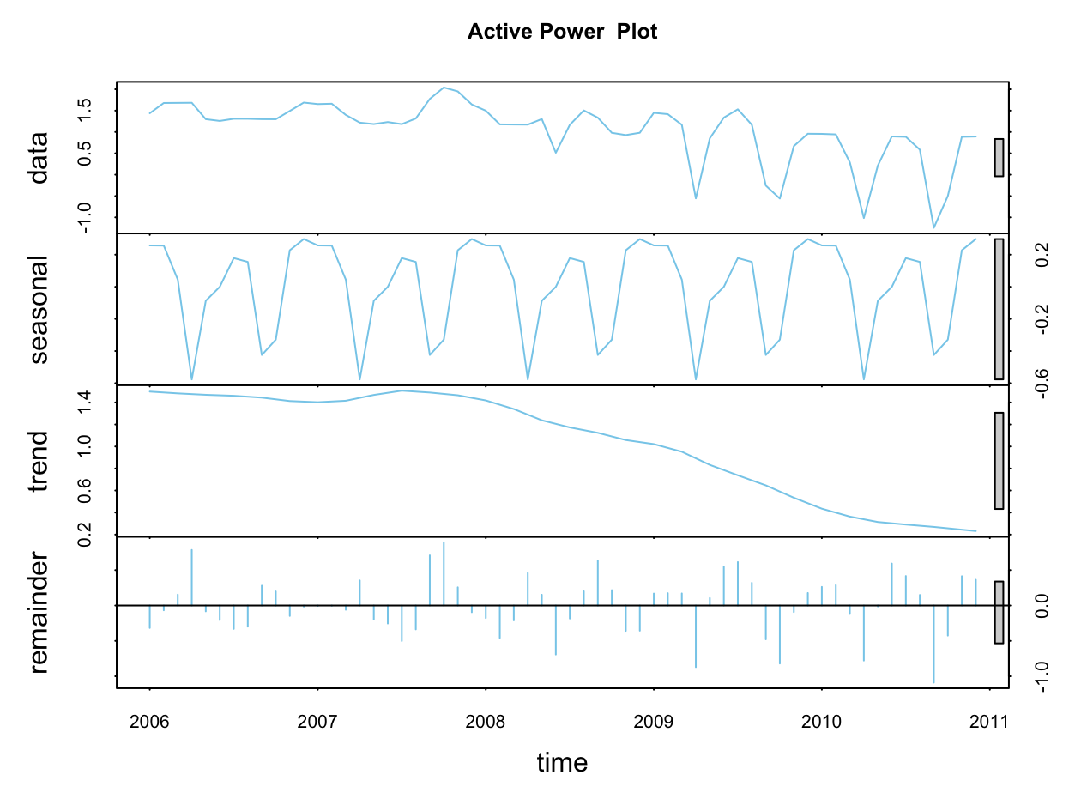
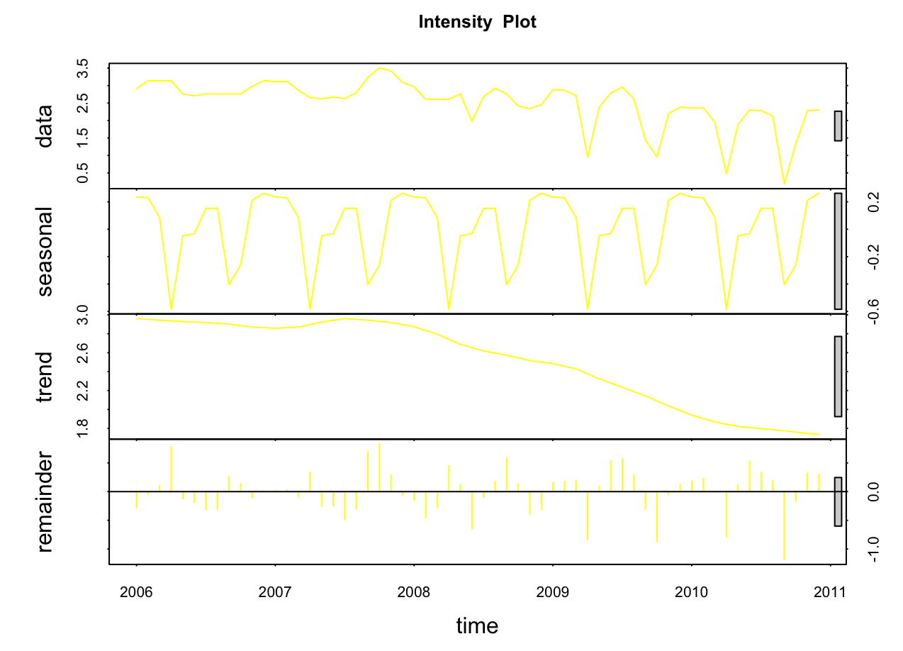
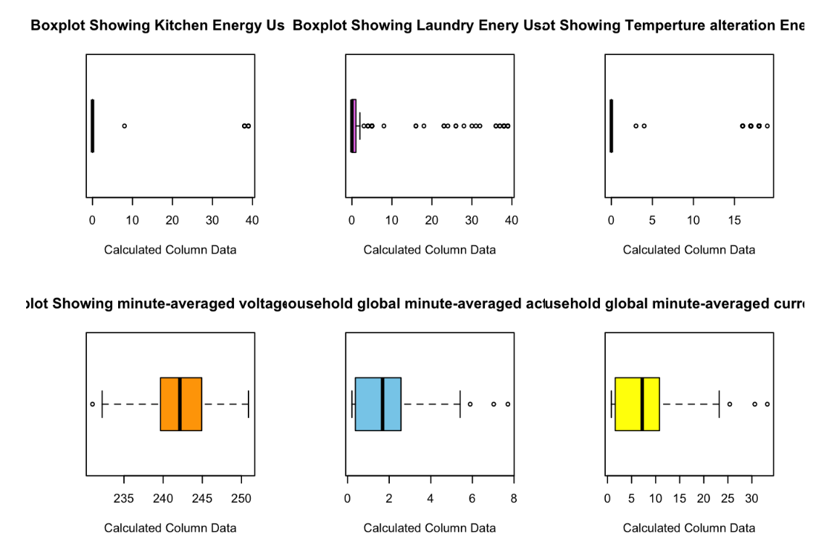
Charts and Graphs and measures

Slide 6
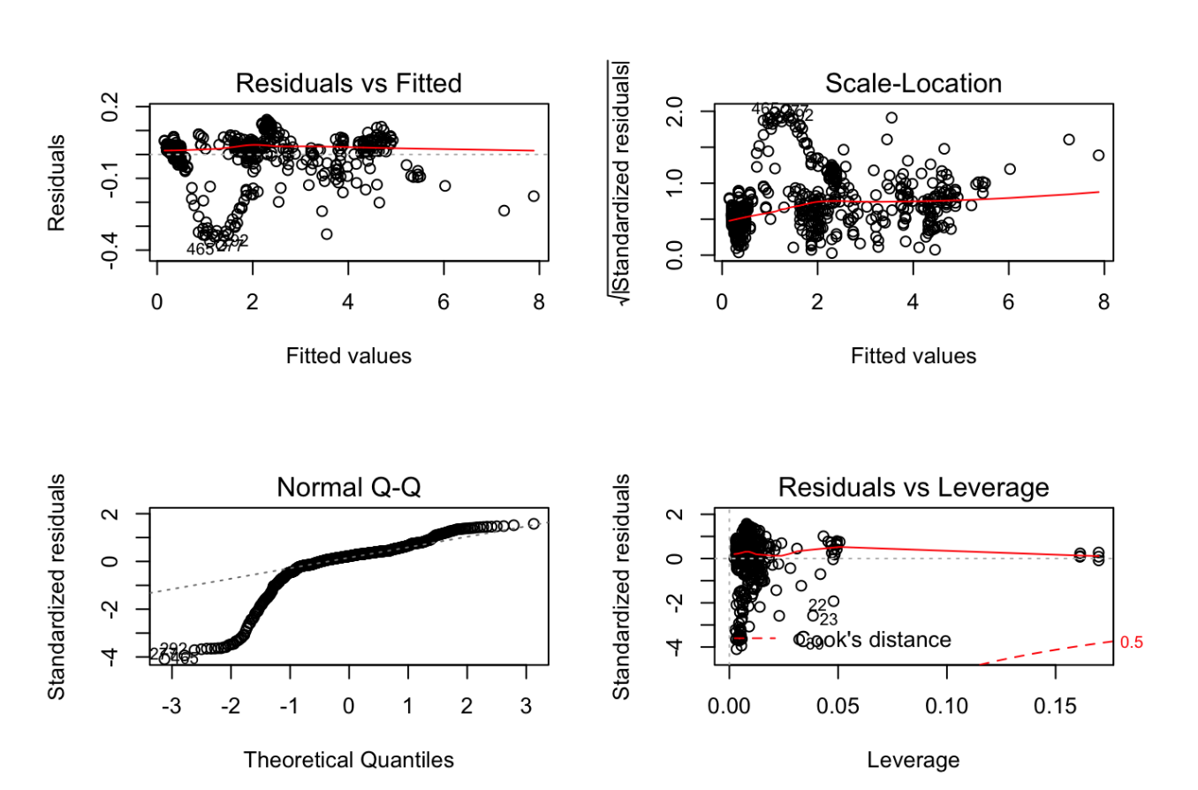
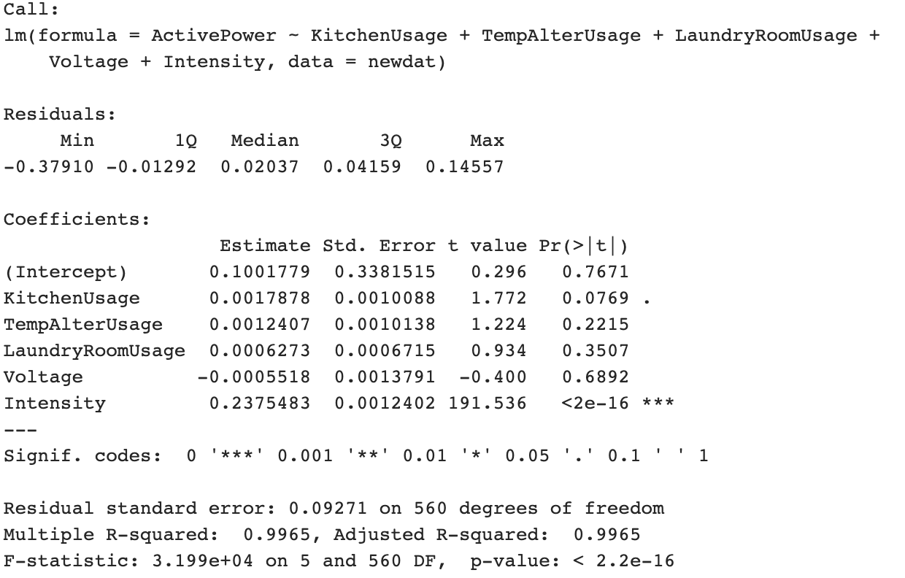
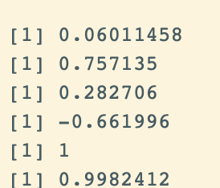
Results of Correlation, Regression, or other analysis
This model is against active power to see which variable effects it the most. We see that all variables are significant since their p-values are all very close to 0, so none of them need to be removed from our model.
We discovered that there appears to be a positive correlation between Active Power: Kitchen usage, Laundry room usage, Voltage, and Intensity, again here we see it is almost a 100% correlation, which supports our time series trends and graphs. There was a negative correlation between Active Power and Temperature alterations usage.
Heteroscedasticity, normality, and influential observations
Kitchen Usage:
TempAlterUsage:
LaundryRoomUsage:
Voltage:
ActivePower:
Intensity:

Slide 7

Conclusions
From my analysis of the data from the 566 measurements gathered in a house located in Sceaux (7km of Paris, France) between December 2006 and November 2010 (47 months) we were able to determine that changing the temperature within a house (electric water-heater and an air-conditioner), is the variable that fluctuates the most seasonally. With energy consumption being the highest during the winter months. We were also able to determine that electric Intensity was almost absolutely correlated with Active power in the house. We also discovered the from the three rooms, the Laundry room was the one that consumed the most energy overall. For the linear regression, we found that all our variables were significant to our model, and that our model met the criteria for heteroscedasticity, normality, and influential observations checks.

Slide 8
Future questions and further analysis
In the future I’d like to see what exact days and times in a month are the most energy consuming intervals.
I’d like to also analyze data from more subjects rather than just one

Slide 9

References
This dataset is made available under the “Creative Commons Attribution 4.0 International (CC BY 4.0)” license
Time Series AnalysisPrabhakaran http://r-statistics.co/Time-Series-Analysis-With-R.html

