Slide 1
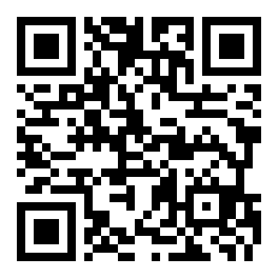
!
Trumen Guard
A collision warning that runs on any phone, before the crash
Mode: Partner product
Owned by Toyota Royal Motors and BYD Royal Motors after-sales; changes the vehicle handover
Try it on your phone now
trumen-com.github.io/road-vision
Team Trumen: Asilbek Shodmonov, Komron Akmalov, Ashraf Shermatov
Notes:
Mode on the first slide, as the rules ask. Invite the jury to scan the QR code now; the demo comes in a minute.

Slide 2
Most cars on our roads would not warn before a crash
2,188
46%
≈ $2 bn
−27%
killed on Uzbekistan's roads in 2025
of crashes hit a pedestrian
yearly cost, about 3% of GDP
rear-end crashes with a warning
Most of the 5.5 million registered vehicles have no forward collision warning: it comes only with new, higher trims, and aftermarket units cost hundreds of dollars installed.
Almost every driver already carries a camera and a processor that can do it: their phone.
Crashes into pedestrians and cyclists are more than half of all crashes here. A warning must cover people, not only cars.
Sources: Gazeta.uz (Jan 2026; Nov 2025), Asian Transport Observatory road safety profile 2025, IIHS (forward collision warning alone, rear-end crashes).
Notes:
One minute. The problem is fatal crashes, and almost half of them involve pedestrians. The tool to warn exists in every pocket.

Slide 3
Royal Motors after-sales owns it; the handover changes
Driver
Royal Motors after-sales
Fleet customers
Mounts the phone, opens one web page. Hears a warning about the car ahead or a person stepping out. Gets a trip report. Pays nothing for the basic warning.
Owns and sells the Safety Pack (mount, set-up, a year of trip reports) at handover and at service visits. Keeps the customer connected between visits.
Taxi and corporate fleets buying Toyota and BYD in bulk pay per vehicle per month for warnings and near misses per driver, for coaching.
The process it changes: vehicle handover
Sale or service done
Safety Pack offered
Phone mounted, lane set in 30 s
Car leaves with a warning
Notes:
Partner product: the unit is Royal Motors after-sales; the process is the handover. No vehicle modification, no type approval: it only warns.

Slide 4
Live demo
A real dashcam crash clip: the band turns yellow, then red, with a beep, before impact
Your video: open any dashcam file; it is analysed in real time in the browser
Your camera: point a phone at the road or a street scene
The trip report: every warning with what, where and time to contact; nothing leaves the phone
trumen-com.github.io/road-vision
Backup: a recorded run of the demo is in the repository (demo/backup.mp4).
Notes:
Two minutes. Play sample 1 (urban crash), then hand a phone to the jury or use their video. If the network fails, play the backup recording.

Slide 5
Physics of looming plus a model learned on real crashes
Camera
Detector
Tracker
Time to contact
Path in metres
Risk model
Warning
phone, 10–30 fps
YOLO11n 512×288
IoU + motion
looming, tau-dot
width-scaled offset
trees on 2 s of features
sound, vibration
All inside the phone browser (onnxruntime-web). No video leaves the phone.
Time to contact from one camera
Is it in my path, in metres
Braking in control or a crash course
An approaching car grows: d(ln h)/dt = 1/TTC. No distance or speed needed. Height, not width: a turning car gets wider, not taller.
Offset ÷ the object's own width does not change with distance, so a parked car stays beside us and a car in our lane stays at zero.
Tau-dot (Lee, 1976): when time to contact stops shrinking, the driver is handling it. Turning is removed using the whole scene's sideways motion.
Ours: tracker, looming fit, metric path test, tau-dot, features, risk model, alert logic, evaluation harness, app. Not ours: YOLO11n weights (AGPL-3.0), onnxruntime (MIT).
Notes:
One minute. Three ideas carry the system; the learned model sits on top of them. Everything we did not write is named.

Slide 6
Tested on 667 held-out real dashcam clips
0.69
21%
63
0.72
mAP, Nexar protocol
of crash clips warned before the event
false warnings per hour of normal driving
ROC AUC
Version | mAP | AUC
Naive: biggest object in front | 0.70 | 0.74
Tracking + time to contact + path, hand-set | 0.65 | 0.67
Trumen Guard (learned trees on 2 s of features) | 0.69 | 0.72
Tried, not shipped: + visual model (lowered mAP) | 0.66 | –
Ranking quality ties the naive baseline (mAP 0.69 vs 0.70). As a live warning, at the same false-warning rate, ours warns before more crashes: 19% vs 15% at 60 per hour, 51% vs 34% at 150.
The threshold was fixed on the training split before testing. mAP 95% interval 0.64–0.76; Kaggle winners reached about 0.9 with server video networks.
Notes:
One minute. Honest numbers from eval/report.py. On ranking we only tie the naive baseline; the gain is as a live warning, where tracking and time to contact give more crashes warned at the same false-alarm rate. The false-warning rate is still too high for production: that is what the pilot tunes on local roads.

Slide 7
Night, rain, speed and cost, and where it fails
Condition | Clips | mAP | 95% interval
Daylight | 611 | 0.69 | 0.63–0.75
Twilight or dark | 56 | 0.76 | 0.61–0.91
Clear or cloudy | 635 | 0.71 | 0.66–0.77
Rain | 32 | 0.58 | 0.44–0.82
Urban | 315 | 0.71 | 0.64–0.79
Highway | 183 | 0.78 | 0.70–0.87
Suburban, rural, other | 169 | 0.61 | 0.51–0.75
Speed and cost
Inference on the phone: WebGPU, or multi-threaded WebAssembly
Detector 46 ms per frame on 2 CPU threads; the live frame rate shows on screen
No server per car; static hosting under 1 cent per car per month
Local cars and plates: classes, not brands; plates are never read
Known failure cases
Crashes from the side or behind: one forward camera cannot see them
Unlit pedestrians at night: the detector misses them
Rain is our weakest group (32 clips, mAP 0.58): wipers and glare break the boxes
Dense stop-and-go traffic: short time to contact is normal there; silenced below 8 km/h by GPS
Notes:
The rules ask for night, rain, speed, cost and failures. Small groups have wide intervals, and we show them.

Slide 8
Why another team cannot rebuild it in a weekend
Measured pipeline
Physics, not only a model
Every rule and threshold was tuned against hundreds of real crash clips; the harness runs the exact browser code headless over the dataset.
Looming, tau-dot and the metric path test explain every warning: which object, where, and in how many seconds.
On the device
Distribution and data
Real time in a phone browser with no server: privacy by design and near-zero cost per car.
Inside Royal Motors after-sales, every handover adds a car; consented trip reports build a Tashkent near-miss dataset no outside team has.
Notes:
The replication test: data, pipeline, integration and domain knowledge.

Slide 9
A $14,900 pilot that pays back in about four months
Pilot, 3 months | USD
Two engineers (local rates) | 9,000
20 phones, 100 windscreen mounts | 3,400
Local test data with consent, 300 clips labelled | 1,200
Hosting, CDN, store fees | 300
Legal and privacy review | 1,000
Total | 14,900
Per year after roll-out (assumptions) | USD
Safety Pack: $39 price − $13 direct cost = $26
24,000 handovers and visits × 5% attach = 1,200 packs | 31,200
Fleets: 300 vehicles × $3 per month | 10,800
Contribution per year | 42,000
Payback of the pilot | ≈ 4 months
Every figure is our estimate, to be confirmed with Royal Motors in the pilot. Not counted: fewer crash repairs and downtime for fleets (IIHS: −27% rear-end crashes with a warning; we assume half until local data proves more) and insurer discounts. Running cost per car is near zero because inference runs on the phone.
Notes:
One and a half minutes. Cost to build and run the pilot, unit economics and payback, every assumption stated.

Slide 10
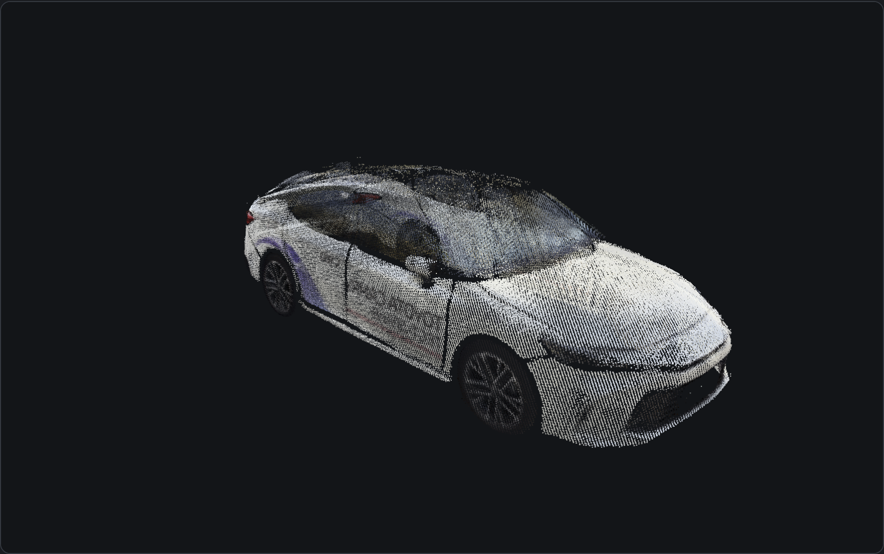
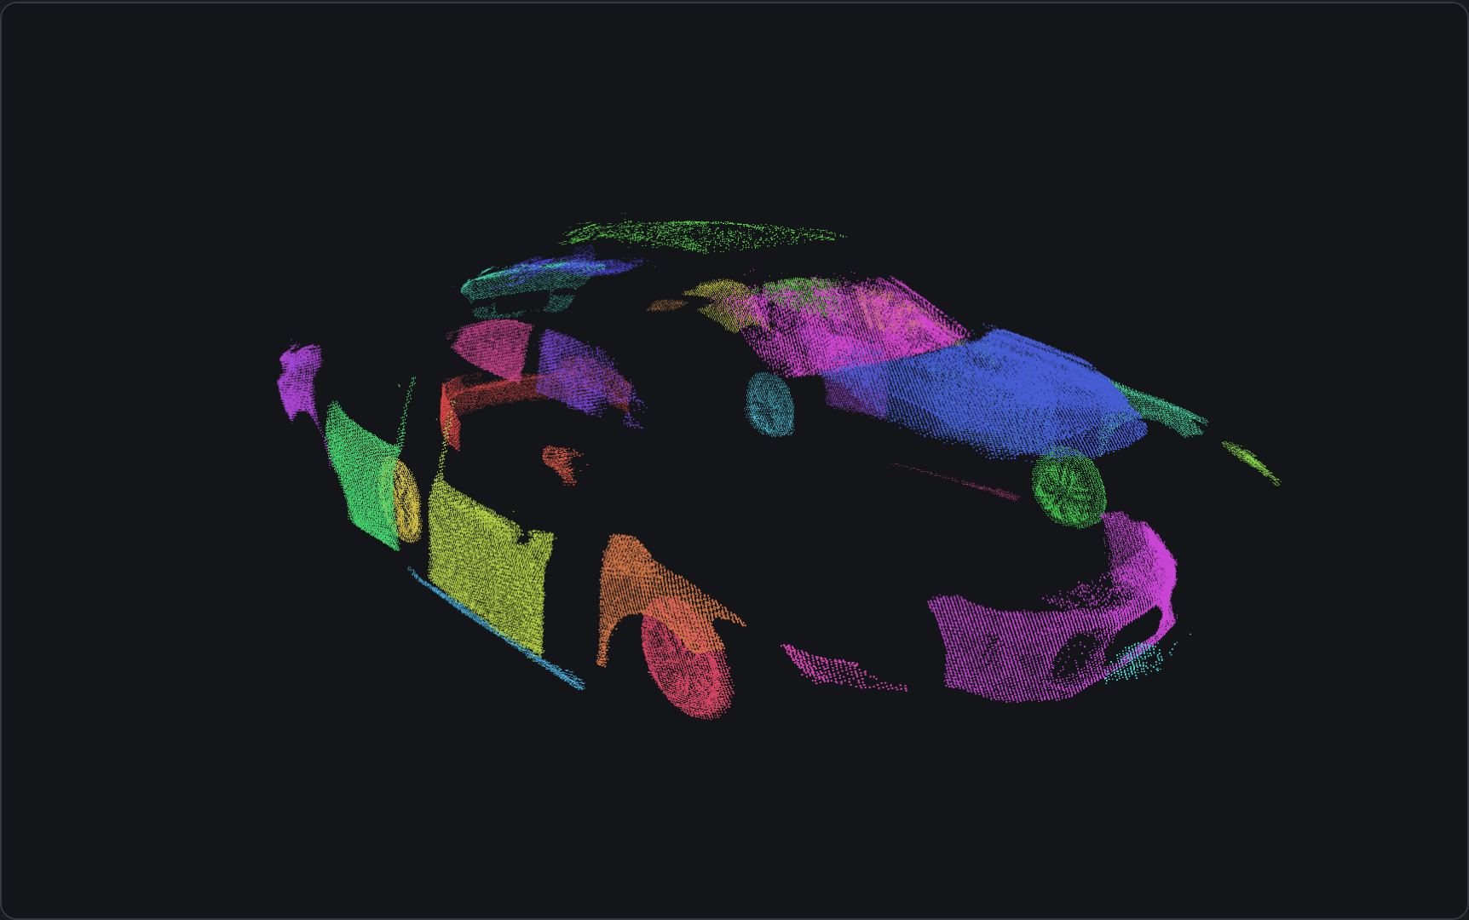
Next product: one walk-around, the car in 3D, part by part
The Royal Motors test-drive Camry at the venue: 29 s video + 9 photos
Split into 32 named exterior parts, each sized and searchable
95 of 95 views placed. Scale from the published length; then wheelbase +2 mm, width +16 mm, height +4 mm vs published. Exported as glTF + JSON.
For after-sales: a 3D condition record at handover and trade-in, and parts lookup. Hidden parts would come from the Toyota/BYD catalogue by VIN.
Notes:
Fifteen seconds, only if time allows. Built during the final as an add-on, live at /scan/ on the same site. Exterior only; plate and people are removed from the model.

Slide 11
Three months to a decision
Month 1
Month 2
Month 3
20 Royal Motors loaner and test-drive cars; record local footage with consent; tune on Tashkent streets, day and night.
Safety Pack at handover in one Toyota and one BYD centre; one fleet customer with 50 vehicles.
Measure attach rate, warnings per 100 km, driver feedback and incidents; decide on roll-out.
Our ask: one after-sales manager as pilot owner, 20 loaner cars, and access to one fleet customer.
Notes:
Half a minute. A concrete ask, then questions.

