Slide 1


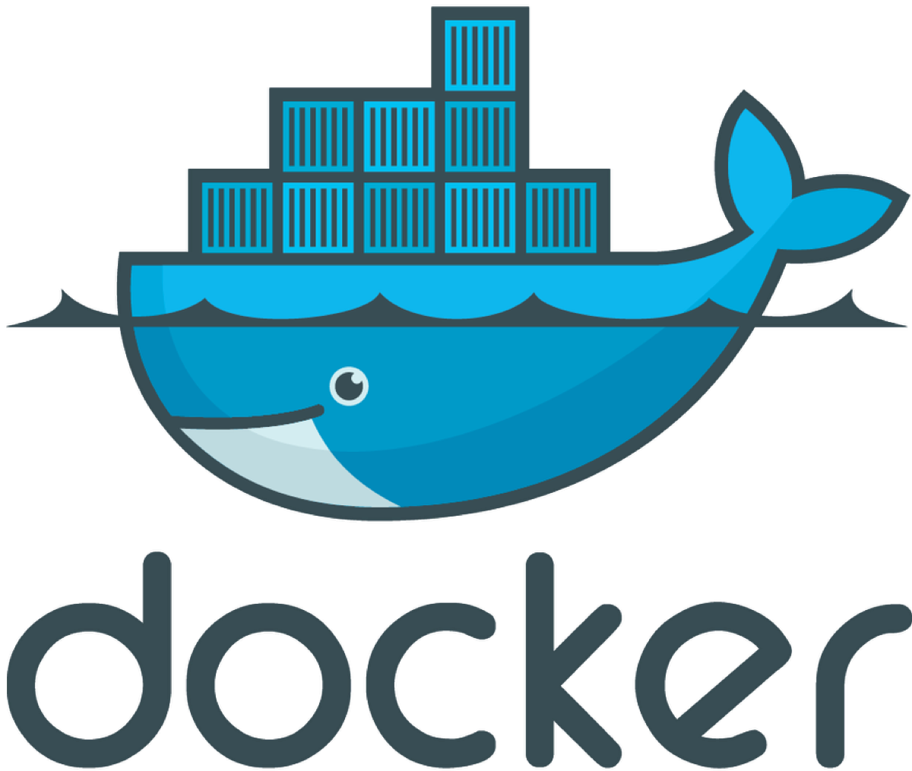



Dockerfile
Docker Compose
trigger, poll
image versioning
+
docker push
build, unit test
Private Registry
docker pull
deployment
Docker for Windows, Mac
Developers
DEV
STAGING
PRODUCTION
collaboration
QC Team
test
DOCKER SWARM MODE

