Slide 1

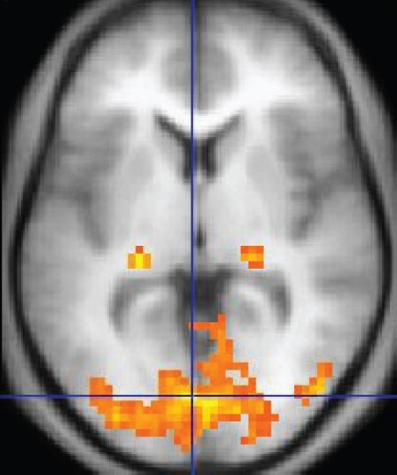
Spatial Resolution in fMRI Neural Decoding
Pod Astarte
Jinghan Huang
Jul 2025
https://upload.wikimedia.org/wikipedia/commons/4/4a/1206_FMRI.jpg

Slide 2
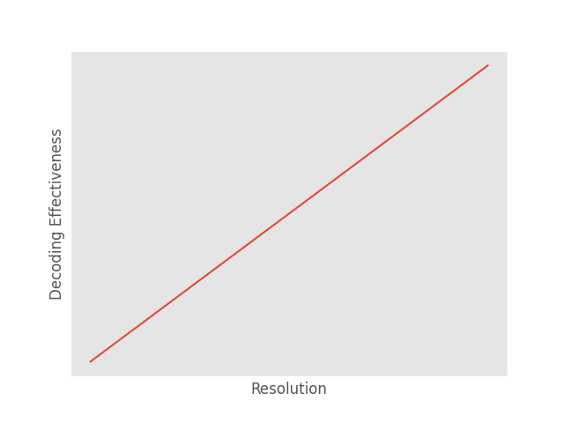
First Question: What is the relationship between spatial resolution and neural decoding?
Naive Assumption
The relationship is actually non-linear (Gardumi et al., 2016)
A. Gardumi, D. Ivanov, L. Hausfeld, G. Valente, E. Formisano, and K. Uludağ, “The effect of spatial resolution on decoding accuracy in fMRI multivariate pattern analysis,” NeuroImage, vol. 132, pp. 32–42, May 2016, doi: 10.1016/j.neuroimage.2016.02.033.

Slide 3
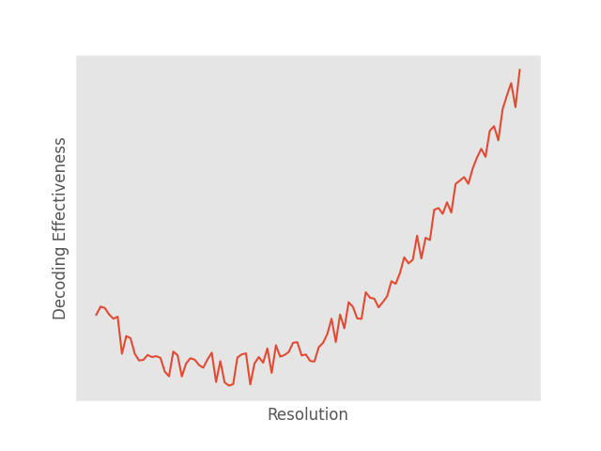
Potential Actual Relationship
Further Questions:
What is the relationship between spatial resolution and different types of neural decoding tasks?
Can we model the relationship?

Slide 4
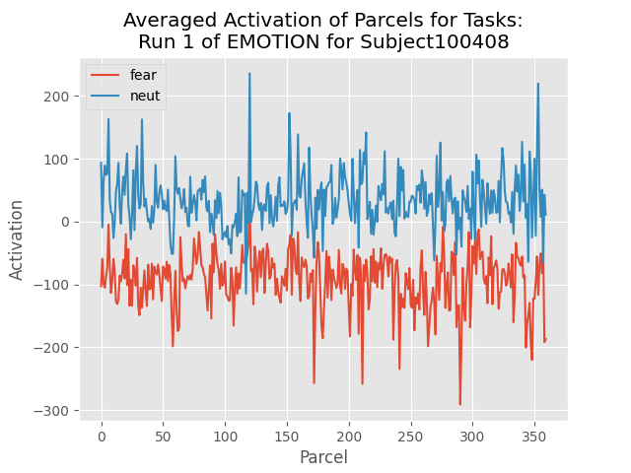
HCP 2021 + Behavior
An Instance
Subject
Experiment [Motor, WM, Emotion, Gambling, Language, Relational]
Run
Data (X) [3D time-series data]
EVs (Y) [Multi-class labels]
Metadata
D. M. Barch et al., “Function in the human connectome: Task-fMRI and individual differences in behavior,” NeuroImage, vol. 80, pp. 169–189, Oct. 2013, doi: 10.1016/j.neuroimage.2013.05.033.

Slide 5
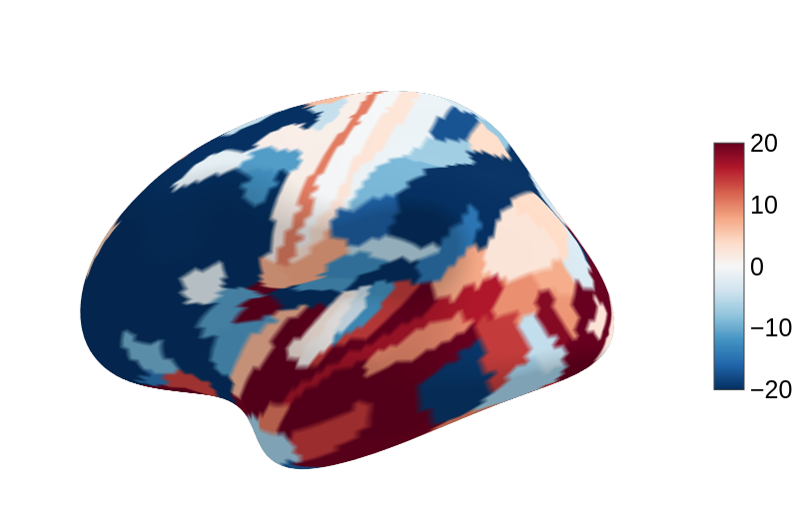
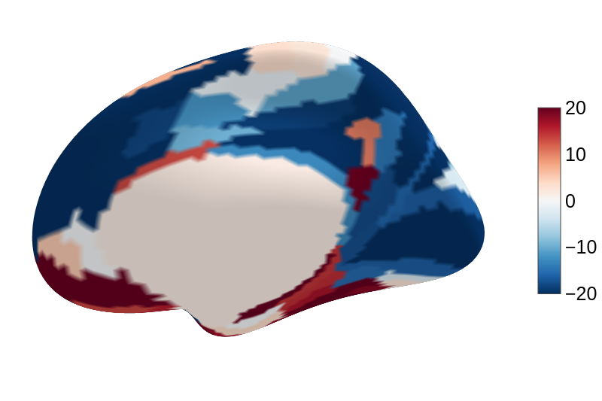
Resolution 1: Parcel
Left Hemisphere
Right Hemisphere

Slide 6
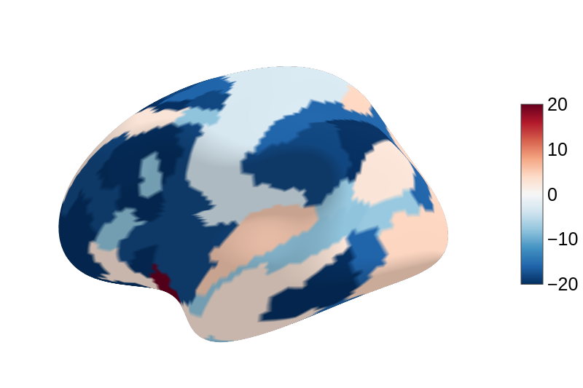
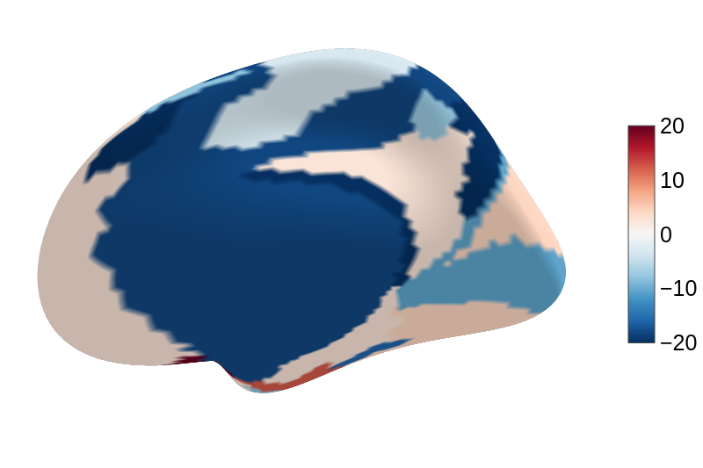
Resolution 2: Network
Left Hemisphere
Right Hemisphere

Slide 7
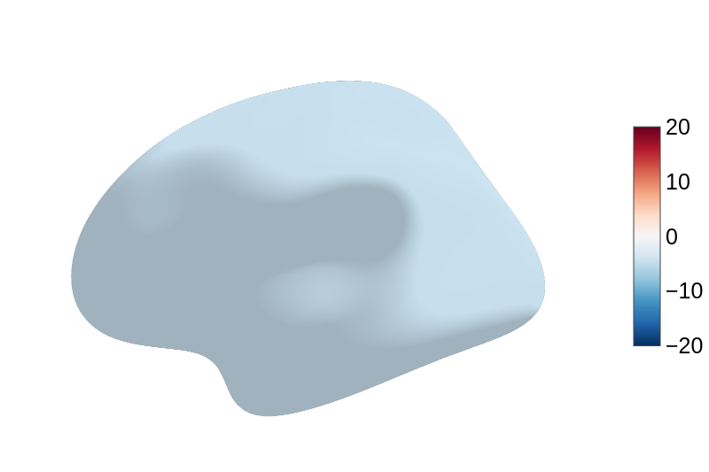
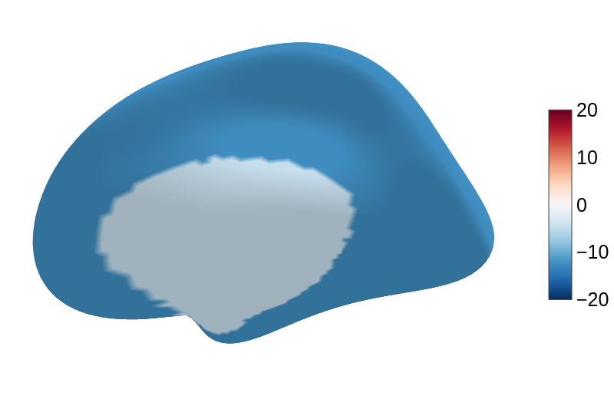
Resolution 3: Hemisphere
Left Hemisphere
Right Hemisphere

Slide 8
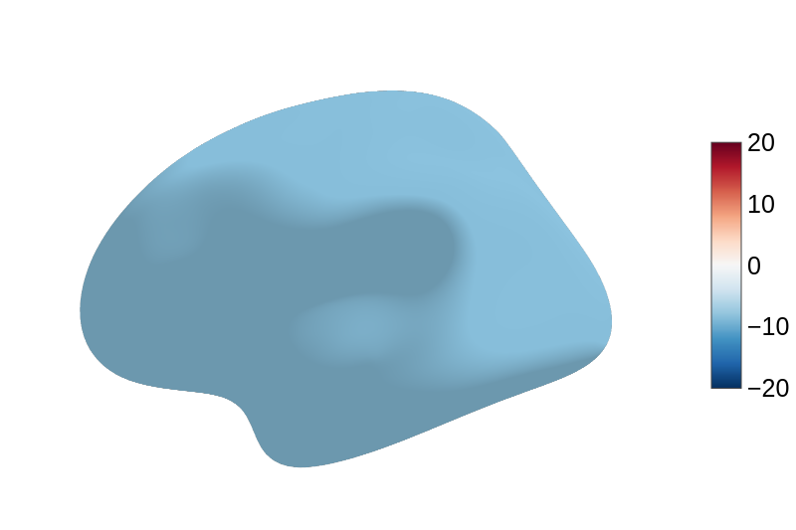
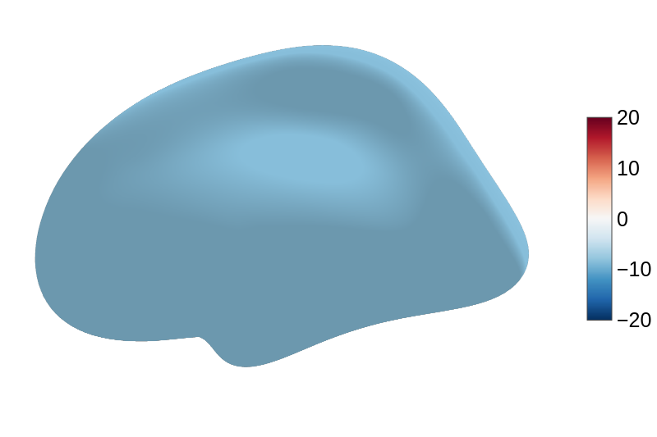
Resolution 4: Cerebral Cortex
Left Hemisphere
Right Hemisphere

Slide 9
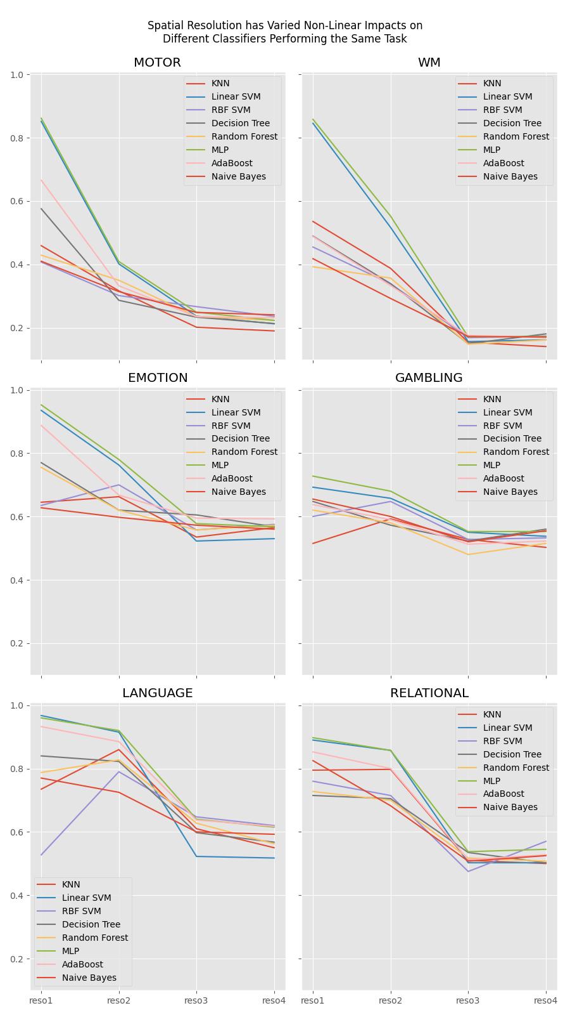
Model-wise Comparison

Slide 10
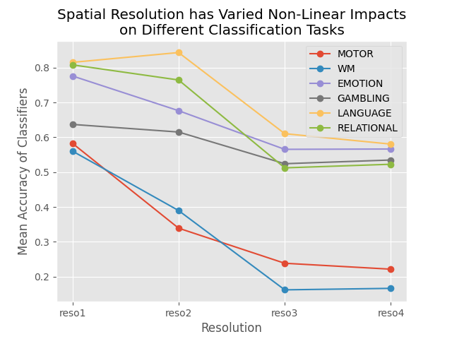
Task-wise Comparison
Outcomes:
Non-linear relationship
Model-wise variability
Task-wise variability
Future works:
Quantification of the correlation
More fine-grained scales

Slide 11
Code available at https://github.com/trumpeter122/NMA2025-fMRI-Spatial-Resolution-and-Neural-Decoding.git
Thank You

