Slide 1
Team 45
[COMP-90042] Cluster and Cloud Computing
Mayank Sharma
(936970)
Duc Trung
Nguyen
(1069760)
Hong Ngoc
Nguyen
(1113959)
Ting-Yu Lin
(1100175)
Nhan Kiet To
(1043668)
Platform Deployment
Data Analysis
Front-end
Tweet Crawling
Back-end
Front-end

Slide 2
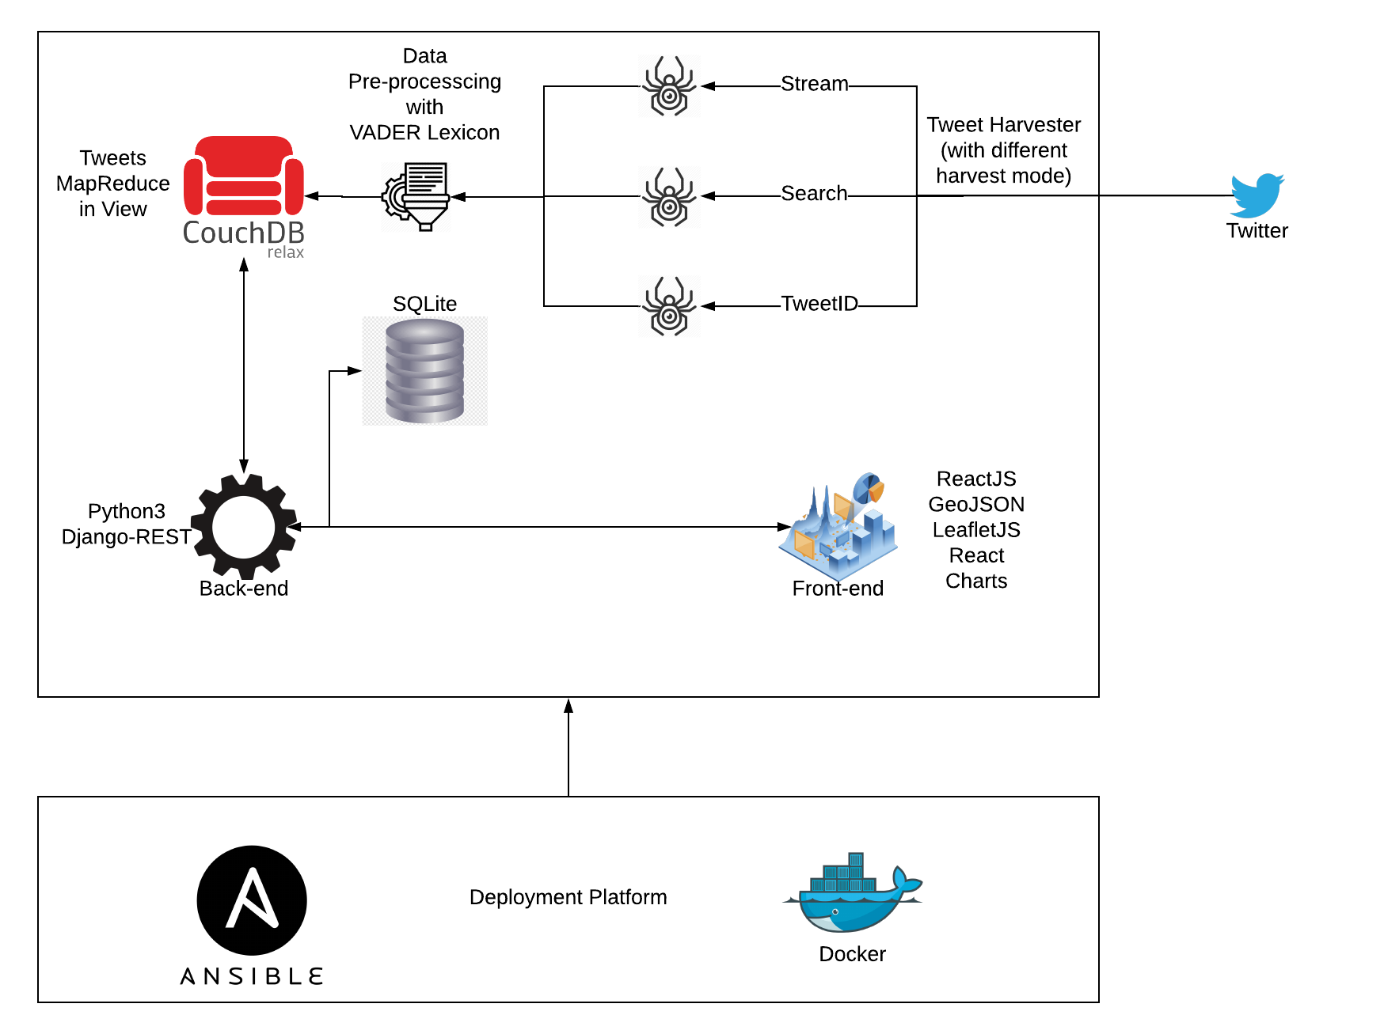

Slide 3
Data Scenario
COVID-19 affects our daily life significantly, in terms of emotion and mobility.
We have built a system to visualize the emotion dynamic and the activity of people in Australia. Also, showing how Australia politicians response.

Slide 4
Results
Emotion
Movement
Politics

