Slide 1

IBM Applied Data Science Capstone Project

Slide 2

This project is an attempt to use data science tools to help find a place to open a coffee shop in the Downtown of Toronto.
Finding a right place to open a venue is very important for a businessman. For a coffee shop, it is essential that it is close to many places such as restaurants to be attractive to more customers.
Our job will be to use data science tools to recommend such a neighborhood in Downtown Toronto

Slide 3

We will need geographical data of Downtown Toronto and its neighborhoods.
For each neighborhood, we want a list of venues within a distance from the center.
We can get data from Wiki pages and FourSquare.

Slide 4

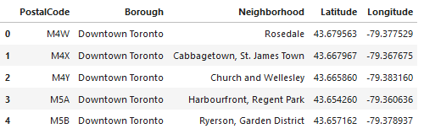
We scrape the table from Wiki page, clean the raw data, and get coordinates of all neighborhoods of Downtown Toronto.
This data frame has 18 rows.

Slide 5
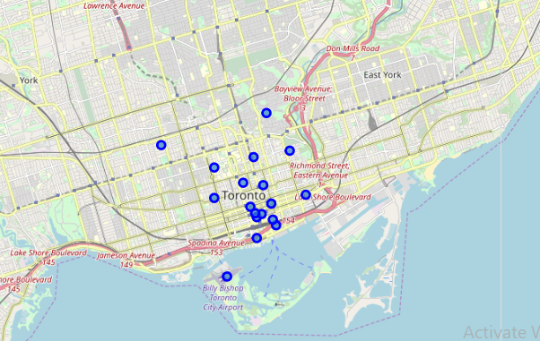
With help from Python library Folium we can visualize map of all neighborhoods of Downtown Toronto

Slide 6

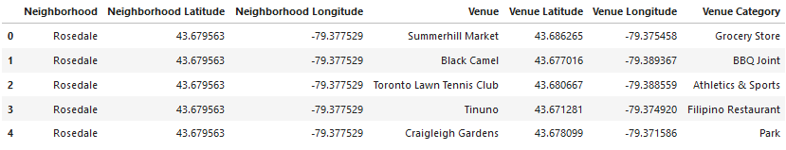
We send requests to FourSquare to get a list of venues within 1.0 km from the center of each neighborhood.

Slide 7
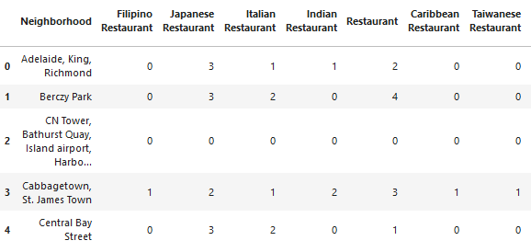
We perform onehot encoding based on Venue category, and extract only categories that are restaurants.
For each such category we count the total number of venues.
This frame has 18 rows and 41 columns.

Slide 8
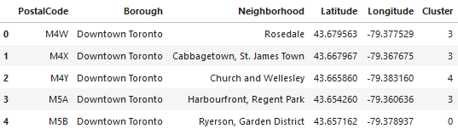
We apply k-means clustering algorithm to divide the neighborhoods into 5 clusters, each cluster consists of neighborhoods of similar diversity of restaurants.

Slide 9
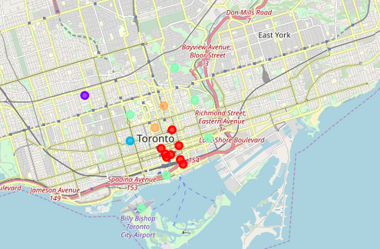
Apply Folium to visualize the clusters

Slide 10

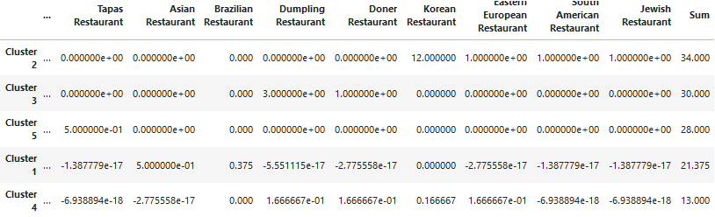
After clustering neighborhoods into clusters of similar diversity, we examine the centers of the clusters, and sort them in the descending order with respect to the total number of restaurants.

Slide 11

Cluster 2 has the largest sum.
Let list all neighborhoods in Cluster 2.
We recommend to open the coffee shop in the neighborhoods of Chinatown, Grange Park, Kensington Market.

Slide 12

