Slide 1

n8n Builders Challenge
Hackathon · Ho Chi Minh City
Saturday, 19 Sep 2026 · 09:00–12:00 · MindX Technology School
Notes:
Welcome everyone to the n8n Builders Challenge in Ho Chi Minh City. Quick intro to n8n, the ambassador program, who I am, then straight into the rules and building.

Slide 2



What is n8n?
n8n (pronounced "n-eight-n") is an AI workflow automation platform. Connect your apps, add AI, and let repetitive work run itself by linking nodes on a visual canvas.
Trigger
Process
Act
Something happens: a new email, a form submission, a webhook or a schedule. The workflow starts.
Nodes fetch, filter and transform data. Drop in an AI Agent to read, reason and decide.
Post to Slack, update a Sheet, create a CRM record. Automatically, every single time.
Notes:
For newcomers: think of n8n as LEGO for automation. Every workflow is Trigger, Process, Act. You can go fully no-code, and drop into JavaScript or Python when you need to.

Slide 3





Why Start with n8n?
500+ Integrations
Ready-made nodes for Google, Slack, Notion, OpenAI and more. HTTP Request covers any other API.
Simple enough to see.
Powerful enough to ship.
Start with drag-and-drop. Add code when you need it. Your first workflow can run in minutes.
AI-Native by Design
Build AI agents, RAG and multi-agent flows. Swap LLMs without rebuilding.
Open & Self-Hostable
Fair-code with 200K+ GitHub stars. Use n8n Cloud or run it on your own Docker or Kubernetes.
Notes:
Three reasons n8n is a great first automation tool: huge integration library, AI built in, and you own your data because you can self-host. 200K+ community members worldwide.

Slide 4


The n8n Ambassador Program
Community leaders who represent n8n locally and globally. Interested? Apply at n8n.io/ambassadors
Host & Teach
Share Expertise
Connect People
Run meetups, workshops and hackathons, just like today’s challenge.
Publish templates, tutorials and real-world use cases for everyone to reuse.
Be the face of the local community, linking builders, companies and the n8n team.
Notes:
Ambassadors are volunteers who grow n8n communities in their cities: hosting events, sharing knowledge, connecting people. If you enjoy today, consider applying at n8n.io/ambassadors.

Slide 5
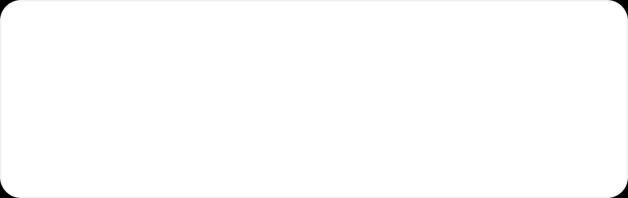
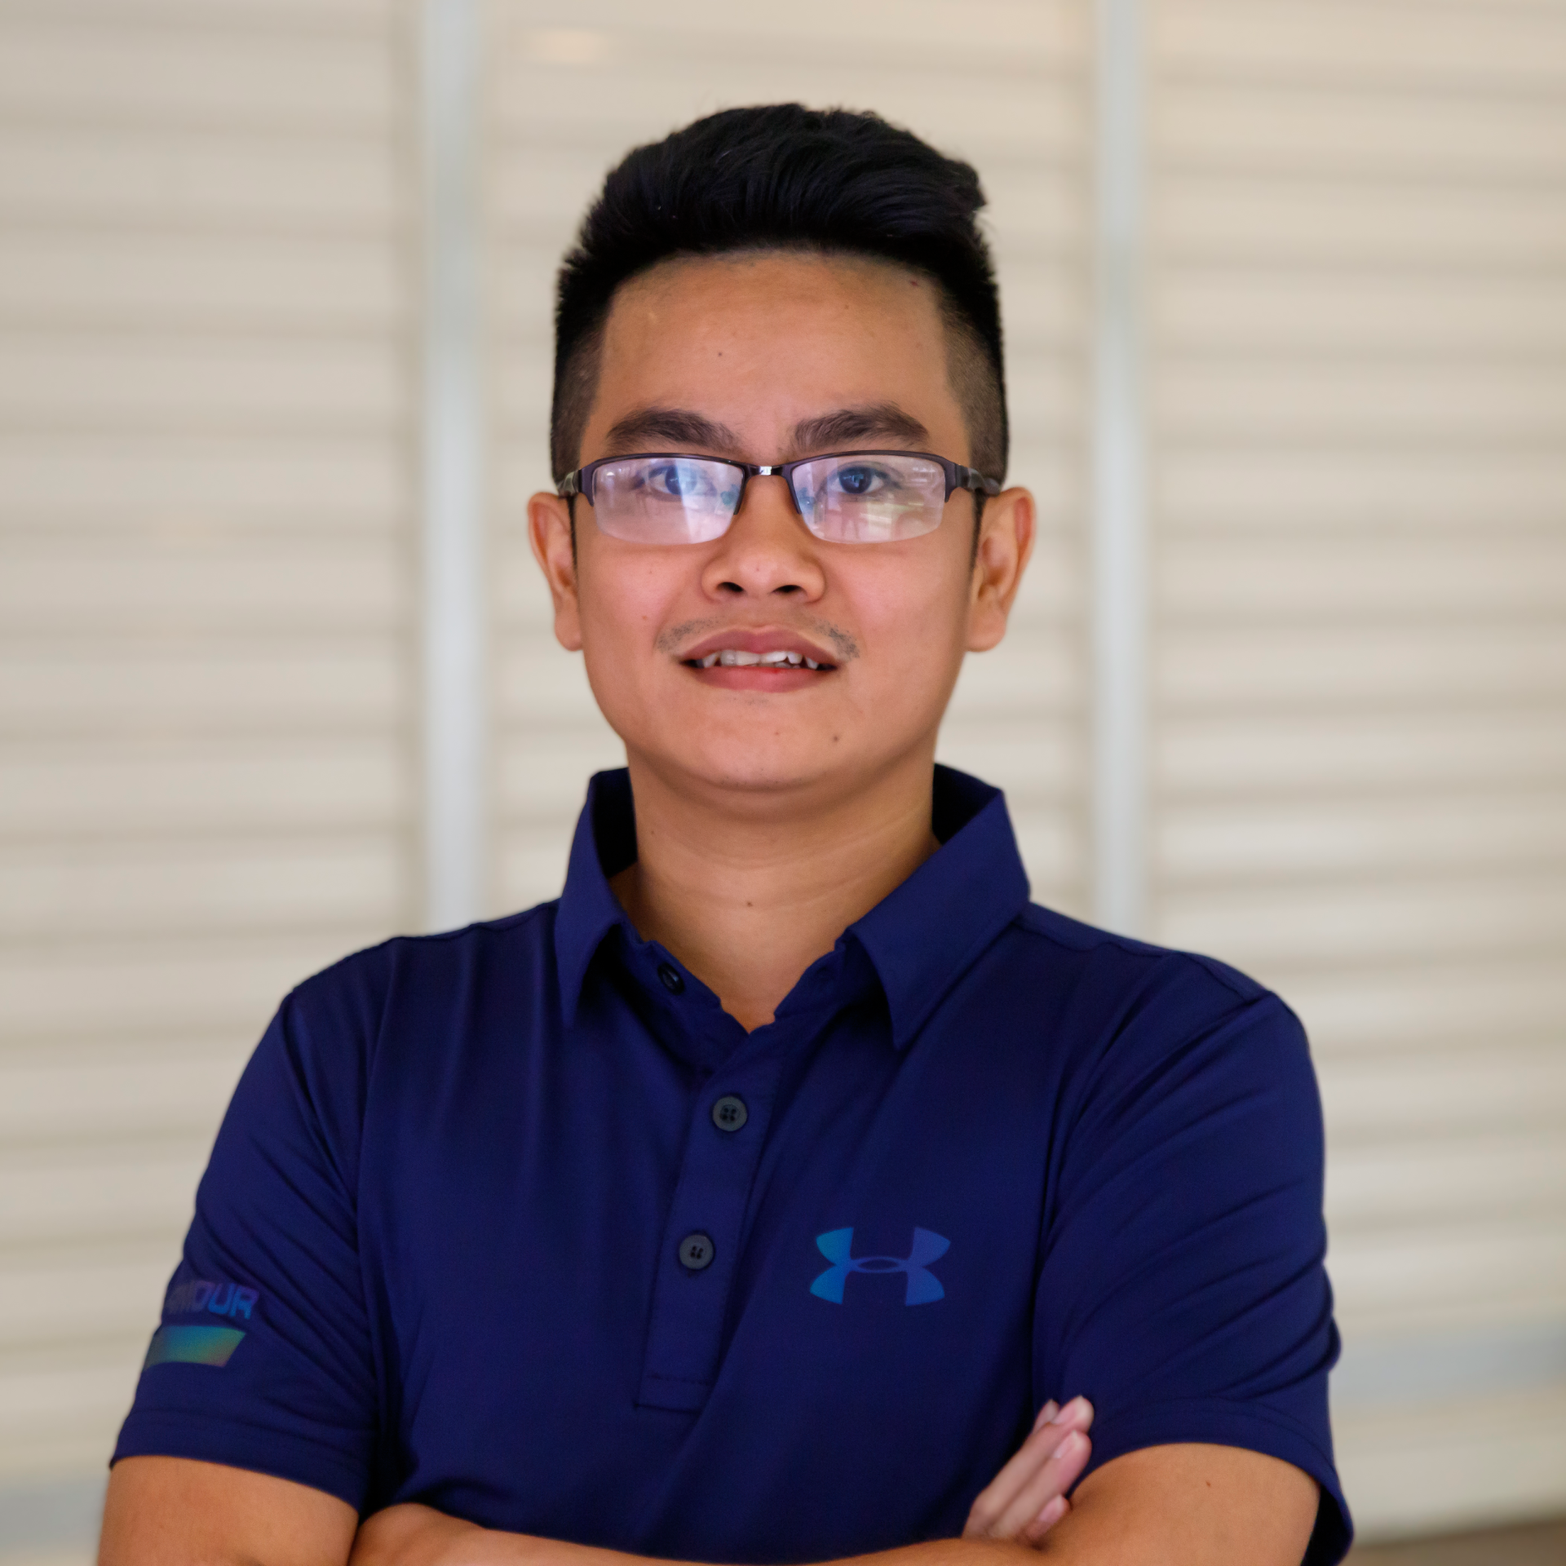
Meet Your Ambassador
#44 n8n Creator Worldwide
Ranked among the top n8n Creators globally, creating since April 2025.
35+ Published Templates
Ready-to-use workflows on the official n8n template library, free for everyone.
Trung Tran
Official n8n Ambassador · Ho Chi Minh City
n8n Creator since April 2025 and official ambassador since June 2026. Here to help you build your first (or fiftieth) workflow.
AI Application Builder
Builds AI agents and automations that make it to production.
Notes:
Short personal intro: n8n Creator since April 2025, 35+ published templates, ranked #44 worldwide. Official n8n Ambassador for Ho Chi Minh City since June 2026. Focused on building AI applications.

Slide 6
The Hackathon
n8n Builders Challenge
2 hours · 10 business briefs · teams of 2–4
Notes:
Now the main event.

Slide 7

Saturday, 19 September: Agenda
MindX Technology School, 9F International Plaza, 343 Pham Ngu Lao, District 1. Free entry · mentors on the floor all morning.
09:00 Check-in
09:15 Kick-off
09:30 Build
10:40 Demos
11:40 Results
Badge pickup, coffee and networking.
Rules explained and three business briefs revealed.
Teams of 2–4 build n8n workflows with mentor support.
Each team gets four minutes to demo live to the judges.
Prizes, then wrap-up and group photo at 12:00.
Notes:
Walk through the timeline. Building time is about 100 minutes, so scope small and ship.

Slide 8


How the Challenge Works
Before You Build
Bring a laptop (n8n instance will be provided)
Form teams of 2–4 (pre-formed teams welcome)
Pick one of the three business briefs
Judging & Demo
Stuck? Grab an on-floor mentor anytime
Usefulness: solves a real business problem
New to n8n? Ask for a quick walkthrough
Completeness: works end-to-end
Aim for a workflow that actually runs
Shipping feasibility: could go live soon
Four-minute live demo, show it running
Winning templates shared with the community
Learn from each other and have fun
Notes:
Judges score on three things: usefulness, completeness and shipping feasibility. A simple workflow that runs beats an ambitious one that doesn't.

Slide 9

What’s Next: Meet Offline Every 2 Months
Bi-monthly offline meetups
The n8n Ho Chi Minh City community meets in person every two months (hackathon, workshop, meetup and more…).
Talks, demos & build sessions
From your first workflow to production AI agents, for newbies and veterans.
Stay in the loop
Follow our Luma page and join the community group to catch the next date.
Notes:
This is just the start. We'll run an offline event every two months. Want to speak or host? Come talk to me.

Slide 10

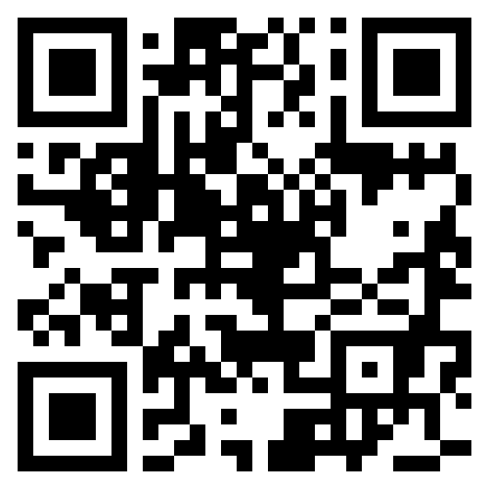
Thank you! Now let’s build.
www.n8nambassador.com
Notes:
Thank you. Let's kick off the building phase!

