Slide 1
Galactic Swarm Optimization

Slide 2
Introduction and ideas
Galactic Swarm Optimization
Choosing Parameters

Slide 3
1. Introduction and ideas
1.1. Introduction
1.2. Ideas

Slide 4
1.1. Introduction

Slide 5
1.2. Ideas
GSO draws an inspiration from the motion of stars inside galaxies and motion of clusters and superclusters of galaxies
1. the motion of stars in galaxies under the attractive influence of large masses
2. on a larger scale, entire galaxies appear as point masses and are attracted to other galaxies
Movement of members of the population towards better solutions can be implemented with other population based strategies ( like swarm optimizations, GA, … )

Slide 6
2. Galactic Swarm Optimization (GSO)
The activities of stars and galaxies are emulated following 2 rules:
1. First, individuals in each subpopulation are attracted to better solutions in the subpopulation according to the PSO algorithm. (phase 1)
2. each subpopulation is assumed to be represented by the best solution found by the subpopulation and treated as a superswarm. PSO is used again.(phase 2)
Some notes:
Phase 1: exploration, phase 2: exploitation. Phase 1 influences to Phase 2, but there is no feedback or information from Phase 2 for preserving diversity of solutions.
In each epoch (consisting of 2 phases) the best solution at phase 2 is saved for the next epoch.

Slide 7
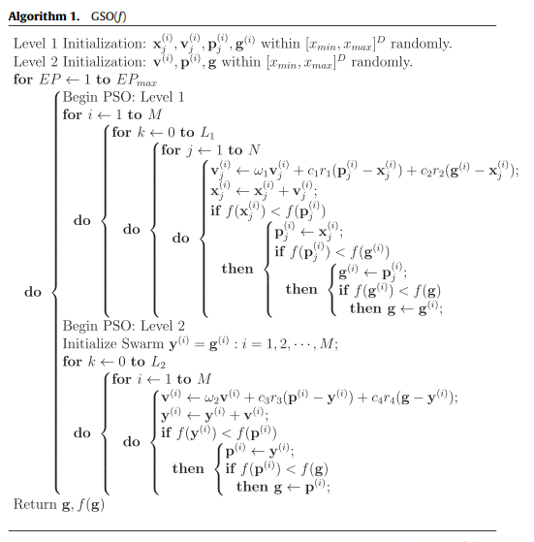
GSO - pseudo code

Slide 8
3. Choosing parameters
The total number of interations in phase 1 : M x N x L1
The total number of interations in phase 2 : M x L2
Likewise for the second level the M global bests of the first level are collected and the second level of PSO is run for the superswarm.
Phase 1: Exploration, Phase 2: Exploitation
In order to obtain exploitation at level comparable to exploration, Phase 1 and Phase should perform similar function evaluation.
So for choosing parameters strategies: M x N x L1 = M x L2
L2 = N x L1
( with M: the number of subswarms at phase 1, N : amount of solutions in each subswarm, L1 and L2 : number of iterations at phase 1 and 2 respectively. )

