Slide 1
THESIS Topic: ISLO - An Improved Sea Lion Optimization Algorithm and Application to Optimizing Cascade Feedforward Neural Network For Cloud Resource Consumption Prediction Problem
Supervisor: Dr. Nguyen Binh Minh
Student: Tran Quang Trung
Student ID: 20154002

Slide 2
CONTENTS
Introduction
Improvements and Proposed Models
Experiments
Conclusion and Future Work

Slide 3
1. INTRODUCTION
1.1. Swarm-based Optimization Algorithms
1.2. Auto-scaling Problem in Cloud Environment
1.3. The Thesis Works

Slide 4
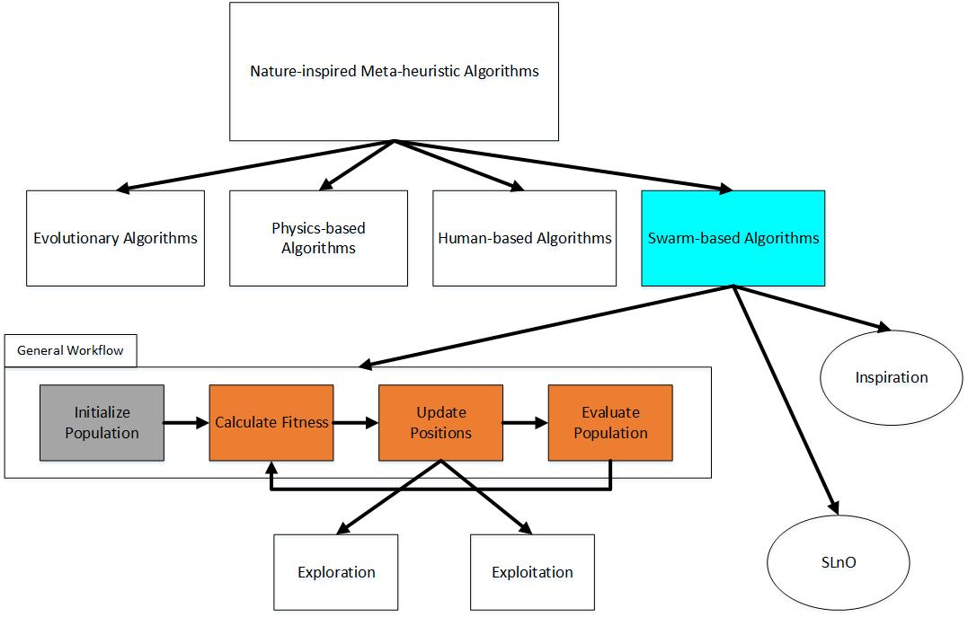
1.1. Swarm-based Optimization Algorithms

Slide 5
1.2. Auto-scaling Problem in Cloud Enviroment

Slide 6
1.3. The Thesis Works
Improve Sea Lion Optimization (SLnO) algorithm.
Use ISLO to optimize Cascade Feedforward Neural Network (ISLO-CFNN model).
Apply ISLO-CFNN model to solving Resources Consumption Prediction problem.

Slide 7
2. IMPROVEMENTS AND MODEL
2.1. Improved Sea Lion Optimization (ISLO) algorithm
2.2. Proposed Model

Slide 8
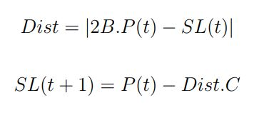
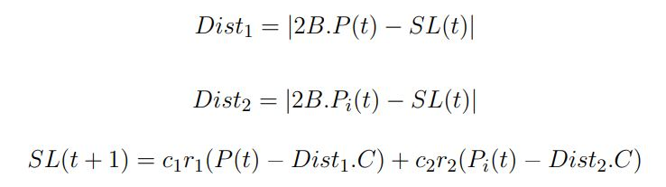
2.1. ISLO algorithm (1)
Improvement in exploitation phase
Original SLnO
ISLO

Slide 9




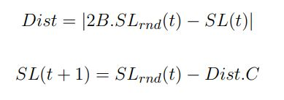
2.1. ISLO algorithm (2)
Improvement in exploration phase
Original SLnO
ISLO
is a random search agent from the current population.
is a random search agent from the current population.
is the best search agent from the current population.

Slide 10
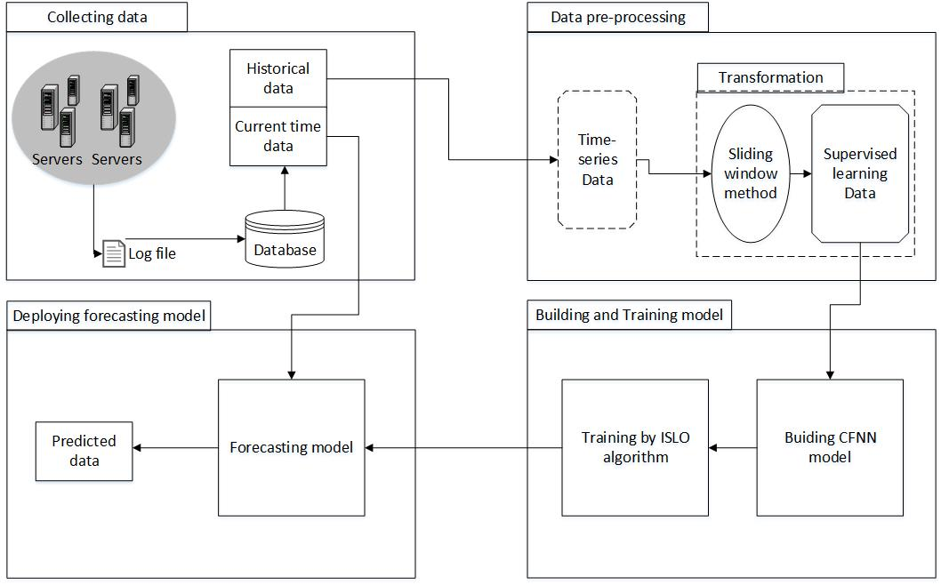
2.2. Proposed Model

Slide 11
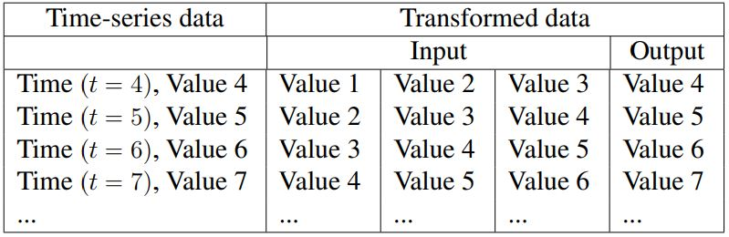

Data Pre-processing
Data Transformation
Data Normalization

Slide 12
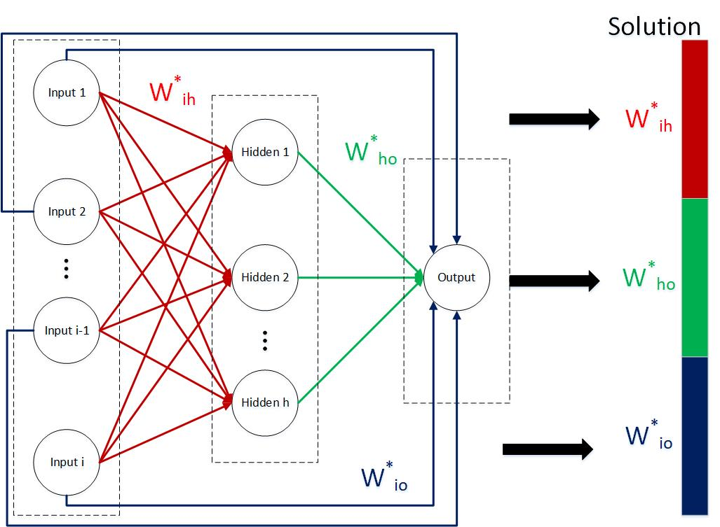
ISLO-CFNN Model – Solution Initialization

Slide 13
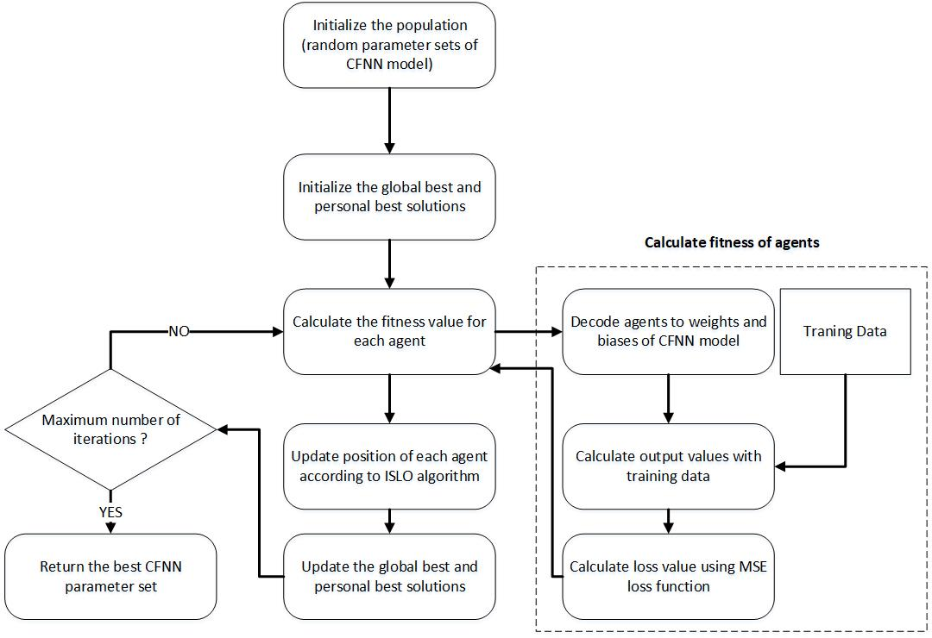
ISLO-CFNN Model – Workflow

Slide 14
3. EXPERIMENTS
3.1. ISLO Experiment
2.2. ISLO-CFNN Experiment

Slide 15
3.1. ISLO Experiment
30 benchmark functions belonging to 4 kinds of functions (CEC 2014 & CEC 2015):
Unimodal functions (F1-F8)
Multimodal functions (F9-F16)
Hybrid functions (F17-F23)
Composition functions (F24-F30)
Experiments on dimension of 50 for each functions
Compared nature-inspired algorithms: GA, PSO, WOA, SLnO, TWO, QSO

Slide 16
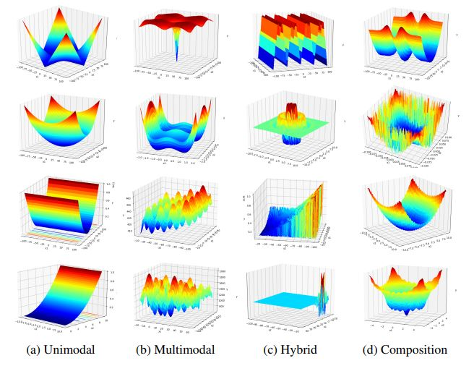
Simulation of several functions

Slide 17
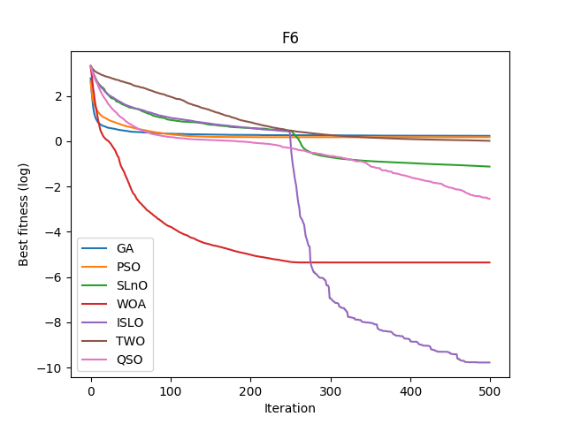
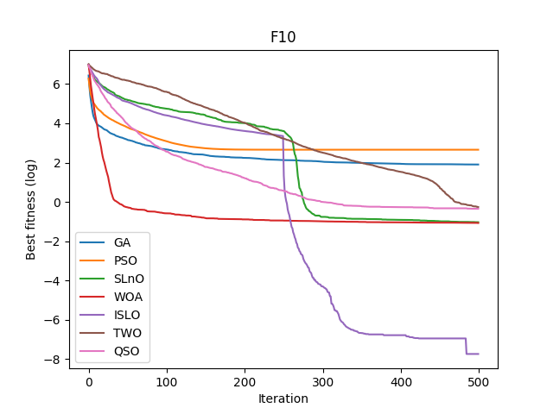
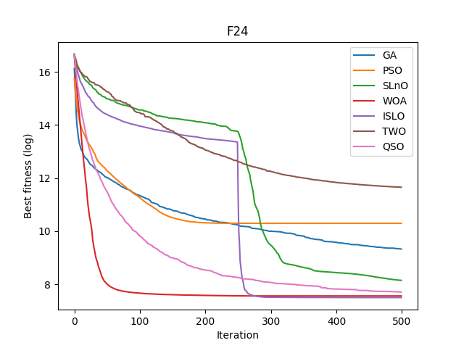
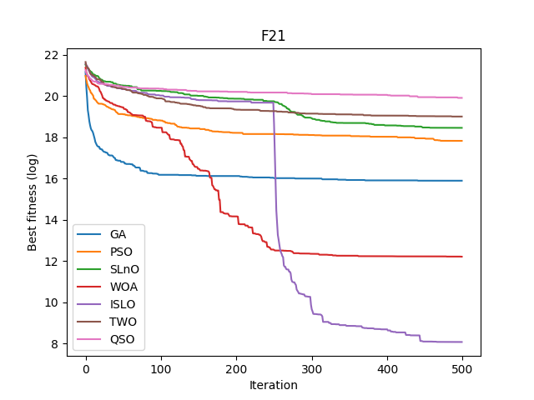
Simulation of Experiment Results

Slide 18
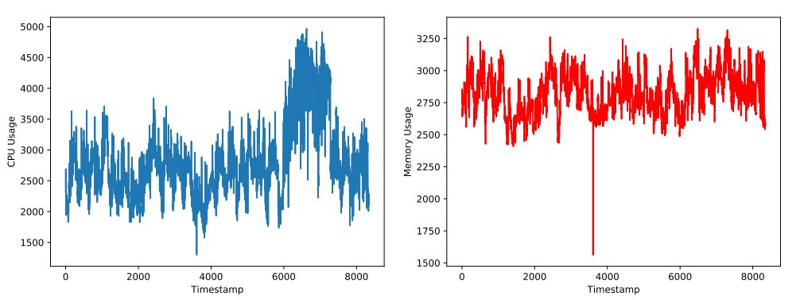
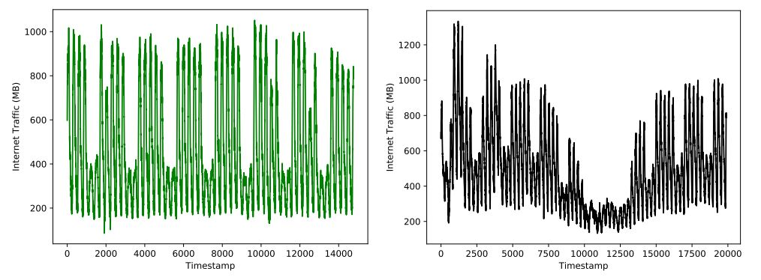
3.2. ISLO-CFNN Experiment - Data

Slide 19
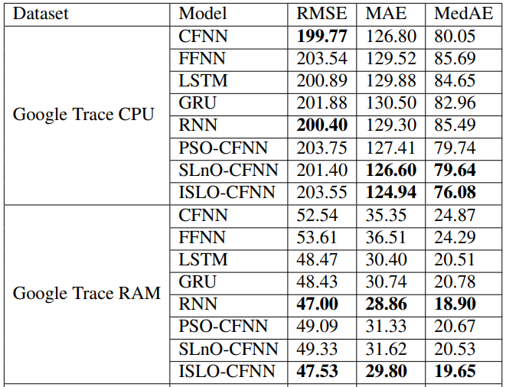
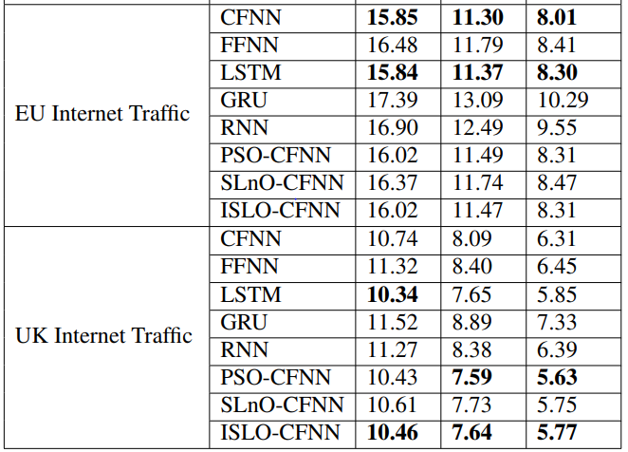
3.2. ISLO-CFNN Experiment – Results (1)

Slide 20
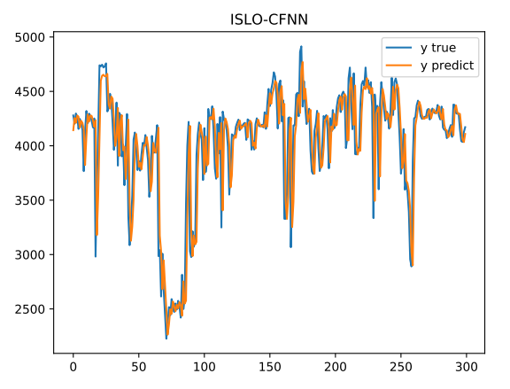
3.2. ISLO-CFNN Experiment – Results (2)
Simulation of ISLO-CFNN’s prediction in Google Trace CPU data.

Slide 21
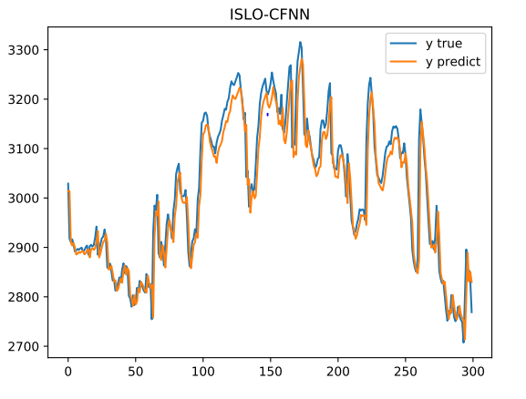
3.2. ISLO-CFNN Experiment – Results (3)
Simulation of ISLO-CFNN’s prediction in Google Trace RAM data.

Slide 22
4. CONCLUSION and FUTURE WORK
4.1. Conclusion
4.2. Future Work

Slide 23
4.1. Conclusion
The thesis already tackles the following works:
Improve SLnO to ISLO algorithm .
Apply ISLO to optimize CFNN model for solving Resources Consumption Prediction problem.

Slide 24
4.2. Future Work
Accelerate ISLO’s convergence speed.
Apply ISLO to hyper-parameter tuning process for Deep Learning models.

