Slide 1
TRIPLEU / APAC HPC-AI 2026
Serving the full model. Meeting the latency gate.
Qwen3-235B-A22B
PD disaggregated inference
BEST INTERNAL RESULT
1,912.30
VNUHCM - TripleU
good output tokens/s
97.44% SLA fraction
N48 / 16 H200
Evidence snapshot | 12 October 2026
Local measurements; organiser re-run and accuracy validation pending.
VNUHCM - TripleU | APAC HPC-AI 2026
01
Notes:
Our declared Qwen Basic result serves the official FP8 checkpoint on 16 H200 GPUs with plain prefill/decode disaggregation. The winning measured configuration is P8-TP4_D8-TP8-EP8 at N48, with our request-scoped NIXL descriptor patch. It achieves 1912.30 good output tokens/s and 97.44% SLA. These are local measurements, not an official organiser score.

Slide 2
QWEN / AI TASK
Best measured stack, with explicit limits
GOOD OUTPUT RATE
REQUESTS WITHIN BOTH SLAs
VALIDATION STATUS
1,912.30
97.44%
Pending
req/s goodput × 200
9.56150 good req/s
1,180 / 1,211 requests
0 errors; 0 cancellations
Full-set accuracy
Organiser official re-run
Evidence: job 22415 / confirm / N48; canonical AIPerf export.
VNUHCM - TripleU | APAC HPC-AI 2026
02
Notes:
Job 22415 used the long 60/120/30 protocol. Of 1211 profiling requests, 1180 met both latency limits; there were no request errors or cancellations. The primary packaged Slurm job now deploys this exact layout and patch, then runs the official client once at N48. Full-set accuracy and official organiser re-verification are pending.

Slide 3
QWEN / AI TASK
Throughput counts only when latency passes
WORKLOAD
PER-REQUEST SLA
POINT ACCEPTANCE
4,000 → 200
3,000 / 20
≥ 90%
Synthetic Shakespeare inputs
Official FP8 checkpoint
TTFT ≤ 3,000 ms
Mean ITL ≤ 20 ms
Requests must pass both
Errors stay in denominator
Closed-loop load: a completed request is immediately replaced, sustaining N concurrent requests.
Task Rules + 2026-09-25 addendum, included under AI_Task/logs/rules/.
VNUHCM - TripleU | APAC HPC-AI 2026
03
Notes:
TTFT measures the wait for the first token. The per-request average ITL measures the time between output tokens. A good request must meet both TTFT at most 3000 ms and mean ITL at most 20 ms. At least 90% must pass; errors remain in the denominator. The synthetic Shakespeare performance workload is distinct from full-set model accuracy checks.

Slide 4
QWEN / AI TASK
One platform, one unchanged checkpoint
COMPUTE
2 × HGX H200 nodes / 16 GPUs total
NETWORK
InfiniBand NDR between the two nodes
MODEL
Qwen3-235B-A22B-Instruct-2507-FP8
SERVING
SGLang 0.5.17 / router 0.3.2 / NIXL 1.3.2
CLIENT
AIPerf 0.12.0; pinned official tokenizer
PRECISION
Published FP8 weights / BF16 KV (auto, verified in logs)
Image metadata, SHA256 and model metadata: AI_Task/job_scripts/environment.json.
VNUHCM - TripleU | APAC HPC-AI 2026
04
Notes:
The platform is two eight-GPU H200 nodes connected by InfiniBand. We reuse the exact organiser SGLang and AIPerf images. SGLang is version 0.5.17, the router 0.3.2, NIXL 1.3.2 and AIPerf 0.12.0. The published FP8 weights are unchanged; worker logs confirm BF16 KV. The included module is a read-only serving-source overlay, not a rebuilt or requantised model.

Slide 5
QWEN / AI TASK
Best layout: 2 prefill + 1 decode worker
NODE 0 / 8 H200
NODE 1 / 8 H200
Prefill worker 0 · 4 GPUs · TP4 / EP1
Decode worker 0
8 GPUs · TP8 / EP8
KV cache
NIXL →
Prefill worker 1 · 4 GPUs · TP4 / EP1
AIPerf N48 → OpenAI-compatible gateway :8000 → Prefill → Decode → streamed tokens
P8-TP4_D8-TP8-EP8 / N48; hetero-tp-request-descriptors-v1; job 22415.
VNUHCM - TripleU | APAC HPC-AI 2026
05
Notes:
Node 0 has two prefill workers, each TP4/EP1 using four GPUs. Node 1 has one decode worker, TP8/EP8 using eight GPUs. NIXL transfers KV across the two possible P/D pairs. All scored requests target the OpenAI-compatible gateway, rather than worker endpoints. No tensor-parallel group spans both nodes.

Slide 6
QWEN / AI TASK
Starting layouts establish our measured reference
Reference layout 07
Previous best layout 09
Prefill: 4 workers × TP2
Decode: 2 workers × TP4 / EP4
Node split: 8 + 8 GPUs
Long run: N32
Prefill: 2 workers × TP4
Decode: 2 workers × TP4 / EP4
Node split: 8 + 8 GPUs
Long run: N40
Trade-off: fewer prefill replicas, wider tensor parallelism; measure the balance under the SLA.
07 and 09 are organiser-provided starting layouts; the team extends the search and transport.
VNUHCM - TripleU | APAC HPC-AI 2026
06
Notes:
Layouts 07 and 09 are organiser-provided starting examples, not libraries or models created by our team. Layout 07 uses four TP2 prefill workers; 09 uses two TP4 prefill workers. Both use two TP4/EP4 decode workers. The previous best was 09/N40. We extend the topology search, select load and patch KV descriptor preparation. The improvement does not isolate one variable.

Slide 7
QWEN / AI TASK
A 17-layout search, with measured coverage
GPU SPLIT P + D
PREFILL TP
DECODE TP
LAYOUTS
8 + 8
2 / 4 / 8
2 / 4 / 8
9
4 + 12
2 / 4
2 / 4
4
12 + 4
2 / 4
2 / 4
4
14/17 originals measured
+ 3 measured EP2 variants
Each completed topology has N16, N32, N40 and N48 actual measurement exports.
AI_Task/logs/COVERAGE.md; pending and failed runs are not counted as completed measurements.
VNUHCM - TripleU | APAC HPC-AI 2026
07
Notes:
The finite search contains 17 topology arrangements across 8+8, 4+12 and 12+4 GPU splits, with compatible TP2/4/8 values. Fourteen exact originals and three explicit EP2 replacements have all four measured sweep points. Three TP8/EP1 originals remain FP8-block-incompatible. Replacements are named separately; failed deployments never count as measurements.

Slide 8
QWEN / AI TASK
Screen quickly; confirm at the full duration
Deploy + initialize
Explore
Long confirmation
All P/D paths
Separate setup prompts
N16 / 32 / 40 / 48
10s + 20s + 30s
Best N48 / latest N32
60s + 120s + 30s
Official timing
60s warmup
120s measurement
30s grace
A short sweep and a long confirmation use different windows; their difference is not an optimisation gain.
Exploratory 10/20/30 vs long 60/120/30; original canonical exports retained.
VNUHCM - TripleU | APAC HPC-AI 2026
08
Notes:
Exploratory runs use 10-second warmup, 20-second measurement and 30-second grace. They screen configurations and are not official scoring runs. Long confirmation uses 60/120/30. The declared entry performs only the official N48 point, without a sweep. Separate setup prompts initialize every P/D path without using the official dataset or seed and without changing official warmup.

Slide 9
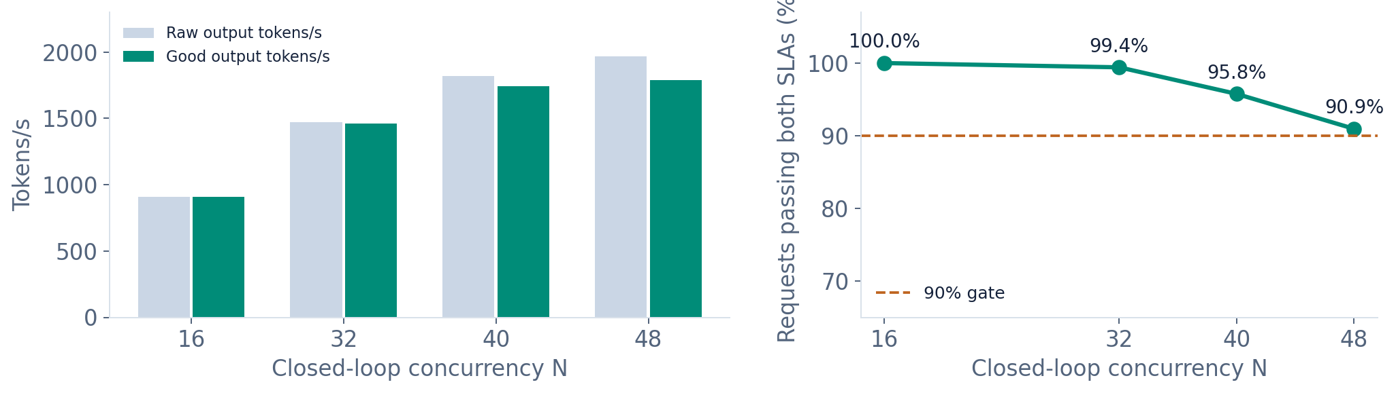
QWEN / AI TASK
Winner sweeps select N48; the long run confirms it
N48 sweep: 1,788.65 good tokens/s; 90.95% SLA. Long N48: 1,912.30; 97.44% SLA.
Job 22415 exploratory sweep: 10s warmup / 20s measurement / 30s grace.
VNUHCM - TripleU | APAC HPC-AI 2026
09
Notes:
All four winning-layout sweeps passed the 90% gate. Short N48 produced 1788.65 good tokens/s with 90.95% SLA. The long N48 confirmation produced 1912.30 with 97.44%. These windows have different durations and populations; their difference is not an optimisation speedup. We select the long confirmation as the declared performance evidence.

Slide 10
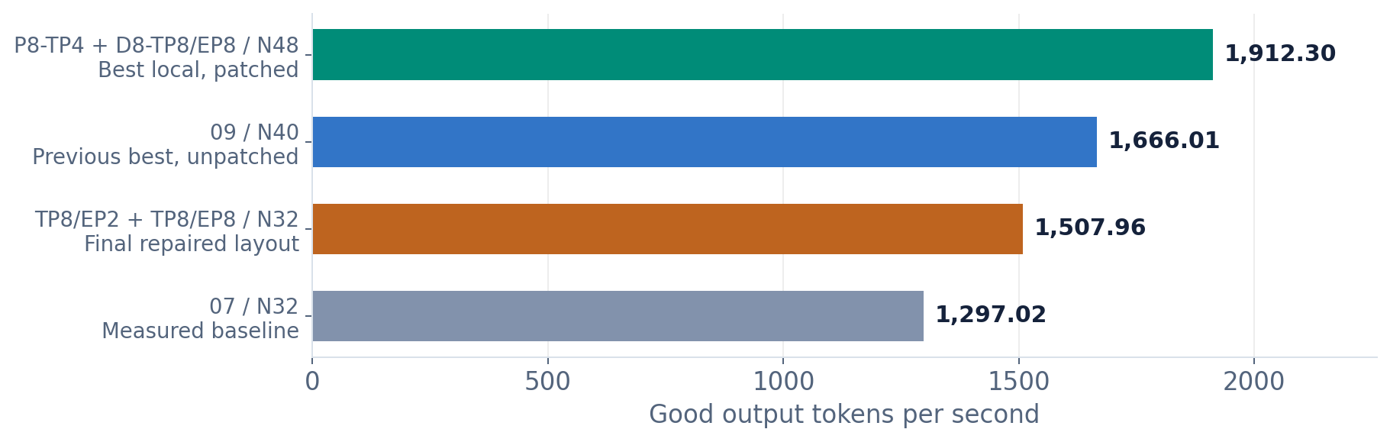
QWEN / AI TASK
Best long run: +14.78% over the previous best
Observed gain includes topology, concurrency and transport changes. Repeated matched A/B is still needed.
Jobs 22415, 22219, 22809 and 22197: long 60/120/30 runs on 16 H200.
VNUHCM - TripleU | APAC HPC-AI 2026
10
Notes:
The winning long run is 14.78% above the previous long result of 1666.01. All bars show passing long measurements on the same 16-H200 platform. Topology, concurrency and transport differ, so this is an observed end-to-end gain, not an isolated NIXL patch speedup. Repeated matched A/B testing remains useful. The baseline is our local run, not the organisers reference score.

Slide 11
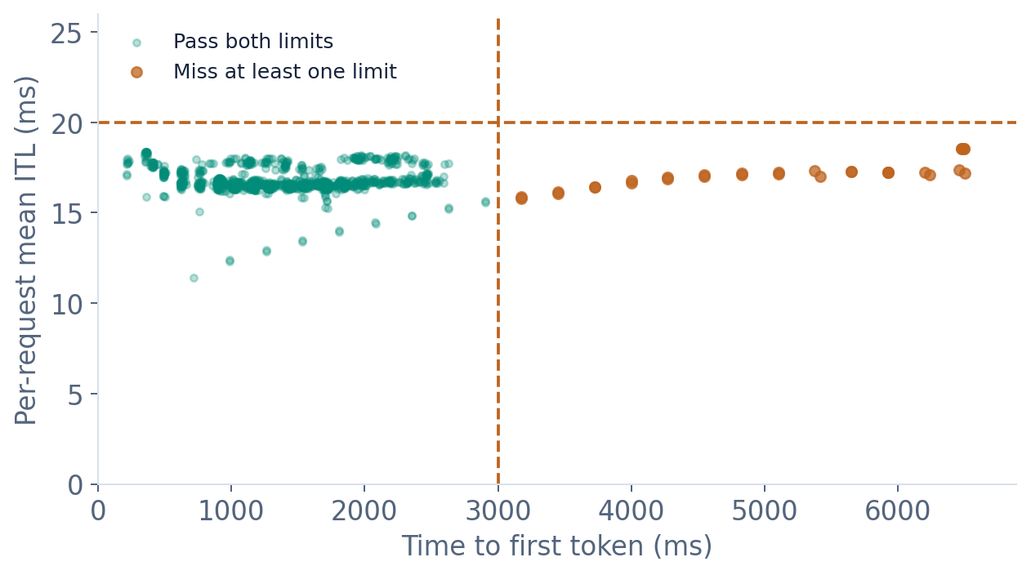
QWEN / AI TASK
Check the gate per request, not from averages
1,180 / 1,211
requests pass both limits
Mean TTFT: 1,482.22 ms
Mean ITL: 16.79 ms
P95 TTFT: 2,456.56 ms
P95 ITL: 17.99 ms
Job 22415 / confirm N48: 1,211 profiling-phase records in the original JSONL.
VNUHCM - TripleU | APAC HPC-AI 2026
11
Notes:
The original JSONL contains 1211 profiling records. Recomputing both per-request limits gives 1180 good requests, exactly matching the 97.44% aggregate fraction. Thirty-one miss a limit; none error or cancel. Aggregate means alone cannot determine whether 90% pass. The displayed TTFT and ITL statistics are performance metrics, not accuracy scores.

Slide 12
QWEN / AI TASK
Failures remain evidence; actual exports count
FP8 sharding
TP8 / EP1 gives a 192-wide expert shard; FP8 block size is 128.
Use a distinct EP2 variant; keep the EP1 original incompatible.
Cold P/D transfer
22778 timed out before measurement; patched 22809 completes.
Request-scoped descriptors; setup deadlines do not relax benchmark SLAs.
Distributed
ports
A deployment hit EADDRINUSE before producing metrics.
Assign explicit distinct ports; preserve the failed logs and source.
Immutable payloads and failed logs remain included; recovery registry distinguishes EP2 variants.
VNUHCM - TripleU | APAC HPC-AI 2026
12
Notes:
Failures expose three practical issues: FP8 expert shard dimensions, slow cold KV path setup, and distributed port collisions. Job 22778 failed before measurement and is not counted as finished. The repaired equal-TP job 22809 has four sweep exports and a long N32 confirmation. A successful repaired run does not prove that a single suspected cause explained every earlier timeout.

Slide 13
QWEN / AI TASK
EP2 makes TP8 compatible with FP8 blocks
TP8 / EP1
TP8 / EP2
128 experts / 1 expert group
1536 ÷ 8 = 192
192 is not divisible by 128
64 experts / group × 2 groups
1536 ÷ 4 = 384
384 = 3 × 128
All 3 EP2 replacements are measured. All experts and weights are retained; the originals stay
labelled.
Checkpoint: MoE intermediate size 1536, 128 experts; image loader requires block_n = 128.
VNUHCM - TripleU | APAC HPC-AI 2026
13
Notes:
TP partitions matrices inside each expert; EP distributes expert groups. With TP8/EP1, the 1536-wide dimension produces a 192-wide shard, incompatible with 128-wide FP8 blocks. EP2 gives effective TP4 and 384-wide shards, exactly three blocks, while retaining all 128 experts and weights. These are explicit variants. The winning layout uses prefill TP4/EP1 and decode TP8/EP8.

Slide 14
QWEN / AI TASK
NIXL: two request-scoped transport patches
Full-pool descriptor plan
720 + 936
≈ 403.8 million source entries / rank
CPU range cases
Both patches GPU-tested
Request-scoped plan
1,507.96
188 entries: contiguous TP8→TP4 or TP8→TP8
latest equal-TP / N32
95.38% SLA; no errors
Byte ranges, head mapping and notifications retained.
Heterogeneous TP: jobs 22294 / 22415. Equal TP8: job 22809. Original source and diffs included.
VNUHCM - TripleU | APAC HPC-AI 2026
14
Notes:
We patch SGLang integration with NIXL, not the underlying NIXL library. The heterogeneous-TP patch passed 720 CPU byte-range comparisons and is used by winning job 22415. The separate restricted equal-TP8 patch passed 936 range cases and five fallback guards; job 22809 confirms GPU operation. For contiguous TP8-to-TP4 or TP8-to-TP8 copies, 4000 tokens need 188 descriptors. This count is not universal for TP4-to-TP8 geometry. Geometry checks do not replace model accuracy.

Slide 15
QWEN / AI TASK
The primary job deploys the winning stack
01
Winning layout
2 prefill TP4 / EP1 + 1 decode TP8 / EP8; N48; all 16 H200.
02
Enabled patch
Read-only NIXL module mount; source hash checked by every worker.
03
One Slurm job
Deploy, initialize both P/D paths, run the locked official command once.
04
Reconstruction
Exact organiser images; published model; portable paths; offline cache.
AI_Task/job_scripts/submit.sbatch; README.md; nixl.patch; measured job 22415.
VNUHCM - TripleU | APAC HPC-AI 2026
15
Notes:
The primary submit.sbatch now selects the measured winning TP4-to-TP8/EP8 layout, concurrency 48 and the exact NIXL module hash. It allocates 16 GPUs, deploys three workers and the gateway, initializes two P/D pairs, then invokes the unchanged official AIPerf command in the same job. Image/model metadata, the patch as text, pinned tokenizer cache and package-relative replay instructions support reconstruction under a dedicated account.

Slide 16
QWEN / AI TASK
Correctness claims follow the available evidence
Published FP8 weights and BF16 KV, unchanged
Worker logs / source
Plain PD on 16 GPUs; no speculative decoding
Configured / local logs
Best long run / N48 latency gate
97.44% pass fraction
Full-set accuracy ≥ 99% of reference
Not yet tested
Organiser reconstruction + official scored re-run
Pending
Local latency evidence is available. Official acceptance and any Bonus validation remain pending.
Qwen addendum Q1/Q2; accuracy pass line: at least 99% of organiser reference score.
VNUHCM - TripleU | APAC HPC-AI 2026
16
Notes:
The model checkpoint and precision remain unchanged; all requests use plain PD without speculative decoding or skipped computation. The descriptor patch is intended to preserve byte geometry, but local latency and CPU geometry checks do not establish the full-set accuracy gate. The organisers accuracy threshold is 99% of their own FP8 reference score. No accuracy pass, official score or verified Bonus claim is made.

Slide 17
QWEN / AI TASK
Topology coverage complete; submission work
remains
Measured coverage
Still outstanding
14 original + 3 EP2 layouts
All four concurrency sweeps
Winning long-run evidence
Both NIXL patches and logs
Full-set accuracy check
Packaged job GPU replay
HPC/OpenFOAM evidence
Official upload and re-run
Snapshot: 2026-10-12T11:17:26.130353+00:00. Job 22809 completed 11 October, 23:18 UTC.
VNUHCM - TripleU | APAC HPC-AI 2026
17
Notes:
Fourteen original layouts plus three explicit EP2 replacements are measured at all four concurrency points. Measuring a layout does not imply that it passes the SLA. The Qwen package contains the winning entry, source patch, English presentation and raw evidence. The full-set accuracy check, packaged orchestration GPU replay and official re-run remain separate validation steps. HPC results were not supplied for this Qwen-scoped workspace.

Slide 18
TRIPLEU / DISCUSSION
Current winner: TP4 prefill + TP8 / EP8 decode
1,912.30
good output tokens per second
97.44% request SLA fraction · N48 / 16 H200 · Official FP8 model
Accuracy and organiser re-verification remain pending.
Job 22415 / N48; hetero-tp-request-descriptors-v1; long 60/120/30 measurement.
VNUHCM - TripleU | APAC HPC-AI 2026
18
Notes:
The declared current winner is 1912.30 good output tokens/s with 97.44% SLA at N48 on 16 H200 GPUs. The organisers supply the checkpoint, images, cluster and locked benchmark. Our contribution is topology/load selection and request-scoped descriptor preparation. All usable search layouts are measured. Official acceptance still depends on organiser reconstruction and accuracy checks.

Slide 19
APPENDIX / Q&A
Appendix: the final repaired layout and selection
Final layout
P8-TP8-EP2_D8-TP8-EP8; job 22809 completed.
N32 long run
1,507.96 good tokens/s; 95.38% SLA; no errors/cancels.
N40 / N48 short sweeps
89.50% / 86.06% SLA: both miss the 90% gate.
Selection
Job 22415 remains the best passing long measurement.
Interpretation
Measured coverage does not mean every layout passes SLA.
Job 22809 / equal-tp8-request-descriptors-v1; sweeps 10/20/30 and confirm 60/120/30.
VNUHCM - TripleU | APAC HPC-AI 2026
19
Notes:
Job 22809 completed the final repaired P8-TP8-EP2_D8-TP8-EP8 layout with four short sweeps and a long N32 confirmation. N40 and N48 reached only 89.50% and 86.06% SLA, below the 90% gate. N32 passed with 1507.96 good tokens/s and 95.38% SLA, but did not beat job 22415. Unpatched job 22750 points remain distinct and are not combined into the patched sweep.

