Slide 1

APAC HPC-AI 2026 / QWEN TASK
Qwen3-235B
PD inference
on 16 H200s
VNUHCM - TripleU
12 October 2026
NVIDIA HGX H200 · product reference image
Local evidence · job 22415 · organiser accuracy and official re-run pending
TripleU / APAC HPC-AI 2026
01
Notes:
Our declared Qwen Basic result serves the official FP8 checkpoint on 16 H200 GPUs with plain prefill/decode disaggregation. The winning measured configuration is P8-TP4_D8-TP8-EP8 at N48, with our request-scoped NIXL descriptor patch. It achieves 1912.30 good output tokens/s and 97.44% SLA. These are local measurements, not an official organiser score.

Slide 2
Measured result
1,912.30
97.44%
good output tokens / second
within both SLAs
Previous best
1,666.01
Declared N48
+14.78%
Job 22415 · N48 · 60s warmup / 120s measurement / 30s grace
TripleU / APAC HPC-AI 2026
02
Notes:
Job 22415 used the long 60/120/30 protocol. Of 1211 profiling requests, 1180 met both latency limits; there were no request errors or cancellations. The primary packaged Slurm job now deploys this exact layout and patch, then runs the official client once at N48. Full-set accuracy and official organiser re-verification are pending.

Slide 3
The latency gate
4,000-token prompt
200 generated tokens
PREFILL
Time to first token ≤ 3,000 ms
Mean ITL ≤ 20 ms
≥ 90% of requests must pass both. Errors stay in the denominator.
Official workload: 4000 input / 200 output tokens; TTFT ≤ 3000ms and mean ITL ≤ 20ms
TripleU / APAC HPC-AI 2026
03
Notes:
TTFT measures the wait for the first token. The per-request average ITL measures the time between output tokens. A good request must meet both TTFT at most 3000 ms and mean ITL at most 20 ms. At least 90% must pass; errors remain in the denominator. The synthetic Shakespeare performance workload is distinct from full-set model accuracy checks.

Slide 4


Two nodes. Sixteen H200 GPUs.
16 GPUs
InfiniBand NDR
MODEL
Published Qwen3 FP8
KV CACHE
BF16, verified in worker logs
SERVER
SGLang 0.5.17 / NIXL 1.3.2
CLIENT
AIPerf 0.12.0
Contest allocation: 2 × HGX H200; photo: NVIDIA H200 product page, not the contest installation
TripleU / APAC HPC-AI 2026
04
Notes:
The platform is two eight-GPU H200 nodes connected by InfiniBand. We reuse the exact organiser SGLang and AIPerf images. SGLang is version 0.5.17, the router 0.3.2, NIXL 1.3.2 and AIPerf 0.12.0. The published FP8 weights are unchanged; worker logs confirm BF16 KV. The included module is a read-only serving-source overlay, not a rebuilt or requantised model.

Slide 5

Winning topology: TP4 prefill → TP8 / EP8 decode
NODE 0 / PREFILL
NODE 1 / DECODE
Worker P0 · TP4 / EP1
Worker D0 · TP8 / EP8
KV cache
NIXL
Worker P1 · TP4 / EP1
8 GPUs
8 GPUs
P8-TP4_D8-TP8-EP8 · two P/D paths · every scored request uses the gateway
TripleU / APAC HPC-AI 2026
05
Notes:
Node 0 has two prefill workers, each TP4/EP1 using four GPUs. Node 1 has one decode worker, TP8/EP8 using eight GPUs. NIXL transfers KV across the two possible P/D pairs. All scored requests target the OpenAI-compatible gateway, rather than worker endpoints. No tensor-parallel group spans both nodes.

Slide 6
From the provided layouts to the selected split
07
09
Selected
PREFILL
PREFILL
PREFILL
4 workers × TP2
2 workers × TP4
2 workers × TP4
DECODE
DECODE
DECODE
2 workers × TP4/EP4
2 workers × TP4/EP4
1 worker × TP8/EP8
1,297.02
1,666.01
1,912.30
Long local runs: 22197 / 22219 / 22415; N32 / N40 / N48 respectively
TripleU / APAC HPC-AI 2026
06
Notes:
Layouts 07 and 09 are organiser-provided starting examples, not libraries or models created by our team. Layout 07 uses four TP2 prefill workers; 09 uses two TP4 prefill workers. Both use two TP4/EP4 decode workers. The previous best was 09/N40. We extend the topology search, select load and patch KV descriptor preparation. The improvement does not isolate one variable.

Slide 7
Seventeen usable layouts measured
P8 + D8 GPUs
P4 + D12 GPUs
P12 + D4 GPUs
Decode TP
Decode TP
Decode TP
2
4
8
2
4
2
4
2
4N
4N
4N
2
4N
4N
2
4N
4N
4
4N
4N
4N
4
4N
4N
4
4N
4N
8
EP2
EP2
EP2
All layouts: N16 / N32 / N40 / N48
Prefill TP
14 exact originals + 3 explicit EP2 replacements; incompatible TP8/EP1 originals remain labelled
TripleU / APAC HPC-AI 2026
07
Notes:
The finite search contains 17 topology arrangements across 8+8, 4+12 and 12+4 GPU splits, with compatible TP2/4/8 values. Fourteen exact originals and three explicit EP2 replacements have all four measured sweep points. Three TP8/EP1 originals remain FP8-block-incompatible. Replacements are named separately; failed deployments never count as measurements.

Slide 8

One job: deployment followed by the official benchmark
Deploy → initialize both P/D paths → AIPerf at N48
Official client timeline
60s
warmup
120s
measurement
30s
grace
Only this window contributes to goodput.
Closed loop: completion immediately triggers the next request, sustaining N48.
Primary submit.sbatch has one N48 invocation; the official command and seed are unchanged
TripleU / APAC HPC-AI 2026
08
Notes:
Exploratory runs use 10-second warmup, 20-second measurement and 30-second grace. They screen configurations and are not official scoring runs. Long confirmation uses 60/120/30. The declared entry performs only the official N48 point, without a sweep. Separate setup prompts initialize every P/D path without using the official dataset or seed and without changing official warmup.

Slide 9
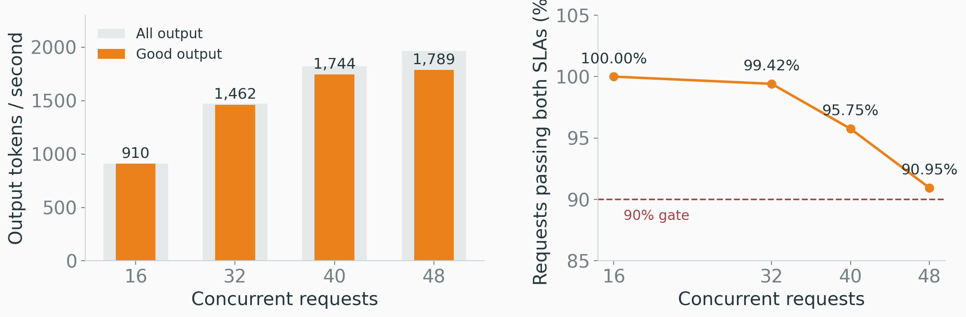
Load selection: N48 passes the short sweep
Short N48: 1,788.65 good tokens/s · 90.95% SLA
Job 22415 · exploratory 10 / 20 / 30 runs; confirmation uses a separate 120s window
TripleU / APAC HPC-AI 2026
09
Notes:
All four winning-layout sweeps passed the 90% gate. Short N48 produced 1788.65 good tokens/s with 90.95% SLA. The long N48 confirmation produced 1912.30 with 97.44%. These windows have different durations and populations; their difference is not an optimisation speedup. We select the long confirmation as the declared performance evidence.

Slide 10
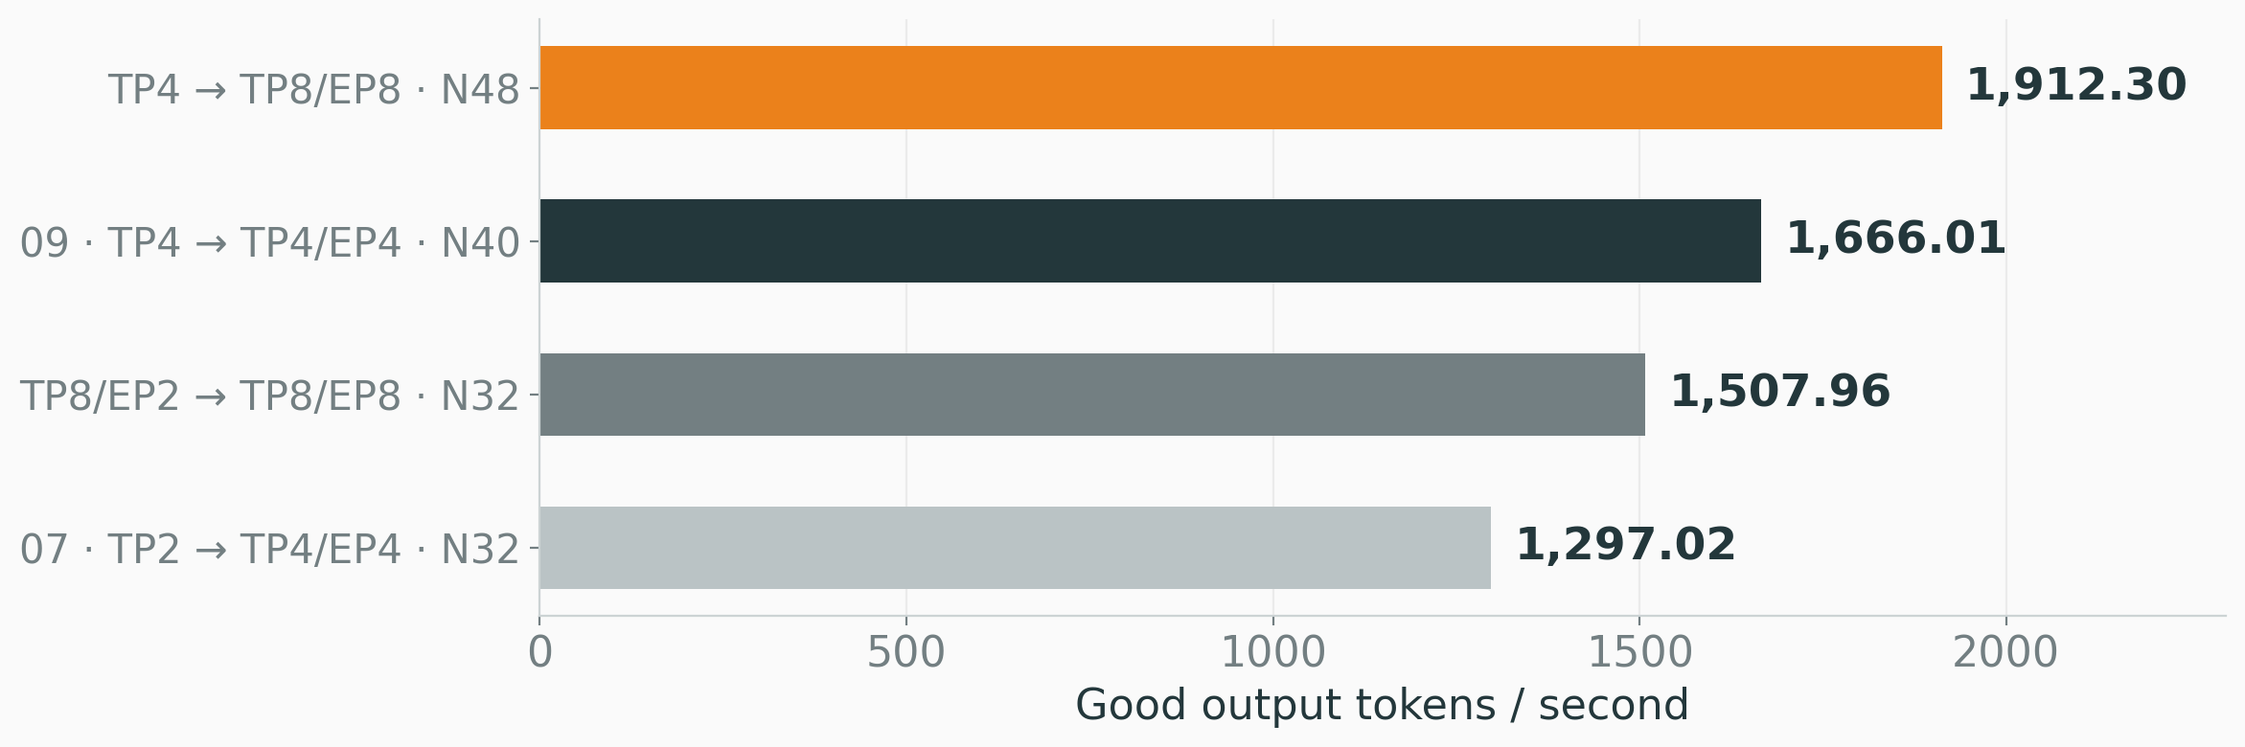
Long-run comparison: +14.78% over the previous best
Topology, concurrency and transport changed; this is an end-to-end gain.
All bars: passing local 60 / 120 / 30 confirmations on the same 16-H200 platform
TripleU / APAC HPC-AI 2026
10
Notes:
The winning long run is 14.78% above the previous long result of 1666.01. All bars show passing long measurements on the same 16-H200 platform. Topology, concurrency and transport differ, so this is an observed end-to-end gain, not an isolated NIXL patch speedup. Repeated matched A/B testing remains useful. The baseline is our local run, not the organisers reference score.

Slide 11
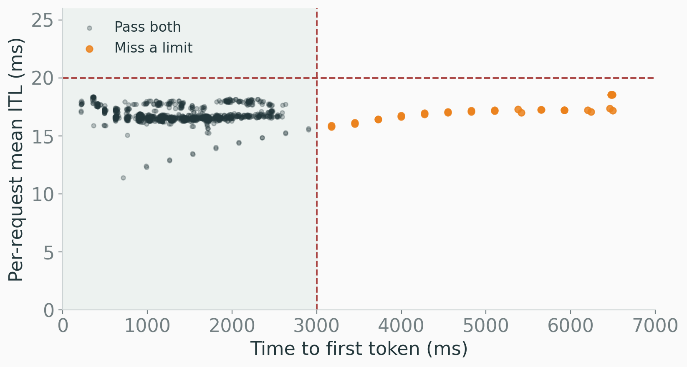
Per-request evidence: 1,180 of 1,211 pass both limits
97.44%
31 miss a limit
0 errors
0 cancellations
TTFT mean 1,482 ms
ITL mean 16.79 ms
Original job-22415 profiling JSONL; counts independently recomputed from both latency limits
TripleU / APAC HPC-AI 2026
11
Notes:
The original JSONL contains 1211 profiling records. Recomputing both per-request limits gives 1180 good requests, exactly matching the 97.44% aggregate fraction. Thirty-one miss a limit; none error or cancel. Aggregate means alone cannot determine whether 90% pass. The displayed TTFT and ITL statistics are performance metrics, not accuracy scores.

Slide 12
Cold setup failed before the benchmark began
Before / job 22778
After / job 22809
480s
COMPLETED
Pair warmup timed out.
No benchmark export.
Workers ready at 269s.
All P/D paths warm at 303s.
Four sweeps + long N32.
Failed jobs remain in the experiment history; they do not count as measurements.
Unpatched 22778 failed; equal-TP-patched 22809 completed. This does not isolate every timeout cause.
TripleU / APAC HPC-AI 2026
12
Notes:
Failures expose three practical issues: FP8 expert shard dimensions, slow cold KV path setup, and distributed port collisions. Job 22778 failed before measurement and is not counted as finished. The repaired equal-TP job 22809 has four sweep exports and a long N32 confirmation. A successful repaired run does not prove that a single suspected cause explained every earlier timeout.

Slide 13
FP8 block alignment requires a distinct EP2 variant
TP8 / EP1
TP8 / EP2
1536 ÷ 8 = 192
1536 ÷ 4 = 384
128
64
128
128
128
A partial block remains.
Three complete 128-wide blocks.
MoE intermediate dimension 1536; FP8 block_n = 128; all 128 experts and published weights retained
TripleU / APAC HPC-AI 2026
13
Notes:
TP partitions matrices inside each expert; EP distributes expert groups. With TP8/EP1, the 1536-wide dimension produces a 192-wide shard, incompatible with 128-wide FP8 blocks. EP2 gives effective TP4 and 384-wide shards, exactly three blocks, while retaining all 128 experts and weights. These are explicit variants. The winning layout uses prefill TP4/EP1 and decode TP8/EP8.

Slide 14
NIXL: describe the request, not the whole KV pool
Whole-pool plan
Request-scoped plan
403.8 million
188
source entries / rank
coalesced entries / request
CPU byte-range cases: 720 heterogeneous TP + 936 equal TP8; both patches served GPU benchmarks.
Geometry example: TP8 source, 94 layers, 4,000 contiguous tokens; not every TP4→TP8 transfer has 188 entries
TripleU / APAC HPC-AI 2026
14
Notes:
We patch SGLang integration with NIXL, not the underlying NIXL library. The heterogeneous-TP patch passed 720 CPU byte-range comparisons and is used by winning job 22415. The separate restricted equal-TP8 patch passed 936 range cases and five fallback guards; job 22809 confirms GPU operation. For contiguous TP8-to-TP4 or TP8-to-TP8 copies, 4000 tokens need 188 descriptors. This count is not universal for TP4-to-TP8 geometry. Geometry checks do not replace model accuracy.

Slide 15
The primary job deploys the winning stack
Reconstruct under a dedicated account
bash setup.sh --check
sbatch submit.sbatch
1
Recorded images
Published FP8 checkpoint; offline tokenizer.
2
Winning layout
Two TP4 prefill workers; one TP8/EP8 decode worker.
3
Enabled patch
Source hash verified by every worker before launch.
AI_Task/job_scripts/submit.sbatch · package-relative paths · read-only NIXL module overlay
TripleU / APAC HPC-AI 2026
15
Notes:
The primary submit.sbatch now selects the measured winning TP4-to-TP8/EP8 layout, concurrency 48 and the exact NIXL module hash. It allocates 16 GPUs, deploys three workers and the gateway, initializes two P/D pairs, then invokes the unchanged official AIPerf command in the same job. Image/model metadata, the patch as text, pinned tokenizer cache and package-relative replay instructions support reconstruction under a dedicated account.

Slide 16


Latency and accuracy are separate acceptance checks
Latency
Accuracy
97.44%
Pending
Organiser full-set checks
Required: ≥99% of reference
FP8 weights remain unchanged
Passing local measurement
Required: at least 90%
Full-set accuracy threshold: 99% of the organisers own FP8 reference score; no accuracy pass is claimed
TripleU / APAC HPC-AI 2026
16
Notes:
The model checkpoint and precision remain unchanged; all requests use plain PD without speculative decoding or skipped computation. The descriptor patch is intended to preserve byte geometry, but local latency and CPU geometry checks do not establish the full-set accuracy gate. The organisers accuracy threshold is 99% of their own FP8 reference score. No accuracy pass, official score or verified Bonus claim is made.

Slide 17
Declared Basic configuration
TP4 prefill → TP8 / EP8 decode
1,912.30
good output tokens / second
N48 · 16 H200 · 97.44% SLA · request-scoped NIXL descriptors
Local performance evidence; accuracy and official organiser re-verification pending
TripleU / APAC HPC-AI 2026
17
Notes:
The declared current winner is 1912.30 good output tokens/s with 97.44% SLA at N48 on 16 H200 GPUs. The organisers supply the checkpoint, images, cluster and locked benchmark. Our contribution is topology/load selection and request-scoped descriptor preparation. All usable search layouts are measured. Official acceptance still depends on organiser reconstruction and accuracy checks.

Slide 18
Appendix · the final repaired TP8 / EP2 layout
SHORT SWEEP
GOOD TOKENS/S
SLA
GATE
N16
933.50
98.15%
Pass
N32
1,393.62
93.02%
Pass
N40
1,624.14
89.50%
Fail
N48
1,708.25
86.06%
Fail
Long N32: 1,507.96 good tokens/s · 95.38% SLA
Job 22809 · equal-tp8-request-descriptors-v1; short sweeps and long confirmation are labelled separately
TripleU / APAC HPC-AI 2026
18
Notes:
Job 22809 completed the final repaired P8-TP8-EP2_D8-TP8-EP8 layout with four short sweeps and a long N32 confirmation. N40 and N48 reached only 89.50% and 86.06% SLA, below the 90% gate. N32 passed with 1507.96 good tokens/s and 95.38% SLA, but did not beat job 22415. Unpatched job 22750 points remain distinct and are not combined into the patched sweep.

Slide 19
Appendix · evidence and reconstruction
PRIMARY ENTRY
AI_Task/job_scripts/submit.sbatch
DECLARED POINT
P8-TP4_D8-TP8-EP8 / N48
SOURCE EVIDENCE
AI_Task/logs/measured/22415/
TEXT PATCH
AI_Task/job_scripts/nixl.patch
REBUILD METHOD
AI_Task/job_scripts/README.md
Team work: topology, load selection and NIXL integration.
Visual theme: Metropolis (CC BY-SA 4.0) · reference image: NVIDIA · icons: Lucide (ISC/MIT)
TripleU / APAC HPC-AI 2026
19
Notes:
Fourteen original layouts plus three explicit EP2 replacements are measured at all four concurrency points. Measuring a layout does not imply that it passes the SLA. The Qwen package contains the winning entry, source patch, English presentation and raw evidence. The full-set accuracy check, packaged orchestration GPU replay and official re-run remain separate validation steps. HPC results were not supplied for this Qwen-scoped workspace.
Visual design adapted from Metropolis by Matthias Vogelgesang, CC BY-SA 4.0, https://github.com/matze/mtheme. The reusable theme adaptation retains CC BY-SA 4.0; presentation content and original TripleU charts/diagrams are separate from the theme license. Third-party assets retain their respective rights. Product photograph: NVIDIA, https://www.nvidia.com/en-us/data-center/h200/, used as a hardware reference, not a contest-cluster photograph. Icons: Lucide, ISC/MIT licenses, https://github.com/lucide-icons/lucide. Arial was selected for cross-platform PowerPoint compatibility. No AI-generated illustration is used.

