Slide 1

APAC HPC-AI 2026 / QWEN TASK
Qwen3-235B
PD inference
on 16 H200s
VNUHCM - TripleU
12 October 2026
NVIDIA HGX H200 · product reference image
Local evidence · job 22415 · organiser accuracy and official re-run pending
TripleU / APAC HPC-AI 2026
01
Notes:
Our declared Qwen Basic result serves the official FP8 checkpoint on 16 H200 GPUs with plain prefill/decode disaggregation. The winning measured configuration is P8-TP4_D8-TP8-EP8 at N48, with our request-scoped NIXL descriptor patch. It achieves 1912.30 good output tokens/s and 97.44% SLA. These are local measurements, not an official organiser score.

Slide 2
Measured result
1,912.30
97.44%
good output tokens / second
within both SLAs
Previous best
1,666.01
Declared N48
+14.78%
Job 22415 · N48 · 60s warmup / 120s measurement / 30s grace
TripleU / APAC HPC-AI 2026
02
Notes:
Job 22415 used the long 60/120/30 protocol. Of 1211 profiling requests, 1180 met both latency limits; there were no request errors or cancellations. The primary packaged Slurm job now deploys this exact layout and patch, then runs the official client once at N48. Full-set accuracy and official organiser re-verification are pending.

Slide 3

Winning topology: TP4 prefill → TP8 / EP8 decode
NODE 0 / PREFILL
NODE 1 / DECODE
Worker P0 · TP4 / EP1
Worker D0 · TP8 / EP8
KV cache
NIXL
Worker P1 · TP4 / EP1
8 GPUs
8 GPUs
P8-TP4_D8-TP8-EP8 · two P/D paths · every scored request uses the gateway
TripleU / APAC HPC-AI 2026
05
Notes:
Node 0 has two prefill workers, each TP4/EP1 using four GPUs. Node 1 has one decode worker, TP8/EP8 using eight GPUs. NIXL transfers KV across the two possible P/D pairs. All scored requests target the OpenAI-compatible gateway, rather than worker endpoints. No tensor-parallel group spans both nodes.

Slide 4
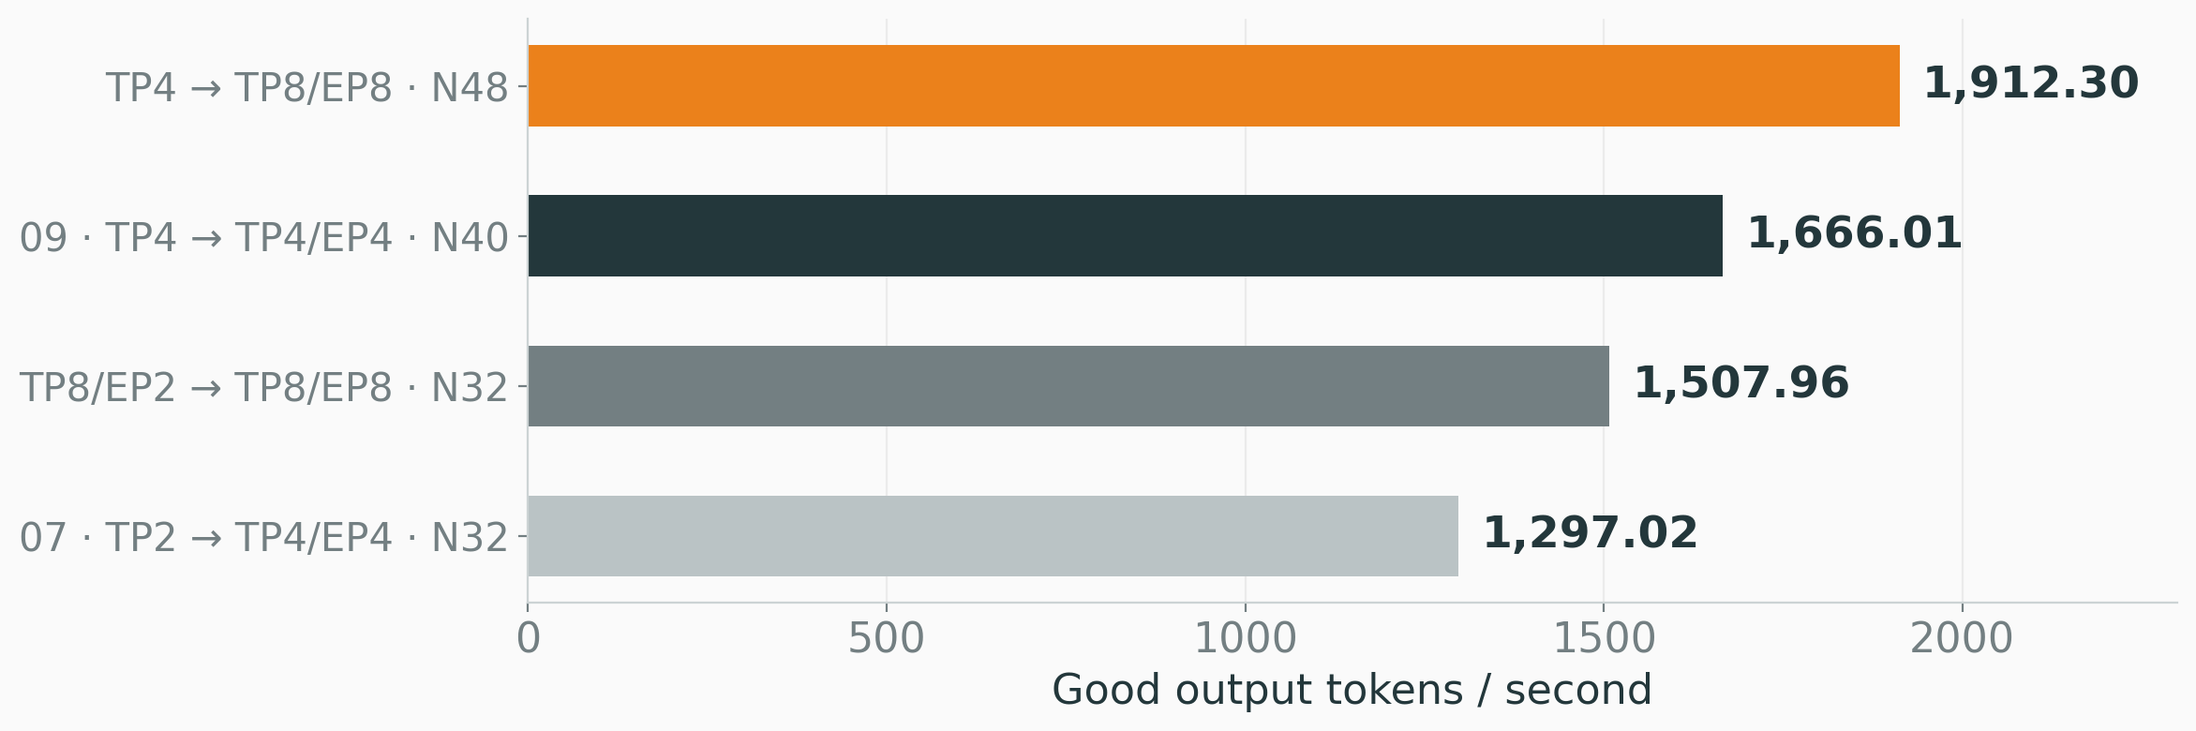
Long-run comparison: +14.78% over the previous best
Topology, concurrency and transport changed; this is an end-to-end gain.
All bars: passing local 60 / 120 / 30 confirmations on the same 16-H200 platform
TripleU / APAC HPC-AI 2026
10
Notes:
The winning long run is 14.78% above the previous long result of 1666.01. All bars show passing long measurements on the same 16-H200 platform. Topology, concurrency and transport differ, so this is an observed end-to-end gain, not an isolated NIXL patch speedup. Repeated matched A/B testing remains useful. The baseline is our local run, not the organisers reference score.

Slide 5

The primary job deploys the winning stack
Reconstruct under a dedicated account
bash setup.sh --check
sbatch submit.sbatch
1
Recorded images
Published FP8 checkpoint; offline tokenizer.
2
Winning layout
Two TP4 prefill workers; one TP8/EP8 decode worker.
3
Enabled patch
Source hash verified by every worker before launch.
AI_Task/job_scripts/submit.sbatch · package-relative paths · read-only NIXL module overlay
TripleU / APAC HPC-AI 2026
15
Notes:
The primary submit.sbatch now selects the measured winning TP4-to-TP8/EP8 layout, concurrency 48 and the exact NIXL module hash. It allocates 16 GPUs, deploys three workers and the gateway, initializes two P/D pairs, then invokes the unchanged official AIPerf command in the same job. Image/model metadata, the patch as text, pinned tokenizer cache and package-relative replay instructions support reconstruction under a dedicated account.

Slide 6
Appendix · evidence and reconstruction
PRIMARY ENTRY
AI_Task/job_scripts/submit.sbatch
DECLARED POINT
P8-TP4_D8-TP8-EP8 / N48
SOURCE EVIDENCE
AI_Task/logs/measured/22415/
TEXT PATCH
AI_Task/job_scripts/nixl.patch
REBUILD METHOD
AI_Task/job_scripts/README.md
Team work: topology, load selection and NIXL integration.
Visual theme: Metropolis (CC BY-SA 4.0) · reference image: NVIDIA · icons: Lucide (ISC/MIT)
TripleU / APAC HPC-AI 2026
19
Notes:
Fourteen original layouts plus three explicit EP2 replacements are measured at all four concurrency points. Measuring a layout does not imply that it passes the SLA. The Qwen package contains the winning entry, source patch, English presentation and raw evidence. The full-set accuracy check, packaged orchestration GPU replay and official re-run remain separate validation steps. HPC results were not supplied for this Qwen-scoped workspace.
Visual design adapted from Metropolis by Matthias Vogelgesang, CC BY-SA 4.0, https://github.com/matze/mtheme. The reusable theme adaptation retains CC BY-SA 4.0; presentation content and original TripleU charts/diagrams are separate from the theme license. Third-party assets retain their respective rights. Product photograph: NVIDIA, https://www.nvidia.com/en-us/data-center/h200/, used as a hardware reference, not a contest-cluster photograph. Icons: Lucide, ISC/MIT licenses, https://github.com/lucide-icons/lucide. Arial was selected for cross-platform PowerPoint compatibility. No AI-generated illustration is used.

