Slide 1
BÁO CÁO ĐỒ ÁN OOP ZOMBIE SLAYER

Slide 2
MỤC TIÊU
Góc nhìn top-down, camera đi theo người chơi (tạo object camera)
Thiết kế hoạt ảnh cho nhân vật, vũ khí, zombie
Thiết kế nhiều màn chơi chia thành các campaign
Có các loại vũ khí: Ak, Flamethrower, SMG,…
Có các loại zombie: zombie thường, zombie sprinter, zombie tanker
Thiết kế UI cho game

Slide 3
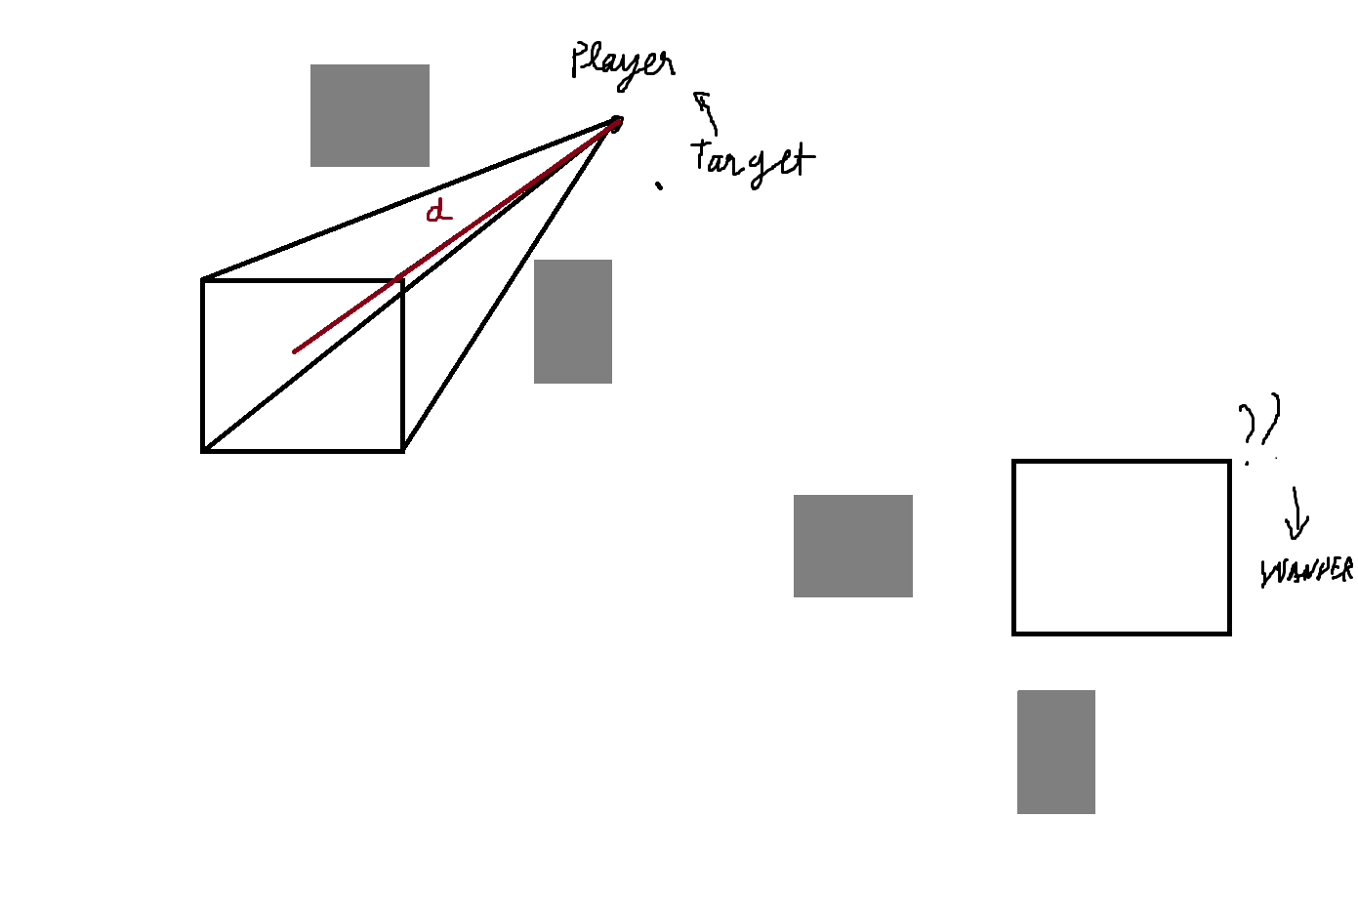
ENEMY

Slide 4
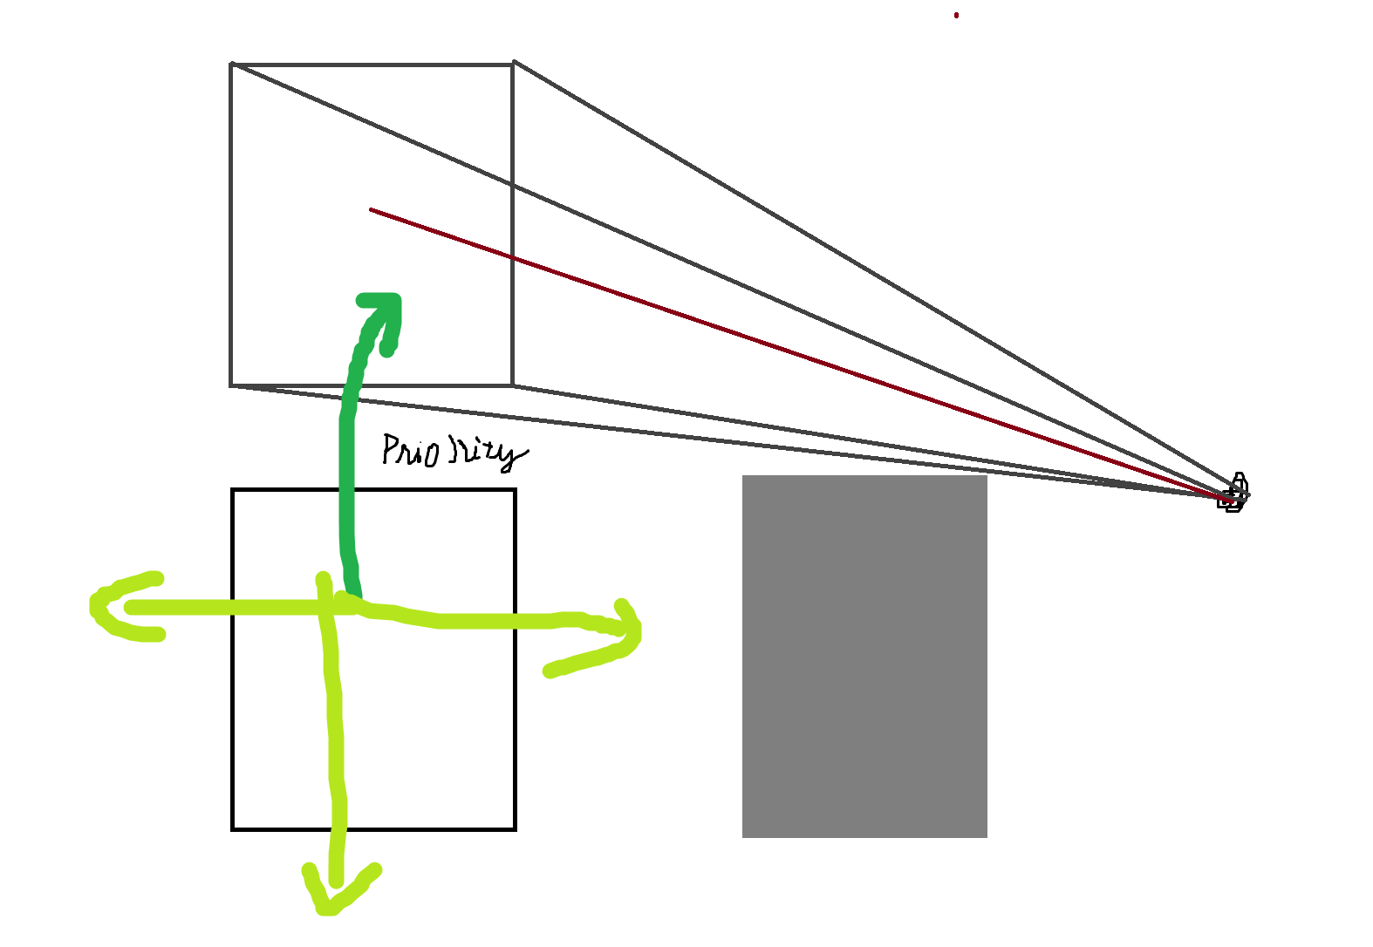
ENEMY

Slide 5
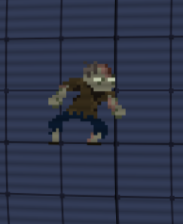
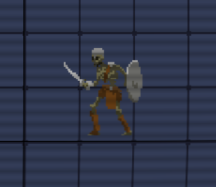
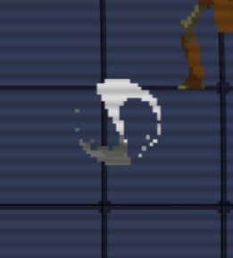
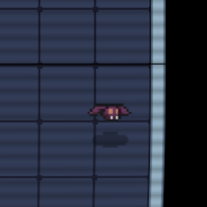
ENEMY

Slide 6
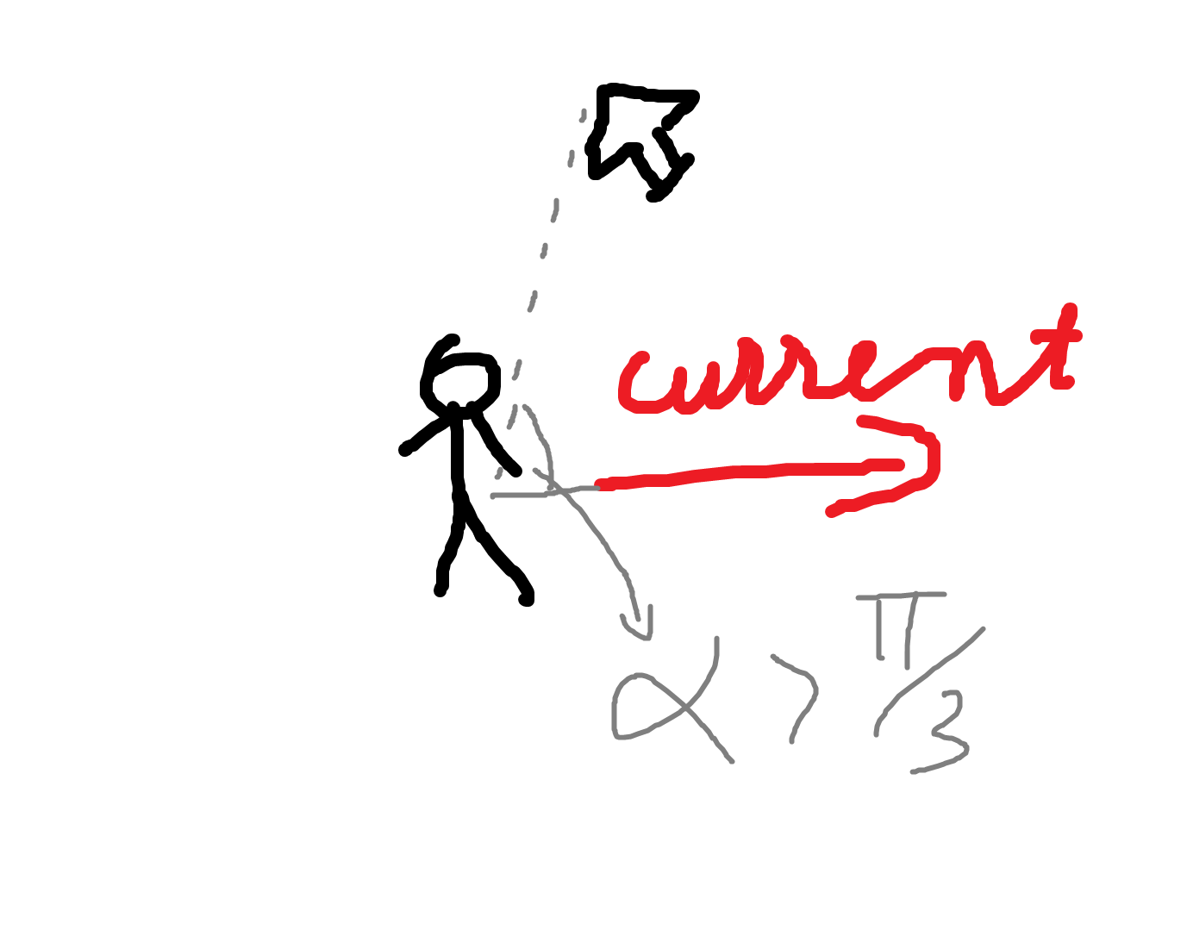
Player

Slide 7
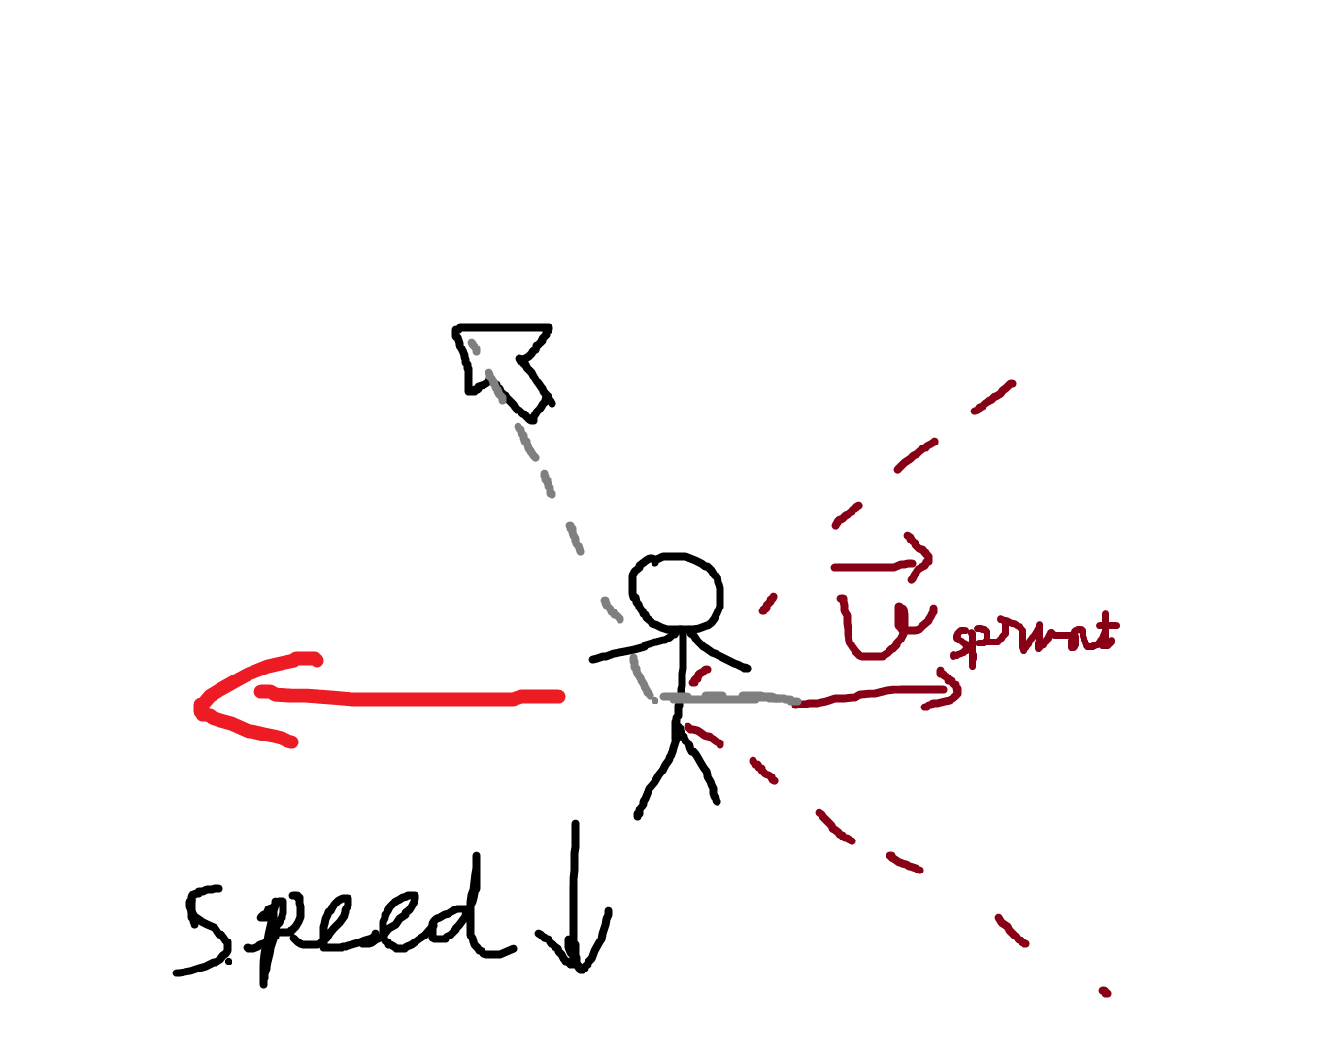
Player

Slide 8
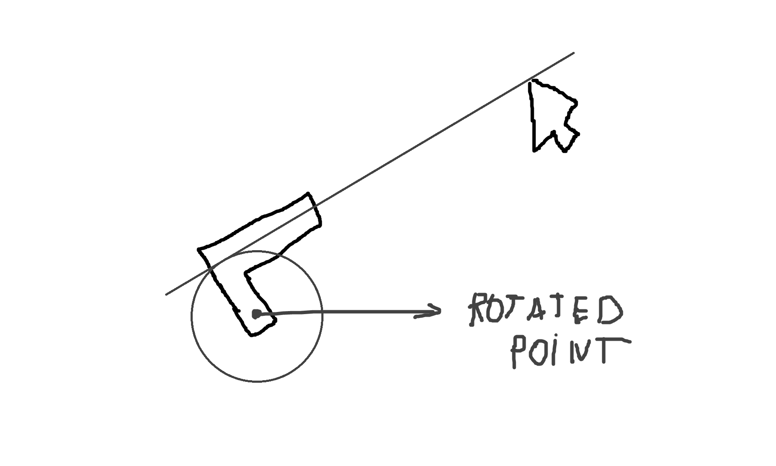
WEAPOn

Slide 9
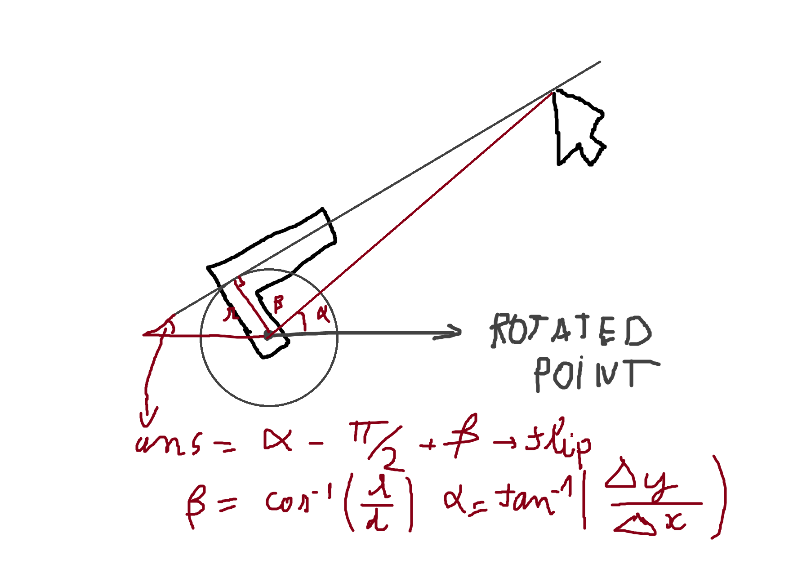
WEAPOn

Slide 10
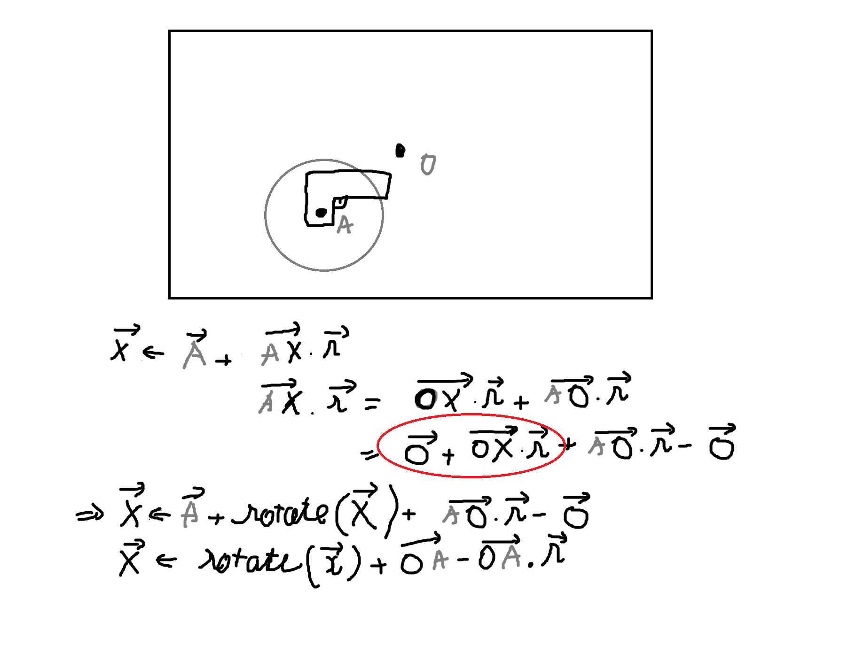
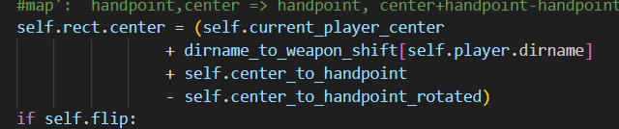
WEAPOn

Slide 11
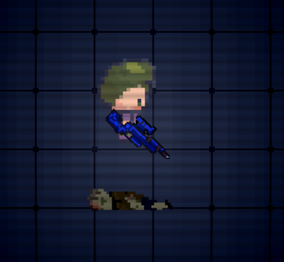
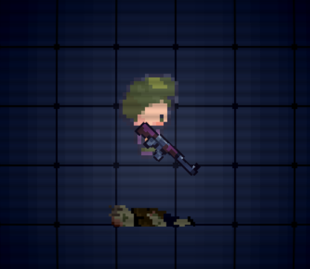
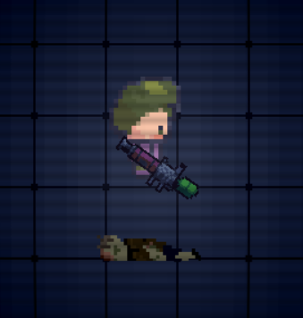
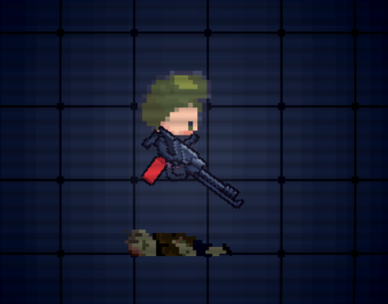
WEAPOn

Slide 12
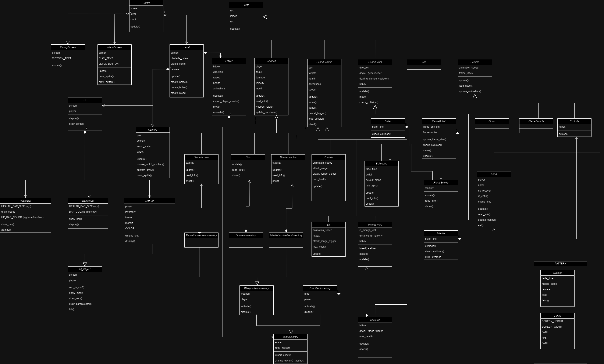

Slide 13


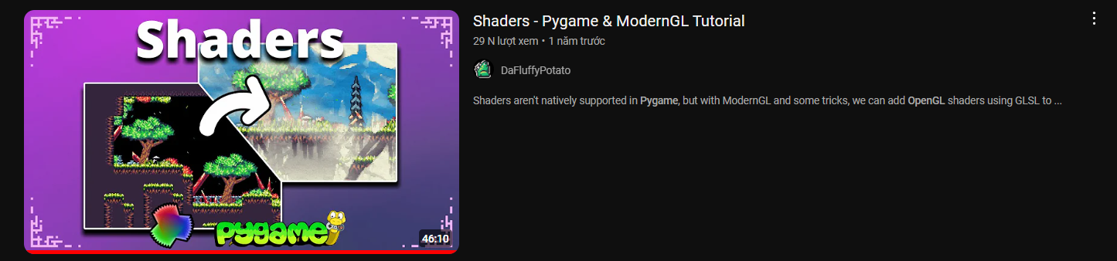
Tài liệu tham khảo

Slide 14
LET’S PLAY

Slide 21

The power of communication

Slide 22
Effective delivery techniques
This is a powerful tool in public speaking. It involves varying pitch, tone, and volume to convey emotion, emphasize points, and maintain interest.
Pitch variation
Tone inflection
Volume control
Effective body language enhances your message, making it more impactful and memorable.
Meaningful eye contact
Purposeful gestures
Maintain good posture
Control your expressions

Slide 23

Navigating Q&A sessions
Maintaining composure during the Q&A session is essential for projecting confidence and authority. Consider the following tips for staying composed:
Stay calm
Actively listen
Pause and reflect
Maintain eye contact
Know your material in advance
Anticipate common questions
Rehearse your responses

Slide 24

Speaking impact
Your ability to communicate effectively will leave a lasting impact on your audience
Effectively communicating involves not only delivering a message but also resonating with the experiences, values, and emotions of those listening

Slide 25
Dynamic delivery
Learn to infuse energy into your delivery to leave a lasting impression
One of the goals of effective communication is to motivate your audience
Metric | Measurement | Target | Actual
Audience attendance | # of attendees | 150 | 120
Engagement duration | Minutes | 60 | 75
Q&A interaction | # of questions | 10 | 15
Positive feedback | Percentage (%) | 90 | 95
Rate of information retention | Percentage (%) | 80 | 85

Slide 26
Final tips & takeaways
Consistent rehearsal
Strengthen your familiarity
Refine delivery style
Pacing, tone, and emphasis
Timing and transitions
Aim for seamless, professional delivery
Practice audience
Enlist colleagues to listen & provide feedback
Seek feedback
Reflect on performance
Explore new techniques
Set personal goals
Iterate and adapt

Slide 27
Speaking engagement metrics
Impact factor | Measurement | Target | Achieved
Audience interaction | Percentage (%) | 85 | 88
Knowledge retention | Percentage (%) | 75 | 80
Post-presentation surveys | Average rating | 4.2 | 4.5
Referral rate | Percentage (%) | 10 | 12
Collaboration opportunities | # of opportunities | 8 | 10

Slide 28
Thank you
Brita Tamm
502-555-0152
brita@firstupconsultants.com
www.firstupconsultants.com

