Slide 1
PRESENTATION REPORT
TOPIC:CUSTOMER CHURN PREDICT
Hồ Chí Minh - 2023

Slide 2
TABLE OF CONTENTS
INTRODUCTION TO THE PROJECT ↗
EXPLORATORY DATA ANALYSIS ↗
EXPERIMENT, RESULTS AND REVIEW ↗
CONCLUDE ↗

Slide 3
INTRODUCTION TO THE PROJECT

Slide 4
INTRODUCTION TO THE TOPIC
Customer churn prediction is a critical aspect of business management, particularly for industries like telecommunications, internet service providers, pay TV companies, insurance firms, and alarm monitoring services. It involves understanding and addressing customer attrition, which refers to the loss of clients or customers.

Slide 5
INTRODUCTION TO THE DATASET
Dataset description: The dataset has 20 variables and over 3333 rows:
State: State name in the US.
Account length: Account type
Area code: Phone area code.
International plan: International call type.
Voice mail plan: Number of voicemails.
Number vmail messages: total number of voice messages received by the user
Total day minutes: total number of minutes spent on phone calls during the day

Slide 6
INTRODUCTION TO THE DATASET
Total day calls : Total number of day calls..
Total day charge: Total charge of day calls
Total eve minutes - Total minutes of evening calls.
Total eve calls - Total number of evening calls.
Total eve calls - Total charge of evening calls
Total night minutes - Total minutes of night calls
Total night calls - Total number of night calls.

Slide 7
INTRODUCTION TO THE DATASET
Total night charge : Total charge of night calls.
Total intl minutes : Total minutes of international calls.
Total intl calls : Total number of international calls.
Total intl charge : Total charge of international calls.
Customer service calls : numerical. Number of calls to customer service
Churn : Customer churn

Slide 8
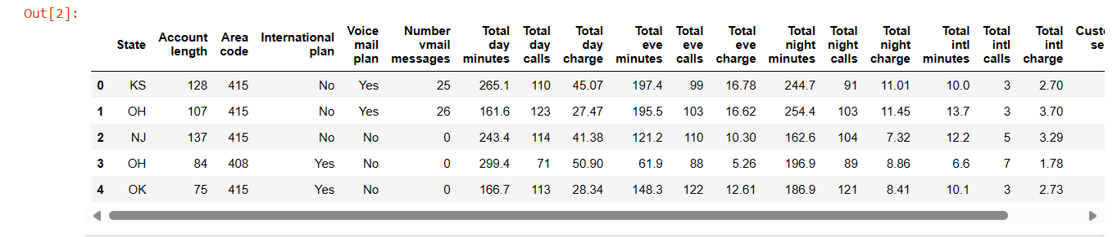
INTRODUCTION TO THE DATASET

Slide 9
METHODS OF USE
Using algorithms Random Forest Classifier .
Using algorithms Decision Tree Classifier.

Slide 10
OUTPUT
Accuracy of rating prediction of the Random Forest model.
Accuracy of rating prediction of the Decision Tree model.

Slide 11
EXPLORATORY DATA ANALYSIS

Slide 12
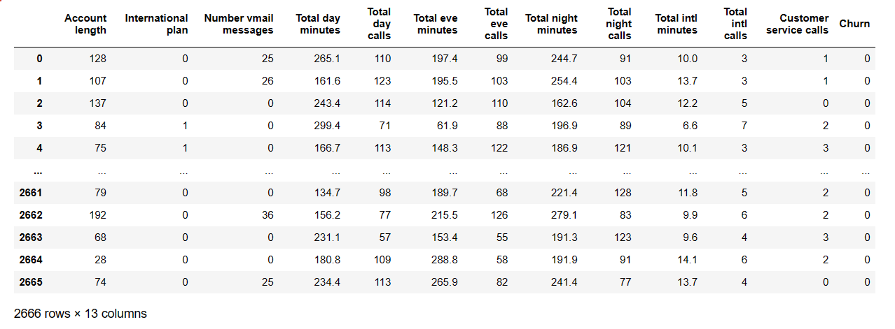
DATASET AFTER PROCESSING

Slide 13
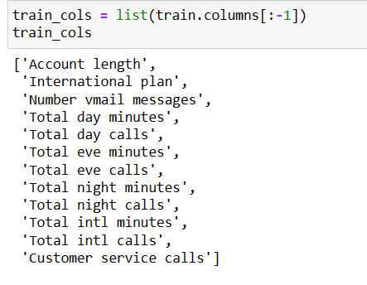
DATASET AFTER PROCESSING

Slide 14
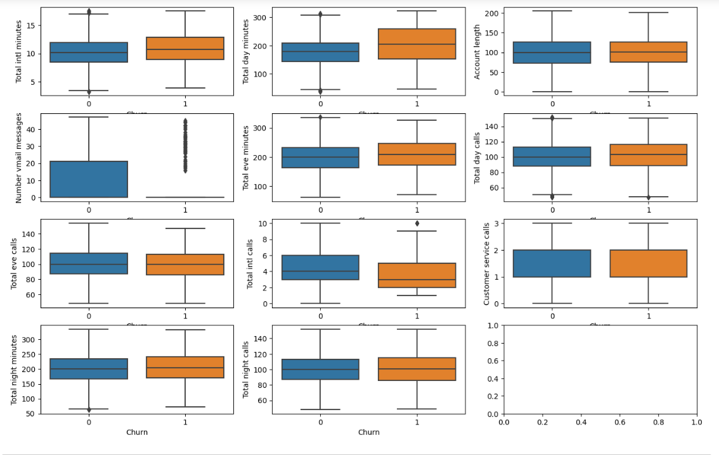
EXPLORING DATA
Boxplots to visualize the distribution of quantitative features after remove outliers

Slide 15
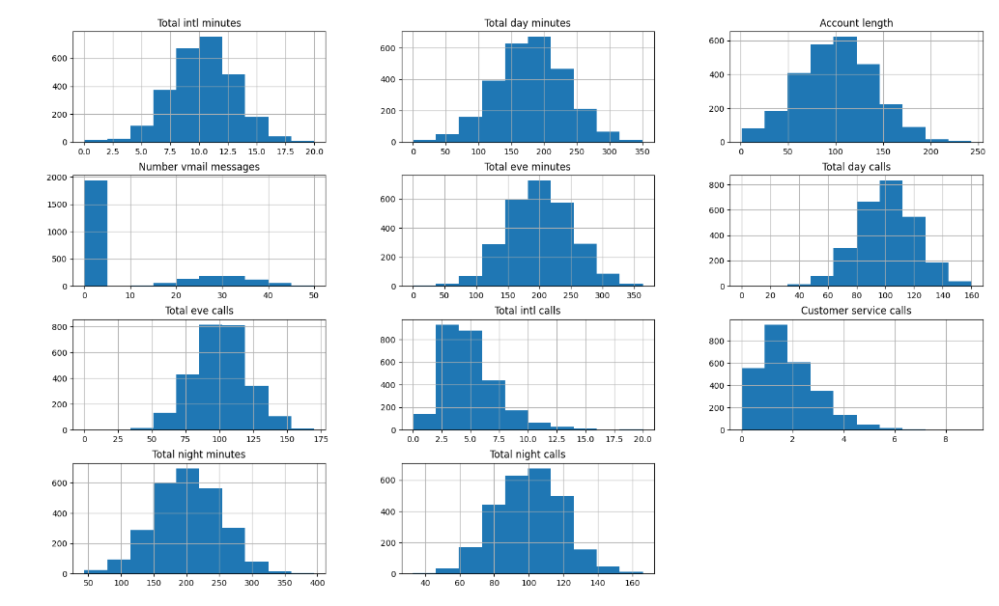
EXPLORING DATA
Extract the numerical features from the dataset

Slide 16
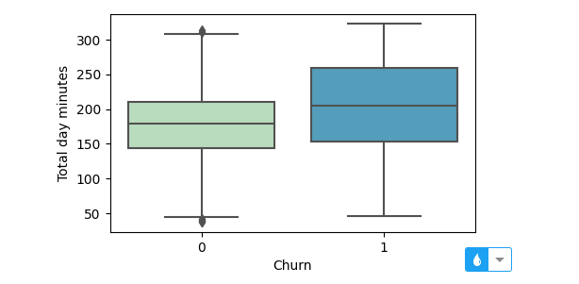
EXPLORING DATA
Distribution of total daytime call duration (total_day_minutes) among loyal and churned customers

Slide 17
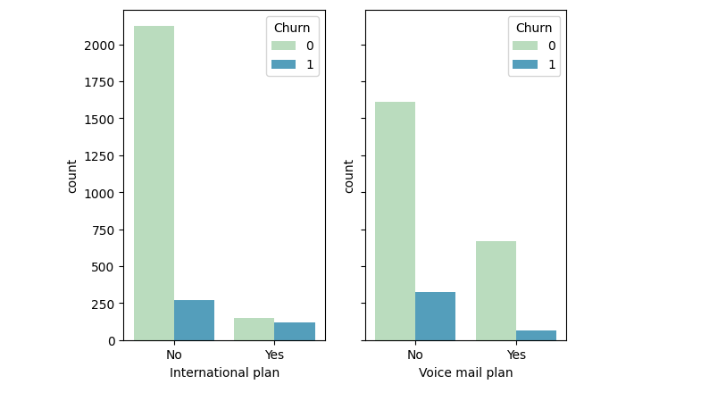
EXPLORING DATA
The first countplot for 'international_plan' with hue 'churn’
The second countplot for 'voice_mail_plan' with hue 'churn'

Slide 18
EXPERIMENT, RESULTS AND REVIEW

Slide 19
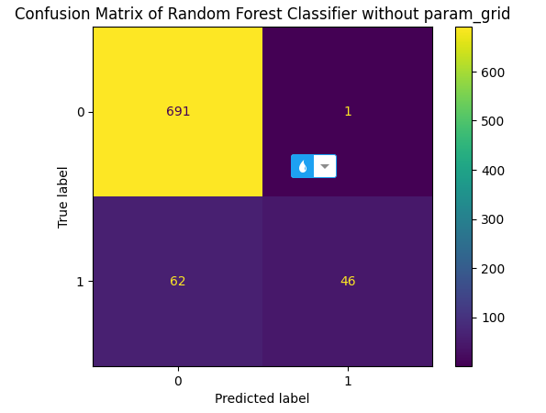
RANDOM FOREST CLASSIFIER MODEL
Before param_grid:
The model’s accuracy value is 0.92125
Confusion Matrix

Slide 20
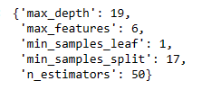
RANDOM FOREST CLASSIFIER MODEL
b. After param_grid:
The model’s accuracy value is 0.92375
Best param_grid:

Slide 21
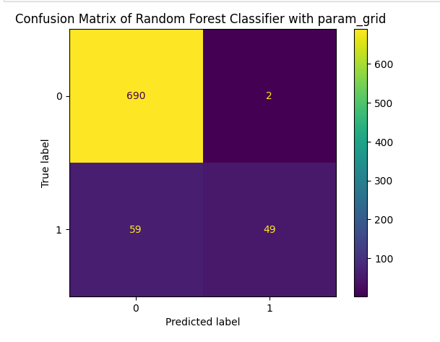
RANDOM FOREST CLASSIFIER MODEL
b. After param_grid:
The model’s accuracy value is 0.92375
Confusion Matrix

Slide 22
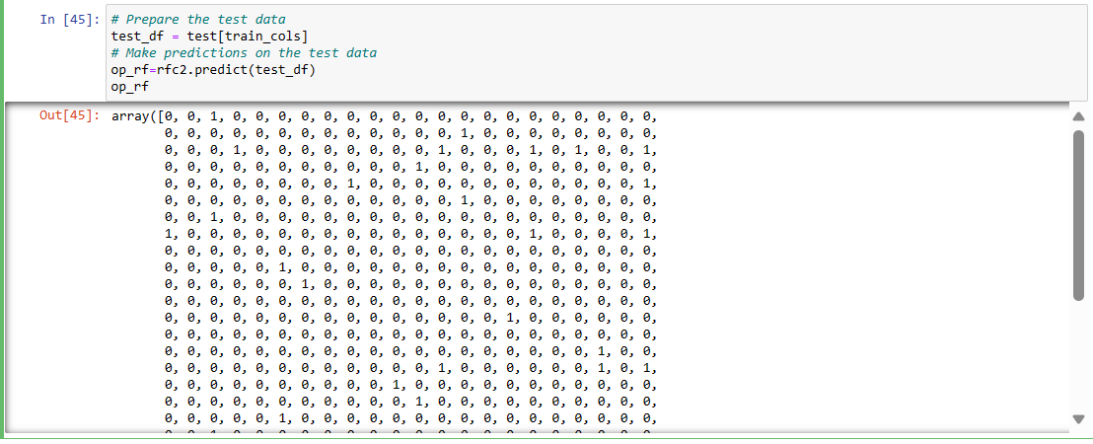
RANDOM FOREST CLASSIFIER MODEL
c. Test on Test Data:

Slide 23
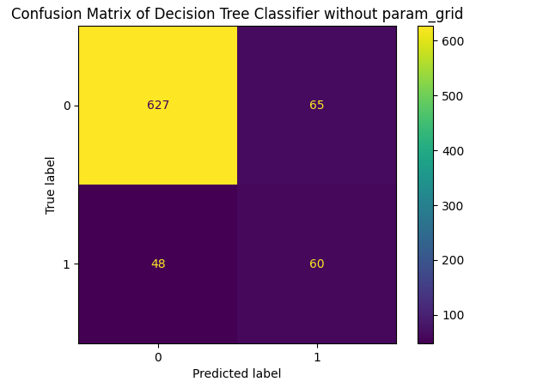
2. DECISION TREE CLASSIFIER MODEL
Before param_grid:
The model’s accuracy value is 0.85875
Confusion Matrix

Slide 24

2. DECISION TREE CLASSIFIER MODEL
b. After param_grid:
The model’s accuracy value is 0.9175
Best param_grid:

Slide 25
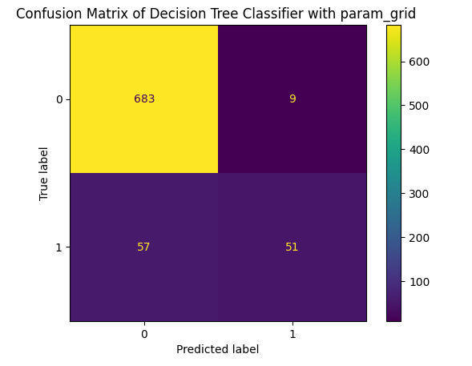
2. DECISION TREE CLASSIFIER MODEL
b. After param_grid:
The model’s accuracy value is 0.9175
Confusion Matrix

Slide 26
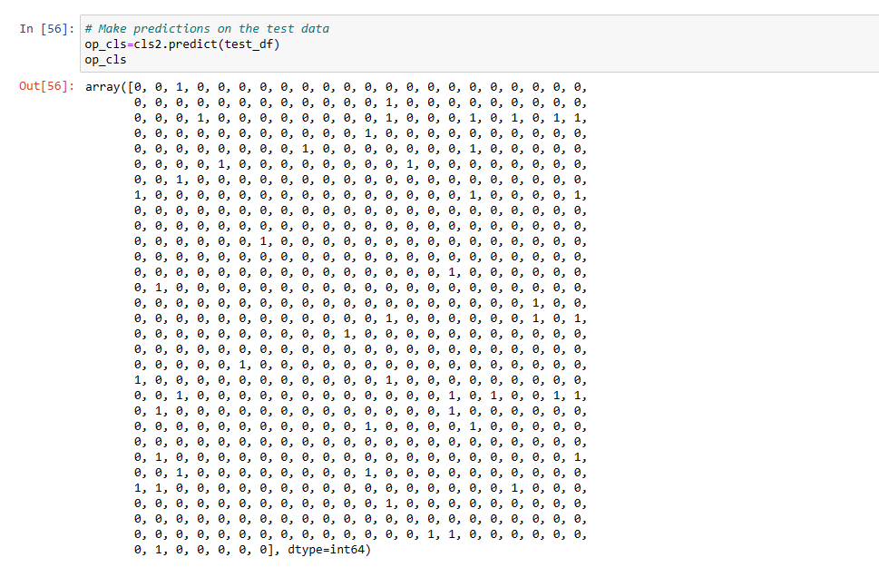
2. DECISION TREE CLASSIFIER MODEL
c. Test on Test Data:

Slide 27
CONCLUDE

Slide 28
Conclude
After parameter tuning, both Random Forest Classifier and Decision Tree models achieved an accuracy of 91%.
Random Forest Classifier has lower computational demands and allows parallel tree construction, it would be a better choice in this case.
Developmental direction
It is possible to explore and develop more algorithms.

Slide 29
THANK YOU FOR WATCHING !!!

