Slide 1

Chapter 3:
Initiating Projects
Note: See the text itself for full citations. Text website is http://intropm.com.

Slide 2
Project Management Process Groups
Project management process groups progress from initiating activities to planning activities, executing activities, monitoring and controlling activities, and closing activities
A process is a series of actions directed toward a particular result

Slide 3
Description of Process Groups
Initiating processes include actions to begin projects and project phases
Planning processes include devising and maintaining a workable scheme to ensure that the project meets its scope, time, and cost goals as well as organizational needs
Executing processes include coordinating people and other resources to carry out the project plans and produce the deliverables of the project or phase.
  A deliverable is a product or service produced or provided as part of a project
Monitoring and controlling processes measure progress toward achieving project goals, monitor deviation from plans, and take corrective action to match progress with plans and customer expectations
Closing processes include formalizing acceptance of the project or phase and bringing it to an orderly end
3

Slide 4
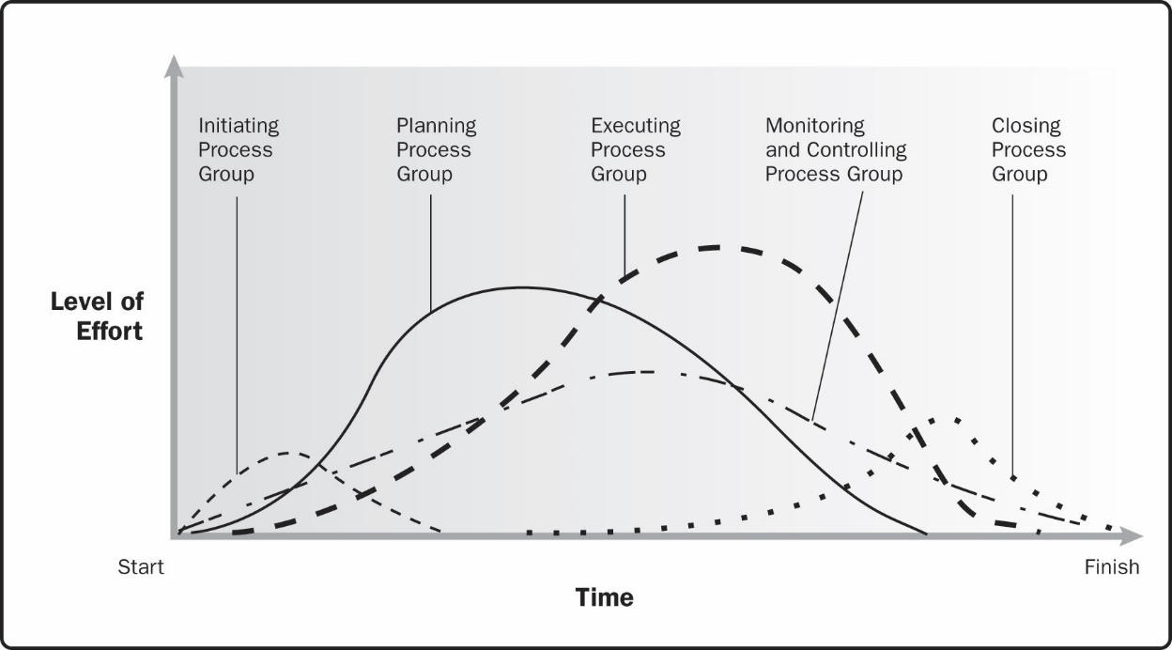
Figure 3-5. Example of process group interactions within a project or phase
Source: Project Management Institute, Inc., A Guide to the Project Management Body of Knowledge (PMBOK® Guide)– Sixth Edition (2017).

Slide 5
Characteristics of the Process Groups
The level of activity and length of each process group varies for every project
  Normally, executing tasks require the most resources and time, followed by planning tasks
  Monitoring and controlling processes are done throughout the project’s life span
  Initiating and closing tasks are usually the shortest (at the beginning and end of a project or phase, respectively), and they require the least amount of resources and time
  However, every project is unique, so there can be exceptions
5

Slide 6
Figure 3-6. Time Spent on Each Project Management Process Group
Process Group | Alpha PM |  | Average PM | Alpha Difference (%)
Initiating | 2% | 1% |  | 100% more
Planning | 21% | 11% |  | 91% more
Executing | 69% | 82% |  | 16% less
Monitoring & Controlling | 5% | 4% |  | 25% more
Closing | 3% | 2% |  | 50% more
Total | 100% | 100%
6

Slide 7
Mapping the Process Groups to the Knowledge Areas
You can map the five process group into the ten project management knowledge areas
Based on the PMBOK® Guide – Sixth Edition (2017), there are 49 total processes in project management
Figure 3-7 provides a big-picture view of the process groups and knowledge areas
7

Slide 8
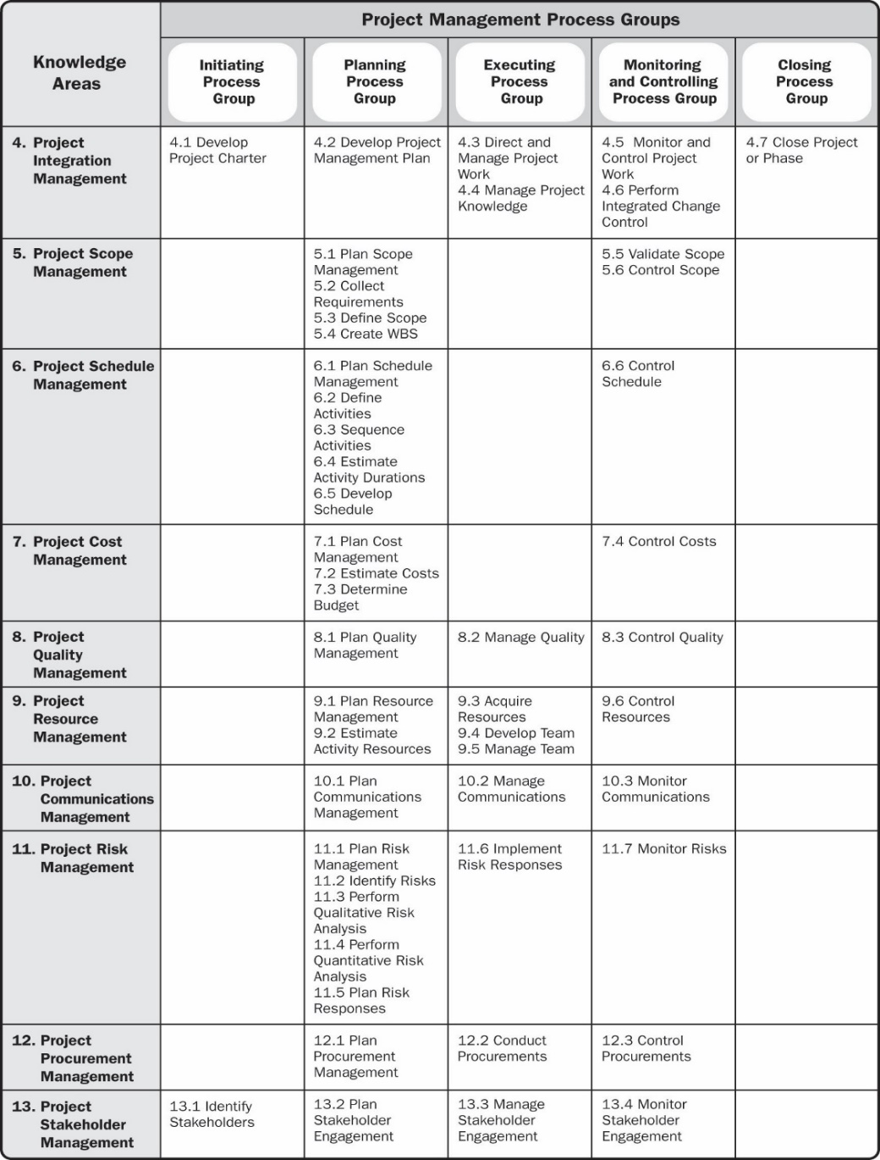
Figure 3-7. Project management process group and knowledge area mapping
Source: Project Management Institute, Inc., A Guide to the Project Management Body of Knowledge (PMBOK® Guide) – Sixth Edition (2017).
8

Slide 9
Developing a Project Management Methodology
The PMBOK® Guide is a standard that describes best practices for what should be done to manage a project
A methodology describes how things should be done, and different organizations often have different ways of doing things
9

Slide 10
Some Examples of Methodologies
PRojects IN Controlled Environments (PRINCE2): Originally developed for IT projects, PRINCE2 was released in 1996 by the U.K. Office of Government Commerce – now used in over 50 countries
Rational Unified Process (RUP) framework: iterative software development process that focuses on team productivity and delivers software best practices to all team members
Six Sigma: Used to improve quality and processes. Six Sigma’s target for perfection is the achievement of no more than 3.4 defects, errors, or mistakes per million opportunities
Agile: Many software development projects use agile methods, meaning they use an iterative workflow and incremental delivery of software in short iterations
10

Slide 11
The Importance of Top Management Commitment
Without top management commitment, many projects will fail
Some projects have a senior manager called a champion who acts as a key proponent for a project
Projects are part of the larger organizational environment, and many factors that might affect a project are out of the project manager’s control
11

Slide 12
How Top Managers Can Help Project Managers Succeed
Provide adequate resources
Approve unique project needs in a timely manner
Encourage cooperation from people in other parts of the organization and deal with political issues
Mentor and coach them on leadership issues
Develop and enforce organizational standards
Support a project management office (PMO)
12

Slide 13
Project Management Office (PMO)
A project management office (PMO) is an organizational entity created to assist project managers in achieving project goals
A PMO can help development standards and methodologies, provide career paths for project managers, and assist project managers with training and certification
13

Slide 14
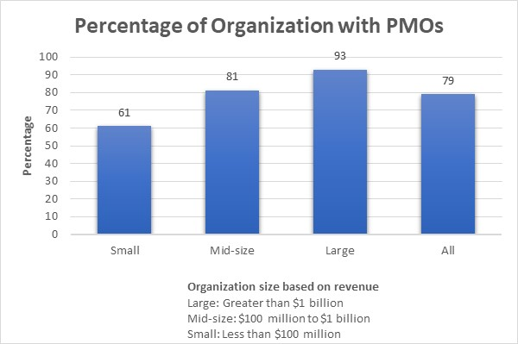
Figure 3-8 Percentage of Organizations with PMOs
Source: PM Solutions, “The State of Project Management 2020,” 2020.

Slide 15
Possible Goals of a PMO
Collect, organize, and integrate project data for the entire organization
Research, develop, and share best practices in project management
Develop and maintain templates, tools, standards, and methodologies
Develop or coordinate training in various project management topics
Develop and provide a formal career path for project managers
Provide project management consulting services
Provide a structure to house project managers while they are acting in those roles or are between projects

Slide 16
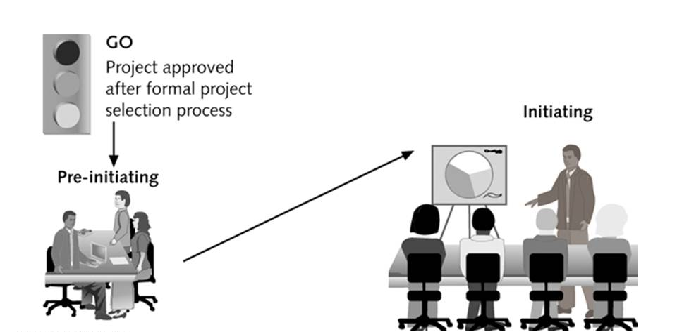
Figure 3-9. Initiating Process Summary
Senior management work together to: Determine scope, time, and cost constraints Identify the project sponsor Select the project manager Develop a business case for the project Review processes/expectations Determine if the project should be divided into two or more smaller projects | Project managers lead efforts to: Identify and understand project stakeholders Create the project charter and assumption log Hold a kick-off meeting
16

Slide 17
Example: Just-In-Time Training Project
The senior managers of the Global Construction decided to divide the project to two phases.
Phase 1 is to clarify the situation.
Note: for a large training project, there is often a study project done first before investing in a large project.
In Just-In-Time Training project:
Lucy, training director would be the sponsor
Mike, the vice president of HR would be the project champion.
Lucy, assigned one of her senior staff member, Ron to manage the project (phase 1).

Slide 18
Figure 3-10. Summary Information for the Just-In-Time Training Phase I Project
Scope Goals
Investigate and document the training taken in the last two years by all internal employees.
Determine what courses were taken, the cost of all training, the process for approving/assigning training, and the evaluation of the training by participants, if available.
Survey employees to get their input on what training they believe they’ll need in the next two years, how they’d like to take the training (i.e., instructor-led in-house, instructor-led through a local college, university, or training company, Web-based, DVD, etc.). Also hold focus groups to determine training needs.
Recommend how to provide the most valuable training for Global Construction employees in the next two years.
Determine the scope, time, and cost goals for the development and implementation of the Just-In-Time Training Phase II project.
18

Slide 19
Figure 3-11. Summary Information for the Just-In-Time Training Phase I Project (continued)
Time Goals: Three months
Cost Goals: $50,000
Approach/Assumptions:
All of the costs would be for internal labor.
All managers and employees would receive information about this study project.
A response rate of 30% would be acceptable for the survey.
The project team would do extensive research to back up their recommendations.
The team would also provide detailed monthly reports and presentations to a steering committee.
The final deliverables would include a one-hour final presentation and a comprehensive project report documenting all of the information and recommendations.
19

Slide 20
Business Case for a Project
A business case is a document that provides financial justification for investing in a project
Typical contents:
  Introduction/Background
  Business Objective
  Current Situation and Problem/Opportunity Statement
  Critical Assumptions and Constraints
  Analysis of Options and Recommendations
  Preliminary Project Requirements
  Budget Estimate and Financial Analysis
  Schedule Estimate
  Potential Risks
  Exhibits
See Figure 3-11 in the text for a sample
20

Slide 21
Exercise
The best or “alpha” project managers spend more time on every process group than other project managers except for which one?
What document provides justification for investing a project?
Project charter
Business case
NPV analysis
Benefits management plan
3) In which of the five project management process groups is the most time and money usually spent?

Slide 22
Initiating Processes
Identifying project stakeholders
Creating the project charter
Creating the assumption log
Holding a kick-off meeting
22

Slide 23
Figure 3-12. Initiating Processes and Outputs (PMBOK® Guide – Sixth Edition)
Knowledge area | Initiating process | Outputs
Project integration management | Develop project charter | Project charter Assumption log
Project stakeholder management | Identify stakeholders | Stakeholder register Change requests Project management plan updates Project documents updates
23

Slide 24
Identifying Stakeholders
Project stakeholders are the people involved in or affected by project activities
  Internal project stakeholders generally include the project sponsor, project team, support staff, and internal customers for the project. Other internal stakeholders include top management, other functional managers, and other project managers
  External project stakeholders include the project’s customers (if they are external to the organization), competitors, suppliers, and other external groups that are potentially involved in or affected by the project, such as government officials and concerned citizens
24

Slide 25
Stakeholder Register and Stakeholder Analysis
A stakeholder register is a document that includes details related to the identified project stakeholders -usually available to many people, so it should not include sensitive information
A stakeholder analysis is a technique for analyzing information to determine which stakeholders’ interests to focus on and how to increase stakeholder support throughout the project
25

Slide 26
Figure 3-13. Sample Stakeholder Register
Name | Position | Internal/ External | Project Role | Contact Information
Mike Sundby | VP of HR | Internal | Project champion | msundy@globalconstruction.com
Lucy Camerena | Training Director | Internal | Project sponsor | lcamerena@globalconstruction.com
Ron Ryan | Senior HR staff member | Internal | Led the Phase I project | rryan@globalconstruction.com
26

Slide 27
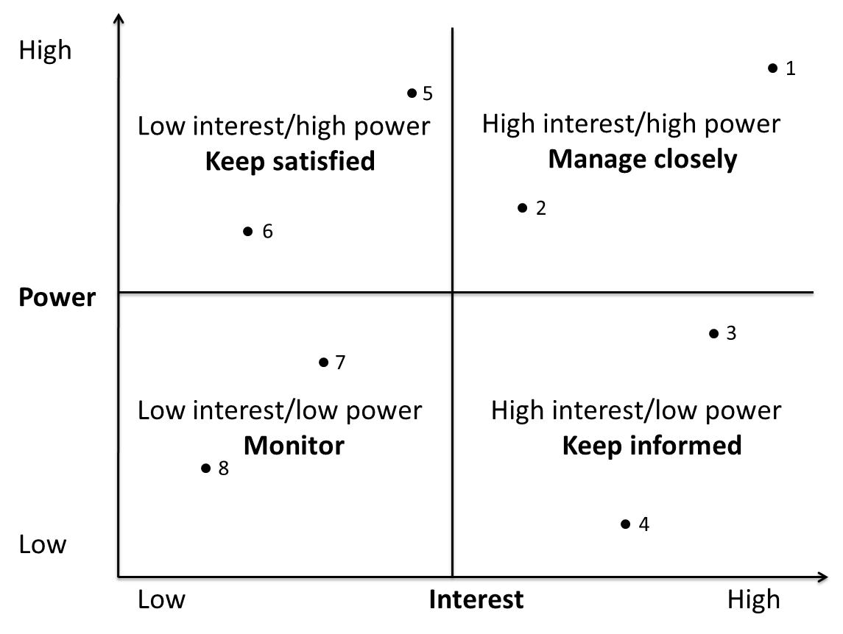
Figure 3-14. Sample Stakeholder Analysis Power/Interest Grid

Slide 28
Categorizing Engagement Levels of Stakeholders
Unaware: Unaware of the project and its potential impacts on them
Resistant: Aware of the project yet resistant to change
Neutral: Aware of the project yet neither supportive nor resistant
Supportive: Aware of the project and supportive of change
Leading: Aware of the project and its potential impacts and actively engaged in helping it succeed

Slide 29
Creating a Project Charter and Assumptions Log
A project charter is a document that formally recognizes the existence of a project and provides a summary of the project’s objectives and management
It authorizes the project manager to use organizational resources to complete the project
Ideally, the project manager will play a major role in developing the project charter
Instead of project charters, some organizations initiate projects using a simple letter of agreement or formal contracts
A crucial part of the project charter is the sign-off section
29

Slide 30
Contents of a Project Charter
The project’s title and date of authorization
The project manager’s name and contact information
A summary schedule or timeline, including the planned start and finish dates; if a summary milestone schedule is available, it should also be included or referenced
A summary of the project’s estimated cost and budget allocation
A brief description of the project objectives, including the business need or other justification for authorizing the project
Project success criteria or approval requirements, including project approval requirements and who signs off on the project.
30

Slide 31
Contents of a Project Charter (continued)
A summary of the planned approach for managing the project, which should describe stakeholder needs and expectations, overall project risk, important assumptions and constraints, and should refer to related documents, such as a communications management plan, as available
A roles and responsibilities matrix
A sign-off section for signatures of key project stakeholders
A comments section in which stakeholders can provide important comments related to the project

Slide 32
Figure 3-16. Sample Project Charter
Project Title: Just-In-Time Training Project Project Start Date: July 1 Projected Finish Date: June 30 (one year later)
Budget Information: The firm has allocated $1,000,000 for this project. Approximately half of these costs will be for internal labor, while the other half will be for outsourced labor and training programs.
Project Manager: Kristin Maur, (610) 752-4896, kmaur@globalconstruction.com
Project Objectives: Develop a new training program that provides just-in-time training to employees on key topics, including supplier management, negotiating skills, project management, and software applications (spreadsheets and Web development). Develop an approach for measuring productivity improvements from this approach to training on an annual basis.
Success Criteria: This project will be successful if it reduces training cost per employee by 10% or $100/employee/year. It should also be completed on time, be run professionally, and meet all of the requirements. The project sponsor will fill out a customer acceptance/project completion form at the end of the project and give the project at least a 7 out of 10 overall rating.
32

Slide 33
Figure 3-16. Sample Project Charter (continued)
Approach section (partial)
  Terminate all internal training courses except the Six Sigma training once new courses are developed
  Communicate to all employees the plans to improve internal training and let them know that tuition reimbursement will continue as is.
Roles and Responsibilities
Comments (partial)
  “I want to review all of the information related to providing the supplier management training. We need to make something available quickly.” Tim

Slide 34
Contents of An Assumptions Log
An assumption log is a document used to record and track assumptions and constraints throughout the project life cycle.
It aids in communicating information to key stakeholders and avoids potential confusion.
Most projects include several assumptions that affect the scope, time, cost, risk, and other knowledge areas.
It is important to document and validate these assumptions.
34

Slide 35
Figure 3-17. Sample Assumptions Log
ID | Assumption Description | Category | Owner | Due Date | Status | Actions
108 | Shipping of materials will only take 2 days | Time | Kristin | Sep. 1 | Closed | Require 2-day shipping
122 | Employees will take some of the training during non-work hours | Human resources | Lucy | Nov. 1 | Open | Meet with dept. heads to discuss

Slide 36
Holding a Project Kick-off Meeting
Experienced project managers know that it is crucial to get projects off to a great start.
A kick-off meeting is a meeting held at the beginning of a project so that stakeholders can meet each other, review the goals of the project, and discuss future plans. Note that the PMBOK® Guide – Sixth Edition, suggests that the kick-off meeting be held during the end of the planning or start of the executing process group. In the author’s experience, it is best hold it earlier.
The project champion should speak first and introduce the project sponsor and project manager
There is often a fair amount of work is done to prepare for the meeting.
If it cannot be held face-to-face, try to include audio and/or video to engage and understand participants.
36

Slide 37
Figure 3-18. Sample Kick-Off Meeting Agenda
Just-In-Time Training Project
Kick-off Meeting
July 16
Meeting Objective: Get the project off to an effective start by introducing key stakeholders, reviewing project goals, and discussing future plans
Agenda:
Introductions of attendees
Review of the project background
Review of project-related documents (i.e., business case, project charter, assumptions log)
Discussion of project organizational structure
Discussion of project scope, time, and cost goals
Discussion of other important topics
List of action items from meeting
Just-In-Time Training Project
Kick-off Meeting
July 16
Meeting Objective: Get the project off to an effective start by introducing key stakeholders, reviewing project goals, and discussing future plans
Agenda:
Introductions of attendees
Review of the project background
Review of project-related documents (i.e., business case, project charter, assumptions log)
Discussion of project organizational structure
Discussion of project scope, time, and cost goals
Discussion of other important topics
List of action items from meeting
Action Item | Assigned To | Due Date
Action Item | Assigned To | Due Date
Date and time of next meeting:
Date and time of next meeting:
37

Slide 38
Exercise
Preparing a stakeholder register and performing a stakeholder analysis are part of which knowledge area?
Which project document is used to record and track assumptions and constraints throughout the project life cycle?

Slide 39
Chapter Summary
The five project management process groups are initiating, planning, executing, monitoring and controlling, and closing.
Mapping the main activities of each project management process group into the ten project management knowledge areas provides a big picture of what activities are involved in project management
39

Slide 40
Chapter Summary (continued)
Global Construction’s Just-In-Time Training project demonstrates the process of initiating a project. After a project is approved, senior managers often meet to perform several pre-initiating tasks
The main tasks normally involved in project initiation are the following:
  Identifying and stakeholders
  Creating the project charter and assumptions log
  Holding a kick-off meeting
40

