Slide 1

Virus Information Application
Class ID: 147839
Group 10:
Hoàng Trung Hiếu | 20226039
Ngô Minh Đức | 20226028
Vũ Nguyên Hạo | 20226037
Trần Tùng Dương | 20226033
Supervisor: Trần Thế Hùng

Slide 2
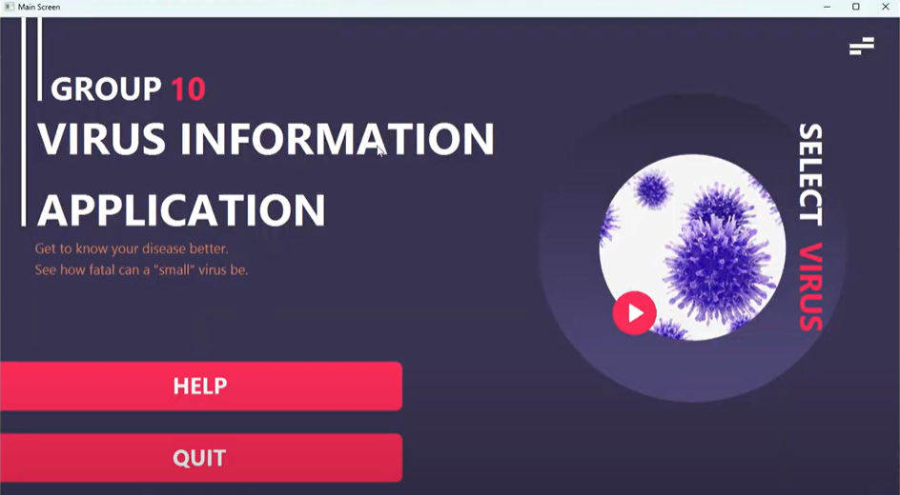
Problem Description
Our application aims to provide valuable information about some of the most common viruses for users, including their basic information, structures and infection processes.

Slide 3
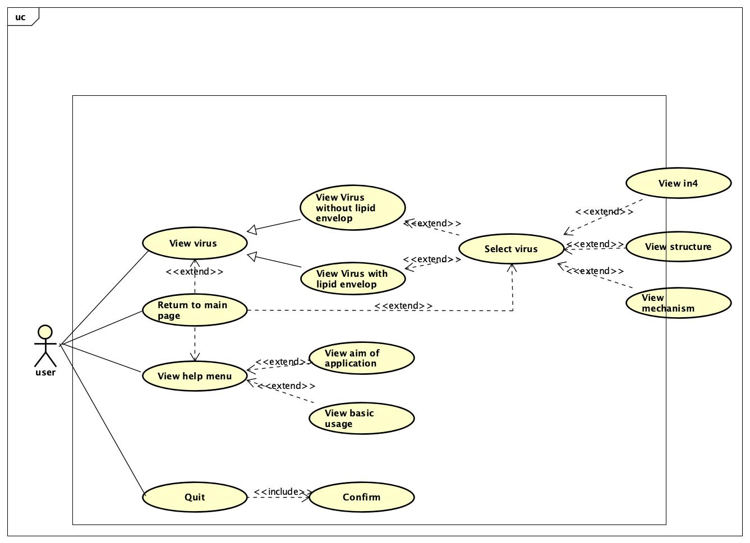
Use Case Diagram

Slide 4
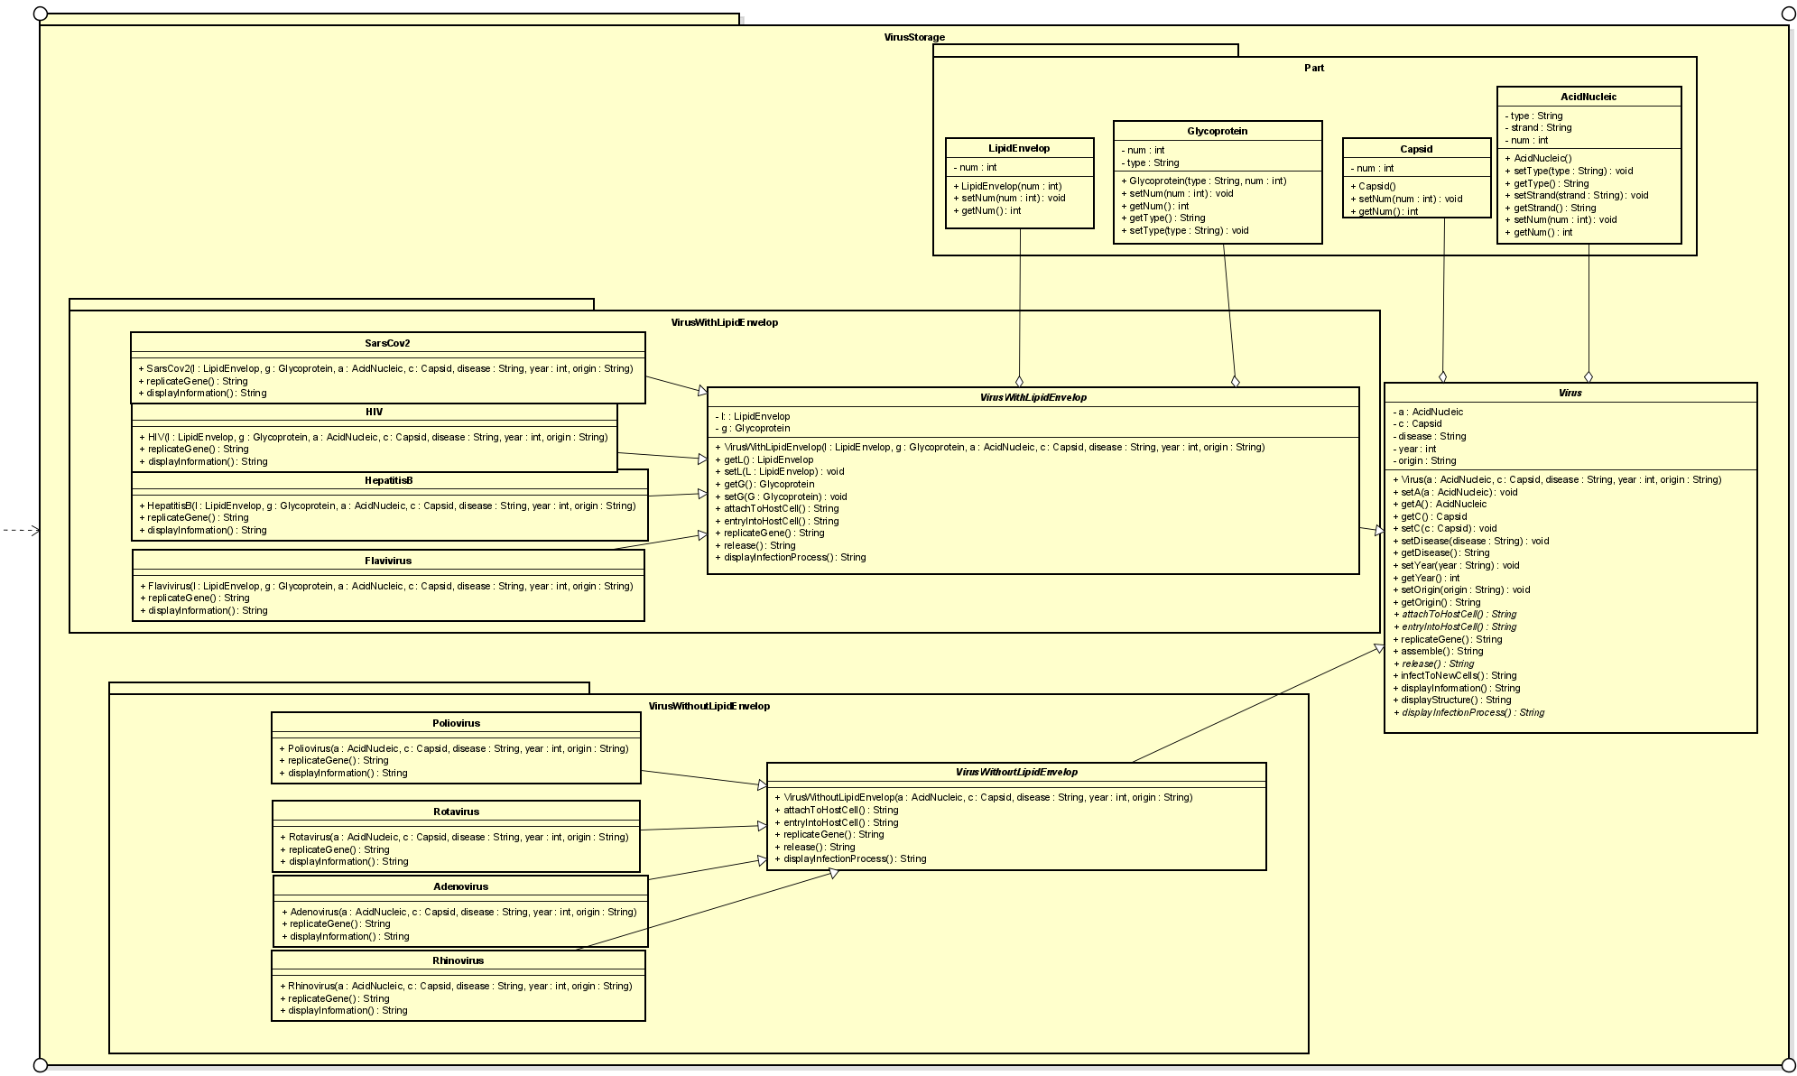
Class Diagram

Slide 5
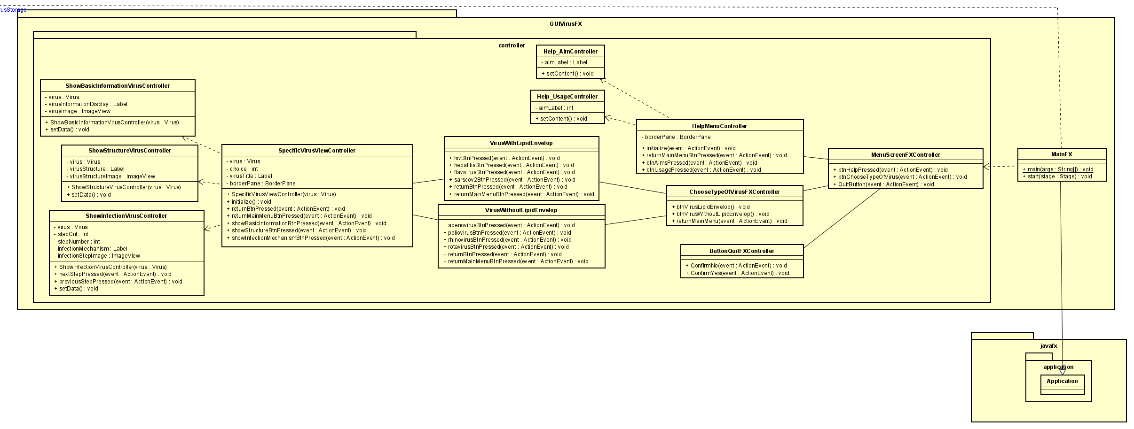
Class Diagram

Slide 6
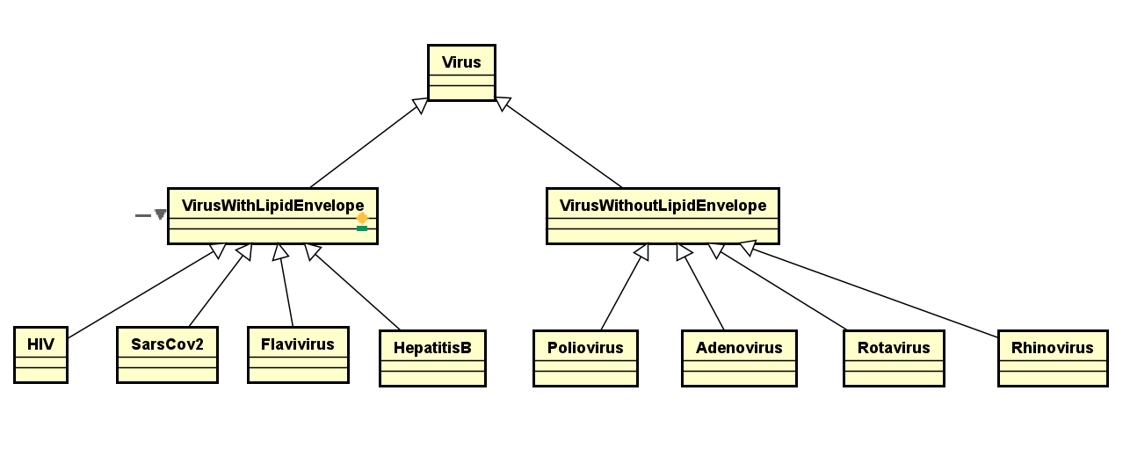
OOP Techniques
Inheritance
Abstract class Virus
2 abstract classes VirusWithLipidEnvelope and VirusWithoutLipidEnvelope inherit from class Virus
8 classes of specific virus inherit from 2 above classes

Slide 7
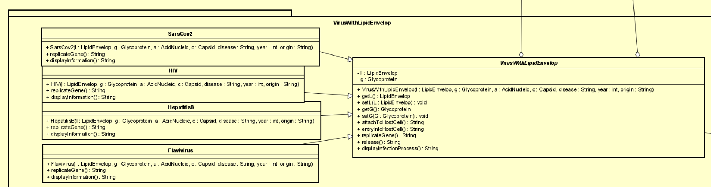
OOP Techniques
Inheritance
Method overriding: The child class has a method with the same name and same signature of a method in its parent class

Slide 8
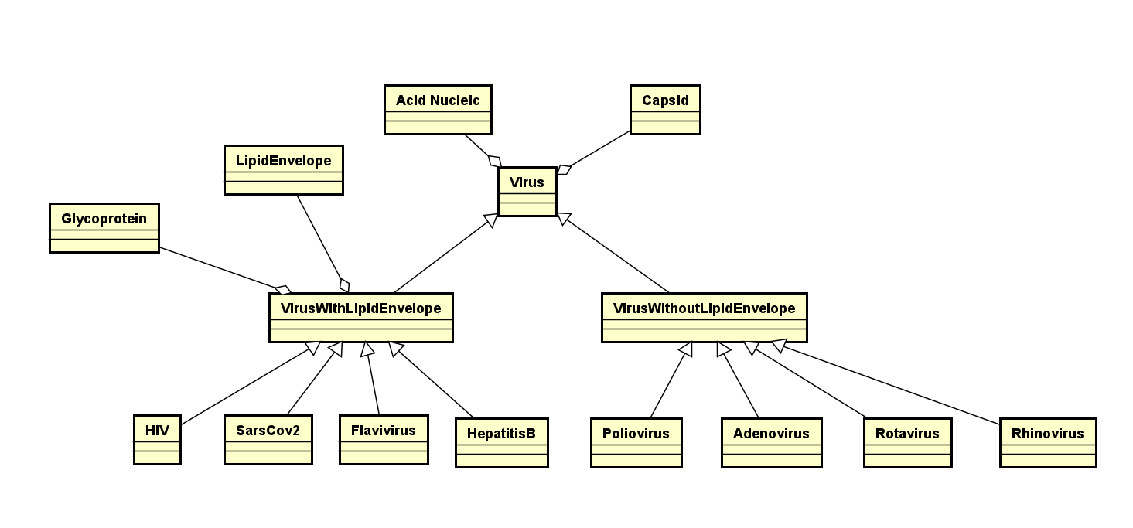
OOP Techniques
2. Aggregation
A virus has some parts, including
Acid Nucleic
Capsid
Lipid Envelope (for VirusWithLipidEnvelope)
Glycoprotein (for VirusWithLipidEnvelope)
3. Polymorphism
A single object can represent multiple different types (upcasting and downcasting)
E.g: HIV can be of HIV, VirusWithLipidEnvelope, and Virus data type

Slide 9
A
K
DEMO
I
M
R
D
A
R
Source: https://www.sciencedirect.com/

Slide 10
THANK YOU !

