Slide 1
C Programming Langue
Dec, 2019

Slide 2
Contents
Basic Module Set Up
Exercise 1
Memory Layout
Structure of Declarations
Attributes of Declarations
Storage Class, Type Qualifiers
Decelerator, Initializations, External Names.
Linkage Models, C++ Compatibility
Memory Layout (Unix/Linux)
Exercise 2

Slide 3
Basic Module Set Up
File .h and .c
What goes into <module.h>
Includes of other module interfaces, type, structure definitions.
Function prototypes.
Macros FORBIDDEN.
What goes into <module.c>
Include of <module.h>
Definition of functions.
All functions not shown as prototypes in <module>.h are declared static.
Layout of <module.h> and <module.c>
Notes:
Typical functionality of a data structure
Typically includes one (or more) structures
Always contains an init and a free function (even if not needed)
Encapsulates all access to the structure via functions (object centration)
For the struct there exist create functions generating an object, free functions freeing an object and delete functions recursively freeing objects

Slide 4
Basic Module Set Up
Example header file layout.
<header>
#ifndef <module uppercase name>
#define <module uppercase name>
/************/
/* Includes */
/************/
< all Includes >
/**************/
/* Structures */
/**************/
< all Structures and Type Definitions >
/**************/
/* Functions */
/**************/
< all Function prototypes >
#endif
<header>
/**************************************/
/**************************************/
/** <module uppercase name> **/
/** **/
/** <short module description> **/
/** **/
/** <disclaimer, copyright statement> **/
/** **/
/** Author: <author> **/
/** **/
/** Contact: <contact details> **/
/**************************************/

Slide 5
Basic Module Set Up
Example source file layout.
Example function description
<header>
#include ”<module>.h”
/**************/
/* Functions */
/**************/
<all Function definitions>
/**************************************************** INPUT: <argument descriptions> RETURNS: <description of the output> CAUTION: <anything special> MEMORY: <dynamic storage allocation effects> SUMMARY: <description of the function> *****************************************************/
Example function description Doxygen style.
/**
* This function encrypt data ....
* @param i
* @param e
* @param n
* @return
*/
long int encrypt(long int i, long int e, long int n);
!! Just following current documentation on your working project.

Slide 6
Coding Style (1/2)
Names are always meaningful.
Avoid expressions on assignments left hand side: a[j + +] = 5;
Avoid gotos..
Avoid -> operator usage outside the <module>.c file where the structure is defined in <module>.h
Tabs/spaces and formatter:
Again: “Following current style on your working project.”

Slide 7
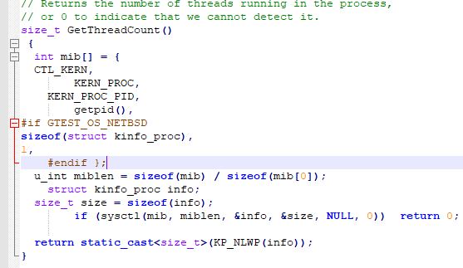
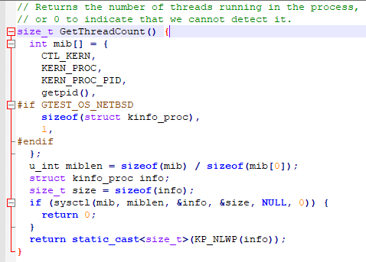
Coding Style (2/2)
Bad Format
Good Format

Slide 8
Remember
Library
stdio: input /output to terminal and file system
string: string and character operations
stdlib: memory access
limits: min and max bounds for standard C data types
Make
make is a utility for building and maintaining groups of programs (and other types of files) from source code
Gcc
Always use options ”-ansi -pedantic -Wall -Wshadow -Wpointer-arith -Wwrite-strings
Use option ”-O2” for optimized code generation
Use option ”-g” for debug code generation

Slide 9
Exercise 1
Clone & update training repository
Inside 01_memory
Editing header.h, func.c and main.c
Layout, formatting, code syntax,...
Build and run program: make && make run
$ # git clone http://gitlab.banvien.com/training/c_cpp.git
$ cd c_cpp && git pull
$ cd 01_memory/
$ make && make run
gcc -DDEBUG -g -o0 -Wall -I. -c main.c -o main.o
gcc -DDEBUG -g -o0 -Wall -I. -c func.c -o func.o
gcc -DDEBUG -g -o0 -Wall func.o main.o -o main
./main
Hello world

Slide 10
Memory Layout
Memory Layout
Structure of Declarations
Attributes of Declarations
Storage Class, Type Qualifiers
Decelerator, Initializations, External Names.
Linkage Models, C++ Compatibility
Memory Layout (Unix/Linux)
Exercise 2

Slide 11
Structure of Declarations
A declaration in C consists of
Storage class specifier: extern, static, auto, register
For syntactical reasons, typedef is also a storage class specifier
Type qualifiers: const, volatile, restrict (C99)
Type specifiers: unsigned, signed, char, int, ..
Declarator.
Can be left out in certain cases
Considered bad style, so we don’t elaborate on it.
Initialize (One or none)
Example
// Use following order: storage class, qualifier, specifier
unsigned volatile long extern int const j;
extern const volatile unsigned long int i = 3;

Slide 12
Attributes of Declarations
Each declaration defines several attributes of the declared object:
Scope | Range in the program text where the object’s identifier is declared.
Visibility | Range in the program text where the declared object can be accessed with its identifier.
Name Space | Which kinds of objects must have distinct names if they shall be referenced at the same time in the same scope
Extent | The lifetime of the object during program runtime
Linkage | Is the object visible from other translation units?

Slide 13
Visibility
One declaration can hide another.
Where does the hiding start? j == 0 or j == 10?
int foo = 10;
int main ( void ) {
float foo ; /* this foo hides outer foo */
// ...
}
{
int i = 0;
{
int j = i;
int i = 10;
}
}
Notes:
Rule: Scope starts at declaration point, not at start of enclosing block

Slide 14
Name Spaces
The same identifier can declare different kinds of objects at the same time (aka overloading).
These object have to be in different name spaces (overloading classes).
C defines the following
Preprocessor macro names
goto labels
struct, union, and enum tags
Names of components of structs and unions
The rest: variables, functions, typedef name
extern int howmany ; // rest name space
extern char str [10]; // rest
typedef double howmany (); // rest : conflict !
extern struct str { int a, b; } x; // tag : no conflict

Slide 15
Extent
Lifetime of object at runtime
Static extent
Storage allocated before program start
Storage remains allocated until program ends.
All functions, top-level declared variables, and local variable declared static or extern have static extent.
Local extent
Created on entry to a block or function
Destroyed at block’s (function’s) exit
Re-created each time block/function is entered.

Slide 16
Storage Class
Auto and register
Auto | Register
Local variable | Local variable and function parameter
Can not be used for global variables | Hint for the compiler that variable is used frequently.
Seldom used explicitly | Nowadays, ready used
Will have a revival in the new C++0x standard | Modern register allocation is powerful enough

Slide 17
Storage Class
Extern and static
Attention!
Note that top-level defined variables without storage class are not extern. They have external linkage, but that is not identical to extern
Extern | Static
Static extent | Static extent
External Linkage | Internal Linkage
Variable: non-defining declaration, no memory will be allocated for the variable (just declared)[*] | Variable: tentative declaration, If no initializer is given, the variable will be initialized to 0
Function: Default for top-level defined functions.
[*] https://www.geeksforgeeks.org/understanding-extern-keyword-in-c/

Slide 18
Type Qualifiers
Const
Const avoid unintentional write to data that should not be written to.
Optimize memory access because it knows that const variable cannot be modified.
Pay attention to pointer rules.
Never cast const variable to non-const ones.
Write access leads to undefined behavior (UndefinedBehavior-ub_64)
Example
int * const const_pointer ; // what is const? the pointer or the data
const int * pointer_to_const;
int * const p, i;
const int *pc , ic;
pc = p = &i; pc = &ic; *p = 5; // all ok
*pc = 5; // all invalid
p = &ic; p = pc; p = ( int *) &ic; // works , but dangerous
Notes:
Rules for const
Understand usage of const
Use const where ever possible
Never de-const-ify code
Never cast const pointer to non-const point
Cast const to non const cause undefined behavior.
https://wiki.sei.cmu.edu/confluence/display/c/EXP05-C.+Do+not+cast+away+a+const+qualification
https://wiki.sei.cmu.edu/confluence/display/c/CC.+Undefined+Behavior#CC.UndefinedBehavior-ub_6

Slide 19
Type Qualifiers
Volatile
Important for concurrency (software and hardware!)
Usually, the compiler has some freedom where to store the contents of variables
Dependent on this storage location, concurrent updates might be seen or not
Example
volatile int flag;
void foo ( void ) {
if ( flag )
do_something ;
// flag modified by another thread
if ( flag )
do_another_thing ;
}
Flag modified by another thread between two accesses.
Assume compiler keeps flag in register in foo.
Reasonable optimization to save memory accesses.
Concurrent update invisible!
When should contents of a variable be visible to other threads?
Notes:
Volatile - Sequence Points
When do the effects on volatile variables need to be visible?
C standard defines so-called sequence points
Between those sequence points volatile variables are not synchronized with memory
Basically, after each statement
But not within (non-short-circuit) expressions
Another argument to not have side effects in expressions
See Annex C of C standard

Slide 20
Type Qualifiers
Volatile - Sequence Points
When do the effects on volatile variables need to be visible?
C standard defines so-called sequence points
Between those sequence points volatile variables are not synchronized with memory
Basically, after each statement
But not within (non-short-circuit) expressions
Another argument to not have side effects in expressions
See Annex C of C standard

Slide 21
Type Qualifiers
Restrict (C99)
The restrict keyword is used for pointer declarations as a type quantifier of the pointer.
This keyword does not add new functionalities. Using this the programmer can inform about an optimization that compiler can make.
Example
Read more on: https://www.geeksforgeeks.org/restrict-keyword-c
void use(int* a, int* b, int* restrict c) {
*a += *c;
// Since c is restrict, compiler will
// not reload value at address c in
// its assembly code. Therefore generated
// assembly code is optimized
*b += *c;
}

Slide 22
Decelerator
Overview
C declaratory can be hard to read.
int *(*(*(* x )())[10])();
Rationale: Look like the use of the declared variable
2 golden rules:
Go from inner to outer
Arrays and functions have higher priority that pointers
int (*x )[5]; // Pointer to an array of 5 ints
int *x [5]; // Array of five pointers to ints
// ...

Slide 23
Decelerator
Overview
Do no use complicated declarators.
Use typedef to break them into pieces.
Is a pointer to an array of pointers to functions, which take a void pointer and return a string.
You must be able to read array and function pointer typedef.
typedef const char *(* printer_t )( void *);
typedef printer_t printers_t [10];
printers_t *x;

Slide 24
Initializations
Guidelines
Separate declaration and initialization. Multiple, comma-separated initializations are hard to read.
Avoid visibility problems (see earlier slides)
Do not initialize eagerly, compiler (with –Wall) will tell you if variable is potentially undefined
Limit scope as much as possible.
Not good
Good
int x = 0; // x not used here, So do not assign value to it.
x = y + 1;
int z = 0;
if (...) {
z = f ();
printf ("%d", z);
}
int x;
x = y + 1;
if (...) {
int z;
z = f ();
printf ("%d", z);
}

Slide 25
Initializations
Implicit Declarations
Usually, all identifiers have to be declared before they are used.
In C89 there is one exception that can lead to hard-to-find bug.
Will print garbage: Depending on endianness, the lower or higher 32 bits of the double 2.718
If function prototype not given call void foo(); is assumed.
Prototype does not describe the function but how it is called!
Thus: Always provide correct prototype
void f( void ) {
g(2.718);
}
void g( int x) {
printf ("%d\n", x);
}

Slide 26
External Names
How to make objects visible/hidden to other translation units?
Easy for functions:
Give static for local linkage.
Give or omit extern for external linkage.
Whole program needs exactly one definition for a (used!) function in one of the translation units.
More complicated for variables:
static imposes local linkage
Else we have external linkage
Giving extern or not makes a difference
Remember: External linkage does not require extern
Notes:
Which declaration of a global-linkage variable creates storage?
There are four models (!) and the standard

Slide 27
External Names
Linkage Models
Common
All declarations with external linkage (no matter if extern or not) create storage.
The linker puts all definitions of the same name to the same address. Named after FORTRAN common zones
Relaxed Ref/Def
Declarations with extern are pure references →No storage allocated
Definitions are declarations without storage class.
In all translation units, at least one definition must exist
Referencing declarations of unused vars may be ignored
Strict Ref/Def
Like relaxed Ref/Def, but exactly one definition must exist
Initialization
Only declarations that initialize the variable create storage

Slide 28
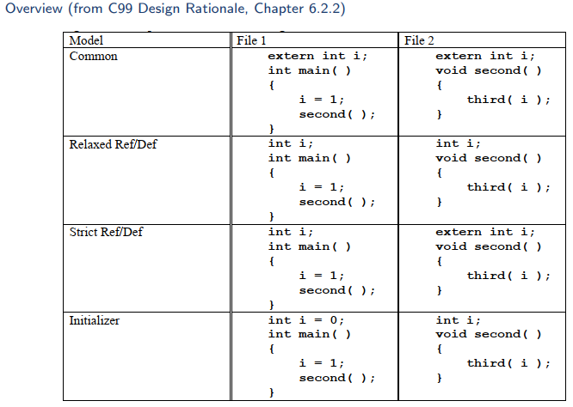
Linkage Models

Slide 29
Linkage Models
The Standard
Combination of strict Ref/Def and Initialization
Only one file has definition
Definition is declaration without storage class specifier or extern with initializer
Having multiple definitions causes undefined behavior! (does not mean that you get an error message!)
Conclusion
False assumption on linkage model can be source of bugs!
gcc under Linux does not use the standard model, but the UNIX one
Do not rely on that when you want to write portable code
Guideline
Use strict Ref/Def. Exactly one file with definition (declaration without storage class). All other declarations use extern

Slide 30
C++ Compatibility
Your C code might be used by a C++ project. Be prepared for that
Biggest issue: C++ mangles function names
extern int my_func ( double , const char *);
int main () {
return my_func (2.345 , " Hallo ");
}
Mangled symbol name: __Z7my_funcdPKc (GCC 4.0.1)
Just including a C header will apply mangling to C declarations
Linker will not be able to find symbols
Surround declaration in .h files with
# ifdef __cplusplus
extern "C" {
# endif
/* Here go the C declarations */
# ifdef __cplusplus
} #
endif

Slide 31
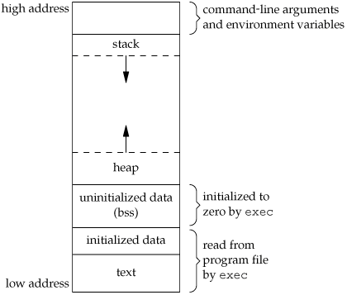
Memory Layout (Unix/Linux)
When executed, the memory of a C program is composed into several segments.
Text
Executable code
Might be read-only to forbid accidental self-modification
Initialized Data
Global/local linkage data that has been initialized
Can be set read-only for const variables
Uninitialized Data BSS
Global/local linkage data that has not been initialized
Is initialize with 0 by the kernel at load time
No space in the binary needs to be waste

Slide 32
Memory Layout (Unix/Linux)
Heap
Dynamically allocated data (malloc)
Usually grows upwards
Stack
Auto variable. Stack frames. Spilled registers
Usually grows downwards
Know where the segments start
Gives you an idea where your pointer point to
Example
You debug and some pointer 0xe502f segfaults
This address is strange (below data, heap, and stack)
You must have overwritten the pointer’s contents

Slide 33
Exercise 2
Continue Exercise 1
Modify header.h, func.c and main.c that cover
Variable ‘s attributes
Scope, Visibility, Name Space, Extent, Linkage
Whole memory segment.
Example
After that, create your branch:
Commit:
and push it.
#include <stdio.h>
char c; /* Uninitialized variable stored in bss*/
int main() {
static int i; /* Uninitialized static variable stored in bss */
return 0;
}
$ git checkout –b TaiHuuVo_Training_C
$ git commit –am "Update memory exercise"
$ git push origin TaiHuuVo_Training_C

Slide 34
Thank You!!

