Slide 1
C Programming Language
STRUCTURES IN C Dec, 2019

Slide 2
Contents
Strings Overview.
Structures.
Typedef.
Union.
Enum.
Exercise.

Slide 3
Strings Overview (1/3)
Strings are one-dimensional array of characters.
Terminated by a null character.
Example
char str[6] = {'H', 'e', 'l', 'l', 'o', '\0'};
// Or
char str[] = "Hello";
str[0] | str[1] | str[2] | str[3] | str[4] | str[5]
H | e | l | l | o | \0

Slide 4
Strings Overview (2/3)
The functions support working on strings. All of them is in <string.h>
strcpy(s1, s2); Copies string s2 into string s1.
strcat(s1, s2); Concatenates string s2 onto the end of string s1.
strlen(s1); Returns the length of string s1.
strcmp(s1, s2); Returns 0 if s1 and s2 are the same; less than 0 if s1<s2; greater than 0 if s1>s2.
strchr(s1, ch); Returns a pointer to the first occurrence of character ch in string s1.
strstr(s1, s2); Returns a pointer to the first occurrence of string s2 in string s1.

Slide 5
Strings Overview (3/3)
Read String from the user.
Using the scanf() function to read a string.
How to read a line of text?
Using the fgets() function to read a line of string.
Print/Display a string.
Using printf from standard I/O library.
String output also is done with the fputs().
int scanf ( const char * format, ... );
char * fgets ( char * str, int num, FILE * stream );
int fprintf ( FILE * stream, const char * format, ... );
int fputs ( const char * str, FILE * stream );

Slide 6
Structures (1/3)
Structure is a user-defined datatype in C language which allows us to combine data of different types together.
So structure helps to construct a complex data type which is more meaningful.
Definition:
Example:
struct [structure_tag] {
member variable 1;
member variable 2;
...
} [structure_variables];
struct Student {
char name[25];
int age;
// F for female and M for male
char gender;
};

Slide 7
Structures (2/3)
Declaring Structure Variables.
Declaring Structure variables separately.
Declaring Structure variables with structure definition.
Accessing Structure Members.
struct Student {
//...
};
struct Student s1, s2; // declaring variables of struct Student
struct Student {
//...
}s1, s2;
struct Student s1;
// s1 is a variable of Student type and age is a member of Student
s1.age = 18;
// using string function to add name
strcpy(s1.name, "My name");

Slide 8
Structures (3/3)
Structure Initialization.
Like a variable of any other datatype, structure variable can also be initialized at compile time. Example:
Nested structures means, that one structure has another stucture as member variable.
struct Point {
int x, y;
};
// initialization struct.
struct Point p1 = { 1 , 2 };
// or initialization of each member separately
struct Point p2;
p2.x = 3;
p2.y = 4;

Slide 9
Typedef (1/2)
typedef is a keyword used in C language to assign alternative names to existing datatypes.
Its mostly used with user defined datatypes, when names of the datatypes become slightly complicated to use in programs.
Syntax:
Example:
typedef <existing_name> <alias_name>
// Define a term ulong for an unsigned long datatype.
typedef unsigned long ulong;
// ulong identifier can be used to define unsigned long type variables. ulong i, j;

Slide 10
Typedef (2/2)
Structure definition using typedef.
typedef and Pointers.
typedef can be used to give an alias name to pointers.
Example:
typedef struct Point {
int x, y;
}point_t;
// define Point type using point_t
point_t p1;
point_t p1;
typedef int* intptr_t;
intptr_t x, y, z;

Slide 11
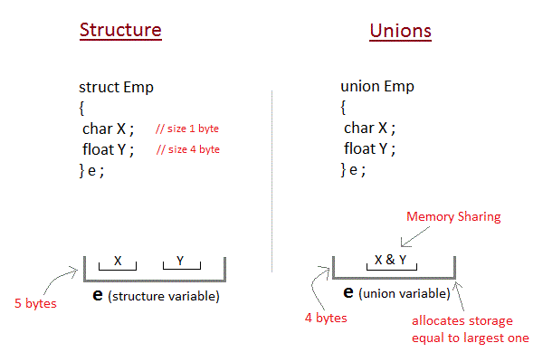
Union (1/2)
Unions are conceptually similar to structures. The syntax to declare/define a union is also similar to that of a structure. The only differences is in terms of storage.
In structure each member has its own storage location.
Whereas all members of union uses a single shared memory location which is equal to the size of its largest data member.
Notes:
Refer: https://www.studytonight.com/c/unions-in-c.php

Slide 12
Union (2/2)
Example:
As you can see here, the values of a get corrupted and only variable c prints the expected result.
This is because in union, the memory is shared among different data types. Hence, the only member whose value is currently stored will have the memory.
In the example, value of the variable c was stored at last, hence the value of other variables is lost.
#include <stdio.h>
union item {
int a;
char ch;
};
int main() {
union item it;
it.a = 12;
it.ch = 'z';
printf("%d\n", it.a);
printf("%c\n", it.ch);
return 0;
}
// Ouput:
// 122
// z

Slide 13
Enum
enum is a user defined datatype in C language. It is used to assign names to the integral constants which makes a program easy to read and maintain.
Here is the syntax of enum in C language:
Example:
enum enum_name{const1, const2, ....... };
#include<stdio.h>
enum week {Mon=10, Tue, Wed, Thur, Fri=10, Sat=16, Sun };
enum day {Mond, Tues, Wedn, Thurs, Frid=18, Satu=11, Sund };
int main() {
printf("enum week: %d\t%d\t%d\t%d\t%d\t%d\t%d\n\n",Mon , Tue, Wed, Thur, Fri, Sat, Sun);
printf("enum day: %d\t%d\t%d\t%d\t%d\t%d\t%d",Mond , Tues, Wedn, Thurs, Frid, Satu, Sund);
return 0;
}
// Output
// enum week: 10 11 12 13 10 16 17
// enum day: 0 1 2 3 18 11 12
Notes:
Refer: https://www.tutorialspoint.com/enum-in-c

Slide 14
Exercise
Complete functional for the program under: 06_Structures_in_C.
Implement Action: 1 - 6
Action 5:
If user input more than content’s length.
Truncate input to max_length.
And then show-up a waring.
Saving user input to program.
$ make run
winpty ./main
1. Get number of vowels in the string
2. Get number of consonants in the string
3. Convert the string to uppercase
4. Convert the string to lowercase
5. Enter another string
6. Exit the program
Select an action:

Slide 15
Thank You!!

