Slide 1
Basic MCU
Dec, 2019

Slide 2
Contents
What is a MCU?
MCU‘s Components
Processor core
I/O
Interrupt
Timer
Other comments
MCU Communication
UART, SPI, IIC
MCU Development
Programming Language
Downloading
Debugging

Slide 3
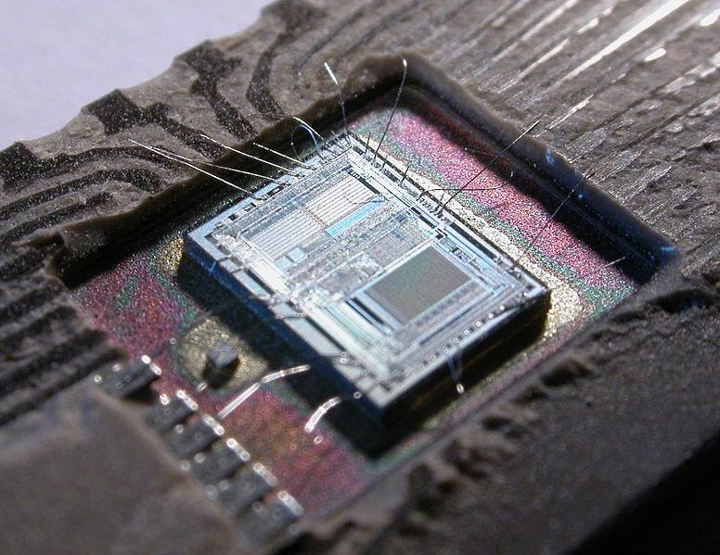
What is a MCU ?
MCU stands for Micro-Controller Unit
Which is a small computer on a single Integrated Circuit chip.
Contains one or more CPUs along with memory and programmable input/output peripherals.
MCUs are designed for embedded applications
Such as automobile engine control systems, implantable medical devices, remote controls, office machines, appliances, power tools.
A microcontroller

Slide 4
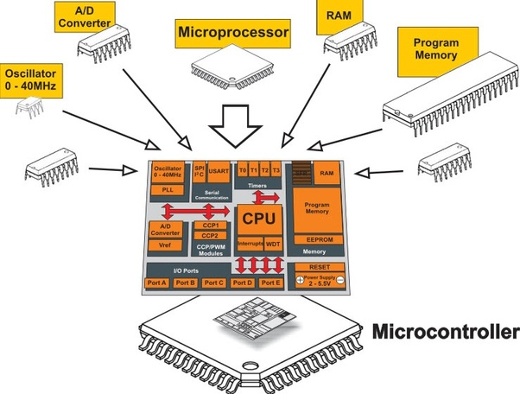
Microcontroller Components
A simple MCU contains.
Microprocessor (Processor Core)
Memory
Digital I/O
Analog I/O
Interrupts
Timer
Other Features
Watchdog Timer
Power Manager
Reset
MCU components

Slide 5
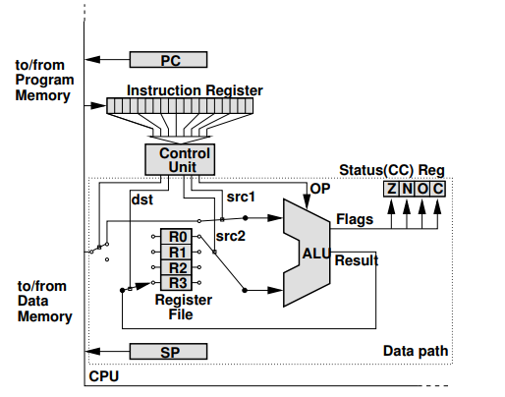
MCU Processor Core
The processor core is the main part of any microcontroller.
Architecture
Instruction Set
Basic processor architecture

Slide 6
Processor Architecture (1/3)
Data Path, which execute instructions.
Control Unit, which basically tells the data path what to do.
Arithmetic Logic Unit (ALU)
Perform computations (AND, ADD, INC,…)
The ALU takes 2 inputs and return the result of the operation as its output.
ALU stores nature of result in the status register
Zero, Negative, Overflow, Carry.
Register File
General Purpose Registers
Dedicated Registers
Index Registers
Basic processor architecture
Notes:
CPU can take the operands for the ALU from the file, and it can store the operation’s result back to the register file. Alternatively, operands/result can come from/be stored to the memory. However, memory access is much slower than access to the register file, so it is usually wise to use the register file if possible.

Slide 7
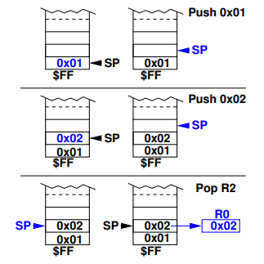
Processor Architecture (2/3)
Stack Pointer
Stack pointer (SP) points to the top of the stack.
The stack is a portion of consecutive memory in the data space.
CPU store/return addresses, possibly register contents during subroutine/interrupt service routine calls.
Stack pointer working

Slide 8
Processor Architecture (3/3)
Control Unit
Determine which operation should be executed next and configure the data path accordingly.
Program counter (PC), is used to store the address of the next program instruction.
The control unit loads this instruction into the instruction register (IR), decodes the instruction, and sets up the data path to execute it.
Data path configuration includes providing the appropriate inputs for the ALU (from registers or memory), selecting the right ALU operation, and making sure that the result is written to the correct destination (register or memory).

Slide 9
Von Neumann versus Harvard Architecture
All MCs use one of two basic design models:
Harvard Architecture and von-Neumann architecture.
They represent two different ways of exchanging data between CPU and memory.
CPU
ROM (program)
CPU
RAM
+
ROM (program)
x8
x8
RAM
x12
Von-Neumann Architecture
Von-Neumann Architecture

Slide 10
RISC and CISC
RISC
“The RISC architecture has simple, hard-wired instructions which often take only one or a few clock cycles to execute. RISC machines feature a small and fixed code size with comparatively few instructions and few addressing modes. As a result, execution of instructions is very fast, but the instruction set is rather simple.”
CISC
“The CISC architecture is characterized by its complex microcode instructions which take many clock cycles to execute. The architecture often has a large and variable code size and offers many powerful instructions and addressing modes. In comparison to RISC, CISC takes longer to execute its instructions, but the instruction set is more powerful.”

Slide 11
Processor Instruction Set
The instruction set is an important characteristic of any CPU.
It influences the code size, that is, how much memory space your program takes.
Choosing the controller whose instruction set best fits your specific needs.
The metrics of the instruction set that are important for a design decision are:
Instruction Size.
CISC machines tend to have longer opcodes than RISC machines.
Execution Speed.
Depending on word size, oscillator frequency.
Available Instructions.
Addressing Modes.

Slide 12
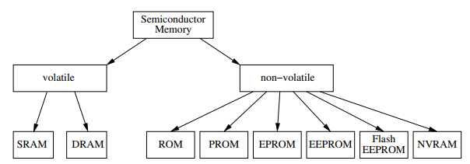
MCU Memory
Register File: A (usually) relatively small memory embedded on the CPU. It is used as a scratchpad for temporary storage of values the CPU is working with.
Data Memory: For longer term storage, generic CPUs usually employ an external memory which is much larger than the register file. Data that is stored there may be short-lived, but may also be valid for as long as the CPU is running.
Instruction Memory: Like the data memory, the instruction memory is usually a relatively large external memory (at least with general CPUs).
Memory type

Slide 13
MCU Memory – Volatile Memory
Volatile memory faster then non-volatile memory.
Static RAM
Static Random Access Memory (SRAM) was the first type of volatile memory.
Consists of an array of cells, each capable of storing one bit of information.
To store a bit of information, a so-called flip-flop is used, which basically consists of six transistor.
Dynamic RAM
Instead of using a lot of transistors to build flip-flops, one bit of information is stored in a capacitor.
At the same chip size, a DRAM has much larger storage capacity compared to an SRAM.

Slide 14
MCU Memory – Non-Volatile Memory
Contrary to SRAMs and DRAMs, non-volatile memories retain their content even when power is cut.
Writing non-volatile memory types is usually much slower and comparatively complicated.
Non-Volatile Memory Type:
ROM (Read Only Memories).
PROM (Programmable Read Only Memory).
EPPROM (Erasable Programmable Read Only Memory).
EEPROM (Electrically Erasable and Programmable ROM).
Flash (Flash-EEPROMs).
NVRAM (Non-Volatile RAM).

Slide 15
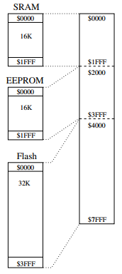
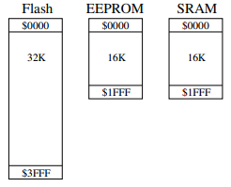
MCU Memory – Accessing (1/2)
Two methods to use multiple type of memory.
Separate Memory Addressing.
All memory types share a common address range

Slide 16
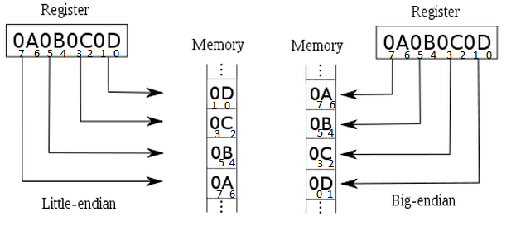
MCU Memory – Accessing (2/2)
Endianness.
Big Endian:
The Big End of the word is stored first.
So, if you write the word 0x1234 to address 0x0100, the high byte 0x12 goes to address 0x0100, and the low byte 0x34 to address 0x0101.
Little Endian:
The low byte is stored first.
Big Endian and Litter Endian Storing Data

Slide 17
I/O Port
An input port is hardware on the microcontroller that allows information about the external world to be entered into the computer.
An output port used to send information out to the external world.
An interface is defined as the collection of the I/O port, external electronics, physical devices, and the software, which combine to allow the computer to communicate with the external world.
Parallel - binary data are available simultaneously on a group of lines.
Serial - binary data are available one bit at a time on a single line.
Analog - data are encoded as an electrical voltage, current, or power.
Time - data are encoded as a period, frequency, pulse width, or phase shift.

Slide 18
Digital I/O
All microcontrollers have at least 1-2 digital I/O pins that can be directly connected to hardware.
I/O pins are generally grouped into ports of 8 pins.
Pins can either be input only, output only, or bidirectional.
The value of the pin is either 1 or 0.
The registers control the behavior of the pins.
Data Direction Register (DDR).
The functionality of a pin (input or output) is determined by clearing or setting its bit in the DDR.
Port Register (PORT) .
This register is used to control the voltage level of output pins.
Port Input Register (PIN).
The PIN register is generally read-only and contains the current state (high or low) of all pin.

Slide 19
Analog I/O (1/3)
We live in an analog world.
The microcontroller is inherently digital, so we need appropriate ways of converting analog signals into the digital world and back again.
Digital/Analog Conversion (DAC)
Using PWM signal, in conjunction with an RC low-pass filer.
Disadvantages: Require a dedicated timer to generate the PWM, need to wait for a few periods until the output signal stabilizes.
Advantage: Simple and only uses up one single output pin.
Using binary-weighted resistor circuit.
Disadvantage: requires many different resistor types with have to be high precision to keep the ratio correct.
Advantage: Saving timer, only 2 register value: R and 2R.

Slide 20
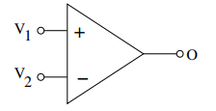
Analog I/O (2/3)
Analog Comparator
Comparators are a bit like digital inputs, but without a Schmitt-trigger and with a configurable threshold.
The analog comparator has two analog inputs and one (digital) output.
It simply compares the two input voltages V1 and V2
O sets its output to 1 if V1 > V2
O sets its output to 0 If V1 ≤ V2
Analog/Digital Conversion
That converts an analog voltage on a pin to a digital number
The most common technique uses the analog voltage to charge up an internal capacitor and then measure the time it takes to discharge across an internal resistor.
The microcontroller monitors the number of clock cycles that pass before the capacitor is discharged.

Slide 21
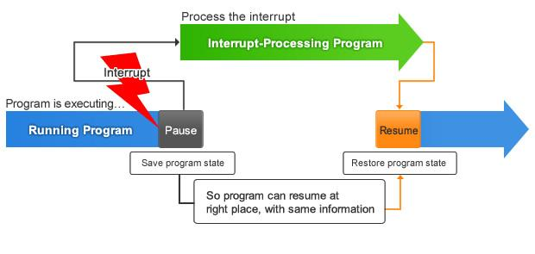
Interrupt
How your program should monitor the input line to ensure a proper and timely reaction ?
polling the input signal.
Waste processor time if the event only occurs infrequently, it is also hard to modify or extend.
The polling code may have to be called from several places in the main program ☹
Interrupt
The microcontroller polls the signal and interrupt the main program only if a state change is detected.
No state change, the main program simple executes without any concerns about the event.
ISR (Interrupt service routine) handles the event.
How the interrupt works

Slide 22
Interrupt Control
As simple as that, there are two bits controller the interrupt.
The Interrupt Enable (IE) bit
Indicate the controller should call an ISR in reaction to the event.
The interrupt Flag (IF) bit
Showing that the interrupt condition has occurred.
Is set by the MCU whenever the event occurs.
Is cleared either automatically upon entering the ISR or manually by the programmer.
MCU also offer one global interrupt enable bit which enables/disables all currently enabled interrupt.
Hence, an ISR is only called if both the IE bit for the interrupt source and the global IE bit are enabled.
Some controllers also offer a nonmaskable interrupt (NMI), which cannot be disabled by the global IE bit.
Useful for particularly important events.

Slide 23
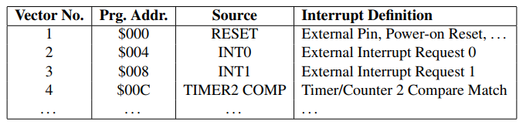
Interrupt Vector Table
Programmer have to tell the controller which particular interrupt service routine should be called.
The mapping of interrupts to ISRs is achieved with the interrupt vector table.
Contains an entry for each distinct interrupt vector.
Each vector has its fixed address in the vector table, which in turn has a fixed base address in program memory.
When an interrupt condition occurs and the corresponding ISR should be called, the controller jump to the appropriate ISR.
ATmega16 Interrupt Vector Table

Slide 24
Interrupt Handling
Detecting the Interrupt Condition
External event.
Compare the sample value with its previous value.
Noise cancellation
Internal event.
MCU provides the hardware to set IF flag if the event occurred.
Naturally, internal events are not affected by noise.
Calling the ISR
Save return address on the stack, then jump to the appropriate new address and come back saving address.
Interrupt Service Routine.
It contains the code necessary to react to the interrupt.
This could include clearing the interrupt flag if it has not already been cleared, or disabling the interrupt if it is not required anymore.

Slide 25
Interrupt or Polling
When we use interrupt instead of polling?
Using Interrupt | Using Polling
Event occurs infrequently. | The operator is human.
Long intervals between two events. | No precise timing is necessary.
The state change is important. | The state is important.
Short impulses, polling might miss them. | Impulses are long.
Event is generated by HW, no bouncing effects or spikes. | The signal is noisy.
Nothing else to do in main, could enter sleep mode. | There is something else to do in main anyway, but not too much.

Slide 26
Timer
Which is strictly speaking a counter module, is an important part of every microcontroller, and most controllers provide one or more timers with 8 and/or 16 bit resolution.
Timers are used for a variety of tasks ranging from simple delays over measurement of periods to waveform generation.
Each timer is basically a counter which is either incremented or decremented upon every clock tick.
System Clock (Internal Clock).
External Pulse (Pulse Accumulator).
External Crystal (Asynchronous Mode).

Slide 27
Timer Features
Input Capture.
Used to timestamp (mostly external) events. Whenever the event occurs (on input capture pin), the timer automatically copies its current count value to an input capture register, where it can be read by the program.
It also sets the input capture flag and can raise an interrupt to notify the application.
Output Compare.
It likes Input Capture but the event occurs when time is reached.
output compare register, where you can enter the time at which the output compare event should happen.
Plus Width Modulation (PWM).
PWM mode is a special case of the output compare.
In it, the timer generates a periodic digital output signal with configurable high-time and period.
Two registers form the main interface to the PWM, one for the period (also called duty cycle) and one for the high-time (or the low-time).

Slide 28
Other Features (1/2)
Watchdog Timer
Used to monitor software execution.
The Watchdog Time starts counting down. When the count value reaches zero, a reset is triggered, thus reinitializing the controller and restarting the program. To avoid this controller reset, the software must reset the watchdog before its count reaches zero.
Power Consumption and Sleeping
Clocking Frequency Reduction
This technique allows the controller to operate as usual, but with a slower frequency.
Voltage Reduction
The controller is generally specified for a certain voltage range. If the voltage drops below this level, the controller may behave arbitrarily.
Shutdown of Unused Modules (Sleep Modes)
Notes:
Microcontrollers are often deployed in mobile devices which run on batteries. In consequence, low power consumption is an important asset for a microcontroller.

Slide 29
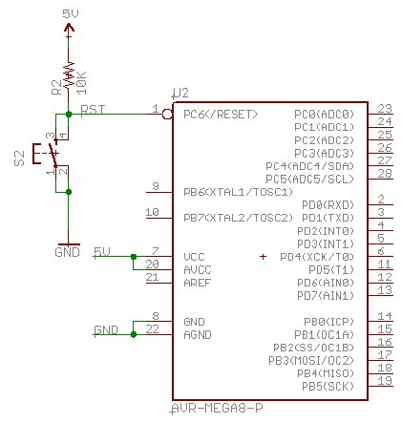
Other Features (2/2)
Reset
The reset is another important feature of microcontrollers, which are often deployed under environmental conditions that can lead to software or hardware failures.
The reset source can be:
Power-On reset
Brown-Out reset
External reset
Watchdog rest
Internal rest
External reset button on Atmega8

Slide 30
Communication Interface
The basic purpose of any such interface is to allow the microcontroller to communicate with other units, be they other microcontrollers, peripherals, or a host PC.
Interfaces categorized by their properties:
Serial or Parallel. Synchronous or Asynchronous.
Bus or Point-to-Point communication. Full-Duplex or Half Duplex.
Master-Slave principle or consist of equal partners.
The basic communication interface on the MCU
SCI (UART)
SPI
IIC

Slide 31
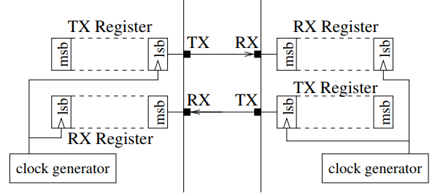
Communication Interface – UART (1/3)
The UART module utilizes two wires, a transmit (TXD) and a receive (RXD) line, for full- or half-duplex communication.
UART module within a microcontroller allows the application to control much of its behavior.
Configurable parameters included:
Number of data bits.
Parity bit
Stop bits.
Baud rate.
Data Transmission
Using Non Return to Zero (NRZ) encoding
Basic structure of a UART module.

Slide 32
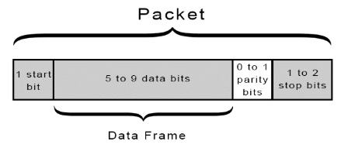
Communication Interface – UART (2/3)
UART transmitted data is organized into packets. Each packet contains 1 start bit, 5 to 9 data bits (depending on the UART), an optional parity bit, and 1 or 2 stop bits:
START BIT
UART pulls the transmission line from high to low for one clock cycle.
DATA FRAME
Actual data being transferred.
PARITY
Parity describes the evenness or oddness of a number
STOP BITS
To signal the end of the data packet.
UART frame
Notes:
The parity bit is a way for the receiving UART to tell if any data has changed during transmission.

Slide 33
Communication Interface – UART (3/3)
Advantages
Only uses two wires.
No clock signal is necessary.
Has a parity bit to allow for error checking.
The structure of the data packet can be changed as long as both sides are set up for it.
Well documented and widely used method.
Disadvantages
The size of the data frame is limited to a maximum of 9 bits.
Doesn’t support multiple slave or multiple master systems.
The baud rates of each UART must be within 10% each other.

Slide 34
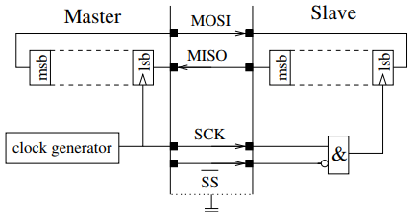
Communication Interface – SPI (1/3)
The Serial Peripheral Interface (SPI) is a simple synchronous point-to-point interface based on a master-slave principle.
It provides full-duplex communication between a master and one slaves.
The interface consists four single-ended line:
MOSI (Master Out, Slave In)
MISO (Master In, Slave Out)
SCK (System Clock)
SS (Slave Select)
SPI interface

Slide 35
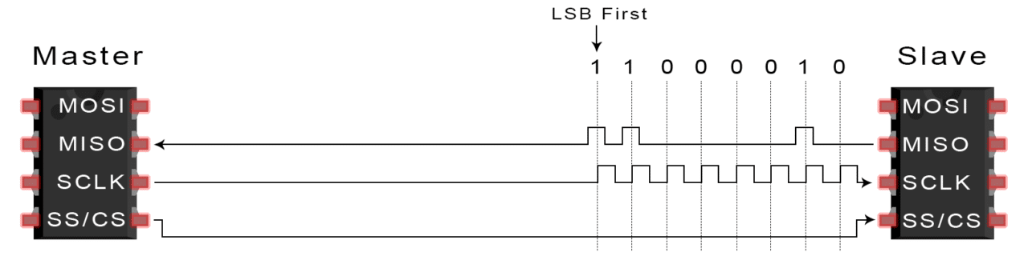
Communication Interface – SPI (2/3)
The Step Of SPI Data Transmission:
The master outputs the clock signal.
The master switches the SS/CS pin to a low voltage state, which activates the slave.
The master sends the data one bit at a time to the slave along the MOSI line. The slave reads the bits as they are received.
If a response is needed, the slave returns data one bit at a time to the master along the MISO line. The master reads the bits as they are received
SPI transmission

Slide 36
Communication Interface – SPI (3/3)
Advantages
No start and stop bits, so the data can be streamed continuously without interruption.
No complicated slave addressing system like I2C.
Higher data transfer rate than I2C (almost twice as fast).
Separate MISO and MOSI lines, so data can be sent and received at the same time.
Disadvantage
Uses four wires (I2C and UARTs use two).
No acknowledgement that the data has been successfully received (I2C has this).
No form of error checking like the parity bit in UART.
Only allows for a single master.

Slide 37
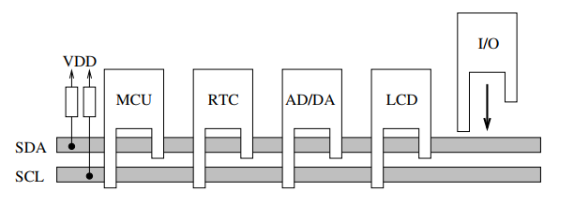
Communication Interface – IIC (1/4)
The Inter-IC bus (IIC or I²C) is a synchronous bus that operates on a master-slave principle.
It uses two single-ended wires SCL (Serial Clock Line) and SDA (Serial Data Line) for half-duplex communication.
Transmission speeds from 100 kbit/s to 3.4 Mbit/s.
Basic configuration of the IIC bus

Slide 38
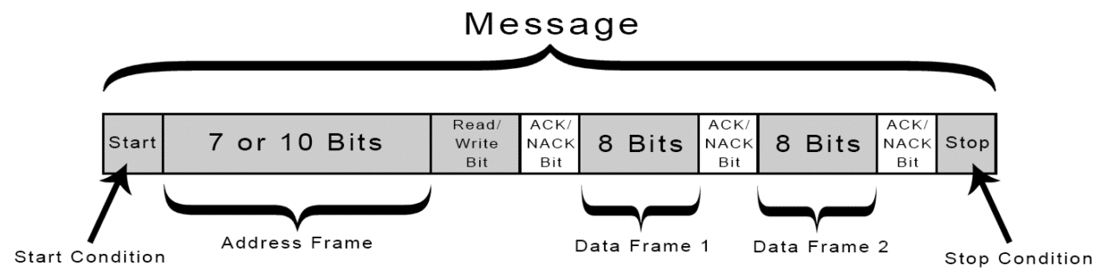
Communication Interface – IIC (2/4)
Start Condition: SDL line switches from a high to low before SCL line switches from high to low.
Address Frame: 7 or 10 bit sequence unique to each slave identifiers.
Read/Write Bit:
Low: Master sending data to slave.
High: request fata from salve.
ACK/NACK Bit.
Stop Condition: SDA line switches from low to high after SCL line switch from low to high.
IIC ‘s message frame

Slide 39
Communication Interface – IIC (3/4)
The Step Of IIC Data Transmission.
The master sends the Start Condition.
The master sends each slave the 7 or 10 bit address of the slave.
Slave return ACK if address is matched (SDA line is low) or return NACK (SDA line is high).
The master sends or receives data frame.
After each data frame has been transferred, the receiving device returns another ACK bit to the sender to acknowledge successful receipt of the frame.
The master send Stop Condition.
Communication Type.
Single Master with Multiple Slaves.
Multiple Masters with Multiple Slaves.

Slide 40
Communication Interface – IIC (4/4)
Advantages.
Only uses two wires.
Supports multiple masters and multiple slaves.
ACK/NACK bit gives confirmation that each frame is transferred successfully.
Hardware is less complicated than with UARTs.
Well known and widely used protocol
Disadvantages:
Slower data transfer rate than SPI.
The size of the data frame is limited to 8 bits.
More complicated hardware needed to implement than SPI.

Slide 41
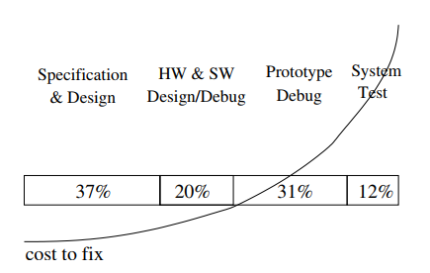
MCU Development
Development Cycle
Design Phase
Implementation
Testing & Debugging
MCU Programming
Language
Download
Debugging
Project time allocation to different phases and the cost associated with fixing a defect as the project progresses.

Slide 42
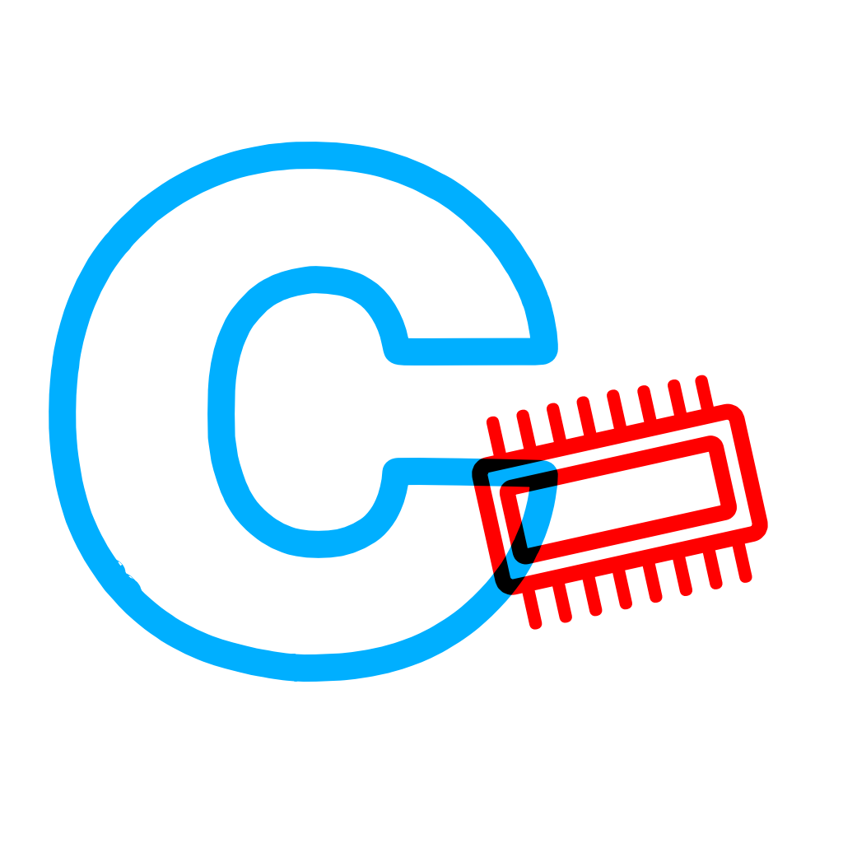

MCU Programming – Language
Assembly Language Programming
Everything you can do in assembly.
Optimize for memory & speed.
Hard to work and maintain.
C Language.
C is easier to program in, compared to Assembly.
C is pretty darn low-level, and it's rare that you'll want to go much lower.
You can write Assembly in C-code, but not C in Assembly-code.
Other language
C++, Java such as: Java Card - Wikipedia (for SIM and ATM cards), Python such as: MicroPython – Wikipedia
Rust, Ada, javascript, Go, Lua, B#, C#, Verilog, VHDL (reading it here)
Assembly and C language Icon

Slide 43
MCU Programming – Download
After a program has been compiled and linked, you need to download the executable to the microcontroller.
Programming Interfaces.
Microcontrollers have at least one, but often several programming interfaces.
ISP, JTAG, DebugWire, HVPP, HVSP, PDI, TPI.
Bootloader.
This is a piece of software already residing in the controller’s memory that takes over new user programs and installs them in the controller.
File Formats.
Intel’s Hex Format.
Each record is made up of six fields: Mark, Length, Offset, Type. Data, Checksum.
Motorola’s S-Record Format.
Each record is made up of the following fields: Start Mark, Type, Length, Address, Data, Checksum.

Slide 44
MCU Programming – Debugging
No debugger.
LEDs, Switches, Buttons.
LEDs can easily be used to trace program execution.
UART logging: More details, you can print out what happen inside the MCU.
ROM Monitor.
The ROM monitor is a piece of software running on the target controller that can be seen as a rudimentary operating system.
Instruction Set Simulator.
Allow the execution of target software on the host PC.
In-Circuit Emulator.
Having additional pin, which used to access to the internal state of MCU.
Debugging Interface.
JTAG, BDM.

Slide 45
Comparing MCU and CPU
Comparing architecture of MCU and CPU
Microcontroller: CPU on a single chip
Microprocessor: CPI and several supporting components.
Memory
Timer
Memory
RAM
ROM
CPU
ROM
Clock
CPU
Clock
RAM
I/O interface
Other peripherals

Slide 46
Thank You!!

