Slide 1
Bash Basic
Dec, 2019

Slide 2
Contents
UNIX Basic Command
Regular Expression Basic
Grep command
Sed command
Awk command
Bash language
Variable
Arithmetic Expansion
Function
Reading User Input
Flow Control
Loop
Exercise

Slide 3
UNIX Basic Command
Navigating Files and Directories:
cd <path>: changes the current working directory.
ls <path>: prints a listing of a specific file or directory; ls on its own lists the current working director (Ex: ls <path>, ls –l <path>, ls –la <path>, …)
pwd: prints the user’s current working directory.
Working With Files and Directories
cp <old> <new>: copies a file.
mkdir <path>: creates a new directory. (Ex: mkdir <path>, mkdir –p <path>, …).
mv <old> <new>: moves (renames) a file or directory.
rm <path>: removes (deletes) a file. (Ex: rm <path>, rm –rf <path>, …).
touch <file>: update timestamps on files.

Slide 4
UNIX Basic Command
Pipes and Filters
cat: displays the contents of its inputs.
head: displays the first 10 lines of its input.
tail: displays the last 10 lines of its input.
sort: sorts its inputs. (Ex: sort, sort –d, sort –u, sort -n …).
wc: counts lines, words, and characters in its inputs. (Ex: wc –l, wc –c, …)
command > file: redirects a command’s output to a file (overwriting any existing content).
command >> file: appends a command’s output to a file.

Slide 5
UNIX Basic Command
Finding Some Things
find: finds files with specific properties that match patterns. (Ex: find <path> –iname “*.txt”, find <path> -type <argument>, …)
grep: selects lines in files that match patterns. (Ex: grep <pattern> <file>, grep –c, grep –e, grep –i, grep –v, …)
Debug
echo <text>: print text to monitor
Help
--help: is an option supported by many bash commands, and programs that can be run from within Bash, to display more information on how to use these commands or programs.
man <command>: displays the manual page for a given command. (Note: man command doesn’t supported in Git Bash, so please use –help instead)
Note: The best way to use the shell is to use pipes to combine simple single-purpose programs.

Slide 6
UNIX Basic Command
Example for PIPE LINE
hieu.nguyen-trung@PC-001 MINGW64 ~/Desktop/Material/c_cpp (test_hieunguyen)
$ cat -n README.md | head -5
1 # Get start.
2
3 1. Clone repository
4
5 ``` bash
- Read file README.md then show the first 5 lines
- Find all things in the current folder, => search the “.c” extension
hieu.nguyen-trung@PC-001 MINGW64 ~/Desktop/Material/c_cpp (test_hieunguyen)
$ find . | grep '\.c$'
./01_memory/func.c
./01_memory/main.c
./02_makefile_debugging/func.c
./02_makefile_debugging/main.c
./03_pre-processor/debug_log.c
./03_pre-processor/main.c
…

Slide 7
UNIX Basic Command
Please try to do all command with recommend option before moving to next slide.
Use “--help” or “stackoverflow” to understand the built-in option for the specific command which you want
$ ls –help | less
Usage: ls [OPTION]... [FILE]...
List information about the FILEs (the current directory by default).
Sort entries alphabetically if none of -cftuvSUX nor --sort is specified.
Mandatory arguments to long options are mandatory for short options too.
-a, --all do not ignore entries starting with .
-A, --almost-all do not list implied . and ..
--author with -l, print the author of each file
-b, --escape print C-style escapes for nongraphic characters
--block-size=SIZE with -l, scale sizes by SIZE when printing them;
e.g., '--block-size=M'; see SIZE format below
:

Slide 8
UNIX Basic Command
Quiz:
Count the files, the directories in folder New_Training then update your script command to Git Server.
Link:
Git http://gitlab.banvien.com/training/c_cpp/tree/test_hieunguyen
Path: c_cpp/99_exercise/00_BASH/New_Training
Output sample:
Result: "86" directories, "149" files in folder ./New_Training

Slide 9
Regular Expression Basic
What is regular expression?
A regular expression (regex) is a method of representing a string matching pattern.
Regular expressions enable strings that match a particular pattern within textual data records to be located and modified and they are often used within utility programs and programming languages that manipulate textual data.
Regular expressions are extremely powerful.
Supporting Software and Tools.
Command Line Tools:
grep
sed
awk
Editors: ed, vi, emacs
Languages: awk, perl, python, php, ruby, tcl, java, javascript, .NET,...

Slide 10
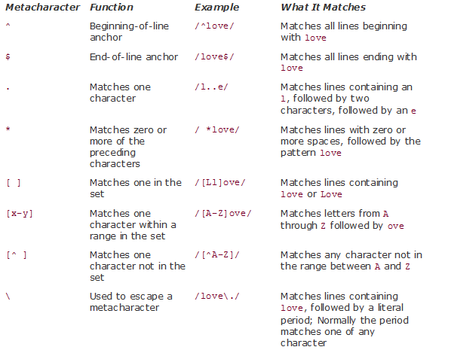
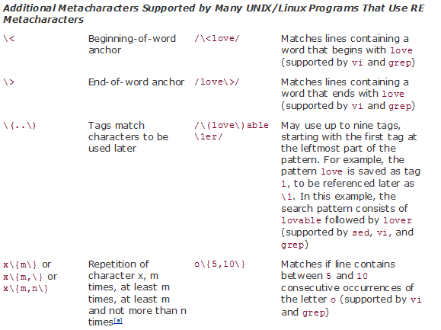
Regular Expression Basic
Meta-character Table:

Slide 11
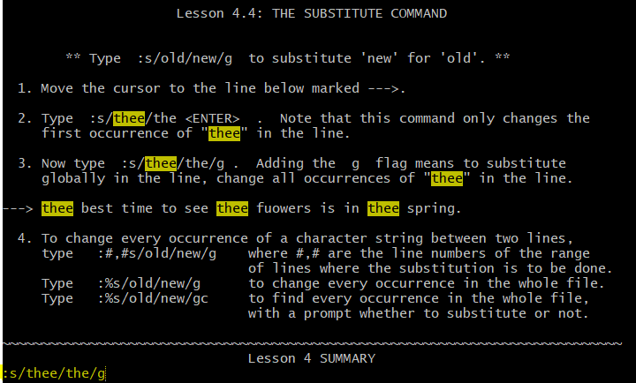
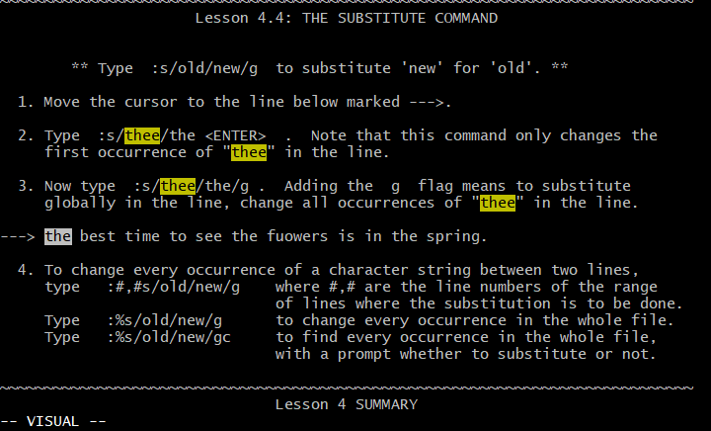
Regular Expression Basic
Example for the substitute purpose in VIM Editor:
Type “vimtutor <ENTER>” in Git Bash to open Tutor for VIM Editor.
Try type “:s/thee/the/g” then you will get the result as the right picture.
Before
After

Slide 12
Regular Expression Basic
Please try to do at least 4 exercise from exercise 1 to exercise 4 in “vimtutor” before moving to next slide.

Slide 13
Regular Expression Basic
Example for the grep command:
Command: “ cat New_Training/Onboarding_Training_Output/Huynh.Nguyen/test/3.ERR123004.txt | grep 'INF' ”
Command: “ cat New_Training/Onboarding_Training_Output/Huynh.Nguyen/test/3.ERR123004.txt | grep '^INF[0-9]\+[5-9]:' ”
Result:
$ cat New_Training/Onboarding_Training_Output/Huynh.Nguyen/test/3.ERR123004.txt | grep 'INF'
INF000001: Tool Version: 1.0.0
INF000002: Command line arguments: MCALConfGen.exe -m adc -l -o ./
INF000004: Opened file <Adc.log> at [03 Oct 2019 - 02:12:14].
INF000005: <3> Error(s) and <0> Warning(s) detected.
INF000009: Execution terminated due to error in the input file.
$ cat New_Training/Onboarding_Training_Output/Huynh.Nguyen/test/3.ERR123004.txt | grep '^INF[0-9]\+[5-9]'
INF000005: <3> Error(s) and <0> Warning(s) detected.
INF000009: Execution terminated due to error in the input file.
What is the difference of these outputs?

Slide 14
grep command
Grep is a command in UNIX, it is used to search a specific string.
Syntax:
Normal using: grep <word> <filename>
Pipeline using: <command> | grep <Regular Expression>
Some useful option that is used with grep:
grep –E <word> <filename>: PATTERN is an extended regular expression or egrep command
grep –i <word> <filename>: ignore case distinctions
grep –v <word> <filename>: select non-matching lines
grep –c <word> <filename>: print only a count of selected lines per FILE

Slide 15
grep command
Quiz:
Create script command to collect all “UUID” in file “App_ADC_U2AEVA1_BGA516.arxml”
Link:
Git: http://gitlab.banvien.com/training/c_cpp/tree/test_hieunguyen
Path: c_cpp/99_exercise/00_BASH/New_Training/TCODE/SampleApp/cdf/App_ADC_U2AEVA1_BGA516.arxml
Output Sample:
742debb7-005d-4ec8-98be-b2f7448fdbdc
583fa164-0186-4061-b0c1-885ce439108d
26b4f04b-307c-4040-8909-4ca0a63502bb
03e99cc8-591d-40fa-9912-2f29123ecabd
b2eb8f87-44d0-4709-ba7a-bef5f669eafe
d2565947-b82c-4c71-910c-2e8522506383
e6101ffd-f93f-4055-a86b-4387b8b813d6
cbc0eb3d-877d-4f81-8fcd-d679149ea44f
d53f165e-54f2-47de-9845-c78891e5b991

Slide 16
sed command
Sed is a streamlined, non-interactive editor. The sed program lets you type your editing commands at the command line, name the file, and then see the output of the editing command on the screen.
Syntax:
Normal using: sed <command> <filename(s)>
Pipeline using: <command> | sed <command>
Some useful command that is used with sed:
a\: appends one or more lines of text to the current line
i\: inserts text above the current line
d: delete lines
n: print lines from the start matching pattern to the end matching pattern
p: prints line
r: reads lines from a file
!: Applies the command to all lines except the selected ones
s: substitutes one string for another
Note: if you want to edit directly in the file then save it, please add option “-i” before <command>

Slide 17
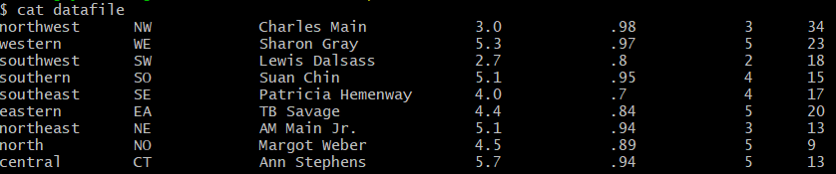
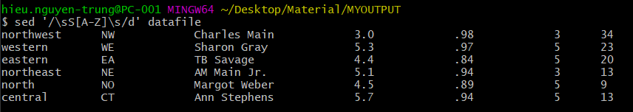
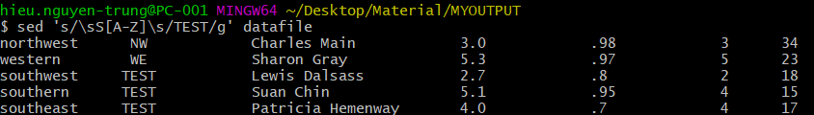
sed command
File datafile below is used for these sample commands below:
Sample command:
+ Cmd “sed '/\sS[A-Z]\s/d' datafile”: use to delete the lines that have a matching pattern.
+ Cmd “sed 's/\sS[A-Z]\s/TEST/g' datafile”: use to search the lines that have a matching pattern then substitute with “new string”.

Slide 18
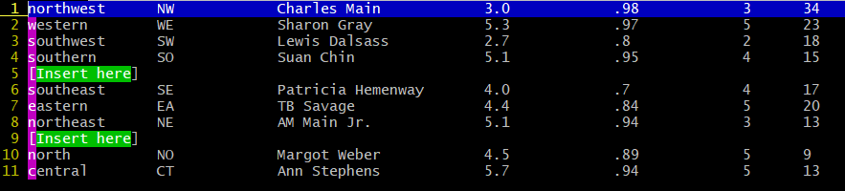
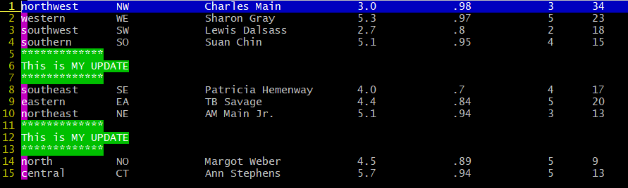
sed command
Quiz:
Create script command to insert text “This is MY UPDATE” to the location “[Insert here]” at the file Input
Link:
Git: http://gitlab.banvien.com/training/c_cpp/tree/test_hieunguyen
Path: c_cpp/99_exercise/00_BASH/sed_ex.txt
Input
Output

Slide 19
awk command
Awk is a UNIX programming language used for manipulating data and generating reports
Syntax:
Normal using: awk <command> <filename>
Pipeline using: <command> | awk <command>
How awk Works:
File “names” with 3 fields or 3 columns:
Tom Savage 100
Molly Lee 200
John Doe 300
The awk commands: awk ‘{print $1, $3}’ names

Slide 20
awk command
Explanation:
Awk takes a line of input (from a file or pipe) and puts the line into an internal variable called $0. Each line is also called a record and is terminated by a new line, by default.
$0
Tom Savage 100
Next, the line is broken into fields (words) separated by whitespace. Each field is stored in a numbered variable, starting with $1. There can be as many as 100 fields.
Tom
$1
Savage
$2
100
$3
How does awk know that white spaces the fields? There is another internal variable, called FS, that designates the field separator. Initially, FS is assigned whitespace – tabs and spaces.
When awk prints the fields, it uses the print function as follow: {print $1, $3}

Slide 21
awk command
Explanation:
And the output shows each field separated by a space, as:
Tom 100
Molly 200
John 300
Some useful command that is used with awk:
awk ‘{print <field>}’ <file>: normal syntax with FS is whitespace
awk –F <delimiter> ‘{print <fields>}’: print fields base on delimiter.
awk –F <delimiter> ‘{printf “%s %d”, <field1>, <field2>}’: use printf function to format the string

Slide 22
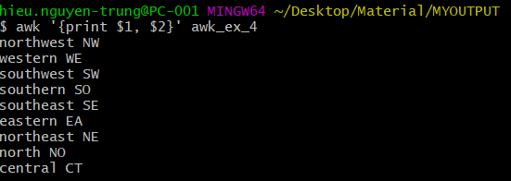
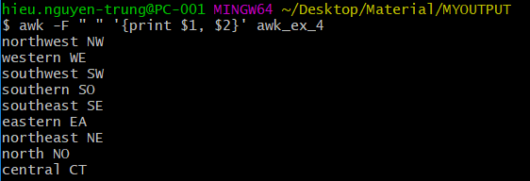
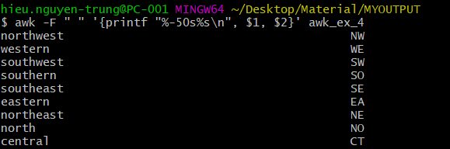
awk command
Sample:

Slide 23
Bash language - Variable
Types of Variables:
There are two types of variable
Local Variable: are known only to the shell which they were created
Environment Variable: are available to any child processes spawned from the shell from which they were created.
Naming Conventions:
Variable must begin with an alphabetic or underscore character
The remaining characters can be alphabetic, decimal digits, or an underscore character.
Format:
Local: Variable=value
Environment: export variable=value
Ex: year=2019
Note: without space before and after operator “=“

Slide 24
Bash language - Variable
SKIP
The declare Built-in:
Format:
declare variable=name
declare option:
-a: treats variable as an array
-f: lists function name as and definition
-F: lists just function names
-i: makes variables integer types
-r: makes variables read-only
-x: exports variable names to subshells
Ex:
declare -a nums=(45 33 100 65)

Slide 25
Bash language - Variable
SKIP
Variable Expansion Modifiers
Modifier | Value
${variable:-word) | If variable is set and is non-null, substitute its value; otherwise, substitute word
${variable:=word} | If variable is set or is non-null, substitute its value; otherwise, set it to word. The value of variable is substituted permanently. Positional parameters may not be assigned in this way.
${variable:+word} | If variable is set and is non-null, substitute word; otherwise, substitute nothing.
${variable:?word} | If variable is set and is non-null, substitute its value; otherwise, print word and exit from the shell. If word is omitted, the message parameter null or not set is printed.
${variable:offset} | Gets the substring of the value in variable starting at offset, where offset starts at 0 to the end of the string.
${variable:offset:length} | Gets the substring of the value in variable starting at offset, length characters over
Sample
1. $ fruit=peach 2. $ echo $(fruit:=-plum} peach 3. $ echo ${newfruit:-apple} apple 4. $ echo $newfruit 5. $ echo $EDITOR # More realistic EXAMPLE 6. $ echo ${EDITOR:-/bin/vi} /bin/vi 7. $ echo $EDITOR 8. $ name= $ echo ${name-Joe} 9. $ echo ${name:-Joe} Joe

Slide 26
Bash language - Variable
Positional Parameters
The special built-in variables, often called positional parameters, are used in shell scripts when passing arguments from the command line, or used in functions to hold the value of arguments passed to the function.
Expression | Function
$0 | References the name of the current shell script
$1-$9 | Positional parameters 1-9
${10} | Positional parameter 10
$# | Evaluates to the number of positional parameters
$* | Evaluates to all the positional parameters
$@ | Same as $*, except when double quoted
“$*” | Evaluates to “$1 $2 $3”, and so on
“$@” | Evaluates to “$1” “$2” “$3”, and so on

Slide 27
Bash language - Variable
Quoting
Metacharater | Meaning
; | Command separator
& | Background processing
( ) | Command grouping; creates a subshell
{ } | Command grouping; does not create a subshell
| | Pipe
< | Input redirection
> | Output redirection
newline | Command termination
space/tab | Word delimiter
$ | Variable substitution character
* [ ] ? | Shell meta-characters for filename expansion

Slide 28
Bash language - Variable
Command Substitution
Command substitution is used when assigning the output of a command to a variable or when substituting the output of a command within a string
Format:
`UNIX command` # Old method with back-quotes
$(UNIX command) # New method
Sample:
The Old Way | The New Way
1. $ echo “The hour is `date +%H` The hour is 09 2. $ name=`awk –F: ‘{print $1}’ database` Ebenezer Scrooge | 1. $ d=$(date) $ echo $d Wed Jul 14 09:35:21 PDT 2004 2. $ lines=$(cat filex) 3. $ echo The time is $(date +%H) The time is 09

Slide 29
Bash language - Arithmetic
The shell performs arithmetic expansion by evaluating an arithmetic expression and substituting the result
Format:
$[ expression ]
$(( expression ))
Ex:
$ echo $[ (5 + 3) * 2 ]
$ echo $(( 5 + 4 ))

Slide 30
Bash language - Function
SKIP
Format:
function_name () { commands ; commands; }
function function_name { commands ; commands; }
function function_name () { commands ; commands; }
Ex:
$ function greet { echo "Hello $LOGNAME, today is $(date)"; }
$ greet
Hello ellie, today is Wed Jul 14 14:56:31 PDT 2004

Slide 31
Bash language - User Input
SKIP
Format:
read answer: reads a line from standard input and assigns it to the variable answer
Ex:
$ echo "Please type your string:"; read var; echo "Your string is: $var"
Please type your string:
Good morning!
Your string is: Good morning!

Slide 32
Bash language - Flow Control
Format:
Ex:
Test Operator | Tests True If
String Test
[ string1 == string2 ] | string1 is equal to string2
[ string1 != string2] | string1 is not equal to string2
[ -z string ] | Length of string is zero
[ -n string ] | Length of string is non-zero
[ -l string ] | Length of string
Logical Test
[ pattern1 -a pattern2 ] | Both pattern1 and pattern2 are true
[ pattern1 –o pattern2 ] | Either pattern1 or pattern2 is true
[ ! pattern ] | Not a pattern match
Integer Test
[ int1 –eq int2 ] | int1 is equal to int2
[ int1 –ne int2 ] | int1 is not equal to int2
[ int1 –gt int2 ] | int1 is greater than int2
[ int1 –ge int2 ] | int1 is greater than or equal to int2
[ int1 –lt int2 ] | int1 is less than int2
[ int1 –le int2 ] | int1 is less than or equal to int2
if command
then
command(s)
elif command
then
command(s)
else
command(s)
fi
if [ $a > $max ]
then
max=$a
fi

Slide 33
Bash language - Loop
Format:
Ex:
for variable in word_list
do
command(s)
done
$ for pal in 1 2 3 4 5; do echo "$pal"; done
1
2
3
4
5
$ for file in `ls`; do if [ -f $file ]; then echo "$file: is a file"; fi; done # Use to check it is a file type or not
README.md: is a file
setup_workspace.sh: is a file

Slide 34
Bash language – Sample Script
Sample script:
$ cat a.sh
#!/bin/bash
input_dir=$1
for file in `ls $input_dir`
do
echo $file
done
$ ./a.sh /c
$Recycle.Bin
$WINDOWS.~BT
Cygwin
Documents
and
Settings

Slide 35
Bash language - Exercise
Exercise 1: (Try if you can)
Write a script to update your SVN local automatically as follow requirement:
Update base on schedule table of hour: 8h, 10h, 13h, 15h.
If the hour is match, task will execute then sleep 1 hour. Otherwise, sleep 10 minutes to reduce the workload for CPU.
Suggestion: svn update, sleep 10m

Slide 36
Bash language - Exercise
Exercise 2: (Try if you can)
Write a script to collect the summary result of test log output as follow requirement:
Input file: c_cpp/99_exercise/00_BASH/ex_loop/test_log.json
Upload your script and log output to GIT Server
Output format
$ ./a.sh ~/Desktop/Material/c_cpp/99_exercise/aaaa
File /c/Users/hieu.nguyen-trung/Desktop/Material/c_cpp/99_exercise/aaaa: is not exist
$ ./a.sh ~/Desktop/Material/c_cpp/99_exercise/00_BASH/datafile.txt
Please specify to the test_log.json
Suggestion: sed –n or grep –A, …

Slide 37

Documents
UNIX Shells by Example Fourth Edition
Notes:
https://github.com/zhzhh/Shell/blob/master/doc/Prentice.Hall-Unix.Shells.By.Example%2C4th.Edition.chm

Slide 38
Thank You!!

