Slide 1
Overview ASA Unit Testing
Dec, 2019

Slide 2
Contents
Overview ASA (adaptive safety automotive) project
JD
Testing Technique
Training Plan’s RBVH

Slide 3
Overview project ASA
Overview about team and customer of RBVH
Điệp (China) + Hải: Dương: COEM: region => china; customer: many; difficulty: less but many small package (always has MC/DC test)
Cường (Japan) + Vi: Hiếu: JOEM: region => japan; customer: less; difficulty: high (MC/DC testing base on customer)
Software Architecture for Unit Testing:
ASA
ASW
Application Software ➔ ASCET (Same UML diagram) ➔ ATT tool – internal tool (Same GAIO csv file : include input, output) ➔ Generate testscript ➔ Run test (You can refer GAIO document to get the similar process)
PSW
Platform Software ➔ Cantata tool (Source, CDF, …) ➔ Input value, expected value ➔ Run testscript (You can refer in the internet)

Slide 4
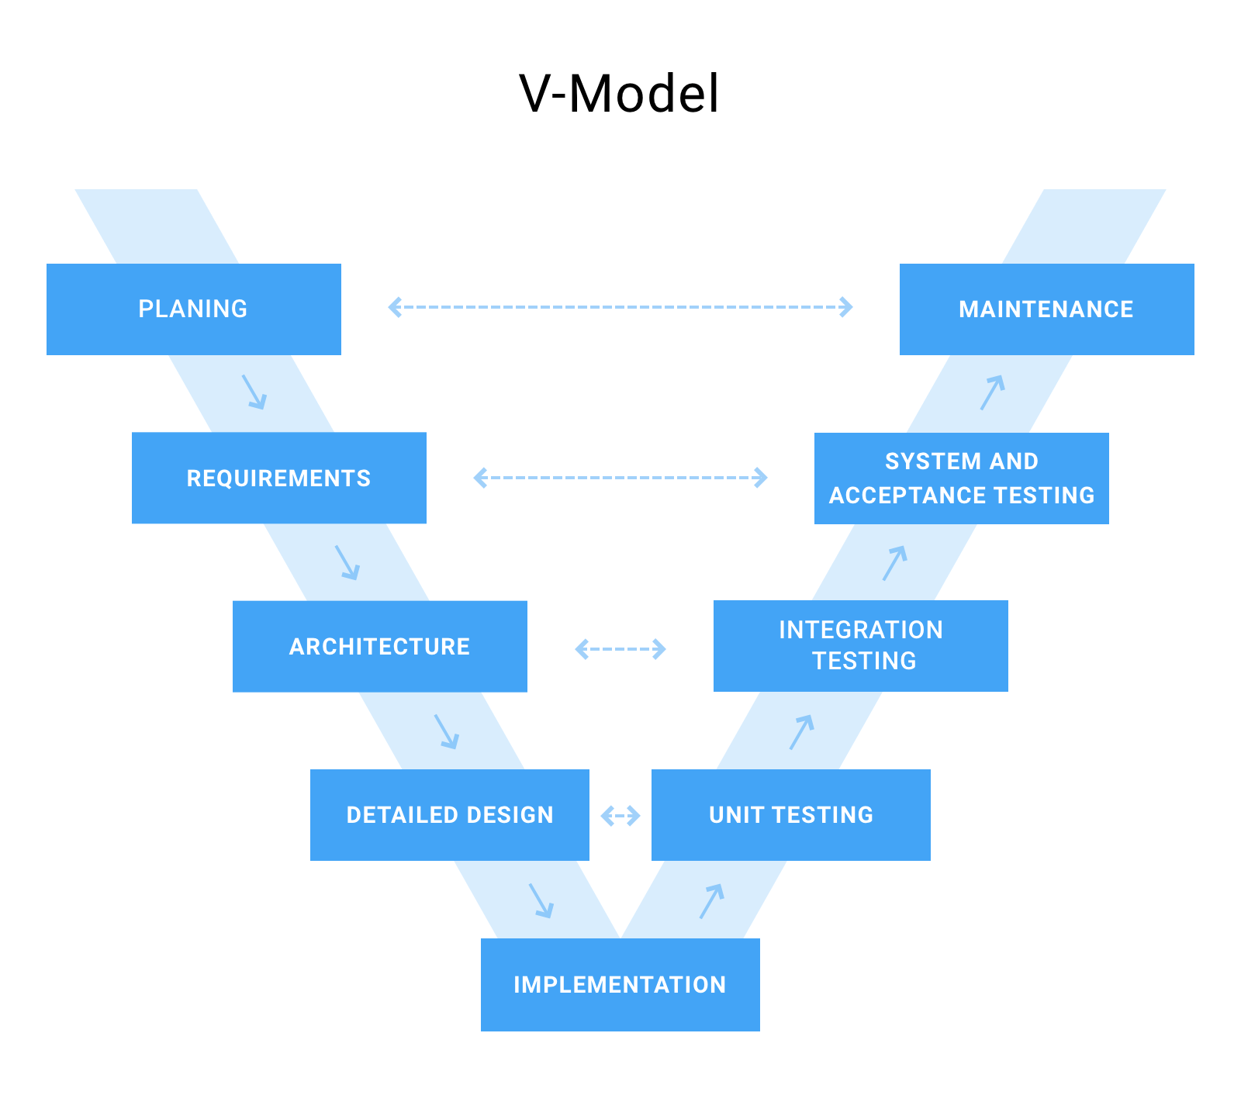
Overview project ASA
V-model in UT
HERE

Slide 5
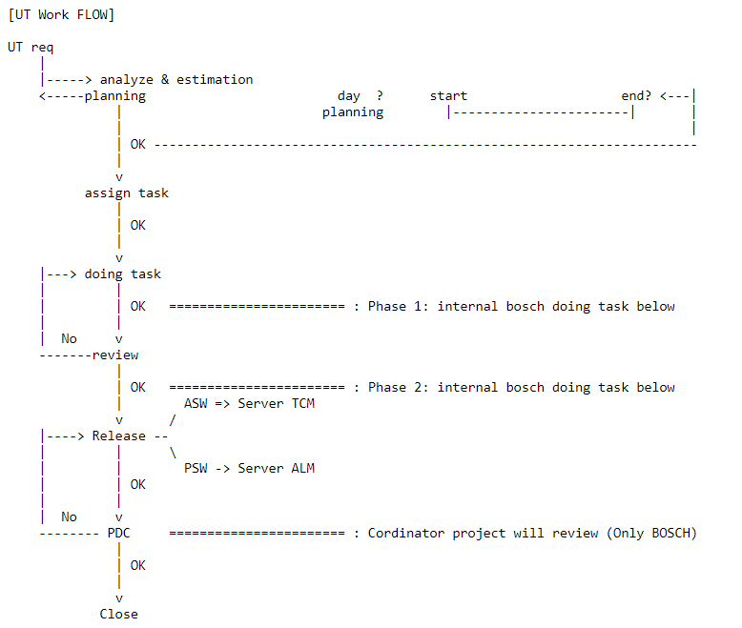
Overview project ASA
Testing activities in UT for JOEM

Slide 6
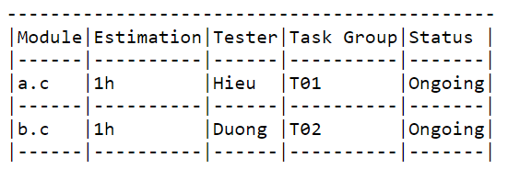
Overview project ASA
Management task by assginment task list:
+ Status flow: On-going -> Ready For Review -> Ready For Delivery -> Ready for PDC -> Complete & Closed
+ Task list structure (task manangement for project will manage by exel in Sharepoint)
`project
|---Analyze
|---Task group
|---T01
|---T02

Slide 7
Overview project ASA
Note: COEM team workflow
+ Don't follow Peer Review model => Assign task package will assign via email => Then leader will estimate and assign to member
+ It follows base on task assignments from customer and it counts effort per hour
+ Urgent package can occur -> support customer depend on priority; if support is acceptable, the working package will be pending & extending the due day.
Note: For All Team
+ If you meet the difficulty issue, please find support as follow process : "self-investigate => if not resolve, contact team member => if not resolve, contact internal team". Please consider contact before the due day, to reduce the risk for phase delivery

Slide 8
Overview project ASA
Unit Test process for each Tester:
Test planning
Monitoring and control
Test analysic
Test design
Test implementation
Test Execution
Test completion

Slide 9
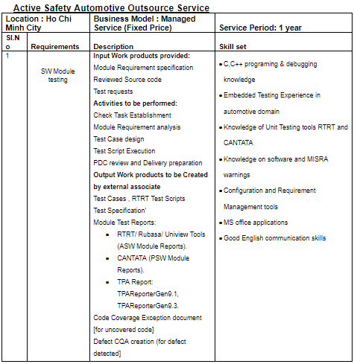
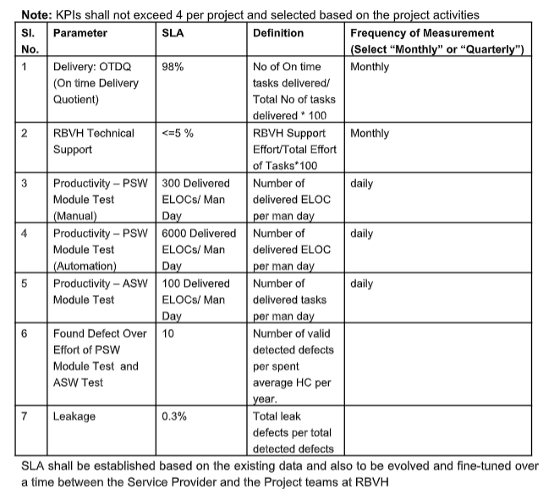
ASA JD & KPIs

Slide 10
KPI/Addition information
KPI:
PSW (Manual test): 300 ELOCs/man/day
PSW (Automation test): 6000 ELOCs/man/day
ASW (Manual test): 130 ELOCs/man/day
Note: apply for each work package (assign task assignment 1 time/month/packages)
Reporting:
Lead check time attendance of team manually (RBVH don’t care).
Lead create report to monitor the KPI, performance, task of member manually. (Note: BanVien’s laptop can not access the data or exel file from Bosch and PC’s Bosch can not transfer data from Bosch to the outside)

Slide 11
Testing technique – Overview
Testing technique overview:
Black box: not applied
White box (structural – code base testing): UT without requirement documents
Method data flow: not applied
Method control flow:
C0: statement coverage
C1: decision coverage
MC/DC: modified condition/decision coverage

Slide 12
Testing technique – Policy Point
Input variable
Return function
Condition
Switch case
Division zero
Overflow
Underflow
Casting
Array
Pointer
Loop
Constant
Integrate/De-integrate

Slide 13
Testing technique – Input variable
Point 1 “Input variable”: Confirm the boundary – range value for the specific input variable that we need to test.
struct ST_PARAM
{
int data;
int ret_code;
} gb_result;
void func1( int enable, int mode, int input )
{
if( enable )
{
switch( mode )
{
case 0:
gb_result.data = input;
break;
case 1:
gb_result.data = input * 10;
break;
case 2:
gb_result.data = input * 100;
break;
case 3:
if( input > 100 )
gb_result.data = 10000;
else
gb_result.data = input *100;
break;
default:
gb_result.data = -1;
}
// return code
gb_result.ret_code = TRUE;
}
else
{
gb_result.data = 0;
gb_result.ret_code = FALSE;
}
}
Explanation:
- We will apply point 1 “input variable” for the which statement has “assign operator”.
- Analyze the boundary – range value for the input variable base on the definition in Spec. If not, please use the range value of type variable.
Example for statement “gb_result.data = input;”:
Input variable: “input”
Boundary - range value of “input”: [-32767; 32768]
Output variable: “gb_result.data”
Value to test: “1”, “0”, “-1”, Min, Max
Confirm the result of output variable is match with the right hand side assignment or not? If not, please record this bug in Bug List document.
Note:
Input variable: A variable is an input variable if its Input property is Yes. Its value can be input from an external source, such as an Architect call flow. Variable is used as input criteria for the assignment/operation/condition…
Output variable: A variable whose Output property is Yes is an output variable.

Slide 14
Testing technique – Input variable
Example for statement “gb_result.data = input;” with the range value is defined in Spec:
Input variable: “input”
Boundary - range value of “input”: [600; 32768]
Output variable: “gb_result.data”
Value to test: “600”, “16684” (The value between 600 and 32768), Max
Confirm the result of output variable is match with the right hand side assignment or not? If not, please record this bug in Bug List document.
Note: RBVH apply white box testing for structural code with test method is control flow: UT without requirement documents ➔ Boundary/range value will not provide

Slide 15
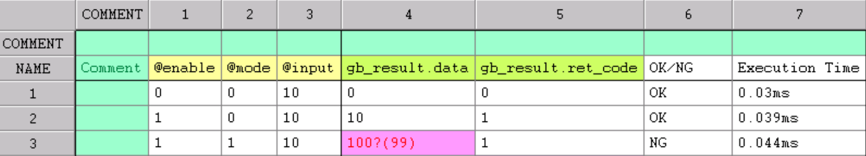
Testing technique – Input variable
Value testing for Input variable
Expected result of output variable
Confirmation
Note: ATT tool is same structure like the figure above (You can refer CoverageMaster document of GAIO for more detail)
+ Left hand side: Input variable part
+ Right hand side: Output variable part

Slide 16
Testing technique – Return function
Point 2 “Return Function”: Confirm the boundary – range value for the specific stub of return function that we need to test.
What are Stub Functions?
Many functions include calls to other functions to perform various tasks. For example, say we have a function named func() that calls another function named sub() as represented visually below.
STUB()
func
sub()
func()
{
switch(sub())
{
case 1:
...
...
}
}
func()
{
switch(sub())
{
case 1:
...
...
}
}
STUB()

Slide 17
Testing technique – Return function
In the example above, the result of function func() is dependent upon the data return by the called function sub(). Therefore, if you wish to test func() as is, you will first have to find the appropriate input conditions for sub() in order to obtain the desired return value to be used in func(). In addition, because the two functions are dependent upon one another, both functions would need to be re-tested whenever either one changes.
➔ This is too complex and inefficient of a method.
➔ In such cases when called functions exist, a stub function may be configured and used instead of the actual called function.
In the example above, the function STUB() takes places of the function sub() allowing one function at a time. Focus to control the return value and focus on testing

Slide 18
Testing technique – Return function
int func3_sub_read_io( int index )
{
//Return value depends on data_table
if( data_table[index]>0x7f )
{
return data_table[index];
}
else
{
return -data_table[index];
}
}
Example:
void func3( int enable, int mode )
{
int retval;
if( enable )
{
// Create stub, make retval an input
retval = func3_sub_read_io( mode );
// Condition based on return value
switch( retval )
{
case 0:
gb_result.data = 0;
break;
case 1:
gb_result.data = 50;
break;
case 2:
gb_result.data = 100;
break;
default:
gb_result.data = -1;
}
gb_result.ret_code = TRUE;
}
else
{
gb_result.data = 0;
gb_result.ret_code = FALSE;
}
}
int AMSTB_func3_sub_read_io(int index)
{
static int volatile AMIN_return;
static int volatile AMOUT_index;
static int volatile AM_count;
AMOUT_index = index;
AM_count++;
return AMIN_return;
}
AMSTB_func3_sub_read_io(mode)

Slide 19
Testing technique – Return function
Example:
Explanation:
- We will apply point 2 “return function” for the which statement has “stub function”.
- Analyze the boundary – range value for the stub function base on the definition in Spec. If not, please use the range value of type variable.
Example for statement “switch (retval):
Input variable: “retval” or “AMSTB_func3_sub_read_io@AMIN_return”
Boundary - range value of “input”: [-32767; 32768]
Value to test: “1”, “0”, “-1”, Min, Max
But the return value of stub function is used with switch case, so we have to use boundary to check. Hence value to test is changed to: “0”, “1”, “2”, Max
Confirm the result of output variable is match with the right hand side assignment or not? If not, please record this bug in Bug List document.
Note:
- According to RBVH’s policy: Tool cantata will generate automatically Stub function; in this point, we only consider return value of stub function ➔ it means we don’t care stub arguments
void func3( int enable, int mode )
{
int retval;
if( enable )
{
// Create stub, make retval an input
retval = func3_sub_read_io( mode );
// Condition based on return value
switch( retval )
{
case 0:
gb_result.data = 0;
break;
case 1:
gb_result.data = 50;
break;
case 2:
gb_result.data = 100;
break;
default:
gb_result.data = -1;
}
gb_result.ret_code = TRUE;
}
else
{
gb_result.data = 0;
gb_result.ret_code = FALSE;
}
}
AMSTB_func3_sub_read_io(mode)

Slide 20
Testing technique – Condition
Point 3 “condition”: Confirm the logic of conditional branch at the threshold value (boundary, boundary+1, boundary-1) when the execution is reached conditional branch
Explanation:
We will apply point 3 “condition” for the which statement has the key word “if”, “else if” to check the ability of source code can reach all branch condition or not
Analyze:
The range value for the “input variable” base on the definition in Spec. If not, please use the range value of type variable
The boundary value base on source code.
Example for statement “if( input > 100 )”:
Input variable: “input”
Range value of “input”: [-32767; 32768]
Boundary/Boundary +1/Boundary -1: 100/101/99
Value to test: “100”, “101”, “99”, Min, Max
Confirm the result True/False of condition is match with “True/False Table”. If not, please record this bug in Bug List document. And make sure MC/DC coverage is 100%.
void func1( int enable, int mode, int input )
{
if( enable )
{
switch( mode )
{
case 0:
gb_result.data = input;
break;
case 1:
gb_result.data = input * 10;
break;
case 2:
gb_result.data = input * 100;
break;
case 3:
if( input > 100 )
gb_result.data = 10000;
else
gb_result.data = input *100;
break;
default:
gb_result.data = -1;
}
// return code
gb_result.ret_code = TRUE;
}
else
{
gb_result.data = 0;
gb_result.ret_code = FALSE;
}
}

Slide 21
Testing technique – Condition
Note: When variable “a” is used again in another block, we don’t need to test with value “Min”, “Max” to reduce the workload.
Ex:
“if (a > 200)“: Value to test: boundary, boundary+1, boundary-1, Min, Max
“if (a > 100)“: Value to test: boundary, boundary+1, boundary-1, Min, Max
if (a > 200){
...
switch(b){
case ...:
...
case ...:
if (a > 100){
}
}
}

Slide 22
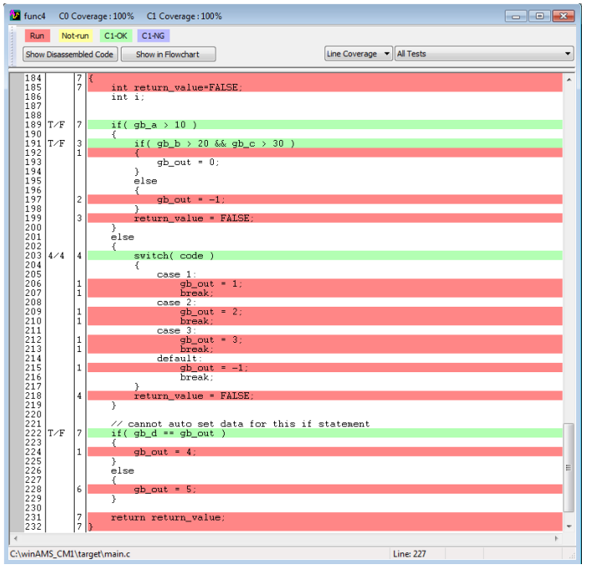
Testing technique – Condition
Example: Confirm the result T/F of the conditions in function “func4” base on Coverage Merge:
int func4( int code )
{
int return_value=FALSE;
int i;
if( gb_a > 10 )
{
if( gb_b > 20 && gb_c > 30 )
{
gb_out = 0;
}
else
{
gb_out = -1;
}
return_value = FALSE;
}
else
{
switch( code )
{
case 1:
gb_out = 1;
break;
case 2:
gb_out = 2;
break;
case 3:
gb_out = 3;
break;
default:
gb_out = -1;
break;
}
return_value = FALSE;
}
// The conditional below uses the above
// calculation result (gb_out)
// Dynamic boundary values may not be
// statically analyzed.
if( gb_d == gb_out )
{
gb_out = 4;
}
else
{
gb_out = 5;
}
return return_value;
}

Slide 23
Testing technique – Switch case
Point 4 “switch case”: Confirm the boundary value of each “case” in block “switch/case” is covered or not.
Explanation:
- We will apply point 4 “switch case” for the which statement has “switch/case statement”.
- Analyze the boundary value for each case in block “switch/case” base on the source code. And the default case” you can use any value in the range value of “input variable” to cover
Example for statement “switch (mode)”:
Input variable: “mode”
Boundary for case 0: 0
Boundary for case 1: 1
Boundary for case 2: 2
Boundary for case 3: 3
Representative value for case “default”: 4
Value to test: “0”, “1”, “2”, “3”, “4”
Confirm the coverage for each case is covered? If not, please record this bug in Bug List document.
void func1( int enable, int mode, int input )
{
if( enable )
{
switch( mode )
{
case 0:
gb_result.data = input;
break;
case 1:
gb_result.data = input * 10;
break;
case 2:
gb_result.data = input * 100;
break;
case 3:
if( input > 100 )
gb_result.data = 10000;
else
gb_result.data = input *100;
break;
default:
gb_result.data = -1;
}
// return code
gb_result.ret_code = TRUE;
}
else
{
gb_result.data = 0;
gb_result.ret_code = FALSE;
}
}

Slide 24
Testing technique – Division Zero
Point 5 “Division Zero”: Confirm the calculation of the division operation has no division zero case.
Explanation:
- We will apply point 5 “division zero” for the which statement has “the division operation with the divisor is input variable”.
- Analyze the boundary – range value for the input variable base on the definition in Spec. If not, please use the range value of type variable.
Example for statement “global_a = input / c + CALIB_VALUE;”:
Input variable: “input”, “c”
Range value for “input” and “c”: [-32767; 32768]
Value of “c” to test: “0”
Confirm the source code has no division zero case. If not, please record this bug in Bug List document.
const int CALIB_VALUE = 5;
int global_a;
void func(int input, int c){
...
global_a = input / c + CALIB_VALUE;
...
}

Slide 25
Testing technique – Overflow
Point 6 “Overflow”: Confirm the calculation of the addition/subtraction/multiplication/division operation, the calculation has no overflow operation.
Explanation:
- We will apply point 6 “overflow” for the which statement has “the addition/multiplication/division operation with the input variable”.
- Analyze the boundary – range value for the input variable base on the definition in Spec. If not, please use the range value of type variable.
Example for statement “global_a = input + c;”:
Input variable: “input”, “c”
Range value for “input” and “c”: [-32767; 32768]
Range value for “global_a”: [-32767; 32768]
When “input” is 32768, and “c” is 32768, the calculation “input + c” will be overflowed
The value of output variable “global_a” will get wrong value.
Example for statement “global_a = input / 0.5 + CALIB_VALUE;”:
When “input” is 32768, the calculation “input/0.5” will be overflowed
The value of output variable “global_a” will get wrong value.
Example for statement “global_a = input * c;”:
When “input” is 32768 and “c” is 32768, the calculation “input * c” will be overflowed
The value of output variable “global_a” will get wrong value.
const int CALIB_VALUE = 5;
int global_a;
void func(int input, int c){
...
global_a = input + c;
...
}
const int CALIB_VALUE = 5;
int global_a;
void func(float input){
...
global_a = input / 0.5 + CALIB_VALUE;
...
}
int global_a;
void func(int input, int c){
...
global_a = input * c;
...
}

Slide 26
Testing technique – Underflow
Point 7 “Underflow”: Confirm the calculation of the addition/subtraction/multiplication/division operation, the calculation has no underflow operation.
Explanation:
- We will apply point 7 “underflow” for the which statement has “the addition/multiplication/division operation with the input variable”.
- Analyze the boundary – range value for the input variable base on the definition in Spec. If not, please use the range value of type variable.
Example for statement “global_a = input + c;”:
Input variable: “input”, “c”
Range value for “input” and “c”: [-32767; 32768]
Range value for “global_a”: [-32767; 32768]
When “input” is -32768, and “c” is -32768, the calculation “input + c” will be under-flowed
The value of output variable “global_a” will get wrong value.
Example for statement “global_a = input / 0.5 + CALIB_VALUE;”:
When “input” is -32768, the calculation “input/0.5” will be under-flowed
The value of output variable “global_a” will get wrong value.
Example for statement “global_a = input * c;”:
When “input” is 32768 and “c” is -32768, the calculation “input * c” will be under-flowed
The value of output variable “global_a” will get wrong value.
const int CALIB_VALUE = 5;
int global_a;
void func(int input, int c){
...
global_a = input + c;
...
}
const int CALIB_VALUE = 5;
int global_a;
void func(float input){
...
global_a = input / 0.5 + CALIB_VALUE;
...
}
int global_a;
void func(int input, int c){
...
global_a = input * c;
...
}

Slide 27
Testing technique – Casting
Point 8 “Casting”: Confirm the assignment statement has no casting error such as cast the value from larger to smaller or from signed number to unsigned number or from decimal to integer.
Explanation:
- We will apply point 7 “underflow” for the which statement has “the addition/multiplication/division operation with the input variable”.
- Analyze the boundary – range value for the input variable base on the definition in Spec. If not, please use the range value of type variable.
[Some simple cases]:
Example for statement “val_char = i_int”:
Input variable: “i_int”
Range value for “i_int”: [-32767; 32768]
Range value for “val_char”: [-127; 128]
When “i_int” is greater than 128 or less than - 127, the output of assignment will be casting from larger number to smaller number.
Example for statement “val_uchar = i_char”:
Input variable: “i_char”
Range value for “i_char”: [-127; 128]
Range value for “val_uchar”: [0; 255]
When “i_char” is negative number, the output of assignment will be casting from signed number to unsigned number.
Example for statement “val_int = i_float”:
When “i_float” is decimal number such as “1.5”, the output of assignment will be casting from decimal number to integer number.
If the statement has casting error, please record this bug in to Bug List document.
int i_int;
char i_char;
float i_float;
char val_char;
unsigned char val_uchar;
float val_float;
void func(int input, int c){
...
val_char = i_int;
...
val_uchar = i_char;
...
val_int = i_float;
...
}

Slide 28
Testing technique – Array
Point 9 “Array”: Confirm the accessing memory allocation of array variable.
Explanation:
We will apply point 9 “array” for the which statement has “array variable”.
Analyze the boundary – range value for the input variable base on the definition in Spec. If not, please use the range value of type variable.
Example for statement “val_float[0] = input”:
Input variable: “input”
Range value for “input”: [-32767; 32768]
➔ Value to test: “-1”, “0”, “1”, Min, Max
Confirm the expected output is same with the input value or not.
Example for statement “val_float[1] = val_float[0] / 2”:
Input variable: “var_float[0]”
Range value for “val_float[0]”: [-32767; 32768] (because val_float[0] = input)
Confirm the expected result of val_float[1] is same with the result calculation of “val_float[0] / 2” or not.
Example for statement “val_float[3] = input * c”:
Input variable: “input”, “c”
Range value for “input” and “c”: [-32767; 32768]
Value to test: “-1”, “0”, “1”, Min, Max
Confirm the expected result of val_float[3] is same with the result calculation of “input * c” or not.
float val_float[10];
void func(int input, int c, int arr[]){
...
val_float[0] = input;
...
val_float[1] = val_float[0] / 2;
...
val_float[3] = input * c;
...
val_float[6] = arr[0] + arr[1];
}

Slide 29
Testing technique – Pointer
Point 10 “Pointer”: Confirm the accessing memory allocation of pointer variable.
Explanation:
We will apply point 10 “pointer” for the which statement has “pointer variable”.
Analyze the boundary – range value for the input variable base on the definition in Spec. If not, please use the range value of type variable.
Example for statement “p_out->temperature = p_in->temperature + CALIB_TEMPERATURE;”:
Input variable: “p_in->temperature”
Range value for “p_in->temperature”: [-50, 50]
➔ Value to test: “-1”, “0”, “1”, Min, Max
Confirm the expected output is same with the result of “p_in->temperature + CALIB_TEMPERATURE” or not.
Note:
Please make sure your pointer is not NULL pointer.
When you meet case below:
“p1” is pointer of struct A
“p2” is pointer of struct B
Assignment statement: *p1 = *p2
➔ You need to check accessing memory allocation for all elements of struct A/B
#define CALIB_TEMPERATURE 5
#define CALIB_PITCH 4
#define CALIB_YAW 3
#define CALIB_ROLL 2
#define CALIB_ACELL 1
struct Sensor{
float temperature; // [-50.0, 50.0] C degree
float pitch; // [-360.0, 360.0] degree
float yaw; // [-360.0, 360.0] degree
float roll; // [-360.0, 360.0] degree
float accel; // [-10.0, 10.0] m/s^2
};
typedef struct Sensor Sensor;
Sensor sensor1 = {1, 2, 3, 4, 5};
void initial_sensor(Sensor * p_in, Sensor * p_out){
p_out->temperature = p_in->temperature + CALIB_TEMPERATURE;
p_out->pitch = p_in->pitch * CALIB_PITCH;
p_out->yaw = p_in->yaw * CALIB_YAW;
p_out->roll = p_in->roll * CALIB_ROLL;
p_out->accel = p_in->accel + CALIB_ACELL;
}

Slide 30
Testing technique – Loop
Point 11 “Loop”: Confirm the expected result of output value at the start/middle/end of loop is correct or not.
Explanation:
We will apply point 11 “loop” for the which statement has “loop keyword” such as “do while”, “for”, “while”.
Analyze the boundary – range value for the input variable base on the definition in Spec. If not, please use the range value of type variable.
Example for statement “p_out->temperature[i] = p_in->temperature[i] + CALIB_TEMPERATURE;”
Input variable: “p_in->temperature[i]”
Range value for “p_in->temperature”: [-50.0, 50.0]
➔ Value to test: “-1”, “0”, “1”, Min, Max
Confirm the expected output is same with the result of “p_in->temperature[i] + CALIB_TEMPERATURE” with “i = 0” & “i = MAX/2” & “i = MAX - 1” or not.
#define CALIB_TEMPERATURE 5
#define CALIB_PITCH 4
#define CALIB_YAW 3
#define CALIB_ROLL 2
#define CALIB_ACELL 1
#define MAX 8
struct Sensor{
float temperature[MAX]; // [-50.0, 50.0] C degree
float pitch[MAX]; // [-360.0, 360.0] degree
float yaw[MAX]; // [-360.0, 360.0] degree
float roll[MAX]; // [-360.0, 360.0] degree
float accel[MAX]; // [-10.0, 10.0] m/s^2
};
typedef struct Sensor Sensor;
Sensor sensor1;
void initial_sensor(Sensor * p_in, Sensor * p_out){
for (int i = 0; i < MAX; i ++){
p_out->temperature[i] = p_in->temperature[i] + CALIB_TEMPERATURE;
p_out->pitch[i] = p_in->pitch[i] * CALIB_PITCH;
p_out->yaw[i] = p_in->yaw[i] * CALIB_YAW;
p_out->roll[i] = p_in->roll[i] * CALIB_ROLL;
p_out->accel[i] = p_in->accel[i] + CALIB_ACELL;
}
}

Slide 31
Testing technique – Constant
Point 12 “Constant”: Confirm the constant variable is not changed whole the execution of source code.
Explanation:
We will apply point 12 “Constant” for the variable which has key word “const” and it is defined a specific value.
Confirm the value of constant variable has no change.
Example for statement “val_int = i_int * c_int;” and statement “val_float = i_float * c_float;”
Constant variable: “c_int”, “c_float”
Confirm the expected output of constant variable is same with the defined value (Eg: Before execution: c_int = 5; c_float = 125.5. After execution: c_int = 5; c_float = 125.5
const int c_int = 5;
...
const float c_float = 125.5;
int i_int;
float val_float;
void func(int input, int c){
...
val_int = i_int * c_int;
...
val_float = i_float * c_float;
...
}

Slide 32
Testing technique – Integrate/De-integrate
Point 13 “In/De-integrate”: Confirm the value before integrate/de-integrate is same with the value after integrate/deintergrate.
Explanation for Integrate:
We will apply point 13 “loop” for the which statement has “shifting keyword or Bitwise operator”
Analyze the boundary – range value for the input variable base on the definition in Spec. If not, please use the range value of type variable.
Example for statement “adc_value = (high_register << 8) | (low_register);” and “adc_value * 5.0 / 1024.0;”
Input variable: “high_register”, “low_register”
Range value for input variable: [0; 255]
➔ Value to test: 0, 1, MAX
Confirm the before value of “(high_register << 8) | (low_register)” at statement “adc_value = (high_register << 8) | (low_register);” is same with the after value at statement “return adc_value * 5.0 / 1024.0”
// ADC 10 bit
float cal_temperature(unsigned char low_register, unsigned char high_register){
//unsigned char low_register; // 8 bit
//unsigned char high_register; // 8 bit
unsigned short adc_value = (high_register << 8) | (low_register); // ADC 10 bit Big Edian
return adc_value * 5.0 / 1024.0;
}
Explanation for De - integrate:
The similar explanation for De - integrate
Example for statement “adc_value = (high_register << 8) | (low_register);” and “adc_value * 5.0 / 1024.0;”
Confirm the value of “value” variable is splitting correctly at these operations “value >> 8” and “value & 0xff”
unsigned char buffer[2] = {0, 0};
void demergre(unsigned char buffer[]){
unsigned short value = 200000;
buffer[0] = (unsigned char)(value >> 8);
buffer[1] = (unsigned char)(value & 0x0f);
}

Slide 33
Compare policy between BV & RBVH
Testing technique:
C0, C1, MC/DC
Input variable: “MAX/MIN, Boundary, Boundary +-1”. We only consider input variable and output variable (global variable)
“Stub point”: Tool cantata will generate automatically Stub function; in this point, we only consider return value of stub function ➔ it means we don’t care stub arguments
“Condition point”: Whether we checked input variable “a” with “MAX, MIN, Boundary, Boundary +-1”, we don’t need to check MAX/MIN again
“Switch point”: only check boundary in each “case”
“Division zero”
“Overflow/Underflow”: if the statement get overflow, raise bug. Don’t need to check all combination of operation if the statement get bug.
“Casting”
“Loop”: check index START/MID/END

Slide 34
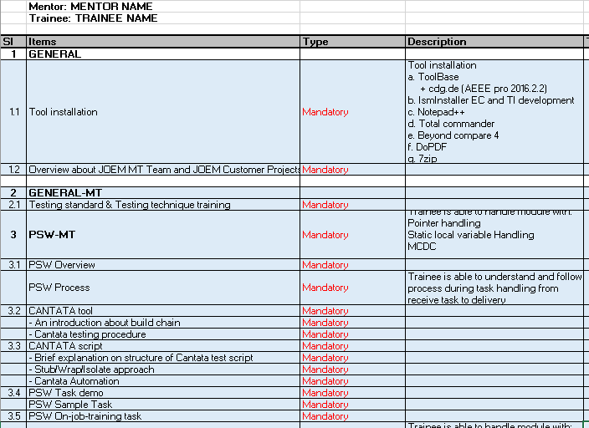
Training Plan’s RBVH

Slide 35
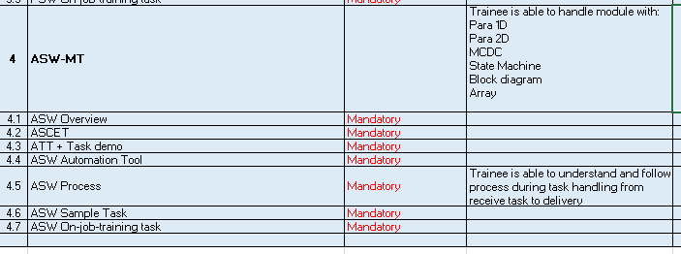
Training Plan’s RBVH

Slide 36
Thank You!!

