Slide 1
Version Control
Dec, 2019

Slide 2
Contents
Version Control Overview
Git
Features
Pros – Cons
SVN
Features
Pros – Cons
Comparing Git and SVN
GitLab
Git Setup
Git branch
Other git command
Exercise: Git

Slide 3
Version Control Overview
Version Control Software (VCS) is also referred as SCM (Source Code Management) tools or RCS (Revision Control System).
Why is "Version Control" necessary?
Version control is a way to keep a track of the changes in the code/documents..
so that if something goes wrong,
… we can make comparisons in different code versions
.. and revert to any previous version that we want.
It is very much required where multiple developers are continuously working on /changing the source code.
There are several Version Control Software Tools.
Git, CVS, SVN
Mercurial, Monotone, Bazaaar, Microsoft TFS, Microsoft VSTS, Microsoft VSS, IBM Rational,…
TODO: The version control tools are used in RVC/BOSCH

Slide 4

Git – Features
Provides strong support for non-linear development.
Distributed repository model.
Compatible with existing systems and protocols like HTTP, FTP, ssh.
Capable of efficiently handling small to large sized projects.
Cryptographic authentication of history.
Pluggable merge strategies.
Toolkit-based design.
Periodic explicit object packing.
Garbage accumulates until collected.

Slide 5
Git Pros – Cons [*]
Pros
Super-fast and efficient performance.
Cross-platform and Open Source.
Code changes can be very easily and clearly tracked.
Easily maintainable and robust.
Offers an amazing command line utility known as git bash.
Also offers GIT GUI where you can very quickly re-scan, state change, sign off, commit & push the code quickly with just a few clicks.
Cons
Complex and bigger history log become difficult to understand.
Does not support keyword expansion and timestamp preservation.
[*] refer: https://www.softwaretestinghelp.com/version-control-software

Slide 6

SVN – Features [*]
Client-server repository model. However, SVK permits SVN to have distributed branches.
Directories are versioned.
Copying, deleting, moving and renaming operations are also versioned.
Supports atomic commits.
Versioned symbolic links.
Free-form versioned metadata.
Space efficient binary diff storage.
Branching is not dependent upon the file size and this is a cheap operation.
Other features – merge tracking, full MIME support, path-based authorization, file locking, standalone server operation.
[*] refer: https://www.softwaretestinghelp.com/version-control-software

Slide 7
SVN – Pros & Cons [*]
Pros
Has a benefit of good GUI tools like TortoiseSVN.
Supports empty directories.
Have better windows support as compared to Git.
Easy to set up and administer.
Integrates well with Windows, leading IDE and Agile tools.
Cons
Does not store the modification time of files.
Does not deal well with filename normalization.
Does not support signed revisions.
[*] refer: https://hackbrightacademy.com/blog/svn-vs-git

Slide 8
Git vs SVN [*]
Why SVN Is Better Than Git
SVN is better than Git for architecture performance, binary files, and usability. And it may be better for access control and auditability, based on your needs.
Why Use Git Instead of SVN?
Git is better than SVN at branching — and it can be better than SVN for access control and auditability, based on your needs.
Git is also more popular. SVN's popularity is waning. And many teams are looking to make a switch.
[*] refer: https://hackbrightacademy.com/blog/svn-vs-git

Slide 9

GitLab
GitLab is a web-based DevOps lifecycle tool that has a Git-repository manager providing wiki, issue-tracking and CI/CD pipeline options.
Url: http://gitlab.banvien.com/
Project
Repository
Issues Tracking
Wiki
CD/CI

Slide 10
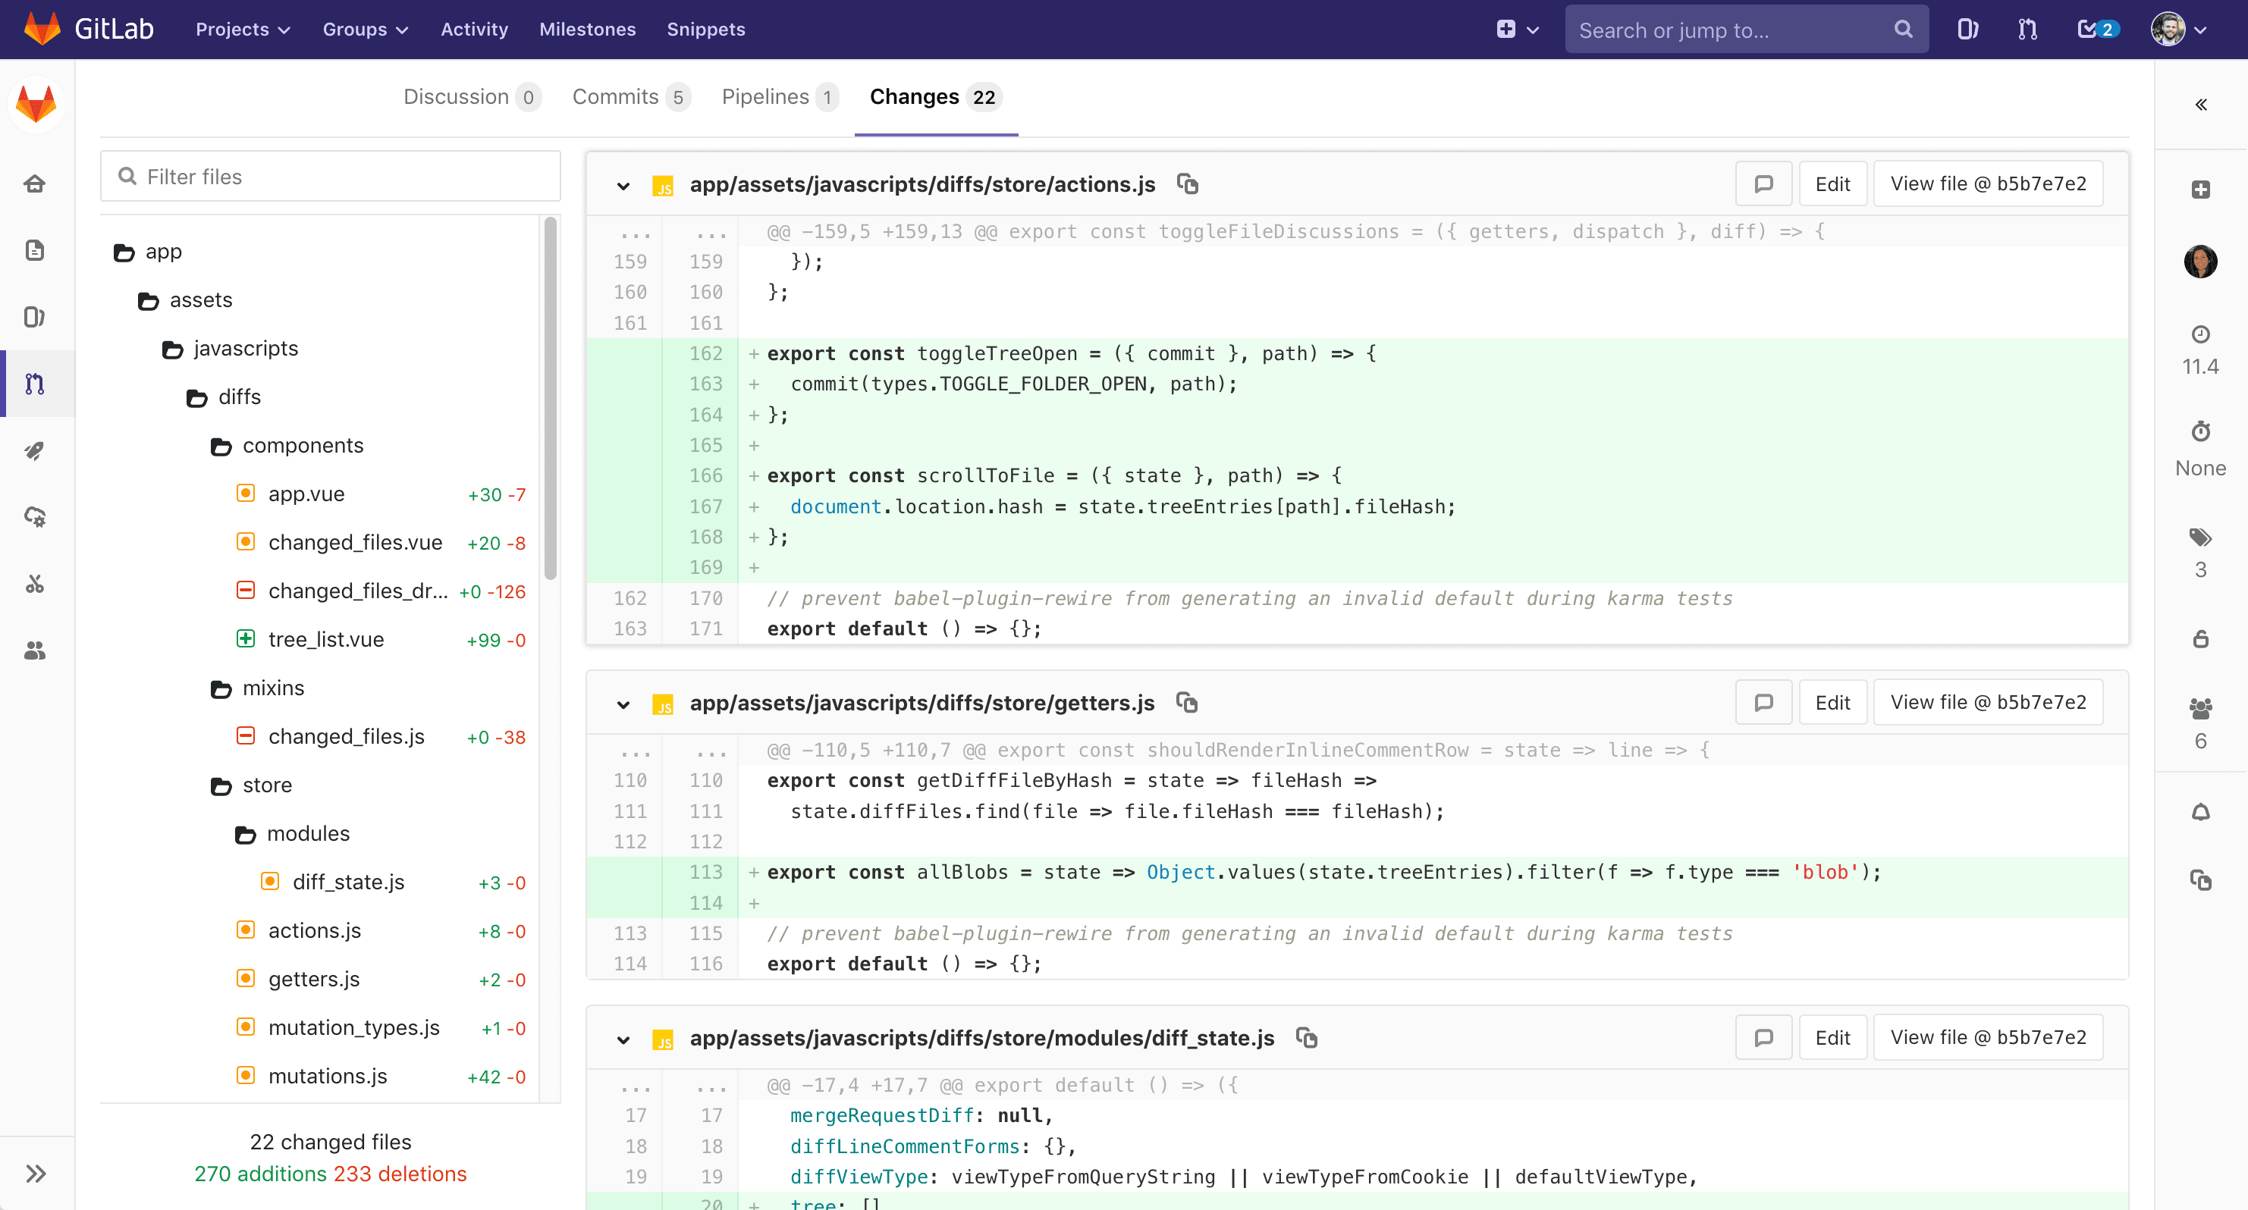
GitLab
Support File Source Tree

Slide 11
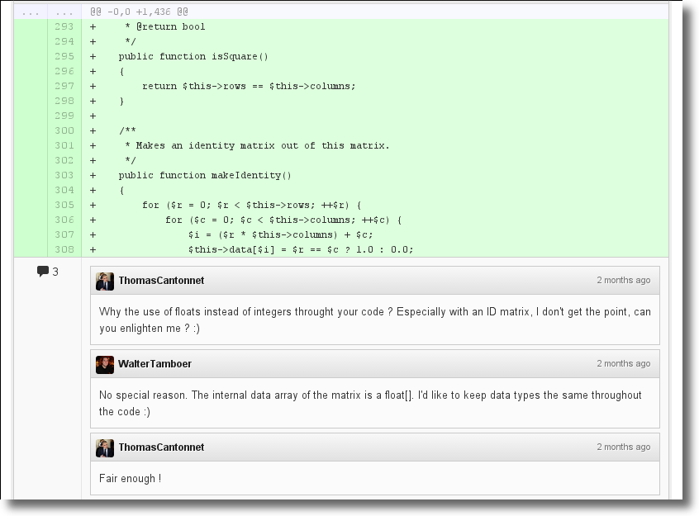
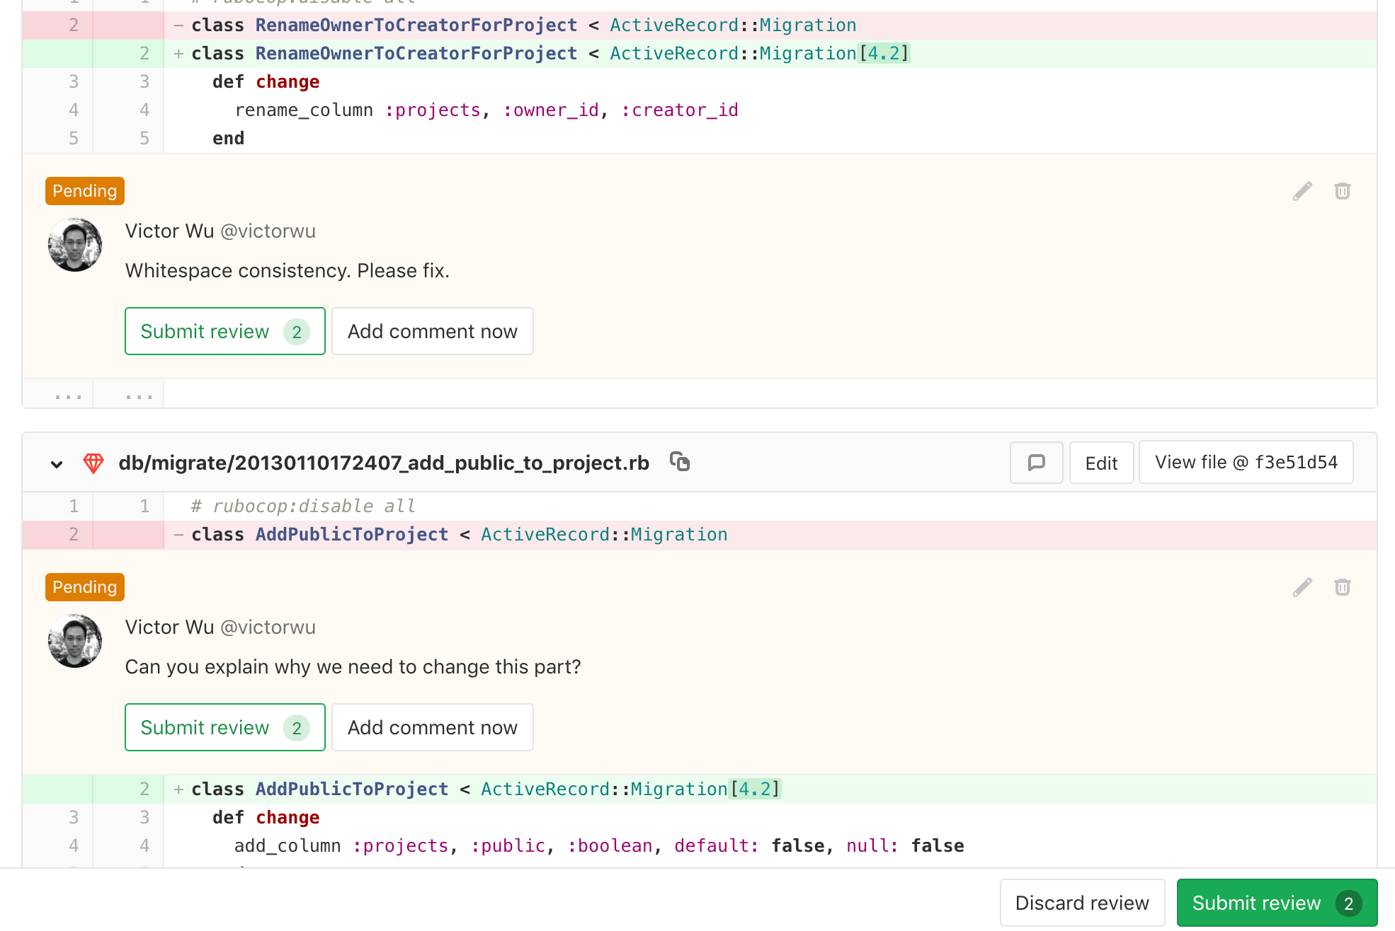
GitLab
Code review

Slide 12
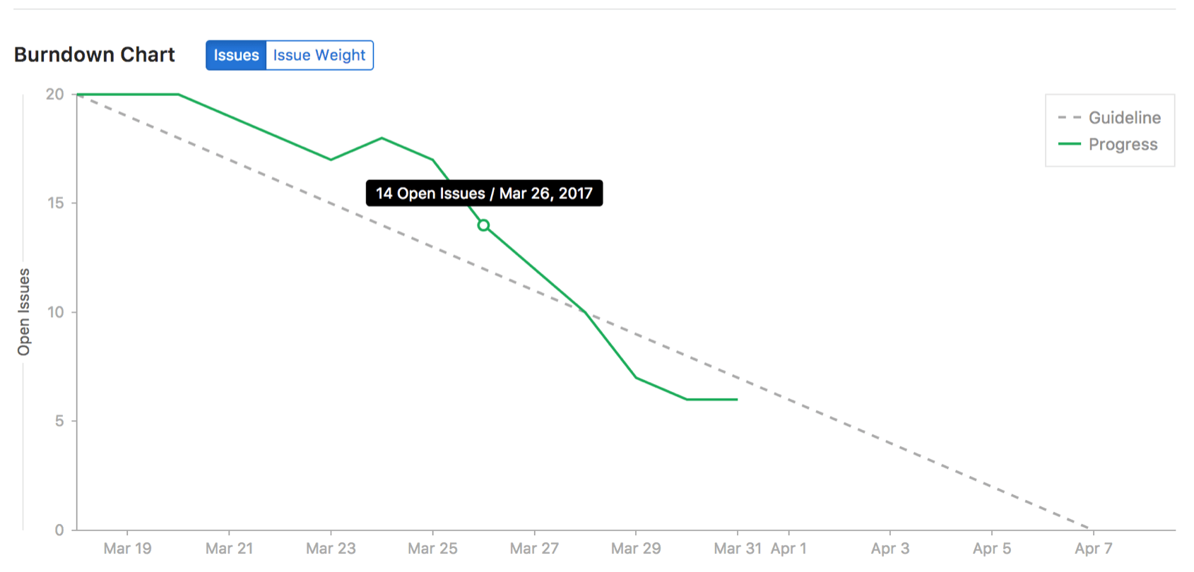
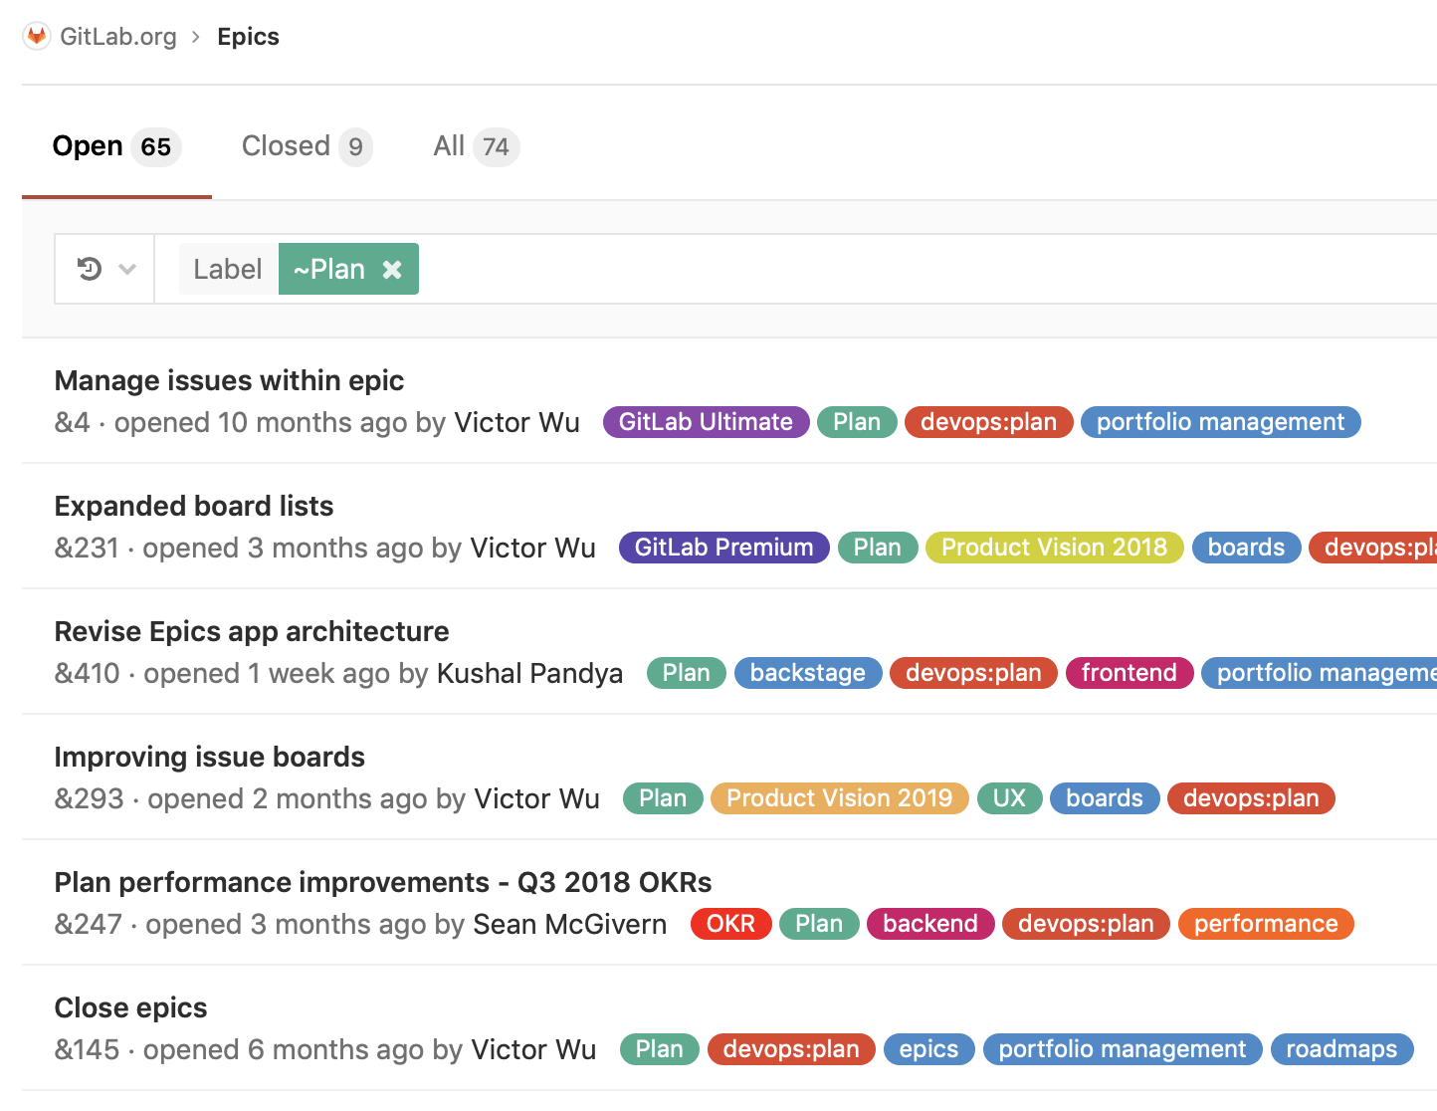
GitLab
Issues track, burn down chart.

Slide 13
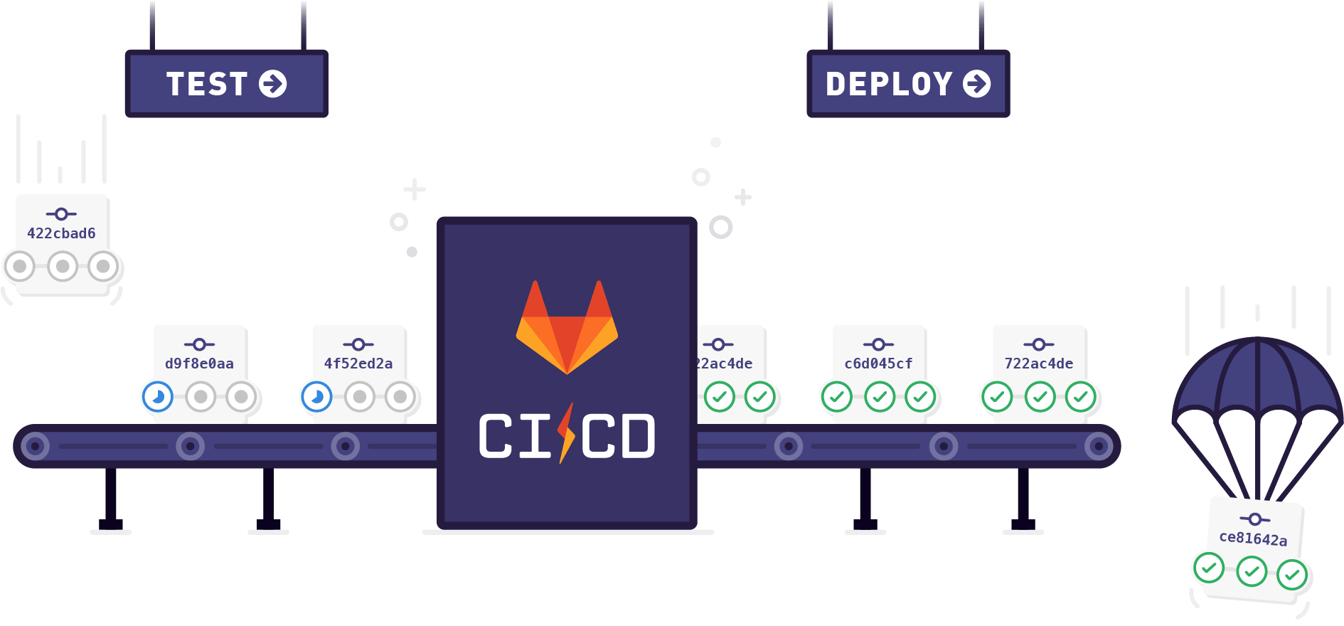
GitLab
Also support CI/CD
And so on..

Slide 14
Git Setup
First, setup user name, email that appears when you commit your work.
Set up vim editor, tools, color, .. (Optional)
Check your config:
Clone (download) an exited git repository:
$ git config --global user.name “Your Name”
$ git config --global user.email your_name@example.com
$git config --list
$ git clone http://gitlab.banvien.com/training/c_cpp.git

Slide 15
Git Branch (1/2)
In a collaborative environment, it is common for several developers to share and work on the same source code. While some developers will be fixing bugs, others will be implementing new features, etc. With so much going on, there needs to be a system in place for managing different versions of the same code base. Branching allows each developer to branch out from the original code base and isolate their work from others. It also helps Git to easily merge versions later on.
Work with branch
Create a branch
And then switch your new branch, which has been created.
$ git branch <branch_name>
$ git checkout <branch_name>

Slide 16
Git Branch (2/2)
Work with branch
After you changed some thing in your branch, let commit it.
Push it to remote
Show branch on local
Show all branch (on remote and local)
$ git commit –a –m ”Fixing issuse1”
$ git push origin <branch_name>
$ git branch
$ git branch --all

Slide 17
Git Other Command
Showing status on your branch.
Showing change on your branch
Logging history
To add file contents to the index.
For more: Refer https://git-scm.com/docs
$ git status
$ git diff
$ git log -1
$ git log
$ git add <file_name>

Slide 18
Exercise: Git
Clone repository at: http://gitlab.banvien.com/training/c_cpp.git
Creating your branch.
Making some changes and then show status/change/history/...
Add your git‘s command history with its output to your branch.
Commit and push it to server.

Slide 19
Thank You!!

