Slide 1
CAN Protocol
23th Dec, 2019

Slide 2
Contents
CAN Introduction
CAN Protocol
CAN Layer
CAN Network
CAN Node
CAN Bus
CAN Stack in AUTOSAR
CAN Frame
CAN Bus Access
Buffers & Protocol Engine Block Diagram
CAN Transmit Procedure
CAN Receive Procedure
CAN Error Detection
CAN Mode Operations
CAN CLASSIC AND CANFD

Slide 3
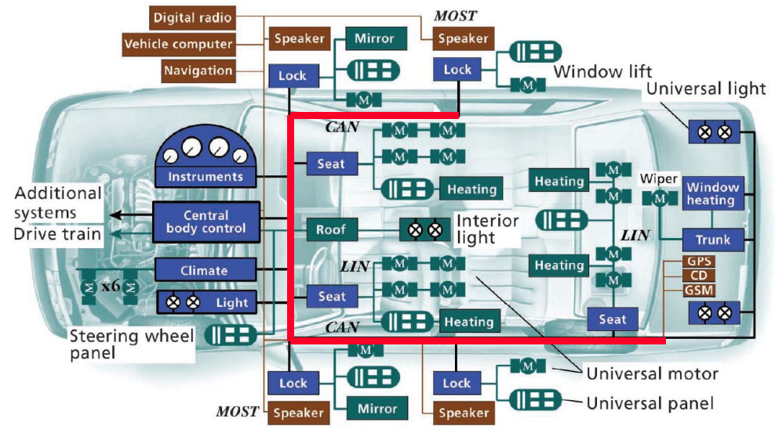
CAN Introduction
What is it?
The CAN is an ISO standard (ISO 11898) for serial communication that was developed 1980 by BOSCH for automotive applications.
Bosch published several versions of the CAN specification and the latest is CAN 2.0 published in 1991.
In 1993, the International Organization for Standardization released the CAN standard ISO 11898: ISO 11898-1 which covers the data link layer, and ISO 11898-2 which covers the CAN physical layer for high-speed CAN (1 Mbits/s). ISO 11898-3 was released later and covers the CAN physical layer for low-speed, fault-tolerant CAN (125 kbits/s).
In 2012, Bosch released CAN FD 1.0 or CAN with Flexible Data-Rate. This specification uses a different frame format that allows a different data length as well as optionally switching to a faster bit rate after the arbitration is decided.
Why is it?
High immunity to electrical interference
The ability to self-diagnose and repair data errors.
Notes:
https://en.wikipedia.org/wiki/CAN_bus

Slide 4
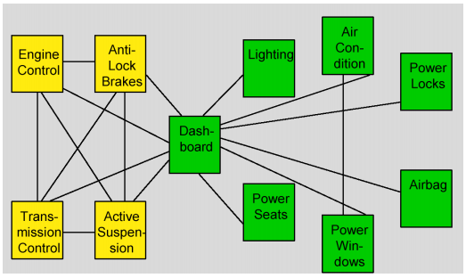
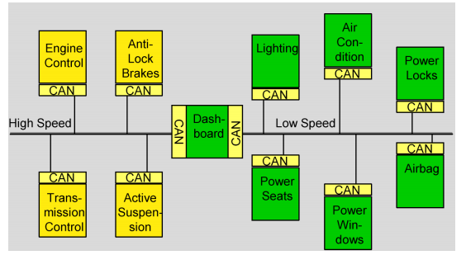
CAN Introduction
Comparing: without CAN and with CAN

Slide 5
CAN protocol - CAN Layer
Application Layer
Object Layer
Responsible for message handling.
Transfer Layer
Arbitration, message validation, error handling.
Physical Layer
Signals handle, how bits are represented and the actual transmission medium covered.
CAN LAYERS
Object Layer
Message Filtering
Message and Status Handling
Transfer Layer
Fault Confinement
Error Detection and Signaling
Message Validation
Acknowledgement
Arbitration
Message Framing
Transfer Rate & Timing
Physical Layer
Signal Level and Bit Representation
Transmission Medium

Slide 6
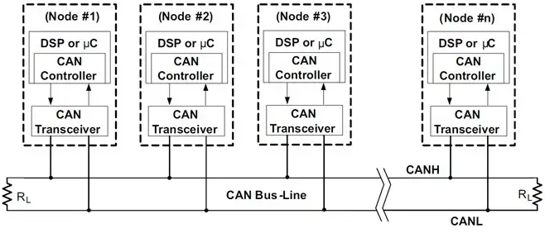
CAN protocol - CAN Network
Include:
CAN Node: CAN Controller & Transceiver
CAN Controller: CAN TxD & CAN RxD
CAN Transceiver: Convert signal from CAN Controller to CAN Bus CAN L & CAN H
Number of CAN nodes in network depends on the performance of the CAN transceiver used and the network speed.
CAN Bus: A pair of differential signal: CAN Low (CANL), CAN High (CANH) with 120 Ohm at the terminals (prevents reflections in a high-speed CAN network)

Slide 7
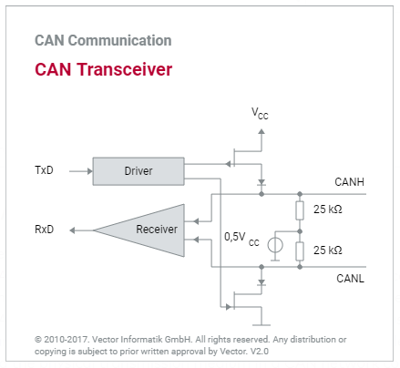
CAN protocol - CAN Node (1/3)
Characteristic:
Transmit/receive the packet data (message) and each message has an ID according to the priority of message.
Each node can receive many different types of message, and each message can be received by many nodes.
CAN Controller may be:
Integrated components (more flexible)
Stand-alone chip components (less space, faster and more reliable communication)
There are two fundamental CAN controller architectures:
CAN controllers with object storage (Full CAN)
CAN controller without object storage (Basic CAN)
CAN Transceiver:
CAN transceivers handle the bus connection.
A CAN transceiver always has two bus pins: one for the CAN high line (CANH) and one for the CAN low line (CANL).

Slide 8
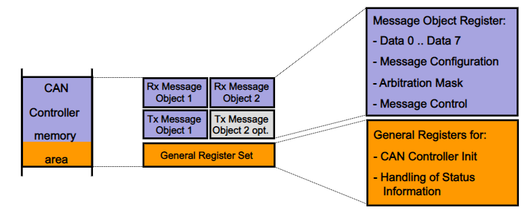
CAN protocol - CAN Node (2/3)
Basic CAN Controller:
Limited number of RX and TX Buffers
Reception of all CAN identifiers, all the time
High CPU load
Cheap implementation
Notes:
https://slideplayer.fr/slide/15623769/

Slide 9
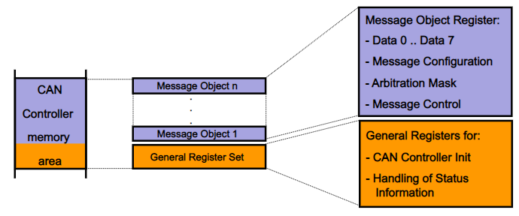
CAN protocol - CAN Node (3/3)
Full CAN Controller:
Many Full – CAN controller provide a “Basic – CAN Feature”
Large number of buffers for RX and TX
Buffers can be pre-defined for specific identifiers
All transmit frames in these buffers participate in arbitration
Less CPU load
More expensive
Notes:
https://slideplayer.fr/slide/15623769/

Slide 10
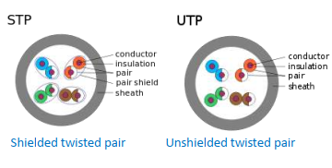
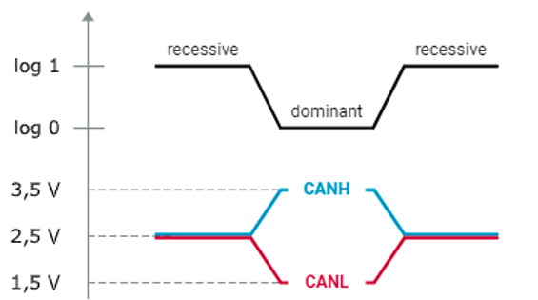
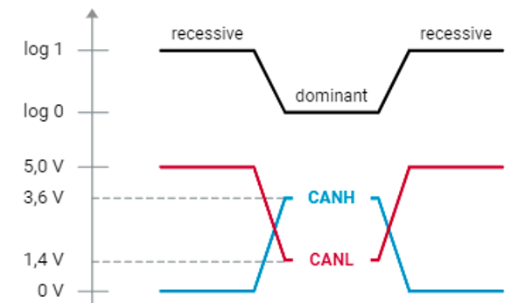
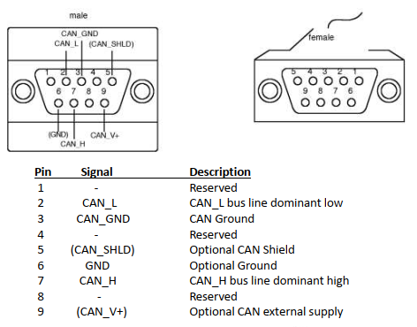
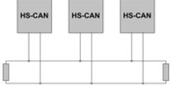
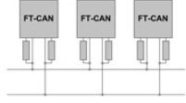
CAN protocol - CAN Bus (1/2)
CAN Bus:
Differential signals: eliminates the negative effects of interference voltage.
Twisted pair: reduces the magnetic field considerably
Features | HS-CAN | FT-CAN
Data link layer standard | ISO 11898-1 | ISO 11898-1
Physical layer standard | ISO 11898-2 | ISO 11898-3
Number of bus wires | 2 (twisted pair) | 2 (twisted pair)
Maximum bus speed | 1 Mbit/s | 125 kbit/s
Bus communication signal
Bus termination principle
Bus wire shortcut-circuit and interrupt tolerance | Limited short-circuit tolerance | Tolerant against any single bus wire short or interrupt
Automotive applications | Engine management Backbone bus Body and comfort | Boy & comfort
Notes:
Refer: https://www.digikey.co.th/en/ptm/n/nxp-semiconductors/can-and-lin-bus-transceiver/tutorial
https://elearning.vector.com/mod/page/view.php?id=340

Slide 11
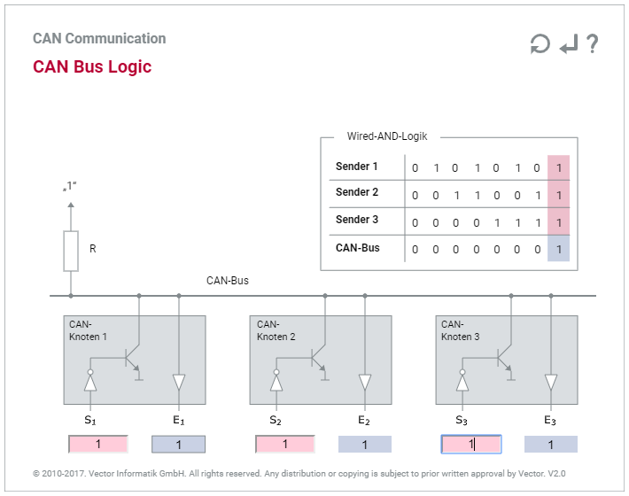
CAN protocol - CAN Bus (2/2)
CAN Bus logic:
The dominant bus level corresponds to logic 0
The recessive bus level corresponds to logic 1
“Wired-AND” function: as soon as one node transmit a dominant bit (zero), the Bus is in the dominant state. Only if all nodes transmit recessive bits (ones), the Bus is in the recessive state.

Slide 12
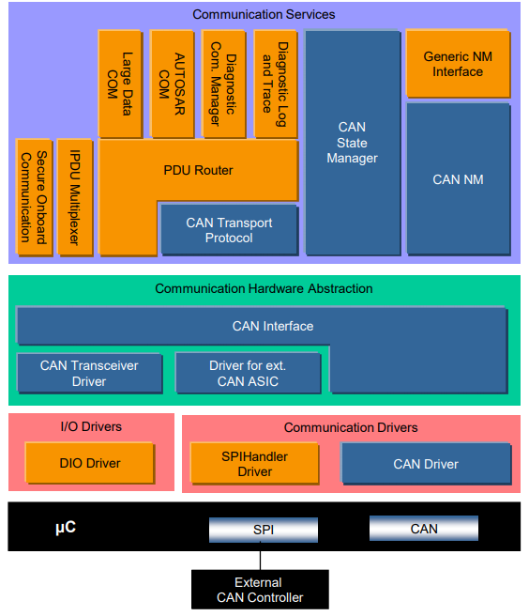
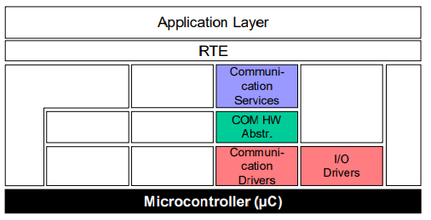
CAN protocol - CAN Stack in Autosar
The CAN Communication Services are a group of modules for vehicle network communication with the communication system CAN.
Task:
Provide a uniform interface to the CAN network. Hide protocol and message properties from the application.
The CAN Communication Stack supports:
Classic CAN communication (CAN 2.0)
CAN FD communication, if supported by hardware
Notes:
https://www.autosar.org/fileadmin/user_upload/standards/classic/4-3/AUTOSAR_EXP_LayeredSoftwareArchitecture.pdf

Slide 13
CAN protocol - CAN Frame (1/6)
The CAN protocol defines four different types of messages:
Data frame: A data frame carries data from a transmitter to the receivers.
Remote frame: A remote frame is transmitted by a node to request the transmission of the data frame with the same identifier, except missing data field.
Error frame: An error frame is transmitted by a node on detecting a bus error.
Overload frame: An overload frame is used to provide for an extra delay between the preceding and the succeeding data or remote frames.
Data frames and remote frames are separated from preceding frames by an inter frame space
Notes:
https://www.nxp.com/docs/en/reference-manual/BCANPSV2.pdf

Slide 14
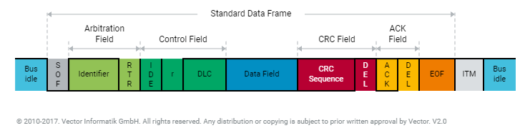
CAN protocol - CAN Frame (2/6)
Data Frame:
SOF: The single dominant start of frame (SOF) bit marks the start of a message, and is used to synchronize the nodes on a bus after being idle
ID: The identifier establishes the priority of the message. The lower the binary value, the higher its priority.
RTR: The single remote transmission request (RTR) bit is dominant when information is required from another node
IDE: A dominant single identifier extension (IDE) bit means that a standard CAN identifier with no extension is being transmitted
r: Reserved bit
DLC: Indicate the number of bytes of data being transmitted
CRC: cyclic redundancy check (CRC) contains the checksum (number of bits transmitted) of the preceding application data for error detection
ACK: the acknowledgment bit
EOF: End Of Frame
Notes:
http://www.ti.com/lit/an/sloa101b/sloa101b.pdf

Slide 15
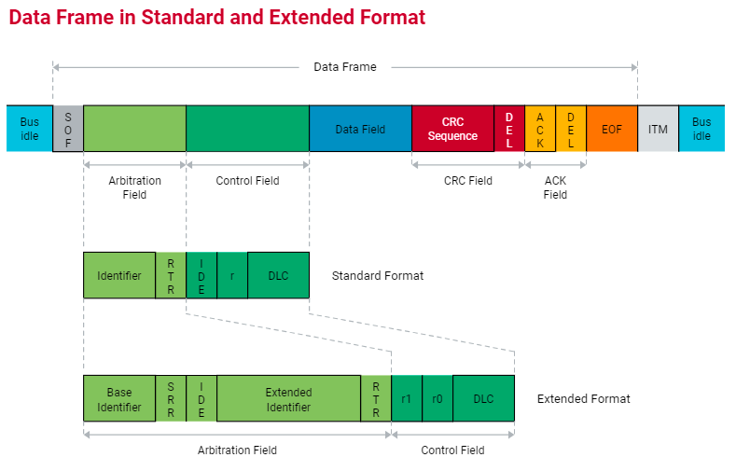
CAN protocol - CAN Frame (3/6)
Data frame – Standard & Extended:
The two formats differ in the length of the identifier. In standard format the ID has 11 bits. In extended format the ID has 29 bits.
SRR: The substitute remote request (SRR) bit replaces the RTR bit in the standard message location as a placeholder in the extended format.
IDE: A recessive bit in the identifier extension (IDE) indicates that more identifier bits follow. The 18 bit extension follows IDE.
r1: Following the RTR and r0 bits, an additional reserve bit has been included ahead of the DLC bit.
Notes:
http://www.ti.com/lit/an/sloa101b/sloa101b.pdf

Slide 16
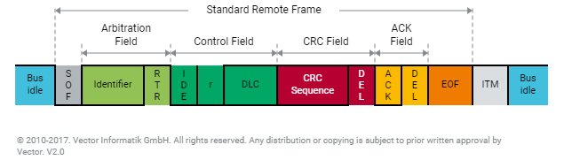
CAN protocol - CAN Frame (4/6)
Remote Frame
The RTR bit of a Remote frame is always recessive (cf. Data frames where the RTR bit is dominant).
There is no Data field in a Remote frame, irrespective of the value of the Data length code which is that of the corresponding Data frame and may be assigned any value within the admissible range 0...8.
CAN controller with object storage, the CAN controller automatically responds to a remote frame. CAN controllers without object storage must let the host know about the remote frame so that it can initiate a response
Notes:
http://www.ti.com/lit/an/sloa101b/sloa101b.pdf
Because CAN controllers without object storage don’t know if it should accept this message or not. So, it request to host to decide. If it is demand message, ACK will be 0 else ACK will be 1

Slide 17
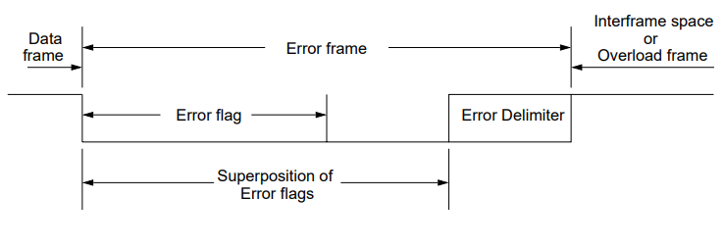
CAN protocol - CAN Frame (5/6)
Error Frame
The Error frame consists of two distinct fields. The first field is given by the superposition of Error flags contributed from different nodes. The second field is the Error delimiter.
If any of CAN nodes detects a violation of the frame format or a stuff error, it immediately sends and Error Frame.
Notes:
http://www.ti.com/lit/an/sloa101b/sloa101b.pdf

Slide 18
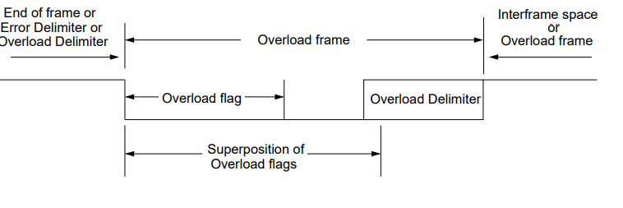
CAN protocol - CAN Frame (6/6)
Overload Frame
The Overload frame contains two bit fields, Overload flag and Overload Delimiter
There are two kinds of Overload condition, both of which lead to the transmission of an Overload flag:
Where the internal conditions of a receiver are such that the receiver requires a delay of the next Data frame or Remote frame
On detection of a dominant bit during INTERMISSION.
Notes:
http://www.ti.com/lit/an/sloa101b/sloa101b.pdf

Slide 19
CAN protocol - CAN BUS ACCESS (1/5)
Principle of Bus Access:
Bus access for all nodes:
ISO 11898-1 defines a multi-master architecture to assure high availability and event-driven data transmission. Each node in the CAN network has the right to access the CAN bus without requiring permission and without prior coordination with other CAN nodes. Although bus access based on an event-driven approach enables very quick reactions to events, there is the inherent risk that several CAN nodes might want to access the CAN bus at the same time, which would lead to undesirable overlaps of data on the CAN bus.
Avoid collisions:
To preserve the communication system’s real-time capability, ISO 11898-1 provides for a bus access that guarantees nondestructive data transport. The so-called CSMA/CA (Carrier Sense Multiple Access with Collision Avoidance) method is used here. The CSMA/CA method ensures that CAN nodes wishing to send do not access the CAN bus until it is available.
Bitwise bus arbitration:
In case of simultaneous bus access, the CSMA/CA method based on bitwise bus arbitration ensures that the highest priority CAN message among the CAN nodes prevails. In principle, the higher the priority of a CAN message the sooner it can be transmitted on the CAN bus. In case of poor system design, low priority CAN messages even run the risk of never being transmitted.
The interactive figure “Principle of Bus Access” is provided to give you a better understanding. It assumes a scenario of two CAN nodes wanting to access the bus during an ongoing message transmission. Please read the instructions so that you can fully utilize the entire functionality of the media object.
Notes:
https://slideplayer.com/slide/10709648/

Slide 20
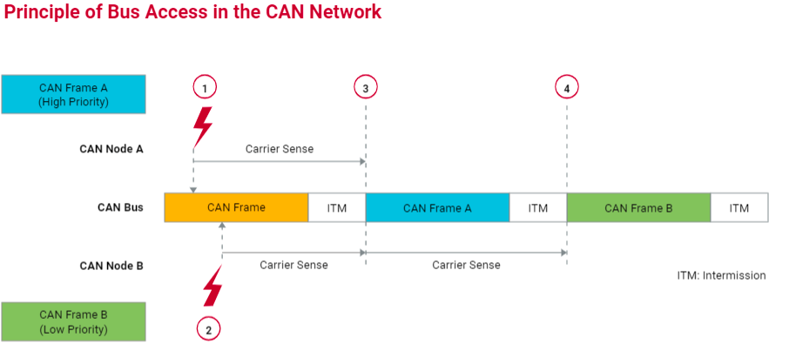
CAN protocol - CAN BUS ACCESS (2/5)
Notes:
https://elearning.vector.com/mod/page/view.php?id=350

Slide 21
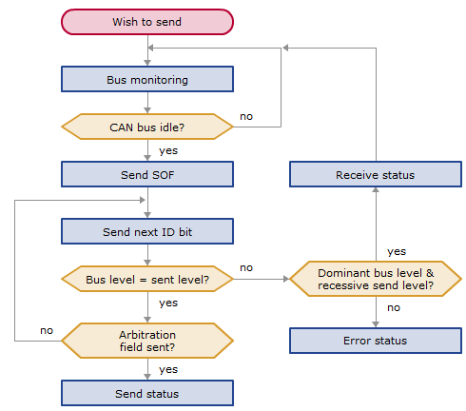
CAN protocol - CAN BUS ACCESS (3/5)
Bus Access Procedure:
Notes:
https://slideplayer.com/slide/10709648/

Slide 22
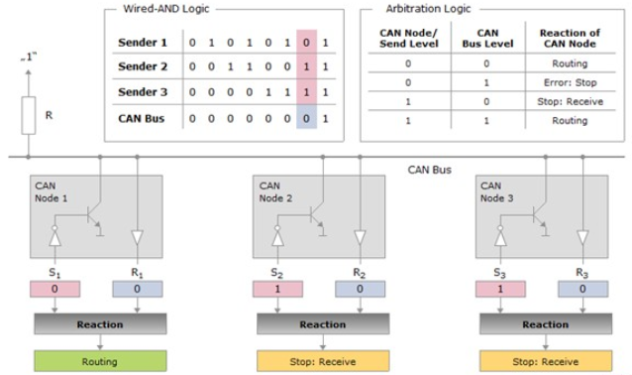
CAN protocol - CAN BUS ACCESS (4/5)
CAN Bus Access logic
Notes:
https://elearning.vector.com/mod/page/view.php?id=351

Slide 23
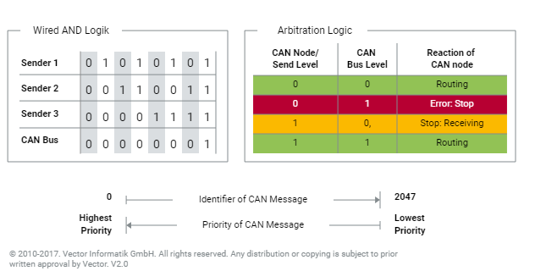
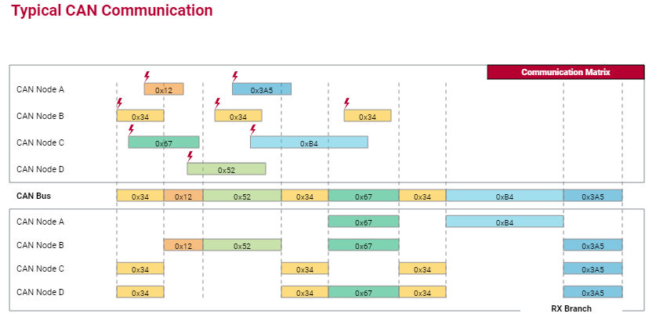
CAN protocol - CAN BUS ACCESS (5/5)
Prioritization of CAN Messages:
The priorities of the CAN messages are encoded via the ID which is transmitted bitwise from the most significant to the least significant bit.
Wired-AND bus logic and arbitration logic ensure that the priority of the CAN message increases with decreasing identifier value: The smaller an identifier is the higher the priority of the CAN message.
Notes:
https://elearning.vector.com/mod/page/view.php?id=351

Slide 24
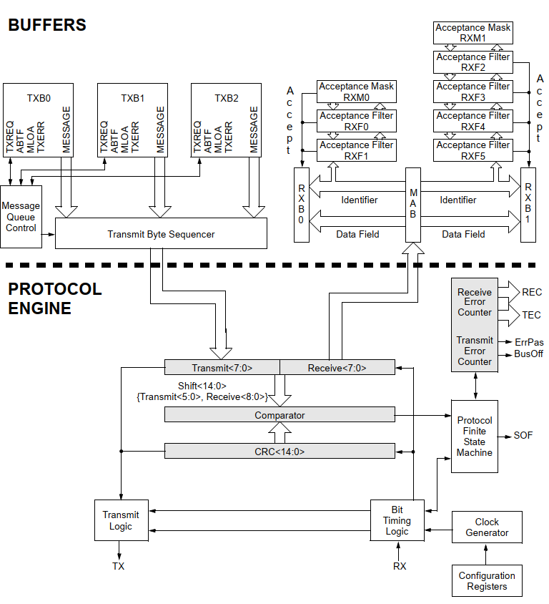
CAN protocol - Buffer & Protocol Engine
CAN Buffers and Protocol Engine Block Diagram of MCP2515:
Notes:
https://elearning.vector.com/mod/page/view.php?id=351

Slide 25
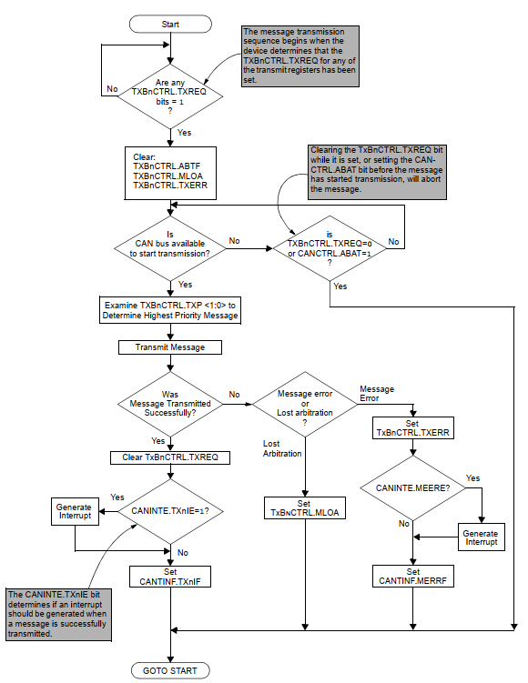
CAN Transmit Procedure
Transmit Procedure of MCP2515
Notes:
Data sheet mcp2515

Slide 26
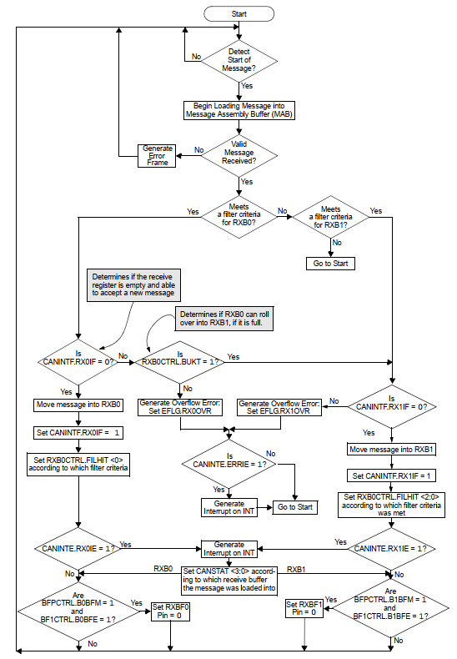
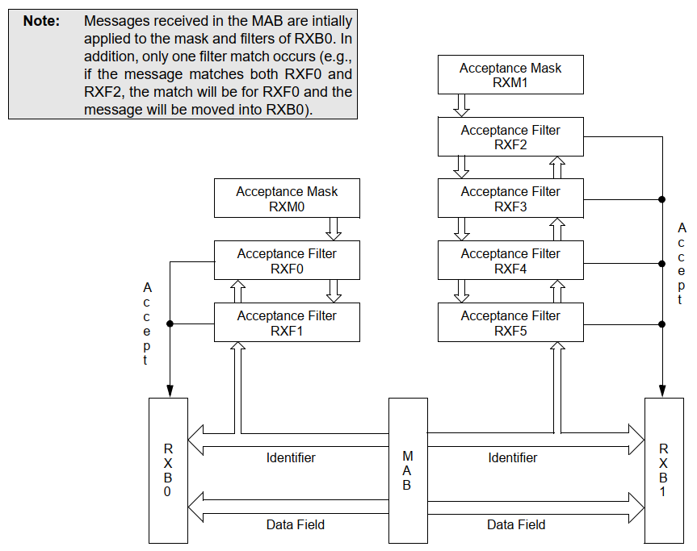
CAN Receive Procedure
Receive Procedure of MCP2515:
Notes:
Data sheet mcp2515

Slide 27
CAN Error Detection
Error Detection of MCP2515:
CRC Error
Acknowledge Error
Form Error: If a node detects a dominant bit in one of the four segments (including EOF, IFS, acknowledge delimiter or CRC delimiter), a form error has occurred
Bit Error: A bit error occurs if a transmitter detects the opposite bit level to what it transmitted (ex: transmitted a dominant and detected a recessive, or transmitted a recessive and detected a dominant).
Stuff Error: lf, between the start-of-frame and the CRC delimiter, six consecutive bits with the same polarity are detected, the bit-stuffing rule has been violated => A stuff error occurs
Error States: Error-active, Error-passive, Bus-off.
Notes:
Data sheet mcp2515

Slide 28
CAN Mode Operations
Instance for MCP2515:
Configuration mode
Sleep mode: The MCP2515 has an internal Sleep mode that is used to minimize the current consumption of the device
Listen-only mode: Listen-only mode is a silent mode, meaning no messages will be transmitted while in this mode, but it can receive all messages
Loopback mode: Loopback mode will allow internal transmission of messages from the transmit buffers to the receive buffers without actually transmitting messages on the CAN bus. This mode can be used in system development and testing
Normal mode: Normal mode is the standard operating mode of the MCP2515. In this mode, the device actively monitors all bus messages and generates acknowledge bits, error frames, etc. This is also the only mode in which the MCP2515 will transmit messages over the CAN bus
Notes:
Data sheet mcp2515

Slide 29
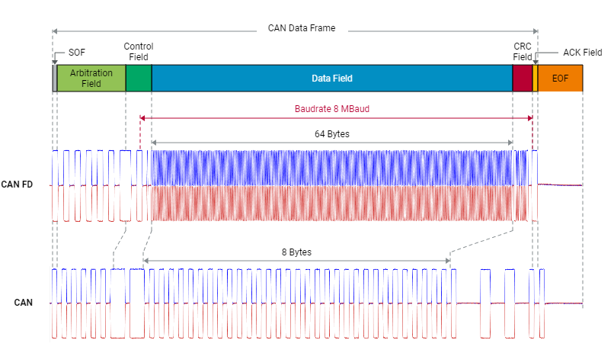
CAN CLASSIC AND CANFD (1/3)
Advantages:
Bus load problems would be reduced dramatically
Using several CAN buses would no longer be necessary
The need for gateways would be reduced if not abolished
Less segmentation of data thanks to larger payloads per frame
A better ratio of payload and overhead data by fewer frames
CAN FD does not define an individual format for Remote Frames. Consequently the CAN FD protocol allows for CAN FD frames to be requested by classical CAN Remote Frames.
Notes:
https://elearning.vector.com/mod/page/view.php?id=351

Slide 30
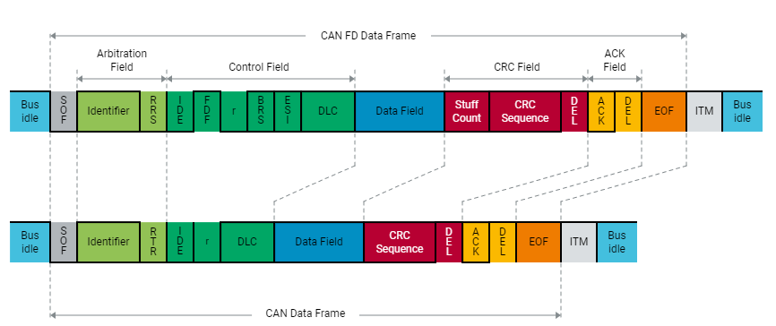
CAN CLASSIC AND CANFD (2/3)
As there are no Remote Frames for CAN FD the RTR bit is not necessary and is substituted by the always dominant Remote Request Substitution bit (RRS). Start of Frame (SOF), Identifier and Identifier Extension Bit (IDE) remain unchanged. Also at the end of the CAN FD frame the Acknowledge Bit (ACK), the corresponding Delimiter (DEL), the End of Frame (EOF) as well as the Intermission Field (ITM) remain as in traditional CAN frames.
Notes:
https://elearning.vector.com/mod/page/view.php?id=351

Slide 31
CAN CLASSIC AND CANFD (3/3)
Distinguishing CAN from CAN FD Frames
The reserve bit of the traditional CAN frame now becomes the switch for the CAN FD format. If transferred dominant as 0, it denotes a classical CAN frame. If it contains the recessive value 1, it denotes a CAN FD frame.
The bit's new name is FDF for Flexible Data Rate Format which establishes the opportunity to transmit a much larger payload. The actual length of the data field and the decision whether to switch to a higher transmission rate or not, follow later in the frame.
CAN FD controllers can send and receive classical CAN frames as well as CAN FD frames. On the other hand, a classical CAN controller will always react with an error frame when receiving a CAN FD frame remain as in traditional CAN frames.
Notes:
https://elearning.vector.com/mod/page/view.php?id=351

Slide 32
Thank You!!

