Slide 1
FAILURE MODE AND EFFECTS ANALYSIS
Hieu Nguyen
Consultant/EMB
January 18, 2019

Slide 2
Objectives
The objectives of training course:
Provide the concepts of FMEA.
Provide the process of FMEA.
The training is not to:
Introduce all FMEA types
A detail guidelines for FMEA.

Slide 3
Agenda
Introduction
What is FMEA?
Objective of FMEA
International standard for FMEA
Types of FMEAs
System FMEA
Design FMEA
Process FMEA

Slide 4
Agenda (Continue - 1)
FMEA procedure
Definition
FMEA Procedure

Slide 5
Introduction

Slide 6
Introduction – What is FMEA?
Failure Mode and Effects Analysis (FMEA) is a method designed to:
Identify predictable potential failure modes and their causes, and the effects of failure.
Identify and implement corrective actions to eliminate potential failure modes.

Slide 7
Introduction – Objective of FMEA
The primary objective of an FMEA is to improve the design
And the other objects for doing FMEA, such as:
Early identification and elimination of potential failure modes
Collect information to reduce future failures.
Emphasize problem prevention
Improve the quality, reliability, and safety of a product/process
Reduce system development time and cost
Minimize late changes and associated cost.

Slide 8


Introduction – International standard for FMEA
In 1993 the Automotive Industry Action Group (AIAG) first published an FMEA standard for the automotive industry.
The Society for Automotive Engineers (SAE) first published related standard J1739 in 1994.
Note: this document is based on SAE standard document.

Slide 9
Types of FMEAs

Slide 10
Types of FMEAs
The three most common types of FMEAs are:
System FMEA
Design FMEA
Process FMEA

Slide 11
Types of FMEAs – System FMEA
Analysis is at highest-level analysis of an entire system, including various subsystems.
Focus on system-related deficiencies, including:
System safety and system integration
Interfaces between subsystems or with other systems, between subsystems or with the surrounding environment
Single-point failures
Functions and relationships that are unique to the system as a whole and could cause the overall system not to work as intended
Human interactions and service

Slide 12
Types of FMEAs – Design FMEA
Analysis is at the subsystem level or component level.
Focus on product design-related deficiencies, including:
Improving the design
Ensuring product operation is safe and reliable during the useful life of the equipment.
Interfaces between adjacent components.

Slide 13
Types of FMEAs – Process FMEA
Analysis is at the manufacturing/assembly process level.
Focus on manufacturing related deficiencies, including:
Improving the manufacturing process
Ensuring the product is built to design requirements in a safe manner, with minimal downtime, scrap and rework.
Manufacturing and assembly operations, shipping, incoming parts, transporting of materials, storage, conveyors, tool maintenance, and labeling.

Slide 14
FMEA

Slide 15
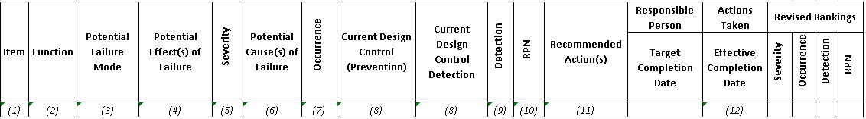
FMEA – Definition
Sample format for FMEA:

Slide 16
FMEA – Definition – Item
An “Item” (1):
For a System FMEA this is the system itself.
For a Design FMEA, this is the subsystem or component under analysis.
For a Process FMEA, this is usually one of the specific steps of the manufacturing or assembly process under analysis, as represented by an operation description.

Slide 17
FMEA – Definition – Item
Example:
1.0 All – Terrain Bicycle System
1.1 Frame Subsystem
1.2 Front Wheel Subsystem
1.3 Rear Wheel Subsystem
1.4 …
1.8 Hand Brake Subsystem
1.8.1 Brake Cable
1.8.2 Brake Pads
1.8.3 Brake Caliper
1.9 Suspension Subsystem
System Item
Subsystem Item
Component Item

Slide 18
FMEA – Definition – Function
A “function” (2) is what the item or process is intended to do, usually to a given standard of performance or requirement.
For Design FMEAs, this is the primary purpose or design intent of the item.
For Process FMEAs, this is the primary purpose of the manufacturing or assembly operation.

Slide 19
FMEA – Definition – Function
Example:
Item/Function | Potential Failure Mode | Potential Effect(s) of Failure | S E V | Potential Cause(s) of Failure | O C C | Current Design Control (Prevention) | Current Design Control (Detection) | D E T
Hand Brake S/S: Provide the correct level of friction between brake pad assembly and wheel rim to safety stop bicycle in the required distance, under all operating conditions. | Insufficient friction delivered by hand brake subsystem between brake pads and wheels during heavy rain conditions. | Bicycle wheel does not slow down when the brake lever is pulled potentially resulting in accident. | 10 | Cable Binds due to inadequate lubrication or poor routing | 4 | Hand Brake Design Guide #123 | Bicycle system durability test #789 | 2
 |  |  |  | External foreign material reduces friction | 2 |  |  | 3
 |  |  |  | Cable breaks | 6 | Cable material selection based on ANSI #ABC | Bicycle system durability test #789 | 4

Slide 20
FMEA – Definition – Failure Mode
A “failure mode” (3) is the anti-function or requirement not being met.
There are 5 types of Failure Modes:
Full Failure
Partial Failure
Intermittent Failure
Degraded Failure
Unintentional Failure
Notes:
Failure Modes are the anti-functions or requirements not being met
There are 5 types of Failure Modes:
Failure to perform a function within defined limits
Inadequate or poor performance of the function
Intermittent performance of a function
Performing an unintended or undesired function

Slide 21
FMEA – Definition – Failure Mode
Example:
Item/Function | Potential Failure Mode | Potential Effect(s) of Failure | S E V | Potential Cause(s) of Failure | O C C | Current Design Control (Prevention) | Current Design Control (Detection) | D E T
Hand Brake S/S: Provide the correct level of friction between brake pad assembly and wheel rim to safety stop bicycle in the required distance, under all operating conditions. | Insufficient friction delivered by hand brake subsystem between brake pads and wheels during heavy rain conditions. | Bicycle wheel does not slow down when the brake lever is pulled potentially resulting in accident. | 10 | Cable Binds due to inadequate lubrication or poor routing | 4 | Hand Brake Design Guide #123 | Bicycle system durability test #789 | 2
 |  |  |  | External foreign material reduces friction | 2 |  |  | 3
 |  |  |  | Cable breaks | 6 | Cable material selection based on ANSI #ABC | Bicycle system durability test #789 | 4

Slide 22
FMEA – Definition – Effect
An “effect” (4) is the consequence of the failure on the system or end user.
Many effects could be possible for any one failure mode.

Slide 23
FMEA – Definition – Effect
Example:
Item/Function | Potential Failure Mode | Potential Effect(s) of Failure | S E V | Potential Cause(s) of Failure | O C C | Current Design Control (Prevention) | Current Design Control (Detection) | D E T
Hand Brake S/S: Provide the correct level of friction between brake pad assembly and wheel rim to safety stop bicycle in the required distance, under all operating conditions. | Insufficient friction delivered by hand brake subsystem between brake pads and wheels during heavy rain conditions. | Bicycle wheel does not slow down when the brake lever is pulled potentially resulting in accident. | 10 | Cable Binds due to inadequate lubrication or poor routing | 4 | Hand Brake Design Guide #123 | Bicycle system durability test #789 | 2
 |  |  |  | External foreign material reduces friction | 2 |  |  | 3
 |  |  |  | Cable breaks | 6 | Cable material selection based on ANSI #ABC | Bicycle system durability test #789 | 4

Slide 24
FMEA – Definition – Severity
“Severity” (5) is a ranking number associated with the most serious effect for a given failure mode, based on the criteria from a severity scale.
It is a relative ranking within the scope of the specific FMEA determined without regard to the likelihood of occurrence or detection
To assign this rating, must assume the failure mode has occurred.
Understand customer effects
Understand internal effects.

Slide 25
FMEA – Definition – Severity
Example of Severity scale:
Category (Product) | Criteria: Severity of Effect (Effect on Product) | Rank
Failure to Meet Safety or Regulatory Requirements | Potential failure mode affects safe operation or regulatory requirements, without warning | 10
 | Potential failure mode affects safe operation or regulatory requirements, with warning | 9
Loss or Degradation of Primary Function | Loss of primary function | 8
 | Degradation of primary function | 7
Loss or Degradation of Secondary Function | Loss of secondary function | 6
 | Degradation of secondary function | 5
Annoyance | Item operable, but with annoyance noticed by > 75% of customers | 4
 | Item operable, but with annoyance noticed by 50% of customers | 3
 | Item operable, but with annoyance noticed by < 25% of customers | 2
No Effect | No noticeable effect | 1

Slide 26
FMEA – Definition – Cause
A “cause” (6) is the specific reason for the failure.
For Design FMEAs, the cause is the design deficiency that results in the failure mode.
For Process FMEAs, the cause is the manufacturing or assembly deficiency that results in the failure mode. At the component level, cause should be taken to the level of failure mechanism
Notes:
An indication of a design weakness resulting in the failure mode (Material failures, Incorrect Assumptions, Design Errors, Component Selection Errors, etc.)
How the failure could occur during production (Human Error, Equipment Error, Calibration Issue Improper mold set-up, Insufficient shot size, mold temperature too high, etc.)

Slide 27
FMEA – Definition – Cause
Example:
Item/Function | Potential Failure Mode | Potential Effect(s) of Failure | S E V | Potential Cause(s) of Failure | O C C | Current Design Control (Prevention) | Current Design Control (Detection) | D E T
Hand Brake S/S: Provide the correct level of friction between brake pad assembly and wheel rim to safety stop bicycle in the required distance, under all operating conditions. | Insufficient friction delivered by hand brake subsystem between brake pads and wheels during heavy rain conditions. | Bicycle wheel does not slow down when the brake lever is pulled potentially resulting in accident. | 10 | Cable Binds due to inadequate lubrication or poor routing | 4 | Hand Brake Design Guide #123 | Bicycle system durability test #789 | 2
 |  |  |  | External foreign material reduces friction | 2 |  |  | 3
 |  |  |  | Cable breaks | 6 | Cable material selection based on ANSI #ABC | Bicycle system durability test #789 | 4

Slide 28
FMEA – Definition – Occurrence
“Occurrence” (7) is a ranking number associated with the likelihood that the failure mode and its associated cause will be present in the item being analyzed.
For System and Design FMEAs, consider the likelihood of occurrence during the design life of the product.
For Process FMEAs consider the likelihood of occurrence during production.

Slide 29
FMEA – Definition – Occurrence
Example of Occurrence scale:
Likelihood of Failure | Criteria: Occurrence of Cause | Criteria: Occurrence of Cause (Incidents per Item) | Rank
Very High | New technology/new design with no history | > 100 per thousand items > 1 in 10 | 10
 | Failure inevitable with new design, new application, or change in operating conditions | 50 per thousand items 1 in 20 | 9
High | Failure likely with new design, new application, or change in operating conditions | 20 per thousand items 1 in 50 | 8
 | Failure uncertain with new design, new application, or change in operating conditions | 10 per thousand items 1 in 100 | 7
Moderate | Frequent failures associated with similar designs or in design testing | 5 per thousand items 1 in 200 | 6
 | Occasional failures associated with similar designs or in design testing | 2 per thousand items 1 in 500 | 5
 | Isolated failures associated with similar design or in design testing | 1 per thousand items 1 in 1000 | 4
Low | Only isolated failures associated with almost identical design or design testing. | 0.5 per thousand items 1 in 2000 | 3
 | No observed failures associated with almost identical design or in design testing | 0.1 per thousand items 1 in 1000 | 2
Very Low | Failure is eliminated through preventative control | < 0.01 per thousand items < 1 in 100000 | 1

Slide 30
FMEA – Definition – Control
“Controls” (8) are the methods or actions currently planned, or already in place, to reduce or eliminate the risk associated with each potential cause.
Controls can be the methods to prevent or detect the cause during product development, or actions to detect a problem during service before it becomes catastrophic. For System or Design FMEAs:
Prevention describe how a cause, failure mode, or effect in the product design is prevented based on current or planned actions.
Detection describe how a failure mode or cause in the product design is detected, based on current or planned actions before the product design is released to production, and are used as input to the detection ranking.

Slide 31
FMEA – Definition – Control
Example:
Item/Function | Potential Failure Mode | Potential Effect(s) of Failure | S E V | Potential Cause(s) of Failure | O C C | Current Design Control (Prevention) | Current Design Control (Detection) | D E T
Hand Brake S/S: Provide the correct level of friction between brake pad assembly and wheel rim to safety stop bicycle in the required distance, under all operating conditions. | Insufficient friction delivered by hand brake subsystem between brake pads and wheels during heavy rain conditions. | Bicycle wheel does not slow down when the brake lever is pulled potentially resulting in accident. | 10 | Cable Binds due to inadequate lubrication or poor routing | 4 | Hand Brake Design Guide #123 | Bicycle system durability test #789 | 2
 |  |  |  | External foreign material reduces friction | 2 |  |  | 3
 |  |  |  | Cable breaks | 6 | Cable material selection based on ANSI #ABC | Bicycle system durability test #789 | 4

Slide 32
FMEA – Definition – Detection
“Detection” (9) is a ranking number associated with the best control from the list of detection-type controls, based on the criteria from the detection scale.
It considers the likelihood of detection of the failure mode/cause, according to defined criteria
It is a relative ranking within the scope of the specific FMEA, and is determined without regard to the severity or likelihood of occurrence

Slide 33
FMEA – Definition – Detection
Example of Detection scale:
Opportunity for Detection | Likelihood of Detection | Criteria: Likelihood of Detection by Design Control | Rank
No detection opportunity | Absolute Uncertainly | No current design control or cannot be detected | 10
Not likely to detect at any stage | Very Remote | Design controls have a weak detection capability | 9
Post Design Freeze and prior to launch | Remote | Product verification after design freeze and prior to launch with pass/fail testing | 8
 | Very Low | Product verification after design freeze and prior to launch with test to failure testing | 7
 | Low | Product verification after design freeze and prior to launch with degradation testing | 6
Prior to Design Freeze | Moderately | Product validation prior to design freeze using pass/fail testing | 5
 | Moderately High | Product validation prior to design freeze using test to failure | 4
 | High | Product validation prior to design freeze using degradation testing | 3
Virtual Analysis Correlated | Very High | Design controls have strong detection capability prior to design freeze | 2
Detection N/A: Failure Prevention | Almost Certain | Failure cause or failure mode cannot occur because it is fully prevented | 1

Slide 34
FMEA – Definition – Risk Priority Number RPN
“RPN” (10) is a numerical ranking of the risk of each potential failure mode/cause.
RPN = severity ranking x occurrence ranking x detection ranking
RPN has a number of limitations and is not a perfect representation of the risk associated with a failure mode and associated cause
Subjective
Continuous
High severity must be considered regardless of RPN value

Slide 35
FMEA – Definition – Risk Priority Number RPN
Example:
Safety | Severity | Occurrence | Detectability | Risk Priority Number RPN = S * O * D | Health of Design
HIGH RISK 4-10 UNACCEPTABLE | 10 | 10 | 10 | 1000 500 400 200 | UNACCEPTABLE Redesign Required
 | 9 | 9 | 9
 | 8 | 8 | 8
 | 7 | 7 | 7
 | 6 | 6 | 6 | 199 150 100 | MARGINAL Action Required
 | 5 | 5 | 5
 | 4 | 4 | 4 | 99 25 1 | GOOD
LOW RISK 1-3 | 3 | 3 | 3
 | 2 | 2 | 2
 | 1 | 1 | 1

Slide 36
FMEA – Definition – Recommended Actions
“Recommended actions” (11) are the tasks recommended by the FMEA team to reduce or eliminate the risk associated with potential causes of failure.
They should consider existing controls, relative importance (prioritization) of the issue, and the cost and effectiveness of the corrective action

Slide 37
FMEA – Definition – Recommended Actions
Example:
Potential Cause(s) of Failure | O C C | Current Design Control (Prevention) | Current Design Control (Detection) | D E T | R P N | Recommended Action
Cable Binds due to inadequate lubrication or poor routing | 4 | Hand Brake Design Guide #123 | Bicycle system durability test #789 | 2 | 80 | Redesign handbrake cable routing to reduce friction and make system insensitive to lubrication degradation
 |  |  |  |  |  | Modify bicycle durability testing to include periodic brake cable checks for binding

Slide 38
FMEA – Definition – Actions Taken
“Action Taken” (12) is the specific action that is implemented to reduce risk to an acceptable level.
It should correlate to the specific recommended action
Is assessed as to effectiveness by a revised severity, occurrence, detection ranking, and corresponding revised RPN.

Slide 39
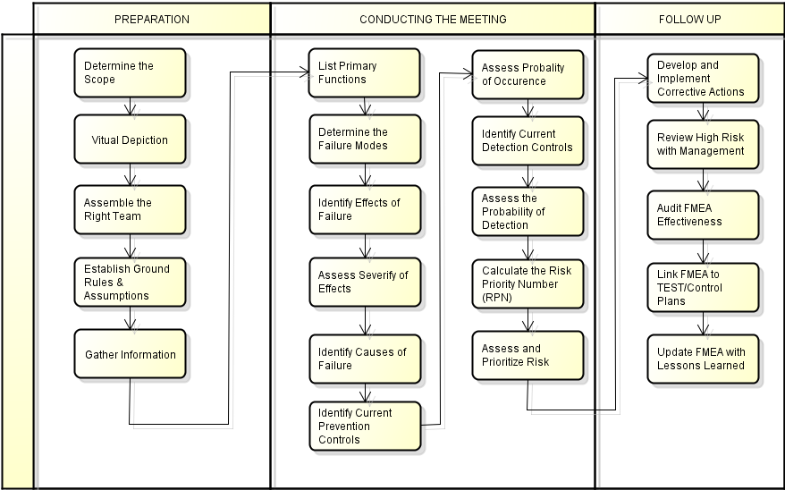
FMEA – Procedure

Slide 40
Thank You

