Slide 1
Peer Review Introduction
Hieu Nguyen
Consultant/EMB
January 15, 2019

Slide 2
Objectives
The objectives of training course:
Provide the concepts of peer review
Provide the general procedure for each type of peer review
Provide sample template.
The training is not to:
Introduce all peer review types
A detail guidelines for peer review

Slide 3
Agenda
Introduction
What is Peer Review?
Why do we need Peer Review?
What should be reviewed?
Who are participant in Peer Review?
Types of Peer Review
Types of Peer Review
Peer Review Selection Matrix

Slide 4
Agenda (Continue - 1)
Inspection
Overview
Characteristic
Inspection procedure
Walkthrough
Overview
Characteristic
Walkthrough procedure

Slide 5
Agenda (Continue - 2)
Desk check
Overview
Measurement and analysic
How to collect data item and measure
Sample templates

Slide 6
Introduction

Slide 7
Introduction – What is Peer Review?
Peer review is the evaluation of work by one or more people with similar competences as the producers of the work.
Goal: To find and remove detects from the work products early and efficiently.
Characteristic:
Be Technical, Not Management.
Time for each meeting: not exceed 2 hours. (If the work product is too long, we should split up into each meeting)

Slide 8
Introduction – Why do we need Peer Review?
Improve schedule performance
Improve quality of artifacts by detecting defects/issues as soon as possible. (Peer Review can find 60 – 100 % of all defects)
Reduce the cost of removing defects.

Slide 9
Introduction – What should be reviewed?
Candidates for review:
Requirement Specs
Architecture, high-level/detailed designs
Source code
Test plans, test designs, test cases
Software development plan
Software verification reports
User documentation

Slide 10
Introduction – Who are participant?
In general, a work product should be reviewed by:
The author
Someone who must base their subsequent work on the work product
Peers of the author
Anyone responsible for a component to which the work product interfaces

Slide 11
Introduction – Who are participant?
Work Product Type | Suggested Reviewers
Architecture or High – Level Design | Architect, requirements analyst, designer, project manager, integration test engineer
Detail Design | Designer, architect, programmer, integration test engineer
Process Documentation | Process improvement group leader, process improvement working group members, management– level process owner, practitioner representatives who will use the process.
Project Plans | Project manager, program manager, business sponsor, marketing or sales representative, technical lead, quality assurance manager
Requirement Specification | Requirement analyst, project manager, architect, designer, system test engineer, quality assurance manager, user or marketing representative, documentation writer, subject matter expert, technical support representative

Slide 12
Introduction – Who are participant?
Work Product Type | Suggested Reviewers
Source Code | Programmer, designer, unit test engineer, maintainer, requirements analyst, coding standards expert.
System Technical Documentation | Author, project manager, maintainer, programmer
Test Documentation | Test engineer, programmer (unit testing) or architect (integration testing) or requirements analyst (system testing), quality assurance representative
User Interface Design | User interface designer, requirements analyst, user, application domain expert, usability or human factors expert, system test engineer
User Manual | Documentation writer, requirements analyst, user or marketing representative, system test engineer, maintainer, designer, instructional designer, trainer, technical support representative

Slide 13
Types of Peer Review

Slide 14
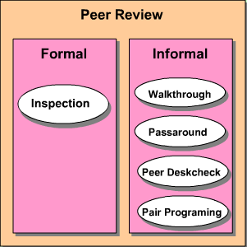
Types of Peer Review
Formal Peer Review
A formal evaluation technique in which artifacts are examined in detail by a person or group rather than the author to identify defects, violations of development standards, and other problems.
Formal peer review is used for high-risk artifacts.
Informal Peer Review
The author will select and distribute the artifacts to participants to examine and have comments.
Informal peer review is used for low-risk artifacts or pre-examining before formal peer review.

Slide 15
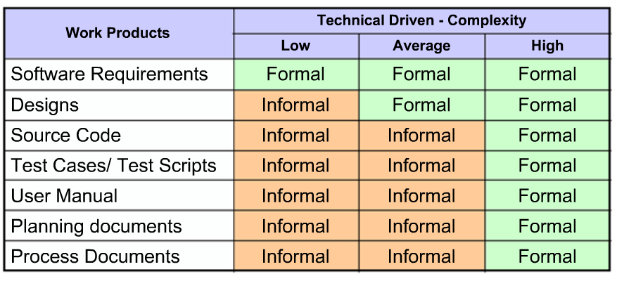
Types of Peer Review - Selection Matrix for SW

Slide 16
Inspection

Slide 17
Inspection – Overview
An inspection is one of the most common sorts of review practices found in artifact project.
In an inspection, a work product is selected for review and a team is gathered for an inspection meeting to review the work product. A moderator is chosen to moderate the meeting. Each inspector prepares for the meeting by reading the work product and noting each defect. In an inspection, a defect is any part of the work product that will keep an inspector from approving it.

Slide 18
Inspection – Characteristic
It is led by the trained moderators.
Time
Completed other informal reviews (walkthrough, deskcheck).
Artifacts is ready for baselining.
Participants for a basic inspection:
Author: The person who created the work product being inspected.
Moderator: The moderator plans the inspection and coordinates it.
Recorder: The person records the defects that are found during the inspection.
Inspector: The person that examines the work product to identify possible defects.

Slide 19
Inspection – Characteristic (Continue)
Deliverables
Revised artifact
Defect list (recorded in Review Records)
Revised checklists, if any.
Notes:
The goals of inspection are:
It helps the author to improve the quality of the document under inspection
It removes defects efficiently and as early as possible
It improve product quality
It create common understanding by exchanging information
It learn from defects found and prevent the occurrence of similar defects

Slide 20
Inspection – Procedure (Entry Criteria)
The author selected an inspection approach for the artifact being reviewed.
All necessary supporting documentations are available.
The author has stated his/her objectives for this inspection.
Reviewers are trained in the peer review process.
Documents to be inspected are identified with a version number.
For a re-inspection, all issues from the previous inspection were resolved.

Slide 21
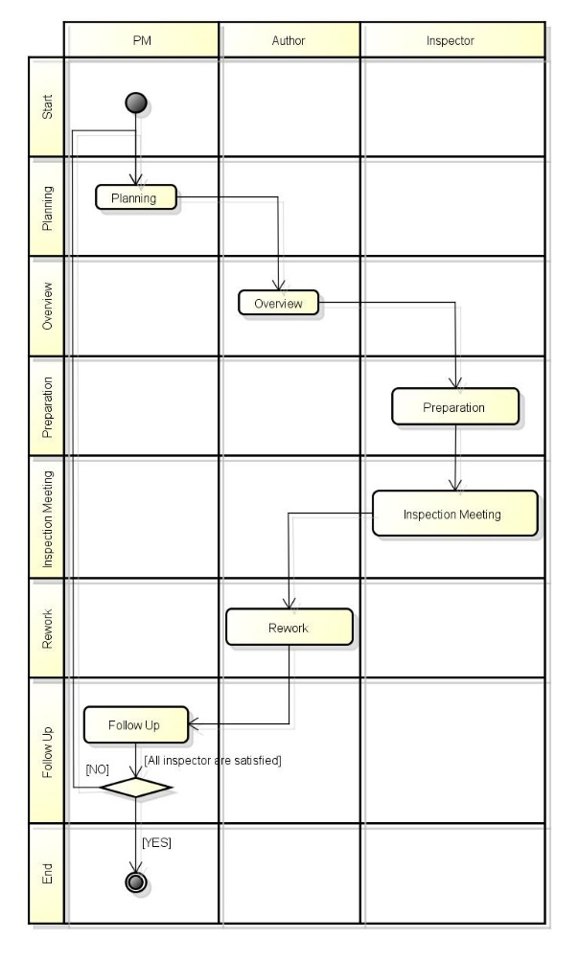
Inspection – Procedure
Follow the process steps:
Step 1: Planning
Step 2: Overview meeting
Step 3: Preparation
Step 4: Inspection meeting
Step 5: Rework
Step 6: Follow-up

Slide 22
Inspection – Procedure
Planning: The inspection is planned by the moderator.
Overview meeting: The author describes the background of the work product.
Preparation: Each inspector examines the work product to identify possible defects.
Inspection meeting: During this meeting the reader reads through the work product, part by part and the inspectors point out the defects for every part.
Rework: The author makes changes to the work product according to the action plans from the inspection meeting.
Follow-up: The changes by the author are checked to make sure everything is correct.

Slide 23
Inspection – Procedure (Exit Criteria)
All of the author’s inspection objectives are satisfied.
Issues raised during the inspection are tracked to closure.
All major defects are logged in the system and are corrected.
The modified work product is checked.
Moderator has collected and recorded the inspection data.
Moderator has delivered the completed Inspection Summary Report and defect counts to the peer review coordinator.

Slide 24
Walkthrough

Slide 25
Walkthrough – Overview
A walkthrough peer review is a form of informal peer review with participants asking questions and making comments about possible errors, violation of development standards, and other problems

Slide 26
Walkthrough – Characteristic
It is led by the authors.
Author guide the participants through the document according to his or her thought process to achieve a common understanding and to gather feedback.
Participants (no specific roles are assigned):
Inside/outside the group: propose better repairs
Inside/outside the industry: more opinions
Deliverables:
Modified the artifact
Notes:
The goals of a walkthrough:
To present the documents both within and outside the software discipline in order to gather the information regarding the topic under documentation.
To explain or do the knowledge transfer and evaluate the contents of the document
To achieve a common understanding and to gather feedback.
To examine and discuss the validity of the proposed solutions

Slide 27
Walkthrough – Procedure (Entry Criteria)
The author selected a walkthrough review approach for the artifact being reviewed.
The author has stated his/her objectives for the review

Slide 28
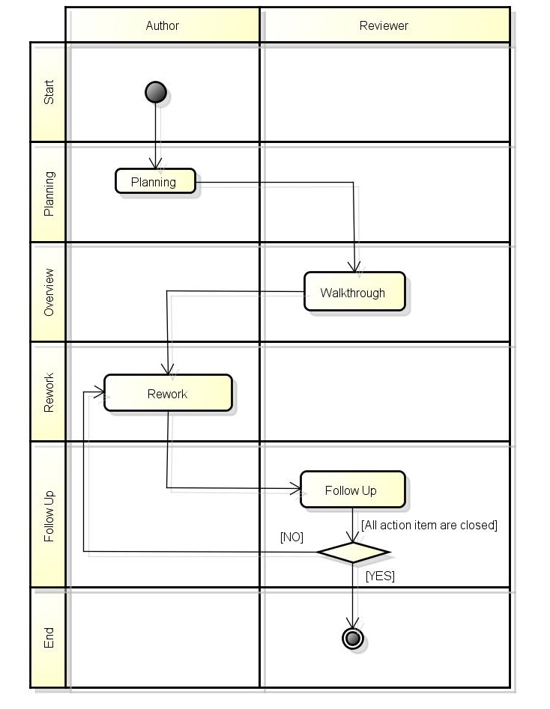
Walkthrough – Procedure
Walkthrough meeting
Author describes the artifact to the reviewers
Author leads discussion on the topics of concerns
Reviewers present comments, possible defects, and provide improvement suggestions to the author
Author reworks based on reviewer comments

Slide 29
Walkthrough – Procedure (Exit Criteria)
The author has made the appropriate changes in the artifact, if any.

Slide 30
Deskcheck

Slide 31
Deskcheck – Overview
A Deskcheck review typically is an informal review.
Only one person besides the author examines the work product.
That reviewer should have checklists and specific analysis methods to increase effectiveness.

Slide 32
Measurement and analysic

Slide 33
Measurement – How to collect and measure
Type of Data Items:
Data Item | Definition
Effort.Planning | total labor hours spent by the moderator and author in planning, scheduling meetings, task
Effort.Overview | total labor hours spent by the participants in an overview meeting, if one was held
Effort.Preparation | total labor hours spent by the inspectors and author preparing for the inspection
Effort.Rework | total labor hours s the author spent correcting defects in the initial deliverable and making other improvements; include verification time from the follow-up stage
Time.Meeting | duration of the inspection meeting in hours
Defects.Found.Major Defects.Found.Minor | total number of major and minor defects found by the inspection team; do not include non-defect issues raised, such as questions, requests for clarification, points of style, or items from the Typo Lists
Defects.Corrected.Major Defects.Corrected.Minor | total number of major and minor defects corrected during rework
Size.Planned, Size.Actual | total physical lines of code (not including comments, and blank lines) or number of document pages that were planned for inspection and that were actually inspected
Number.of.Inspectors | number of active participants in the inspection meeting

Slide 34
Measurement – How to collect and measure
Type of Data Items:
Data Item | Definition
Inspection.Appraisal | inspection team's decision about disposition of the inspected work product (accepted as is, accepted conditionally, re-inspect following rework)
Defect.Density | Defects.Found.Total/Size.Actual
Defects.Found.Total | Defects.Found.Major + Defects.Found.Minor
Defects.Corrected.Total | Defects.Corrected.Major + Defects.Correct.Minor
Effort.Inspection | Effort.Planning + Effort.Overview + Effor.Preparation + Effort.Meeting + Effort.Rework
Effort.per.Defect | Effort.Inspection / Defects.Found.Total
Effort.per.Unit.Size | Effort.Inspection / Size.Actual
Percent.Inspected | 100 * Size.Actual / Size.Planned
Percent.Majors | 100 * Defects.Found.Major / Defects.Found.Total
Rate.Inspection | Size.Actual / Time.Meeting
Rate.Preparation | Size.Planned / (Effort.Preparation / Number.of.Inspectors)
Rework.per.Defect | Effort.Rework / Defects.Corrected.Total

Slide 35
Measurement – How to collect and measure
The moderator will collect the data items from each review meeting.
These data items are used to calculate the process, to monitor and improve the proves.
The moderator will record the data items in the Summary Report, Issue Log report them to the organization’s peer review coordinator.
The peer review data for practitioners and managers. Coordinator will maintain these metrics in a repository and produce periodic reports of summary.

Slide 36
Measurement – Analysis
Accept Conditionally
If the defect is critical and it’s expected to impact other work products, the inspection team will verify closure to ensure all impacted items are also corrected and the issue is resolved
Resubmit
If major defects > 15, inspection team recommends re-view again.

Slide 37
Sample template

Slide 38

Measurement – Checklist

Slide 39
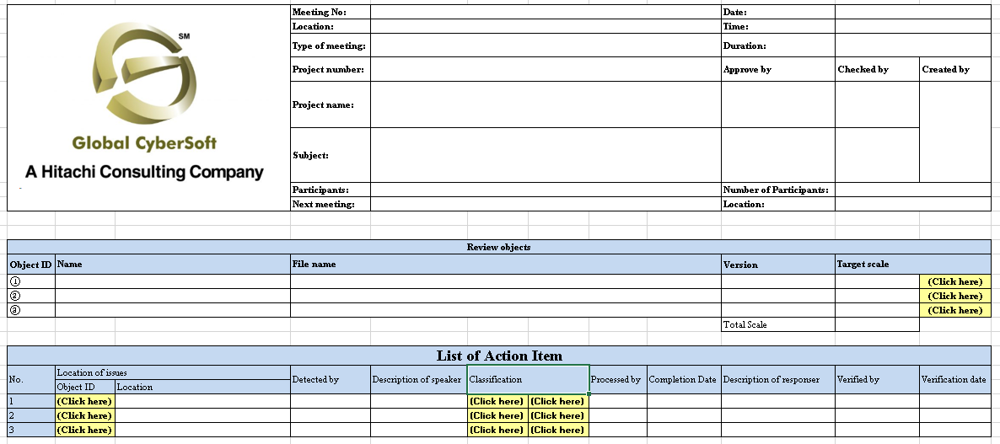
Measurement – Minute/AI record

Slide 40
Summary

Slide 41
Summary
 | Formal | Informal
Objective | Find anomalies; verify resolution; verify product quality | Find anomalies; examine alternatives; improve product forum for learning
Decision making | Review team petitions author to act on recommendations. | The team agrees on changes to be made by the author
Change verification | Leader verifies that action items are closed; change verification left to other project controls | Leader verifies that action items are closed; change verification left to other project controls
Group size | 3 – 6 people | 2 – 7 people
Attendance | Peers meet with documented attendance | Technical leadership and peer mix; documented attendance
Leadership | Trained facilitator | Facilitator or author
Volume of material | Moderate to high | Low
Presenter | A reader | Author
Data collection | Meeting minutes | As desired
Outputs | Review report | As desired

Slide 42
Thank You

