Slide 1
TOPIC: LIGHTFM/HYBRID MATRIX FACTORIZATION
Lecturer: TS. Nguyễn Sĩ Thìn
Students: Hồ Văn Trung Nguyễn Văn Chiến

Slide 2
CONTENT
1
INTRODUCTION TO RECOMENDATION SYSTEM
2
CLASSIFICATION OF RECOMMENDATION SYSTEM
3
LIGHTFM ?
4
LIGHTFM HYBRID RECOMMENDER FOR MOVIELENS
5
DEMO

Slide 3

INTRODUCTION TO RECOMENDATION SYSTEM
1. WHAT IS RECOMMENDATION SYSTEM?
A recommendation system is a system that identifies and delivers recommended content or digital items to a user using the user's preferences. The recommendation system has become an important feature in modern websites.
For example, on Amazon, Netflix or Flickr. Clicks, revenue and other success measures can be increased by adopting effective recommendation systems.

Slide 4
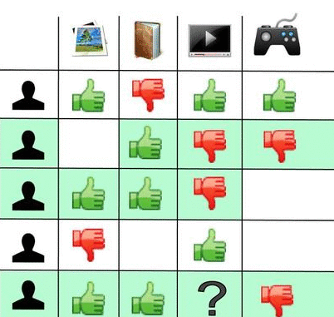
CLASSIFICATION OF RECOMMENDATION SYSTEM
Collaborative Filtering ?
Collaborative filtering is a method of making automatic predictions (filtering) about the interests of a user by collecting preferences or taste information from many users (collaborating)

Slide 5
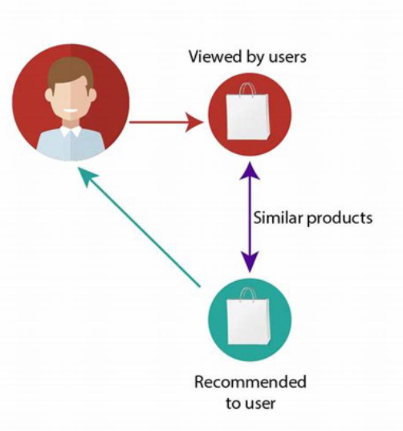
CLASSIFICATION OF RECOMMENDATION SYSTEM
Content-Based Filtering ?
These filtering methods are based on the description of an item and a profile of the user’s preferred choices

Slide 6
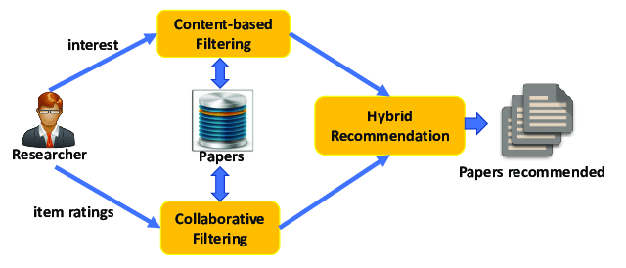
CLASSIFICATION OF RECOMMENDATION SYSTEM
Hybrid recommender system ?
Hybrid recommender system is a special type of recommender system that combines both content and collaborative filtering method. Combining collaborative filtering and content-based filtering could be more effective in some cases. Hybrid approaches can be implemented in several ways: by making content-based and collaborative-based predictions separately and then combining them; by adding content-based capabilities to a collaborative-based approach (and vice versa).

Slide 7
LIGHTFM
1.WHAT IS LIGHTFM?
LightFM is a hybrid matrix factorisation model representing users and items as linear combinations of their content features’ latent factors
Matrix factorization is a collaborative filtering method to find the relationship between items’ and users’ entities.
In LightFM, like in a collaborative filtering model, users and items are represented as latent vectors (embeddings). However, just as in a CB model, these are entirely defined by functions (in this case, linear combinations) of embeddings of the content features that describe each product or user.

Slide 8
LIGHTFM
2. HOW LIGHTFM WORKS?
LightFM model learns embeddings (latent representations in a high-dimensional space) for users and items in a way that encodes user preferences over items. When multiplied together, these representations produce scores for every item for a given user; items scored highly are more likely to be interesting to the user

Slide 9
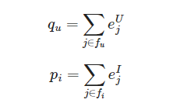
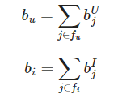
LIGHTFM
2. HOW LIGHTFM WORKS?
The embedding (latent representation) of user u and item i are the sum of its respective features’ latent vectors:
Similarly the biases for user u and item i are the sum of its respective bias vectors. These variables capture the variation in behaviour across users and items:

Slide 10


LIGHTFM
2. HOW LIGHTFM WORKS?
In LightFM, the representation for each user/item is a linear weighted sum of its feature vectors.
The prediction for user u and item i can be modelled as sigmoid of the dot product of user and item vectors, adjusted by its feature biases as follows:
As the LightFM is constructed to predict binary outcomes e.g. S+ and S−, the function σ() is based on the sigmoid function.
The LightFM algorithm estimates interaction latent vectors and bias for features. For model fitting, the cost function of the model consists of maximising the likelihood of data conditional on the parameters described above using stochastic gradient descent. The likelihood can be expressed as follows:

Slide 11
LIGHTFM
3. Learning-to-rank
LightFM is probably the only recommender package implementing the WARP (Weighted Approximate-Rank Pairwise) loss for implicit feedback learning-to-rank. Generally, it perfoms better than the more popular BPR (Bayesian Personalised Ranking) loss — often by a large margin.
Like the BPR model, WARP deals with (user, positive item, negative item) triplets. Unlike BPR, the negative items in the triplet are not chosen by random sampling: they are chosen from among those negatie items which would violate the desired item ranking given the state of the model. This approximates a form of active learning where the model selects those triplets that it cannot currently rank correctly.

Slide 12
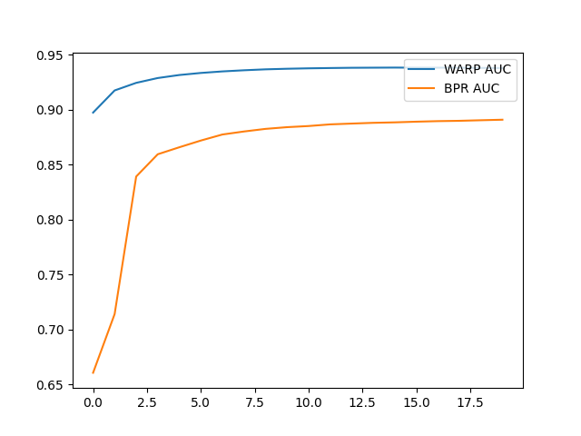
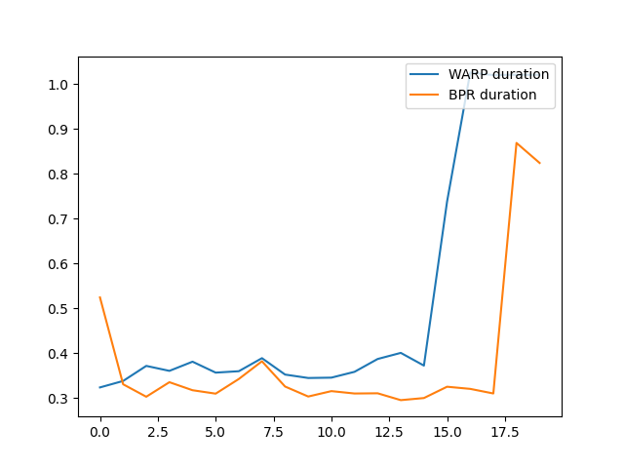
LIGHTFM
3. Learning-to-rank
Accuracy
Fitting speed

Slide 13
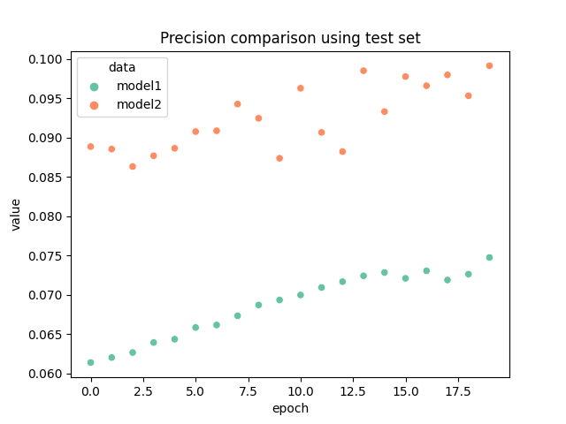
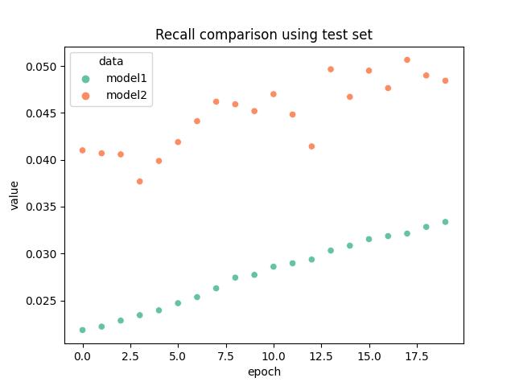
LIGHTFM
4. Comparison LightFM using only explicit feedbacks and using both explicit feedbacks and implicit
Precision
Recall

Slide 14
LIGHTFM HYBRID RECOMMENDER CHO MOVIE LENS
Gather Data
Pre- Process Data
Prepare Data for Light FM model
Sample prediction
Build and Train LightFM model
Evaluate Model Performance

Slide 15

DEMO

Slide 16
Thank You

Slide 17
QUOTE
[1]
https://www.kaggle.com/code/niyamatalmass/lightfm-hybrid-recommendation-system/notebook
[2] https://github.com/microsoft/recommenders/blob/main/examples/02_model_hybrid/lightfm_deep_dive.ipynb?fbclid=IwAR2eVhULqadC-zq4-tLVkhyPPsVyl_TGxLX-rdD3FF2ni1Emspg0kMbO0R8
[3]
https://making.lyst.com/lightfm/docs/home.html

