Slide 1


Human Computer Interaction and Design COMP1649
Designing HCI Studies
Jitu Nath

Slide 2


Lecture Overview
Designing Studies
Different Types of Variables in Studies
Studying Behaviour and Attitudes Quantitative and Qualitative data Contexts for HCI studies
●
●
●
●

Slide 3

Learning Outcomes
The activities in this lecture are linked to the module learning outcomes
A. Deploy theory, design principles, tools and methodologies to implement and evaluate human computer interactions;
B. Carry out design research to inform development of systems and applications;

Slide 4

Designing HCI Studies
Step1 - Define Your Usability Goals
Step2 - Identify your variables Step3 - Study Setup
Step 4 - Evaluate your results
●
●
●

Slide 5
Designing HCI Studies
Problem situation - You have just designed and built a prototype of your new mobile app or web application and you need to evaluate it.

Slide 6

Designing HCI Studies

Slide 7

Usability Goals
What tasks do you expect your users to do using your system?
Usability goals need to be operational and specific. You need to be able to assess if they have been achieved.
What will you measure in your study?

Slide 8

Identify your variables
There are typically two main types of variables (measurements)
  Independent Variables
  Dependent Variables
  Control Variables

Slide 9
Identify your variables
Dependent Variable
measures the usability goal
Examples - the time it took to complete a task, how many questions did a user manage to answer correctly
It is the outcome, user behavior, or performance metrics that are measured during an experiment
How much do I study → Independent variable
My score → dependent variable

Slide 10
Identify your variables
Independent Variable
is a variable that the experimenter controls and manipulates to examine if there is a correlation
Examples - what type of device (e.g. desktop, tablet or mobile), time of the day, study group, demographics of participants
Focus in class → Independent variable
Do good or bad in test → dependent variable

Slide 11
Identify your variables
Think about the variables you are interested in before running your study.
How do you want to analyse them? What tables, plots and graphs are you going to use?

Slide 12
Common things to measure
Task completion time
How much of a task was completed (e.g. in %)
Ratio of success to failure
The time your users spent trying to rectify/ recover from errors
Number/percentage of errors
Comparison with competitors e.g. number/ percentage of competitors better
Frequency of help and documentation use

Slide 13
Relationship between Variables
Causal relationship - do X and Y co-vary? You need to measure both X and Y.
Correlational relationship - Does X cause Y? Requires measuring X and Y and manipulating
X. Beware of other confounding variables that need to be accounted for

Slide 14

Activity (20 minutes)
Work in small groups (3-4 people). Thinking about the design of a research study for your coursework task.
Describe what you are going to measure;
List your independent and dependent variables.
Present your findings

Slide 15


Statistical Significance

Slide 16

How to run a study
In-Person
Online study
How do you know which UX method to use when?

Slide 17
Choosing a UX research method
Behavioural methods- researchers observe what people do;
  best suited for assessing if something is discoverable, findable, understandable or usable

Slide 18
Choosing a UX research method
Attitudinal methods - Ask users questions or users are self-reporting what they do;
  used when you're wondering what people have to say (likes/dislikes), if something is desirable

Slide 19
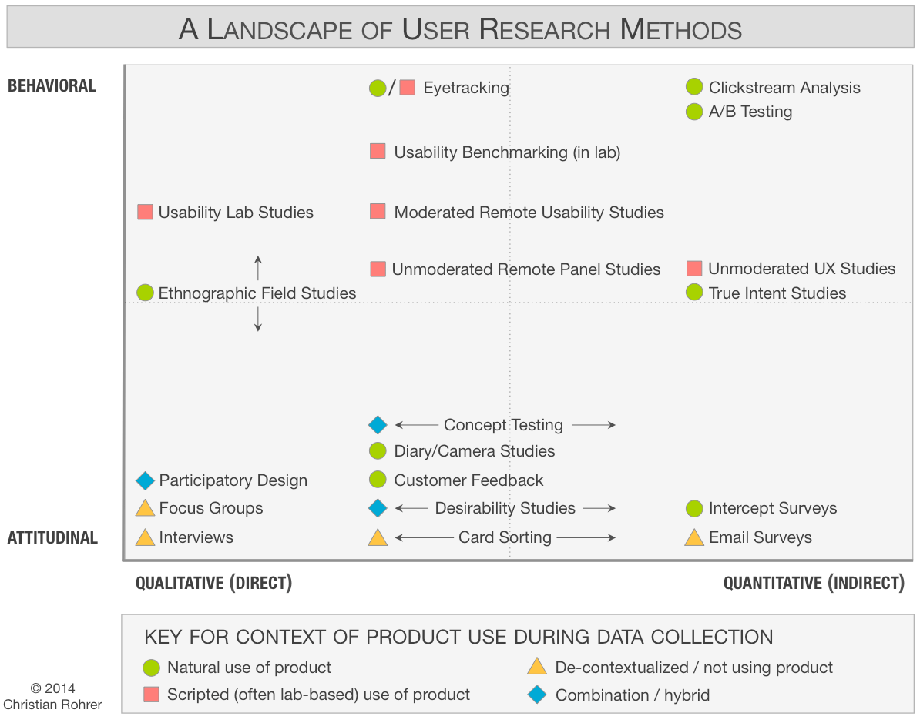
Choosing a UX research method

Slide 20
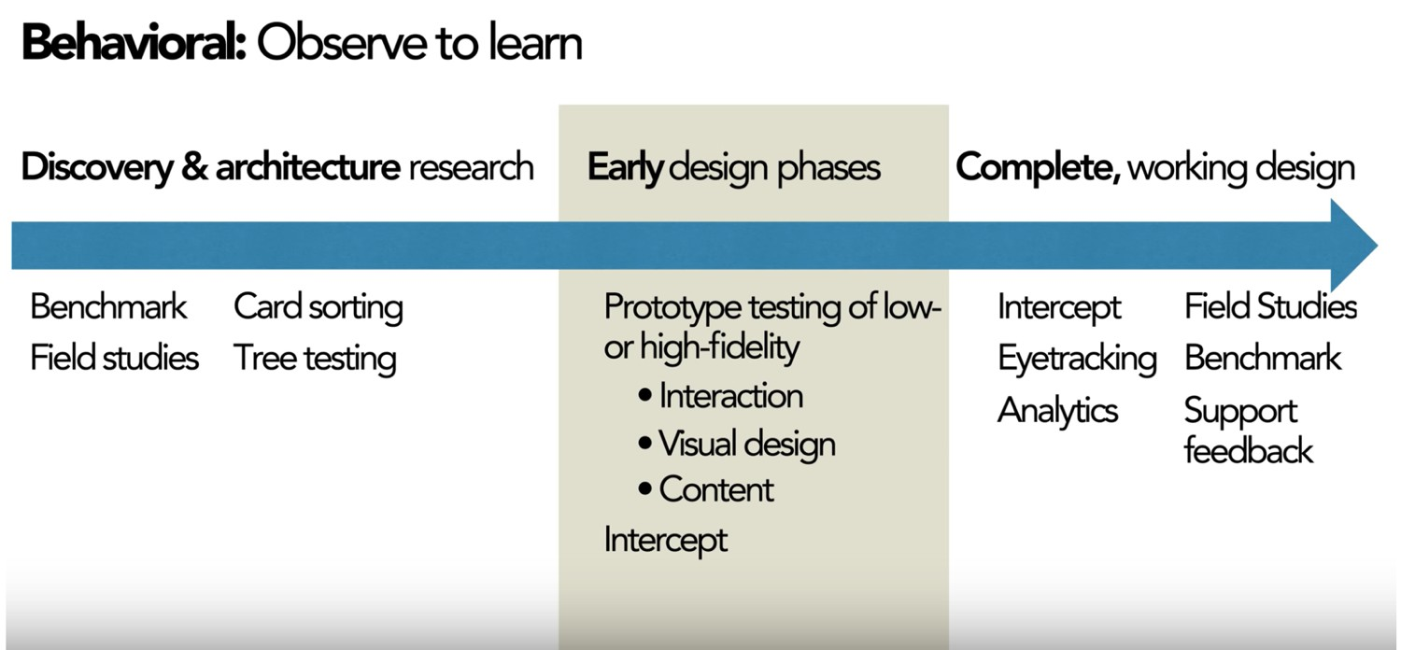
Choosing a UX research method
Source: Nielsen/Norman Group

Slide 21
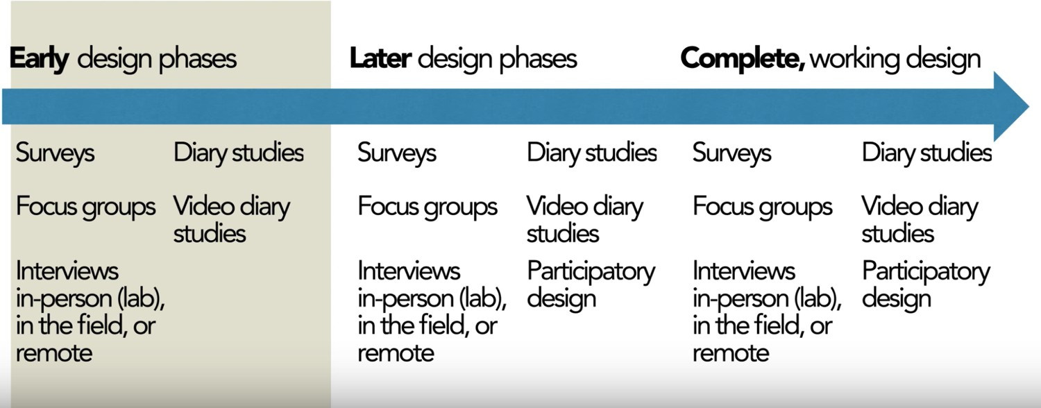
Choosing a UX research method
Attitudinal methods
Source: Nielsen/Norman Group

Slide 22

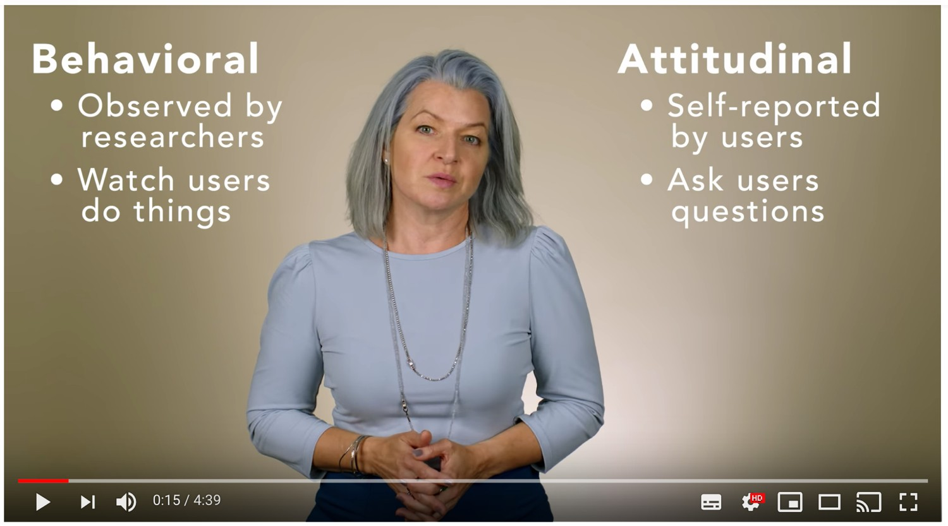
What type of study?

Slide 23

Quantitative Research
Quantitative data - number metrics elicited through indirect assessment of the usability of a design e.g. measuring of
user performance (time to complete a task, number of errors etc.) or by measuring people’s perceptions of usability (e.g. satisfaction ratings)

Slide 24
Quantitative Research
Often comparison to a known standard or competitor product
Not good at describing usability
Not good at pointing out issues people have encountered

Slide 25

Qualitative Research
Qualitative data - offer a direct assessment of the usability of a system or design. Researchers will observe and find
specific usability issues and areas of a design that are problematic. Opportunity to follow-up on specific issues.

Slide 26
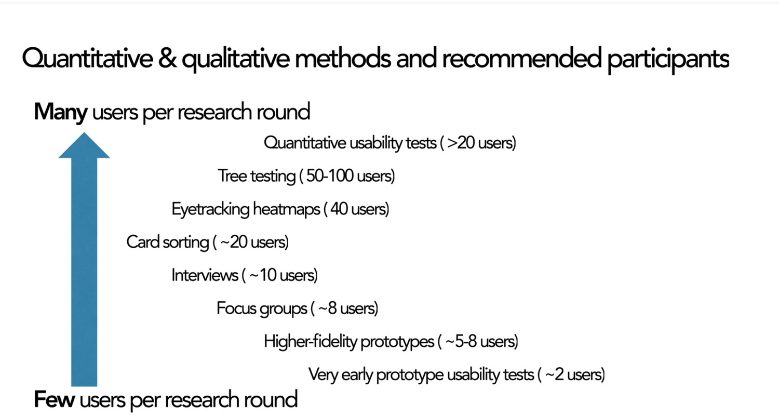
Quant and Qual Overview
Source: Nielsen/Norman Group

Slide 27
Context for research studies
Controlled environments - studies in usability labs and controlled settings
Remote and online studies
High contextual studies e.g. in peoples’ homes or places of work;

Slide 28
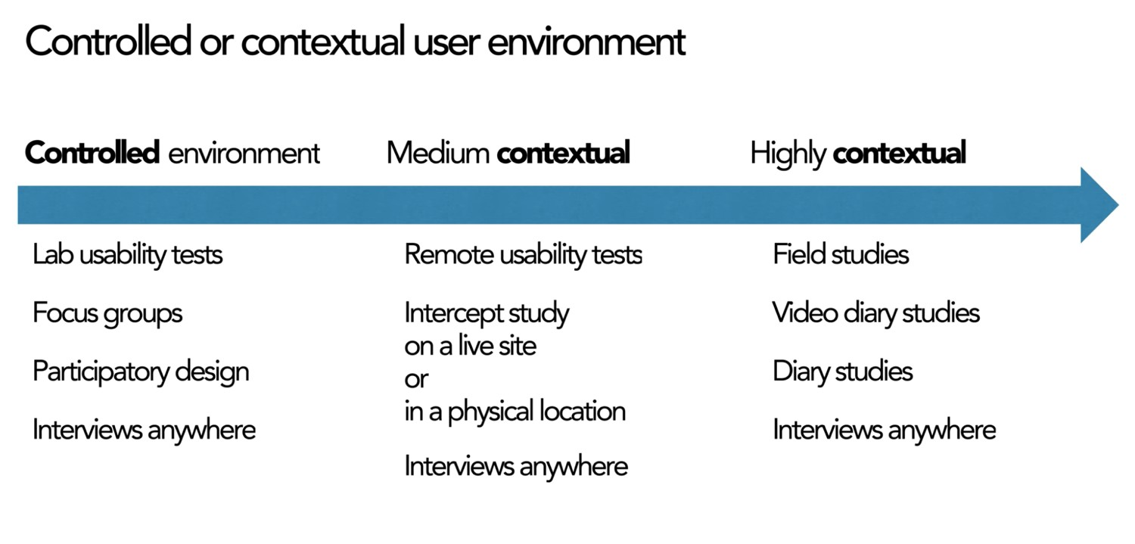
Contexts for User Studies
Source: Nielsen/Norman Group

Slide 29
Activity (20 minutes)
Continue to work in your small groups. Thinking about the design of a research study for your coursework task.
List at least one quantitative and one qualitative research method you could use to evaluate your design;
Describe the context for the study and how you would analyse the data for each of the studies.
Present your findings

Slide 30

Session Summary
We discussed the different steps involved in designing HCI user studies
We discussed the different variable types in user studies
We discussed behavioural and attitudinal research methods
We compared and analysed differences between quantitative and qualitative data
We discussed the different contexts for HCI user studies

Slide 31

Additional resources
Designing Interactive Systems (Benyon, 2014)
Encyclopedia of Human-Computer Interaction

