Slide 1
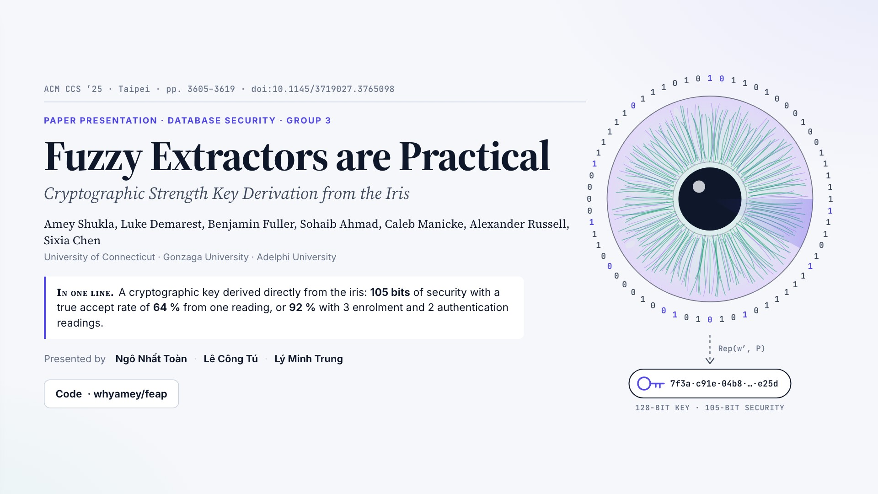
Notes:
ACM CCS ’25 · Taipei · pp. 3605–3619 · doi:10.1145/3719027.3765098
PAPER PRESENTATION · DATABASE SECURITY · GROUP 3
Fuzzy Extractors are Practical
Cryptographic Strength Key Derivation from the Iris
Amey Shukla, Luke Demarest, Benjamin Fuller, Sohaib Ahmad, Caleb Manicke, Alexander Russell, Sixia Chen
University of Connecticut · Gonzaga University · Adelphi University
In one line.A cryptographic key derived directly from the iris: 105 bits of security with a true accept rate of 64 % from one reading, or 92 % with 3 enrolment and 2 authentication readings.
Presented by
Ngô Nhất Toàn
·
Lê Công Tú
·
Lý Minh Trung
Code
· whyamey/feap

Slide 2

Notes:
Contents
1
Introduction & research context
Headline result · the problem · limits of prior work · contributions
§1
2
System overview
Block A (feature extractor) and Block B (fuzzy extractor)
§2
3
Block B — fuzzy extractor
Two baselines, then four improvements, seen from the attacker and the honest user
§3–4
4
Block A — feature extractor
ThirdEye → VersionOne → VersionTwoR
§6
5
Experiments & results
Attacker side · honest-user side · final operating point · comparison
§5, §7
6
Demo
The authors' code, re-run on synthetic iris embeddings
feap
7
Discussion & conclusion
What the 105 bits depend on · is it practical?
§8
?
Question review
Six questions, one per idea
Q1–6

Slide 3

Notes:
Part 1
Introduction & research context
1.1
The paper at a glance
1.2
Problem statement
1.3
Limits of prior work
1.4
Contributions

Slide 4
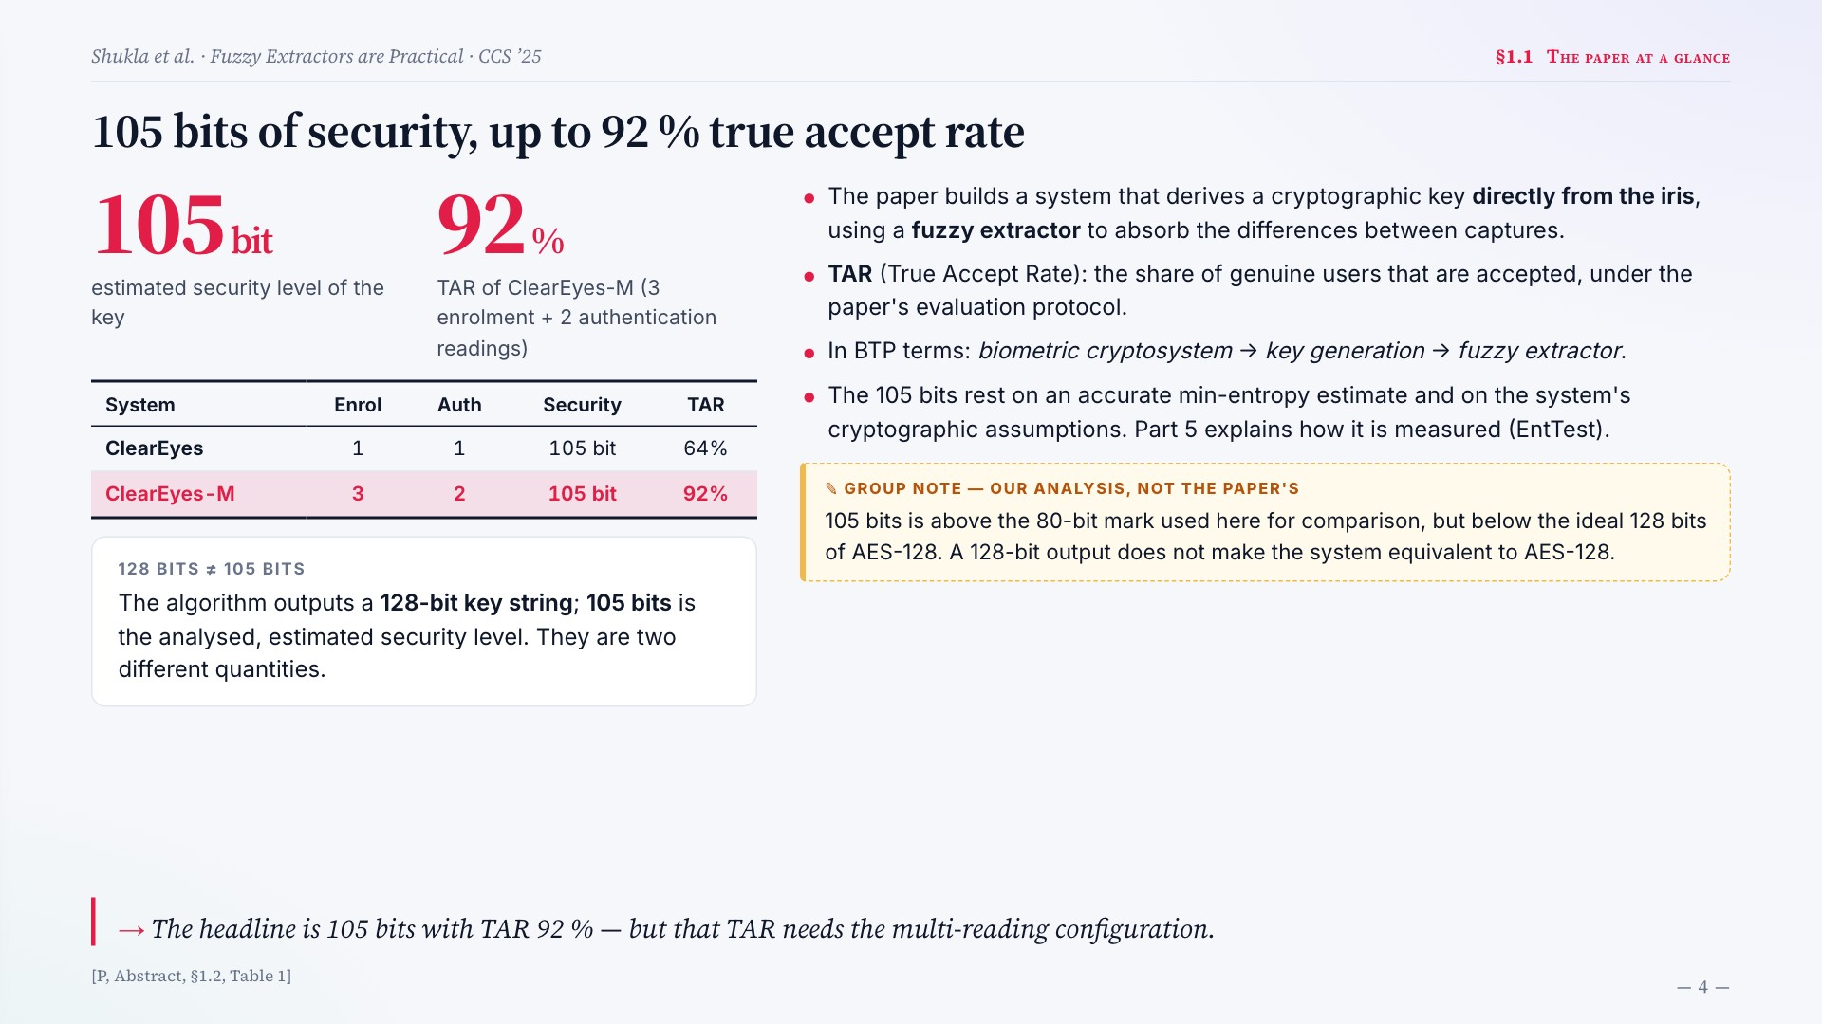
Notes:
105 bits of security, up to 92 % true accept rate
105bit
estimated security level of the key
92%
TAR of ClearEyes-M (3 enrolment + 2 authentication readings)
System Enrol Auth Security TAR
ClearEyes 1 1 105 bit 64%
ClearEyes-M 3 2 105 bit 92%
128 BITS ≠ 105 BITS
The algorithm outputs a 128-bit key string; 105 bits is the analysed, estimated security level. They are two different quantities.
The paper builds a system that derives a cryptographic key directly from the iris, using a fuzzy extractor to absorb the differences between captures.
TAR (True Accept Rate): the share of genuine users that are accepted, under the paper's evaluation protocol.
In BTP terms: biometric cryptosystem → key generation → fuzzy extractor.
The 105 bits rest on an accurate min-entropy estimate and on the system's cryptographic assumptions. Part 5 explains how it is measured (EntTest).
105 bits is above the 80-bit mark used here for comparison, but below the ideal 128 bits of AES-128. A 128-bit output does not make the system equivalent to AES-128.
The headline is 105 bits with TAR 92 % — but that TAR needs the multi-reading configuration.
[P, Abstract, §1.2, Table 1]

Slide 5
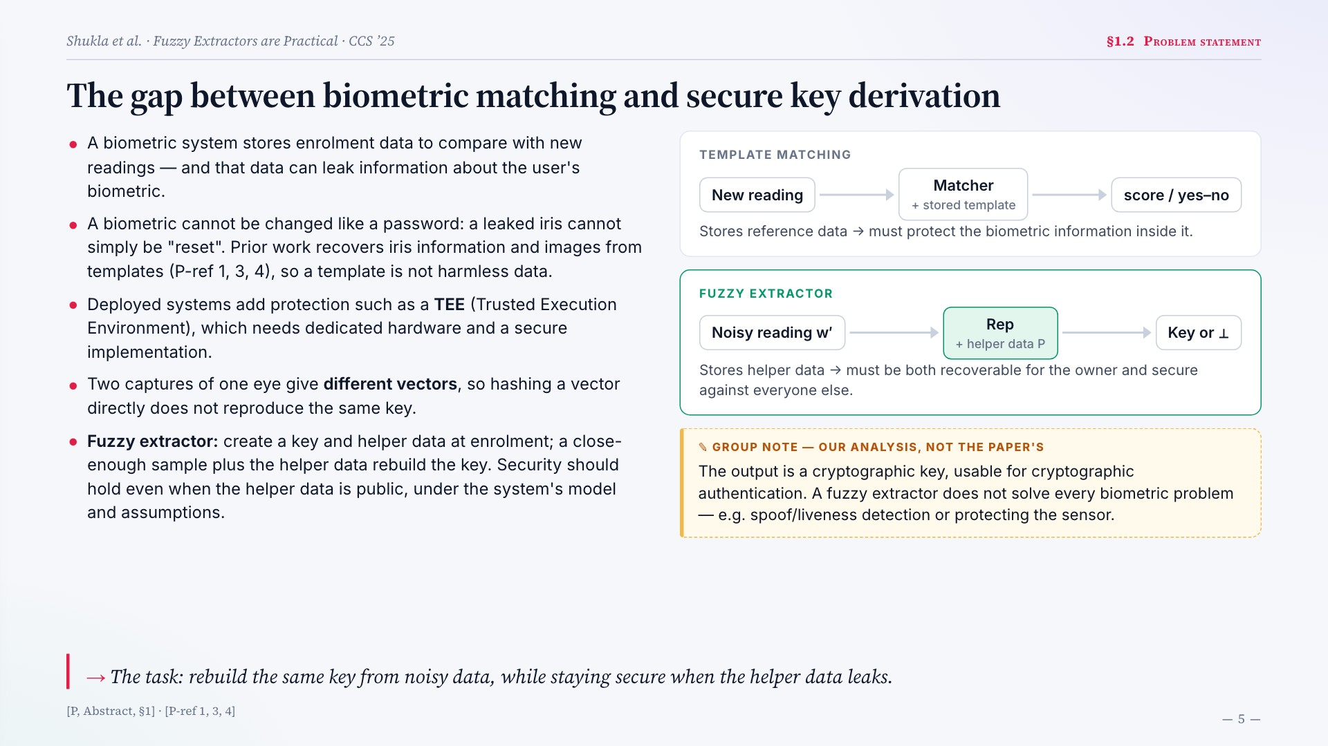
Notes:
The gap between biometric matching and secure key derivation
A biometric system stores enrolment data to compare with new readings — and that data can leak information about the user's biometric.
A biometric cannot be changed like a password: a leaked iris cannot simply be "reset". Prior work recovers iris information and images from templates (P-ref 1, 3, 4), so a template is not harmless data.
Deployed systems add protection such as a TEE (Trusted Execution Environment), which needs dedicated hardware and a secure implementation.
Two captures of one eye give different vectors, so hashing a vector directly does not reproduce the same key.
Fuzzy extractor: create a key and helper data at enrolment; a close-enough sample plus the helper data rebuild the key. Security should hold even when the helper data is public, under the system's model and assumptions.
TEMPLATE MATCHING
New reading
Matcher
+ stored template
score / yes–no
Stores reference data → must protect the biometric information inside it.
FUZZY EXTRACTOR
Noisy reading w′
Rep
+ helper data P
Key or ⊥
Stores helper data → must be both recoverable for the owner and secure against everyone else.
The output is a cryptographic key, usable for cryptographic authentication. A fuzzy extractor does not solve every biometric problem — e.g. spoof/liveness detection or protecting the sensor.
The task: rebuild the same key from noisy data, while staying secure when the helper data leaks.
[P, Abstract, §1] · [P-ref 1, 3, 4]

Slide 6
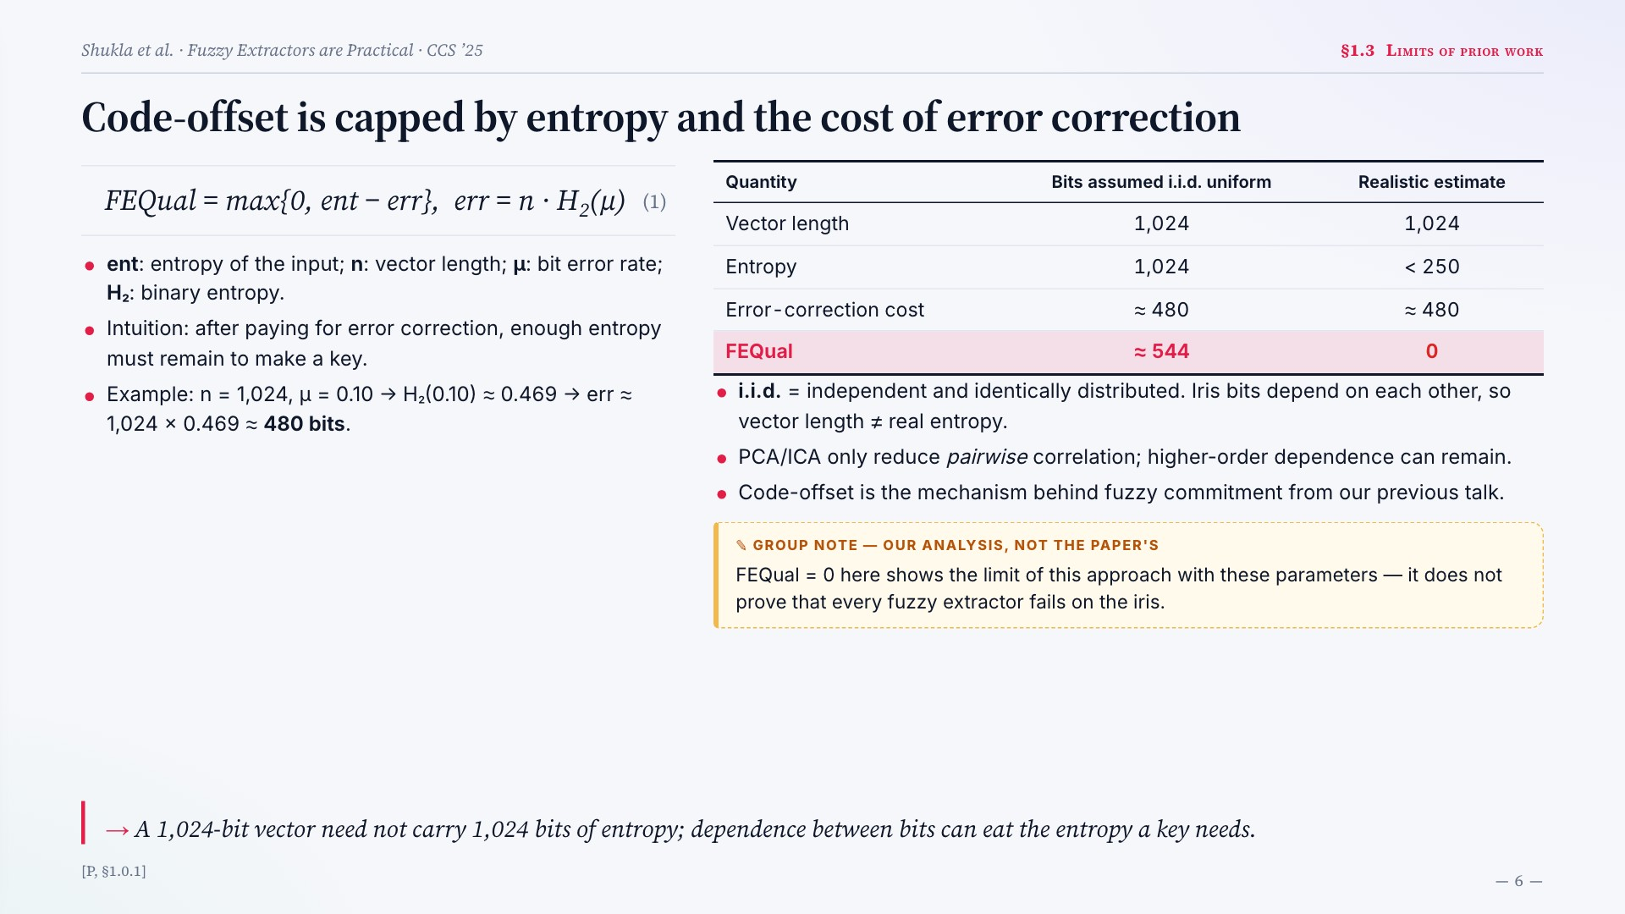
Notes:
Code-offset is capped by entropy and the cost of error correction
FEQual = max{0, ent − err}, err = n · H2(μ)
(1)
ent: entropy of the input; n: vector length; μ: bit error rate; H₂: binary entropy.
Intuition: after paying for error correction, enough entropy must remain to make a key.
Example: n = 1,024, μ = 0.10 → H₂(0.10) ≈ 0.469 → err ≈ 1,024 × 0.469 ≈ 480 bits.
Quantity Bits assumed i.i.d. uniform Realistic estimate
Vector length 1,024 1,024
Entropy 1,024 < 250
Error-correction cost ≈ 480 ≈ 480
FEQual ≈ 544 0
i.i.d. = independent and identically distributed. Iris bits depend on each other, so vector length ≠ real entropy.
PCA/ICA only reduce pairwise correlation; higher-order dependence can remain.
Code-offset is the mechanism behind fuzzy commitment from our previous talk.
FEQual = 0 here shows the limit of this approach with these parameters — it does not prove that every fuzzy extractor fails on the iris.
A 1,024-bit vector need not carry 1,024 bits of entropy; dependence between bits can eat the entropy a key needs.
[P, §1.0.1]

Slide 7
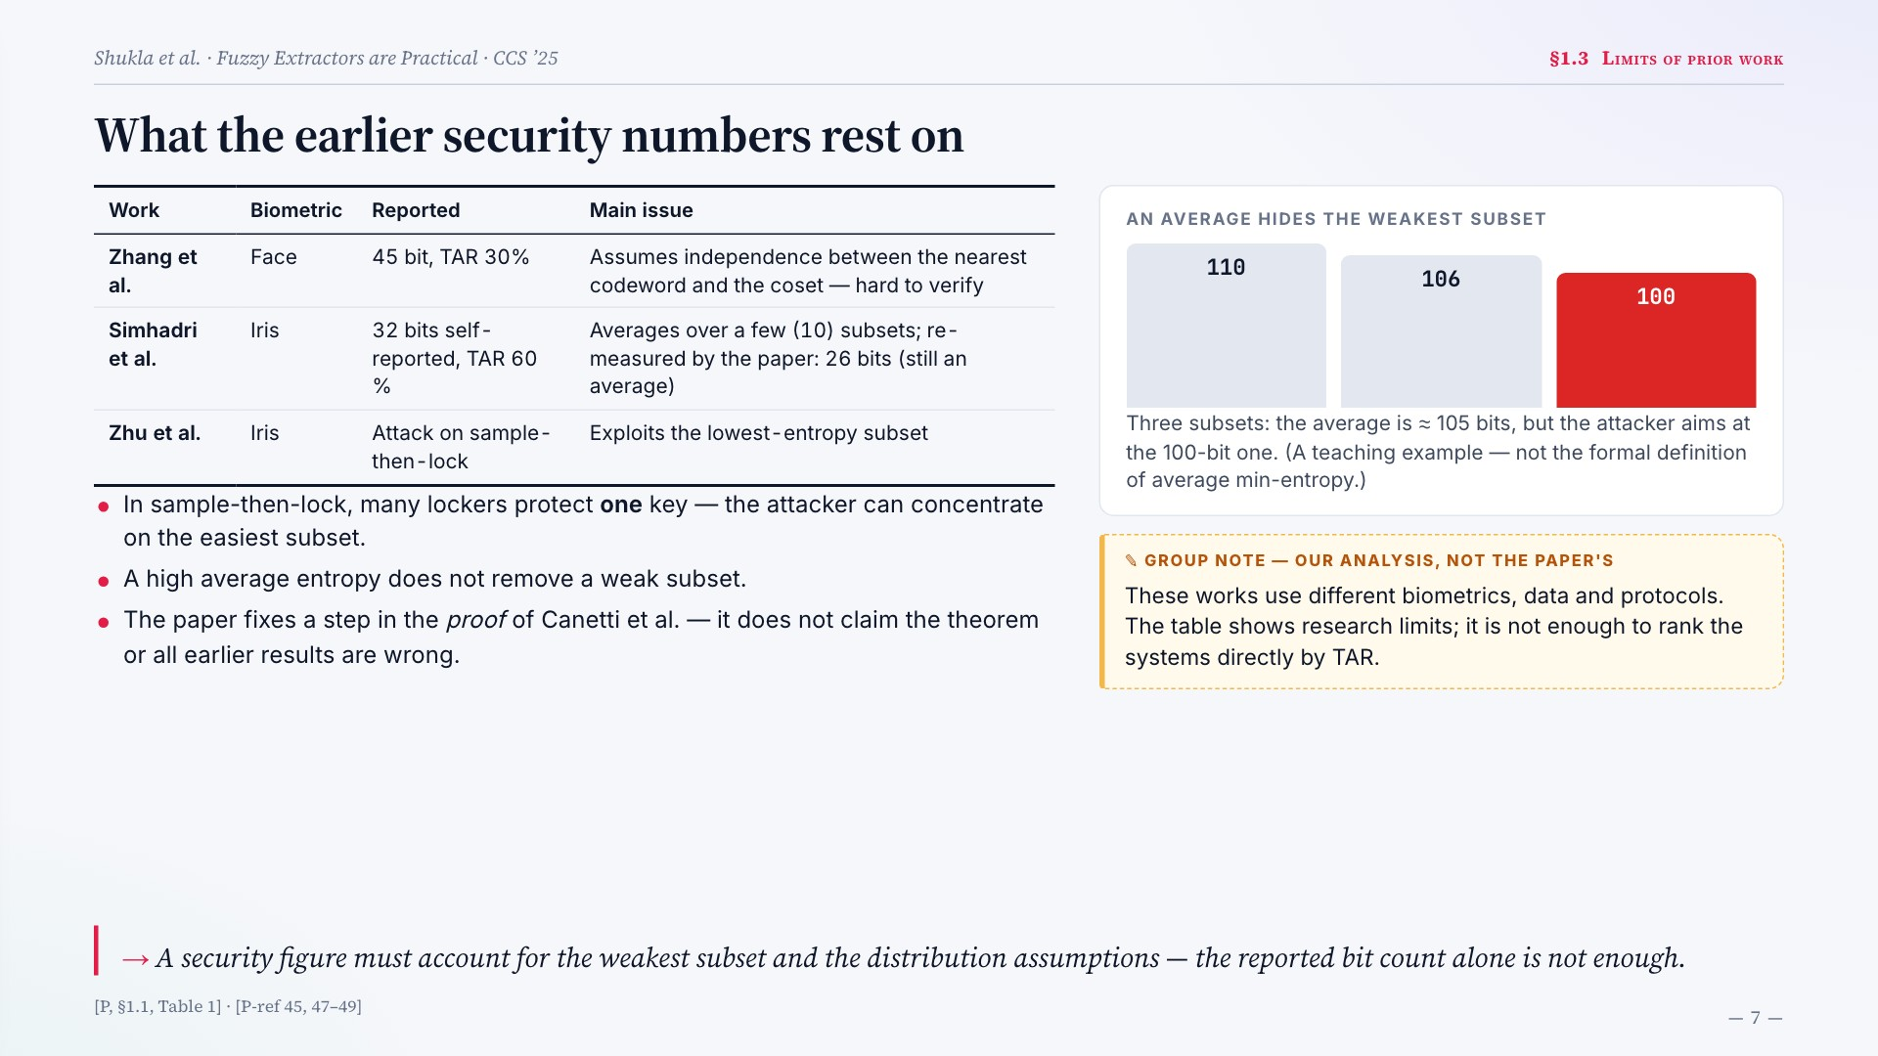
Notes:
What the earlier security numbers rest on
Work Biometric Reported Main issue
Zhang et al. Face 45 bit, TAR 30% Assumes independence between the nearest codeword and the coset — hard to verify
Simhadri et al. Iris 32 bits self-reported, TAR 60 % Averages over a few (10) subsets; re-measured by the paper: 26 bits (still an average)
Zhu et al. Iris Attack on sample-then-lock Exploits the lowest-entropy subset
In sample-then-lock, many lockers protect one key — the attacker can concentrate on the easiest subset.
A high average entropy does not remove a weak subset.
The paper fixes a step in the proof of Canetti et al. — it does not claim the theorem or all earlier results are wrong.
AN AVERAGE HIDES THE WEAKEST SUBSET
110
106
100
Three subsets: the average is ≈ 105 bits, but the attacker aims at the 100-bit one. (A teaching example — not the formal definition of average min-entropy.)
These works use different biometrics, data and protocols. The table shows research limits; it is not enough to rank the systems directly by TAR.
A security figure must account for the weakest subset and the distribution assumptions — the reported bit count alone is not enough.
[P, §1.1, Table 1] · [P-ref 45, 47–49]

Slide 8
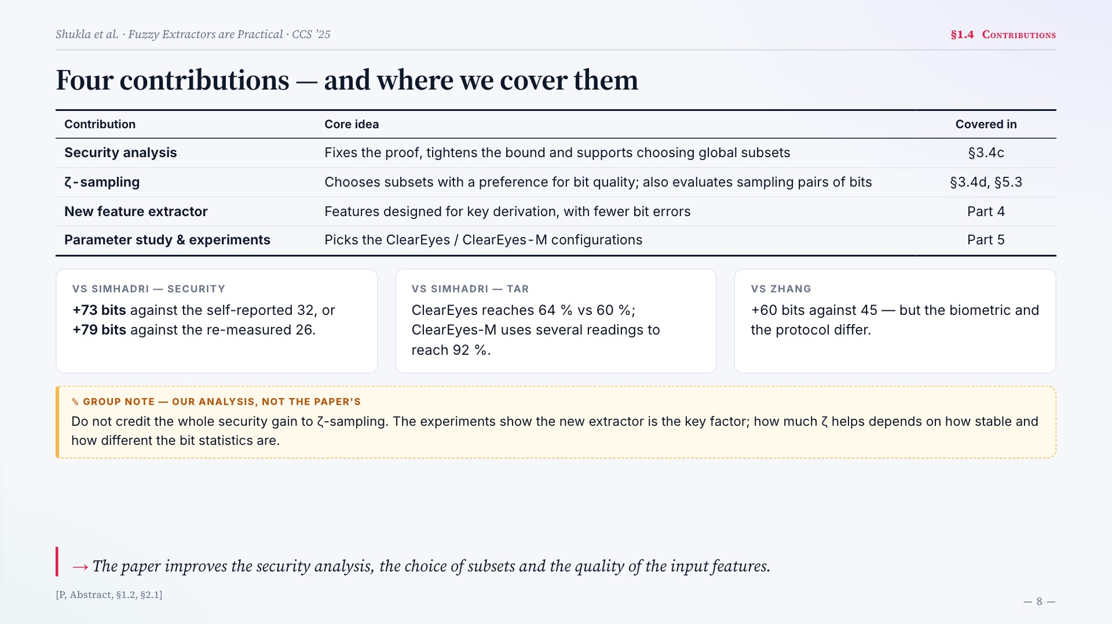
Notes:
Four contributions — and where we cover them
Contribution Core idea Covered in
Security analysis Fixes the proof, tightens the bound and supports choosing global subsets §3.4c
ζ-sampling Chooses subsets with a preference for bit quality; also evaluates sampling pairs of bits §3.4d, §5.3
New feature extractor Features designed for key derivation, with fewer bit errors Part 4
Parameter study & experiments Picks the ClearEyes / ClearEyes-M configurations Part 5
VS SIMHADRI — SECURITY
+73 bits against the self-reported 32, or +79 bits against the re-measured 26.
VS SIMHADRI — TAR
ClearEyes reaches 64 % vs 60 %; ClearEyes-M uses several readings to reach 92 %.
VS ZHANG
+60 bits against 45 — but the biometric and the protocol differ.
Do not credit the whole security gain to ζ-sampling. The experiments show the new extractor is the key factor; how much ζ helps depends on how stable and how different the bit statistics are.
The paper improves the security analysis, the choice of subsets and the quality of the input features.
[P, Abstract, §1.2, §2.1]

Slide 9

Notes:
Part 2
System overview
2.1
Iris image → feature vector → key
2.2
Where the paper improves

Slide 10
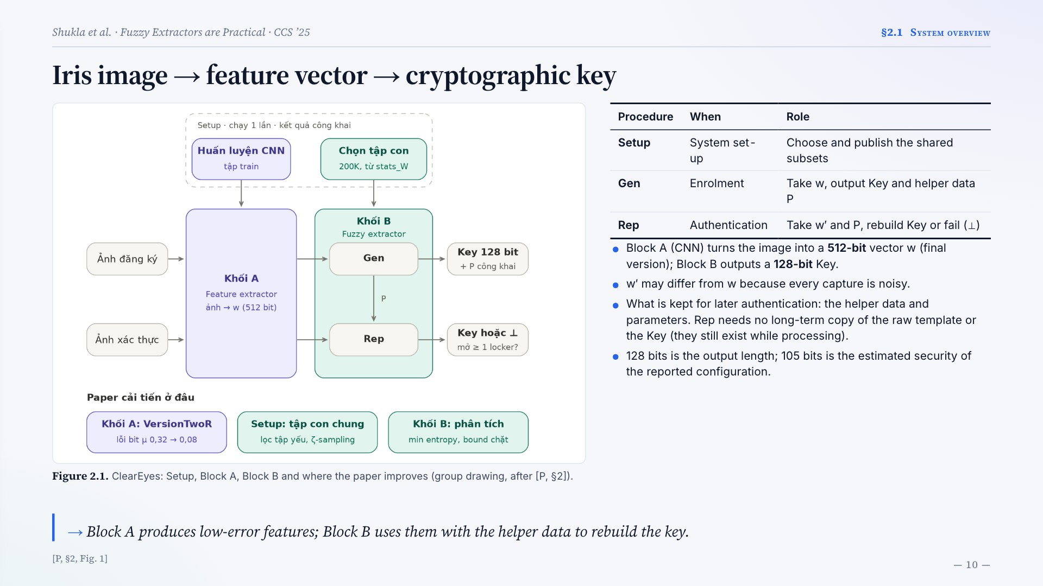
Notes:
Iris image → feature vector → cryptographic key
Figure 2.1. ClearEyes: Setup, Block A, Block B and where the paper improves (group drawing, after [P, §2]).
Procedure When Role
Setup System set-up Choose and publish the shared subsets
Gen Enrolment Take w, output Key and helper data P
Rep Authentication Take w′ and P, rebuild Key or fail (⊥)
Block A (CNN) turns the image into a 512-bit vector w (final version); Block B outputs a 128-bit Key.
w′ may differ from w because every capture is noisy.
What is kept for later authentication: the helper data and parameters. Rep needs no long-term copy of the raw template or the Key (they still exist while processing).
128 bits is the output length; 105 bits is the estimated security of the reported configuration.
Block A produces low-error features; Block B uses them with the helper data to rebuild the key.
[P, §2, Fig. 1]

Slide 11
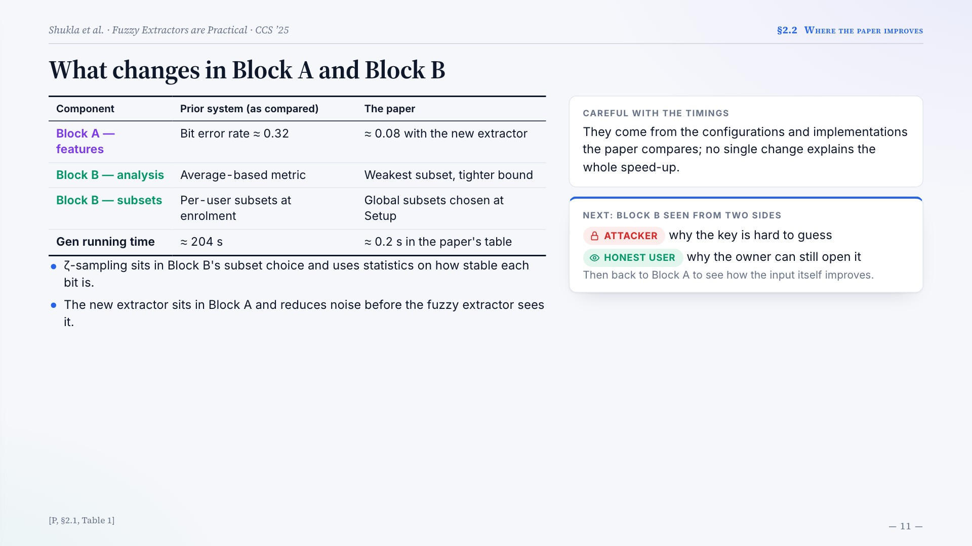
Notes:
What changes in Block A and Block B
Component Prior system (as compared) The paper
Block A — features Bit error rate ≈ 0.32 ≈ 0.08 with the new extractor
Block B — analysis Average-based metric Weakest subset, tighter bound
Block B — subsets Per-user subsets at enrolment Global subsets chosen at Setup
Gen running time ≈ 204 s ≈ 0.2 s in the paper's table
ζ-sampling sits in Block B's subset choice and uses statistics on how stable each bit is.
The new extractor sits in Block A and reduces noise before the fuzzy extractor sees it.
CAREFUL WITH THE TIMINGS
They come from the configurations and implementations the paper compares; no single change explains the whole speed-up.
NEXT: BLOCK B SEEN FROM TWO SIDES
ATTACKER
why the key is hard to guess
HONEST USER
why the owner can still open it
Then back to Block A to see how the input itself improves.
[P, §2.1, Table 1]

Slide 12
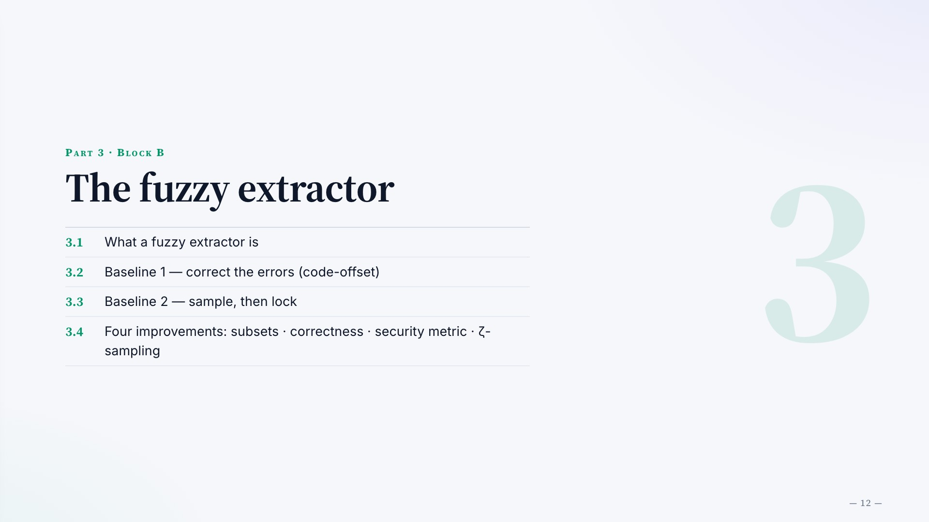
Notes:
Part 3 · Block B
The fuzzy extractor
3.1
What a fuzzy extractor is
3.2
Baseline 1 — correct the errors (code-offset)
3.3
Baseline 2 — sample, then lock
3.4
Four improvements: subsets · correctness · security metric · ζ-sampling

Slide 13
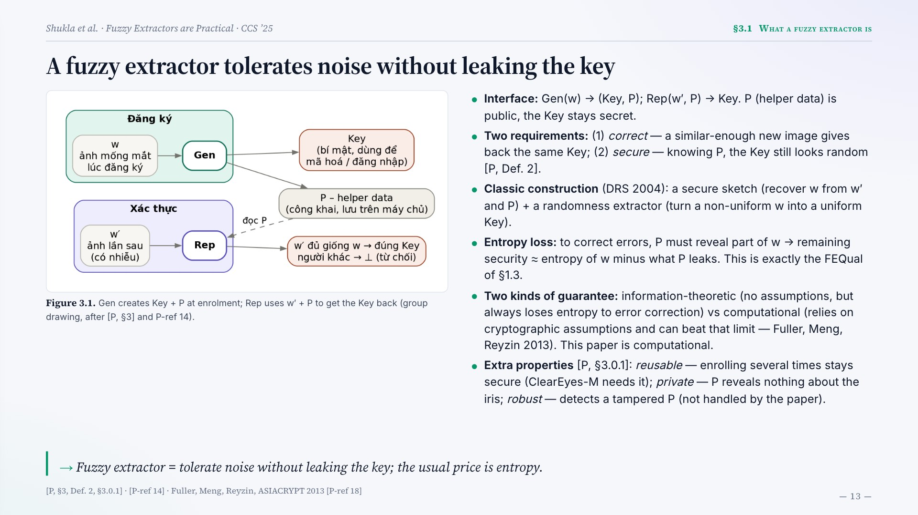
Notes:
A fuzzy extractor tolerates noise without leaking the key
Figure 3.1. Gen creates Key + P at enrolment; Rep uses w′ + P to get the Key back (group drawing, after [P, §3] and P-ref 14).
Interface: Gen(w) → (Key, P); Rep(w′, P) → Key. P (helper data) is public, the Key stays secret.
Two requirements: (1) correct — a similar-enough new image gives back the same Key; (2) secure — knowing P, the Key still looks random [P, Def. 2].
Classic construction (DRS 2004): a secure sketch (recover w from w′ and P) + a randomness extractor (turn a non-uniform w into a uniform Key).
Entropy loss: to correct errors, P must reveal part of w → remaining security ≈ entropy of w minus what P leaks. This is exactly the FEQual of §1.3.
Two kinds of guarantee: information-theoretic (no assumptions, but always loses entropy to error correction) vs computational (relies on cryptographic assumptions and can beat that limit — Fuller, Meng, Reyzin 2013). This paper is computational.
Extra properties [P, §3.0.1]: reusable — enrolling several times stays secure (ClearEyes-M needs it); private — P reveals nothing about the iris; robust — detects a tampered P (not handled by the paper).
Fuzzy extractor = tolerate noise without leaking the key; the usual price is entropy.
[P, §3, Def. 2, §3.0.1] · [P-ref 14] · Fuller, Meng, Reyzin, ASIACRYPT 2013 [P-ref 18]

Slide 14
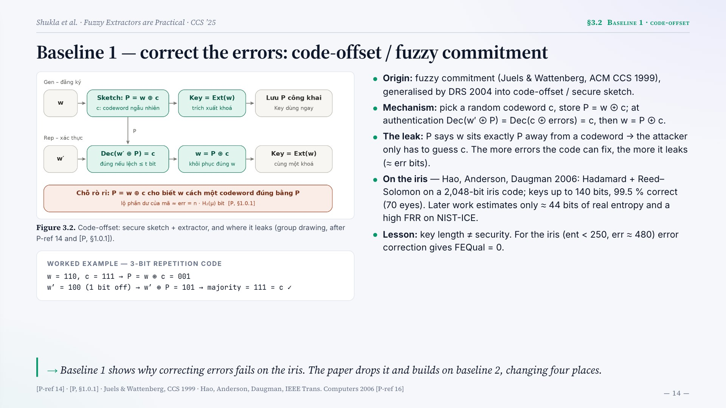
Notes:
Baseline 1 — correct the errors: code-offset / fuzzy commitment
Figure 3.2. Code-offset: secure sketch + extractor, and where it leaks (group drawing, after P-ref 14 and [P, §1.0.1]).
WORKED EXAMPLE — 3-BIT REPETITION CODE
w = 110, c = 111 → P = w ⊕ c = 001
w′ = 100 (1 bit off) → w′ ⊕ P = 101 → majority = 111 = c ✓
Origin: fuzzy commitment (Juels & Wattenberg, ACM CCS 1999), generalised by DRS 2004 into code-offset / secure sketch.
Mechanism: pick a random codeword c, store P = w ⊕ c; at authentication Dec(w′ ⊕ P) = Dec(c ⊕ errors) = c, then w = P ⊕ c.
The leak: P says w sits exactly P away from a codeword → the attacker only has to guess c. The more errors the code can fix, the more it leaks (≈ err bits).
On the iris — Hao, Anderson, Daugman 2006: Hadamard + Reed–Solomon on a 2,048-bit iris code; keys up to 140 bits, 99.5 % correct (70 eyes). Later work estimates only ≈ 44 bits of real entropy and a high FRR on NIST-ICE.
Lesson: key length ≠ security. For the iris (ent < 250, err ≈ 480) error correction gives FEQual = 0.
Baseline 1 shows why correcting errors fails on the iris. The paper drops it and builds on baseline 2, changing four places.
[P-ref 14] · [P, §1.0.1] · Juels & Wattenberg, CCS 1999 · Hao, Anderson, Daugman, IEEE Trans. Computers 2006 [P-ref 16]

Slide 15
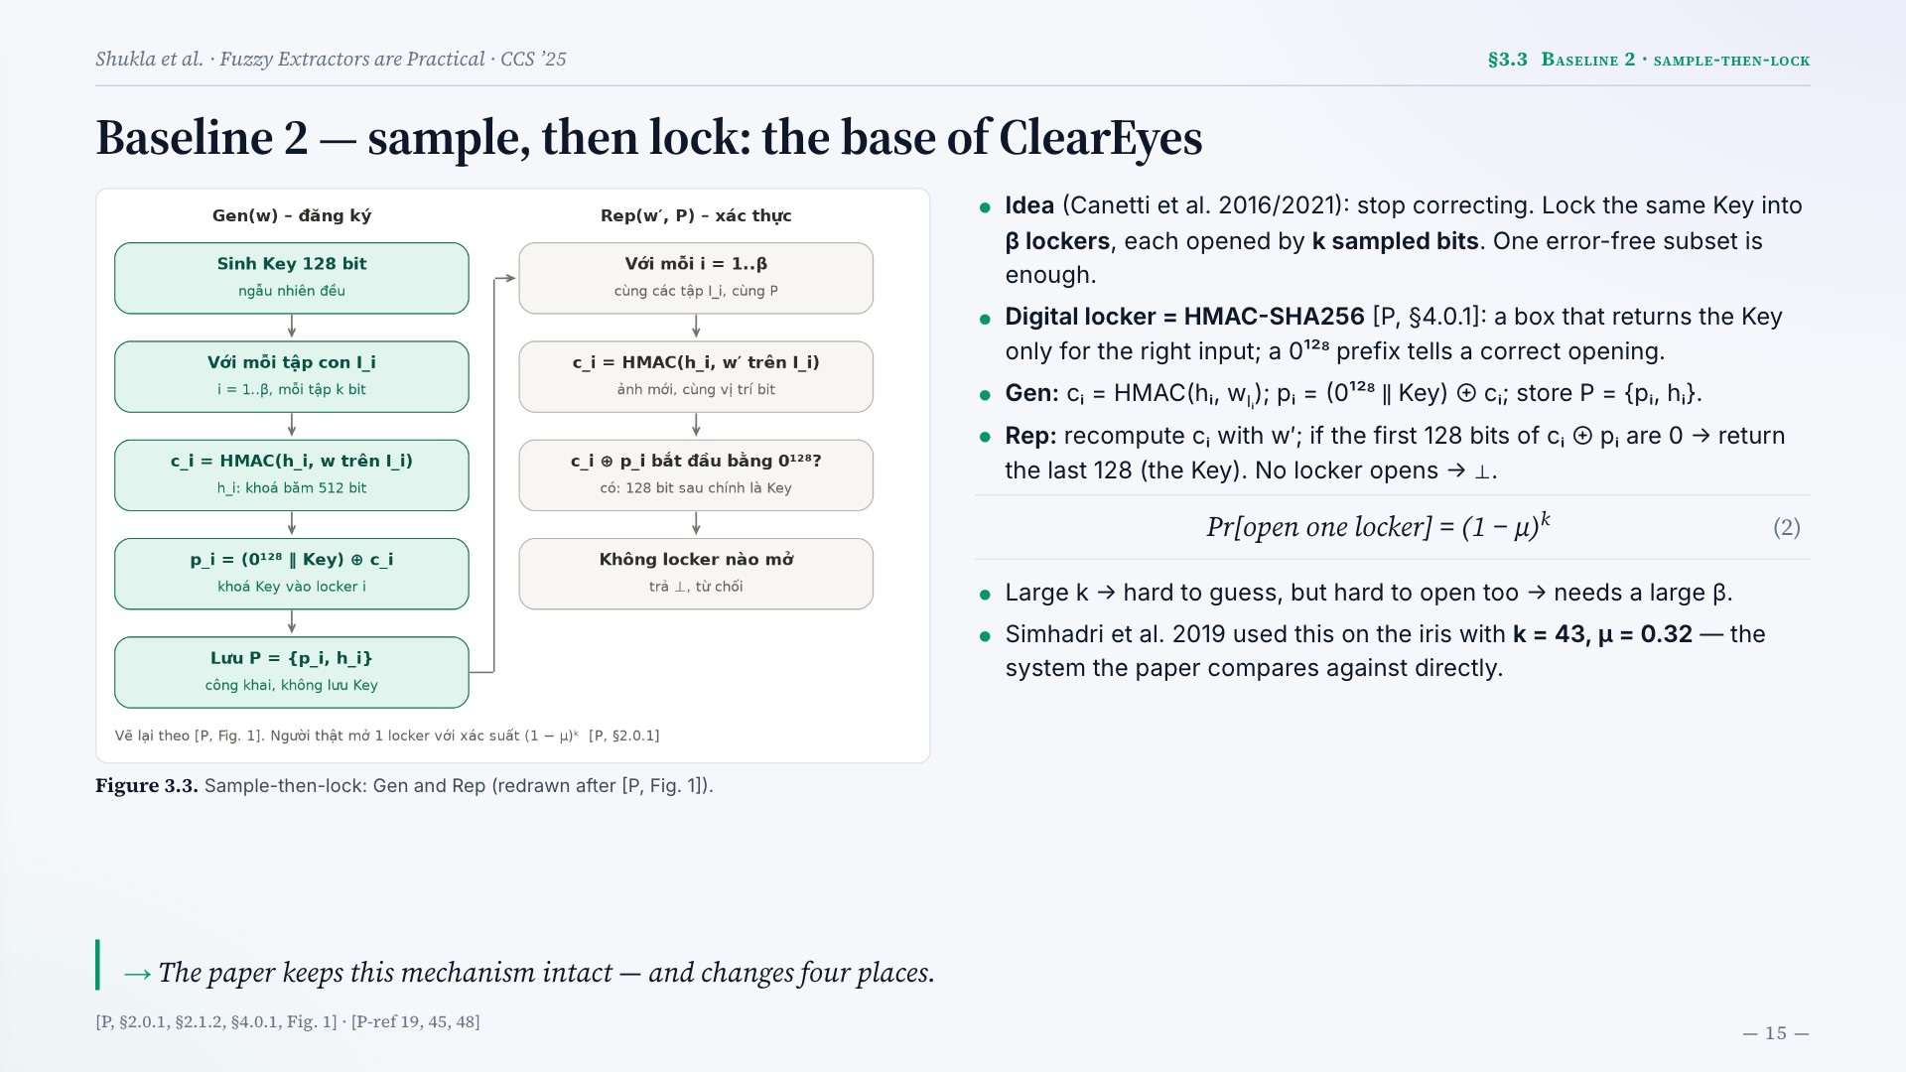
Notes:
Baseline 2 — sample, then lock: the base of ClearEyes
Figure 3.3. Sample-then-lock: Gen and Rep (redrawn after [P, Fig. 1]).
Idea (Canetti et al. 2016/2021): stop correcting. Lock the same Key into β lockers, each opened by k sampled bits. One error-free subset is enough.
Digital locker = HMAC-SHA256 [P, §4.0.1]: a box that returns the Key only for the right input; a 0¹²⁸ prefix tells a correct opening.
Gen: cᵢ = HMAC(hᵢ, wIᵢ); pᵢ = (0¹²⁸ ‖ Key) ⊕ cᵢ; store P = {pᵢ, hᵢ}.
Rep: recompute cᵢ with w′; if the first 128 bits of cᵢ ⊕ pᵢ are 0 → return the last 128 (the Key). No locker opens → ⊥.
Pr[open one locker] = (1 − μ)k
(2)
Large k → hard to guess, but hard to open too → needs a large β.
Simhadri et al. 2019 used this on the iris with k = 43, μ = 0.32 — the system the paper compares against directly.
The paper keeps this mechanism intact — and changes four places.
[P, §2.0.1, §2.1.2, §4.0.1, Fig. 1] · [P-ref 19, 45, 48]

Slide 16
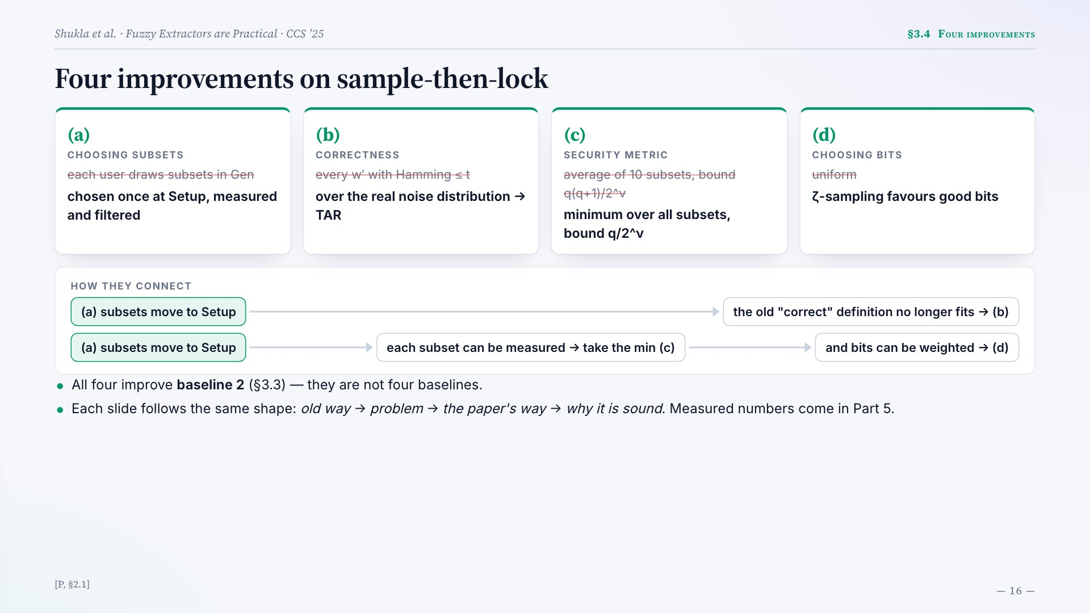
Notes:
Four improvements on sample-then-lock
(a)
CHOOSING SUBSETS
each user draws subsets in Gen
chosen once at Setup, measured and filtered
(b)
CORRECTNESS
every w′ with Hamming ≤ t
over the real noise distribution → TAR
(c)
SECURITY METRIC
average of 10 subsets, bound q(q+1)/2^ν
minimum over all subsets, bound q/2^ν
(d)
CHOOSING BITS
uniform
ζ-sampling favours good bits
HOW THEY CONNECT
(a) subsets move to Setup
the old "correct" definition no longer fits → (b)
(a) subsets move to Setup
each subset can be measured → take the min (c)
and bits can be weighted → (d)
All four improve baseline 2 (§3.3) — they are not four baselines.
Each slide follows the same shape: old way → problem → the paper's way → why it is sound. Measured numbers come in Part 5.
[P, §2.1]

Slide 17
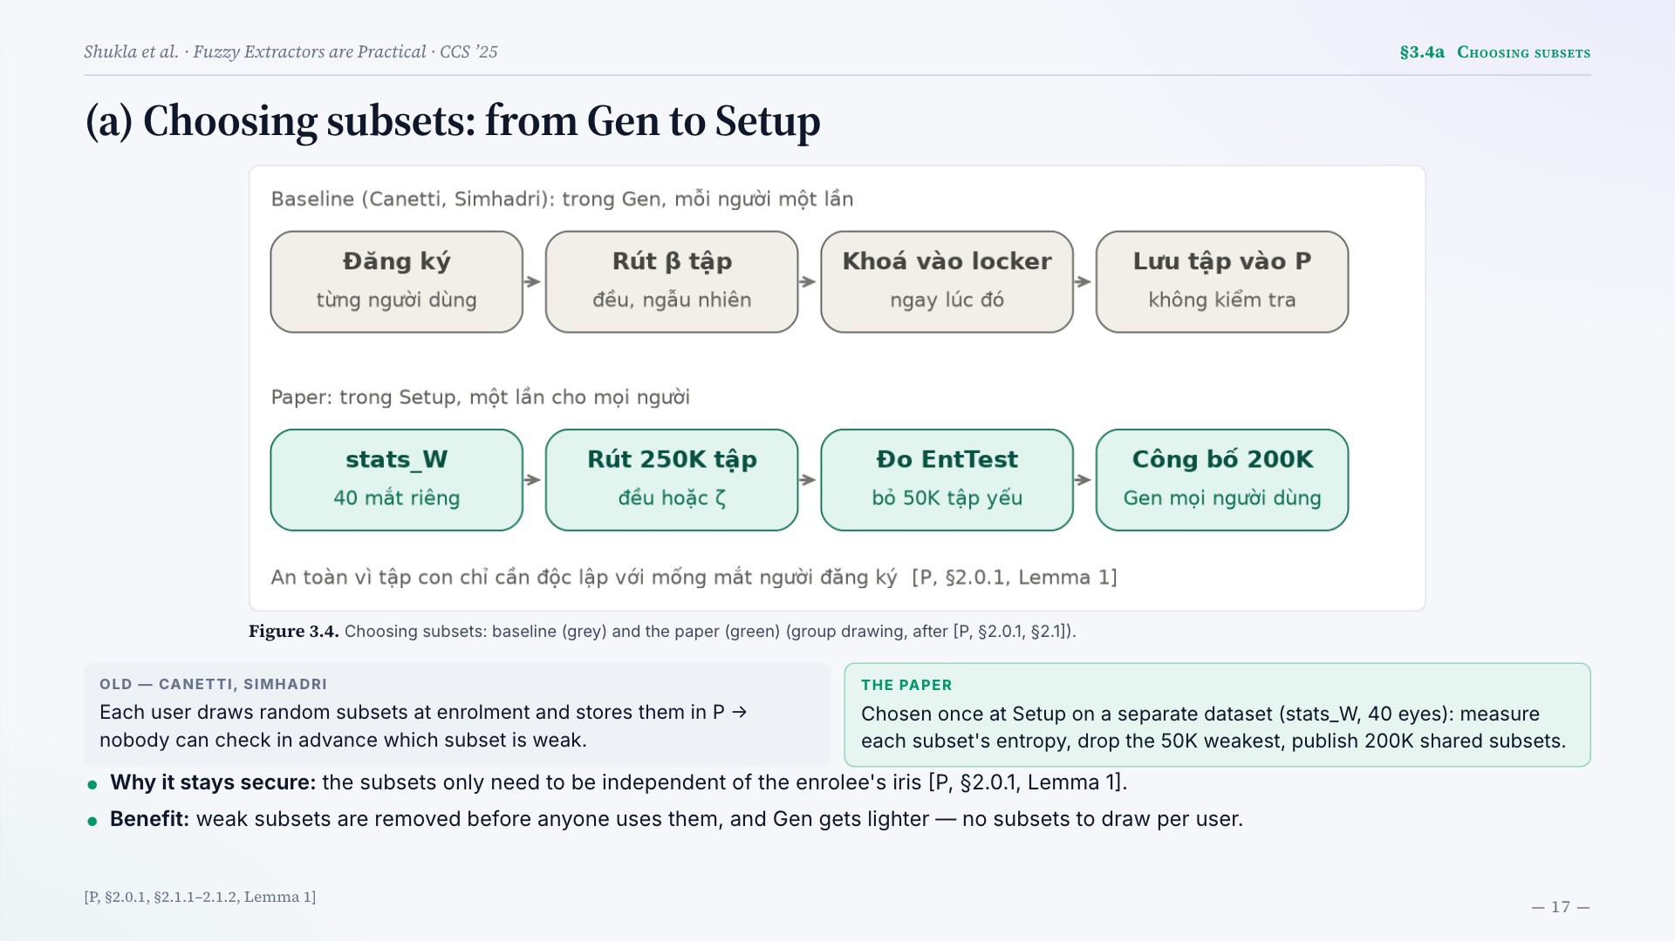
Notes:
(a) Choosing subsets: from Gen to Setup
Figure 3.4. Choosing subsets: baseline (grey) and the paper (green) (group drawing, after [P, §2.0.1, §2.1]).
OLD — CANETTI, SIMHADRI
Each user draws random subsets at enrolment and stores them in P → nobody can check in advance which subset is weak.
THE PAPER
Chosen once at Setup on a separate dataset (stats_W, 40 eyes): measure each subset's entropy, drop the 50K weakest, publish 200K shared subsets.
Why it stays secure: the subsets only need to be independent of the enrolee's iris [P, §2.0.1, Lemma 1].
Benefit: weak subsets are removed before anyone uses them, and Gen gets lighter — no subsets to draw per user.
[P, §2.0.1, §2.1.1–2.1.2, Lemma 1]

Slide 18
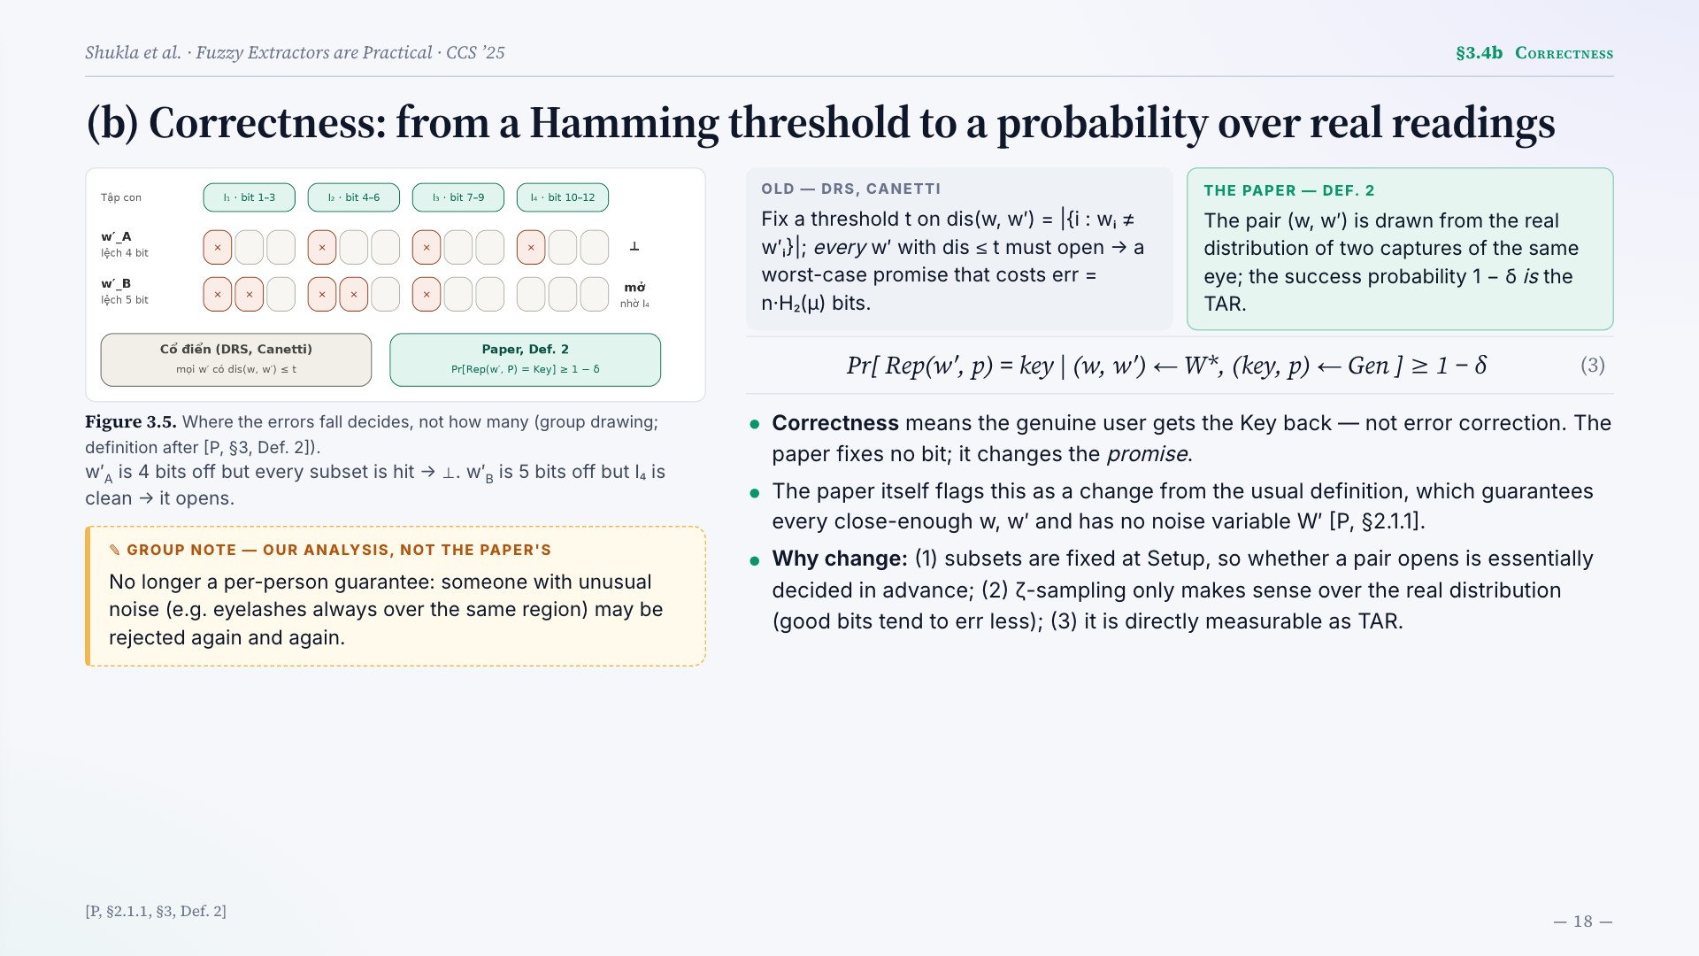
Notes:
(b) Correctness: from a Hamming threshold to a probability over real readings
Figure 3.5. Where the errors fall decides, not how many (group drawing; definition after [P, §3, Def. 2]).
w′A is 4 bits off but every subset is hit → ⊥. w′B is 5 bits off but I₄ is clean → it opens.
No longer a per-person guarantee: someone with unusual noise (e.g. eyelashes always over the same region) may be rejected again and again.
OLD — DRS, CANETTI
Fix a threshold t on dis(w, w′) = |{i : wᵢ ≠ w′ᵢ}|; every w′ with dis ≤ t must open → a worst-case promise that costs err = n·H₂(μ) bits.
THE PAPER — DEF. 2
The pair (w, w′) is drawn from the real distribution of two captures of the same eye; the success probability 1 − δ is the TAR.
Pr[ Rep(w′, p) = key | (w, w′) ← W*, (key, p) ← Gen ] ≥ 1 − δ
(3)
Correctness means the genuine user gets the Key back — not error correction. The paper fixes no bit; it changes the promise.
The paper itself flags this as a change from the usual definition, which guarantees every close-enough w, w′ and has no noise variable W′ [P, §2.1.1].
Why change: (1) subsets are fixed at Setup, so whether a pair opens is essentially decided in advance; (2) ζ-sampling only makes sense over the real distribution (good bits tend to err less); (3) it is directly measurable as TAR.
[P, §2.1.1, §3, Def. 2]

Slide 19
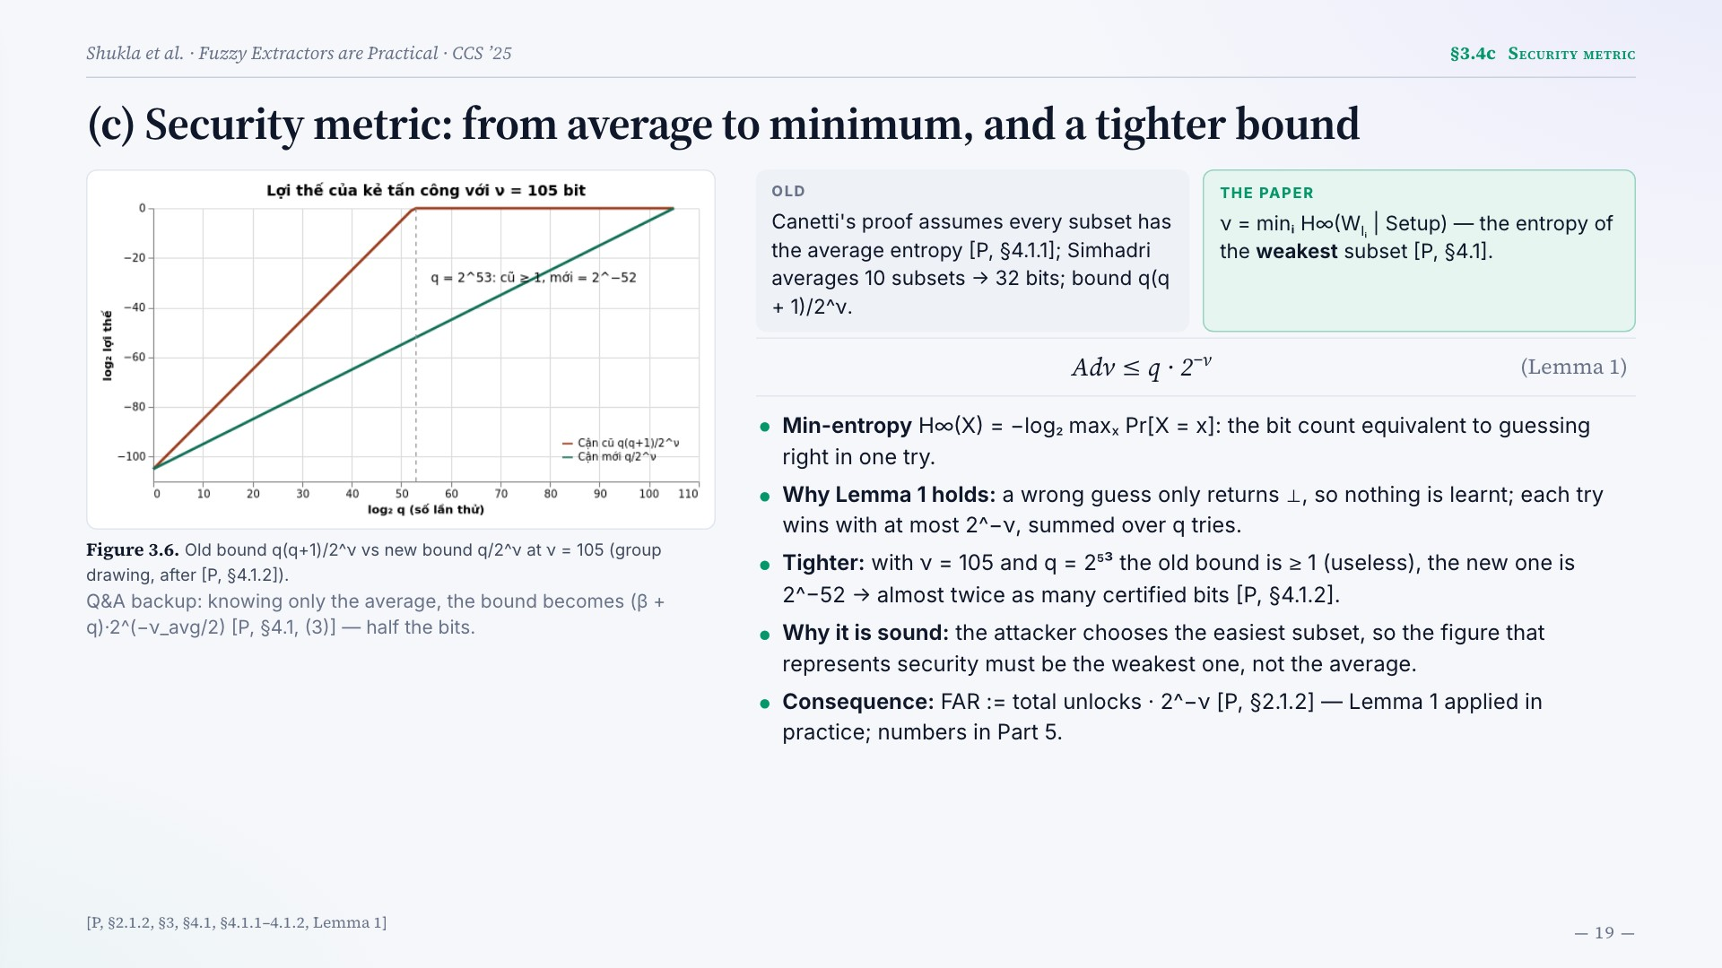
Notes:
(c) Security metric: from average to minimum, and a tighter bound
Figure 3.6. Old bound q(q+1)/2^ν vs new bound q/2^ν at ν = 105 (group drawing, after [P, §4.1.2]).
Q&A backup: knowing only the average, the bound becomes (β + q)·2^(−ν_avg/2) [P, §4.1, (3)] — half the bits.
OLD
Canetti's proof assumes every subset has the average entropy [P, §4.1.1]; Simhadri averages 10 subsets → 32 bits; bound q(q + 1)/2^ν.
THE PAPER
ν = minᵢ H∞(WIᵢ | Setup) — the entropy of the weakest subset [P, §4.1].
Adv ≤ q · 2−ν
(Lemma 1)
Min-entropy H∞(X) = −log₂ maxₓ Pr[X = x]: the bit count equivalent to guessing right in one try.
Why Lemma 1 holds: a wrong guess only returns ⊥, so nothing is learnt; each try wins with at most 2^−ν, summed over q tries.
Tighter: with ν = 105 and q = 2⁵³ the old bound is ≥ 1 (useless), the new one is 2^−52 → almost twice as many certified bits [P, §4.1.2].
Why it is sound: the attacker chooses the easiest subset, so the figure that represents security must be the weakest one, not the average.
Consequence: FAR := total unlocks · 2^−ν [P, §2.1.2] — Lemma 1 applied in practice; numbers in Part 5.
[P, §2.1.2, §3, §4.1, §4.1.1–4.1.2, Lemma 1]

Slide 20
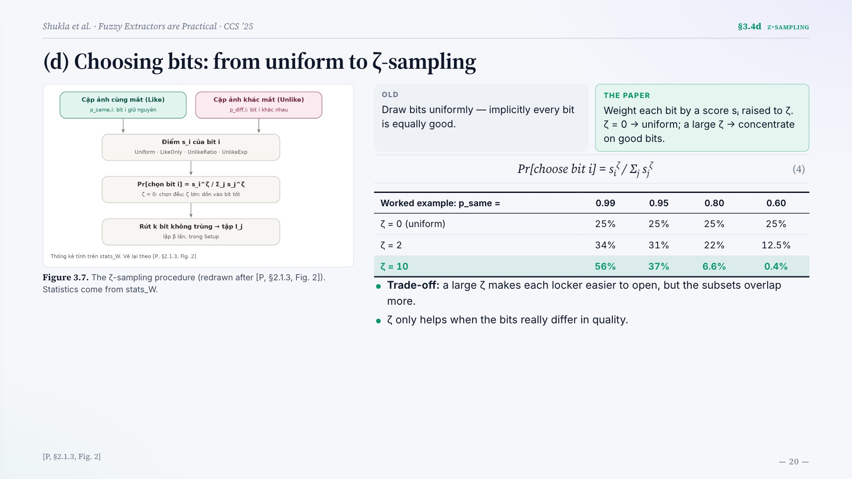
Notes:
(d) Choosing bits: from uniform to ζ-sampling
Figure 3.7. The ζ-sampling procedure (redrawn after [P, §2.1.3, Fig. 2]). Statistics come from stats_W.
OLD
Draw bits uniformly — implicitly every bit is equally good.
THE PAPER
Weight each bit by a score sᵢ raised to ζ. ζ = 0 → uniform; a large ζ → concentrate on good bits.
Pr[choose bit i] = siζ / Σj sjζ
(4)
Worked example: p_same = 0.99 0.95 0.80 0.60
ζ = 0 (uniform) 25% 25% 25% 25%
ζ = 2 34% 31% 22% 12.5%
ζ = 10 56% 37% 6.6% 0.4%
Trade-off: a large ζ makes each locker easier to open, but the subsets overlap more.
ζ only helps when the bits really differ in quality.
[P, §2.1.3, Fig. 2]

Slide 21
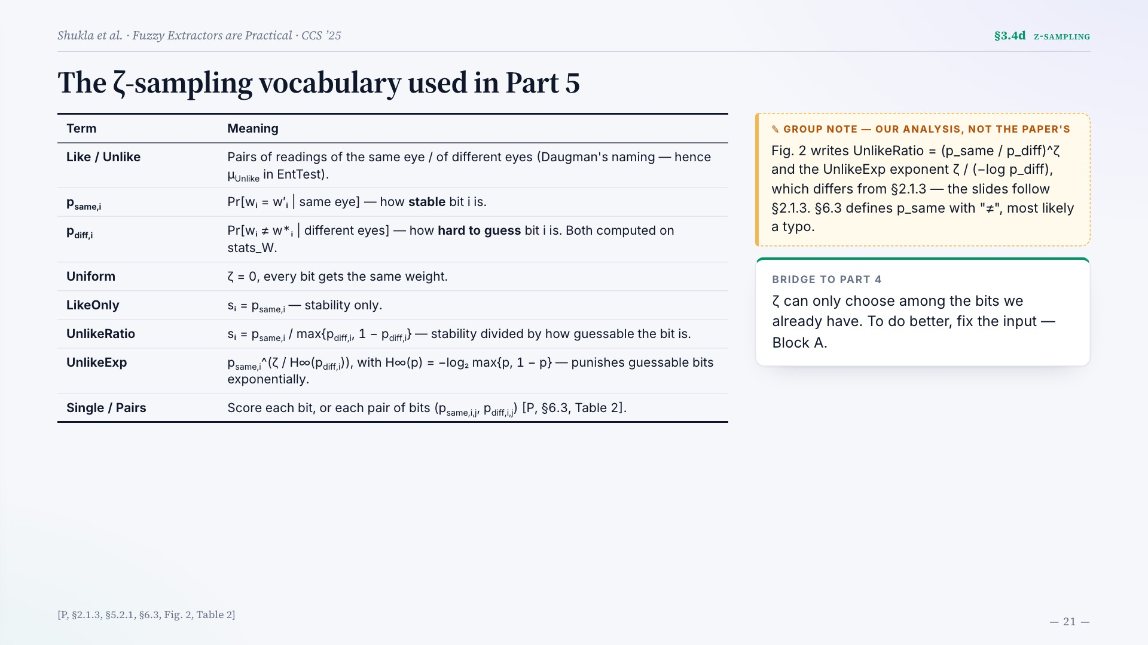
Notes:
The ζ-sampling vocabulary used in Part 5
Term Meaning
Like / Unlike Pairs of readings of the same eye / of different eyes (Daugman's naming — hence μUnlike in EntTest).
psame,i Pr[wᵢ = w′ᵢ | same eye] — how stable bit i is.
pdiff,i Pr[wᵢ ≠ w*ᵢ | different eyes] — how hard to guess bit i is. Both computed on stats_W.
Uniform ζ = 0, every bit gets the same weight.
LikeOnly sᵢ = psame,i — stability only.
UnlikeRatio sᵢ = psame,i / max{pdiff,i, 1 − pdiff,i} — stability divided by how guessable the bit is.
UnlikeExp psame,i^(ζ / H∞(pdiff,i)), with H∞(p) = −log₂ max{p, 1 − p} — punishes guessable bits exponentially.
Single / Pairs Score each bit, or each pair of bits (psame,i,j, pdiff,i,j) [P, §6.3, Table 2].
Fig. 2 writes UnlikeRatio = (p_same / p_diff)^ζ and the UnlikeExp exponent ζ / (−log p_diff), which differs from §2.1.3 — the slides follow §2.1.3. §6.3 defines p_same with "≠", most likely a typo.
BRIDGE TO PART 4
ζ can only choose among the bits we already have. To do better, fix the input — Block A.
[P, §2.1.3, §5.2.1, §6.3, Fig. 2, Table 2]

Slide 22

Notes:
Part 4 · Block A
The feature extractor
4.1
Why fix Block A
4.2
One baseline, two designs
4.3
ThirdEye → VersionOne
4.5
VersionTwo → VersionTwoR
4.6
The versions side by side

Slide 23
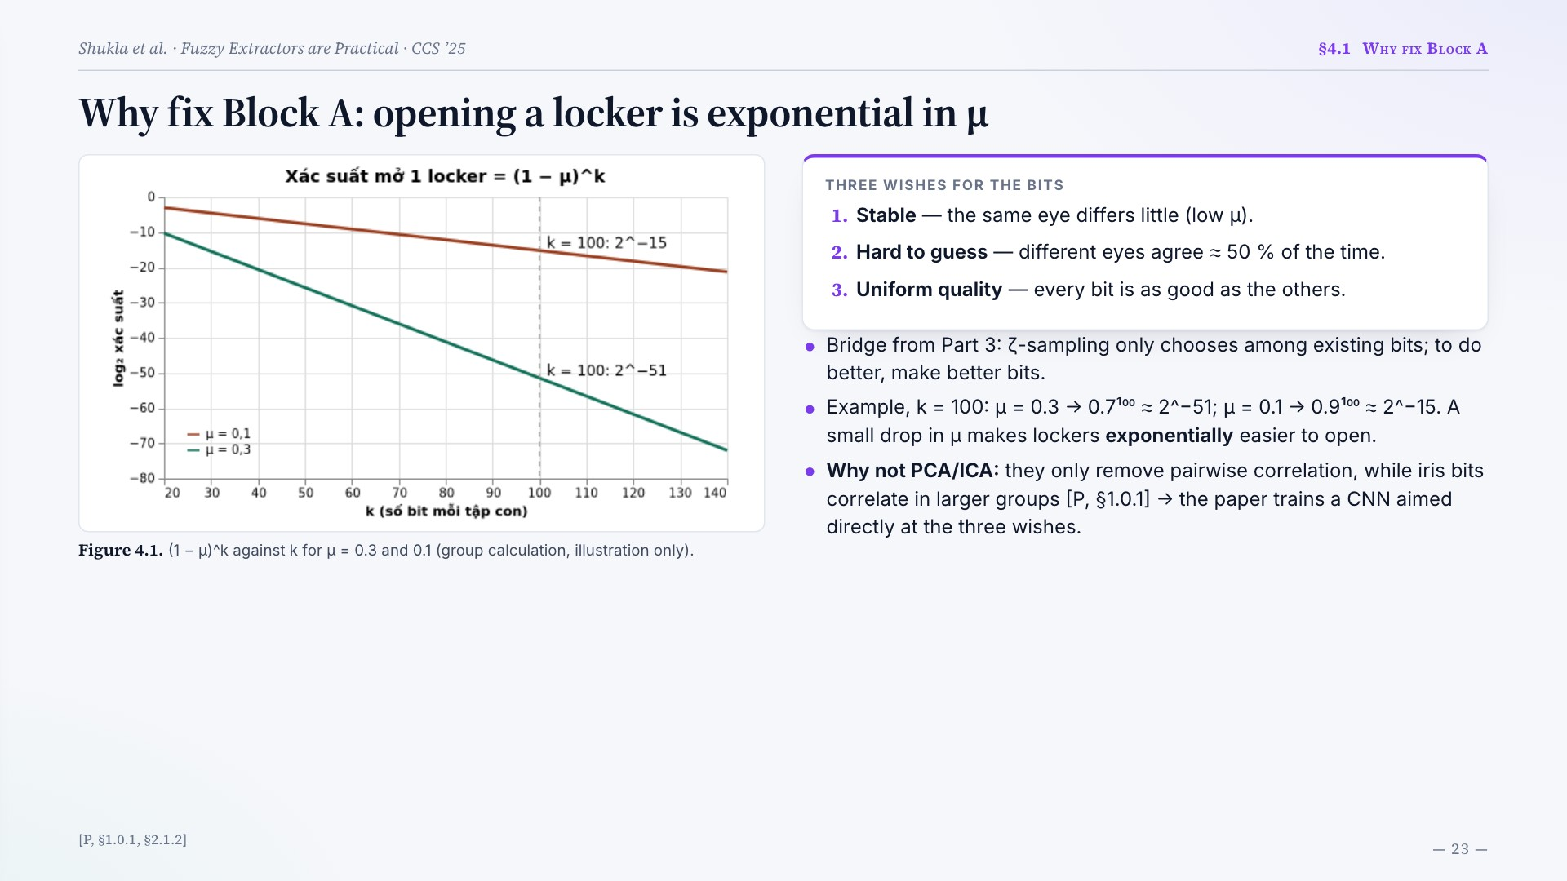
Notes:
Why fix Block A: opening a locker is exponential in μ
Figure 4.1. (1 − μ)^k against k for μ = 0.3 and 0.1 (group calculation, illustration only).
THREE WISHES FOR THE BITS
Stable — the same eye differs little (low μ).
Hard to guess — different eyes agree ≈ 50 % of the time.
Uniform quality — every bit is as good as the others.
Bridge from Part 3: ζ-sampling only chooses among existing bits; to do better, make better bits.
Example, k = 100: μ = 0.3 → 0.7¹⁰⁰ ≈ 2^−51; μ = 0.1 → 0.9¹⁰⁰ ≈ 2^−15. A small drop in μ makes lockers exponentially easier to open.
Why not PCA/ICA: they only remove pairwise correlation, while iris bits correlate in larger groups [P, §1.0.1] → the paper trains a CNN aimed directly at the three wishes.
[P, §1.0.1, §2.1.2]

Slide 24
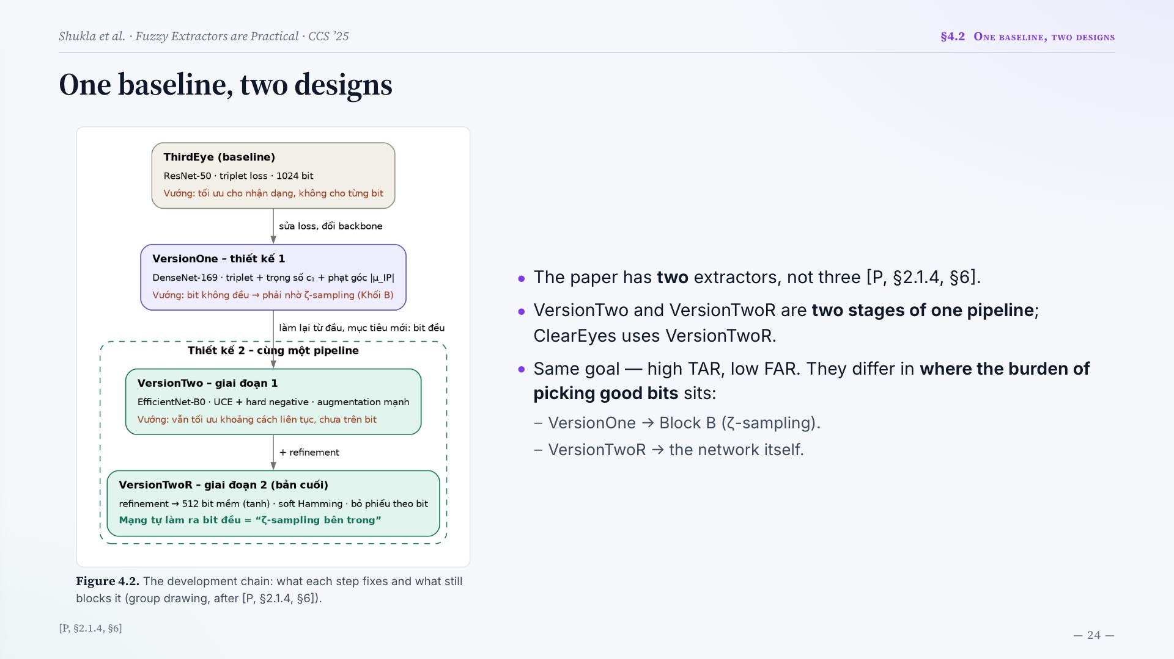
Notes:
One baseline, two designs
Figure 4.2. The development chain: what each step fixes and what still blocks it (group drawing, after [P, §2.1.4, §6]).
The paper has two extractors, not three [P, §2.1.4, §6].
VersionTwo and VersionTwoR are two stages of one pipeline; ClearEyes uses VersionTwoR.
Same goal — high TAR, low FAR. They differ in where the burden of picking good bits sits:
VersionOne → Block B (ζ-sampling).
VersionTwoR → the network itself.
[P, §2.1.4, §6]

Slide 25
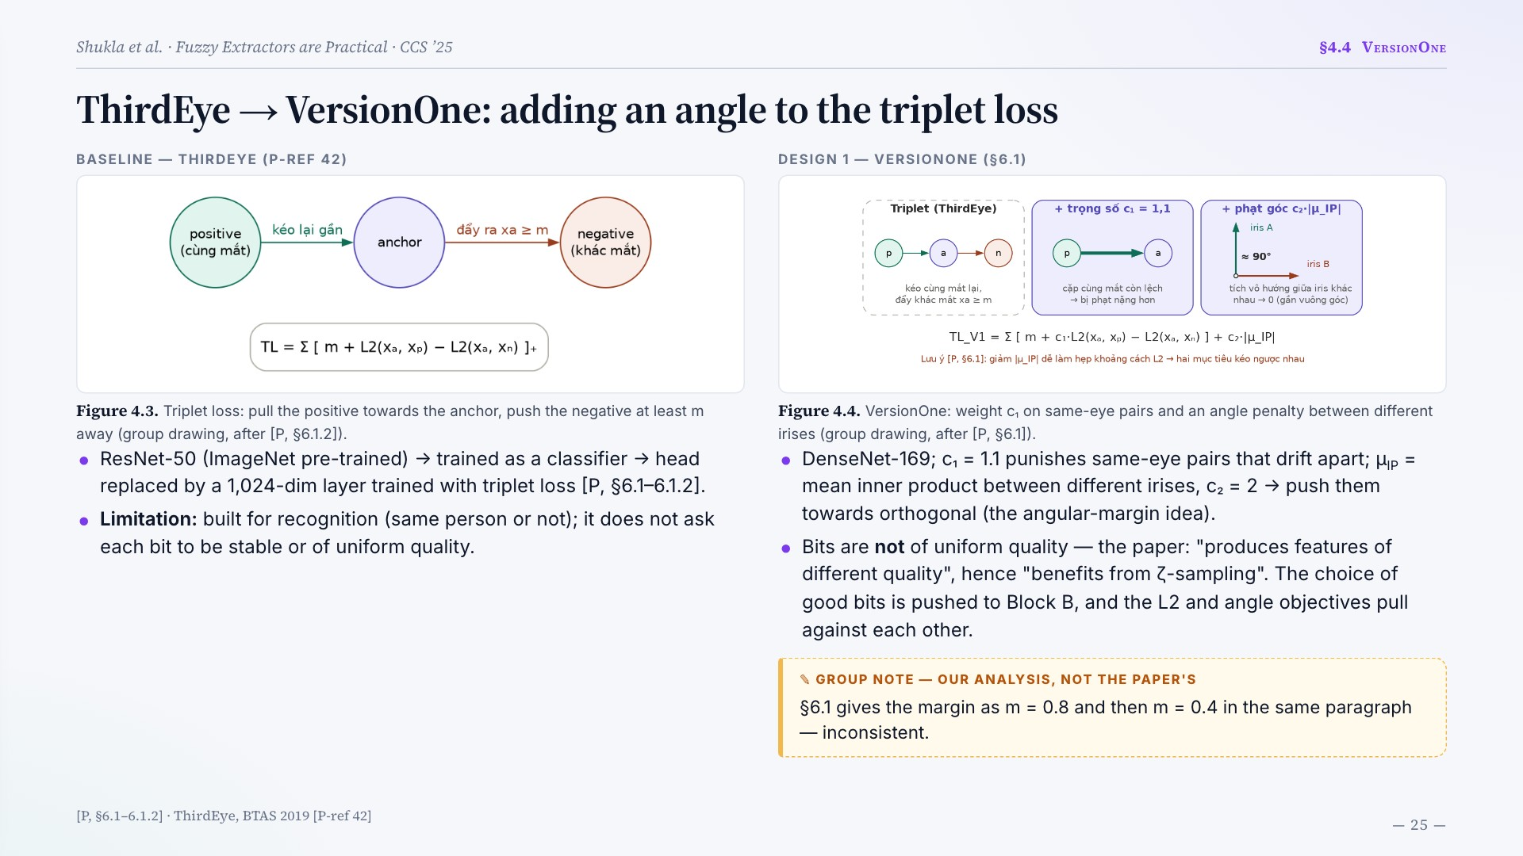
Notes:
ThirdEye → VersionOne: adding an angle to the triplet loss
BASELINE — THIRDEYE (P-REF 42)
Figure 4.3. Triplet loss: pull the positive towards the anchor, push the negative at least m away (group drawing, after [P, §6.1.2]).
ResNet-50 (ImageNet pre-trained) → trained as a classifier → head replaced by a 1,024-dim layer trained with triplet loss [P, §6.1–6.1.2].
Limitation: built for recognition (same person or not); it does not ask each bit to be stable or of uniform quality.
DESIGN 1 — VERSIONONE (§6.1)
Figure 4.4. VersionOne: weight c₁ on same-eye pairs and an angle penalty between different irises (group drawing, after [P, §6.1]).
DenseNet-169; c₁ = 1.1 punishes same-eye pairs that drift apart; μIP = mean inner product between different irises, c₂ = 2 → push them towards orthogonal (the angular-margin idea).
Bits are not of uniform quality — the paper: "produces features of different quality", hence "benefits from ζ-sampling". The choice of good bits is pushed to Block B, and the L2 and angle objectives pull against each other.
§6.1 gives the margin as m = 0.8 and then m = 0.4 in the same paragraph — inconsistent.
[P, §6.1–6.1.2] · ThirdEye, BTAS 2019 [P-ref 42]

Slide 26
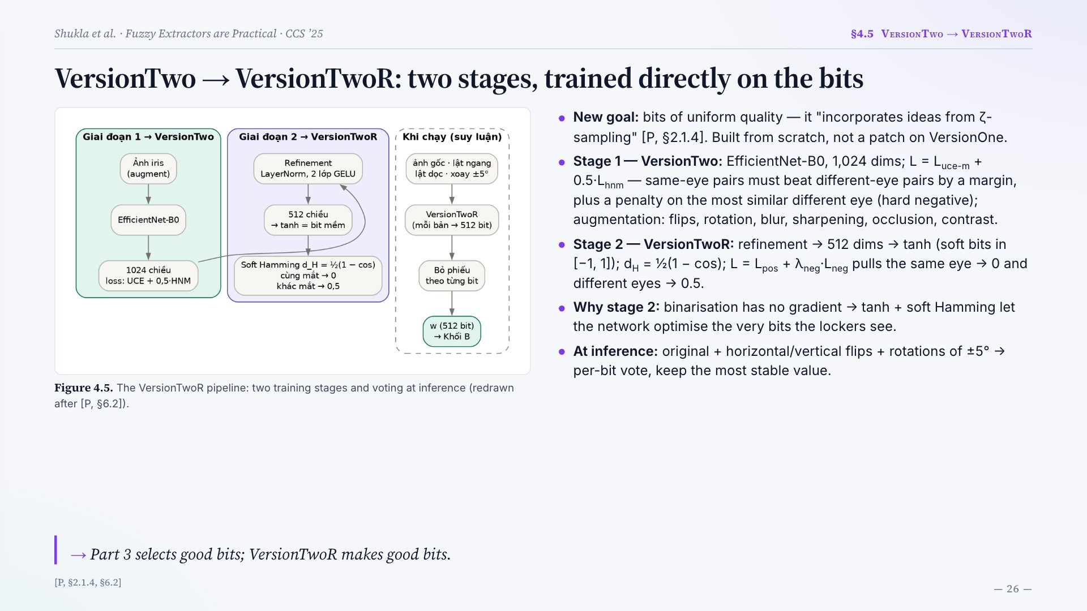
Notes:
VersionTwo → VersionTwoR: two stages, trained directly on the bits
Figure 4.5. The VersionTwoR pipeline: two training stages and voting at inference (redrawn after [P, §6.2]).
New goal: bits of uniform quality — it "incorporates ideas from ζ-sampling" [P, §2.1.4]. Built from scratch, not a patch on VersionOne.
Stage 1 — VersionTwo: EfficientNet-B0, 1,024 dims; L = Luce-m + 0.5·Lhnm — same-eye pairs must beat different-eye pairs by a margin, plus a penalty on the most similar different eye (hard negative); augmentation: flips, rotation, blur, sharpening, occlusion, contrast.
Stage 2 — VersionTwoR: refinement → 512 dims → tanh (soft bits in [−1, 1]); dH = ½(1 − cos); L = Lpos + λneg·Lneg pulls the same eye → 0 and different eyes → 0.5.
Why stage 2: binarisation has no gradient → tanh + soft Hamming let the network optimise the very bits the lockers see.
At inference: original + horizontal/vertical flips + rotations of ±5° → per-bit vote, keep the most stable value.
Part 3 selects good bits; VersionTwoR makes good bits.
[P, §2.1.4, §6.2]

Slide 27
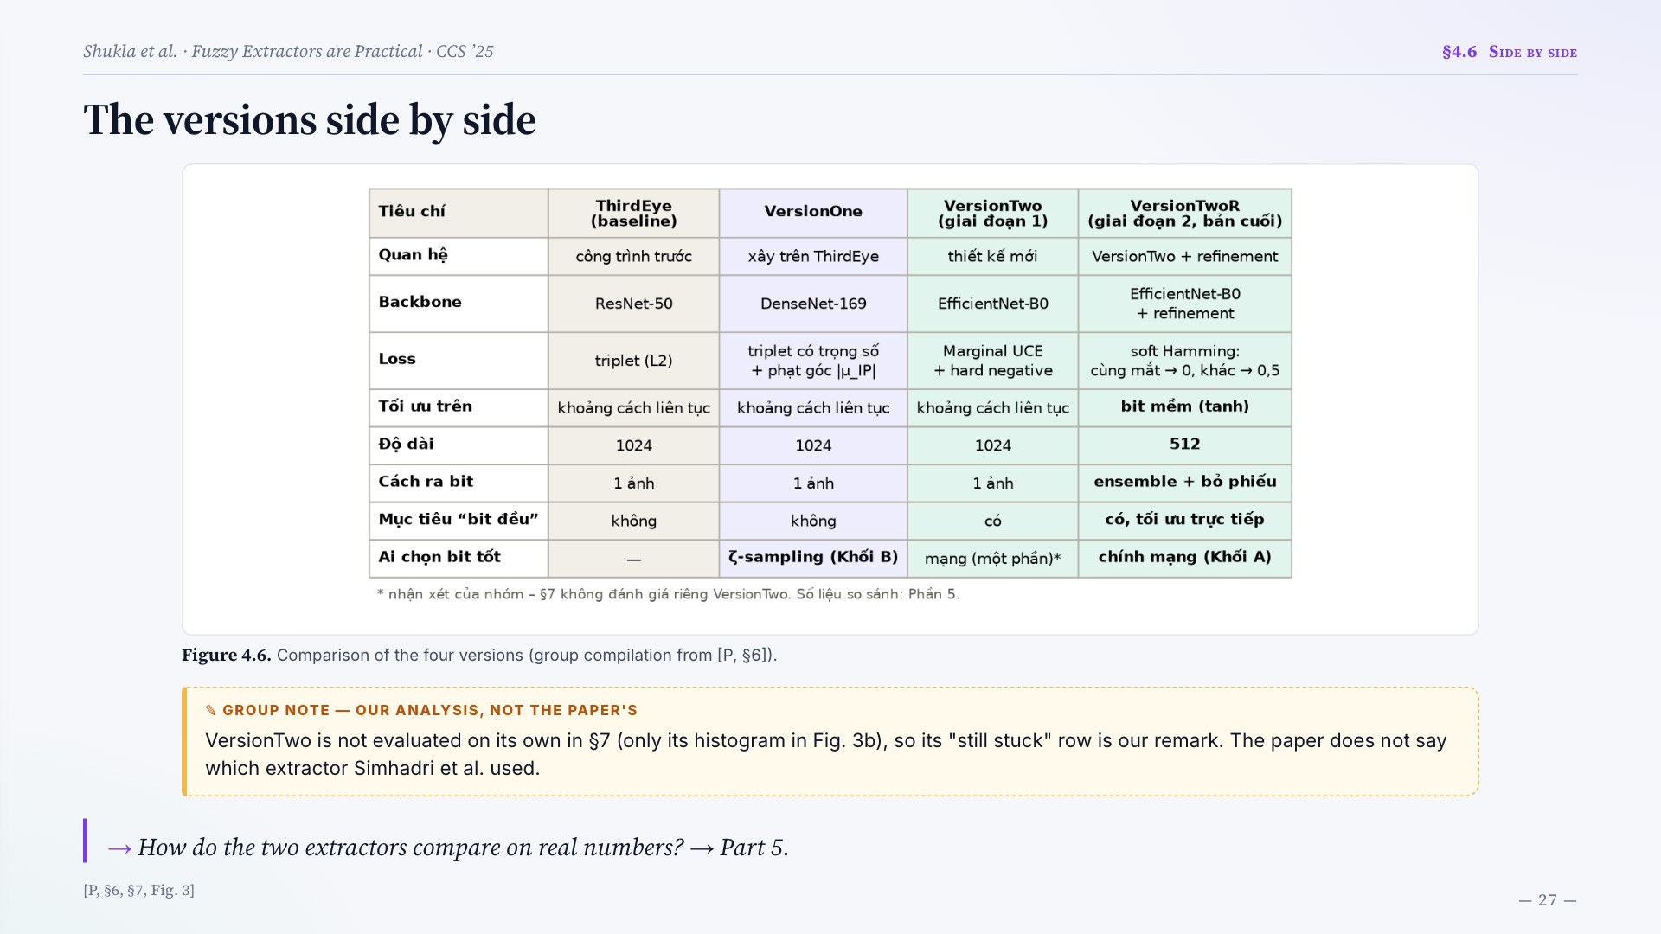
Notes:
The versions side by side
Figure 4.6. Comparison of the four versions (group compilation from [P, §6]).
VersionTwo is not evaluated on its own in §7 (only its histogram in Fig. 3b), so its "still stuck" row is our remark. The paper does not say which extractor Simhadri et al. used.
How do the two extractors compare on real numbers? → Part 5.
[P, §6, §7, Fig. 3]

Slide 28
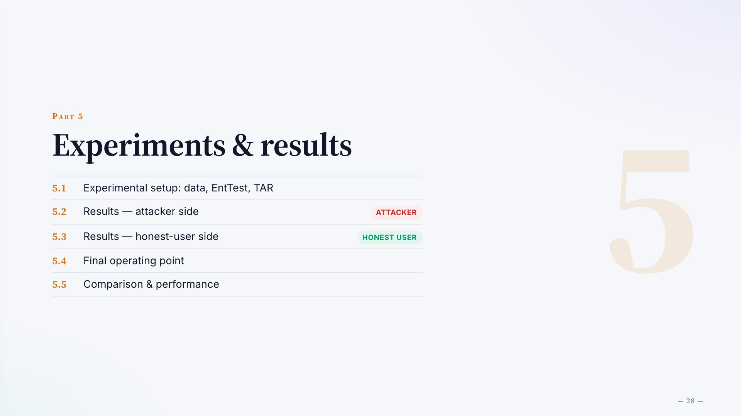
Notes:
Part 5
Experiments & results
5.1
Experimental setup: data, EntTest, TAR
5.2
Results — attacker side
ATTACKER
5.3
Results — honest-user side
HONEST USER
5.4
Final operating point
5.5
Comparison & performance

Slide 29
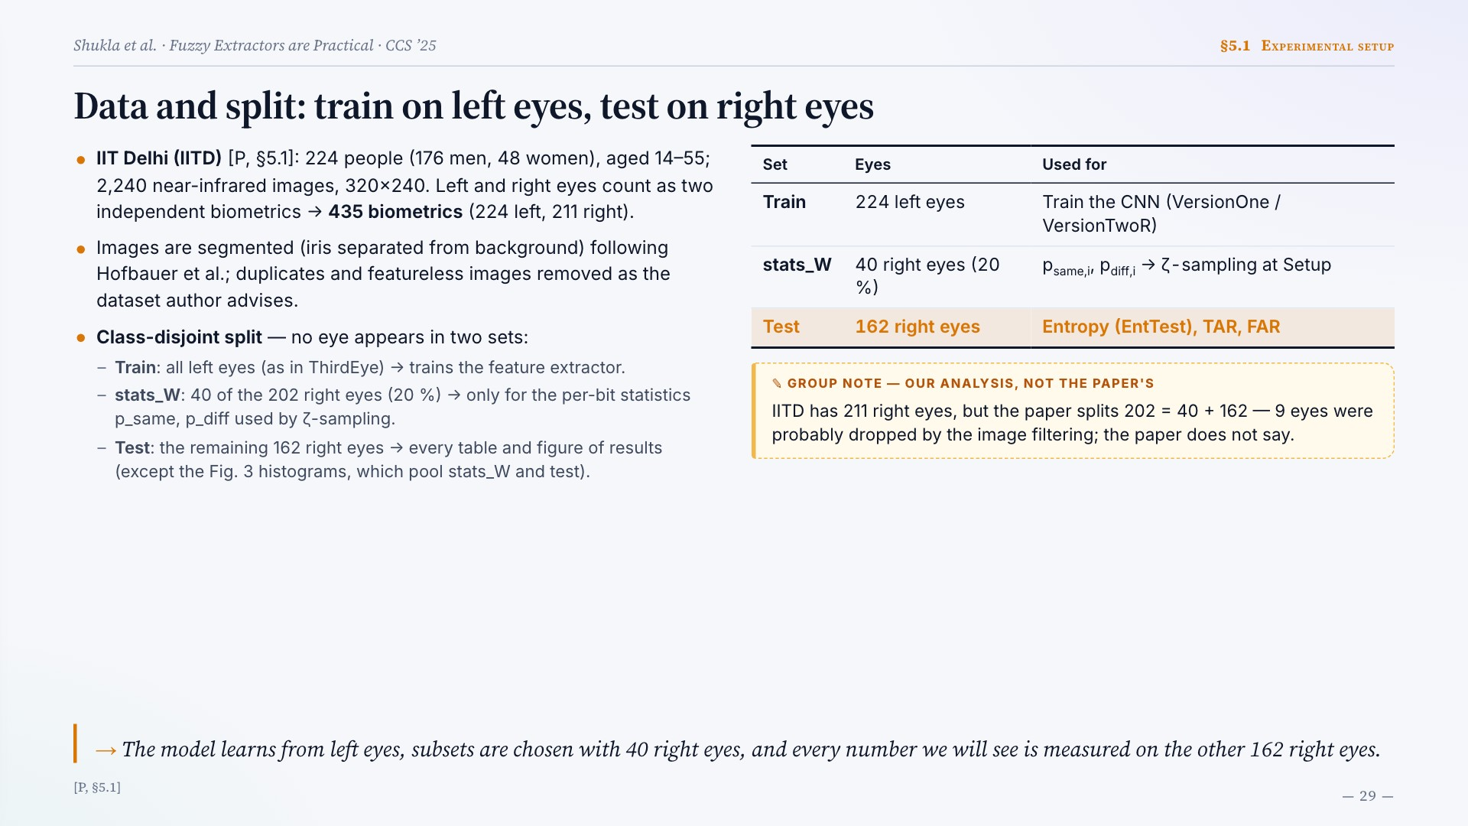
Notes:
Data and split: train on left eyes, test on right eyes
IIT Delhi (IITD) [P, §5.1]: 224 people (176 men, 48 women), aged 14–55; 2,240 near-infrared images, 320×240. Left and right eyes count as two independent biometrics → 435 biometrics (224 left, 211 right).
Images are segmented (iris separated from background) following Hofbauer et al.; duplicates and featureless images removed as the dataset author advises.
Class-disjoint split — no eye appears in two sets:
Train: all left eyes (as in ThirdEye) → trains the feature extractor.
stats_W: 40 of the 202 right eyes (20 %) → only for the per-bit statistics p_same, p_diff used by ζ-sampling.
Test: the remaining 162 right eyes → every table and figure of results (except the Fig. 3 histograms, which pool stats_W and test).
Set Eyes Used for
Train 224 left eyes Train the CNN (VersionOne / VersionTwoR)
stats_W 40 right eyes (20 %) psame,i, pdiff,i → ζ-sampling at Setup
Test 162 right eyes Entropy (EntTest), TAR, FAR
IITD has 211 right eyes, but the paper splits 202 = 40 + 162 — 9 eyes were probably dropped by the image filtering; the paper does not say.
The model learns from left eyes, subsets are chosen with 40 right eyes, and every number we will see is measured on the other 162 right eyes.
[P, §5.1]

Slide 30
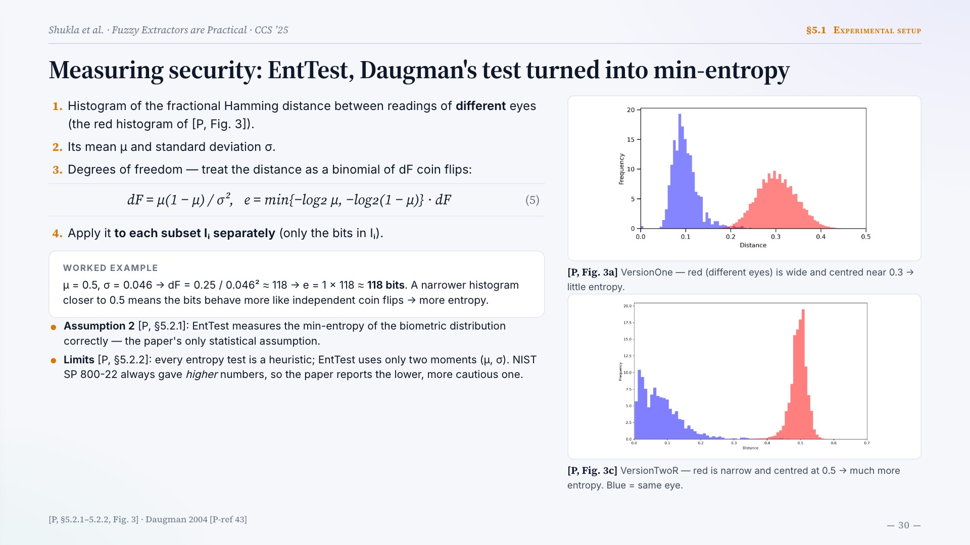
Notes:
Measuring security: EntTest, Daugman's test turned into min-entropy
Histogram of the fractional Hamming distance between readings of different eyes (the red histogram of [P, Fig. 3]).
Its mean μ and standard deviation σ.
Degrees of freedom — treat the distance as a binomial of dF coin flips:
dF = μ(1 − μ) / σ², e = min{−log₂ μ, −log₂(1 − μ)} · dF
(5)
Apply it to each subset Iᵢ separately (only the bits in Iᵢ).
WORKED EXAMPLE
μ = 0.5, σ = 0.046 → dF = 0.25 / 0.046² ≈ 118 → e = 1 × 118 ≈ 118 bits. A narrower histogram closer to 0.5 means the bits behave more like independent coin flips → more entropy.
Assumption 2 [P, §5.2.1]: EntTest measures the min-entropy of the biometric distribution correctly — the paper's only statistical assumption.
Limits [P, §5.2.2]: every entropy test is a heuristic; EntTest uses only two moments (μ, σ). NIST SP 800-22 always gave higher numbers, so the paper reports the lower, more cautious one.
[P, Fig. 3a] VersionOne — red (different eyes) is wide and centred near 0.3 → little entropy.
[P, Fig. 3c] VersionTwoR — red is narrow and centred at 0.5 → much more entropy. Blue = same eye.
[P, §5.2.1–5.2.2, Fig. 3] · Daugman 2004 [P-ref 43]

Slide 31
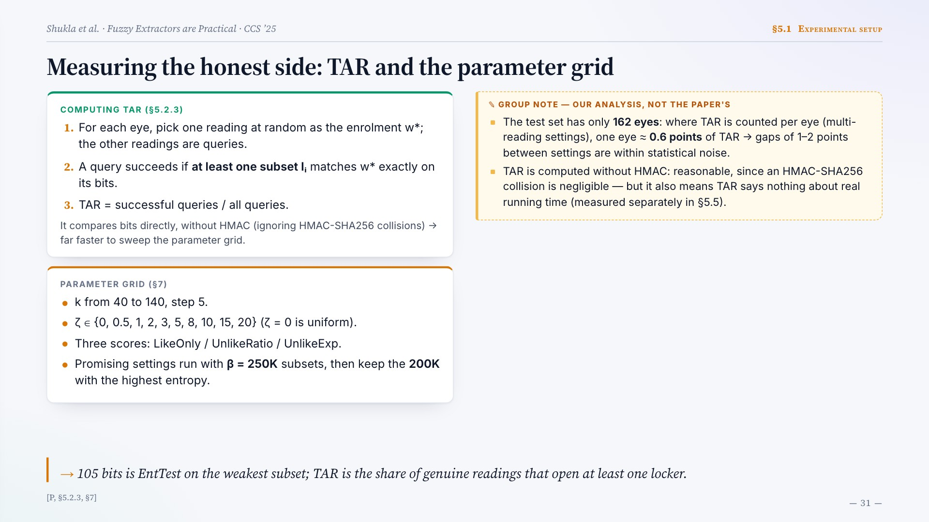
Notes:
Measuring the honest side: TAR and the parameter grid
COMPUTING TAR (§5.2.3)
For each eye, pick one reading at random as the enrolment w*; the other readings are queries.
A query succeeds if at least one subset Iᵢ matches w* exactly on its bits.
TAR = successful queries / all queries.
It compares bits directly, without HMAC (ignoring HMAC-SHA256 collisions) → far faster to sweep the parameter grid.
PARAMETER GRID (§7)
k from 40 to 140, step 5.
ζ ∈ {0, 0.5, 1, 2, 3, 5, 8, 10, 15, 20} (ζ = 0 is uniform).
Three scores: LikeOnly / UnlikeRatio / UnlikeExp.
Promising settings run with β = 250K subsets, then keep the 200K with the highest entropy.
The test set has only 162 eyes: where TAR is counted per eye (multi-reading settings), one eye ≈ 0.6 points of TAR → gaps of 1–2 points between settings are within statistical noise.
TAR is computed without HMAC: reasonable, since an HMAC-SHA256 collision is negligible — but it also means TAR says nothing about real running time (measured separately in §5.5).
105 bits is EntTest on the weakest subset; TAR is the share of genuine readings that open at least one locker.
[P, §5.2.3, §7]

Slide 32
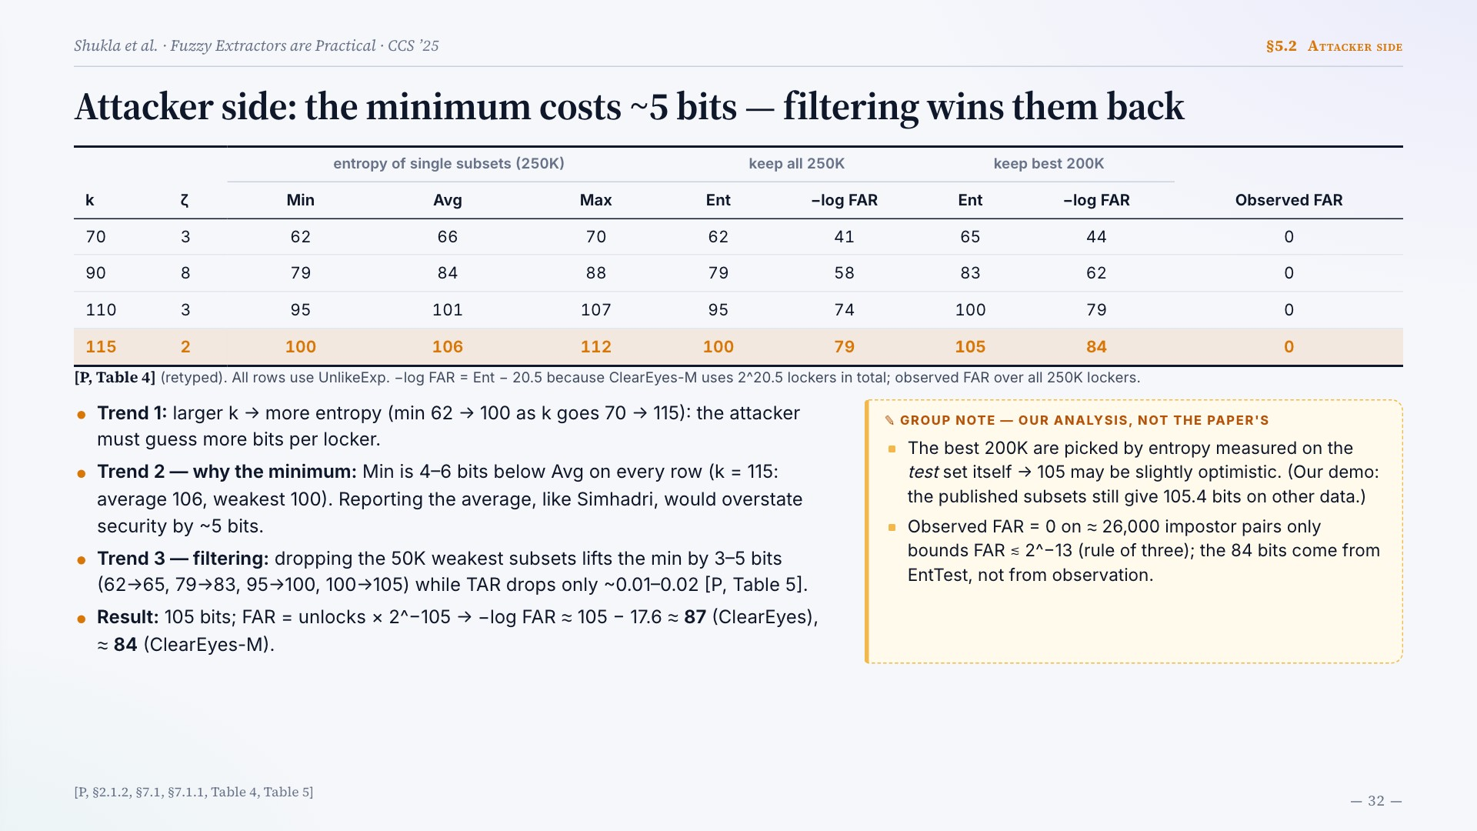
Notes:
Attacker side: the minimum costs ~5 bits — filtering wins them back
k ζ entropy of single subsets (250K) keep all 250K keep best 200K Observed FAR
Min Avg Max Ent −log FAR Ent −log FAR
70 3 62 66 70 62 41 65 44 0
90 8 79 84 88 79 58 83 62 0
110 3 95 101 107 95 74 100 79 0
115 2 100 106 112 100 79 105 84 0
[P, Table 4] (retyped). All rows use UnlikeExp. −log FAR = Ent − 20.5 because ClearEyes-M uses 2^20.5 lockers in total; observed FAR over all 250K lockers.
Trend 1: larger k → more entropy (min 62 → 100 as k goes 70 → 115): the attacker must guess more bits per locker.
Trend 2 — why the minimum: Min is 4–6 bits below Avg on every row (k = 115: average 106, weakest 100). Reporting the average, like Simhadri, would overstate security by ~5 bits.
Trend 3 — filtering: dropping the 50K weakest subsets lifts the min by 3–5 bits (62→65, 79→83, 95→100, 100→105) while TAR drops only ~0.01–0.02 [P, Table 5].
Result: 105 bits; FAR = unlocks × 2^−105 → −log FAR ≈ 105 − 17.6 ≈ 87 (ClearEyes), ≈ 84 (ClearEyes-M).
The best 200K are picked by entropy measured on the test set itself → 105 may be slightly optimistic. (Our demo: the published subsets still give 105.4 bits on other data.)
Observed FAR = 0 on ≈ 26,000 impostor pairs only bounds FAR ≲ 2^−13 (rule of three); the 84 bits come from EntTest, not from observation.
[P, §2.1.2, §7.1, §7.1.1, Table 4, Table 5]

Slide 33
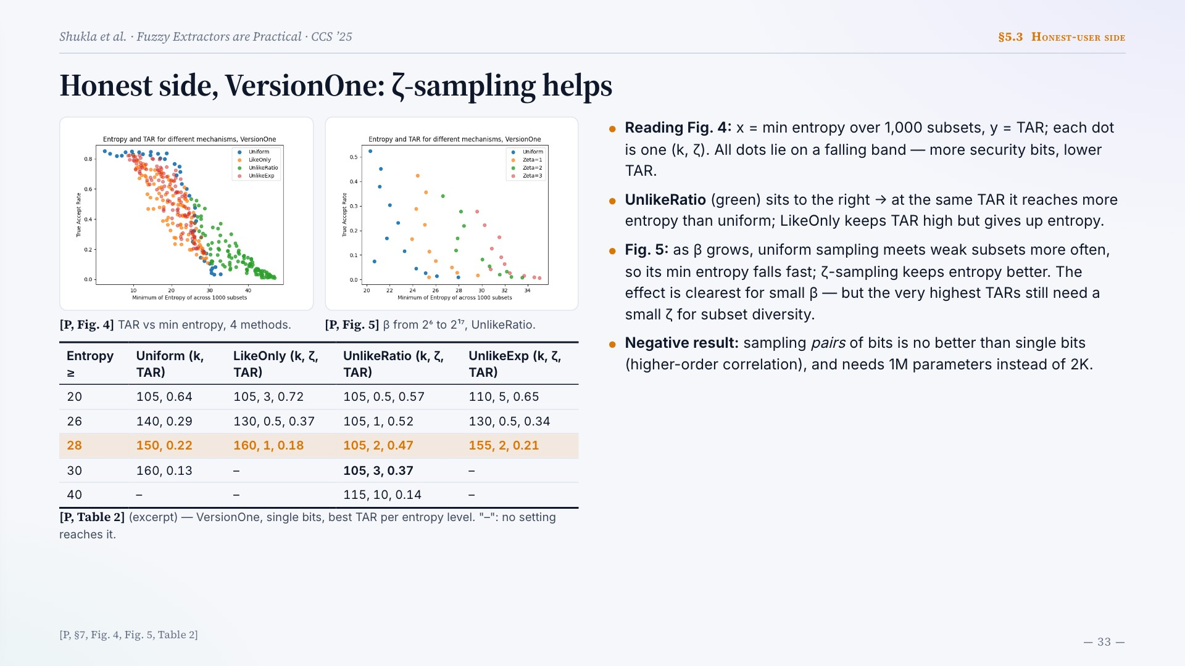
Notes:
Honest side, VersionOne: ζ-sampling helps
[P, Fig. 4] TAR vs min entropy, 4 methods.
[P, Fig. 5] β from 2⁶ to 2¹⁷, UnlikeRatio.
Entropy ≥ Uniform (k, TAR) LikeOnly (k, ζ, TAR) UnlikeRatio (k, ζ, TAR) UnlikeExp (k, ζ, TAR)
20 105, 0.64 105, 3, 0.72 105, 0.5, 0.57 110, 5, 0.65
26 140, 0.29 130, 0.5, 0.37 105, 1, 0.52 130, 0.5, 0.34
28 150, 0.22 160, 1, 0.18 105, 2, 0.47 155, 2, 0.21
30 160, 0.13 – 105, 3, 0.37 –
40 – – 115, 10, 0.14 –
[P, Table 2] (excerpt) — VersionOne, single bits, best TAR per entropy level. "–": no setting reaches it.
Reading Fig. 4: x = min entropy over 1,000 subsets, y = TAR; each dot is one (k, ζ). All dots lie on a falling band — more security bits, lower TAR.
UnlikeRatio (green) sits to the right → at the same TAR it reaches more entropy than uniform; LikeOnly keeps TAR high but gives up entropy.
Fig. 5: as β grows, uniform sampling meets weak subsets more often, so its min entropy falls fast; ζ-sampling keeps entropy better. The effect is clearest for small β — but the very highest TARs still need a small ζ for subset diversity.
Negative result: sampling pairs of bits is no better than single bits (higher-order correlation), and needs 1M parameters instead of 2K.
[P, §7, Fig. 4, Fig. 5, Table 2]

Slide 34
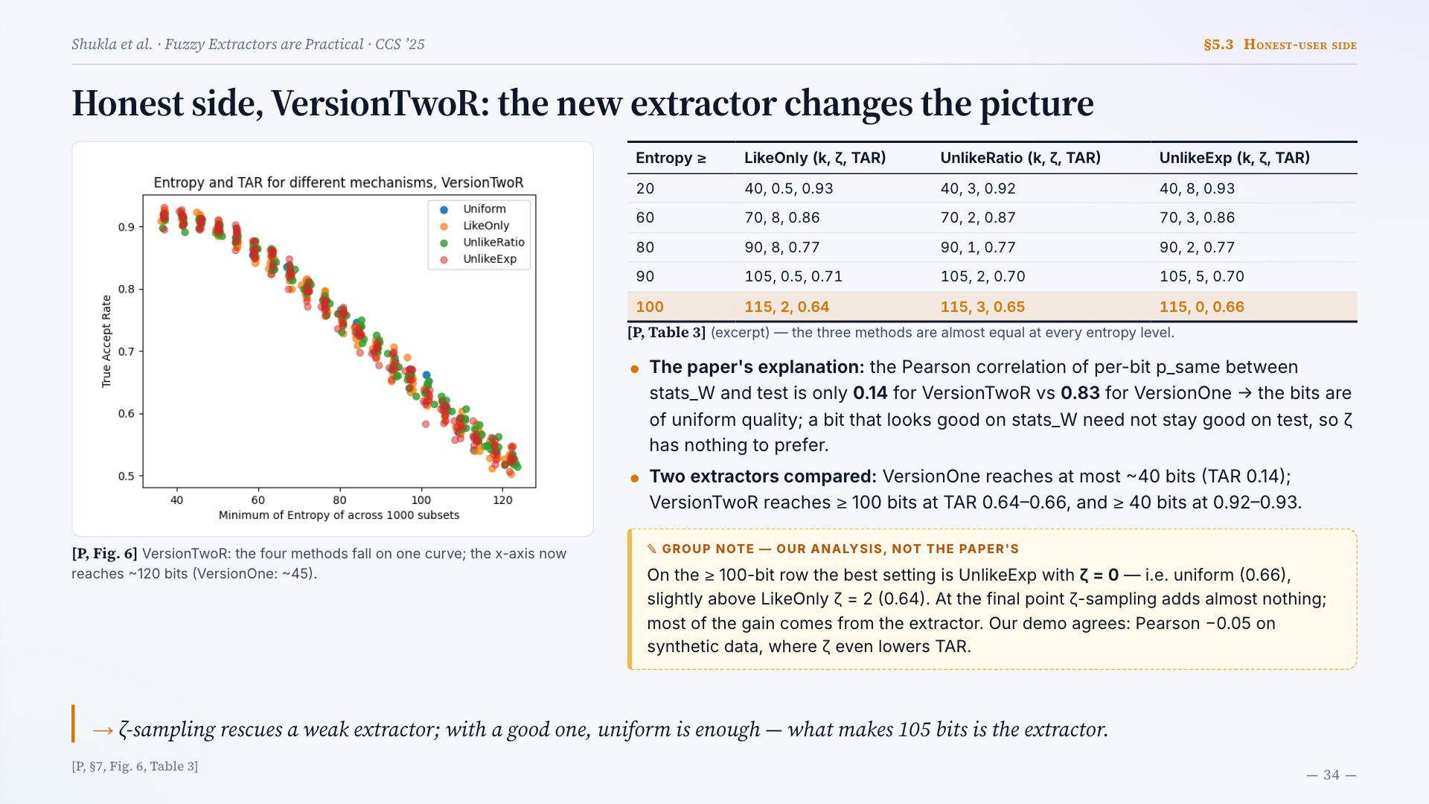
Notes:
Honest side, VersionTwoR: the new extractor changes the picture
[P, Fig. 6] VersionTwoR: the four methods fall on one curve; the x-axis now reaches ~120 bits (VersionOne: ~45).
Entropy ≥ LikeOnly (k, ζ, TAR) UnlikeRatio (k, ζ, TAR) UnlikeExp (k, ζ, TAR)
20 40, 0.5, 0.93 40, 3, 0.92 40, 8, 0.93
60 70, 8, 0.86 70, 2, 0.87 70, 3, 0.86
80 90, 8, 0.77 90, 1, 0.77 90, 2, 0.77
90 105, 0.5, 0.71 105, 2, 0.70 105, 5, 0.70
100 115, 2, 0.64 115, 3, 0.65 115, 0, 0.66
[P, Table 3] (excerpt) — the three methods are almost equal at every entropy level.
The paper's explanation: the Pearson correlation of per-bit p_same between stats_W and test is only 0.14 for VersionTwoR vs 0.83 for VersionOne → the bits are of uniform quality; a bit that looks good on stats_W need not stay good on test, so ζ has nothing to prefer.
Two extractors compared: VersionOne reaches at most ~40 bits (TAR 0.14); VersionTwoR reaches ≥ 100 bits at TAR 0.64–0.66, and ≥ 40 bits at 0.92–0.93.
On the ≥ 100-bit row the best setting is UnlikeExp with ζ = 0 — i.e. uniform (0.66), slightly above LikeOnly ζ = 2 (0.64). At the final point ζ-sampling adds almost nothing; most of the gain comes from the extractor. Our demo agrees: Pearson −0.05 on synthetic data, where ζ even lowers TAR.
ζ-sampling rescues a weak extractor; with a good one, uniform is enough — what makes 105 bits is the extractor.
[P, §7, Fig. 6, Table 3]

Slide 35
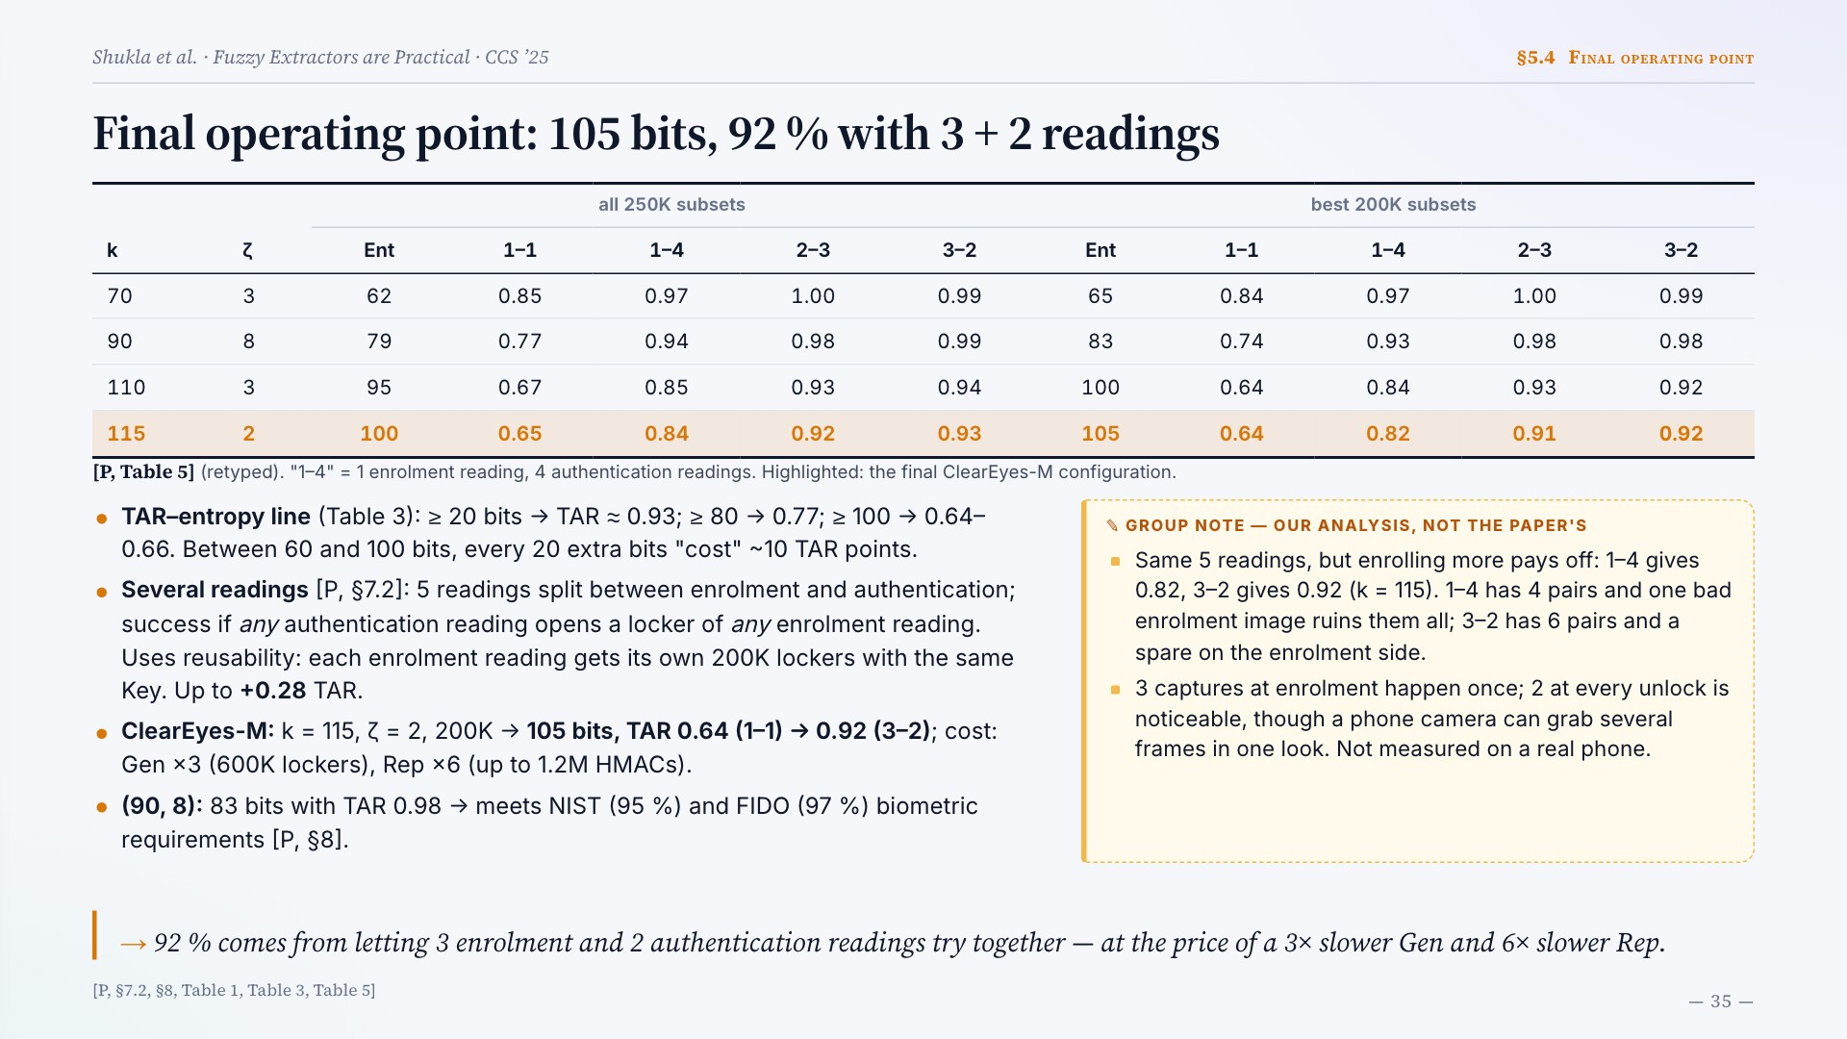
Notes:
Final operating point: 105 bits, 92 % with 3 + 2 readings
k ζ all 250K subsets best 200K subsets
Ent 1–1 1–4 2–3 3–2 Ent 1–1 1–4 2–3 3–2
70 3 62 0.85 0.97 1.00 0.99 65 0.84 0.97 1.00 0.99
90 8 79 0.77 0.94 0.98 0.99 83 0.74 0.93 0.98 0.98
110 3 95 0.67 0.85 0.93 0.94 100 0.64 0.84 0.93 0.92
115 2 100 0.65 0.84 0.92 0.93 105 0.64 0.82 0.91 0.92
[P, Table 5] (retyped). "1–4" = 1 enrolment reading, 4 authentication readings. Highlighted: the final ClearEyes-M configuration.
TAR–entropy line (Table 3): ≥ 20 bits → TAR ≈ 0.93; ≥ 80 → 0.77; ≥ 100 → 0.64–0.66. Between 60 and 100 bits, every 20 extra bits "cost" ~10 TAR points.
Several readings [P, §7.2]: 5 readings split between enrolment and authentication; success if any authentication reading opens a locker of any enrolment reading. Uses reusability: each enrolment reading gets its own 200K lockers with the same Key. Up to +0.28 TAR.
ClearEyes-M: k = 115, ζ = 2, 200K → 105 bits, TAR 0.64 (1–1) → 0.92 (3–2); cost: Gen ×3 (600K lockers), Rep ×6 (up to 1.2M HMACs).
(90, 8): 83 bits with TAR 0.98 → meets NIST (95 %) and FIDO (97 %) biometric requirements [P, §8].
Same 5 readings, but enrolling more pays off: 1–4 gives 0.82, 3–2 gives 0.92 (k = 115). 1–4 has 4 pairs and one bad enrolment image ruins them all; 3–2 has 6 pairs and a spare on the enrolment side.
3 captures at enrolment happen once; 2 at every unlock is noticeable, though a phone camera can grab several frames in one look. Not measured on a real phone.
92 % comes from letting 3 enrolment and 2 authentication readings try together — at the price of a 3× slower Gen and 6× slower Rep.
[P, §7.2, §8, Table 1, Table 3, Table 5]

Slide 36
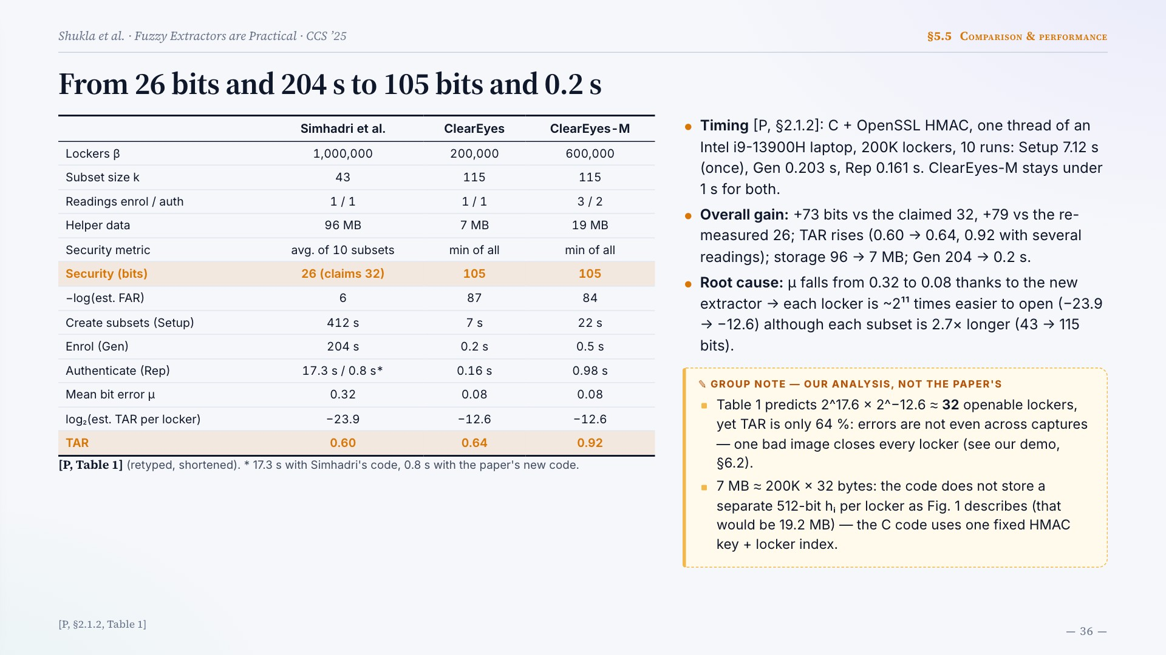
Notes:
From 26 bits and 204 s to 105 bits and 0.2 s
Simhadri et al. ClearEyes ClearEyes-M
Lockers β 1,000,000 200,000 600,000
Subset size k 43 115 115
Readings enrol / auth 1 / 1 1 / 1 3 / 2
Helper data 96 MB 7 MB 19 MB
Security metric avg. of 10 subsets min of all min of all
Security (bits) 26 (claims 32) 105 105
−log(est. FAR) 6 87 84
Create subsets (Setup) 412 s 7 s 22 s
Enrol (Gen) 204 s 0.2 s 0.5 s
Authenticate (Rep) 17.3 s / 0.8 s* 0.16 s 0.98 s
Mean bit error μ 0.32 0.08 0.08
log₂(est. TAR per locker) −23.9 −12.6 −12.6
TAR 0.60 0.64 0.92
[P, Table 1] (retyped, shortened). * 17.3 s with Simhadri's code, 0.8 s with the paper's new code.
Timing [P, §2.1.2]: C + OpenSSL HMAC, one thread of an Intel i9-13900H laptop, 200K lockers, 10 runs: Setup 7.12 s (once), Gen 0.203 s, Rep 0.161 s. ClearEyes-M stays under 1 s for both.
Overall gain: +73 bits vs the claimed 32, +79 vs the re-measured 26; TAR rises (0.60 → 0.64, 0.92 with several readings); storage 96 → 7 MB; Gen 204 → 0.2 s.
Root cause: μ falls from 0.32 to 0.08 thanks to the new extractor → each locker is ~2¹¹ times easier to open (−23.9 → −12.6) although each subset is 2.7× longer (43 → 115 bits).
Table 1 predicts 2^17.6 × 2^−12.6 ≈ 32 openable lockers, yet TAR is only 64 %: errors are not even across captures — one bad image closes every locker (see our demo, §6.2).
7 MB ≈ 200K × 32 bytes: the code does not store a separate 512-bit hᵢ per locker as Fig. 1 describes (that would be 19.2 MB) — the C code uses one fixed HMAC key + locker index.
[P, §2.1.2, Table 1]

Slide 37
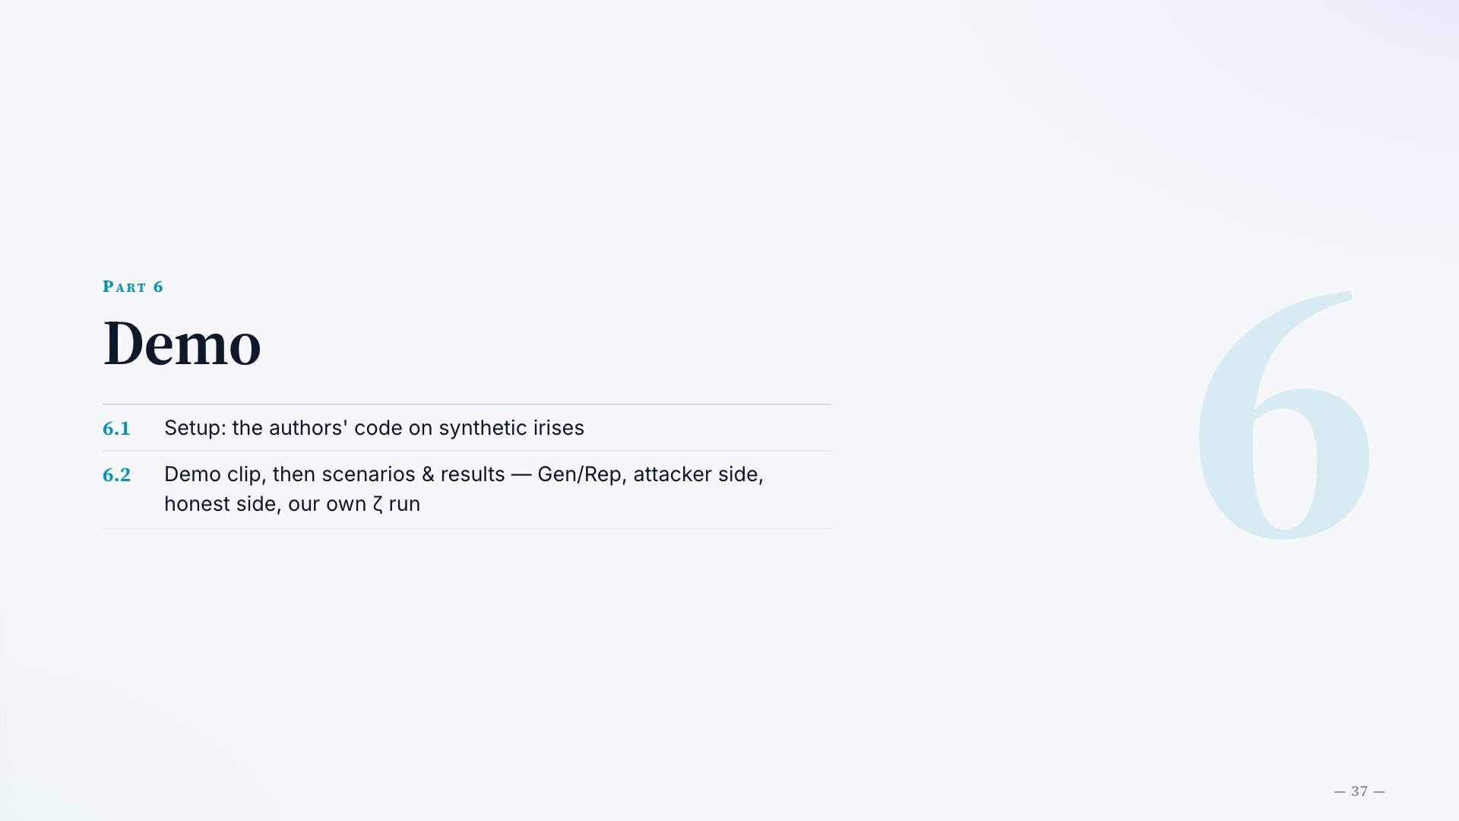
Notes:
Part 6
Demo
6.1
Setup: the authors' code on synthetic irises
6.2
Demo clip, then scenarios & results — Gen/Rep, attacker side, honest side, our own ζ run

Slide 38
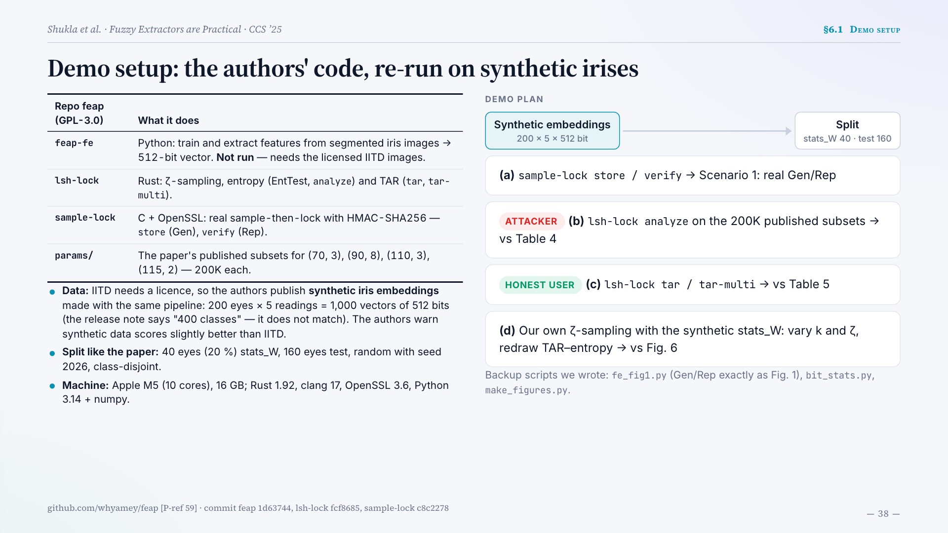
Notes:
Demo setup: the authors' code, re-run on synthetic irises
Repo feap (GPL-3.0) What it does
feap-fe Python: train and extract features from segmented iris images → 512-bit vector. Not run — needs the licensed IITD images.
lsh-lock Rust: ζ-sampling, entropy (EntTest, analyze) and TAR (tar, tar-multi).
sample-lock C + OpenSSL: real sample-then-lock with HMAC-SHA256 — store (Gen), verify (Rep).
params/ The paper's published subsets for (70, 3), (90, 8), (110, 3), (115, 2) — 200K each.
Data: IITD needs a licence, so the authors publish synthetic iris embeddings made with the same pipeline: 200 eyes × 5 readings = 1,000 vectors of 512 bits (the release note says "400 classes" — it does not match). The authors warn synthetic data scores slightly better than IITD.
Split like the paper: 40 eyes (20 %) stats_W, 160 eyes test, random with seed 2026, class-disjoint.
Machine: Apple M5 (10 cores), 16 GB; Rust 1.92, clang 17, OpenSSL 3.6, Python 3.14 + numpy.
DEMO PLAN
Synthetic embeddings
200 × 5 × 512 bit
Split
stats_W 40 · test 160
(a) sample-lock store / verify → Scenario 1: real Gen/Rep
ATTACKER
(b) lsh-lock analyze on the 200K published subsets → vs Table 4
HONEST USER
(c) lsh-lock tar / tar-multi → vs Table 5
(d) Our own ζ-sampling with the synthetic stats_W: vary k and ζ, redraw TAR–entropy → vs Fig. 6
Backup scripts we wrote: fe_fig1.py (Gen/Rep exactly as Fig. 1), bit_stats.py, make_figures.py.
github.com/whyamey/feap [P-ref 59] · commit feap 1d63744, lsh-lock fcf8685, sample-lock c8c2278

Slide 39
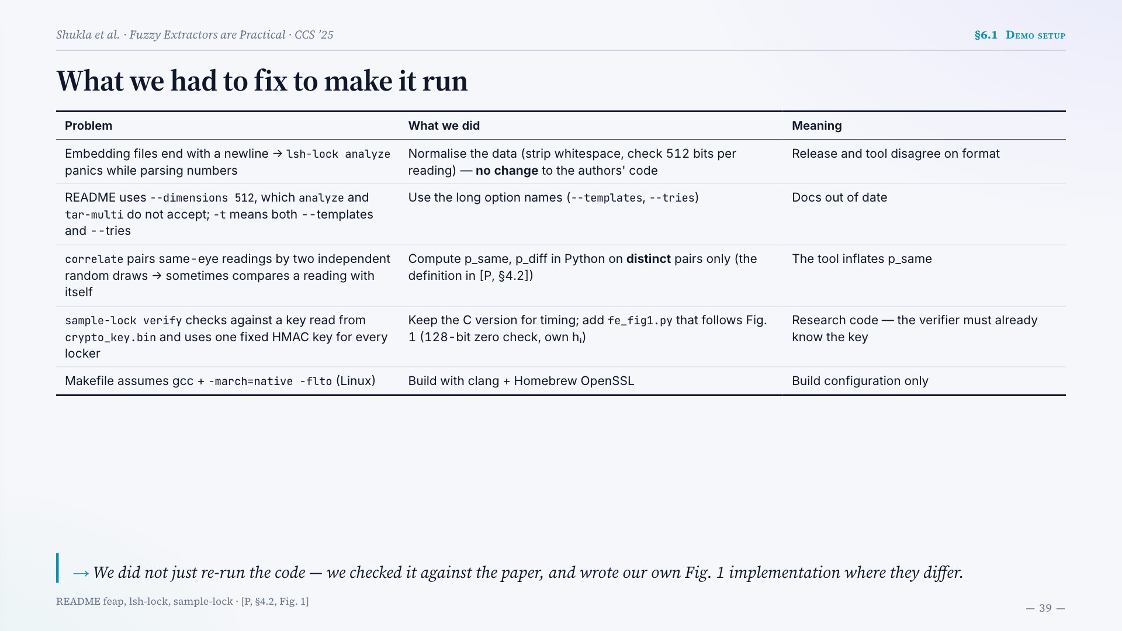
Notes:
What we had to fix to make it run
Problem What we did Meaning
Embedding files end with a newline → lsh-lock analyze panics while parsing numbers Normalise the data (strip whitespace, check 512 bits per reading) — no change to the authors' code Release and tool disagree on format
README uses --dimensions 512, which analyze and tar-multi do not accept; -t means both --templates and --tries Use the long option names (--templates, --tries) Docs out of date
correlate pairs same-eye readings by two independent random draws → sometimes compares a reading with itself Compute p_same, p_diff in Python on distinct pairs only (the definition in [P, §4.2]) The tool inflates p_same
sample-lock verify checks against a key read from crypto_key.bin and uses one fixed HMAC key for every locker Keep the C version for timing; add fe_fig1.py that follows Fig. 1 (128-bit zero check, own hᵢ) Research code — the verifier must already know the key
Makefile assumes gcc + -march=native -flto (Linux) Build with clang + Homebrew OpenSSL Build configuration only
We did not just re-run the code — we checked it against the paper, and wrote our own Fig. 1 implementation where they differ.
README feap, lsh-lock, sample-lock · [P, §4.2, Fig. 1]

Slide 40
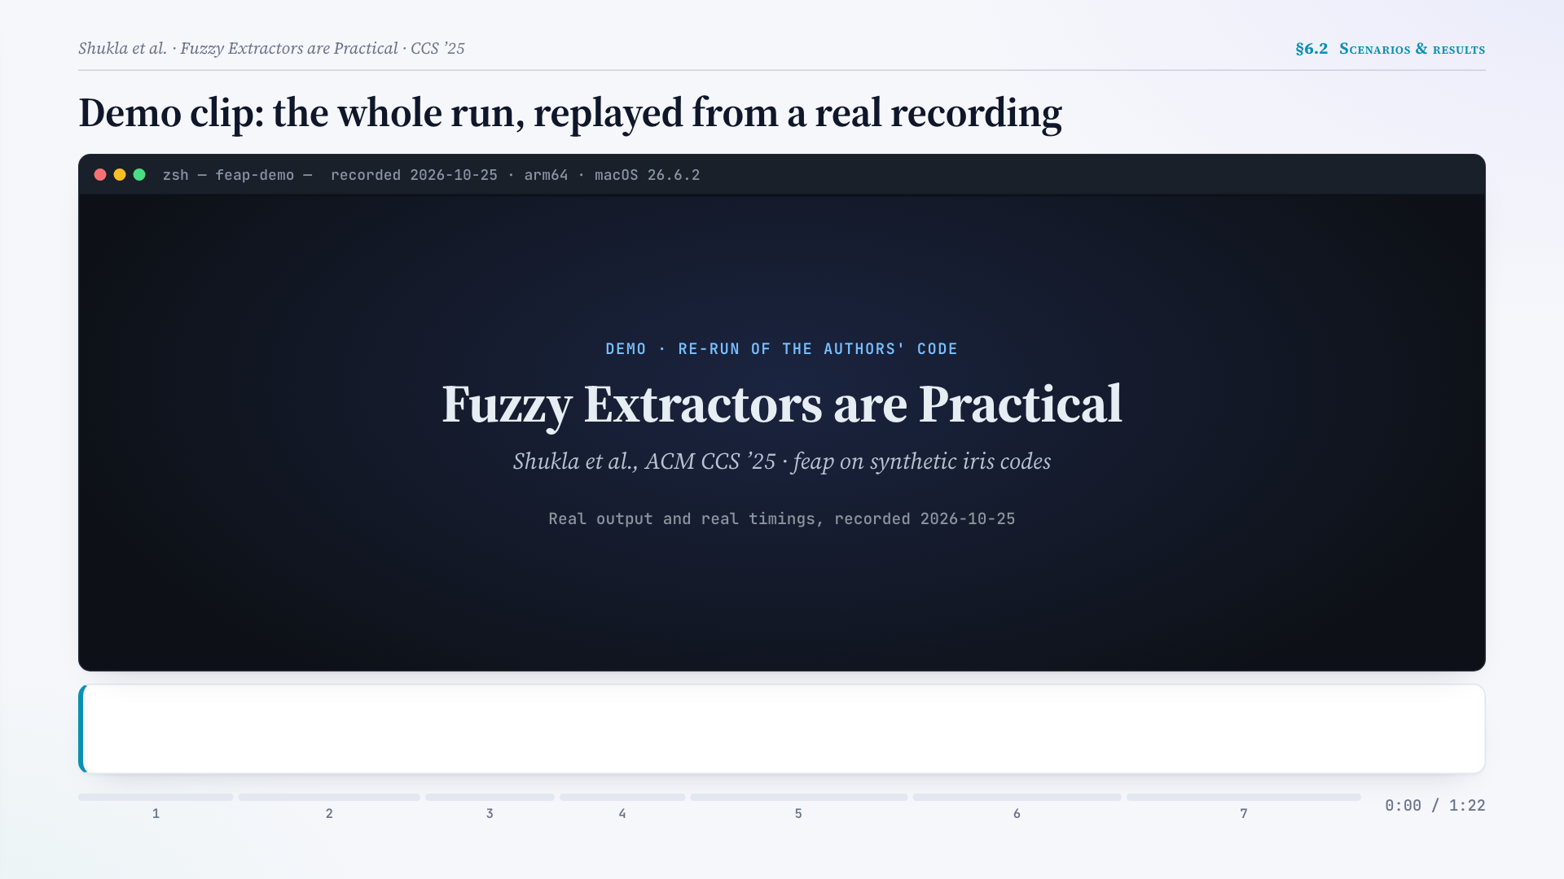
Notes:
Demo clip: the whole run, replayed from a real recording
(Click the video to play.)
1/7 THE DATA — The authors' synthetic test set: 160 eyes × 5 readings. Each reading w is a 512-bit iris code — what Block A outputs. → w ∈ {0,1}512 · 160 × 5
2/7 GEN — ENROL — Enrol reading 1 of eye 70001: each of the paper's 200,000 published subsets (k = 115 bits) locks the key with HMAC-SHA256. The lockers are the helper data. → Helper data 6.4 MB · 0.108 s
3/7 REP — SAME EYE — Reading 3 of the same eye (3.3 % of bits differ): the second locker already opens and gives back exactly the enrolled key. → ✓ Same key · 0.006 s
4/7 REP — ANOTHER EYE — Eye 70002 differs in about half of the bits: all 200,000 lockers are tried and none opens → ⊥ (reject). → ⊥ Rejected · 0.097 s
5/7 NOISY READINGS → SEVERAL READINGS — Our Python version of Fig. 1: readings 2, 4, 5 of the same eye (11–16 % off) open no locker — false rejects, which is why 1-reading TAR is only ≈ 0.7. Enrolling 3 readings, like ClearEyes-M, lets reading 4 in. → 1 reading: 1 of 4 in → 3 readings: ✓
6/7 ATTACKER SIDE — ENTTEST — How hard is it to guess the bits of a locker? Min-entropy of the published subsets, measured on other eyes: the first 1,000 subsets live, all 200,000 run beforehand (≈ 4 min). → Min-entropy 105.4 bit · paper 105
7/7 HONEST SIDE — TAR — And do real users get in? ClearEyes-M setting — 3 readings to enrol, 2 tries to log in — over all 160 eyes. → TAR 0.9875 · 158 / 160 eyes

Slide 41
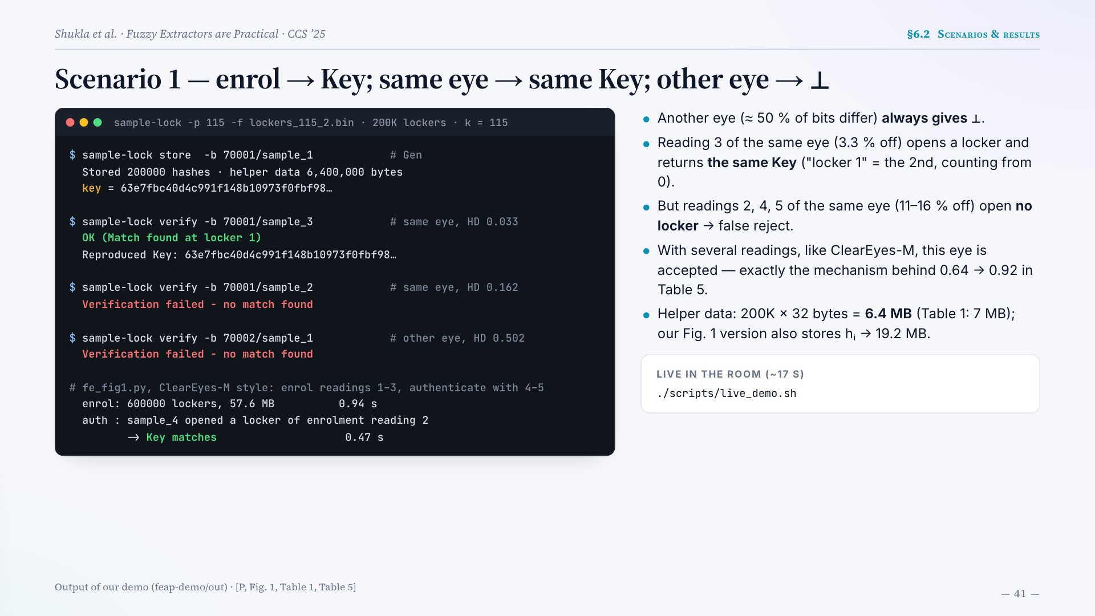
Notes:
Scenario 1 — enrol → Key; same eye → same Key; other eye → ⊥
sample-lock -p 115 -f lockers_115_2.bin · 200K lockers · k = 115
$ sample-lock store -b 70001/sample_1 # Gen
Stored 200000 hashes · helper data 6,400,000 bytes
key = 63e7fbc40d4c991f148b10973f0fbf98…
$ sample-lock verify -b 70001/sample_3 # same eye, HD 0.033
OK (Match found at locker 1)
Reproduced Key: 63e7fbc40d4c991f148b10973f0fbf98…
$ sample-lock verify -b 70001/sample_2 # same eye, HD 0.162
Verification failed - no match found
$ sample-lock verify -b 70002/sample_1 # other eye, HD 0.502
Verification failed - no match found
# fe_fig1.py, ClearEyes-M style: enrol readings 1–3, authenticate with 4–5
enrol: 600000 lockers, 57.6 MB 0.94 s
auth : sample_4 opened a locker of enrolment reading 2
-> Key matches 0.47 s
Another eye (≈ 50 % of bits differ) always gives ⊥.
Reading 3 of the same eye (3.3 % off) opens a locker and returns the same Key ("locker 1" = the 2nd, counting from 0).
But readings 2, 4, 5 of the same eye (11–16 % off) open no locker → false reject.
With several readings, like ClearEyes-M, this eye is accepted — exactly the mechanism behind 0.64 → 0.92 in Table 5.
Helper data: 200K × 32 bytes = 6.4 MB (Table 1: 7 MB); our Fig. 1 version also stores hᵢ → 19.2 MB.
LIVE IN THE ROOM (~17 S)
./scripts/live_demo.sh
Output of our demo (feap-demo/out) · [P, Fig. 1, Table 1, Table 5]

Slide 42
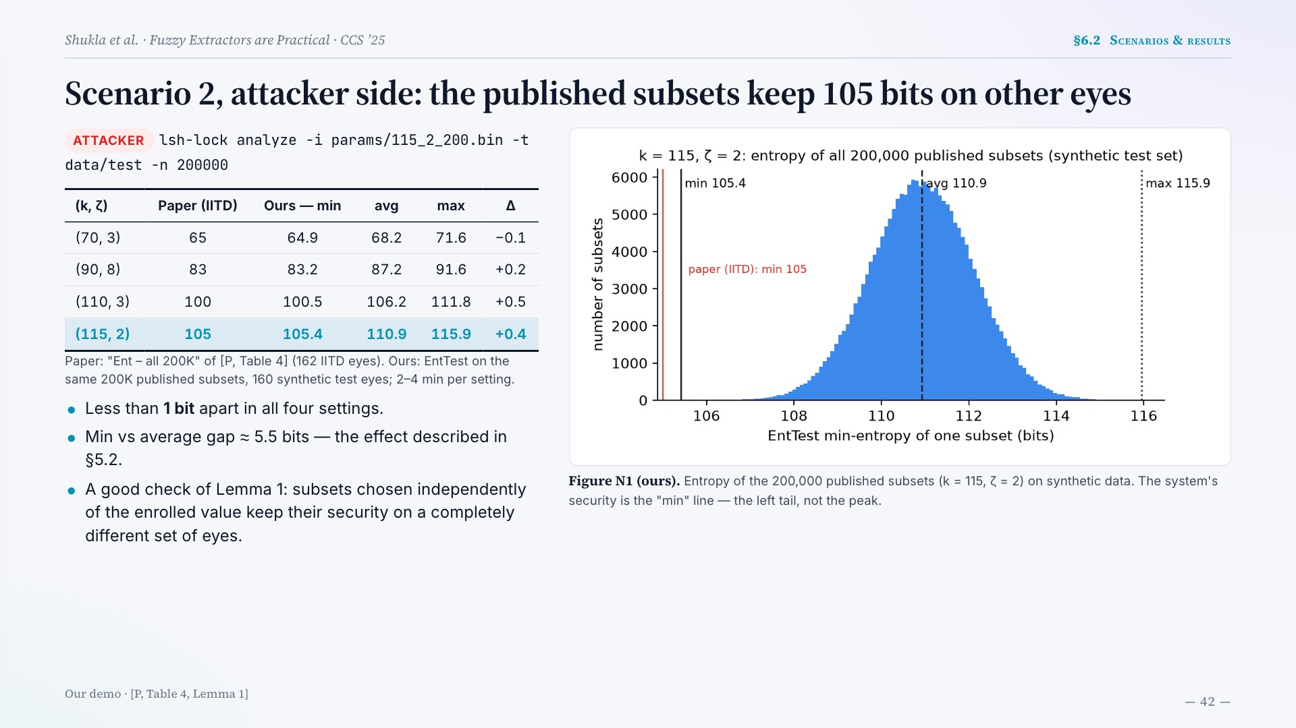
Notes:
Scenario 2, attacker side: the published subsets keep 105 bits on other eyes
ATTACKER
lsh-lock analyze -i params/115_2_200.bin -t data/test -n 200000
(k, ζ) Paper (IITD) Ours — min avg max Δ
(70, 3) 65 64.9 68.2 71.6 −0.1
(90, 8) 83 83.2 87.2 91.6 +0.2
(110, 3) 100 100.5 106.2 111.8 +0.5
(115, 2) 105 105.4 110.9 115.9 +0.4
Paper: "Ent – all 200K" of [P, Table 4] (162 IITD eyes). Ours: EntTest on the same 200K published subsets, 160 synthetic test eyes; 2–4 min per setting.
Less than 1 bit apart in all four settings.
Min vs average gap ≈ 5.5 bits — the effect described in §5.2.
A good check of Lemma 1: subsets chosen independently of the enrolled value keep their security on a completely different set of eyes.
Figure N1 (ours). Entropy of the 200,000 published subsets (k = 115, ζ = 2) on synthetic data. The system's security is the "min" line — the left tail, not the peak.
Our demo · [P, Table 4, Lemma 1]

Slide 43
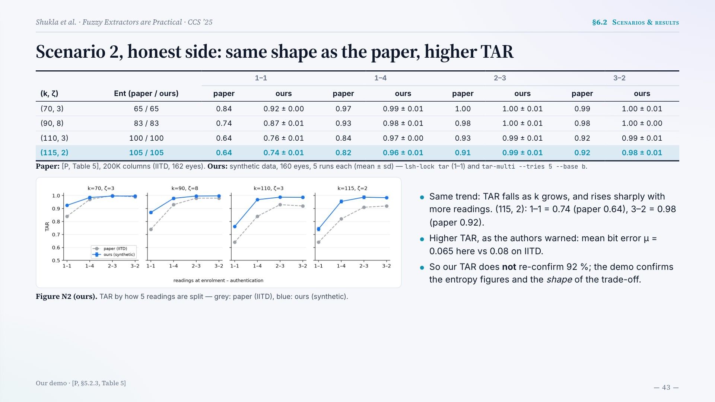
Notes:
Scenario 2, honest side: same shape as the paper, higher TAR
(k, ζ) Ent (paper / ours) 1–1 1–4 2–3 3–2
paper ours paper ours paper ours paper ours
(70, 3) 65 / 65 0.84 0.92 ± 0.00 0.97 0.99 ± 0.01 1.00 1.00 ± 0.01 0.99 1.00 ± 0.01
(90, 8) 83 / 83 0.74 0.87 ± 0.01 0.93 0.98 ± 0.01 0.98 1.00 ± 0.01 0.98 1.00 ± 0.00
(110, 3) 100 / 100 0.64 0.76 ± 0.01 0.84 0.97 ± 0.00 0.93 0.99 ± 0.01 0.92 0.99 ± 0.01
(115, 2) 105 / 105 0.64 0.74 ± 0.01 0.82 0.96 ± 0.01 0.91 0.99 ± 0.01 0.92 0.98 ± 0.01
Paper: [P, Table 5], 200K columns (IITD, 162 eyes). Ours: synthetic data, 160 eyes, 5 runs each (mean ± sd) — lsh-lock tar (1–1) and tar-multi --tries 5 --base b.
Figure N2 (ours). TAR by how 5 readings are split — grey: paper (IITD), blue: ours (synthetic).
Same trend: TAR falls as k grows, and rises sharply with more readings. (115, 2): 1–1 = 0.74 (paper 0.64), 3–2 = 0.98 (paper 0.92).
Higher TAR, as the authors warned: mean bit error μ = 0.065 here vs 0.08 on IITD.
So our TAR does not re-confirm 92 %; the demo confirms the entropy figures and the shape of the trade-off.
Our demo · [P, §5.2.3, Table 5]

Slide 44
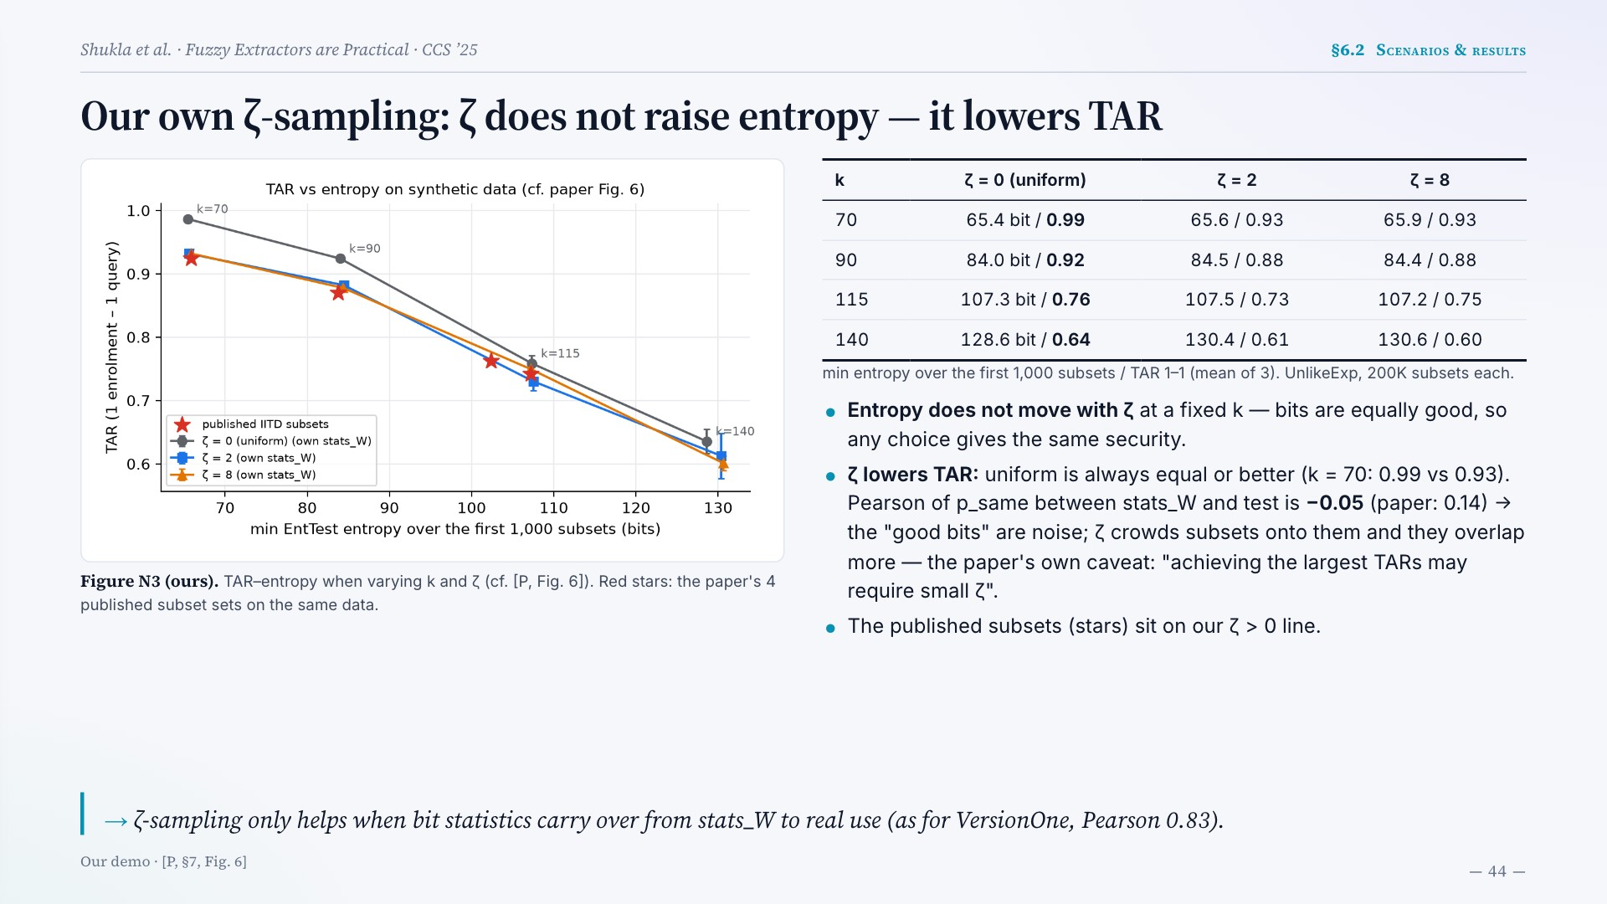
Notes:
Our own ζ-sampling: ζ does not raise entropy — it lowers TAR
Figure N3 (ours). TAR–entropy when varying k and ζ (cf. [P, Fig. 6]). Red stars: the paper's 4 published subset sets on the same data.
k ζ = 0 (uniform) ζ = 2 ζ = 8
70 65.4 bit / 0.99 65.6 / 0.93 65.9 / 0.93
90 84.0 bit / 0.92 84.5 / 0.88 84.4 / 0.88
115 107.3 bit / 0.76 107.5 / 0.73 107.2 / 0.75
140 128.6 bit / 0.64 130.4 / 0.61 130.6 / 0.60
min entropy over the first 1,000 subsets / TAR 1–1 (mean of 3). UnlikeExp, 200K subsets each.
Entropy does not move with ζ at a fixed k — bits are equally good, so any choice gives the same security.
ζ lowers TAR: uniform is always equal or better (k = 70: 0.99 vs 0.93). Pearson of p_same between stats_W and test is −0.05 (paper: 0.14) → the "good bits" are noise; ζ crowds subsets onto them and they overlap more — the paper's own caveat: "achieving the largest TARs may require small ζ".
The published subsets (stars) sit on our ζ > 0 line.
ζ-sampling only helps when bit statistics carry over from stats_W to real use (as for VersionOne, Pearson 0.83).
Our demo · [P, §7, Fig. 6]

Slide 45
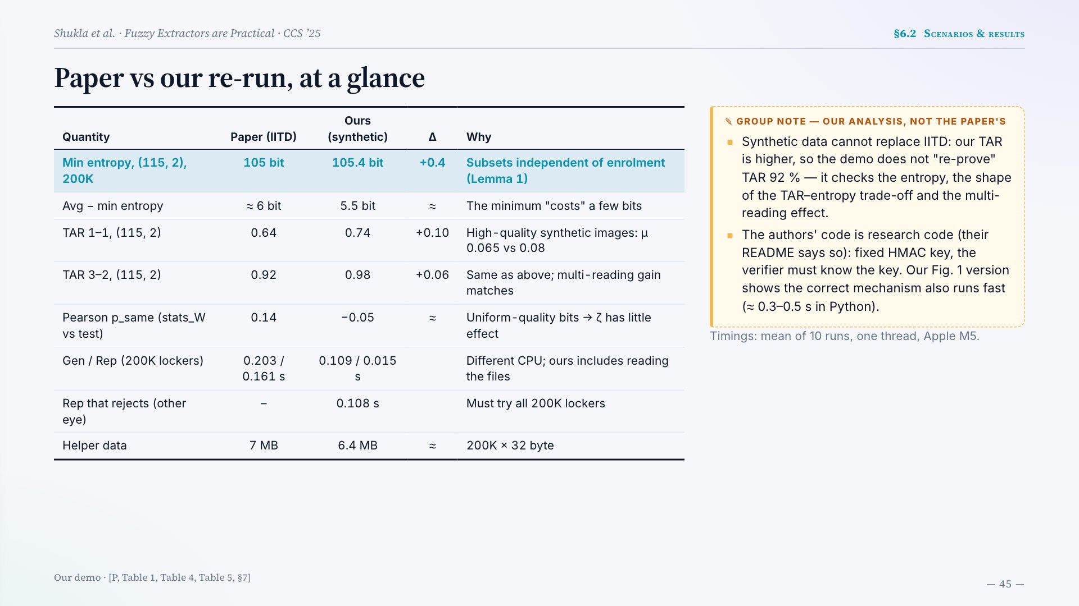
Notes:
Paper vs our re-run, at a glance
Quantity Paper (IITD) Ours (synthetic) Δ Why
Min entropy, (115, 2), 200K 105 bit 105.4 bit +0.4 Subsets independent of enrolment (Lemma 1)
Avg − min entropy ≈ 6 bit 5.5 bit ≈ The minimum "costs" a few bits
TAR 1–1, (115, 2) 0.64 0.74 +0.10 High-quality synthetic images: μ 0.065 vs 0.08
TAR 3–2, (115, 2) 0.92 0.98 +0.06 Same as above; multi-reading gain matches
Pearson p_same (stats_W vs test) 0.14 −0.05 ≈ Uniform-quality bits → ζ has little effect
Gen / Rep (200K lockers) 0.203 / 0.161 s 0.109 / 0.015 s Different CPU; ours includes reading the files
Rep that rejects (other eye) – 0.108 s Must try all 200K lockers
Helper data 7 MB 6.4 MB ≈ 200K × 32 byte
Synthetic data cannot replace IITD: our TAR is higher, so the demo does not "re-prove" TAR 92 % — it checks the entropy, the shape of the TAR–entropy trade-off and the multi-reading effect.
The authors' code is research code (their README says so): fixed HMAC key, the verifier must know the key. Our Fig. 1 version shows the correct mechanism also runs fast (≈ 0.3–0.5 s in Python).
Timings: mean of 10 runs, one thread, Apple M5.
Our demo · [P, Table 1, Table 4, Table 5, §7]

Slide 46

Notes:
Part 7
Discussion & conclusion
7.1
What the 105 bits depend on · BTP criteria & deployment
7.2
Three ideas — and is it practical?

Slide 47
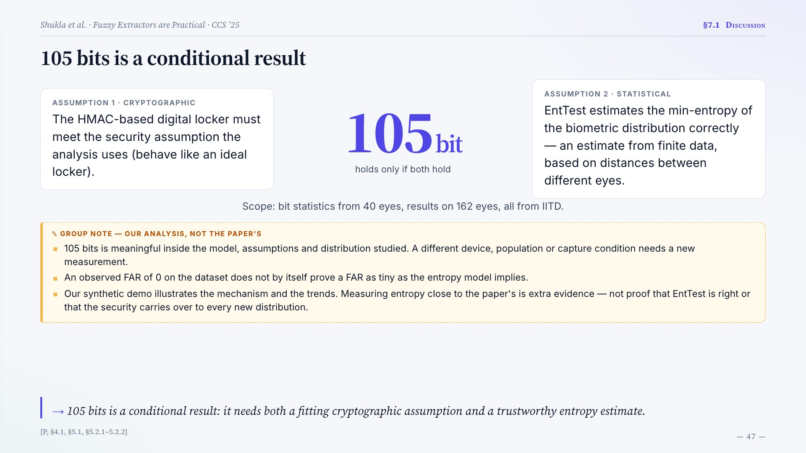
Notes:
105 bits is a conditional result
ASSUMPTION 1 · CRYPTOGRAPHIC
The HMAC-based digital locker must meet the security assumption the analysis uses (behave like an ideal locker).
105bit
holds only if both hold
ASSUMPTION 2 · STATISTICAL
EntTest estimates the min-entropy of the biometric distribution correctly — an estimate from finite data, based on distances between different eyes.
Scope: bit statistics from 40 eyes, results on 162 eyes, all from IITD.
105 bits is meaningful inside the model, assumptions and distribution studied. A different device, population or capture condition needs a new measurement.
An observed FAR of 0 on the dataset does not by itself prove a FAR as tiny as the entropy model implies.
Our synthetic demo illustrates the mechanism and the trends. Measuring entropy close to the paper's is extra evidence — not proof that EntTest is right or that the security carries over to every new distribution.
105 bits is a conditional result: it needs both a fitting cryptographic assumption and a trustworthy entropy estimate.
[P, §4.1, §5.1, §5.2.1–5.2.2]

Slide 48
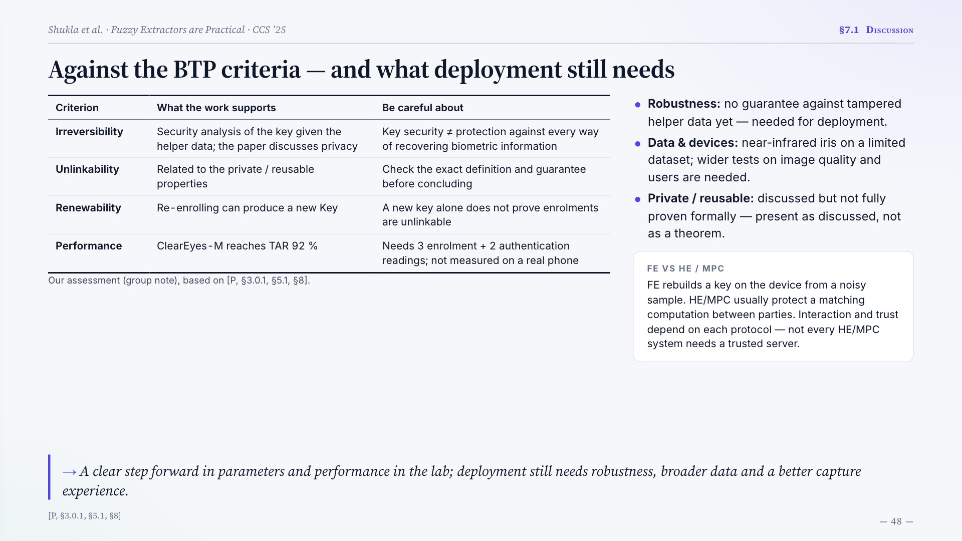
Notes:
Against the BTP criteria — and what deployment still needs
Criterion What the work supports Be careful about
Irreversibility Security analysis of the key given the helper data; the paper discusses privacy Key security ≠ protection against every way of recovering biometric information
Unlinkability Related to the private / reusable properties Check the exact definition and guarantee before concluding
Renewability Re-enrolling can produce a new Key A new key alone does not prove enrolments are unlinkable
Performance ClearEyes-M reaches TAR 92 % Needs 3 enrolment + 2 authentication readings; not measured on a real phone
Our assessment (group note), based on [P, §3.0.1, §5.1, §8].
Robustness: no guarantee against tampered helper data yet — needed for deployment.
Data & devices: near-infrared iris on a limited dataset; wider tests on image quality and users are needed.
Private / reusable: discussed but not fully proven formally — present as discussed, not as a theorem.
FE VS HE / MPC
FE rebuilds a key on the device from a noisy sample. HE/MPC usually protect a matching computation between parties. Interaction and trust depend on each protocol — not every HE/MPC system needs a trusted server.
A clear step forward in parameters and performance in the lab; deployment still needs robustness, broader data and a better capture experience.
[P, §3.0.1, §5.1, §8]

Slide 49
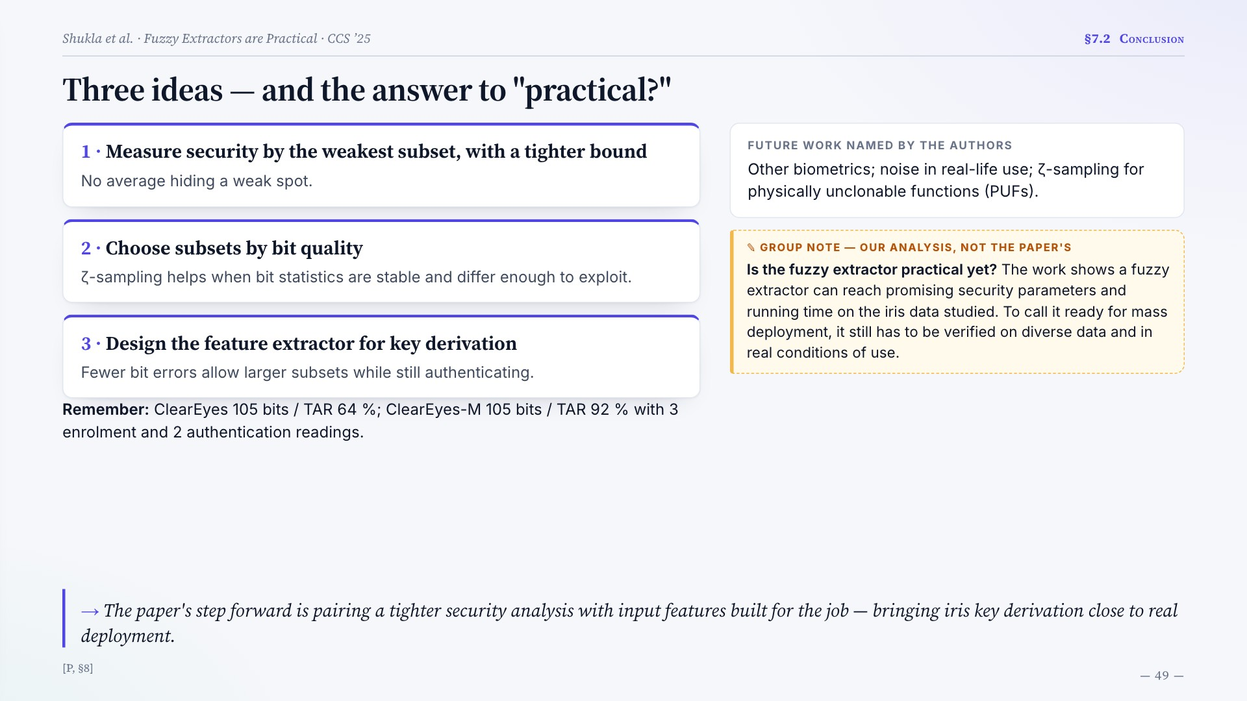
Notes:
Three ideas — and the answer to "practical?"
1 · Measure security by the weakest subset, with a tighter bound
No average hiding a weak spot.
2 · Choose subsets by bit quality
ζ-sampling helps when bit statistics are stable and differ enough to exploit.
3 · Design the feature extractor for key derivation
Fewer bit errors allow larger subsets while still authenticating.
Remember: ClearEyes 105 bits / TAR 64 %; ClearEyes-M 105 bits / TAR 92 % with 3 enrolment and 2 authentication readings.
FUTURE WORK NAMED BY THE AUTHORS
Other biometrics; noise in real-life use; ζ-sampling for physically unclonable functions (PUFs).
Is the fuzzy extractor practical yet? The work shows a fuzzy extractor can reach promising security parameters and running time on the iris data studied. To call it ready for mass deployment, it still has to be verified on diverse data and in real conditions of use.
The paper's step forward is pairing a tighter security analysis with input features built for the job — bringing iris key derivation close to real deployment.
[P, §8]

Slide 50
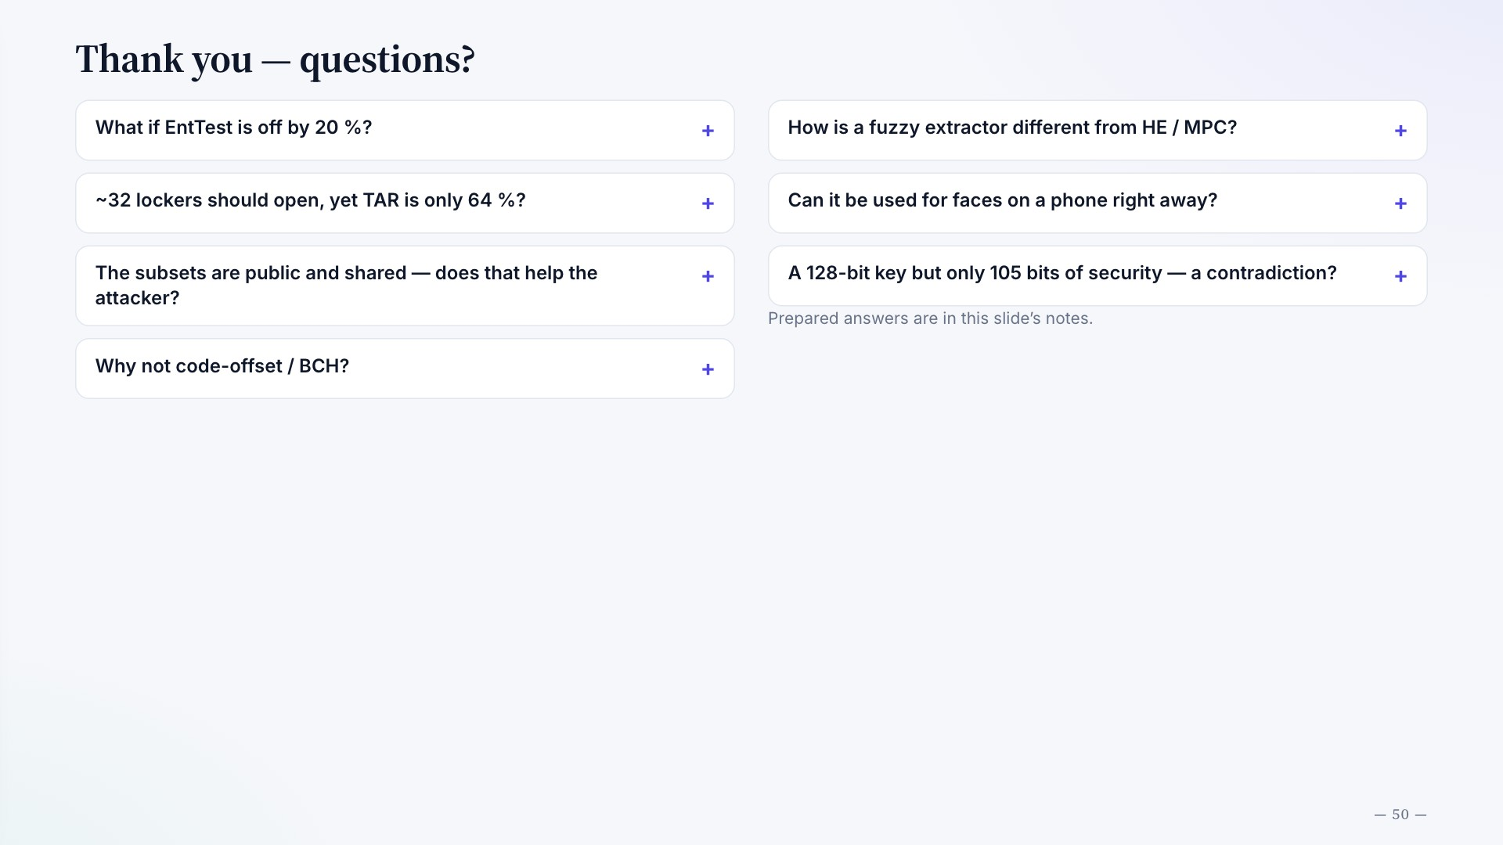
Notes:
Thank you — questions?
What if EntTest is off by 20 %?
105 × 0.8 = 84 bits for the weakest subset. By Lemma 1 an attacker with q = 2⁴⁰ tries still has advantage ≤ 2^−44; −log FAR ≈ 66 (ClearEyes), ≈ 63.5 (ClearEyes-M). Fine for authentication, but no longer 80+ bits as a long-term key. NIST SP 800-22 always gave higher numbers, so EntTest is the cautious one; in our demo it was stable across datasets (105 vs 105.4).
~32 lockers should open, yet TAR is only 64 %?
The 32 assumes every pair has the same error rate μ. Real errors vary a lot: with k = 115, β = 200K, the expected number of open lockers drops to 1 at distance d* ≈ 0.101; on our data 17 % of same-eye pairs are farther than that and get rejected (Figure N4). Correlated errors and overlapping subsets explain the rest — hence several readings beat a larger β.
The subsets are public and shared — does that help the attacker?
The analysis already assumes the attacker knows all subsets. Lemma 1 only needs them to be chosen independently of the enrolee's iris; security is then the entropy of the weakest published subset, ≤ q·2^−ν. Publishing them is what lets Setup filter weak subsets out.
Why not code-offset / BCH?
Error correction makes the helper data cost entropy. In the example, correction costs ≈ 480 bits while the real entropy is below 250, so FEQual = 0. That says these parameters and the iris distribution are hard for this approach — not that BCH is always useless.
How is a fuzzy extractor different from HE / MPC?
A FE creates and rebuilds one stable key from noisy data, with helper data. HE/MPC compute something — e.g. a match — while limiting what each party learns. Different goals and models; whether a server or interaction is needed depends on the protocol.
Can it be used for faces on a phone right away?
The FE idea is not tied to the iris, but 105 bits / 92 % are iris results in a specific setting. Faces have different features and noise, so the extractor, the entropy and the TAR must all be designed and measured again.
A 128-bit key but only 105 bits of security — a contradiction?
No. 128 bits is the length of the key string; 105 bits is the security level from the analysis and entropy estimate. The system is limited by the biometric source and the public information, not by the output length.
Prepared answers are in this slide’s notes.

Slide 51
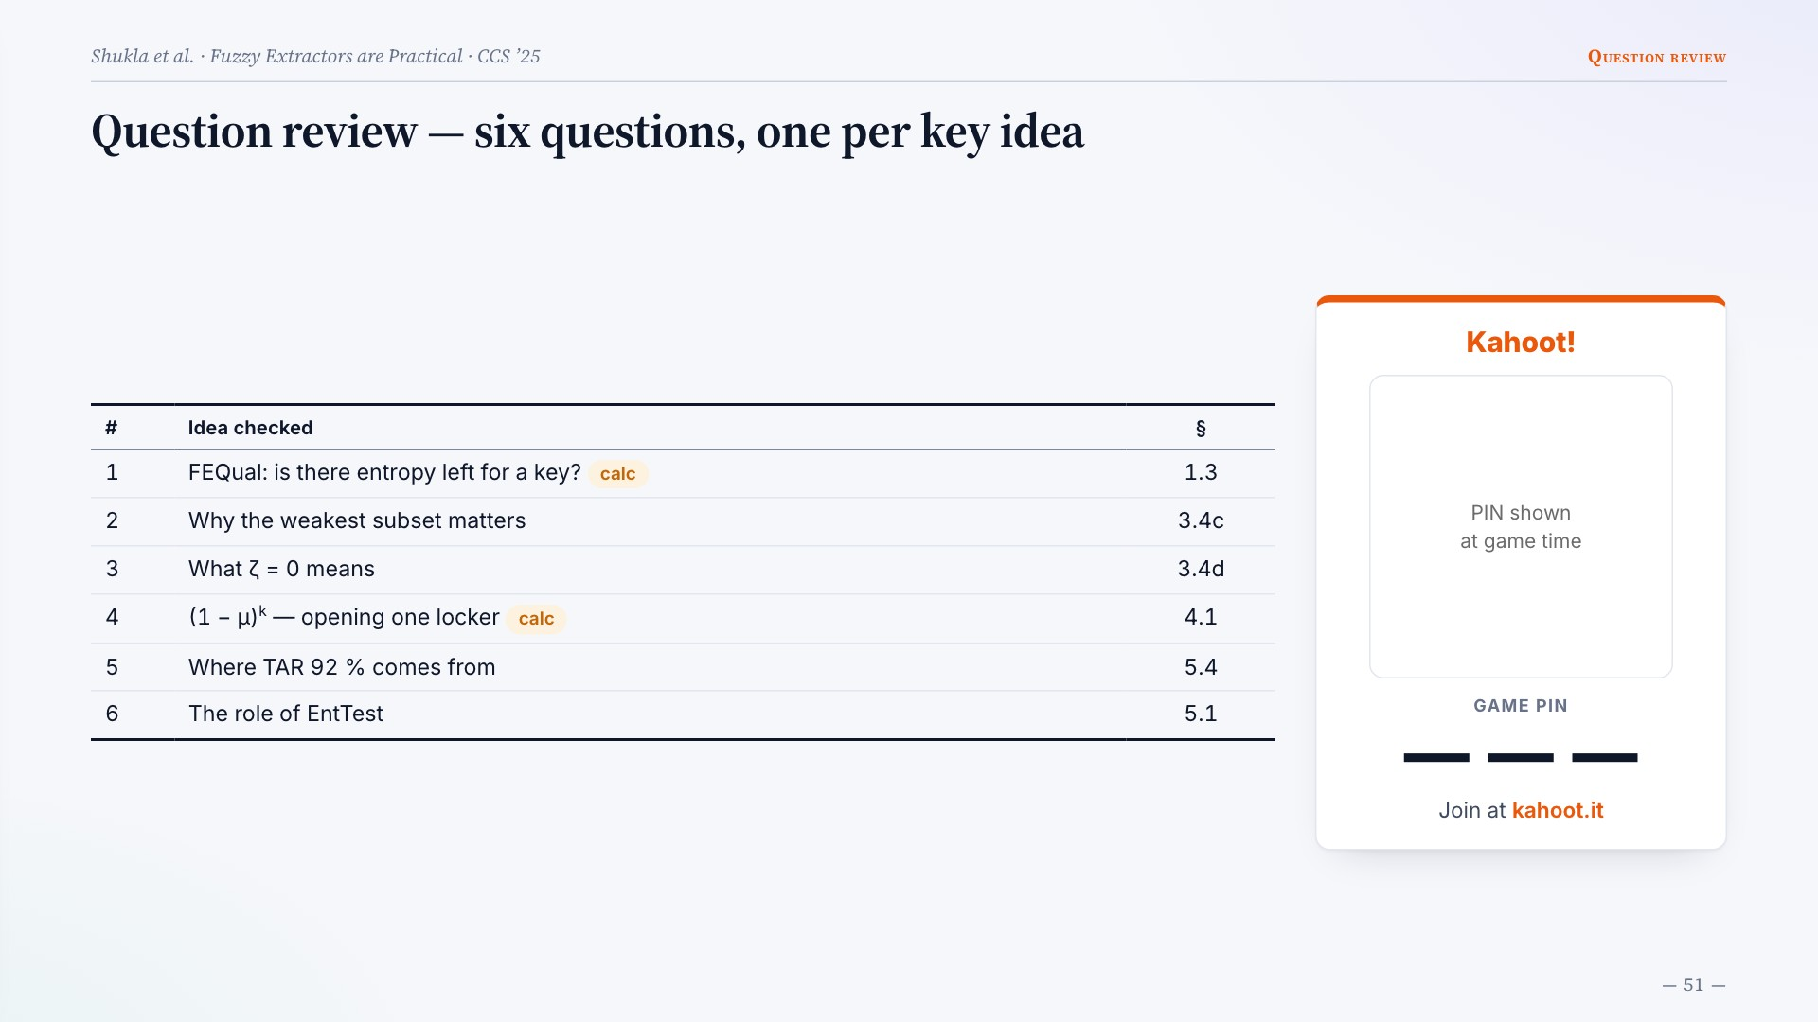
Notes:
Question review — six questions, one per key idea
# Idea checked §
1 FEQual: is there entropy left for a key?
calc
1.3
2 Why the weakest subset matters 3.4c
3 What ζ = 0 means 3.4d
4 (1 − μ)k — opening one locker
calc
4.1
5 Where TAR 92 % comes from 5.4
6 The role of EntTest 5.1
Kahoot!
PIN shown
at game time
GAME PIN
— — —
Join at kahoot.it

Slide 52
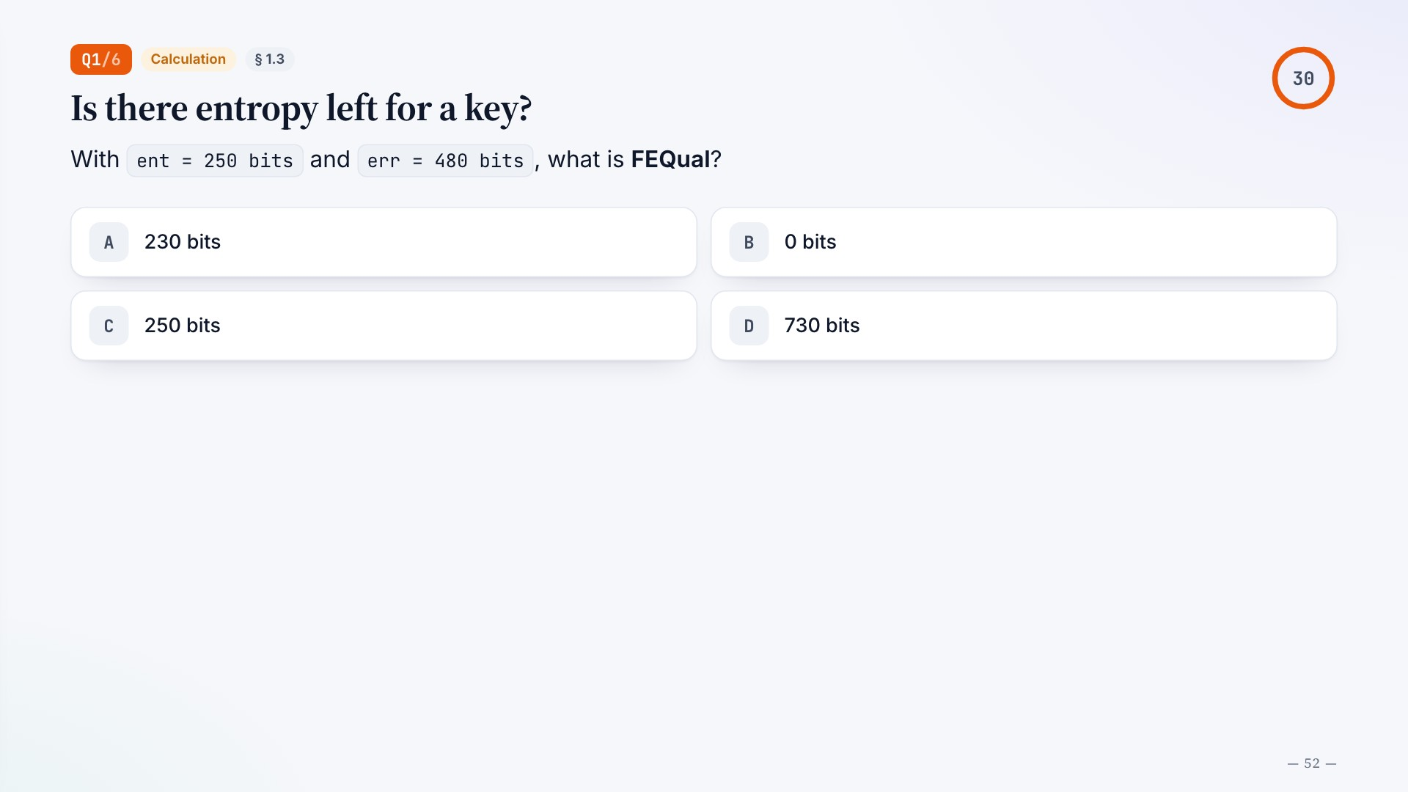
Notes:
Q1/6
Calculation
§ 1.3
Is there entropy left for a key?
With ent = 250 bits and err = 480 bits, what is FEQual?
A
230 bits
B
0 bits
C
250 bits
D
730 bits

Slide 53
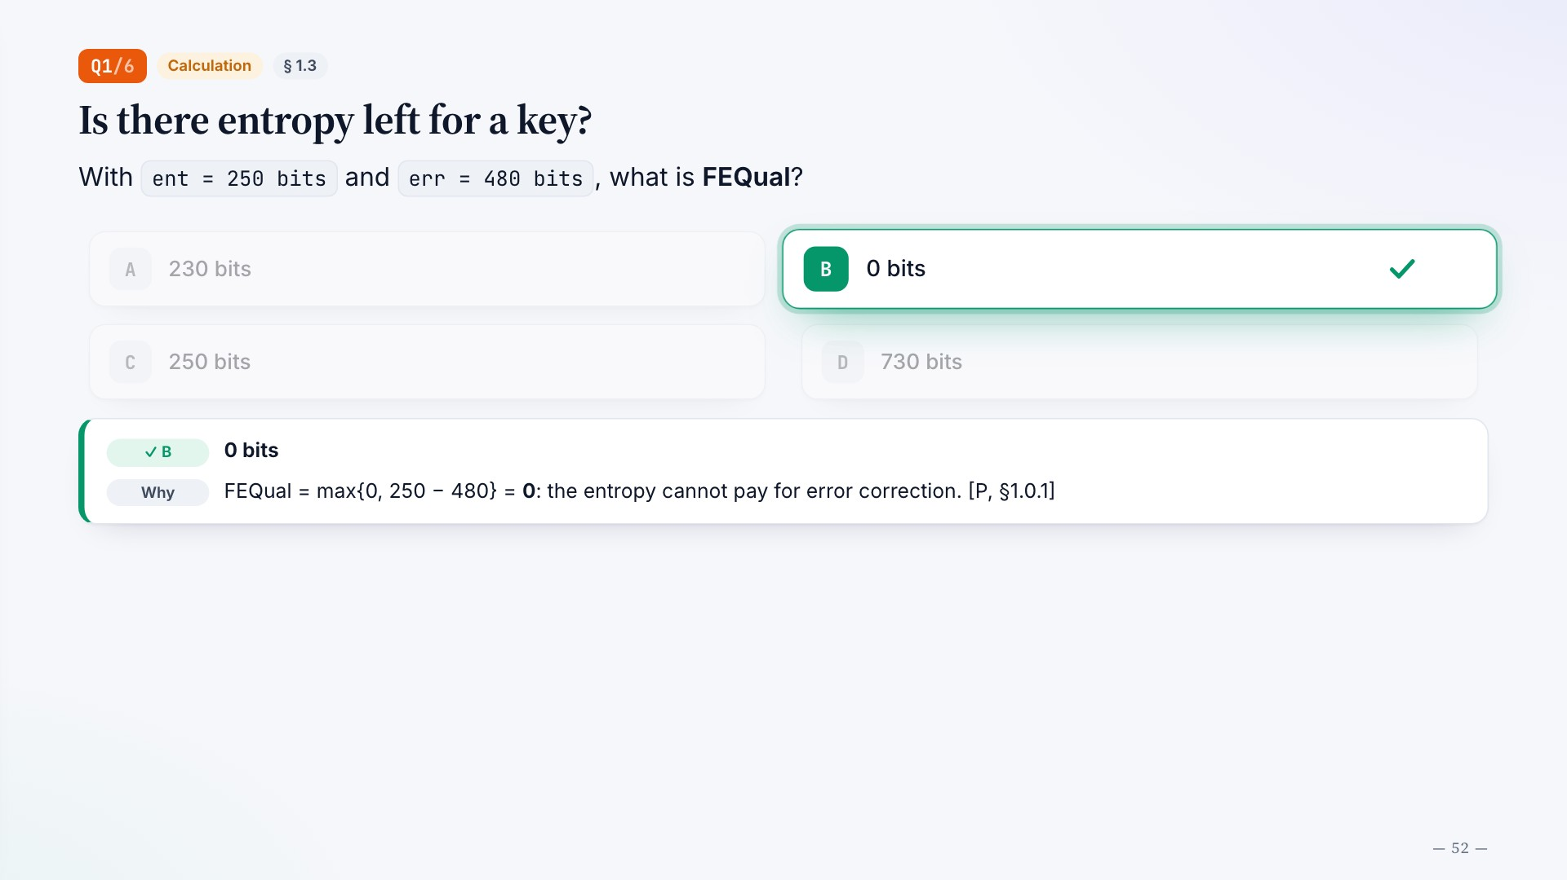
Notes:
Q1/6
Calculation
§ 1.3
Is there entropy left for a key?
30
With ent = 250 bits and err = 480 bits, what is FEQual?
A
230 bits
B
0 bits
C
250 bits
D
730 bits
✓ B
0 bits
Why
FEQual = max{0, 250 − 480} = 0: the entropy cannot pay for error correction. [P, §1.0.1]

Slide 54
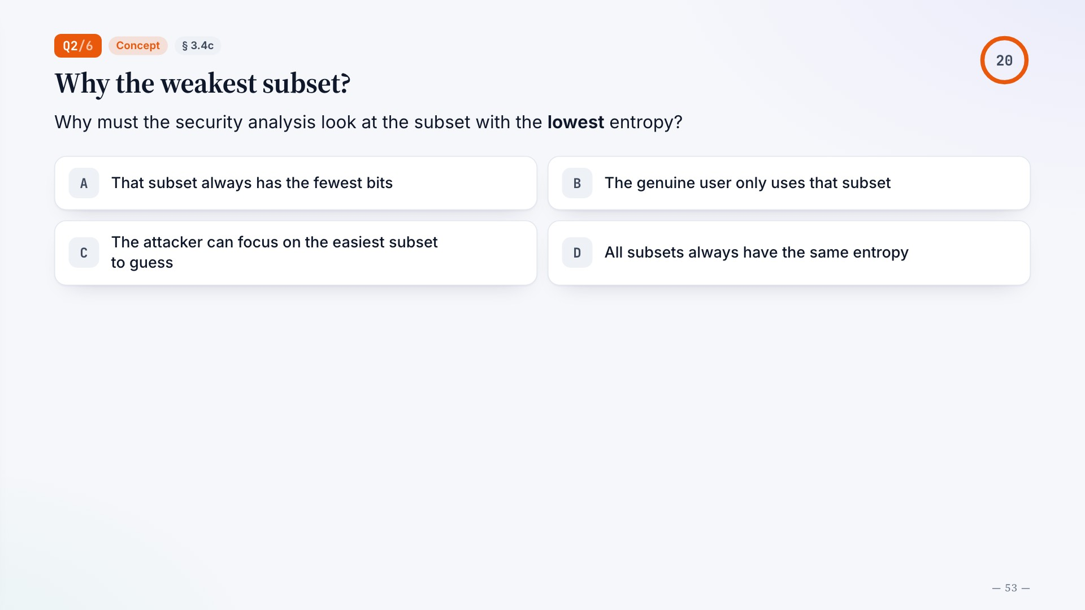
Notes:
Q2/6
Concept
§ 3.4c
Why the weakest subset?
Why must the security analysis look at the subset with the lowest entropy?
A
That subset always has the fewest bits
B
The genuine user only uses that subset
C
The attacker can focus on the easiest subset to guess
D
All subsets always have the same entropy

Slide 55
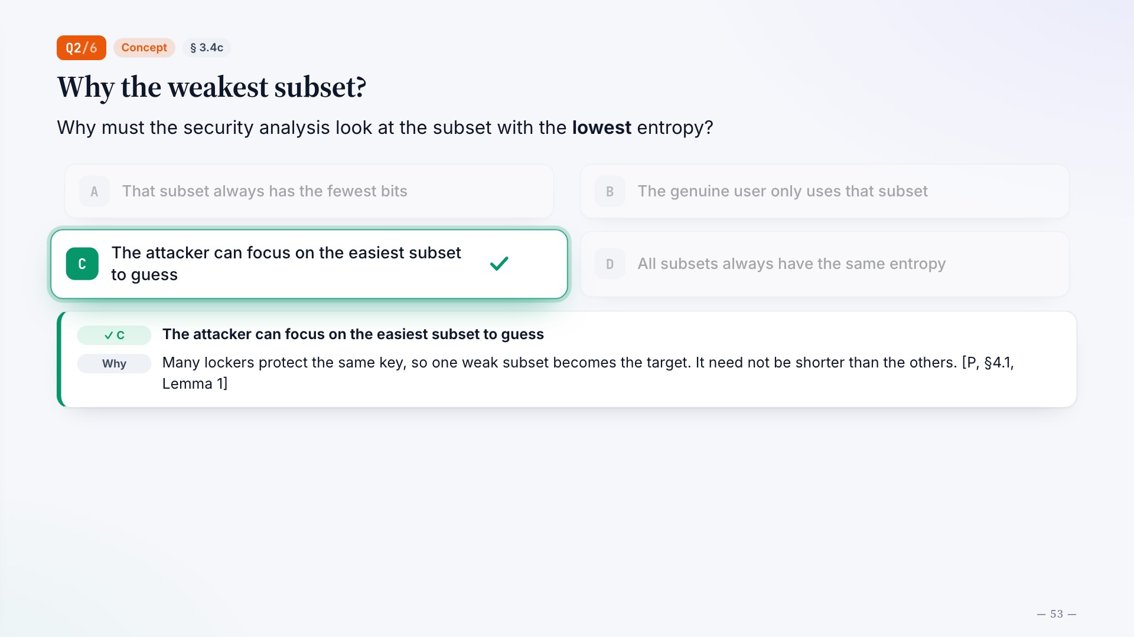
Notes:
Q2/6
Concept
§ 3.4c
Why the weakest subset?
20
Why must the security analysis look at the subset with the lowest entropy?
A
That subset always has the fewest bits
B
The genuine user only uses that subset
C
The attacker can focus on the easiest subset to guess
D
All subsets always have the same entropy
✓ C
The attacker can focus on the easiest subset to guess
Why
Many lockers protect the same key, so one weak subset becomes the target. It need not be shorter than the others. [P, §4.1, Lemma 1]

Slide 56

Notes:
Q3/6
Concept
§ 3.4d
ζ = 0 in ζ-sampling
In the bit-selection rule with weight p_same,i^ζ, what does ζ = 0 correspond to?
A
Uniform choice among eligible bits
B
Only the bit with the largest p_same
C
Drop every bit that has errors
D
Choose bits by the enrolee’s identity

Slide 57

Notes:
Q3/6
Concept
§ 3.4d
ζ = 0 in ζ-sampling
20
In the bit-selection rule with weight p_same,i^ζ, what does ζ = 0 correspond to?
A
Uniform choice among eligible bits
B
Only the bit with the largest p_same
C
Drop every bit that has errors
D
Choose bits by the enrolee’s identity
✓ A
Uniform choice among eligible bits
Why
Every weight becomes 1, so sampling is uniform; a large ζ concentrates on bits with high p_same. [P, §2.1.3]

Slide 58

Notes:
Q4/6
Calculation
§ 4.1
Opening one locker
With independent bit errors, μ = 0.10 and k = 2, what is the probability that a whole subset is error-free?
A
0.18
B
0.81
C
0.90
D
0.99

Slide 59

Notes:
Q4/6
Calculation
§ 4.1
Opening one locker
30
With independent bit errors, μ = 0.10 and k = 2, what is the probability that a whole subset is error-free?
A
0.18
B
0.81
C
0.90
D
0.99
✓ B
0.81
Why
(1 − μ)k = 0.9² = 0.81. It drops as k grows; a lower μ allows a larger k. The model ignores correlated errors. [P, §2.1.2]

Slide 60

Notes:
Q5/6
Concept
§ 5.4
Where 92 % comes from
ClearEyes-M reaches TAR 92 % in its final configuration. With how many readings?
A
1 enrolment, 1 authentication
B
1 enrolment, 4 authentication
C
3 enrolment, 2 authentication
D
5 enrolment, 5 authentication

Slide 61

Notes:
Q5/6
Concept
§ 5.4
Where 92 % comes from
20
ClearEyes-M reaches TAR 92 % in its final configuration. With how many readings?
A
1 enrolment, 1 authentication
B
1 enrolment, 4 authentication
C
3 enrolment, 2 authentication
D
5 enrolment, 5 authentication
✓ C
3 enrolment, 2 authentication
Why
More readings give more enrolment–authentication pairs that can match. 1–1 gives 64 % at the same 105 bits. [P, Table 5]

Slide 62

Notes:
Q6/6
Concept
§ 5.1
The role of EntTest
What role does EntTest play in the 105-bit figure?
A
Encrypts the iris image before storage
B
Estimates the min-entropy of the subsets
C
Measures the running time of HMAC
D
Proves the real FAR is 0 for every user

Slide 63

Notes:
Q6/6
Concept
§ 5.1
The role of EntTest
20
What role does EntTest play in the 105-bit figure?
A
Encrypts the iris image before storage
B
Estimates the min-entropy of the subsets
C
Measures the running time of HMAC
D
Proves the real FAR is 0 for every user
✓ B
Estimates the min-entropy of the subsets
Why
It supplies the entropy estimate used by the analysis; its accuracy is an assumption. FAR = 0 on the sample does not prove FAR = 0. [P, §5.2.1–5.2.2]

Slide 64

Notes:
References
[P] A. Shukla, L. Demarest, B. Fuller, S. Ahmad, C. Manicke, A. Russell, S. Chen, “Fuzzy Extractors are Practical: Cryptographic Strength Key Derivation from the Iris,” in Proc. ACM CCS ’25, 2025, pp. 3605–3619, doi: 10.1145/3719027.3765098.
R. Canetti, B. Fuller, O. Paneth, L. Reyzin, A. Smith, “Reusable fuzzy extractors for low-entropy distributions,” J. Cryptology, vol. 34, no. 1, pp. 1–33, 2021. [P-ref 48]
S. Simhadri, J. Steel, B. Fuller, “Cryptographic authentication from the iris,” in Proc. ISC, 2019, pp. 465–485. [P-ref 45]
K. Zhang, H. Cui, Y. Yu, “Facial template protection via lattice-based fuzzy extractors,” IACR ePrint 2021/1559. [P-ref 47]
F. Zhu et al., “A secure and practical sample-then-lock scheme for iris recognition,” in Proc. ICPR, 2022, pp. 833–839. [P-ref 49]
Y. Dodis, R. Ostrovsky, L. Reyzin, A. Smith, “Fuzzy extractors: How to generate strong keys from biometrics and other noisy data,” SIAM J. Comput., vol. 38, no. 1, pp. 97–139, 2008. [P-ref 14]
J. Daugman, “How iris recognition works,” IEEE Trans. Circuits Syst. Video Technol., vol. 14, no. 1, pp. 21–30, 2004. [P-ref 43]
B. Lynn, M. Prabhakaran, A. Sahai, “Positive results and techniques for obfuscation,” in Proc. EUROCRYPT, 2004, pp. 20–39. [P-ref 52]
S. Ahmad, B. Fuller, “ThirdEye: Triplet based iris recognition without normalization,” in Proc. BTAS, 2019. [P-ref 42]
A. Shukla, S. Ahmad, L. Demarest, B. Fuller, “Fuzzy extractors are practical,” 2025. github.com/whyamey/feap [P-ref 59]
A. Juels, M. Wattenberg, “A fuzzy commitment scheme,” in Proc. ACM CCS, 1999.
F. Hao, R. Anderson, J. Daugman, “Combining crypto with biometrics effectively,” IEEE Trans. Computers, vol. 55, no. 9, 2006. [P-ref 16]
B. Fuller, X. Meng, L. Reyzin, “Computational fuzzy extractors,” in Proc. ASIACRYPT, 2013. [P-ref 18]

Slide 65

Notes:
Group 3 · Database Security · Fuzzy Extractors are Practical (ACM CCS ’25)
Thank you for listening
A key from the iris: 105 bits of security, measured on the weakest subset.
Ngô Nhất Toàn
·
Lê Công Tú
·
Lý Minh Trung

