Slide 1
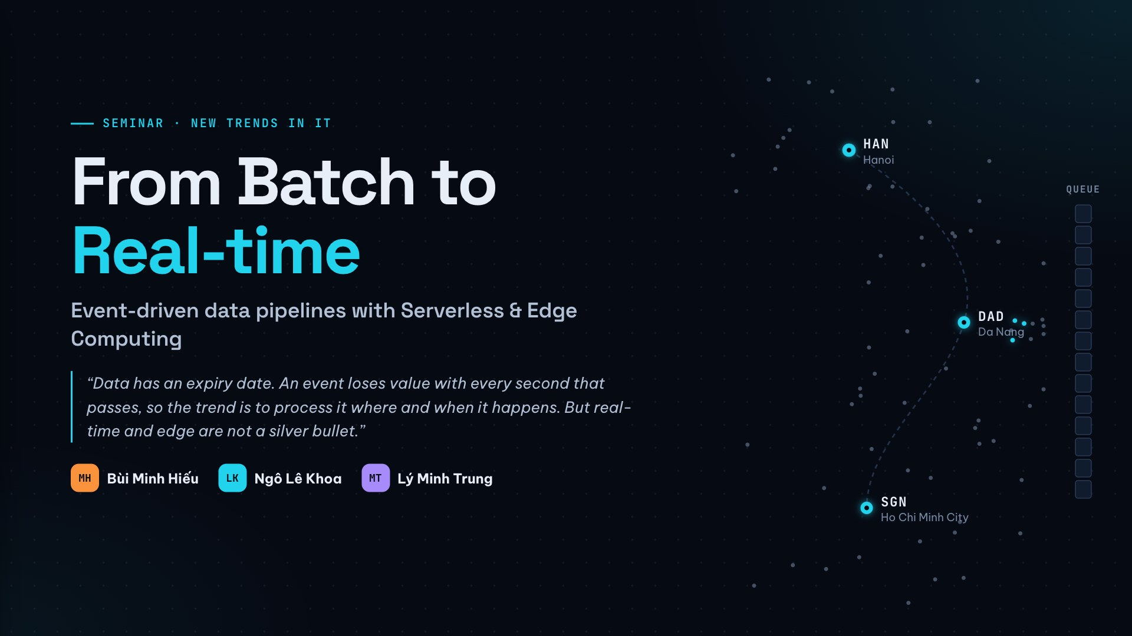
Notes:
Introduce the topic, the course and the team. Open with the thread that runs through the talk: data has an expiry date — an event loses value every second, so the trend is to process it where and when it happens. We will also see that real-time and edge are not a silver bullet.

Slide 2
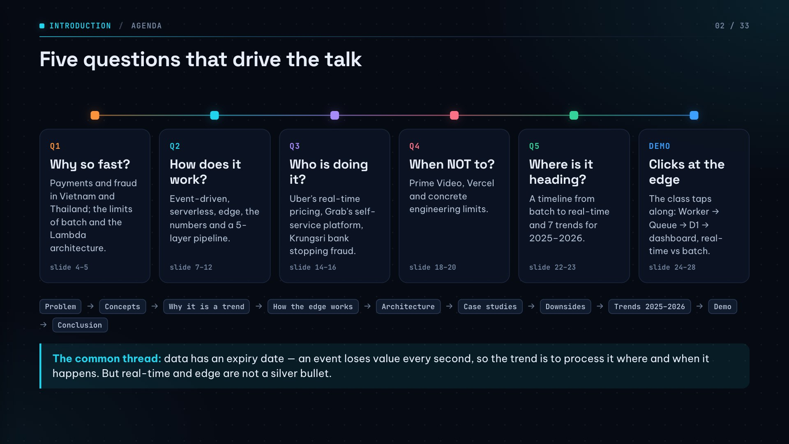
Notes:
The talk follows five questions: why so fast, how, who, when not to, and where next. The chips show the detailed order: problem → concepts → why it is a trend → how the edge works → architecture → case studies → downsides → trends → demo → conclusion.

Slide 3
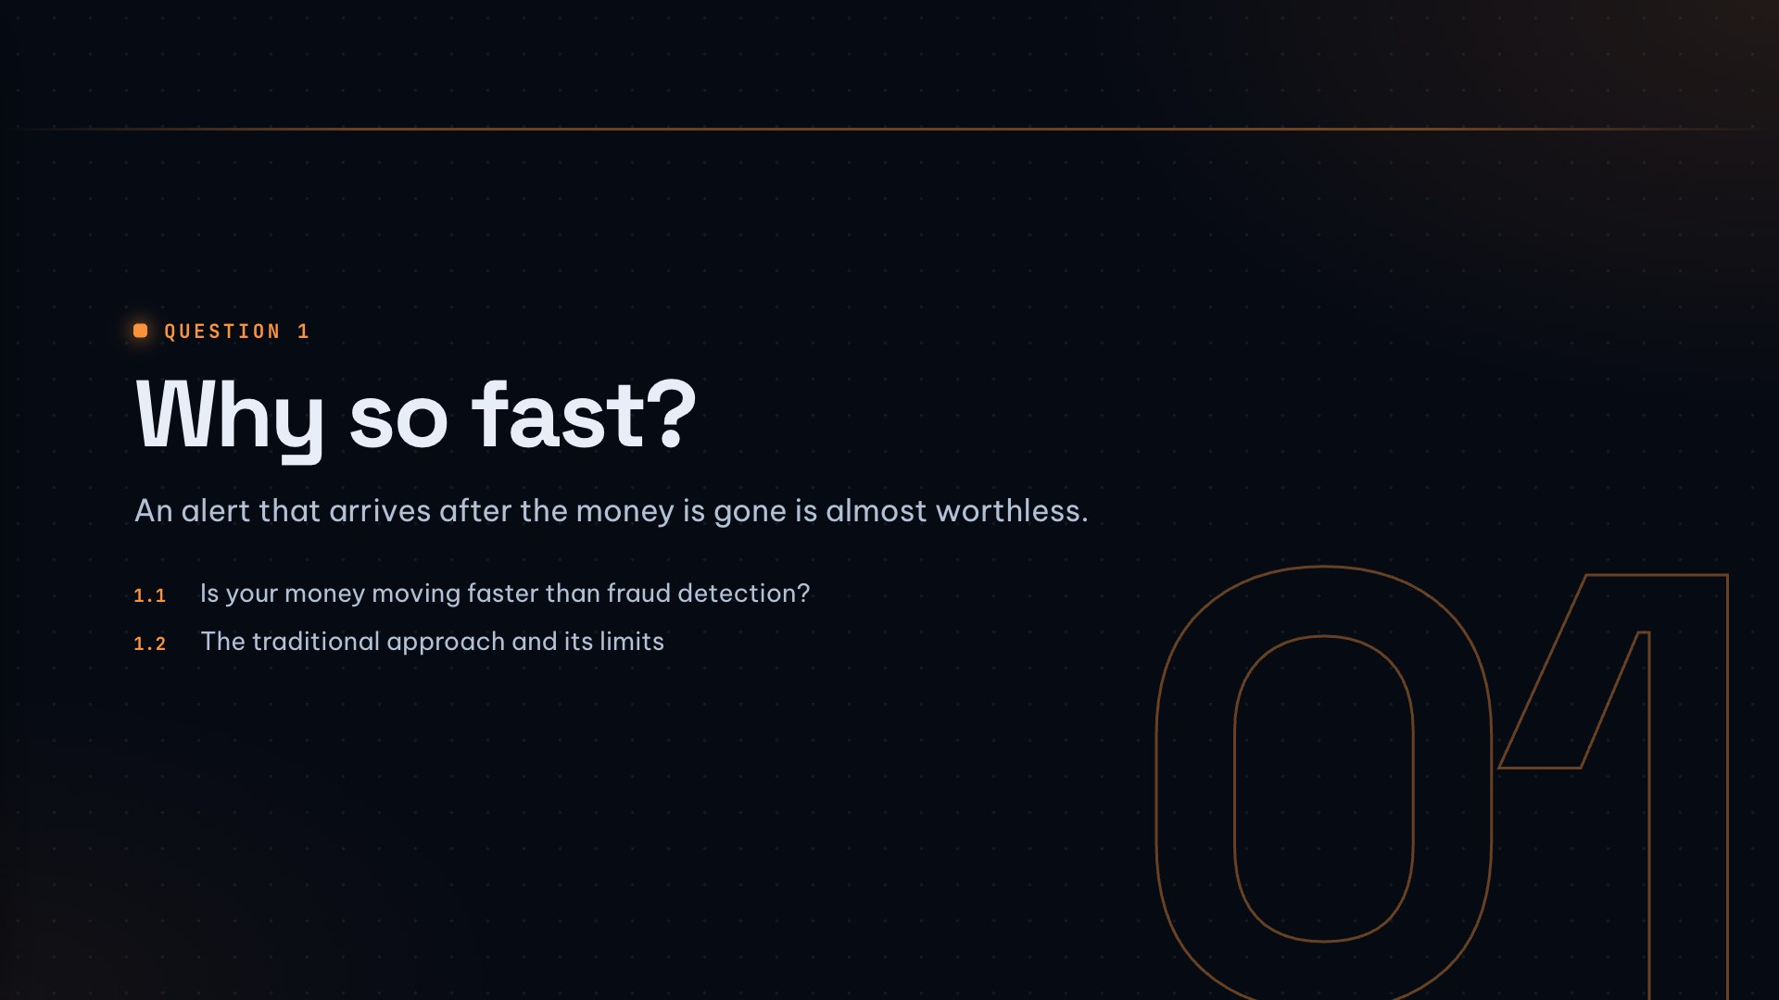

Slide 4
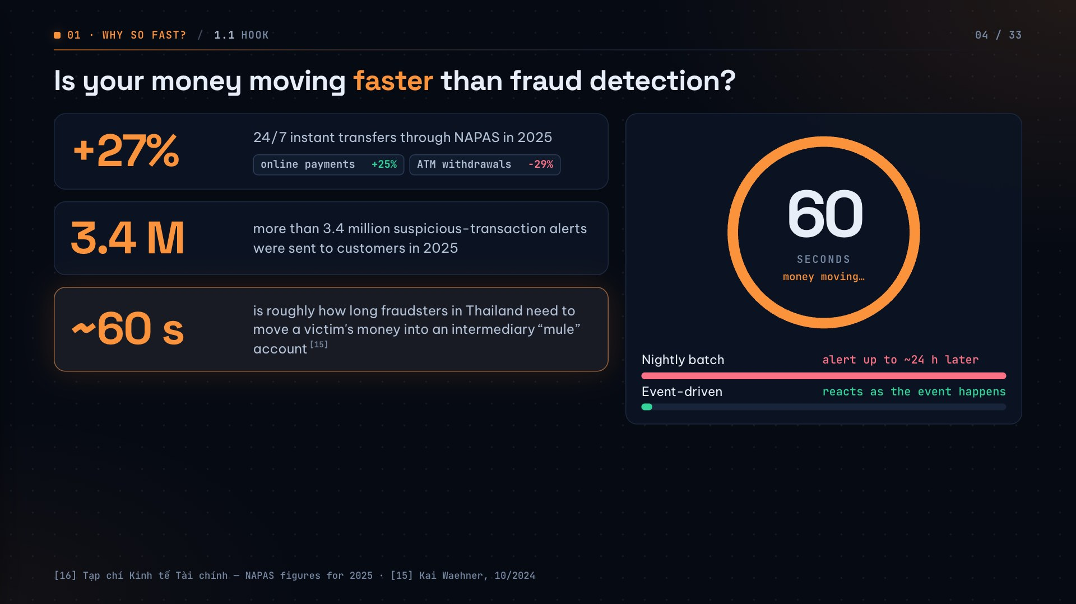
Notes:
A fraud alert that arrives after the money has left is almost worthless. If the system only runs a nightly report, the fraudster has a whole day to cash out. That is why the world is moving from batch processing to event processing. (The ring on the right counts down a real 60 seconds when the slide opens.)

Slide 5
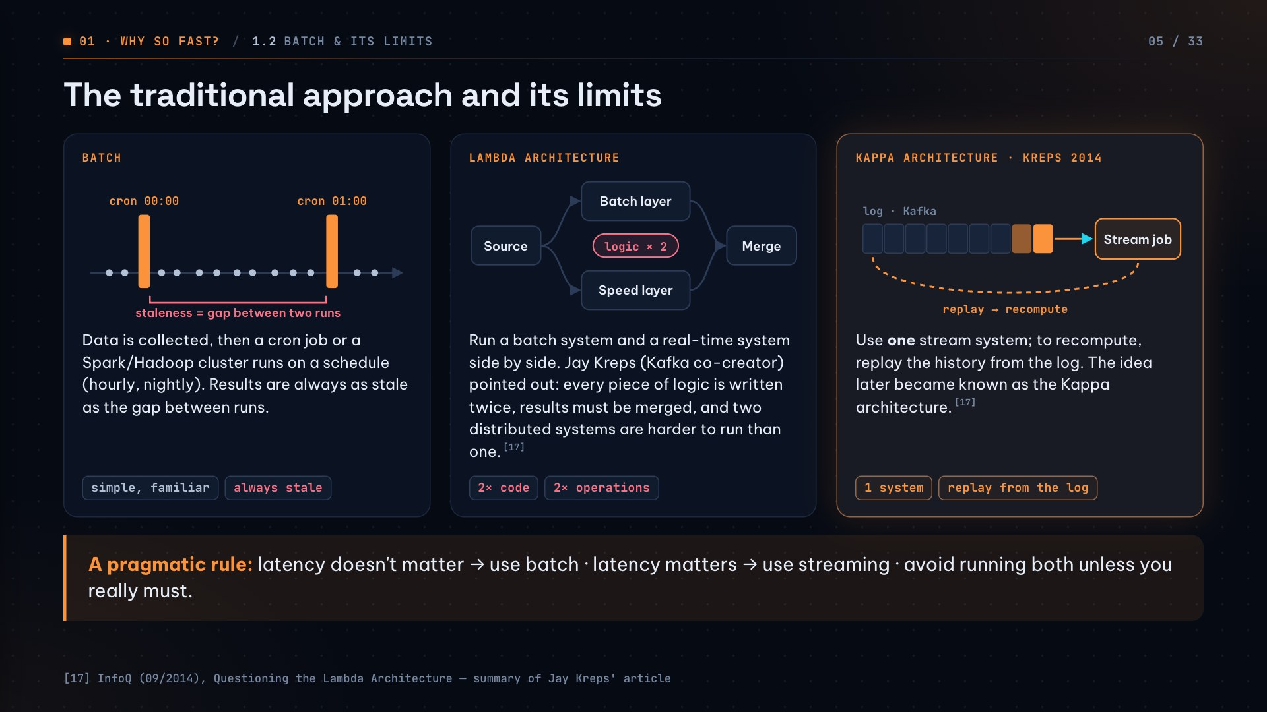
Notes:
Batch results are always as stale as the gap between runs. The Lambda architecture tries to have both, at the cost of writing logic twice and running two systems. Kreps proposed a single stream system that replays the log to recompute. The rule is pragmatic: latency doesn't matter → batch; latency matters → stream; avoid both unless you must.

Slide 6
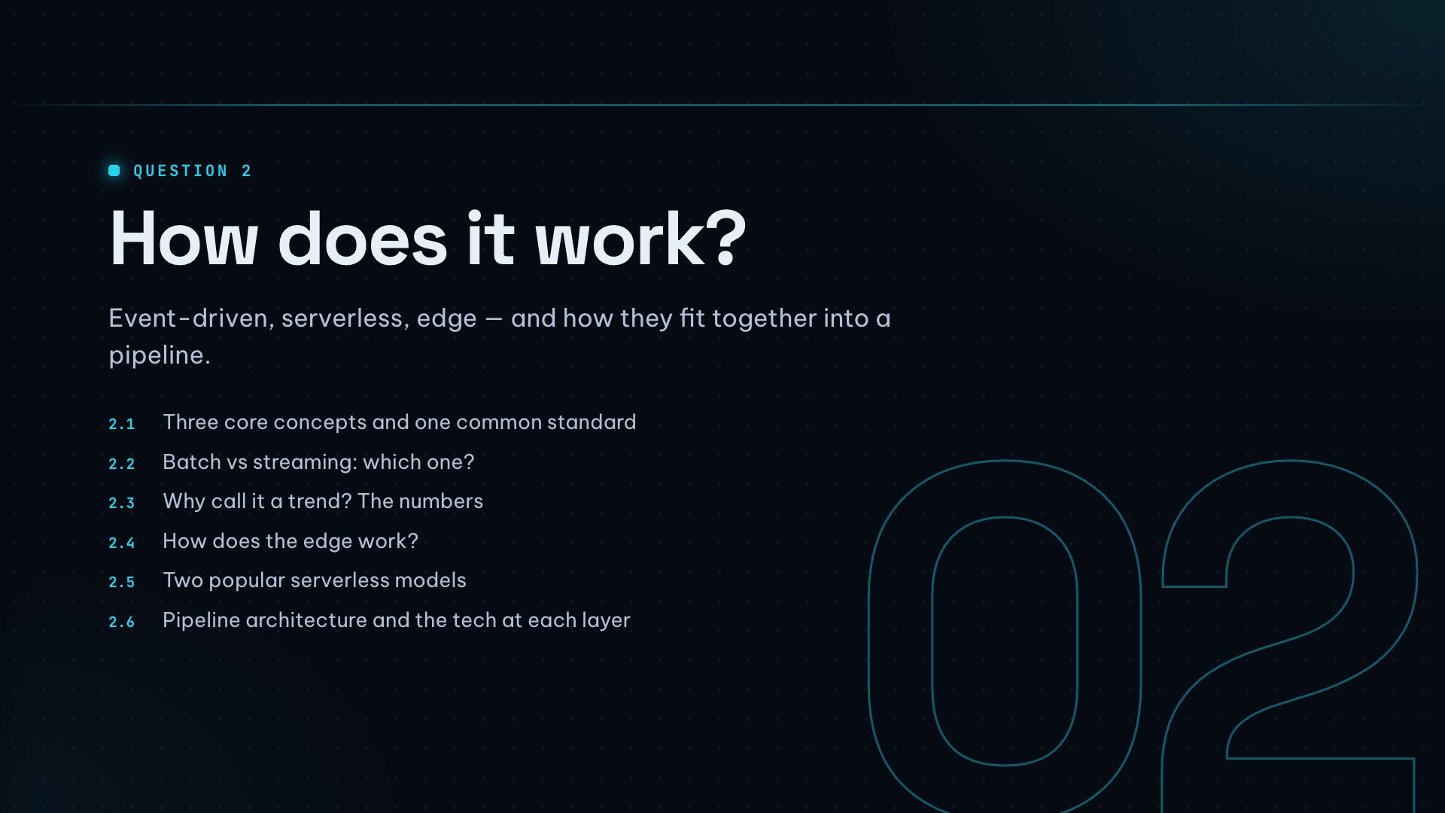

Slide 7
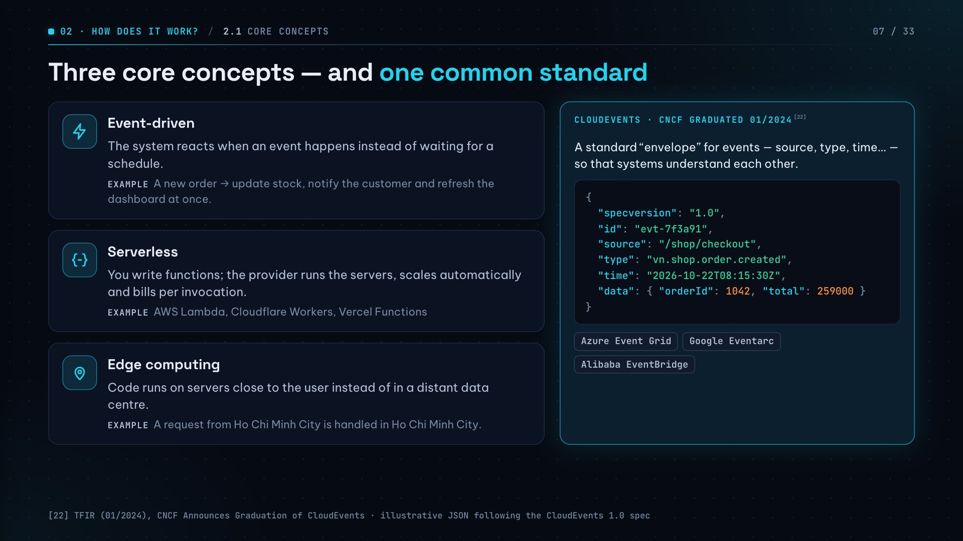
Notes:
Three concepts: event-driven means reacting to events; serverless means writing functions without managing servers; edge means running code close to users. CloudEvents shows event-driven has matured enough to have an industry standard — much as HTTP standardised the web.

Slide 8
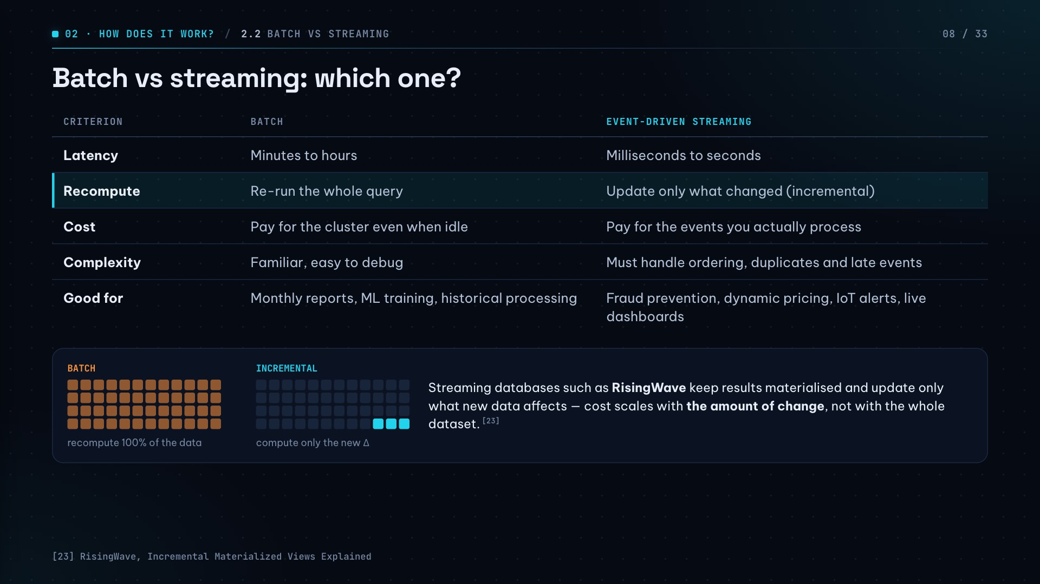
Notes:
Stress the “Recompute” row: streaming databases like RisingWave keep results ready and update only what new data affects, so cost scales with change, not with the full dataset. The trade-off is complexity: ordering, duplicates and late events.

Slide 9
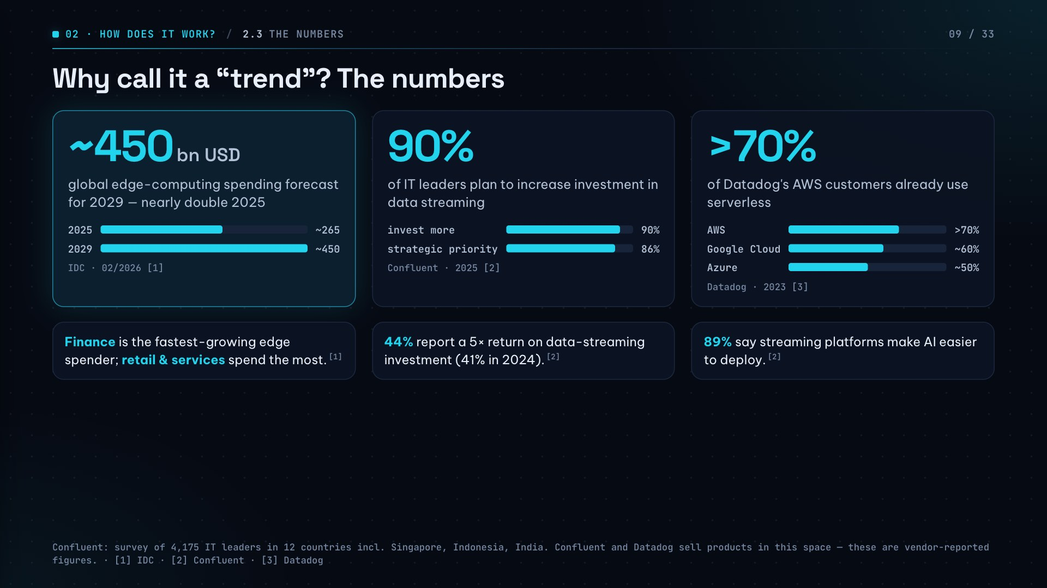
Notes:
Three headline numbers: edge spending near USD 450 bn by 2029 (almost double 2025), 90% of IT leaders want to invest more in streaming, and more than 70% of Datadog's AWS customers use serverless. Say the source out loud: “according to Confluent / Datadog” — both sell products in this space.

Slide 10
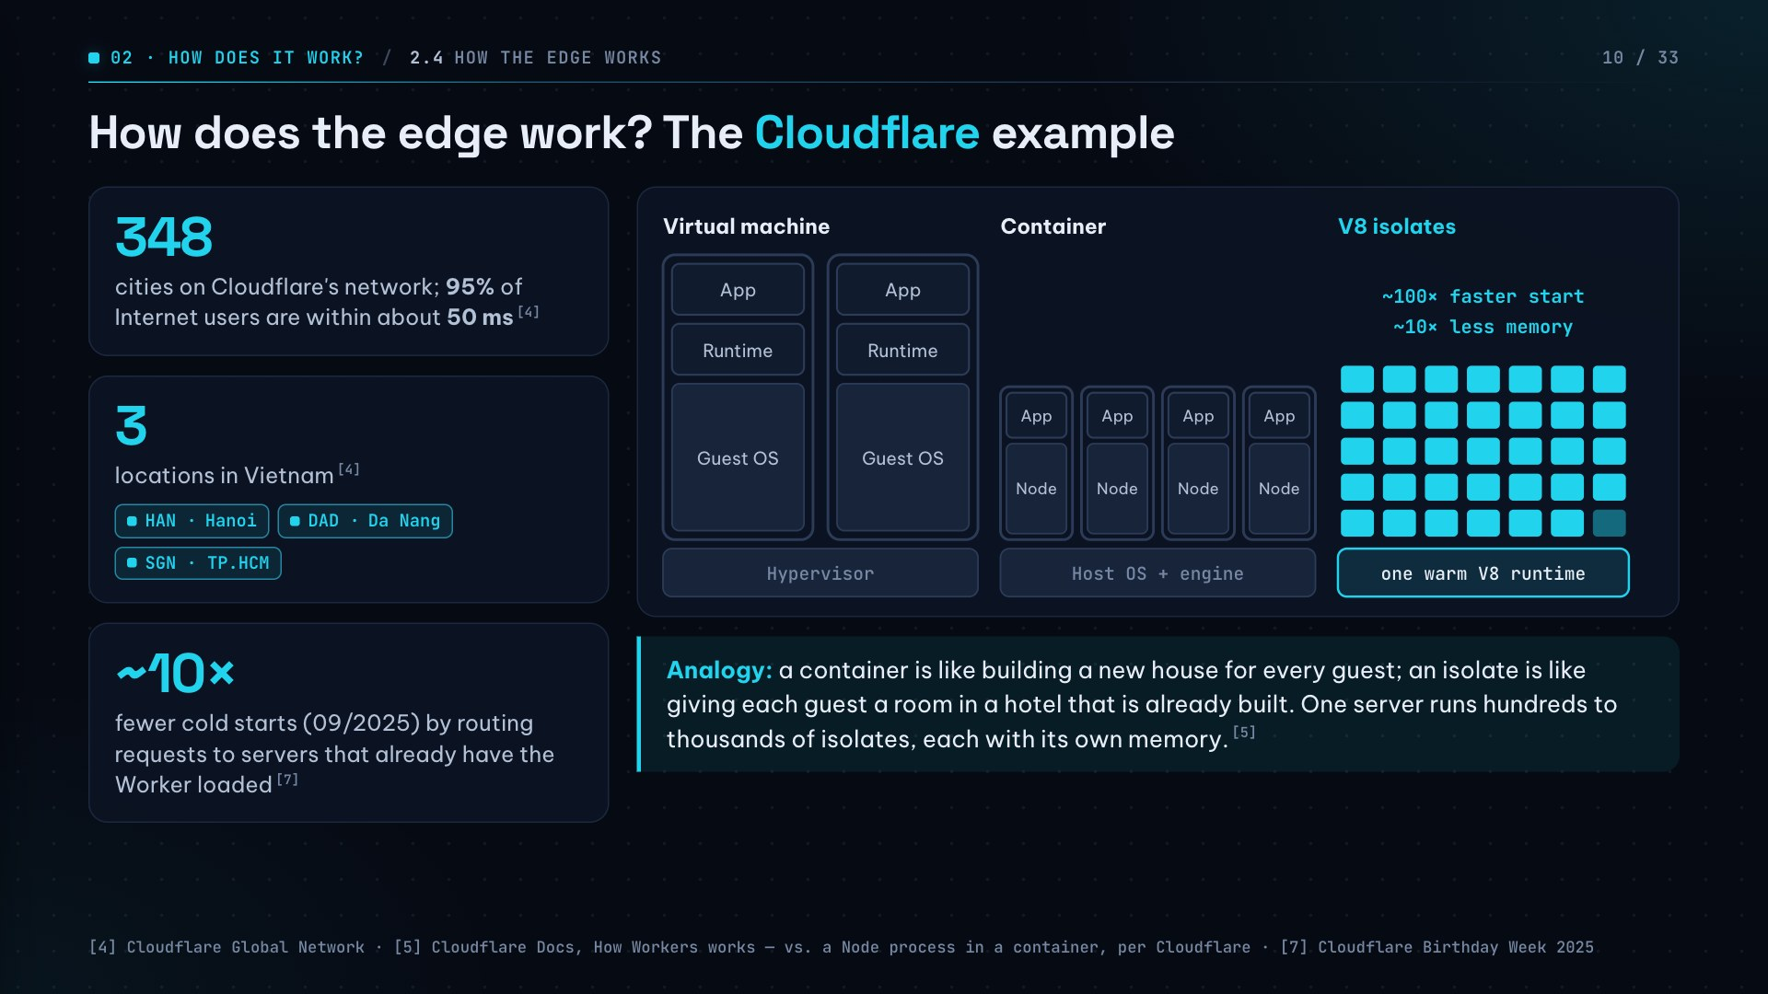
Notes:
Instead of booting a container or VM per function, Workers create isolates inside a runtime that is already running. Per Cloudflare, isolates start about 100× faster and use about 10× less memory. Analogy: a container builds a new house for every guest; an isolate hands out a room in a hotel that already exists.

Slide 11
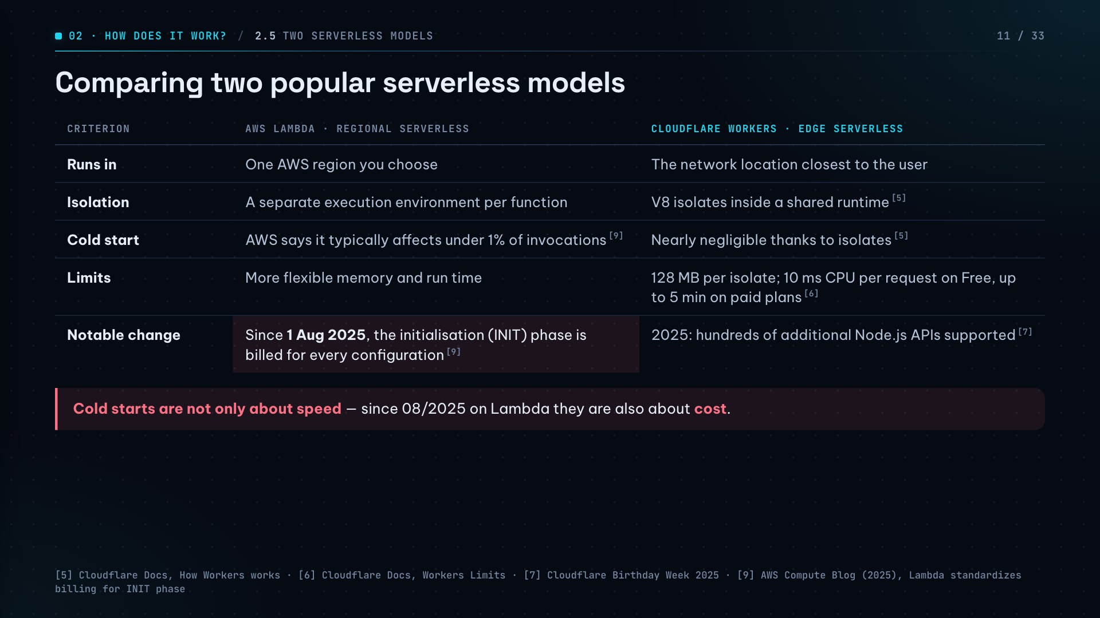
Notes:
Lambda runs in a region you pick with a dedicated execution environment per function; Workers run at the location nearest the user using V8 isolates. Worth highlighting: AWS started billing the INIT phase in August 2025 — cold starts now cost money, not just time.

Slide 12
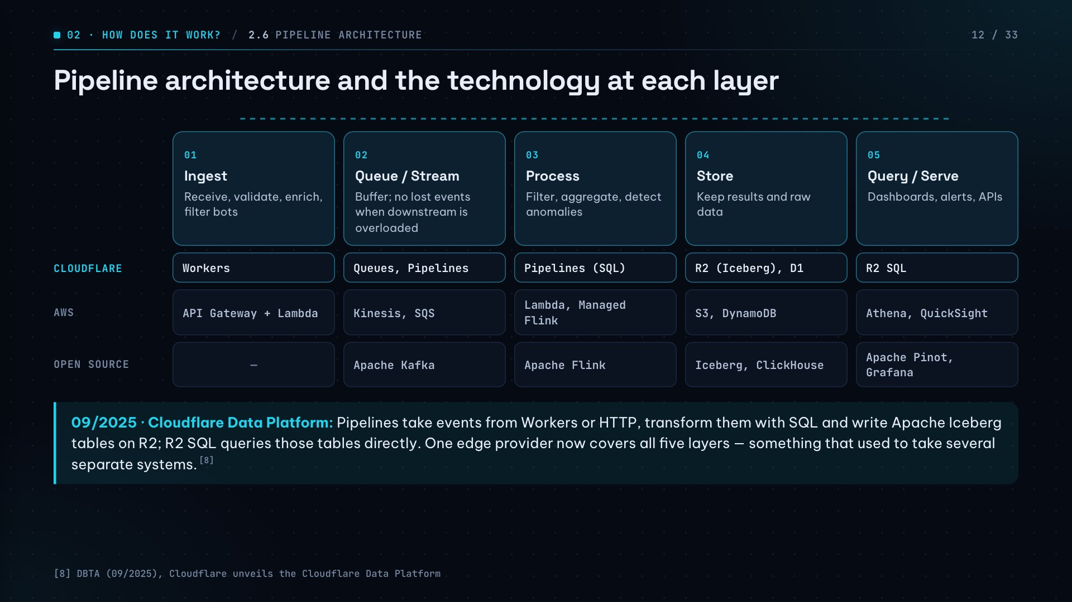
Notes:
This is the most important slide. Follow one “product click” event left to right through the five layers: ingest at the edge, buffer in a queue, process, store, then query/serve. Note that a single edge provider now offers all five layers, which used to require stitching together several systems.

Slide 13
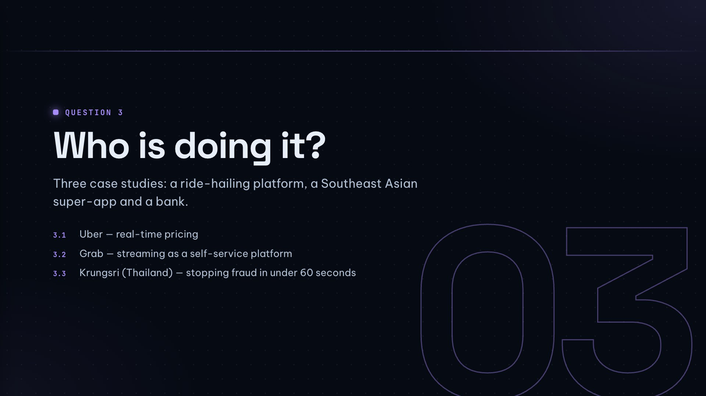

Slide 14
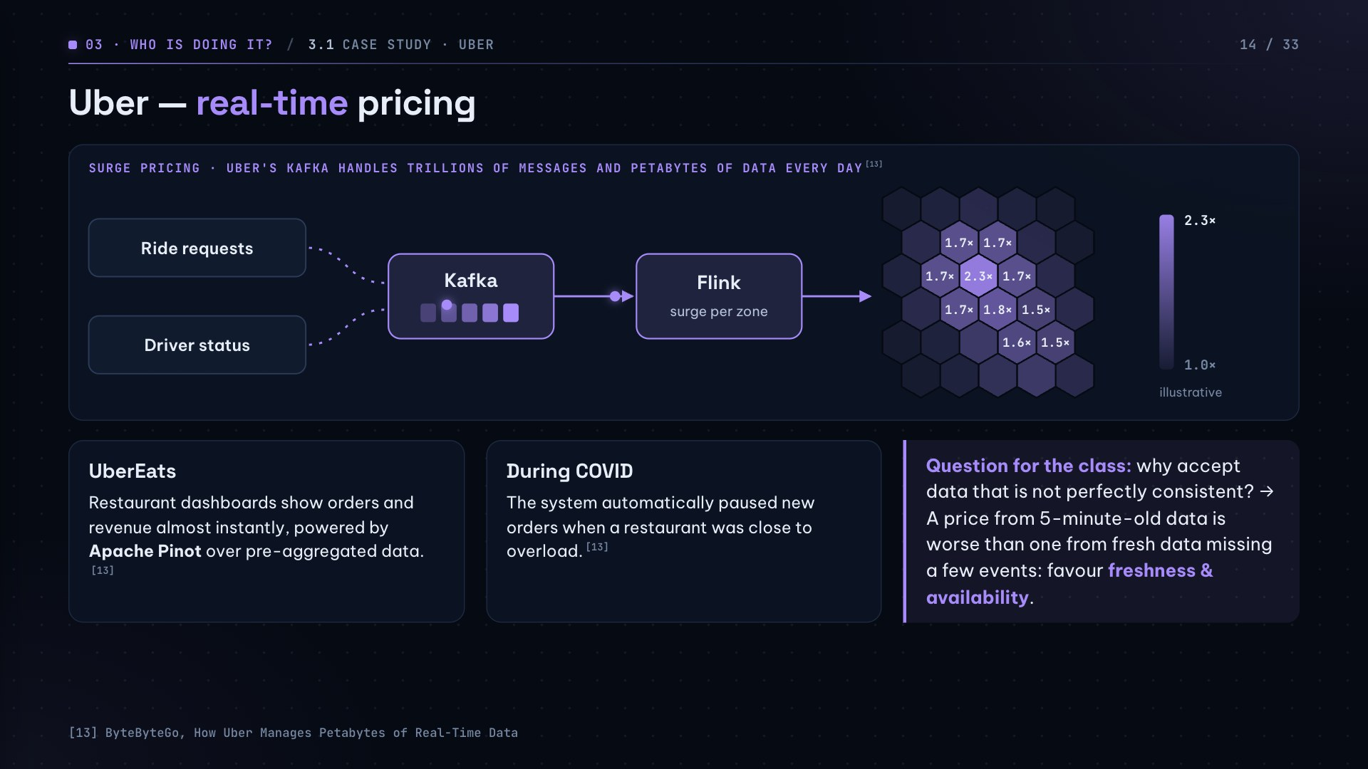
Notes:
Kafka ingests ride requests and driver status; Flink computes a surge multiplier per zone. Ask the class: why accept imperfect consistency? Because a price from 5-minute-old data is worse than one from fresh data missing a few events. The multiplier map is illustrative.

Slide 15
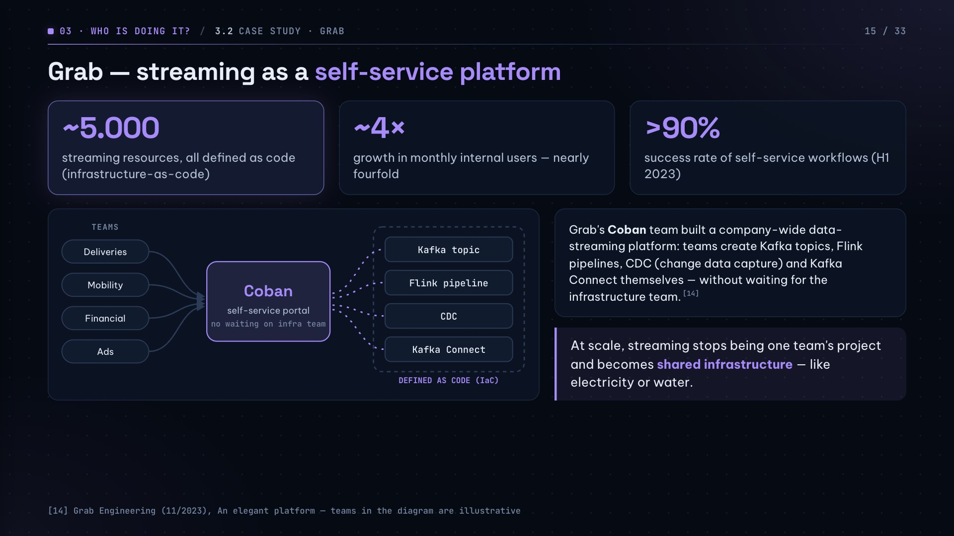
Notes:
Grab is a case close to home for Vietnam. Message: at scale, streaming is no longer one team's project but shared infrastructure, like utilities. About 5,000 resources managed as code; internal users up almost 4×; over 90% of self-service workflows succeed.

Slide 16
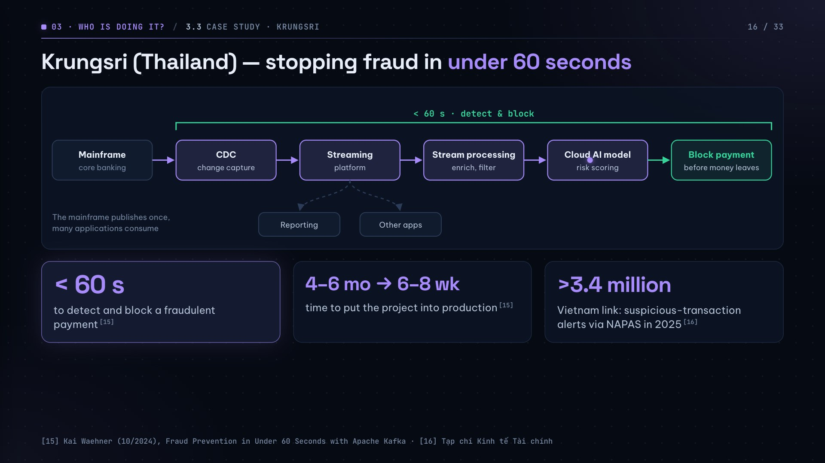
Notes:
Problem: fraudsters move money to mule accounts within 60 seconds. Solution: CDC pulls transactions from the core mainframe into a streaming platform, stream processing enriches them and a cloud AI model scores the risk. Key point: the bank kept its mainframe and attached streaming to it, so the mainframe publishes once and many apps consume — gradual change, not a rewrite.

Slide 17
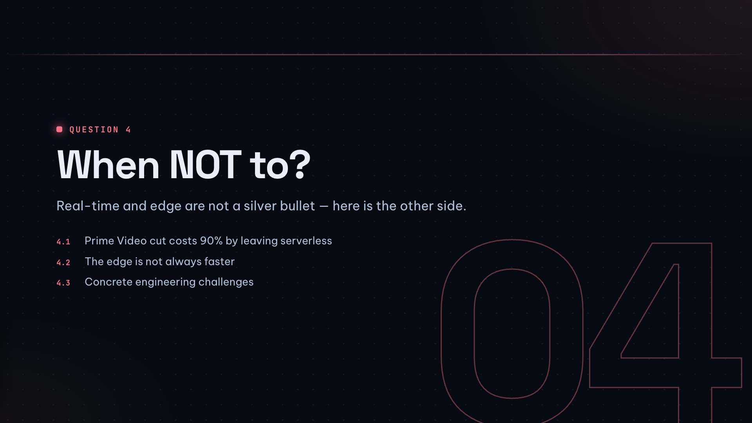

Slide 18
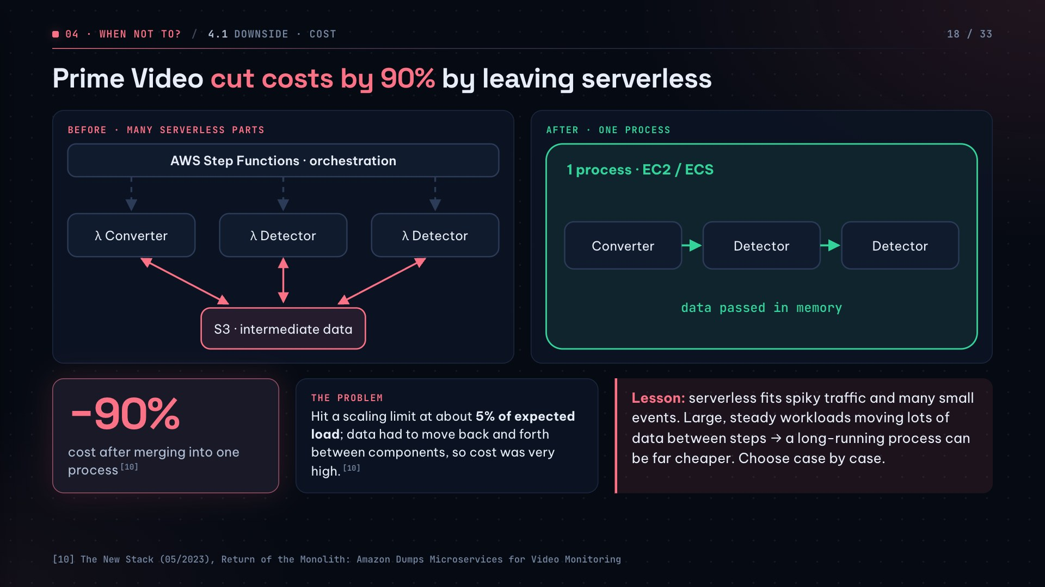
Notes:
Prime Video's video-quality monitoring started as many serverless parts (Step Functions + Lambda). It hit a scaling limit at about 5% of expected load and was expensive because data moved between steps. Merging into one process on EC2/ECS cut costs by 90%. The authors themselves stress choosing case by case.

Slide 19
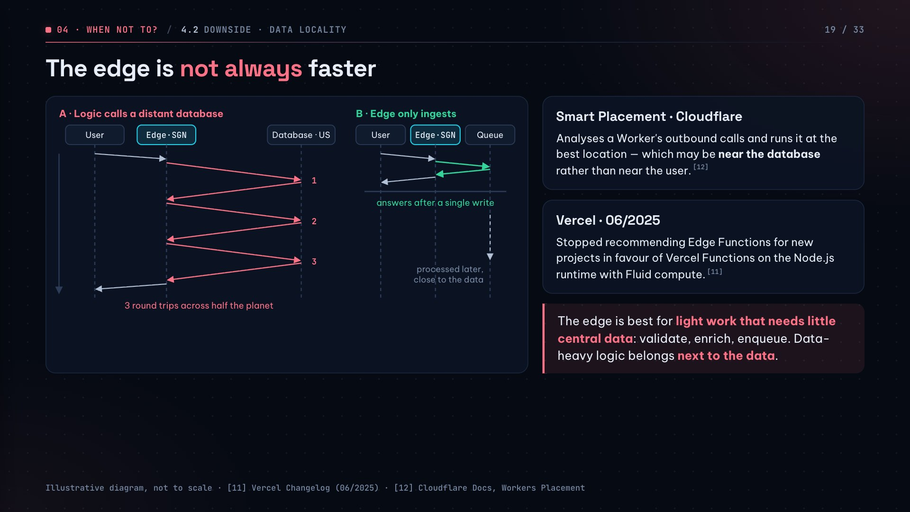
Notes:
The data-locality problem: code runs next to the user but the database is far away. If each request calls the database several times, every call is a round trip across half the planet — slower overall than running next to the database (diagram A). The edge shines at ingestion: validate, enrich, enqueue (diagram B).

Slide 20
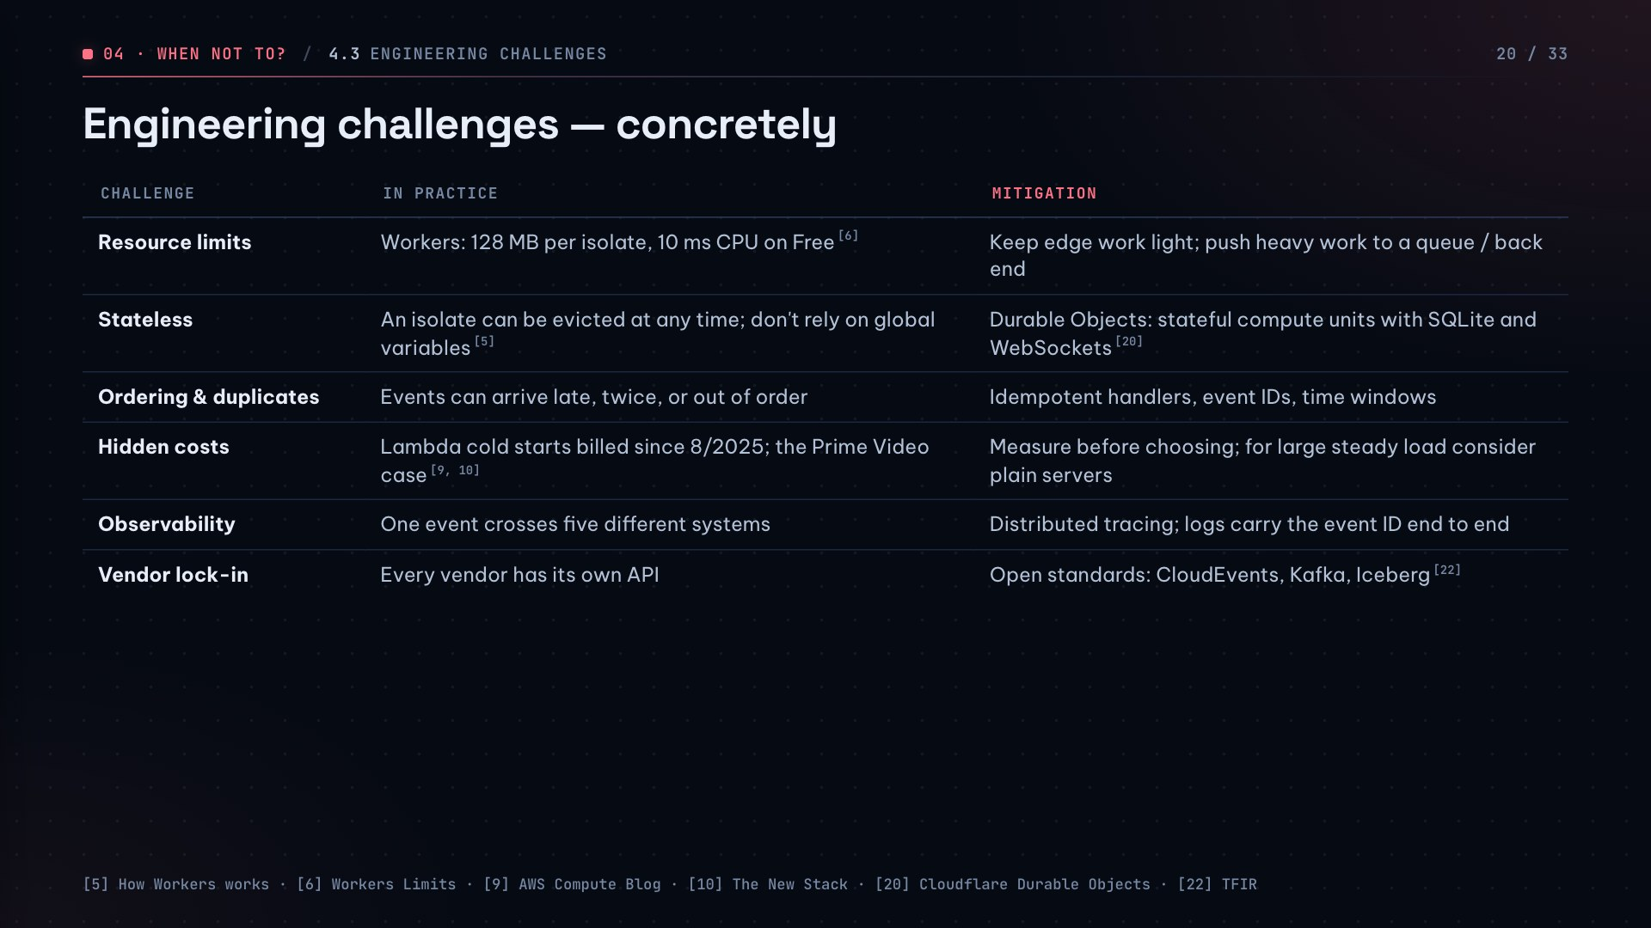
Notes:
Walk quickly through the six challenges and their mitigations. Stress two: handlers must be idempotent because events can arrive twice or out of order; and open standards (CloudEvents, Kafka, Iceberg) reduce vendor lock-in.

Slide 21
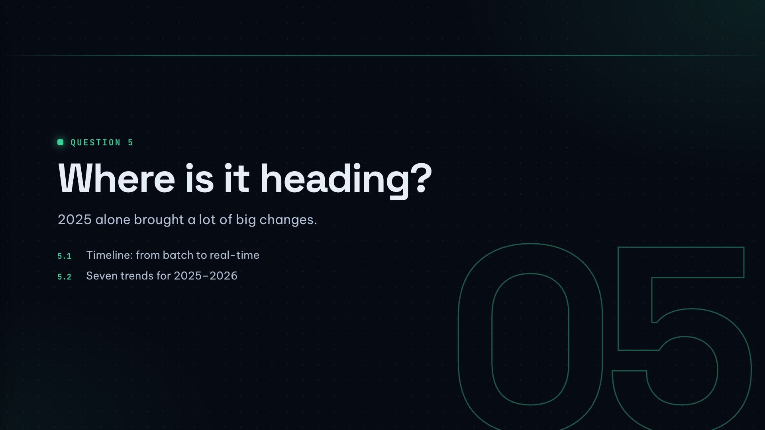

Slide 22
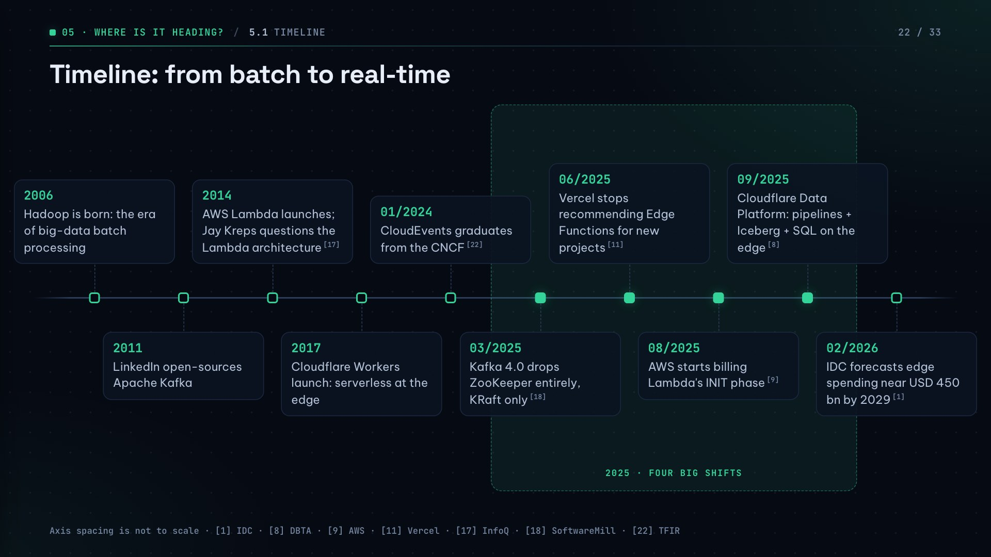
Notes:
Read left to right: 2006 Hadoop opens the batch era; 2011 Kafka; 2014 Lambda and Kreps' question; 2017 Workers bring serverless to the edge. The shaded band shows the pace of change: 2025 alone had four big shifts — Kafka 4.0, Vercel stepping back from Edge Functions, AWS billing INIT, Cloudflare Data Platform.

Slide 23
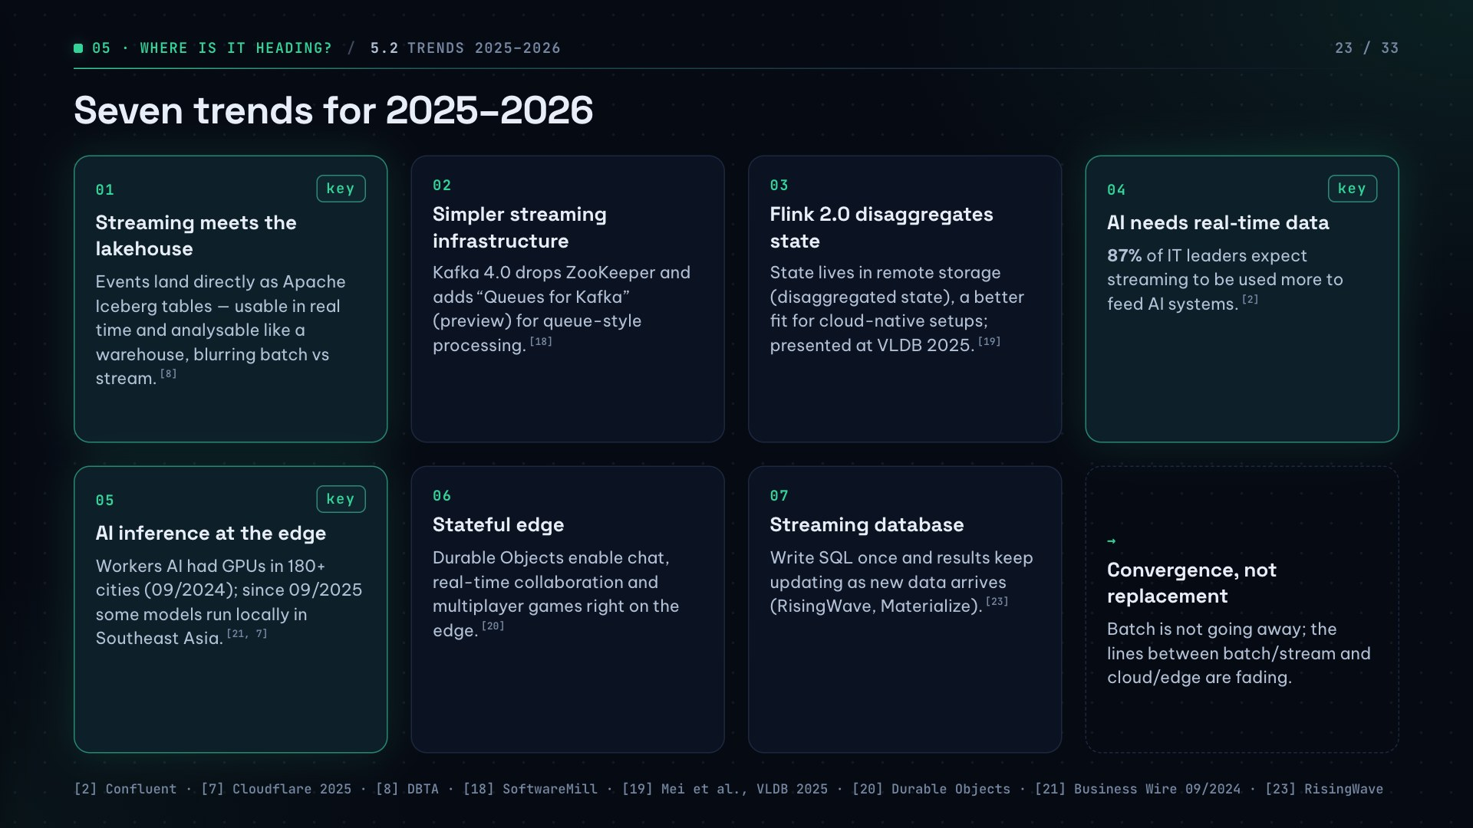
Notes:
If short on time, focus on the three highlighted trends: streaming meets the lakehouse, AI needs real-time data, and AI inference at the edge. The last tile sums it up: convergence, not replacement.

Slide 24
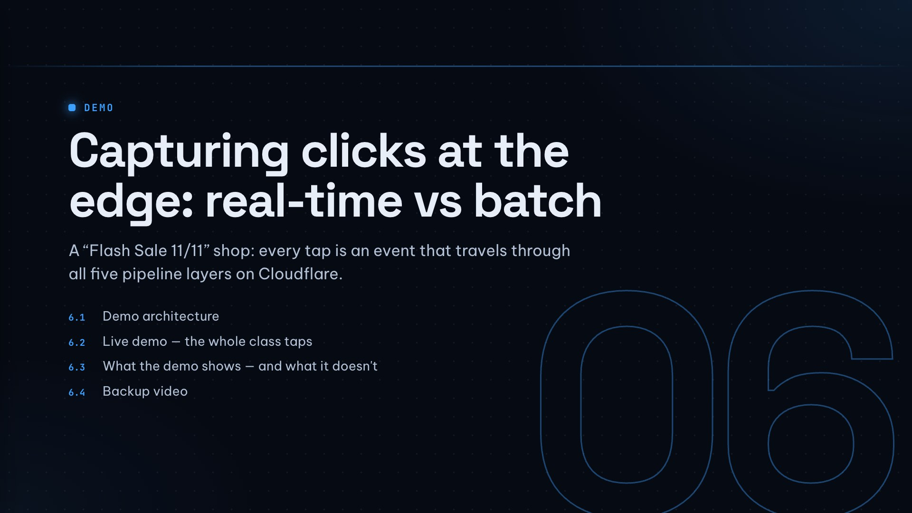

Slide 25
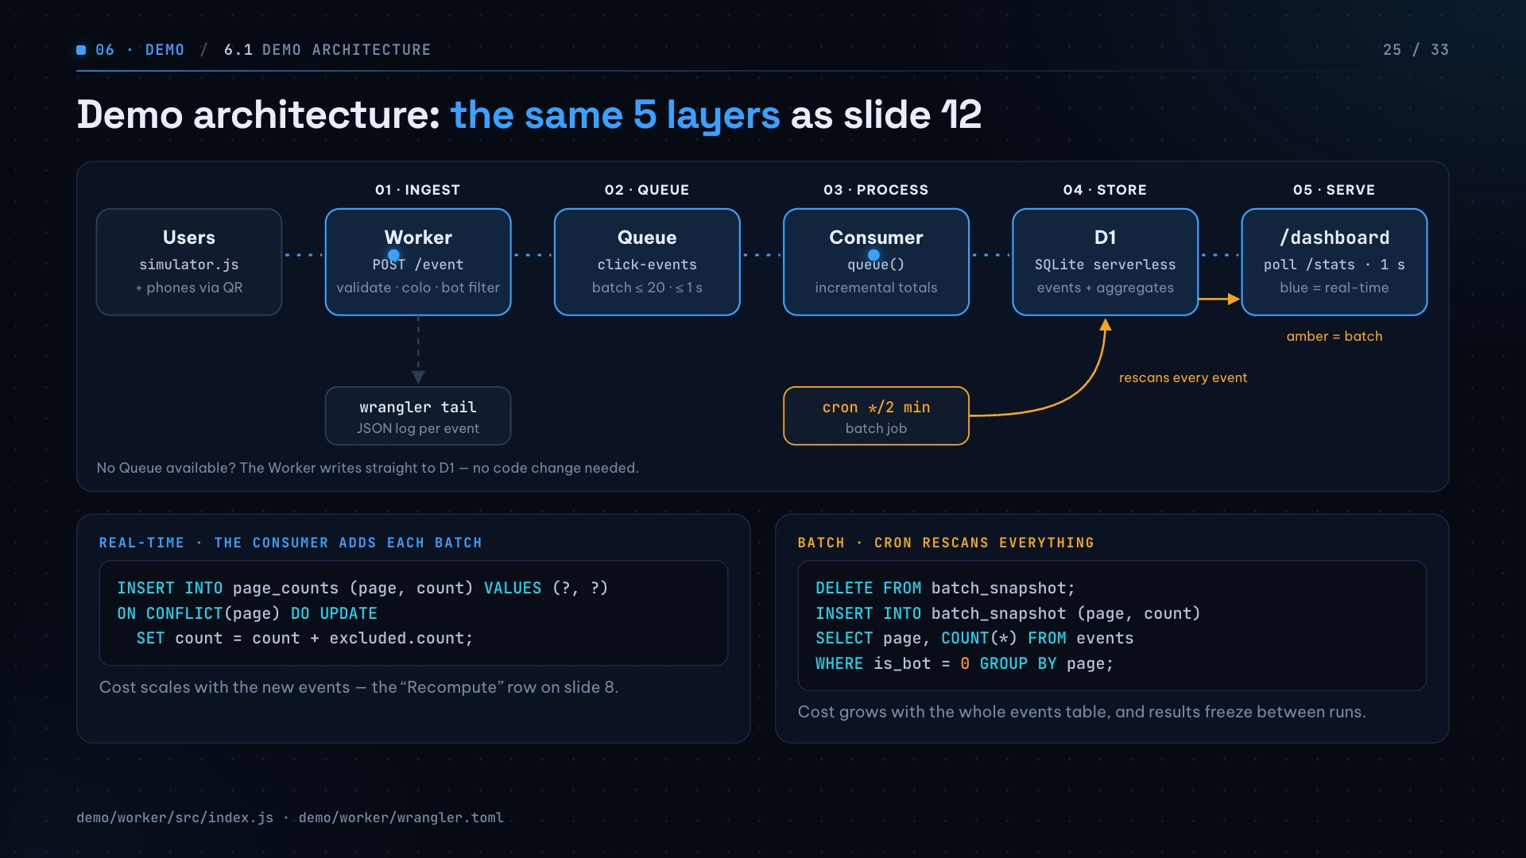
Notes:
The demo simulates a flash-sale shop. Every product tap sends an event to a Cloudflare Worker at the edge; it goes through a queue, a consumer adds it into D1, and the dashboard shows it immediately. A cron batch job runs alongside for comparison. The two SQL snippets are the difference: real-time adds only what is new, batch rescans everything.

Slide 26
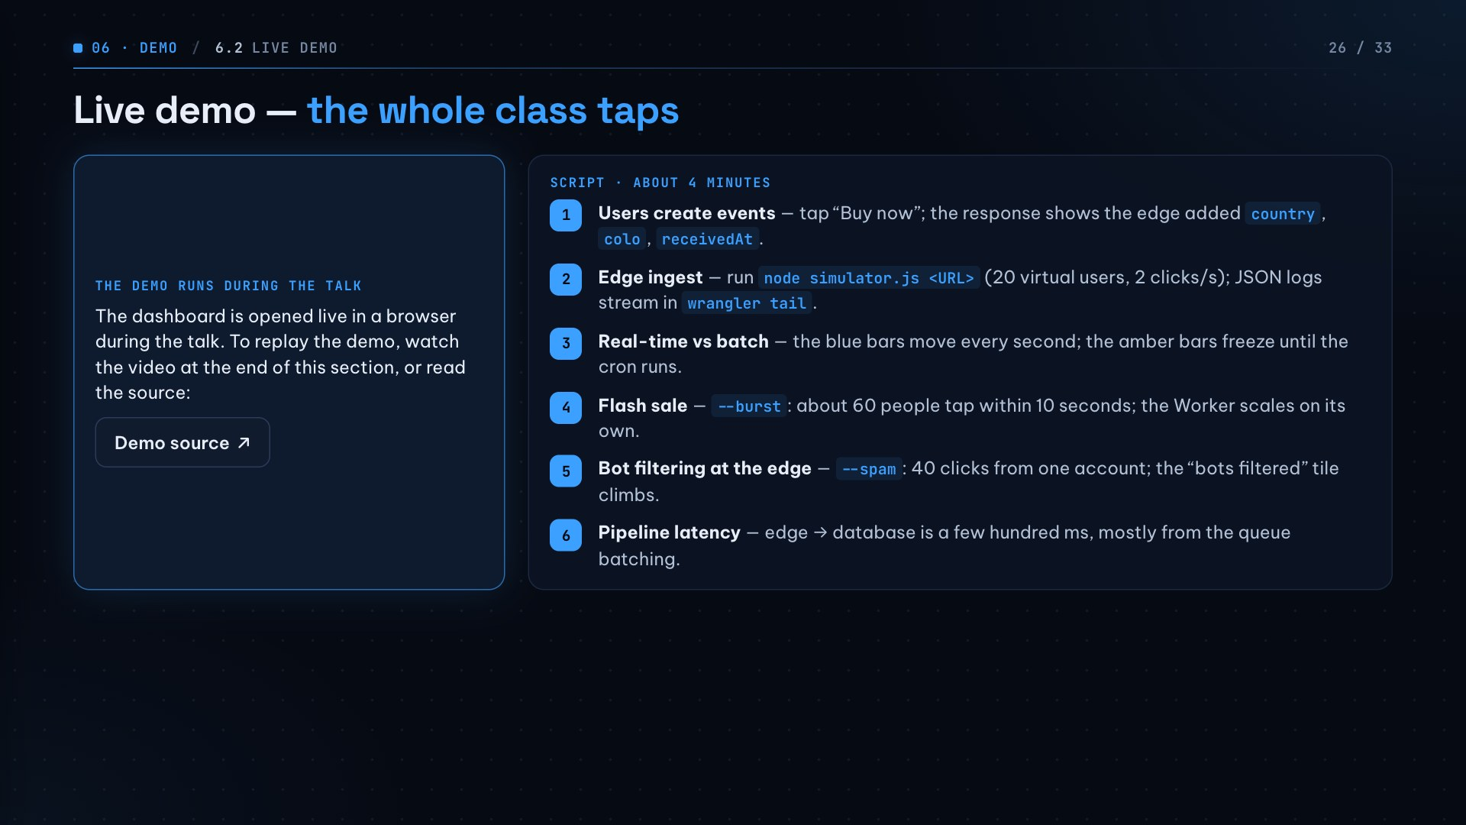
Notes:
Before the demo: call /reset, open /dashboard full-screen in another tab, keep a terminal running npm run tail. Show the QR so the class joins the shop, then switch to the dashboard. At step 3, link back to the Hook slide: with batch you only know when the job runs; with an event-driven pipeline you know as it happens. At step 5, say the bot filter is best-effort because the edge is stateless.

Slide 27
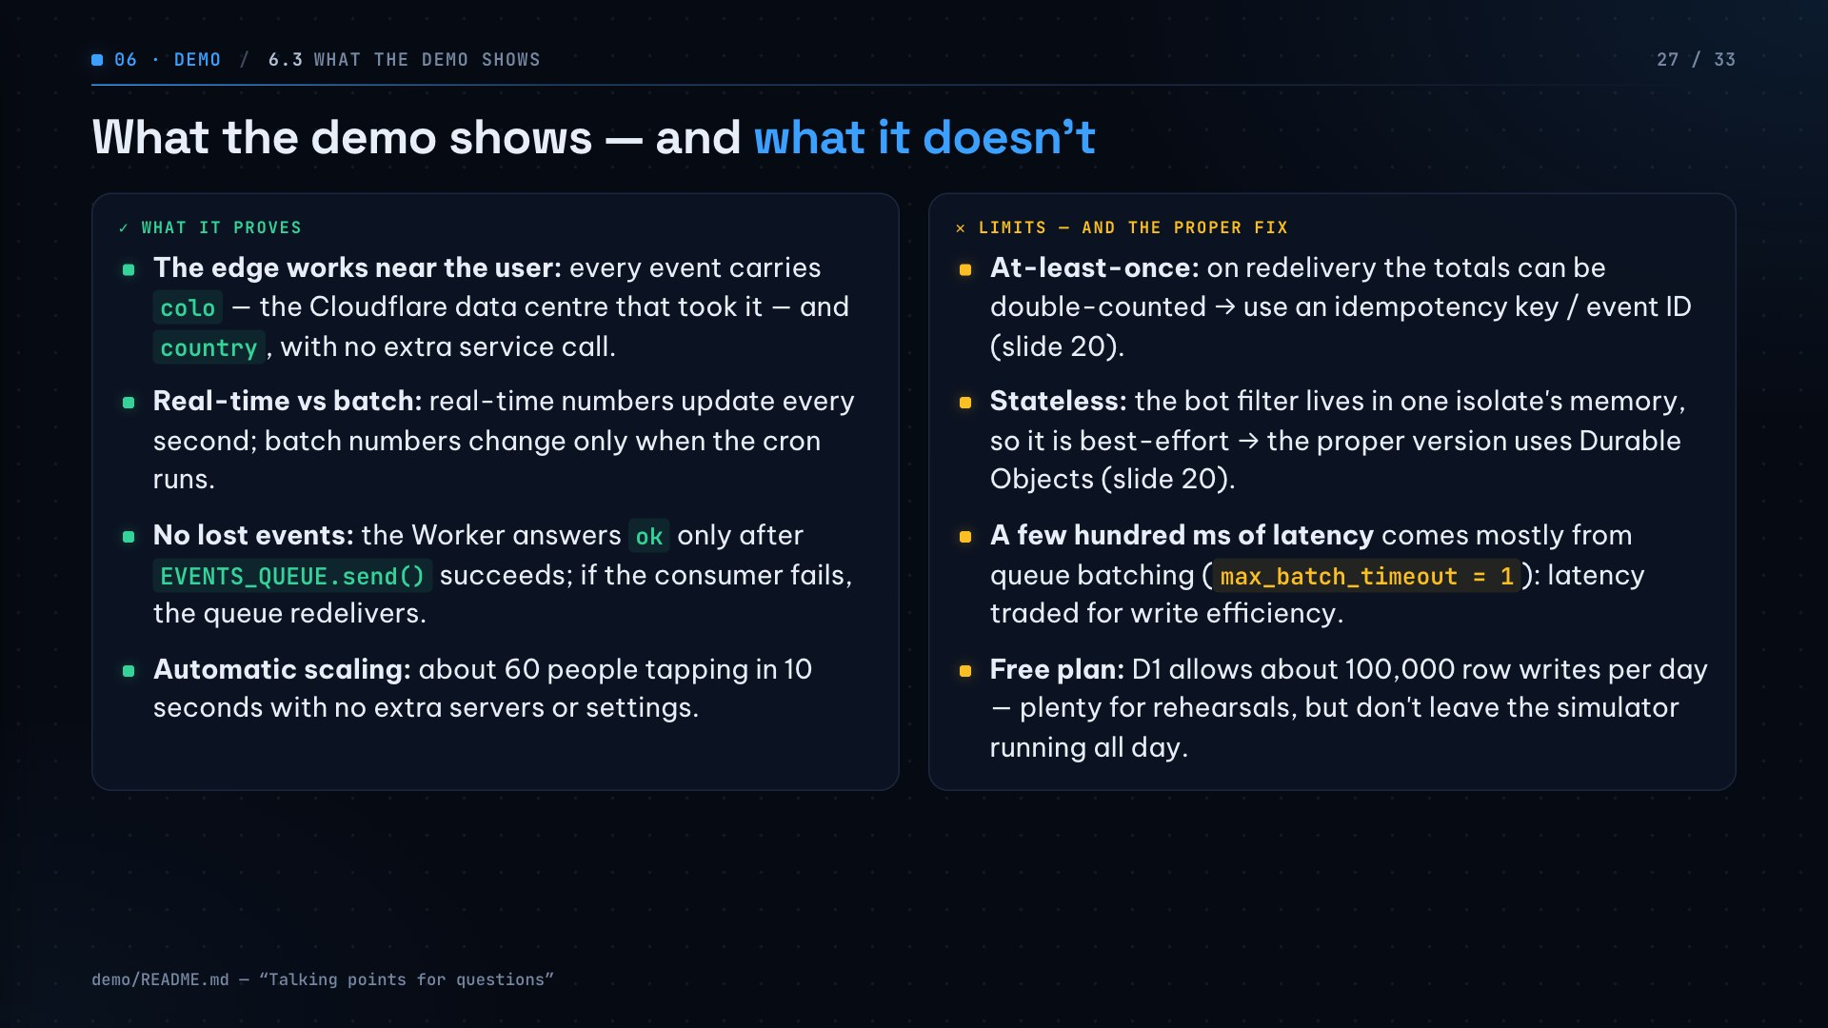
Notes:
This slide ties the demo back to chapter 4: what the demo does, and where a real system needs more care. If asked “is it exactly-once?”, answer: no, the queue is at-least-once, so you need an idempotency key.

Slide 28
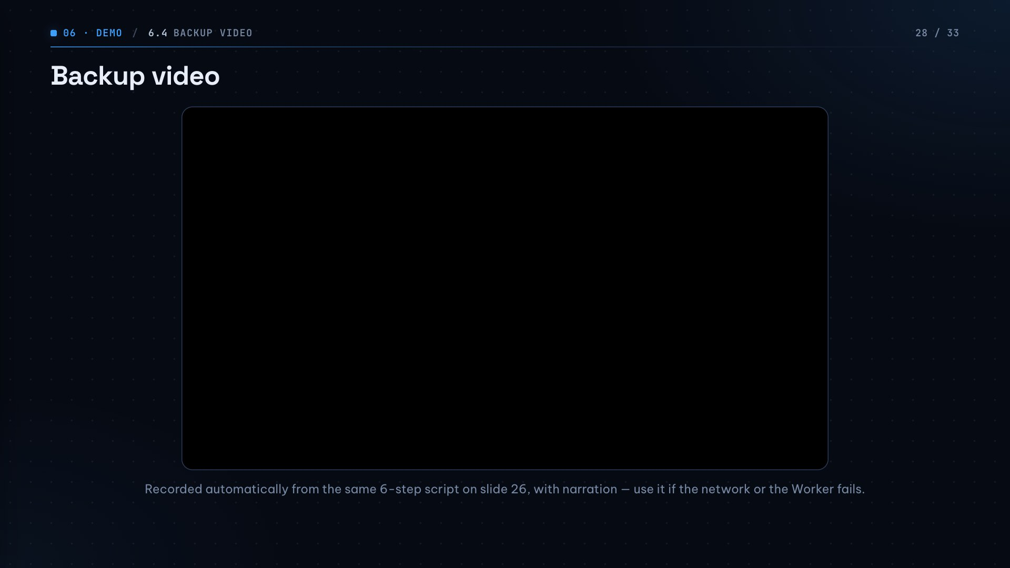
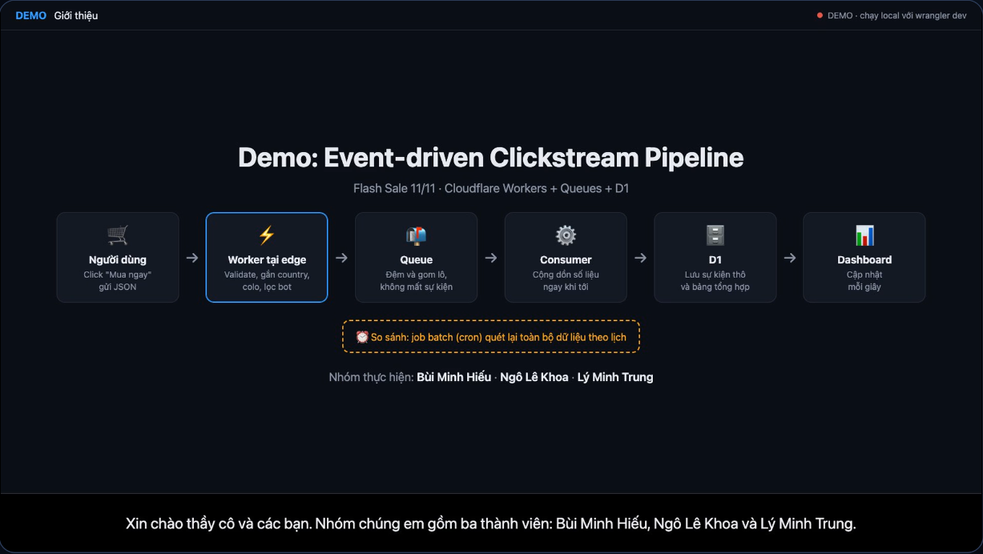
Notes:
Use this slide only if the live demo fails. The video is about 3 minutes long, narrated, following the same 6-step script.

Slide 29
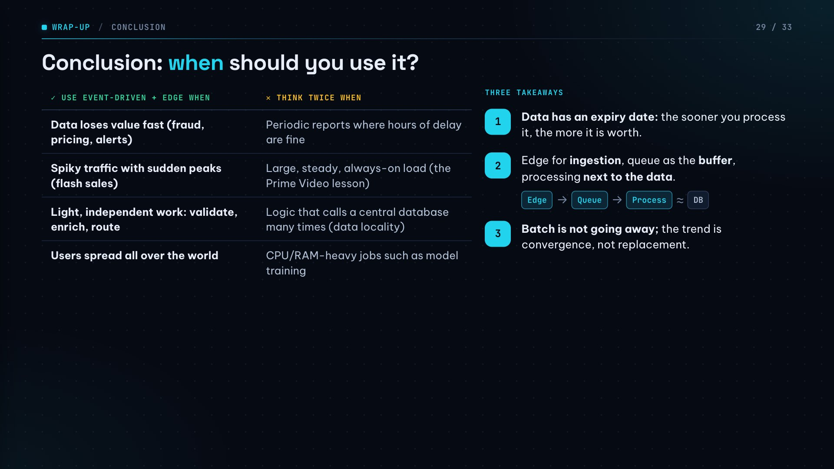
Notes:
The table is the decision guide: use it when data loses value fast, traffic is spiky, work is light and users are spread out; reconsider for periodic reports, large steady load, data-heavy logic or heavy compute. Close with the three takeaways.

Slide 30
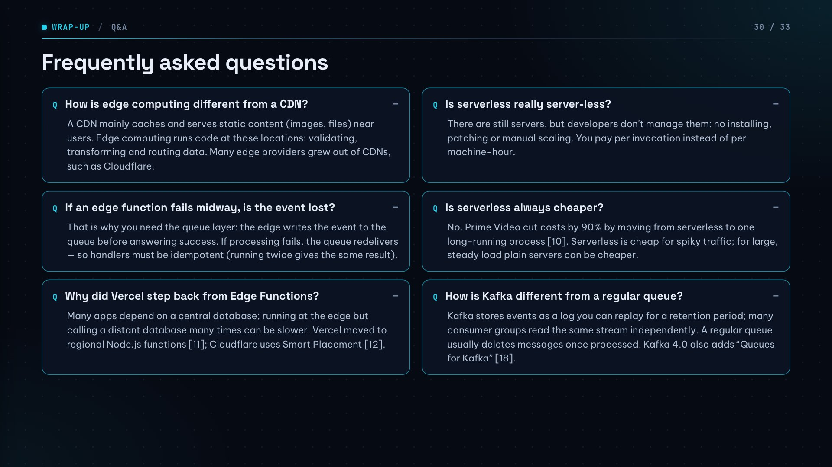
Notes:
Questions the class is likely to ask. Click each one to reveal a suggested answer.

Slide 31
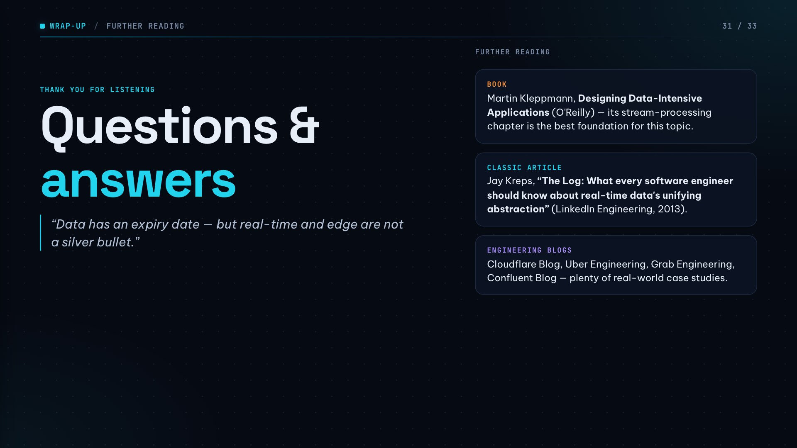

Slide 32
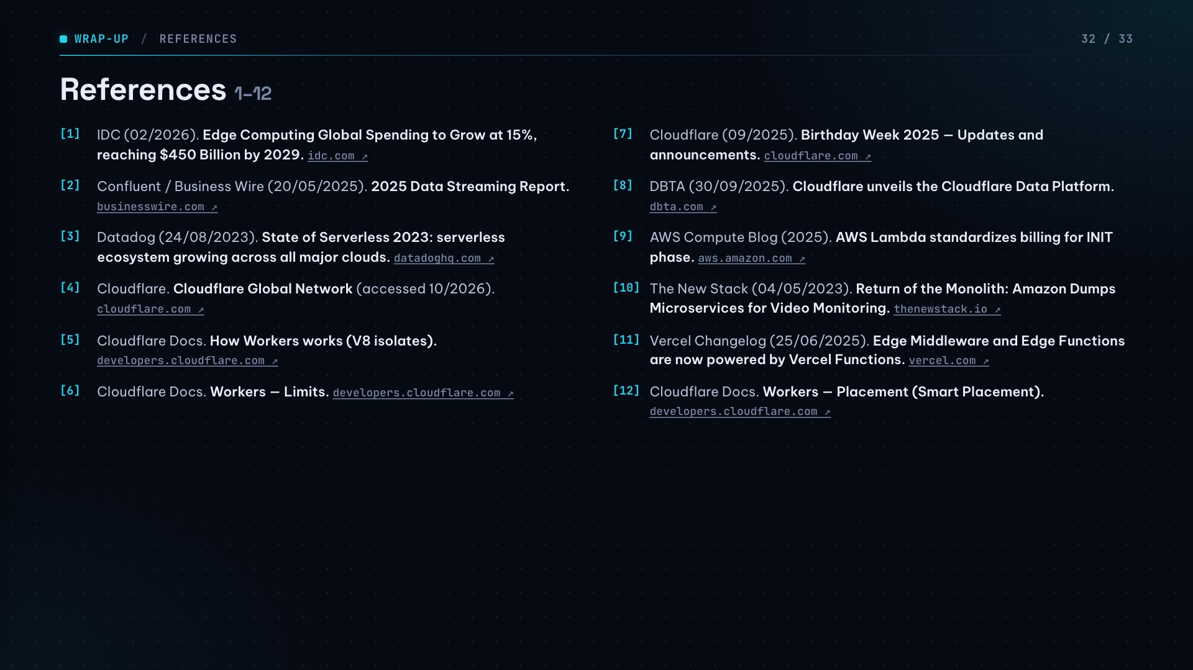

Slide 33


