Slide 1
Single-trial EEG: frequent vs target
• Nencki-Symfonia | all 42 oddball participants
• Classical ML, compact CNN and model explanations
• Lê Minh Đức · Nguyễn Đức Trung · Phạm Sỹ Toàn
• Đỗ Hoàng Minh · Đào Văn Việt
Nencki-Symfonia EEG | 42 subjects • Lê Minh Đức • 30 s
01
Notes:
Hello. Our project classifies single EEG trials as frequent or target stimuli. We compare conventional machine learning with a compact convolutional network, then inspect which sensors and times affect the network. We use real data from the dataset specified in the course. We analyze all forty-two participants in the oddball dataset, using subject-disjoint testing.

Slide 2
Three questions
• Which tested method performs best on unseen people?
• Does deep learning outperform classical ML here?
• Can we interpret what the CNN uses?
Nencki-Symfonia EEG | 42 subjects • Lê Minh Đức • 40 s
02
Notes:
We address three questions from the assignment. First, we rank the tested methods by mean held-out ROC-AUC. Second, we compare the CNN with classical methods on identical subjects and trials. Third, we investigate sensor and time sensitivity. Single-trial classification means one EEG response produces one prediction. The ERP averages shown later are visual summaries, not the classification inputs.

Slide 3
Real data and preprocessing
• 24,200 retained trials; 240 rejected; all 42 participants retained
• S5 = standard; S6 = target; distractors excluded
• 16 sensors · 0.5–30 Hz · 128 Hz
• Epoch −0.2 to 1.0 s · baseline correction · amplitude rejection
Nencki-Symfonia EEG | 42 subjects • Lê Minh Đức • 55 s
03
Notes:
We downloaded the oddball recordings of forty-two participants from OpenNeuro ds004621. S5 is the frequent stimulus and S6 is the target; we exclude S7 distractors and button-response markers. We selected sixteen sensors before evaluation. We average-reference those sensors, filter continuous signals from point five to thirty hertz, baseline-correct stimulus epochs, reject large or flat epochs, and resample to one hundred twenty-eight hertz. We did not apply ICA, so remaining artifacts are a limitation. The download manifest and preprocessing audit make these steps traceable.

Slide 4
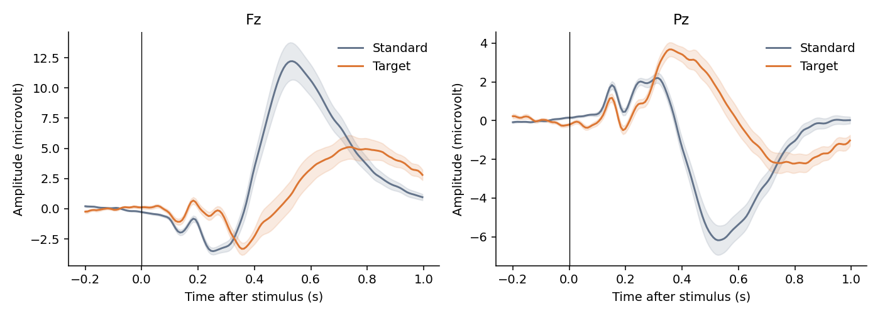
ERP signal and candidate features
Subject-weighted mean; shading = between-subject SE | ML: 20 × 50-ms means per sensor = 320 features
Nencki-Symfonia EEG | 42 subjects • Nguyễn Đức Trung • 55 s
04
Notes:
These are subject-weighted grand-average responses at frontal Fz and parietal Pz. Shading shows between-subject standard error. We compare the observed condition differences with the oddball ERP expectation. Averaged waveforms can look clearer than individual trials, which is why classification is harder than reading this plot. Classical models use twenty fifty-millisecond amplitude windows at each sensor. These features capture when a positive or negative response occurs without averaging different trials together.

Slide 5
A comparison with held-out subjects
• 5 outer folds: 8 or 9 test subjects
• 26–27 train + 7 validation + 8–9 test subjects
• Train-only scaling; validation chooses settings
• LDA · RBF SVM · Random Forest · compact EEG CNN
Nencki-Symfonia EEG | 42 subjects • Nguyễn Đức Trung • 65 s
05
Notes:
We separate people in every outer fold. Five folds hold out eight or nine people each. Seven other people form validation, leaving twenty-six or twenty-seven for training. Validation selects the SVM penalty, forest depth and CNN checkpoint. The CNN uses temporal and grouped spatial convolutions inspired by EEGNet. Every retained trial is tested exactly once per model. Scaling and class weights use training data only. All methods share the same splits. Fold means and standard deviations describe performance and variability; they are not confidence intervals.

Slide 6
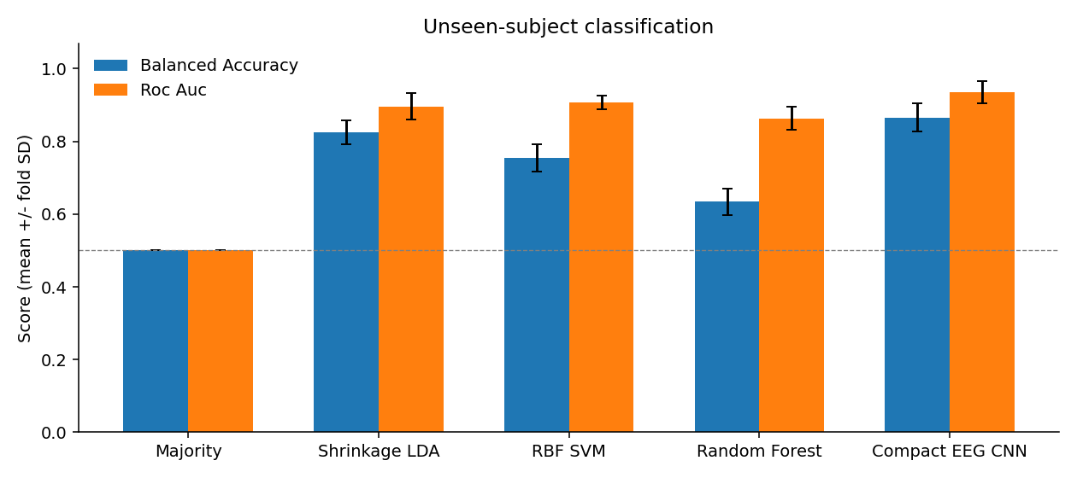
Which method performed best?
Best mean AUC: Compact EEG CNN = 0.936 ± 0.031 | Balanced accuracy: 0.866 | Error bars = fold SD; majority baseline = 0.5
Nencki-Symfonia EEG | 42 subjects • Phạm Sỹ Toàn • 65 s
06
Notes:
The highest mean ROC-AUC among the tested methods was 0.936, achieved by Compact EEG CNN. Its mean balanced accuracy was 0.866. The majority classifier illustrates why raw accuracy is insufficient: it favors the frequent class while its balanced accuracy and AUC remain one half. Our ranking is descriptive. It does not show a worldwide best method or guarantee performance on a new independent cohort.

Slide 7
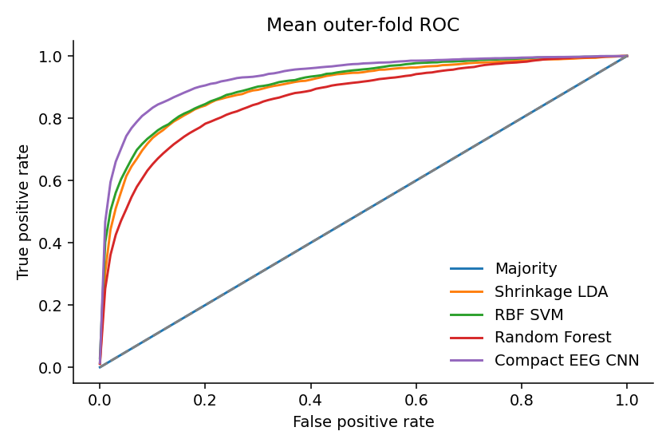
Did deep learning win?
The CNN exceeds RBF SVM by 0.029 mean ROC-AUC in this experiment. | CNN − strongest ML: +0.029 mean AUC | One base seed · 42 participants · limited search | More data and repeated seeds are needed
Nencki-Symfonia EEG | 42 subjects • Phạm Sỹ Toàn • 50 s
07
Notes:
The CNN exceeds RBF SVM by 0.029 mean ROC-AUC in this experiment. The CNN-minus-strongest-classical-model mean AUC difference was +0.029. The ROC curves show the average sensitivity and false-positive tradeoff within held-out folds. This experiment cannot establish that deep learning is always better or worse. Our sample is small, training budgets differ, and we ran one base seed. A stronger follow-up would repeat seeds and validation splits and use an independent cohort. The report gives all fold-level results so variability remains visible.

Slide 8
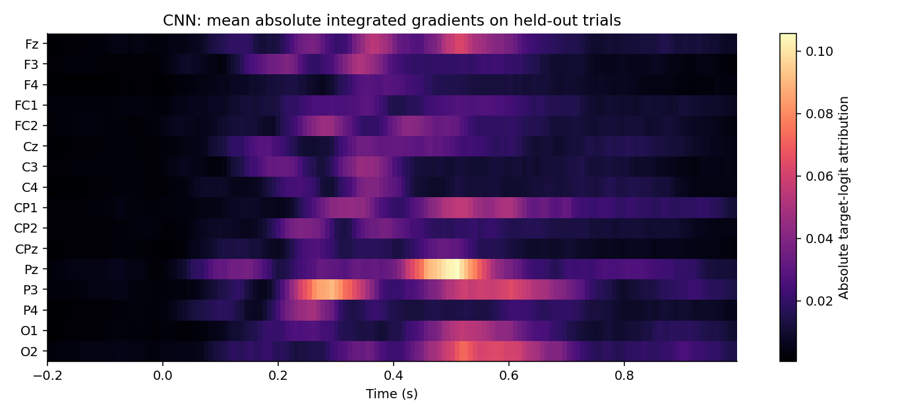
Where does the CNN look?
Integrated gradients on held-out trials | Training-mean baseline; absolute sensitivity | Sensor/time evidence is not causal localization
Nencki-Symfonia EEG | 42 subjects • Đỗ Hoàng Minh • 65 s
08
Notes:
We use integrated gradients to trace the target logit from the training-mean baseline to each held-out trial. The three largest mean absolute channel-attribution totals are Pz, P3, O2. The greatest mean occlusion AUC decrease is 0.019 in the 0.4-0.5 s window. These quantities describe model reliance, not a causal neural source. The map displays absolute sensitivity, so brighter values do not by themselves indicate positive target evidence. We compare these patterns with the ERP curves, while recognizing that eye movement, visual differences and motor responses may also contribute.

Slide 9
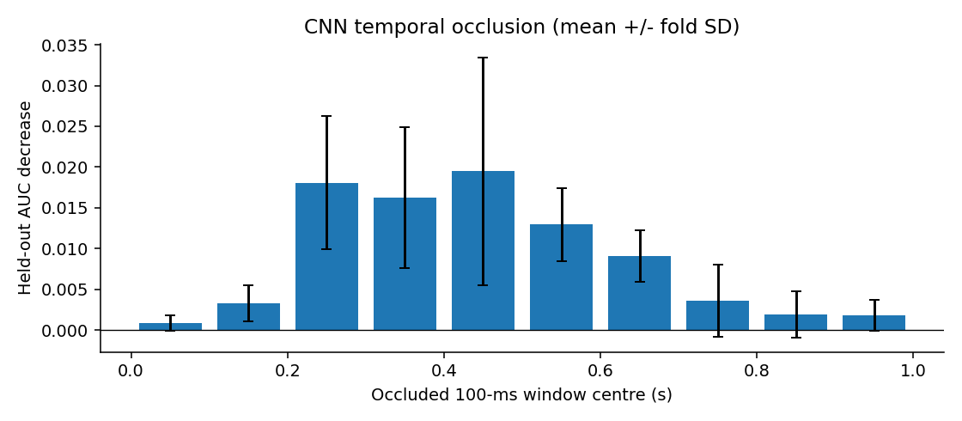
Test the explanation by occlusion
Largest mean AUC drop: 0.4–0.5 s | Replace one 100-ms window with training mean | Perturbation evidence; motor/artifact confounds remain
Nencki-Symfonia EEG | 42 subjects • Đỗ Hoàng Minh • 60 s
09
Notes:
We also replace one hundred milliseconds at a time with the training mean and measure the change in held-out AUC. The largest mean decrease occurred between 0.4 and 0.5 seconds. A positive bar indicates that removing that window worsened discrimination. Negative bars indicate improvement under this perturbation. Occlusion provides a second view of model reliance, although abrupt masking can create unnatural signals. Neither this analysis nor gradients prove a neural cause.

Slide 10
Answers, limits and next steps
• RQ1: Compact EEG CNN leads the tested pilot by AUC
• RQ2: CNN − strongest ML = +0.029
• RQ3: partial explanations from gradients + occlusion
• Next: repeated seeds, artifact and motor-response controls
Nencki-Symfonia EEG | 42 subjects • Đào Văn Việt • 55 s
10
Notes:
To conclude, Compact EEG CNN gave the highest mean AUC under our subject-disjoint protocol. The CNN exceeds RBF SVM by 0.029 mean ROC-AUC in this experiment. We obtained partial sensor and time explanations through integrated gradients and occlusion. The main limits are the convenience sample, one seed and remaining artifacts or motor activity. We provide the code, exact splits, data hashes, predictions and a result-integrity checker. Our next steps are repeated seeds, compliance sensitivity analysis and negative controls. Thank you. We are ready for questions.

Slide 11
References (backup)
[1] Dzianok P et al. (2022). The Nencki-Symfonia electroencephalography/event-related potential dataset. GigaScience 11:giac015. https://doi.org/10.1093/gigascience/giac015
[2] Dzianok P et al. Supporting data. GigaScience Database. https://doi.org/10.5524/100990
[3] OpenNeuro ds004621. https://github.com/OpenNeuroDatasets/ds004621 . Downloaded file URLs, ETags and SHA-256 values are recorded per subject in results_full/preparation_summary.json.
[4] Lawhern VJ et al. (2018). EEGNet: A Compact Convolutional Network for EEG-based Brain-Computer Interfaces. https://arxiv.org/abs/1611.08024
[5] Sundararajan M, Taly A, Yan Q (2017). Axiomatic Attribution for Deep Networks. https://arxiv.org/abs/1703.01365
[6] MNE-Python, Epochs documentation. https://mne.tools/stable/generated/mne.Epochs.html

Slide 12
Proposed contributions (backup)
Lê Minh Đức | 24022291 | Preprocessing and data quality | 20%
Nguyễn Đức Trung | 24022473 | ERP features and classical ML | 20%
Phạm Sỹ Toàn | 24022467 | CNN training and model comparison | 20%
Đỗ Hoàng Minh | 24022399 | Visualization and CNN explanations | 20%
Đào Văn Việt | 24022489 | Reproducibility, report and integration | 20%
Total 100%. Proposed only: confirm actual individual work before submission.

